Slide 1
FIRST FINANCE
How RAG Chooses Evidence
Why retrieval exists—and how it can fail before generation
SESSION 04 · 11:30–12:00 · 10 MIN CONCEPTS + 20 MIN NOTEBOOK
First Finance - Arnaud Demes
Notes:
Open with the problem: one answer needs a few passages, not an entire filing. RAG is the application decision that selects evidence before generation.
[Sources]
- chapters/04-rag-from-scratch.md
- https://arxiv.org/abs/2005.11401
[/Sources]

Slide 2
WHY RETRIEVAL
One answer should not inherit an entire filing
COMPLETE NVIDIA FY2026 10-K
~90,105 estimated tokens
ONE CONCISE ANSWER
RAG selects a small, testable evidence set before the model call
~250
Focus · lower input volume · citations · separate retrieval checks
A large context window answers “can it fit?” RAG answers “what evidence should this question receive?”
First Finance - Arnaud Demes
WHY RAG
02
Notes:
The complete filing becomes roughly 90,105 estimated text tokens after naive flattening. The 250-token answer bar is an illustrative teaching budget, not a provider limit. The point is that evidence selection and model capacity answer different questions.
[Sources]
- https://www.sec.gov/Archives/edgar/data/1045810/000104581026000021/nvda-20260125.htm
- chapters/04-rag-from-scratch.md
[/Sources]

Slide 3
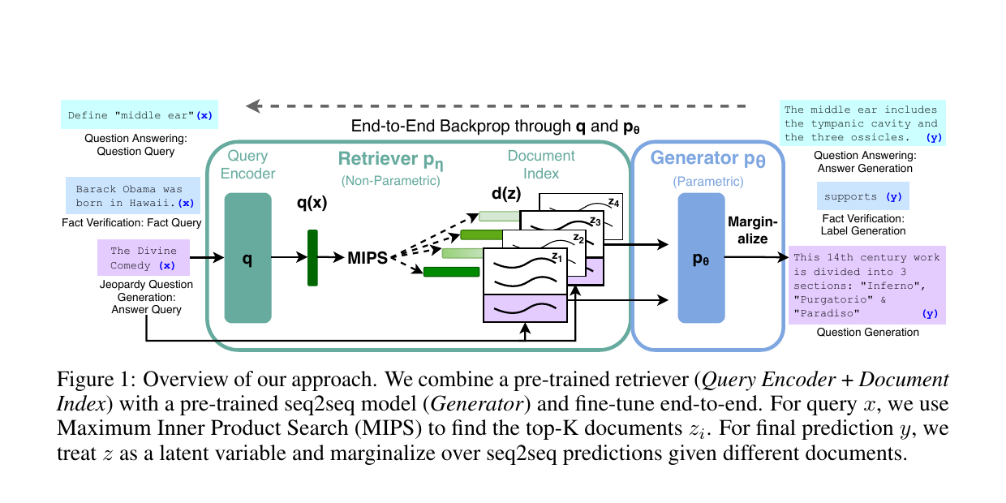
ORIGINAL ARCHITECTURE
RAG combines external memory with generation
The enduring idea
Query
↓
Retrieve top-k
↓
Generate with evidence
Lewis et al., NeurIPS 2020 · Figure 1
First Finance - Arnaud Demes
ARCHITECTURE
03
Notes:
Lewis et al. introduced RAG as a combination of a parametric generator and a non-parametric document memory accessed through retrieval. The course baseline uses TF-IDF rather than their trained dense retriever, but the evidence-before-generation boundary is the same.
[Sources]
- https://arxiv.org/abs/2005.11401
- https://arxiv.org/pdf/2005.11401
[/Sources]

Slide 4

ENTERPRISE RAG
RAG connects internal knowledge to AI—without retraining
Why teams use it
Fresh content
No retraining
Citations
Access rules
Microsoft Learn · AWS guidance
First Finance - Arnaud Demes
INTERNAL KNOWLEDGE
04
Notes:
A standard enterprise RAG system has two distinct moments. First, internal documents and business data are indexed. At question time, the application retrieves a small set of relevant evidence and supplies it to the model as grounding context. The model is not retrained on every document update.
This pattern is widely used because knowledge can stay current independently of the model; retrieved passages can carry citations; and retrieval can apply identity and permission filters. Those controls are design responsibilities, not automatic guarantees.
[Sources]
- https://learn.microsoft.com/en-us/azure/architecture/ai-ml/guide/secure-multitenant-rag
- https://docs.aws.amazon.com/prescriptive-guidance/latest/retrieval-augmented-generation-options/what-is-rag.html
- https://docs.aws.amazon.com/prescriptive-guidance/latest/agentic-ai-serverless/grounding-and-rag.html
- https://arxiv.org/abs/2005.11401
- Visual generated with the built-in OpenAI image generation tool; no brands, logos, or real evidence depicted.
[/Sources]

Slide 5
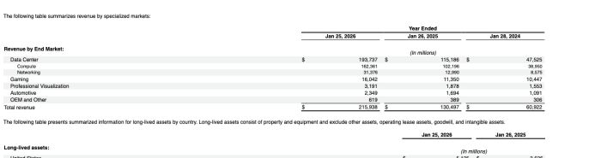
REAL SOURCE
The answer lives inside an official SEC filing
$193.7B
Data Center revenue
$215.9B
Total revenue
Official filing · Revenue by End Market · $ in millions
The facts are present. The engineering question is whether parsing and retrieval preserve them.
First Finance - Arnaud Demes
SOURCE
05
Notes:
The official Revenue by End Market table reports fiscal 2026 Data Center revenue of $193,737 million and total revenue of $215,938 million. This is the exact source the notebook parses; it is not a manually written fact card.
[Sources]
- https://www.sec.gov/Archives/edgar/data/1045810/000104581026000021/nvda-20260125.htm
- https://www.sec.gov/Archives/edgar/data/1045810/000104581026000021/0001045810-26-000021-index.htm
[/Sources]

Slide 6
NAIVE PARSING
Flattening preserves words—but destroys financial structure
OFFICIAL HTML/XBRL
ONE FLAT TEXT STREAM
64 tables
Data Center $ 193,737 $ 115,186 … Gaming 16,042 … Total revenue $ 215,938 …
row · column · period · unit
section · footnote · hierarchy
strip tags
The values remain; their relationships become implicit.
Retrieval cannot recover a relationship the parser no longer represents explicitly.
First Finance - Arnaud Demes
PARSING
06
Notes:
The filing contains 64 HTML tables and no semantic h1-h6 heading elements. The lesson's naive parser removes markup and collapses visible text. It keeps lexical evidence but discards explicit table and hierarchy boundaries.
[Sources]
- https://www.sec.gov/Archives/edgar/data/1045810/000104581026000021/nvda-20260125.htm
- chapters/04-rag-from-scratch.md
[/Sources]

Slide 7
NAIVE CHUNKING
Character windows ignore where financial meaning begins and ends
1,600 characters per window
C001
C002
C003
C004
C005
C006
258 windows
200-character overlap
Overlap softens the cut. It does not understand tables, headings or units.
First Finance - Arnaud Demes
CHUNKING
07
Notes:
The deterministic policy uses 1,600-character windows with 200-character overlap and produces 258 candidates from the flattened filing. Overlap reduces abrupt boundary loss but does not create document understanding.
[Sources]
- chapters/04-rag-from-scratch.md
[/Sources]

Slide 8
RETRIEVAL
Top-k becomes the model's evidence boundary
C152
0.289
C160
0.261
TOP-K = 2
C225
0.253
C162
0.234
C163
0.231
MODEL SEES
C247
0.223
NVDA-C152
NVDA-C160
C161
0.203
C147
0.180
C170
0.178
C248
0.171
Everything below the line remains in the corpus—but is absent from generation.
First Finance - Arnaud Demes
RANKING
08
Notes:
For the maintained growth question, the deterministic TF-IDF ranking selects NVDA-C152 and NVDA-C160. Cosine similarity is a ranking signal, not probability or calibrated confidence. Top-k is an application boundary.
[Sources]
- https://scikit-learn.org/stable/modules/generated/sklearn.feature_extraction.text.TfidfVectorizer.html
- https://scikit-learn.org/stable/modules/generated/sklearn.metrics.pairwise.cosine_similarity.html
- chapters/04-rag-from-scratch.md
[/Sources]

Slide 9
CONTROLLED CONTEXT
RAG constructs a new prompt from selected evidence
QUESTION
RANK
SELECT
ASSEMBLE
GENERATE
What drove
FY2026 growth?
TF-IDF + cosine
258 windows
C152 + C160
top-k = 2
instructions + IDs
source URL + question
Luna answer
with citations
The model does not search the filing. It receives the prompt the application assembled.
First Finance - Arnaud Demes
PROMPT
09
Notes:
RAG is an application pipeline. The application transforms the query, ranks the corpus, applies top-k, assembles provenance-bearing evidence, and only then invokes the model. The live notebook run uses gpt-5.6-luna through the shared gateway.
[Sources]
- https://arxiv.org/abs/2005.11401
- https://developers.openai.com/api/docs/models/gpt-5.6-luna
[/Sources]

Slide 10
FAILURE LAB
The correct table ranks #21—so generation never sees it
TOP 2
21
precise revenue table
PARSE
CHUNK
RETRIEVE
GENERATE
△
△
✕
—
values kept
structure flattened
character window
ignores table boundary
required window
outside top-k
not responsible
evidence never arrived
First Finance - Arnaud Demes
DIAGNOSE
10
Notes:
For the maintained precise-revenue question, the window containing $193,737 million ranks 21st under the fixed TF-IDF policy. Because top-k is two, the table is absent from the prompt. The earliest measured failure is retrieval, influenced by flattened parsing and naive chunk construction; changing the generator cannot restore unseen evidence.
[Sources]
- chapters/04-rag-from-scratch.md
- https://www.sec.gov/Archives/edgar/data/1045810/000104581026000021/nvda-20260125.htm
[/Sources]

Slide 11
LEARNING PROGRESSION
Improve the stage that produced the measured weakness
Flattened HTML
Canonical blocks + tables
LESSON 05
Character windows
Structure-aware chunking
LESSON 05
Lexical TF-IDF
Embeddings + hybrid retrieval
LESSON 06
Simple global top-k
Filters + fusion + reranking
LESSON 06
Do not call every improvement “better RAG.” Each changes a distinct, testable stage.
First Finance - Arnaud Demes
NEXT
11
Notes:
Lesson 05 holds retrieval simple and improves the units created by parsing and chunking. Lesson 06 holds those evidence units stable and upgrades representation, filtering, fusion and reranking. Diagnose the stage before changing the stack.
[Sources]
- chapters/04-rag-from-scratch.md
- chapters/05-document-and-chunking-lab.md
- chapters/06-hybrid-retrieval.md
[/Sources]

Slide 12
FIRST FINANCE
Quick quiz
Choose one answer for each question.
1. What creates the model's evidence boundary?
A Top-k selection | B Temperature | C Fine-tuning
2. Why is the Lesson 04 parser called naive?
A It flattens structure | B It uses HTML | C It keeps URLs
3. The required table ranks #21 with top-k=2. Which stage failed first?
A Generation | B Retrieval | C Presentation
LESSON 04 · 3 QUESTIONS · 3 MINUTES
First Finance - Arnaud Demes
Notes:
Use the quiz to verify the causal chain: the application selects evidence, naive parsing flattens financial structure, and a table below top-k is a retrieval failure before generation.
[Sources]
- chapters/04-rag-from-scratch.md
[/Sources]

Slide 13
FIRST FINANCE
Answers
Check the idea, not only the letter.
1. A. Top-k selection
Top-k decides which ranked windows enter the model prompt.
2. A. It flattens structure
Words survive, but table and hierarchy relationships become implicit.
3. B. Retrieval
The correct table never entered top-k, so generation never saw it.
LESSON 04 · ANSWERS
First Finance - Arnaud Demes
Notes:
Close on the diagnostic habit: inspect parsing, chunking and retrieval before blaming the model.
[Sources]
- chapters/04-rag-from-scratch.md
[/Sources]

