Slide 1
FIRST FINANCE
Financial Documents and Chunking
Preserve financial structure before retrieval begins
SESSION 05 · 13:30–15:00 · 20 MIN CONCEPTS + 70 MIN NOTEBOOK
First Finance - Arnaud Demes
Notes:
Resume with the hidden assumption from Lesson 04: the passages had already been prepared.
This session builds the missing document-engineering layer.
[Sources]
- Course-owned diagram and copy.
[/Sources]

Slide 2
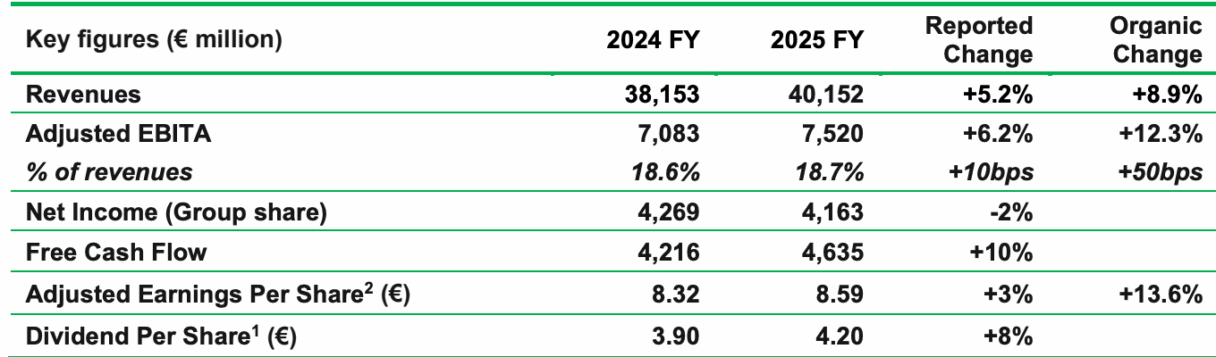
REAL DOCUMENT
A financial table can look obvious—and still extract ambiguously
OFFICIAL TABLE
DEFAULT PDFPLUMBER OUTPUT
DEFAULT: 9 rows × 15 columns
Header: Key figures | ∅ | ∅ | 2024 FY | …
Revenue: ∅ | 38,153 | ∅ | 40,152 | …
Result: visually plausible, structurally ambiguous
Official Schneider Electric FY2025 results · page 1
Geometry is detected; schema still needs validation.
A table is evidence only after headers, rows, units and provenance pass.
First Finance - Arnaud Demes
DOCUMENT
02
Notes:
Use the real Schneider Electric FY2025 table to show that visual clarity is not the same as machine-readable structure.
The default pdfplumber detector identifies geometry, but the returned 9 × 15 matrix contains blank separator cells and ambiguous headers. The learning objective is to validate the schema before trusting extracted numbers.
[Sources]
- https://www.se.com/ww/en/assets/564/document/528237/release-fy-results-2025.pdf (official Schneider Electric FY2025 results; table image on slide)
- https://github.com/jsvine/pdfplumber (official pdfplumber documentation; extraction behavior described on slide)
[/Sources]

Slide 3
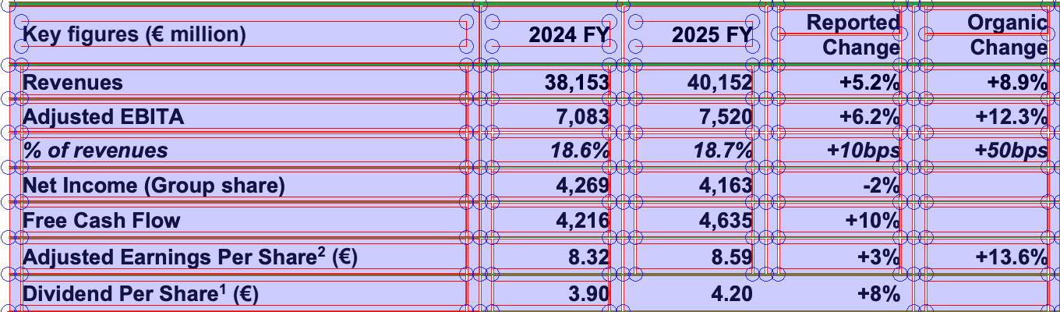
TABLE QUALITY GATE
Table detection is not evidence until the schema passes
01
03
04
Default extraction
Validate schema
Optional parser
lines · coordinates
headers · row widths · units
Docling · OCR · VLM
Pass → create DocumentBlock. Fail → tune pdfplumber or escalate.
Baseline runs everywhere
Docling remains optional
First Finance - Arnaud Demes
QUALITY GATE
03
Notes:
The red and blue overlay is generated by pdfplumber's tablefinder debug view on the same official Schneider Electric table used on slide 2.
Teach the baseline first: inspect geometry, validate headers/row widths/units, and only then create a DocumentBlock. If the quality gate fails, tune pdfplumber settings or escalate to an optional heavier parser such as Docling, OCR, or a vision-language model.
[Sources]
- https://github.com/jsvine/pdfplumber (official pdfplumber documentation; tablefinder debug overlay)
- https://github.com/docling-project/docling/blob/main/docs/getting_started/installation.md (official Docling installation guide; optional escalation path)
[/Sources]

Slide 4
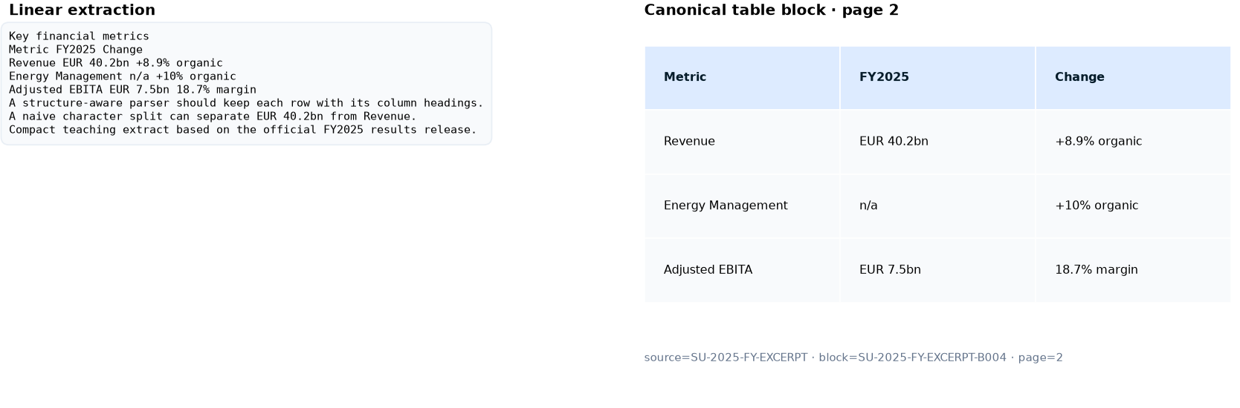
PARSING QUALITY
Good parsing preserves relationships; bad parsing leaves a text dump
Trust the parse only when rows, units, page and source IDs survive together.
First Finance - Arnaud Demes
PROVENANCE
04
Notes:
This is the executed Figure 3 from the Lesson 05 notebook. The left side shows the linear text returned from the PDF teaching extract; the right side shows the normalized table block with row/column relationships and provenance.
Ask learners to identify what becomes machine-checkable on the right: headers, rows, units, page, source ID and block ID.
[Sources]
- notebooks/05_document_and_chunking_lab.ipynb (executed offline Figure 3)
- https://www.se.com/ww/en/assets/564/document/528237/release-fy-results-2025.pdf (official Schneider Electric FY2025 results underlying the teaching extract)
[/Sources]

Slide 5
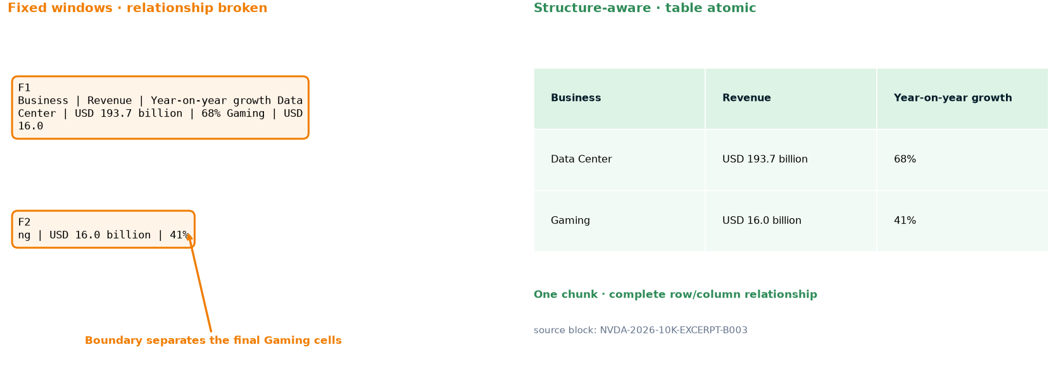
CHUNK INTEGRITY
A number is unsafe when its row or header is missing
A chunk may retrieve the right number and still destroy the financial relationship.
First Finance - Arnaud Demes
BOUNDARIES
05
Notes:
This is the executed Figure 11 from the Lesson 05 notebook. The fixed 90-character window cuts the word Gaming and separates the final cells; the structure-aware strategy keeps the complete table atomic.
The point is diagnostic: retrieval can still find USD 16.0 billion, but the selected fragment no longer proves that the value belongs to Gaming or that 41% is its year-on-year growth.
[Sources]
- notebooks/05_document_and_chunking_lab.ipynb (executed offline Figure 11)
- https://www.sec.gov/Archives/edgar/data/1045810/000104581026000029/nvda-20260125.htm (official NVIDIA fiscal 2026 Form 10-K underlying the teaching extract)
[/Sources]

Slide 6
SEMANTIC + CONTEXTUAL
Embedding boundaries, hierarchy and context solve different failures
EMBEDDING BOUNDARY
PARENT–CHILD
RAW + GENERATED CONTEXT
PARENT SECTION
RAW EVIDENCE
NVIDIA FY2026 · stable source text
model + threshold → boundary
GENERATED CONTEXT
CHILD 1
CHILD 2
CHILD 3
Fiscal 2026 revenue context
+ raw evidence at retrieval
retrieve small · expand verified parent
offline: 1.37× tokens · latency · retrieval gain
Generated context augments raw_text; preserve IDs, pages and provenance.
First Finance - Arnaud Demes
STRATEGIES
06
Notes:
Separate three decisions. Embedding model plus threshold creates semantic boundaries. Parent-child links separate matching from reading. Contextual enrichment is one bounded JSON transformation, not agentic chunking; generated context augments immutable raw_text. The 1.37x token ratio is the deterministic Notebook 05 offline measurement.
[Sources]
- https://platform.openai.com/docs/guides/embeddings
- https://docs.ollama.com/capabilities/embeddings
- Course Notebook 05 offline execution, contextual-chunks-v1
[/Sources]

Slide 7
FAILURE LAB
A retrievable number can still be analytically unsafe
FIXED WINDOWS
STRUCTURE-AWARE
F1 Business | Revenue | Growth
Data Center | USD 193.7bn | 68%
Gaming | USD 16.0
Business
Revenue
Year-on-year growth
Data Center
USD 193.7bn
68%
F2 bn | 41%
Gaming
USD 16.0bn
41%
Boundary separates Gaming value from its complete row
One chunk · complete row/column relationship
MEASURED ON THE NOTEBOOK FIXTURES
Fixed table integrity
Structured table integrity
Fixed retrieval@2
Structured retrieval@2
0%
100%
75%
100%
First Finance - Arnaud Demes
FAILURE
07
Notes:
The parser recovered the table correctly; the fixed chunker broke the relationship.
Do not change the model or retriever before repairing the evidence unit.
The metrics are generated by Notebook 05 over four maintained fixture questions.
[Sources]
- https://www.sec.gov/Archives/edgar/data/1045810/000104581026000021/nvda-20260125.htm
[/Sources]

Slide 8
STRATEGY DECISION
Escalate chunking complexity only when evaluation justifies it
STRUCTURE-AWARE
SEMANTIC + HIERARCHICAL
LLM CONTEXTUAL
tables + headings intact
default for filings
embedding boundary
+ verified parent
generated context
+ immutable raw_text
when matching is weak
NON-NEGOTIABLE
MEASURE BEFORE ADDING
table integrity · provenance · stable IDs
tokens · latency · recall · transformation risk
NEXT · LESSON 06
Keep the chunks; improve candidate retrieval with embeddings, filters, fusion and reranking.
First Finance - Arnaud Demes
DECISION
08
Notes:
Use structure-aware chunks as the filing baseline. Add semantic boundaries or hierarchy when matching is weak; add LLM contextual enrichment only when passages remain ambiguous and measured retrieval improves enough to justify tokens, latency and transformation risk.
[Sources]
- Course-owned decision matrix
- Course Notebook 05 offline execution
[/Sources]

Slide 9
FIRST FINANCE
Quick quiz
Choose one answer for each question.
1. What should be checked before choosing chunks?
A Extraction quality | B Agent retries | C Model price
2. What must survive every document transformation?
A Provenance | B Font colour | C Chat history
3. What do hierarchical chunks separate?
A Retrieval and reading context | B Users and roles | C Models and APIs
LESSON 05 · 3 QUESTIONS · 3 MINUTES
First Finance - Arnaud Demes
Notes:
Instructor purpose: Check the three core decisions before the lesson closes.
Planned timing: 3 minutes.
Facilitation: ask for one letter per question.
[Sources]
- chapters/05-document-and-chunking-lab.md
[/Sources]

Slide 10
FIRST FINANCE
Answers
Check the idea, not only the letter.
1. A. Extraction quality
Bad reading order or lost tables cannot be repaired by better chunk sizes.
2. A. Provenance
Stable IDs, pages and sources keep evidence traceable.
3. A. Retrieval and reading context
Small children retrieve precisely while parents restore context.
LESSON 05 · CORRECTION
First Finance - Arnaud Demes
Notes:
Instructor purpose: Correct the quiz and restate the practical rule behind each answer.
Planned timing: 3 minutes.
Facilitation: ask learners to explain each rule in their own words.
[Sources]
- chapters/05-document-and-chunking-lab.md
[/Sources]

