Slide 1
FIRST FINANCE
Hybrid Retrieval: Exact Terms + Meaning
Filter first, combine BM25 and dense search, then rerank the evidence you cite
SESSION 06 · 15 MIN CONCEPTS + 30 MIN NOTEBOOK
First Finance - Arnaud Demes
Notes:
Open with the failure pattern: finance questions mix literal identifiers and semantic intent. One retrieval channel cannot reliably protect both.

Slide 2
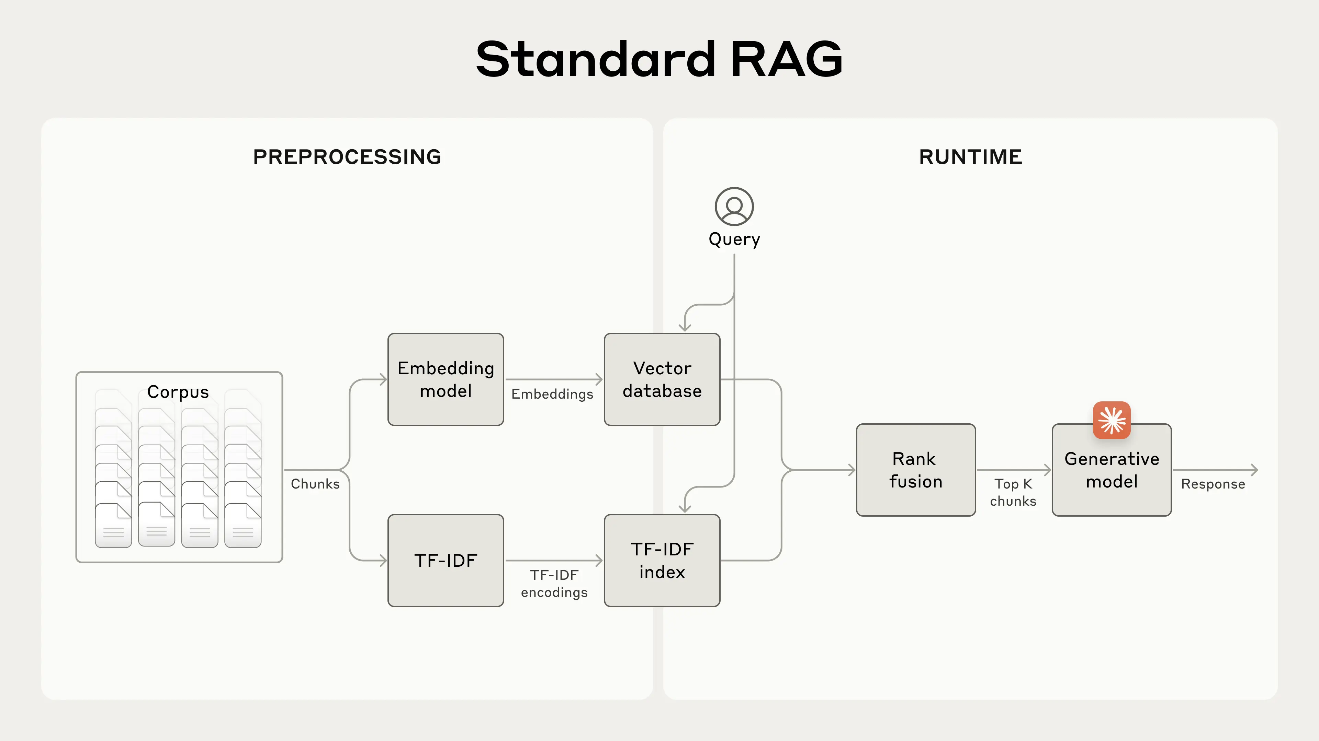
WHY HYBRID RETRIEVAL
Run lexical and semantic search in parallel—then fuse ranks
THE PATTERN
Lexical + semantic
Fuse ranks
LAB UPGRADE
BM25 replaces TF-IDF
First Finance - Arnaud Demes
ARCHITECTURE
02
Notes:
Explain the backbone before the algorithms. The same corpus is searched through a lexical channel and an embedding channel. Rank fusion combines ordering rather than incompatible raw score scales. Anthropic labels the lexical branch TF-IDF in this visual; the lesson implements BM25 as the stronger lexical baseline.
[Sources]
- https://www.anthropic.com/engineering/contextual-retrieval

Slide 3
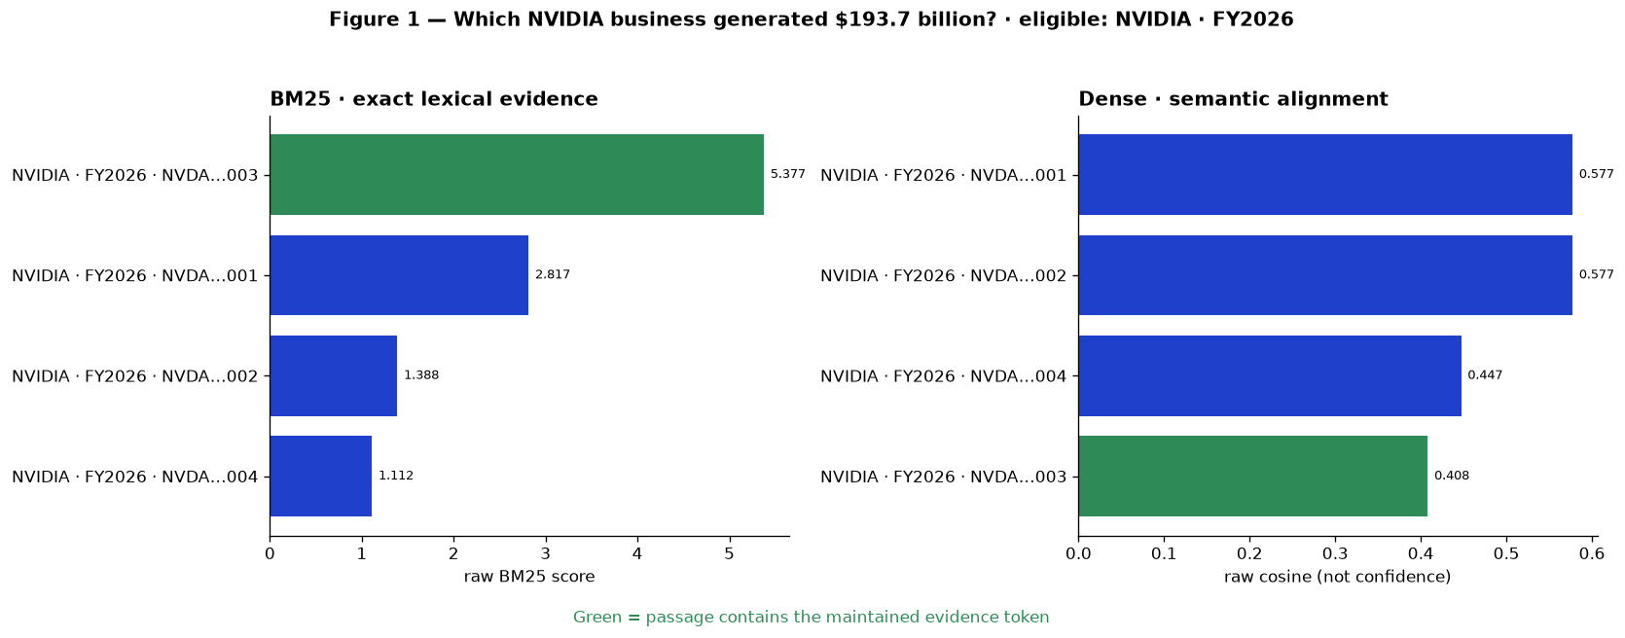
COMPLEMENTARY CHANNELS
BM25 finds the figure; dense search finds the meaning
First Finance - Arnaud Demes
CHANNELS
03
Notes:
Read the green passage first: BM25 rewards the maintained evidence token. Dense retrieval ranks by semantic proximity and can miss a literal figure. The channels are complementary, and their raw scores are intentionally not compared.
[Sources]
- https://www.sec.gov/Archives/edgar/data/1045810/000104581026000021/nvda-20260125.htm

Slide 4
SAFETY GATE
Filter first: ineligible passages never enter either candidate list
COMPANY
BM25
NVIDIA
ELIGIBLE PASSAGES
exact lexical candidates
company AND period AND type AND section
PERIOD
DENSE
FY2026
semantic candidates
Only eligible passages
may be scored
DOCUMENT
ABSTAIN
10-K teaching extract
no eligible passage
Post-filtering cannot recover eligible evidence omitted from a global top-k.
First Finance - Arnaud Demes
ELIGIBILITY
04
Notes:
Filters define the eligible corpus before either channel scores passages. Post-filtering cannot restore evidence that was pushed out of a global top-k by another company or period.
[Sources]
- https://learn.microsoft.com/en-us/azure/search/hybrid-search-overview

Slide 5
RECIPROCAL-RANK FUSION
RRF adds rank contributions—not raw channel scores
BM25 RANKS · w=1
A · rank 1
B · rank 2
C · rank 3
D · r4
B = .03252
DENSE RANKS · w=1
B · rank 1
C · rank 2
A · rank 3
A = .03227
FUSED · k=60
B · 1/62 + 1/61 = 0.03252
A · 1/61 + 1/63 = 0.03227
B ranks first
RRF(p) = Σ w / (60 + rank); deduplicate by passage ID; keep every contribution visible.
First Finance - Arnaud Demes
FUSION
05
Notes:
RRF assigns a contribution from each channel rank and adds them. It never pretends BM25 and cosine scores share units. Keep each contribution visible so the final ordering remains inspectable.
[Sources]
- https://qdrant.tech/documentation/search/hybrid-queries/

Slide 6
RERANKING BOUNDARY
Retrieve for recall; rerank for final evidence quality
TRANSPARENT RERANK
FUSED SET
FINAL EVIDENCE
lexical coverage=.25
numeric coverage=.45
section overlap=.10
candidate_k = 4
eligible + deduplicated
final_k = 2
budgeted + cited
metadata eligibility=.10
fusion signal=.10
HARD BOUNDARY
SCORE SEMANTICS
pre-filtered only · no silent broadening
provider-neutral · offline illustrative · not confidence
DECISION
The reranker spends a small evidence budget on visible, finance-aware features.
First Finance - Arnaud Demes
RERANK
06
Notes:
Candidate retrieval should be broad enough to protect recall, but reranking should operate only on the eligible, deduplicated set. This lesson uses visible finance-aware features so students can explain why the final passages win.
[Sources]
- https://www.anthropic.com/engineering/contextual-retrieval

Slide 7
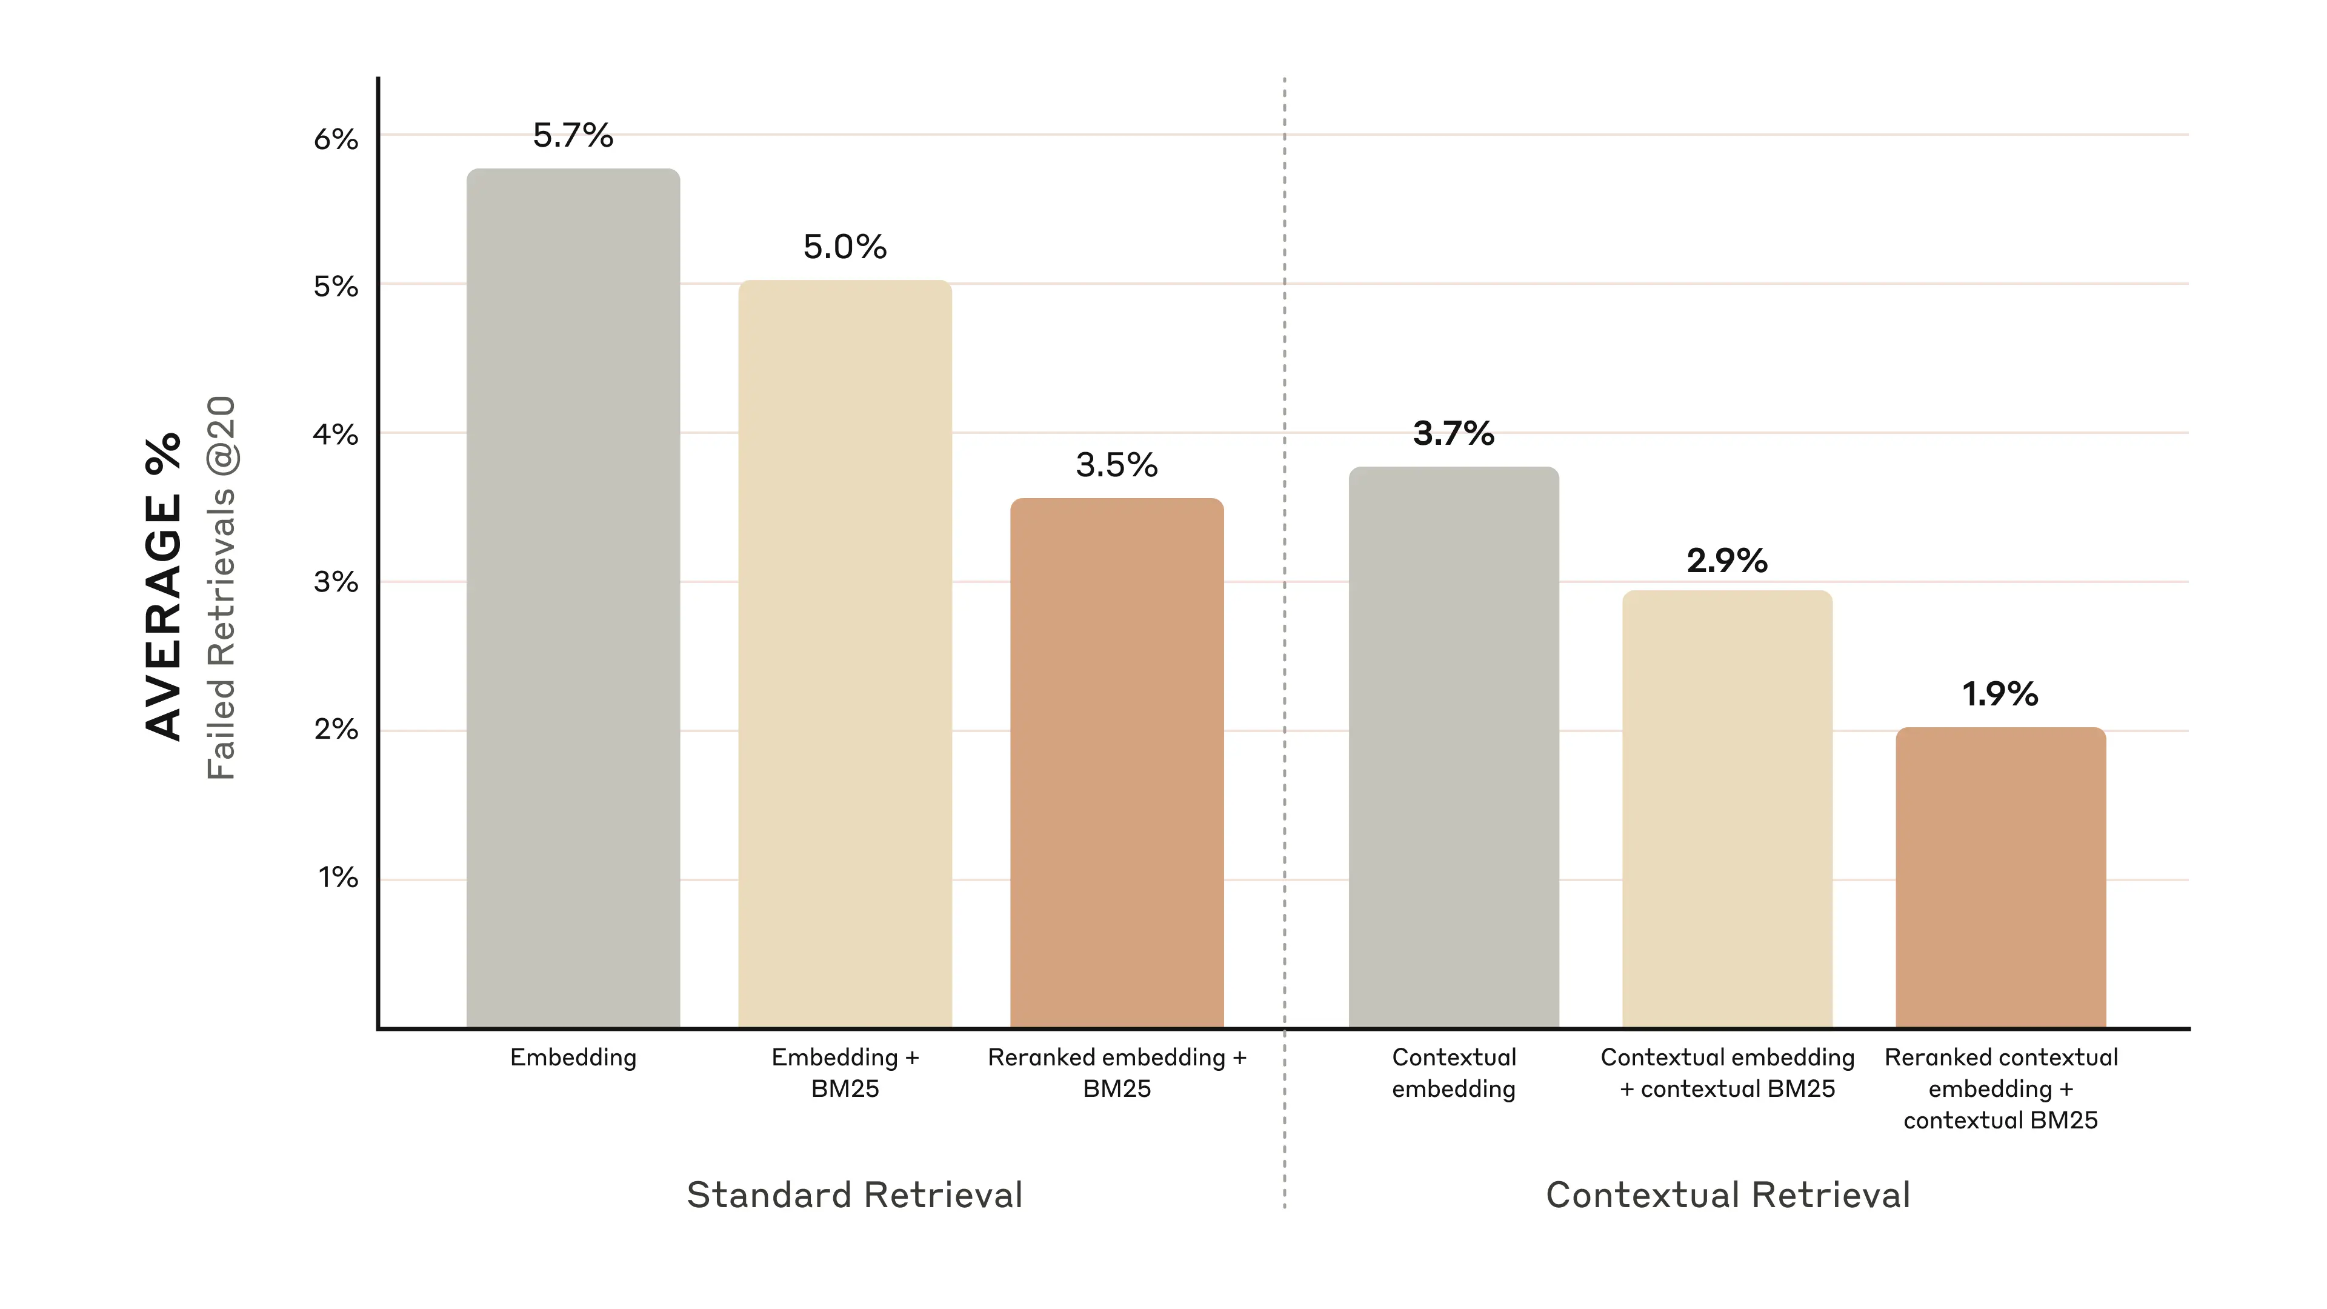
EVIDENCE FROM PRACTICE
Hybrid retrieval + reranking cut failed retrievals by 67%
67% FEWER
FAILED RETRIEVALS
5.7% → 1.9%
Top-20 benchmark
First Finance - Arnaud Demes
BENCHMARK
07
Notes:
Anthropic reports average failed retrievals at top 20 falling from 5.7% for embeddings alone to 1.9% for reranked contextual embeddings plus contextual BM25. This is evidence for the architecture, not a promise that every corpus will obtain the same result.
[Sources]
- https://www.anthropic.com/engineering/contextual-retrieval

Slide 8
DESIGN BACKBONE
Each stage repairs a different retrieval failure
01
02
03
04
05
Eligibility
BM25
Dense
RRF
Rerank
wrong company · period · type
exact figures · names · identifiers
concepts · paraphrases · related meaning
rank fusion · no score calibration
final evidence budget · cited passages
Hybrid works because the stages are complementary—not interchangeable.
protect corpus precision
protect answer evidence
First Finance - Arnaud Demes
BACKBONE
08
Notes:
Use this slide as the mental model. Eligibility fixes corpus scope; BM25 fixes literal matching; dense search fixes paraphrase and conceptual recall; RRF fixes incomparable channel scores; reranking fixes the final evidence budget.
[Sources]
- https://learn.microsoft.com/en-us/azure/search/hybrid-search-overview
- https://www.anthropic.com/engineering/contextual-retrieval

Slide 9
30-MINUTE LAB
The notebook proves each design choice—without busywork
01
02
03
04
05
Load evidence
Compare channels
Filter first
Fuse + rerank
Score 4 queries
7 manifest-derived passages
BM25 versus dense
block cross-company leakage
RRF contributions stay visible
rank-1 evidence recovery
Six figures explain the complete retrieval argument.
16 cells · 8 code
offline deterministic · live embeddings optional
First Finance - Arnaud Demes
LAB
09
Notes:
The lab is intentionally compact. Students run six figures, reproduce the exact-number miss and cross-company leakage, inspect RRF contributions and reranker features, and finish with a four-query rank-1 scorecard.

Slide 10
FIRST FINANCE
Can you defend the retrieval order?
Choose the answer that preserves retrieval correctness.
1. Which channel best protects exact figures?
A BM25 | B Dense | C Reranker
2. When should eligibility filters run?
A Before ranking | B After fusion | C After the answer
3. What does reciprocal-rank fusion combine?
A Rank positions | B Raw score scales | C Token counts
LESSON 06 · 3 QUESTIONS · 3 MINUTES
First Finance - Arnaud Demes
Notes:
Pause before revealing the answers. Ask learners to explain the mechanism, not only choose a letter.

Slide 11
FIRST FINANCE
Answers
The mechanism matters more than the letter.
1. A. BM25
Lexical scoring protects exact figures, names and identifiers.
2. A. Before ranking
Ineligible evidence must never enter either candidate list.
3. A. Rank positions
RRF fuses rank positions without pretending channel scores share one scale.
LESSON 06 · CORRECTION
First Finance - Arnaud Demes
Notes:
Close by restating the retrieval order: define eligibility, retrieve through BM25 and dense channels, fuse ranks, rerank a smaller set, and cite the final evidence.

