Slide 1
FIRST FINANCE
Find the Failure in a RAG System
Measure retrieval, generation and abstention before changing the system
SESSION 07 · 15 MIN CONCEPTS + 30 MIN NOTEBOOK
First Finance - Arnaud Demes
Notes:
Open with the distinction between a fluent demo and a diagnosable system.
[Sources]
- chapters/07-rag-evaluation.md
- notebooks/07_rag_evaluation.ipynb
[/Sources]

Slide 2
WHY EVALUATE
A fluent answer can hide five different failures
01
02
03
04
05
Retrieval
Filters
Citation
Grounding
Abstention
wrong evidence
wrong company / period
missing or invented ID
unsupported claim
answers unsupported work
One successful demo cannot tell you which layer will fail next.
same question · different failure owner
measure by layer · inspect by trace
First Finance - Arnaud Demes
DATASET
02
Notes:
Use the five cards to show why one overall quality score cannot diagnose RAG.
[Sources]
- https://developers.openai.com/api/docs/guides/evaluation-best-practices
- src/finai_academy/evaluation.py
[/Sources]

Slide 3
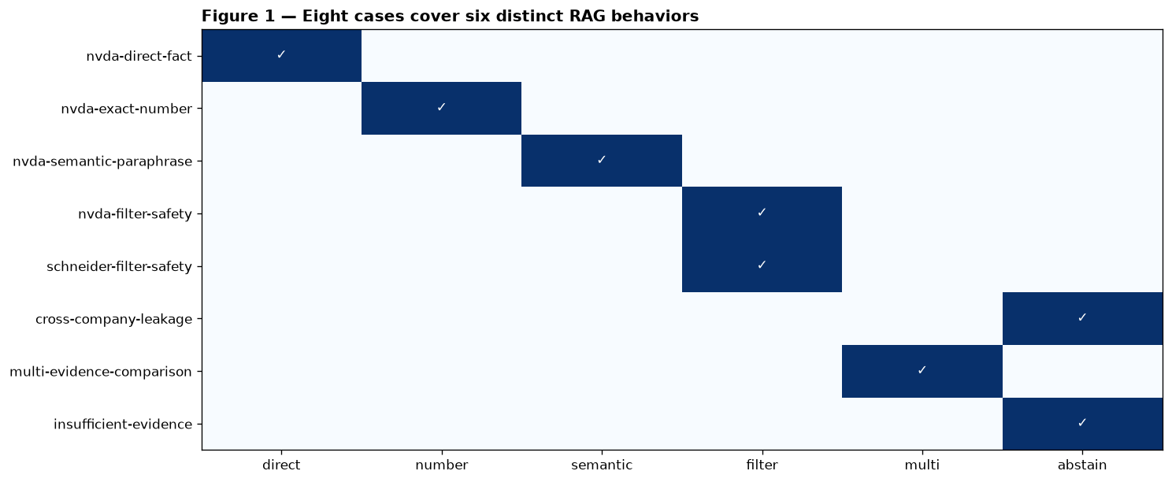
EVALUATION DATASET
A golden set must cover behavior—not just contain questions
First Finance - Arnaud Demes
DATASET
03
Notes:
Read across the matrix: each row protects a different behavior contract.
[Sources]
- notebooks/07_rag_evaluation.ipynb — Figure 1
- assets/course-data/evaluation/rag_cases_v1.json
[/Sources]

Slide 4
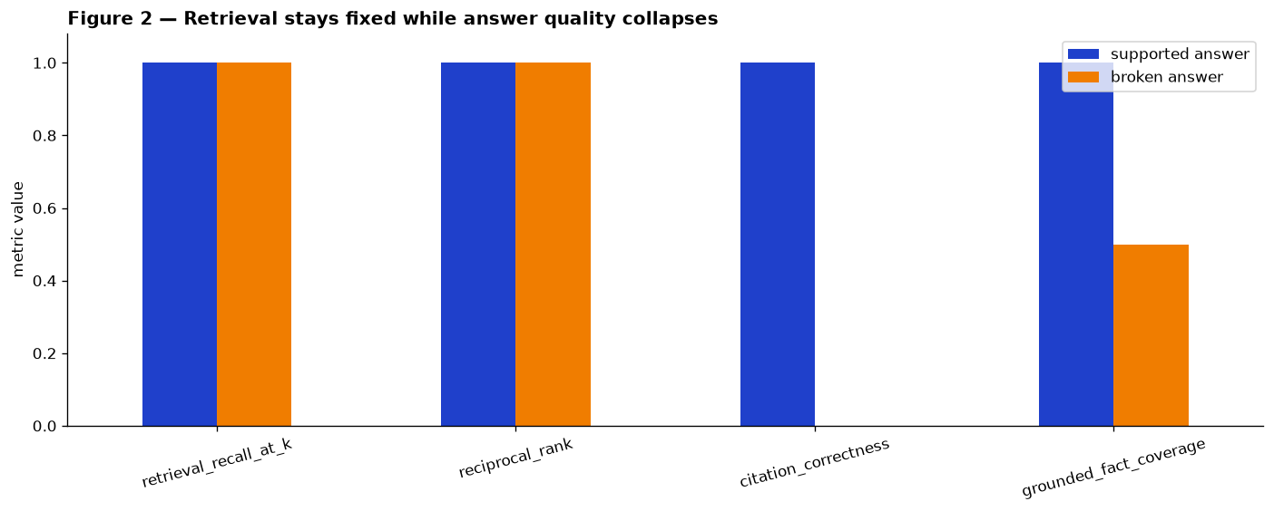
CONTROLLED FAILURE
The same retrieved evidence can still produce a failed answer
First Finance - Arnaud Demes
DIAGNOSE
04
Notes:
Retrieval recall and rank remain fixed; citation and grounded-fact metrics expose the answer defect.
[Sources]
- notebooks/07_rag_evaluation.ipynb — Figure 2
- src/finai_academy/evaluation.py
[/Sources]

Slide 5
METRICS BY LAYER
Each failure layer requires a different test
RETRIEVAL · 0…1
expected IDs
∩ top-k
÷ expected
R@k
MRR = 1 / first relevant rank
ANSWER · 0…1
cited IDs
∩ returned IDs
÷ cited IDs
citation correctness
ABSTENTION · BOOLEAN
unsupported question
explicit abstain = true
correct
Cheap first: reproducible · inspectable · fast enough for every change.
First Finance - Arnaud Demes
METRICS
05
Notes:
Work one finance case through retrieval recall, citation correctness and explicit abstention.
[Sources]
- src/finai_academy/evaluation.py
- https://developers.openai.com/api/docs/guides/evaluation-best-practices
[/Sources]

Slide 6
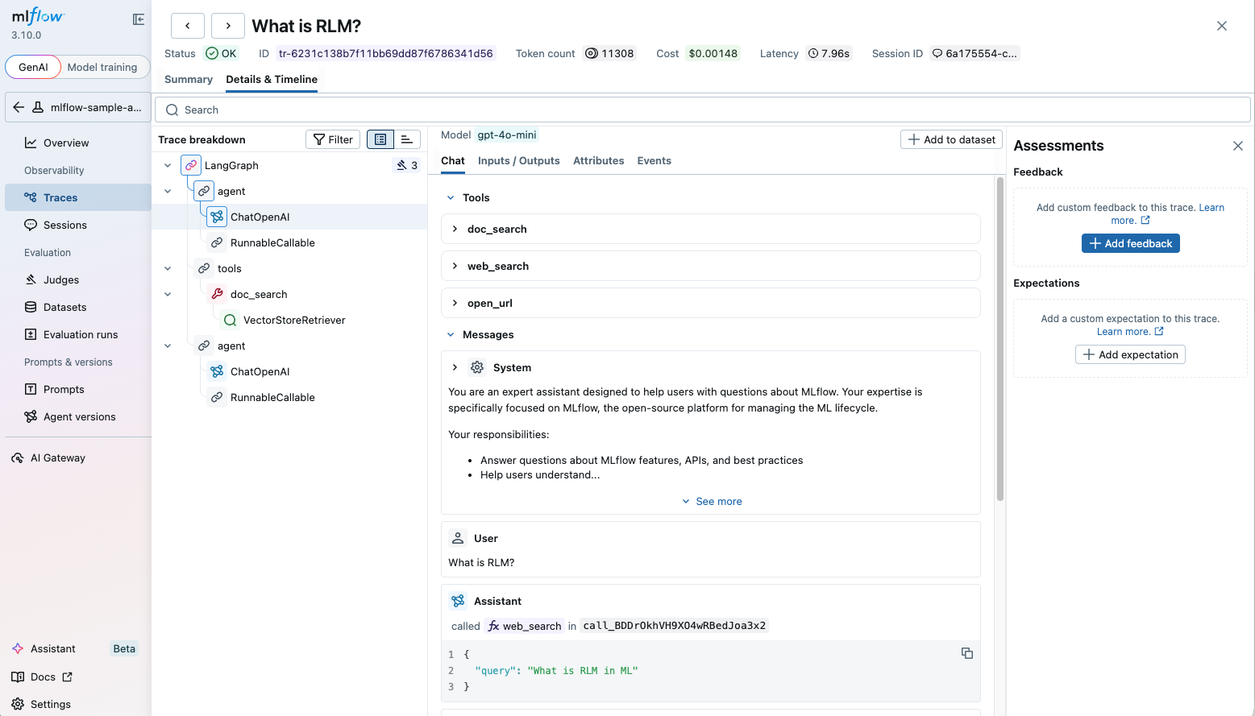
REAL MLFLOW TRACE
A trace shows exactly where the pipeline broke
Source: MLflow docs · First Finance - Arnaud Demes
TRACE
06
Notes:
Point to the span tree, latency timeline and input/output panel. The notebook persists bm25, dense, fusion, rerank, context and generation spans.
[Sources]
- https://mlflow.org/docs/latest/genai/tracing/observe-with-traces/ui
- https://mlflow.org/docs/latest/images/llms/tracing/trace-ui-detail-view.png
- src/finai_academy/mlflow_evaluation.py
[/Sources]

Slide 7
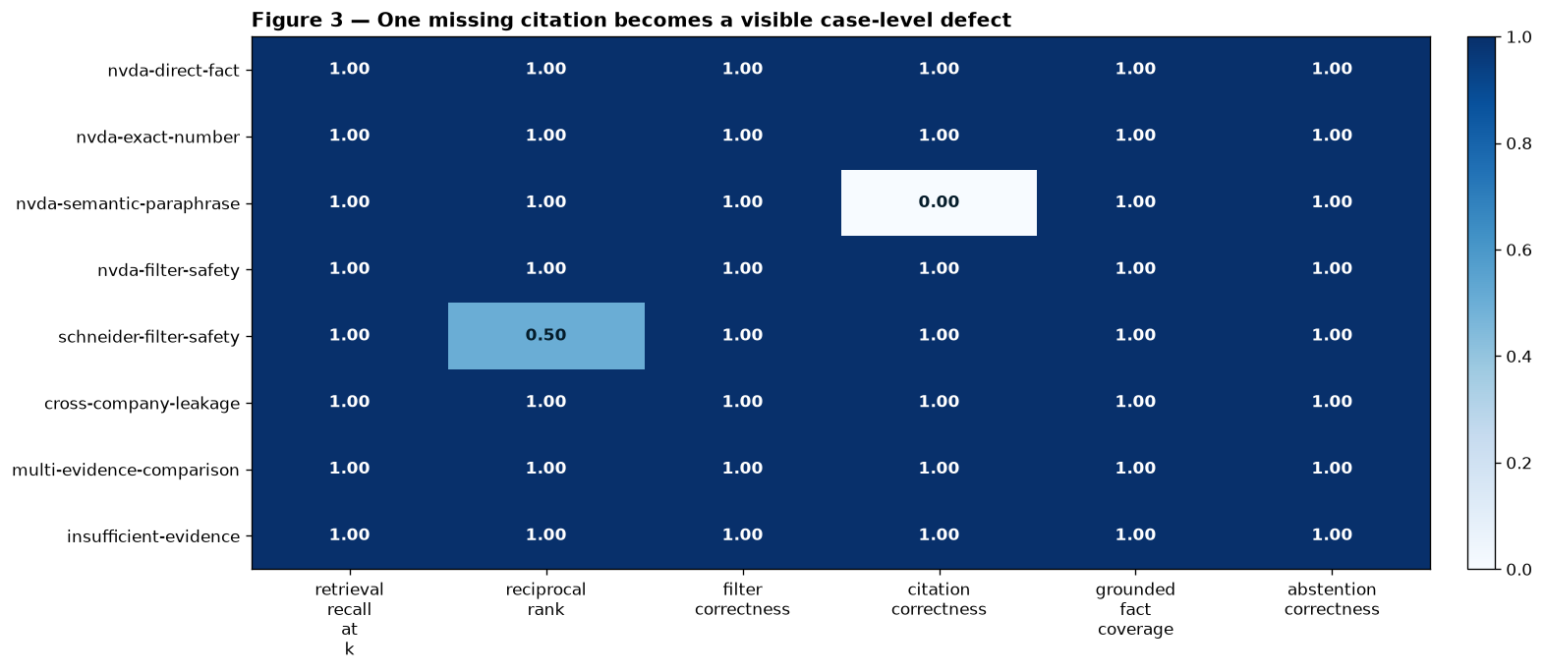
CASE-LEVEL EVIDENCE
Case-level metrics reveal the defect aggregate scores hide
First Finance - Arnaud Demes
CASES
07
Notes:
The semantic-paraphrase row retrieves the correct evidence but has citation correctness 0.0.
[Sources]
- notebooks/07_rag_evaluation.ipynb — Figure 3
- assets/course-data/evaluation/rag_cases_v1.json
[/Sources]

Slide 8
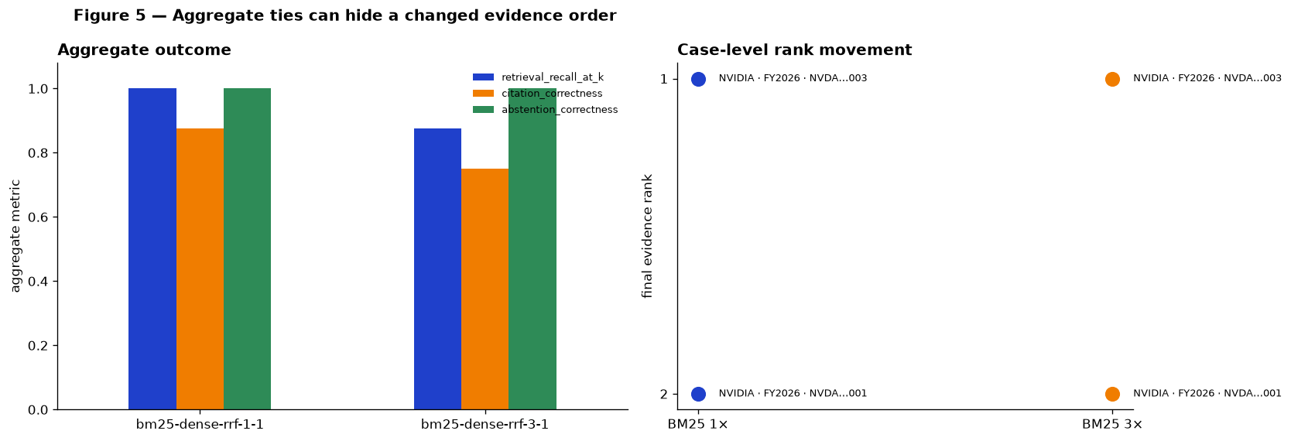
CONTROLLED COMPARISON
A moved rank proves impact—not improvement
First Finance - Arnaud Demes
COMPARE
08
Notes:
Only the BM25 RRF weight changes from 1 to 3. The rank moves while aggregate outcomes remain aligned.
[Sources]
- notebooks/07_rag_evaluation.ipynb — Figure 5
- src/finai_academy/mlflow_evaluation.py
[/Sources]

Slide 9
FAILURE OWNERSHIP
The failed metric tells you which component to fix
GENERATION
RETRIEVAL
ABSTENTION
citation
grounded facts
recall · rank
filter leakage
unsupported work
answered anyway
prompt · context
answer schema
FIRST FAILED LAYER
TRACE EVIDENCE
owns the diagnosis; the corresponding component owns the repair.
proves stage inputs · outputs · timing · failure location
NEXT
Repair one owner, rerun the same versioned cases, and compare again.
First Finance - Arnaud Demes
DECIDE
09
Notes:
Map each first failed metric to the application component that can repair it. Do not tune retrieval for a citation failure.
[Sources]
- chapters/07-rag-evaluation.md — Failure ownership
- src/finai_academy/evaluation.py
[/Sources]

Slide 10
FIRST FINANCE
Quick quiz
Choose the component or comparison rule that the evidence supports.
1. Recall@k is 1.0 but citation correctness is 0.0. What failed?
A Retrieval | B Generation | C Dataset version
2. Which comparison isolates an RRF weight change?
A Same cases + prompt | B New cases + prompt | C One demo
3. What should you inspect after a citation failure?
A BM25 index | B Generation span | C Stock price
LESSON 07 · 3 QUESTIONS · 3 MINUTES
First Finance - Arnaud Demes
Notes:
Ask for one letter per question, then require learners to name the evidence behind it.
[Sources]
- chapters/07-rag-evaluation.md
[/Sources]

Slide 11
FIRST FINANCE
Answers
Diagnose before changing: the metric names the failing layer; the trace shows the evidence.
1. B. Generation
The right passage arrived; generation omitted or mis-cited the evidence ID.
2. A. Same cases + prompt
Keep cases, prompt, models and budgets fixed; change only the RRF weight.
3. B. Generation span
Inspect generation inputs, output, citations and timing before touching retrieval.
LESSON 07 · CORRECTION
First Finance - Arnaud Demes
Notes:
Close by restating the rule: diagnose the first failed layer, repair its owner, rerun the same cases.
[Sources]
- chapters/07-rag-evaluation.md
[/Sources]

