Slide 1
FIRST FINANCE
Who Chooses the Next Step?
Workflows use code-defined routes. Agents let the model direct execution.
SESSION 08 · 10 MIN CONCEPTS + 30 MIN NOTEBOOK
First Finance - Arnaud Demes
Notes:
Opening: workflows and agents can use the same models and tools; the controller is different.
[Sources]
- chapters/08-workflows-vs-agents.md
- https://www.anthropic.com/engineering/building-effective-agents
[/Sources]

Slide 2
Is the path known?
Who chooses the next step?
WORKFLOW
Python code
Coded by you
Uses results
Known route
PREDICTABLE
AGENT
One model
Chosen by the model
Selects tools
VARIABLE
VALUE TEST
Quality gain?
Must beat workflow baseline
MEASURE IT
Tool output does not define an agent. The controller does.
First Finance - Arnaud Demes
COMPARE
02
Notes:
Use the rows to separate code-defined control from model-directed control.
[Sources]
- https://www.anthropic.com/engineering/building-effective-agents
- https://docs.langchain.com/oss/python/langgraph/workflows-agents
- chapters/08-workflows-vs-agents.md
[/Sources]

Slide 3
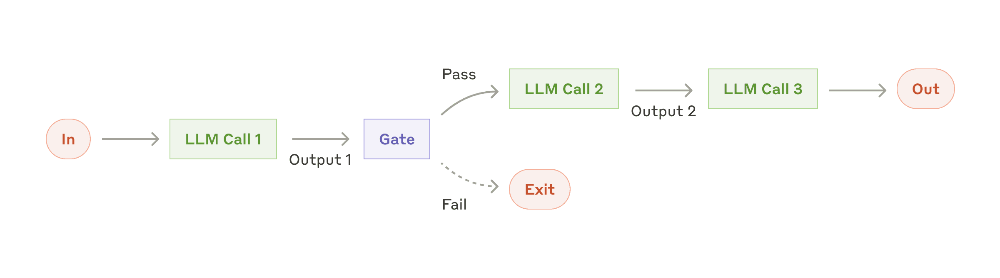
WORKFLOW PROOF
Workflows can use results, branch and stop
If you can draw every step before the run, use a workflow.
Anthropic · prompt chaining
Fixed path + programmatic gate
First Finance - Arnaud Demes
COMPARE
03
Notes:
Anthropic's prompt-chaining example proves that workflow steps can consume previous outputs and include gates.
[Sources]
- https://www.anthropic.com/engineering/building-effective-agents
- assets/lesson-08/anthropic-prompt-chaining.png
[/Sources]

Slide 4
TYPED TOOL BOUNDARY
The model proposes. Python validates and runs.
MODEL REQUEST
tool name
arguments
validate
typed
Invalid requests stop here
PYTHON EXECUTION
get_market_price
convert_currency
tool registry
tool result
TYPED OBSERVATION
value · currency
source · date
verified
Schemas, allowlists and provenance stay deterministic.
First Finance - Arnaud Demes
TOOLS
04
Notes:
The model proposes typed fields; Python validates, invokes the allowlisted function and records provenance.
[Sources]
- src/finai_academy/agent_workflows.py
- https://developers.openai.com/api/docs/guides/structured-outputs
- https://developers.openai.com/api/docs/guides/function-calling
[/Sources]

Slide 5
DIRECT LOOKUP
One known action: use a one-step workflow
01
02
03
04
05
Question
Choose tool
get_market_price
Observation
Answer
NVDA price?
choose one tool
Python call
price · currency · source
from tool data
No model-directed loop is needed.
known path
predictable · easy to test
First Finance - Arnaud Demes
WORKFLOW
05
Notes:
A direct lookup has one known action, so a workflow is the simplest adequate controller.
[Sources]
- notebooks/08_workflows_vs_agents.ipynb
- src/finai_academy/agent_workflows.py
[/Sources]

Slide 6
TWO-STEP WORKFLOW
Price to FX succeeds because code owns the route
01
02
03
04
05
Question
Code route
get_market_price
Pass observed value
convert_currency
NVDA price in EUR
price then FX
214.57 USD
214.57 USD
183.76 EUR
A dependency is data flow, not agent control.
route known before run
workflow status: completed
First Finance - Arnaud Demes
WORKFLOW
06
Notes:
The route is known before execution: price, then FX. Code passes the observed price and currency into conversion.
[Sources]
- notebooks/08_workflows_vs_agents.ipynb
- src/finai_academy/agent_workflows.py
- assets/course-data/market/lesson08_market_snapshot_v1.json
[/Sources]

Slide 7
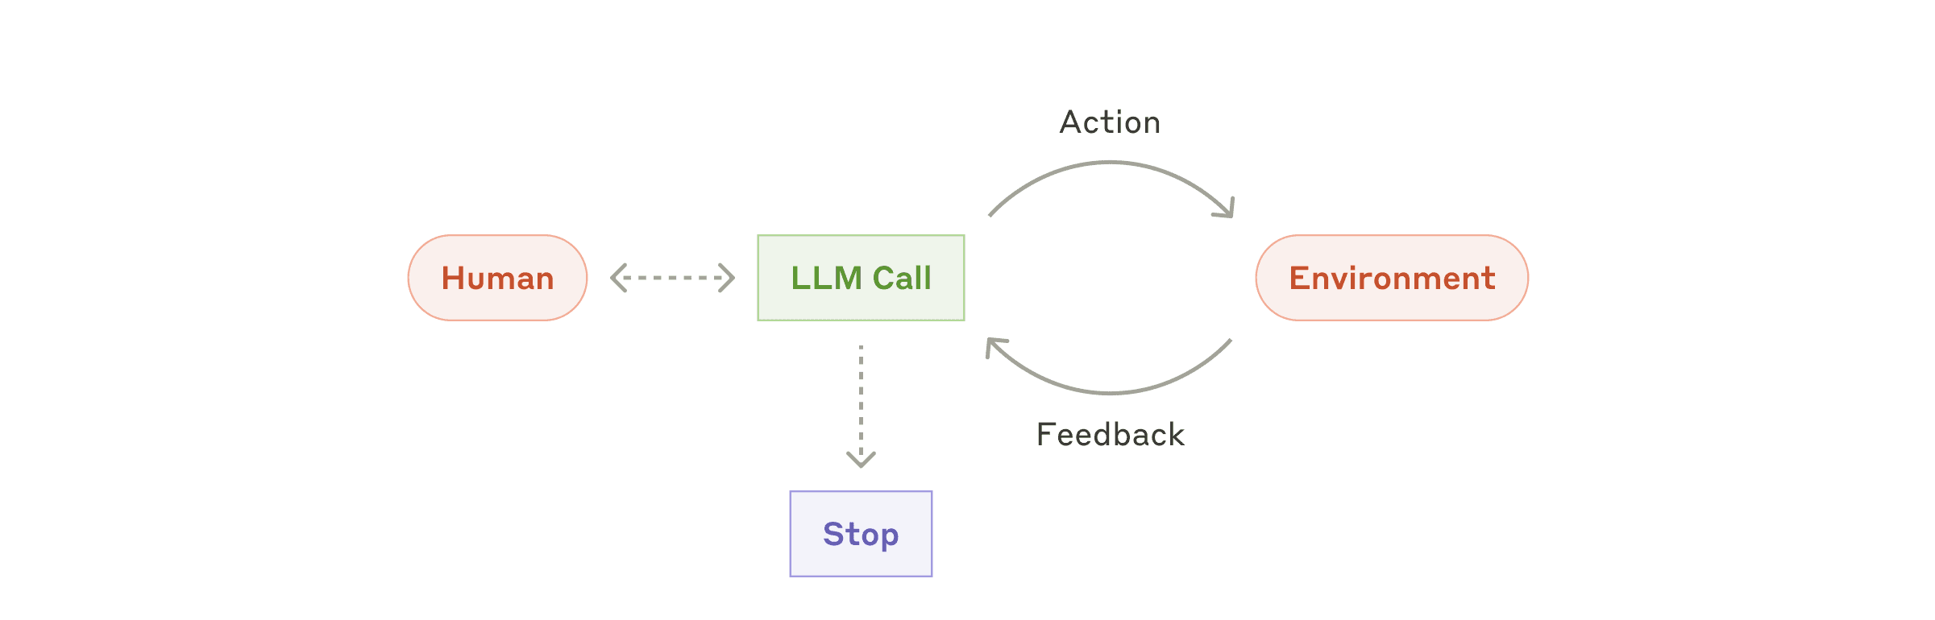
AGENT LOOP
An agent lets the model choose after each result
Environment feedback changes the model's next action.
Anthropic · autonomous agent
MAX_STEPS = 4
First Finance - Arnaud Demes
AGENT
07
Notes:
Anthropic depicts an autonomous agent as an LLM acting on and receiving feedback from its environment, with a stop path.
[Sources]
- https://www.anthropic.com/engineering/building-effective-agents
- assets/lesson-08/anthropic-autonomous-agent.png
[/Sources]

Slide 8
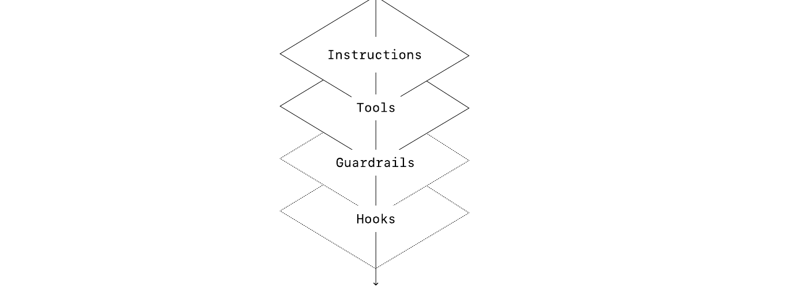
BOUNDED BY CODE
An agent still needs tools, instructions and exit conditions
The model directs execution. The application owns the boundary.
OpenAI · single-agent system
MAX_STEPS stops the loop
First Finance - Arnaud Demes
TRACE
08
Notes:
OpenAI recommends an incremental approach and describes agent runs as loops with exit conditions such as errors or maximum turns.
[Sources]
- https://openai.com/business/guides-and-resources/a-practical-guide-to-building-ai-agents/
- assets/lesson-08/openai-single-agent-loop.png
[/Sources]

Slide 9
WORKFLOW OR AGENT?
Choose an agent only when the model adds measured value
AGENT
WORKFLOW
LESSON 09
Open-ended path
Chosen by the model
Known path
Coded by you
tool errors
+ safe retry
typed tools · trace
MAX_STEPS
DECISION RULE
EVALUATE
Use an agent only when model-directed control flow creates measurable value.
quality · latency · cost · failure rate
NEXT
Lesson 09: explicit state, recovery and safe retries.
First Finance - Arnaud Demes
DECIDE
09
Notes:
Choose the lowest-complexity controller that reaches the quality target. Measure any agent advantage.
[Sources]
- https://www.anthropic.com/engineering/building-effective-agents
- https://openai.com/business/guides-and-resources/a-practical-guide-to-building-ai-agents/
- chapters/08-workflows-vs-agents.md
[/Sources]

Slide 10
FIRST FINANCE
Quick quiz
Choose one answer for each question.
1. Can a workflow pass one tool result into the next step?
A Yes, if code defines the route | B No | C Only with agents
2. What makes the system an agent?
A The model chooses the next action | B It uses two tools | C It has a loop
3. When should you add an agent?
A Measured value on an open path | B Every multi-step task | C When code is hard
LESSON 08 · 3 QUESTIONS · 3 MINUTES
First Finance - Arnaud Demes
Notes:
Instructor purpose: test the corrected workflow-versus-agent distinction.
[Sources]
- chapters/08-workflows-vs-agents.md
[/Sources]

Slide 11
FIRST FINANCE
Answers
Check the idea, not only the letter.
1. A. Yes, if code defines the route
Workflows can chain, branch and loop through observed data.
2. A. The model chooses the next action
Control flow, not tool count, defines an agent.
3. A. Measured value on an open path
Extra autonomy must improve quality enough to justify its cost.
LESSON 08 · CORRECTION
First Finance - Arnaud Demes
Notes:
Instructor purpose: correct the quiz and restate the decision rule.
[Sources]
- chapters/08-workflows-vs-agents.md
[/Sources]

