Slide 1
FIRST FINANCE
A Tool Error Can Become the Next Input
External feedback can correct an action. Application code decides whether another attempt is allowed.
SESSION 09 · 10 MIN CONCEPTS + 30 MIN NOTEBOOK
First Finance - Arnaud Demes
Notes:
Opening: a tool error can be transformed into structured feedback, but the application owns the permission to retry.
[Sources]
- chapters/09-self-correcting-agent.md
- https://developers.openai.com/api/docs/guides/structured-outputs
[/Sources]

Slide 2
WHY RECOVERY MATTERS
An unhandled error ends the task
01
02
03
04
05
Question
Agent
Tool
Exception
No answer
Compare P/E
metric = PE
unsupported_metric
application stops
trace ends
Catching the error is not enough. The next action needs useful feedback.
before recovery
one error · failed task
First Finance - Arnaud Demes
PROBLEM
02
Notes:
The baseline fails because the error terminates execution instead of becoming an observation.
[Sources]
- notebooks/09_self_correcting_agent.ipynb
- src/finai_academy/self_correcting_agent.py
[/Sources]

Slide 3
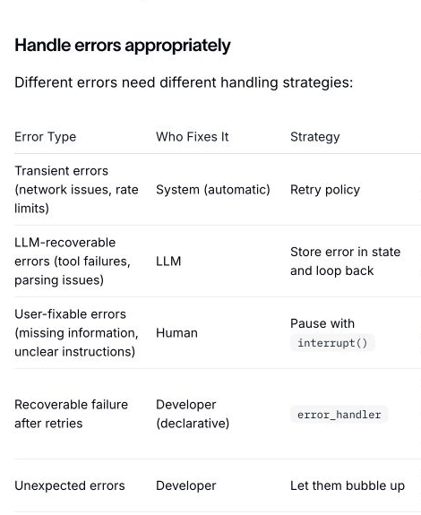
OFFICIAL ERROR STRATEGIES
Errors need different recovery strategies
LANGGRAPH
TRANSIENT · MODEL-CORRECTABLE · USER-FIXABLE · UNEXPECTED
First Finance - Arnaud Demes
GRAPH
03
Notes:
LangGraph distinguishes transient, LLM-recoverable, user-fixable, and unexpected failures. The course uses the label model-correctable for LLM-recoverable tool requests.
[Sources]
- https://docs.langchain.com/oss/python/langgraph/thinking-in-langgraph#handle-errors-appropriately
- assets/lesson-09/langgraph-error-strategies.png
[/Sources]

Slide 4
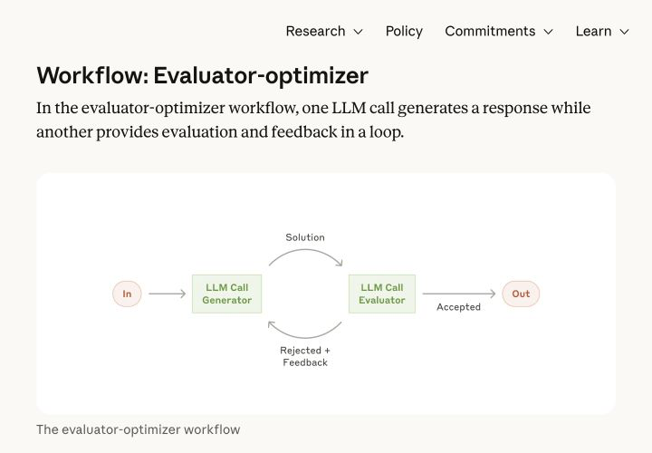
WHAT SELF-CORRECTION MEANS
External feedback changes the next action
External feedback changes an action. Self-critique evaluates a generated answer.
First Finance - Arnaud Demes
FEEDBACK
04
Notes:
Anthropic's evaluator-optimizer depicts generated output, evaluator feedback, and a revised attempt. In this lesson, feedback comes from an external tool contract rather than the model judging its own answer.
[Sources]
- https://www.anthropic.com/engineering/building-effective-agents#workflow-evaluator-optimizer
- assets/lesson-09/anthropic-evaluator-optimizer-crop.png
- https://arxiv.org/abs/2310.01798
[/Sources]

Slide 5
LANGGRAPH MAKES THE RECOVERY ROUTE EXPLICIT
State decides where the graph goes next
MODEL ACTION
tool request
finish
update state
route
DECIDE
TOOL OBSERVATION
ok
error
store feedback
LOOP
APPLICATION GUARDS
MAX_RETRIES
MAX_TOOL_CALLS
STOP
The model proposes. LangGraph routes. Python validates and executes.
First Finance - Arnaud Demes
ROUTE
05
Notes:
LangGraph makes the recovery route explicit in state and conditional edges. The host validates actions and owns stop conditions.
[Sources]
- https://docs.langchain.com/oss/python/langgraph/graph-api
- src/finai_academy/self_correcting_agent.py
[/Sources]

Slide 6
TYPED FEEDBACK
A precise error is a prompt for the next action
01
02
03
04
05
Question
Agent
Tool
Feedback
Context
Compare P/E
NVDA metric = PE
unsupported_metric
Valid metrics: EPS, P/E
retryable = true
The rejected value and valid alternatives remain visible in the trace.
error_count = 1
retry available
First Finance - Arnaud Demes
ERROR
06
Notes:
The tool returns a typed unsupported_metric observation with the rejected value, valid alternatives, and retryability.
[Sources]
- notebooks/09_self_correcting_agent.ipynb
- src/finai_academy/self_correcting_agent.py
- https://developers.openai.com/api/docs/guides/function-calling
[/Sources]

Slide 7
CORRECTED PATH
The agent uses the valid name returned by the tool
01
02
03
04
05
Error observed
Correct request
NVIDIA
Schneider
Finish
unsupported_metric
metric = P/E
P/E = 52.4
P/E = 31.8
source + date
External feedback changes the next observable action.
MAX_RETRIES = 1
tool_calls = 3
First Finance - Arnaud Demes
RECOVER
07
Notes:
The observable correction is PE to P/E. Successful evidence for both companies is required before finish. The values are controlled course data.
[Sources]
- assets/course-data/market/lesson09_metrics_snapshot_v1.json
- notebooks/09_self_correcting_agent.ipynb
[/Sources]

Slide 8
BOUNDED OUTCOMES
The same graph can complete safely or stop safely
CORRECTED PATH
PE fails
P/E succeeds
two companies
FINISH
COMPLETED
REPEATED FAILURE
PE fails
PE repeats
retry budget
STOP
BOUNDARY
MAX_RETRIES = 1
MAX_TOOL_CALLS = 4
CODE-OWNED
Budgets bound behavior. They do not guarantee answer quality.
First Finance - Arnaud Demes
GUARDS
08
Notes:
The notebook demonstrates both a completed recovery and retry_budget_exhausted. Budgets bound execution rather than answer quality.
[Sources]
- notebooks/09_self_correcting_agent.ipynb
- src/finai_academy/self_correcting_agent.py
[/Sources]

Slide 9
PRODUCTION RULE
Self-correction does not guarantee truth
APPLICATION
FEEDBACK
LESSON 10
typed state
budgets
evidence
changes
the next action
MCP tools
discovered at runtime
trace · source · date
KEEP
DO NOT ASSUME
external feedback · bounded retries
a corrected action is a correct answer
DAY 2
Next: expose financial tools and resources through MCP.
First Finance - Arnaud Demes
NEXT
09
Notes:
External feedback can improve the next action, but intrinsic self-correction is not a general truth guarantee. Lesson 10 moves to MCP-discovered tools.
[Sources]
- https://arxiv.org/abs/2310.01798
- chapters/09-self-correcting-agent.md
[/Sources]

Slide 10
FIRST FINANCE
Quick quiz
Choose one answer for each question.
1. Which error should loop back to the model?
A Model-correctable | B Every timeout | C Unknown bug
2. What should handle a transient timeout?
A System retry with backoff | B Agent self-critique | C Ignore it
3. What do budgets guarantee?
A Bounded behavior | B Correct answers | C Live data
LESSON 09 · 3 QUESTIONS · 3 MINUTES
First Finance - Arnaud Demes
Notes:
Instructor purpose: classify errors and distinguish model recovery from system retry.
[Sources]
- chapters/09-self-correcting-agent.md
- https://docs.langchain.com/oss/python/langgraph/thinking-in-langgraph#handle-errors-appropriately
[/Sources]

Slide 11
FIRST FINANCE
Answers
Check the idea, not only the letter.
1. A. Model-correctable
Return a precise observation so the model can propose a valid action.
2. A. System retry with backoff
Transient infrastructure failures should not consume model reasoning retries.
3. A. Bounded behavior
Budgets stop loops; they do not prove the final answer is true.
LESSON 09 · CORRECTION
First Finance - Arnaud Demes
Notes:
Instructor purpose: correct the quiz and restate the boundary of retry budgets.
[Sources]
- chapters/09-self-correcting-agent.md
[/Sources]

