Slide 1
FIRST FINANCE
Connect Financial Tools with MCP
One open protocol for AI applications, tools, and financial knowledge
SESSION 10 · 10 MIN CONCEPTS + 30 MIN NOTEBOOK
First Finance - Arnaud Demes
Notes:
MCP is the connector layer between an AI application and external tools or knowledge. The core teaching point is that the protocol standardizes access while the host still owns control.
[Sources]
- chapters/10-financial-mcp.md
- https://modelcontextprotocol.io/specification/2026-07-28/architecture
[/Sources]

Slide 2
THE PROBLEM
Without MCP, every AI application needs custom integrations
AI APPLICATIONS
FINANCIAL SYSTEMS
Annual filings
Analyst
Copilot
3 × 4
Internal research
Research
Agent
12 custom connectors
Every new app or system adds more code to build, secure, and maintain.
Metric store
Planning
Assistant
CRM / workflow
The integration surface grows as N × M.
First Finance - Arnaud Demes
COUPLING
02
Notes:
Without a shared protocol, every application-to-system pair needs custom integration code. Anthropic described this fragmentation as a scalability problem when introducing MCP.
[Sources]
- https://www.anthropic.com/news/model-context-protocol
- chapters/10-financial-mcp.md
[/Sources]

Slide 3
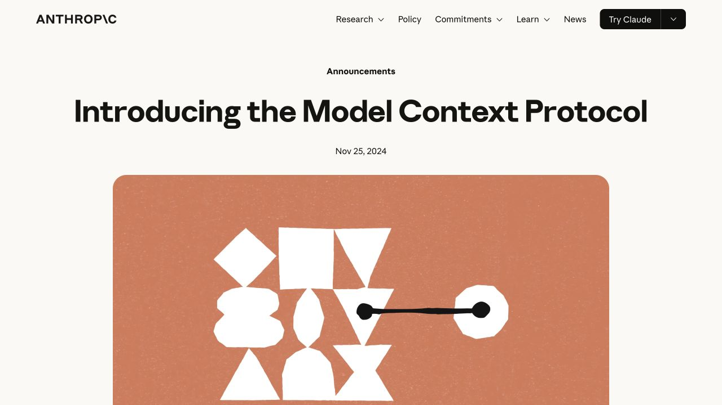
ORIGIN
Anthropic introduced MCP as an open connector standard
25 NOV
2024
Anthropic open-sourced the
Model Context Protocol
A universal protocol for AI applications to connect with tools and data sources.
Created at Anthropic. Built as an open ecosystem standard.
Official Anthropic announcement
First Finance - Arnaud Demes
ORIGIN
03
Notes:
Anthropic announced and open-sourced MCP on 25 November 2024 as a universal standard for connecting AI systems with data sources. The visual is a screenshot of the official announcement page.
[Sources]
- https://www.anthropic.com/news/model-context-protocol
- assets/lesson-10/anthropic-mcp-launch.png
[/Sources]

Slide 4
WHY MCP
One shared protocol replaces a web of custom connectors
BEFORE MCP
WITH MCP
APP 1
FILINGS
APP 1
FILINGS
RESEARCH
MCP
RESEARCH
APP 2
APP 2
METRICS
METRICS
APP 3
APP 3
CRM
CRM
N × M custom code
N + M protocol endpoints
First Finance - Arnaud Demes
STANDARD
04
Notes:
The left side shows the many-to-many connector problem. The right side shows the architectural benefit: applications and servers implement one shared contract. The N + M notation is an explanatory model, not a protocol performance claim.
[Sources]
- https://www.anthropic.com/news/model-context-protocol
- https://modelcontextprotocol.io/specification/2026-07-28/architecture
[/Sources]

Slide 5
MCP ARCHITECTURE
The host controls one MCP client per server
HOST / AI APPLICATION
Owns context, lifecycle, consent, policy, and the final answer
MCP CLIENT 1
one connection
MCP SERVER
Annual reports
MODEL + USER
MCP CLIENT 2
one connection
MCP SERVER
Internal research
policy gate
MCP CLIENT 3
one connection
MCP SERVER
Metric store
Each client communicates with exactly one server.
First Finance - Arnaud Demes
ARCH
05
Notes:
The current specification uses a client-host-server architecture. A host can run several client instances, and each client communicates with exactly one server. MCP 2026-07-28 is stateless: every request carries protocol version and capabilities.
[Sources]
- https://modelcontextprotocol.io/specification/2026-07-28/architecture
[/Sources]

Slide 6
THREE PRIMITIVES
Resources, tools, and prompts serve different jobs
RESOURCE
TOOL
PROMPT
application-controlled
model-controlled
user-controlled
finance://coverage
get_company_metric
compare_companies
Different controller, same MCP protocol
First Finance - Arnaud Demes
PRIMITIVES
06
Notes:
MCP servers expose prompts, resources, and tools. The current specification describes prompts as user-controlled, resources as application-controlled, and tools as model-controlled. Model-controlled means the model may propose a call; host policy still decides whether execution is permitted.
[Sources]
- https://modelcontextprotocol.io/specification/2026-07-28/server/index
- src/finai_academy/financial_mcp_server.py
[/Sources]

Slide 7
DISCOVERY
Discovery happens before execution
01
02
03
04
05
06
DISCOVER
INSPECT
APPROVE
CALL
VALIDATE
RECORD
server/discover or list
name + input schema
host policy gate
resource or tool
result + domain rules
source + evidence
Our host chooses to discover first, then permits only a validated read-only call.
LOCAL STDIO · REMOTE MCP · same control pattern
First Finance - Arnaud Demes
DISCOVERY
07
Notes:
The lesson deliberately discovers and inspects capabilities before execution, even though server/discover is optional in the 2026-07-28 stateless protocol. This creates a clear teaching sequence: understand the schema, apply policy, call, validate, and record evidence.
[Sources]
- https://modelcontextprotocol.io/specification/2026-07-28/architecture
- notebooks/10_financial_mcp.ipynb
- src/finai_academy/financial_mcp_client.py
[/Sources]

Slide 8
FINANCE USE CASE
MCP gives finance assistants controlled access to internal knowledge
ANNUAL REPORTS
PDF + tables
finance://coverage
MCP
SERVERS
FINANCE
ASSISTANT
INTERNAL RESEARCH
notes + memos
standard capabilities
compare_companies
search_financial_documents
METRIC STORE
approved KPIs
get_company_metric
One assistant can answer with the source, date, and evidence ID attached.
First Finance - Arnaud Demes
FINANCE
08
Notes:
The finance example connects annual reports, internal research, and approved metrics through focused MCP servers. The course server exposes finance://coverage, get_company_metric, search_financial_documents, and compare_companies.
[Sources]
- src/finai_academy/financial_mcp_server.py
- notebooks/10_financial_mcp.ipynb
- chapters/10-financial-mcp.md
[/Sources]

Slide 9
TRUST BOUNDARY
The protocol standardizes access, not trust
HOST / TRUST BOUNDARY
AUTHENTICATION
HOST
POLICY
ARGUMENT VALIDATION
DISCOVERED
MCP SERVER
APPROVAL
EVIDENCE TRAIL
ALLOWLIST
LOCAL STDIO
or
REMOTE MCP
server_url
DISCOVERY IS NOT PERMISSION
First Finance - Arnaud Demes
TRUST
09
Notes:
The protocol does not make a discovered server trustworthy. The host must enforce authentication, approval, allowlists, argument validation, and evidence. MCP supports local stdio and remote HTTP transports; the trust policy remains a host responsibility.
[Sources]
- https://modelcontextprotocol.io/specification/2026-07-28/architecture
- https://modelcontextprotocol.io/specification/2026-07-28/basic/transports
- chapters/10-financial-mcp.md
[/Sources]

Slide 10
FIRST FINANCE
Quick quiz
Choose one answer for each question.
1. What problem is MCP designed to reduce?
A Custom point-to-point integrations | B Model training | C PDF size
2. Who owns permission and the final answer?
A Host | B MCP server | C Transport
3. In the architecture, one MCP client talks to...
A Exactly one server | B Every server | C No server
LESSON 10 · 3 QUESTIONS · 3 MINUTES
First Finance - Arnaud Demes
Notes:
Instructor purpose: check that learners can explain the integration problem, the host's responsibility, and the one-client-to-one-server relationship.
[Sources]
- https://www.anthropic.com/news/model-context-protocol
- https://modelcontextprotocol.io/specification/2026-07-28/architecture
[/Sources]

Slide 11
FIRST FINANCE
Answers
Check the idea, not only the letter.
1. A. Custom point-to-point integrations
MCP replaces many custom connectors with one shared protocol contract.
2. A. Host
The host owns context, consent, policy, evidence, and the final response.
3. A. Exactly one server
A host may run many clients, but each client communicates with one server. Lesson 11 adds planning across capabilities.
LESSON 10 · ANSWERS · LESSON 11 NEXT
First Finance - Arnaud Demes
Notes:
Instructor purpose: correct the quiz and transition to Lesson 11, where an agent plans across several controlled capabilities.
[Sources]
- chapters/10-financial-mcp.md
- https://modelcontextprotocol.io/specification/2026-07-28/architecture
[/Sources]

