Slide 1
FIRST FINANCE
Plan-and-Execute Financial Analyst
Approve the strategy before the first tool call
NVIDIA + SCHNEIDER ELECTRIC · PLAN · EXECUTE · VERIFY
First Finance - Arnaud Demes
Notes:
[Sources]
chapters/11-plan-and-execute-analyst.md
https://www.anthropic.com/engineering/building-effective-agents
[/Sources]

Slide 2
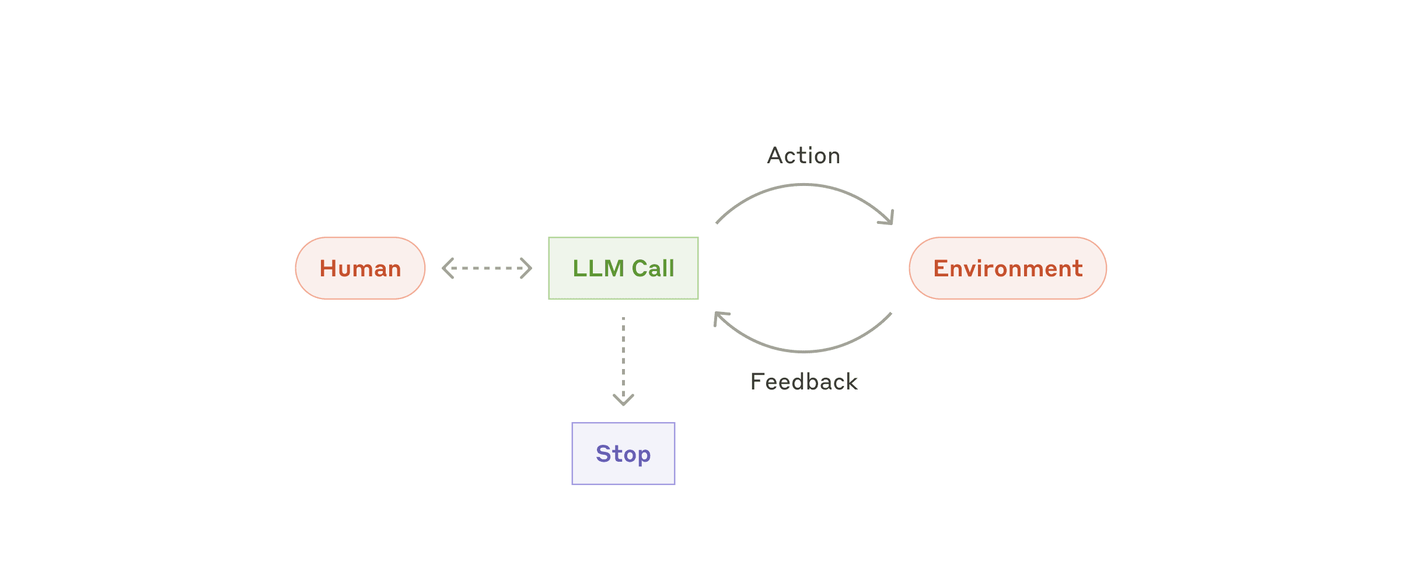
WHY PLAN
One mission, several evidence gaps
MISSION
Compare two companies with valuation and operating evidence.
Valuation metric for both companies
Operating evidence from documents
A source for every factual claim
The plan coordinates several evidence needs before the loop begins.
Planning earns its cost when the evidence path is uncertain.
First Finance - Arnaud Demes
MISSION
02
Notes:
[Sources]
chapters/11-plan-and-execute-analyst.md
https://www.anthropic.com/engineering/building-effective-agents
assets/lesson-11/anthropic-autonomous-agent.png
[/Sources]

Slide 3
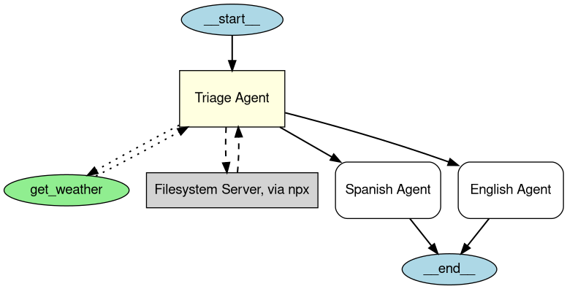
HOST POLICY
A graph shows connections, not authorization
HOST POLICY
1
Validate the typed plan
2
Enforce a six-step budget
3
Permit read-only MCP tools
Example agent graph
4
Gate the final evidence
BOUNDARY
The model proposes a path. The host decides whether it may run.
First Finance - Arnaud Demes
CONTROL
03
Notes:
[Sources]
chapters/11-plan-and-execute-analyst.md
https://openai.github.io/openai-agents-python/visualization/
assets/lesson-11/openai-agent-graph.png
[/Sources]

Slide 4
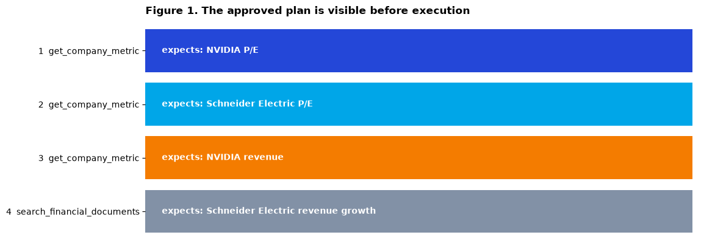
APPROVED PLAN
The plan is visible before any tool runs
APPROVE ONLY IF
1
Schema valid
2
Tool permitted
3
Budget respected
Approval happens before attempt 1.
First Finance - Arnaud Demes
PLAN
04
Notes:
[Sources]
chapters/11-plan-and-execute-analyst.md
notebooks/11_plan_and_execute_analyst.ipynb
assets/lesson-11/approved-plan.png
[/Sources]

Slide 5
MCP DISCOVERY
MCP discovery narrows the agent's choices
DISCOVERED
→
ALLOWLISTED
→
ARGUMENTS VALIDATED
get_company_metric
search_financial_documents
ticker: str · metric: str
company: str · query: str · top_k
Returns value, date and source
Returns evidence IDs and source references
Discovery offers capabilities. Host policy turns them into permission.
runtime offer
host decision
First Finance - Arnaud Demes
MCP
05
Notes:
[Sources]
chapters/11-plan-and-execute-analyst.md
https://modelcontextprotocol.io/specification/2025-06-18/server/tools
src/finai_academy/planning_mcp_executor.py
[/Sources]

Slide 6
TYPED FAILURE
A typed failure becomes part of the trace
ATTEMPT 3
get_company_metric
Do not hide it
Do not retry it unchanged
Do not rewrite history
RETAIN
ticker NVDA
metric Revenue
status error
error_code unsupported_metric
retryable false
The failure remains visible, so the strategy change is auditable.
retryable: false
one replan maximum
First Finance - Arnaud Demes
TRACE
06
Notes:
[Sources]
chapters/11-plan-and-execute-analyst.md
notebooks/11_plan_and_execute_analyst.ipynb
src/finai_academy/plan_execute_graph.py
[/Sources]

Slide 7
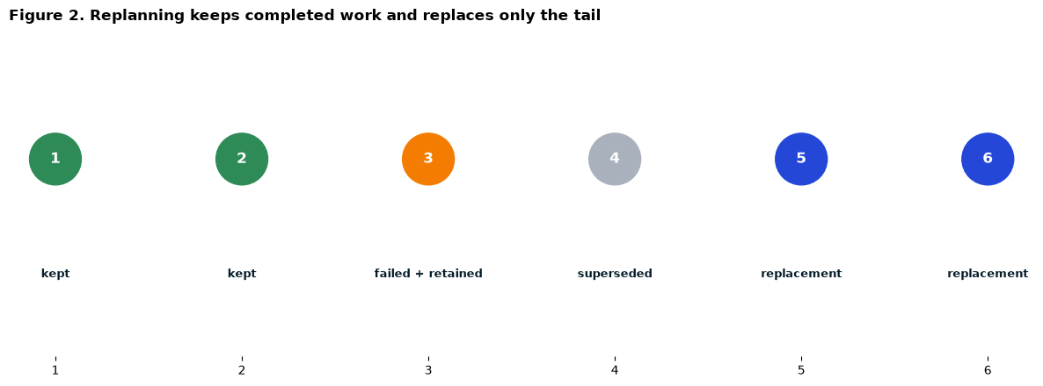
TAIL REVISION
One failed metric changes the remaining strategy
KEEP
RETAIN + SUPERSEDE
REPLACE
Steps 1-2 stay. Step 3 remains. Step 4 is superseded. Steps 5-6 replace the tail.
First Finance - Arnaud Demes
REPLAN
07
Notes:
[Sources]
chapters/11-plan-and-execute-analyst.md
notebooks/11_plan_and_execute_analyst.ipynb
assets/lesson-11/replan-trace.png
[/Sources]

Slide 8
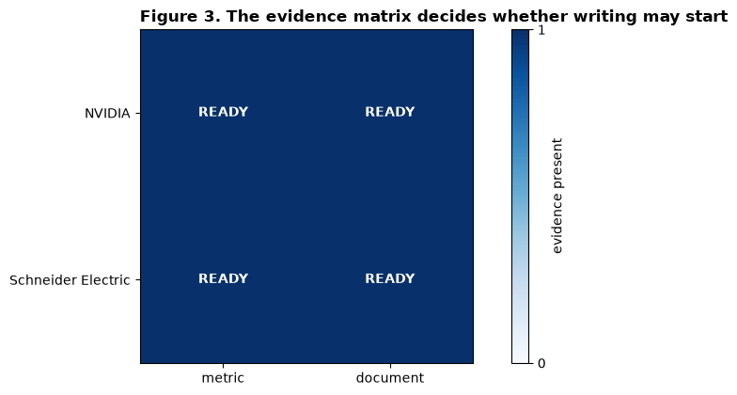
EVIDENCE GATE
The evidence gate blocks fluent incompleteness
WRITE ONLY IF
1
NVIDIA metric
2
NVIDIA document
3
Schneider metric
4
Schneider document
A fluent report with one missing evidence cell still fails.
First Finance - Arnaud Demes
GATE
08
Notes:
[Sources]
chapters/11-plan-and-execute-analyst.md
notebooks/11_plan_and_execute_analyst.ipynb
assets/lesson-11/evidence-gate.png
[/Sources]

Slide 9
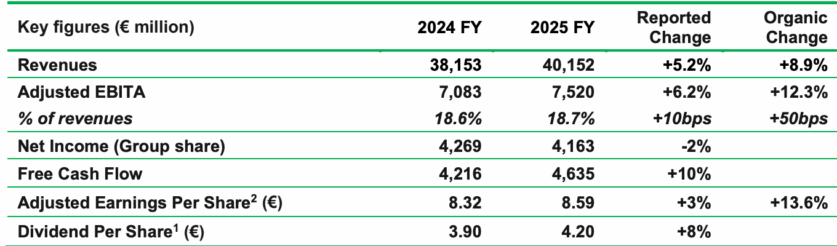
LESSON 12 HANDOFF
Every claim must point back to evidence
EVIDENCE ID
SU-FY2025-ENERGY-MANAGEMENT-001
→
CITED FACT
Schneider Electric reported FY2025 revenue of EUR 40.2 billion and an adjusted EBITA margin of 18.7%.
OFFICIAL REPORT
Schneider Electric FY2025 results
source + evidence ID + claim
LESSON 12
Score the path and the answer separately.
First Finance - Arnaud Demes
EVALUATE
09
Notes:
[Sources]
chapters/11-plan-and-execute-analyst.md
assets/lesson-05/schneider-fy2025-results.pdf
assets/course-data/mcp/lesson10_evidence_catalog_v1.json
chapters/12-evaluating-agentic-systems.md
[/Sources]

Slide 10
FIRST FINANCE
Quick quiz
Choose one answer for each question.
1. Who validates a plan before execution?
A Host | B Model alone | C PDF parser
2. What does a replan replace?
A Unfinished work | B Successful evidence | C The company universe
3. What blocks an incomplete briefing?
A Evidence gate | B Streaming | C A chart
LESSON 11 · 3 QUESTIONS · 3 MINUTES
First Finance - Arnaud Demes
Notes:
Instructor purpose: Check the three core decisions before the lesson closes.
Planned timing: 3 minutes.
Facilitation: ask for one letter per question.
[Sources]
- chapters/11-plan-and-execute-analyst.md
[/Sources]

Slide 11
FIRST FINANCE
Answers
Check the idea, not only the letter.
1. A. Host
The planner proposes steps; application policy checks them.
2. A. Unfinished work
Successful observations stay immutable while the remaining tail changes.
3. A. Evidence gate
The report stops if either company lacks required evidence.
LESSON 11 · CORRECTION
First Finance - Arnaud Demes
Notes:
Instructor purpose: Correct the quiz and restate the practical rule behind each answer.
Planned timing: 3 minutes.
Facilitation: ask learners to explain each rule in their own words.
[Sources]
- chapters/11-plan-and-execute-analyst.md
[/Sources]

