Slide 1
FIRST FINANCE
Evaluate the agent, not only the answer
Evaluating Agentic Systems with MLflow
PATH · ANSWER · TRACE · RELEASE
First Finance - Arnaud Demes
Notes:
Instructor purpose: Frame the lesson around release evidence: the agent's path, answer, trace, and decision.
Planned timing: 0:00-1:00
[Sources]
chapters/12-evaluating-agentic-systems.md
https://mlflow.org/docs/latest/genai/eval-monitor/quickstart/
[/Sources]

Slide 2
WHY EVALUATE
A good answer can still come from a bad agent
BOUNDED PATH
PLAN
TOOL
EVIDENCE
COPY
SAME ANSWER
REDUNDANT PATH
PLAN + TOOL
TOOL AGAIN
REPORT
DIFFERENT PATH
RISK
correct evidence
extra call after gate
FAIL
The final paragraph cannot reveal redundant calls or a failed gate.
First Finance - Arnaud Demes
PATH
02
Notes:
Instructor purpose: Contrast two equally plausible answers whose execution paths carry very different risk.
Planned timing: 1:00-2:15
[Sources]
chapters/12-evaluating-agentic-systems.md
https://mlflow.org/docs/latest/genai/tracing/
[/Sources]

Slide 3
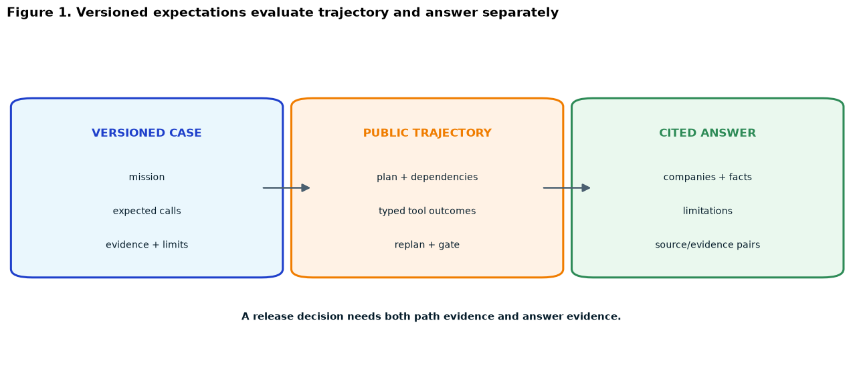
EVALUATION CONTRACT
Score the answer and the path separately
LAYER | VISIBLE METRICS | FINANCE QUESTION
TRAJECTORY | tool_call_correctness tool_call_efficiency | Right capabilities, order, and call budget?
ANSWER | answer_relevance answer_completeness | Required companies, facts, comparison, and limits?
EVIDENCE | citation_integrity | Does every source and evidence ID pair match an observation?
INPUT
PUBLIC PATH
CITED ANSWER
The release decision needs both scorecards.
First Finance - Arnaud Demes
SCORE
03
Notes:
Instructor purpose: Separate path correctness and efficiency from answer completeness and citation integrity.
Planned timing: 2:15-3:45
[Sources]
chapters/12-evaluating-agentic-systems.md
notebooks/12_evaluating_agentic_systems.ipynb
assets/lesson-12/evaluation-contract.png
https://mlflow.org/docs/latest/genai/eval-monitor/scorers/index.html
[/Sources]

Slide 4
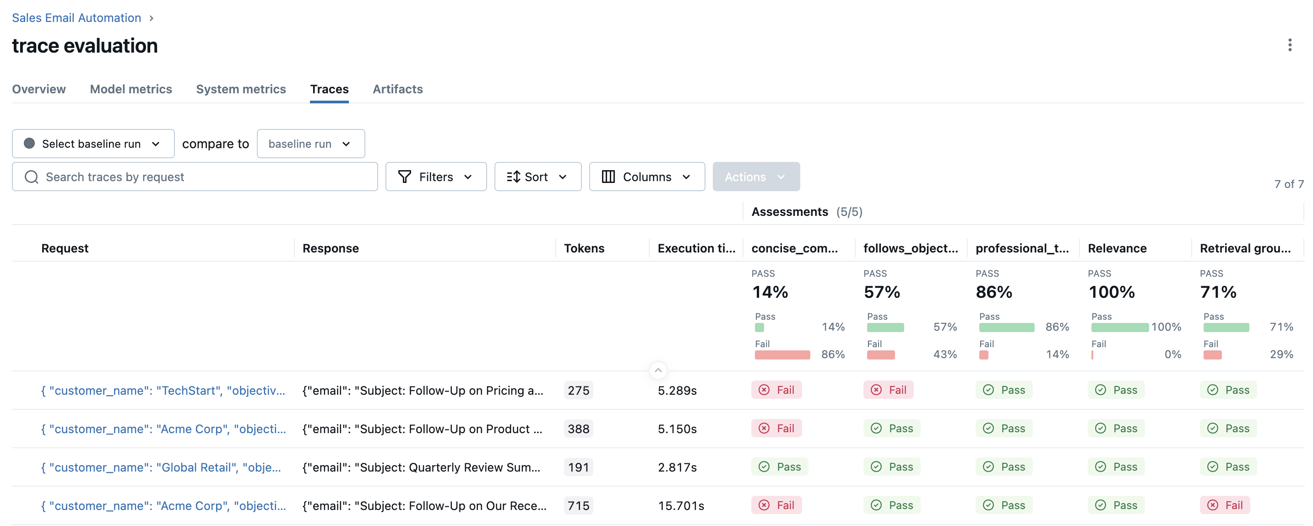
MLFLOW EVALUATION
MLflow turns every case into inspectable evidence
EVALUATION RUN
1
Versioned cases
2
Run the agent
3
Apply scorers
4
Open failures
Inputs + expectations
One root trace per case
Path + answer metrics
Inspect spans and owners
One run compares cases; each row opens the trace behind the score.
First Finance - Arnaud Demes
RUN
04
Notes:
Instructor purpose: Show how a versioned dataset becomes one comparable MLflow run with a trace behind every row.
Planned timing: 3:45-5:15
[Sources]
chapters/12-evaluating-agentic-systems.md
https://www.mlflow.org/docs/latest/genai/eval-monitor/running-evaluation/traces/
assets/lesson-12/mlflow-trace-evaluation-overview.png
[/Sources]

Slide 5
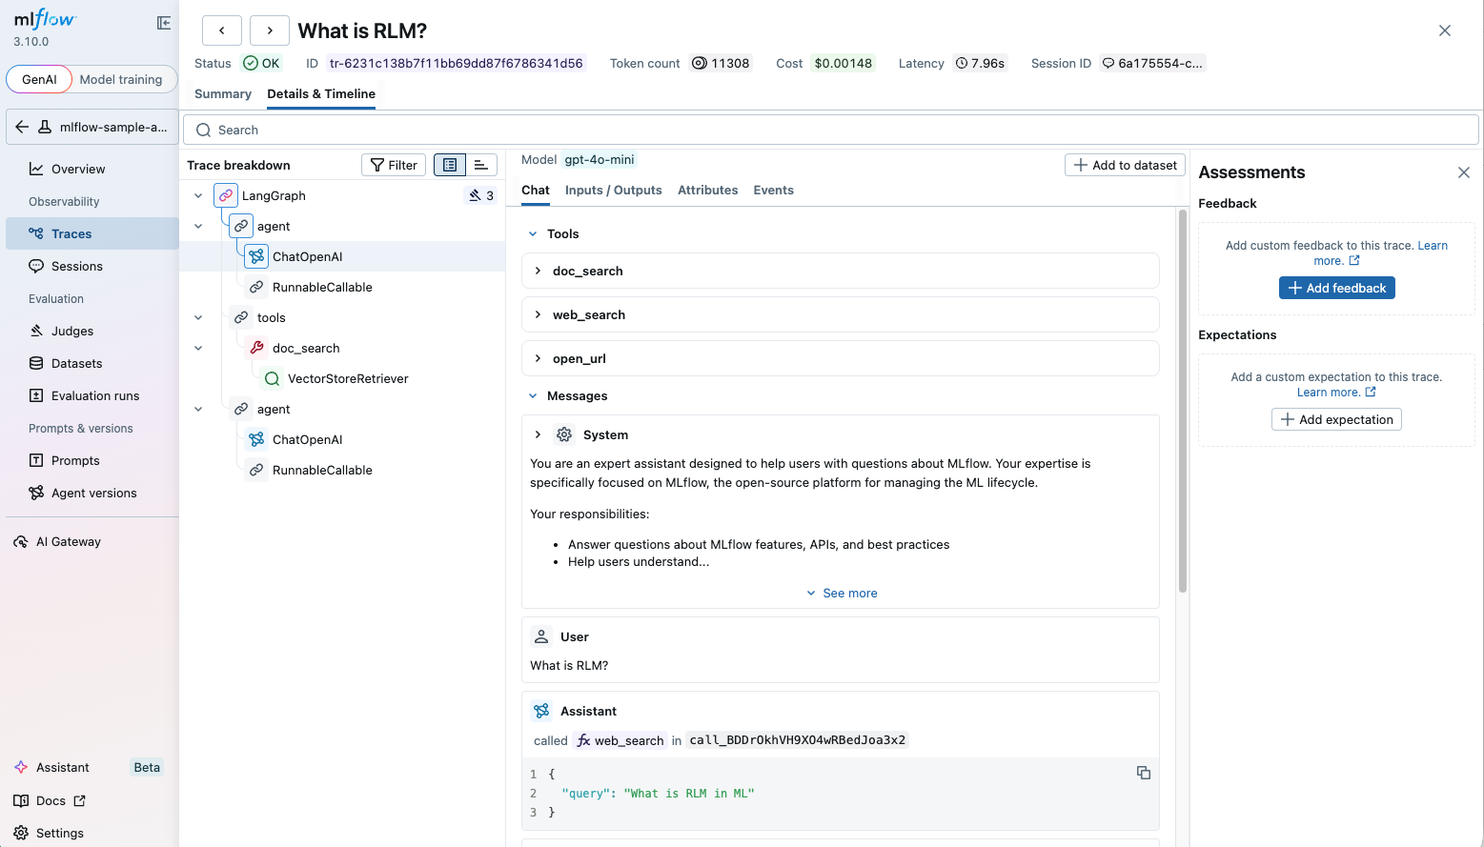
TRACE VIEWER
A trace reveals what the agent actually did
HOW TO READ IT
1
Span tree
Where time and branching occurred
2
Inputs / outputs
What entered and left each span
3
Tools + errors
Calls, arguments and typed failures
4
Assessments
Scores, feedback and expectations
TRACE
Open a score, follow its span tree, find the earliest public failure.
First Finance - Arnaud Demes
TRACE
05
Notes:
Instructor purpose: Teach the MLflow trace viewer as the debugging surface for spans, tool calls, errors, and assessments.
Planned timing: 5:15-7:00
[Sources]
chapters/12-evaluating-agentic-systems.md
https://mlflow.org/docs/latest/genai/tracing/observe-with-traces/ui
assets/lesson-12/mlflow-trace-detail.png
[/Sources]

Slide 6
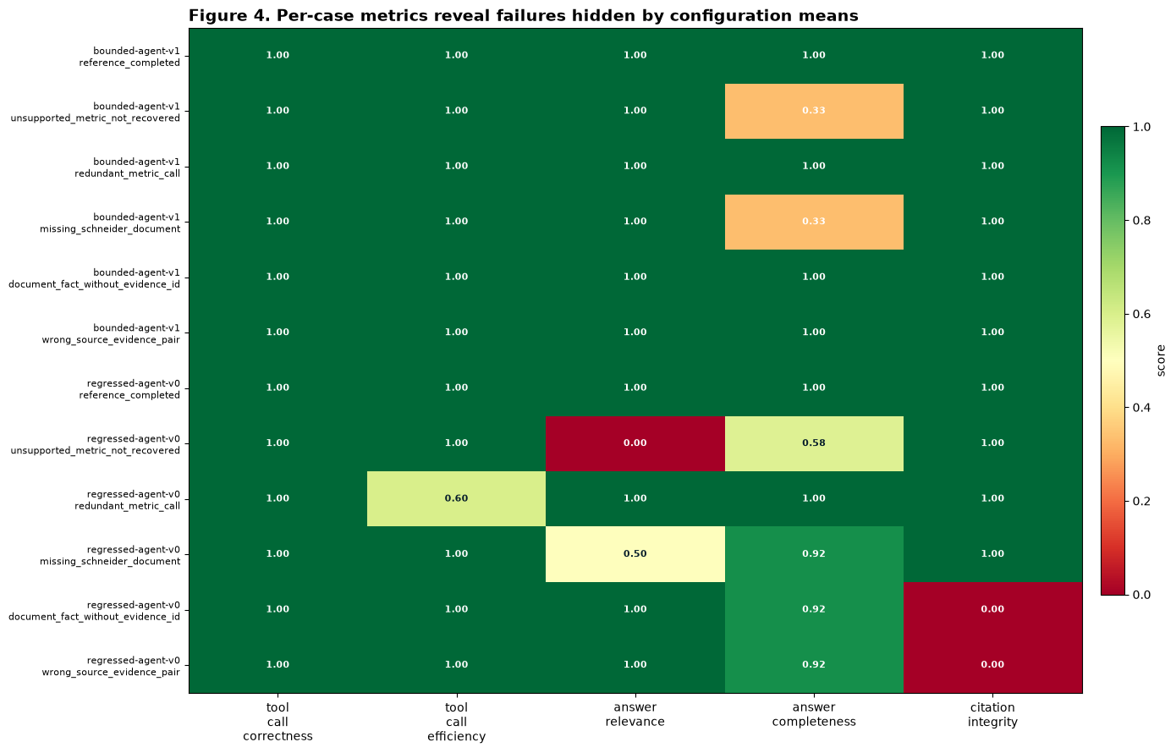
CASE-LEVEL SCORES
Per-case failures matter more than averages
READ ROWS BEFORE MEANS
Averages can hide one severe citation or stop-control failure.
✓
Find the weakest case
✓
Open its trace
✓
Locate the first failed span
✓
Assign the fix to its owner
First Finance - Arnaud Demes
CASES
06
Notes:
Instructor purpose: Read the lowest case before trusting a configuration average, then open the matching trace.
Planned timing: 7:00-8:30
[Sources]
chapters/12-evaluating-agentic-systems.md
notebooks/12_evaluating_agentic_systems.ipynb
assets/lesson-12/per-case-heatmap.png
[/Sources]

Slide 7
RELEASE GATES
Code gates release; judges add context
DECISION LAYER | DETERMINISTIC RELEASE GATE | OPTIONAL LLM JUDGE
INPUT | Public fields and exact evidence pairs | Trace and answer text
STRENGTH | Reproducible, offline finance rules | Semantic nuance
FAILURE | Blocks release | NOT RUN or review signal
ROLE | Required for every case | Never overrides the gate
Deterministic checks decide release. Optional judges never override the gate.
First Finance - Arnaud Demes
GATE
07
Notes:
Instructor purpose: Keep deterministic finance rules as release gates and optional semantic judges as context.
Planned timing: 8:30-9:45
[Sources]
chapters/12-evaluating-agentic-systems.md
https://mlflow.org/docs/latest/genai/eval-monitor/scorers/index.html
[/Sources]

Slide 8
FAILURE OWNERSHIP
Fix the earliest public owner
SCORE PATTERN | EARLIEST PUBLIC OWNER | RELEASE
Answer good, path bad | Planner or replanner | BLOCK
Path good, answer incomplete | Evidence gate or report writer | BLOCK
CITATION INTEGRITY = 0 | Report writer | BLOCK
Correct typed stop, no briefing | Evidence gate | PASS
A trace turns a low score into an actionable owner and next step.
First Finance - Arnaud Demes
OWNER
08
Notes:
Instructor purpose: Map each failed score to the earliest public component that can own and fix it.
Planned timing: 9:45-11:00
[Sources]
chapters/12-evaluating-agentic-systems.md
https://mlflow.org/docs/latest/genai/tracing/observe-with-traces/ui
[/Sources]

Slide 9
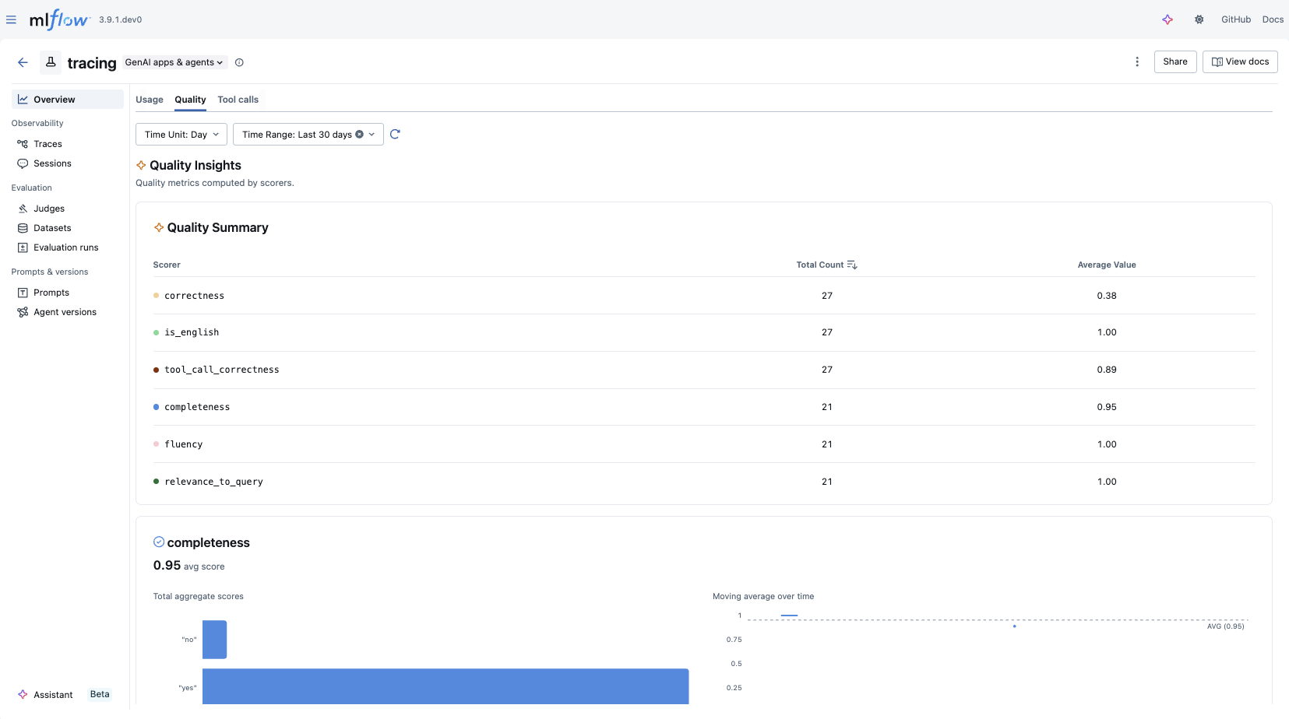
RELEASE DECISION
Release only when path, answer, and citations pass
RELEASE ONLY IF
✓
Public path passes
✓
Answer passes
✓
Citations resolve
✓
No forbidden stop behavior
Any failure blocks release and becomes the next experiment.
CAPSTONE
Use the failures to design the capstone, not to hide them.
First Finance - Arnaud Demes
RELEASE
09
Notes:
Instructor purpose: Close with a release checklist and use dashboard failures to define the capstone experiment.
Planned timing: 11:00-12:30
[Sources]
chapters/12-evaluating-agentic-systems.md
https://mlflow.org/docs/latest/genai/tracing/observe-with-traces/dashboard/
assets/lesson-12/mlflow-quality-dashboard.png
[/Sources]

Slide 10
FIRST FINANCE
Quick quiz
Choose one answer for each question.
1. Should path quality and answer quality be scored separately?
A Yes | B No | C Only with OpenAI
2. Which gate must run for every release case?
A Deterministic gate | B Optional LLM judge | C Manual demo
3. How should an unavailable optional judge be recorded?
A NOT RUN | B PASS | C Zero cost
LESSON 12 · 3 QUESTIONS · 3 MINUTES
First Finance - Arnaud Demes
Notes:
Instructor purpose: Check the three core decisions before the lesson closes.
Planned timing: 3 minutes.
Facilitation: ask for one letter per question.
[Sources]
- chapters/12-evaluating-agentic-systems.md
[/Sources]

Slide 11
FIRST FINANCE
Answers
Check the idea, not only the letter.
1. A. Yes
A plausible answer can still come from an inefficient or unsafe path.
2. A. Deterministic gate
Stable rules make release decisions reproducible and inspectable.
3. A. NOT RUN
An optional judge must never be silently replaced or reported as executed.
LESSON 12 · CORRECTION
First Finance - Arnaud Demes
Notes:
Instructor purpose: Correct the quiz and restate the practical rule behind each answer.
Planned timing: 3 minutes.
Facilitation: ask learners to explain each rule in their own words.
[Sources]
- chapters/12-evaluating-agentic-systems.md
[/Sources]

