Slide 1
National Center for Charitable Statistics

Slide 2


Slide 3


Business Master File (BMF)
Sampling framework for 990 research
New UNIFIED format
1.9M active nonprofits + 1.6M historic
standardized geographies
better validation of org attributes

Slide 4

990
CORE
Series
Best panel for longitudinal financial analysis
Coverage from 1989-2023
Separate panels for public charities, private foundations, and other 501c nonprofits
(how many variables?)
New HARMONIZED format
Variable names standardized over time
Geographies standardized + crosswalks available
Use consistent organizational attributes

Slide 5

Standardized Geographies
Legacy files had inconsistent geographies
Now uses a single geography based on the most recent address we have for nonprofits to make panels consistent
Lat-Lon and geographic IDs in BMF and CORE files
GEO Crosswalk framework
Crosswalks for 13 different geographies – allow for easy data aggregation or to merge outside datasets
Pre-compiled panel of census variables from 1990-2020

Slide 6

NTEE
Fields
National Taxonomy of Exempt Entities
Industry classification system for the nonprofit sector
Updated NTEEV2 Format
Designed to make sampling easier
Separates org types and activities
Dictionary is built into the NCCS R package

Slide 7
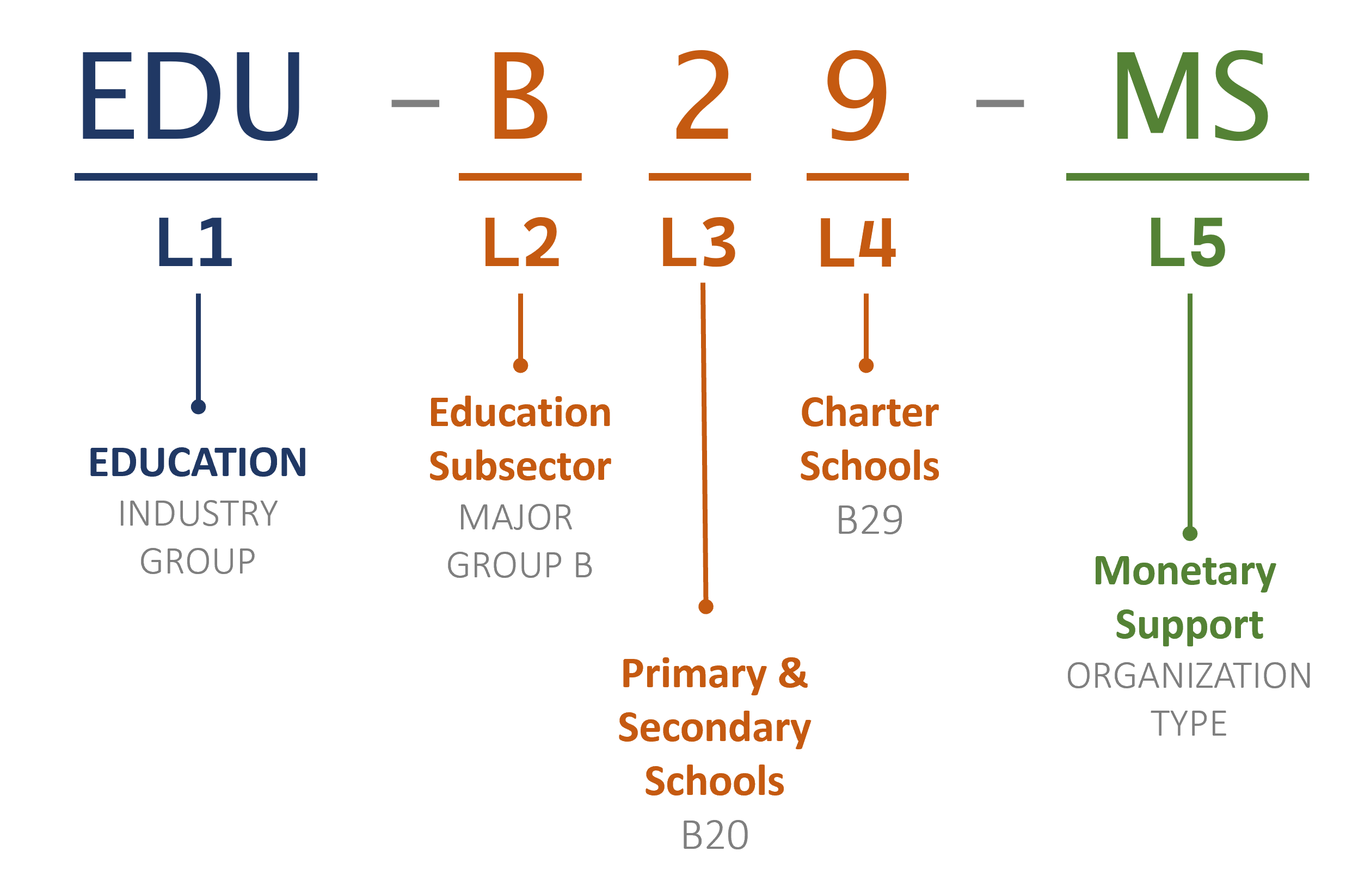
NTEE V2
#> "ART-A26-MT" "ART-A20-PA"
#> "ART-A25-PA“ "ART-A20-MS"
#> "ART-A26-MM” "ART-A23-RG"
#> "ART-A20-NS" "ART-A20-RG"
#> "ART-A24-RG" "ART-A25-RG"
#> "ART-A26-RG" "ART-A27-RG"
parse_ntee(
ntee.group = "all",
ntee.code = "A2x",
ntee.orgtype = "all" )

Slide 8




Slide 9
|YEAR | 990| 990EZ| 990PF| 990T|
|:----|-------:|-------:|-------:|------:|
|2007 | 17| 17| 0| 0|
|2008 | 87| 114| 20| 0|
|2009 | 33,311| 15,470| 2345| 0|
|2010 | 123,026| 63,326| 25249| 0|
|2011 | 159,504| 82,048| 34597| 0|
|2012 | 179,688| 93,750| 39933| 0|
|2013 | 198,856| 104,375| 45887| 0|
|2014 | 218,620| 116,417| 53442| 0|
|2015 | 233,520| 124,894| 58815| 0|
|2016 | 243,903| 130,485| 62988| 0|
|2017 | 261,612| 139,146| 68950| 0|
|2018 | 271,442| 149,384| 80138| 0|
|2019 | 283,741| 152,669| 87805| 0|
|2020 | 323,393| 172,020| 116,484| 23,302|
|2021 | 355,254| 219,703| 129,136| 24,575|
|2022 | 663,940| 349,484| 176,778| 38,610|
|2023 | 235,492| 266,856| 179,826| 8866|
First year efiling is mandatory

Slide 10

Annual Surveys from 2020 onward
Operational insights that better capture sector trends beyond what is available on 990 forms
Representative national sample of organizations
Public use data files
Multi-Institution Collaboration
Urban Institute: NCCS + Teresa Derrick-Mills
American University: Lewis Faulk
George Mason University: Mirae Kim, Alan Abramson
Georgia Tech: Calton Pu
NSF Funding + Ongoing Philanthropic Support
Nonprofit Trends Survey

Slide 11

Political Action Committees
(527 orgs)
Form 8871 database of PACs
Nonprofits that have filed to act as political action committees
Form 8872 activities
Donations made to nonprofits
Expenditures on political campaigns
Also see Schedule C: Lobbying Activities
Available in the EFILE database

Slide 12
Regulations
Project:
Legal Compendium
Dataset
V1: 2016
Cindy Lott, Faisal Sheikh, Karin Kunstler Goldman, Belinda Johns, Marcus Gaddy and Maura R. Farrell
Cindy Lott, Mary Shelly, Nathan Dietz, Put Barber, Rob Greenleaf
Mary Shelly, Cindy Lott, Ethan Roberson
Elizabeth Boris, Teresa Harrison, Jesse Lecy
V2: 2019
V3: 2024
V4: 2024

Slide 13
Putting it all together: modular and transparent data engineering workflows

Slide 14
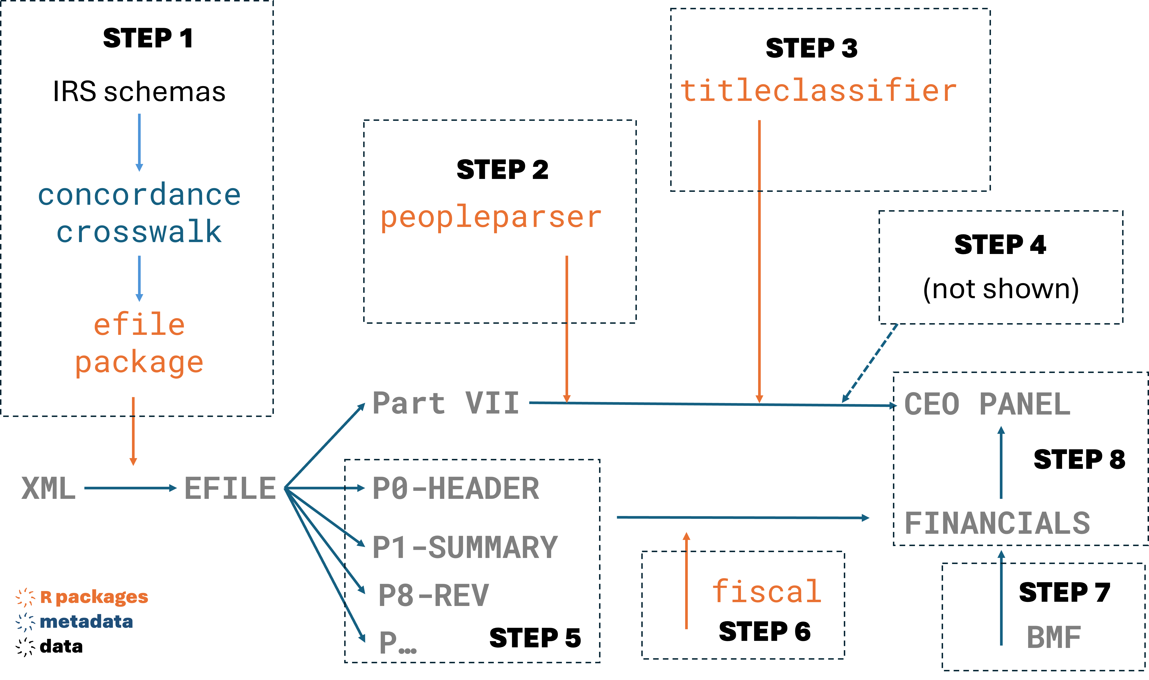

Slide 15
Nonprofits at the Glass Cliff? A Research Example

Slide 16
The Big Idea
Glass Cliff Phenomenon: Women are more likely to be appointed to precarious leadership positions relative to their male counterparts
Firm Performance
CEO Transition
t-2
t-1
t
t+1
t+2
Time

Slide 17
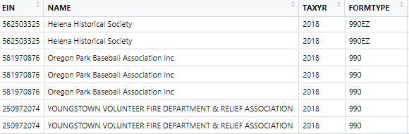
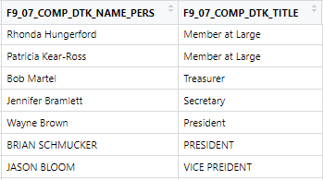
peopleparser
titleclassifier
(eventually unnec.)
Data Preparation
(locating transitions)
Base Data:
PartVII
2009-2019
Final Data:
CEO by Year by Financials
Left Join Tables:
F9_P01_T00_Summary
F9_P08_T00_Revenue
F9_P09_T00_Expenses
F9_P10_T00_Balance_Sheet
F9_P11_T00_Assets
fiscal
(calculate financials)

Slide 18
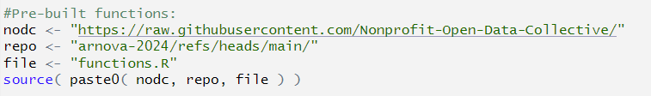
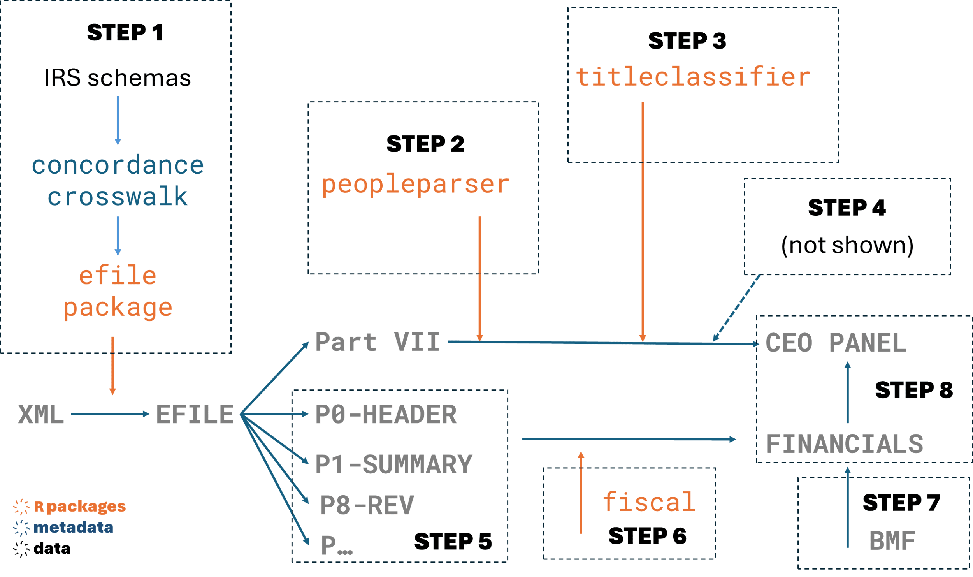
Step 1

Slide 19
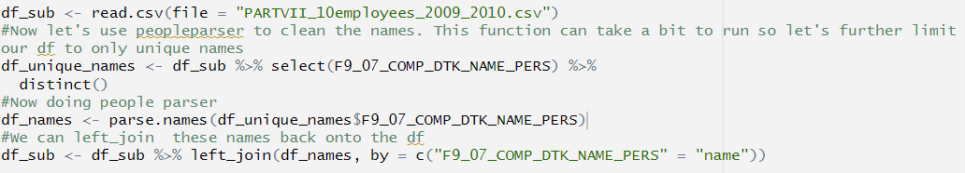
Step 2

Slide 20
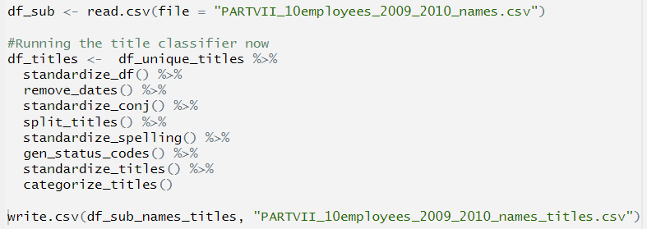
Step 3

Slide 21

Step 4

Slide 22
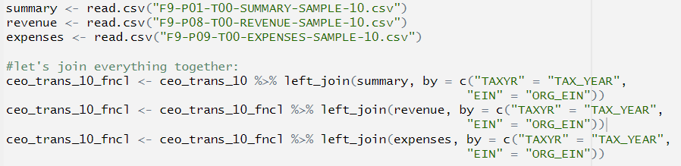
Step 5

Slide 23
Step 6

Slide 24
Step 7 & 8

Slide 25
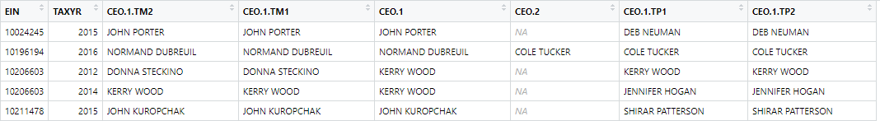
Processed Data Visual
Time
t-2
t-1
CEO transition
t+1
t+2
M
M
M
baseline
F
“savior effect”
treatment
F
treatment
F
25

Slide 26
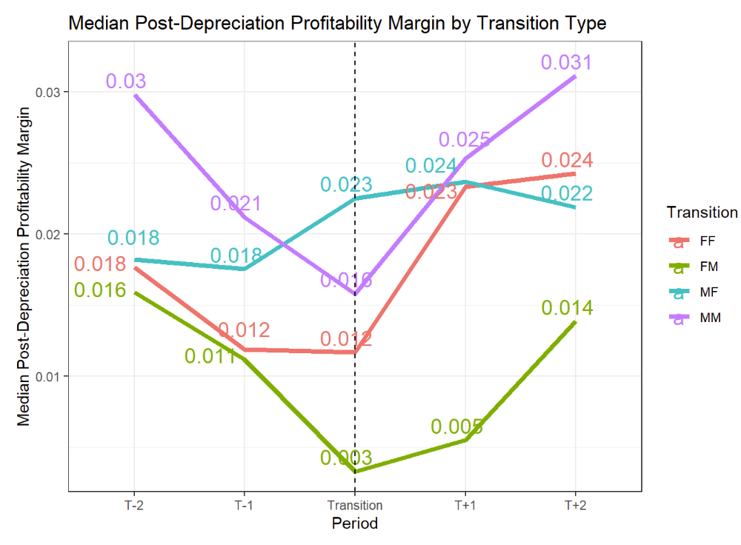

Slide 27
