Slide 1
Dashboard UI Design

Slide 2
Example of simple and clean: https://shiny.rstudio.com/gallery/freedom-press-index.html

Slide 3
COMPENSATION APPRAISAL TOOL

Slide 4
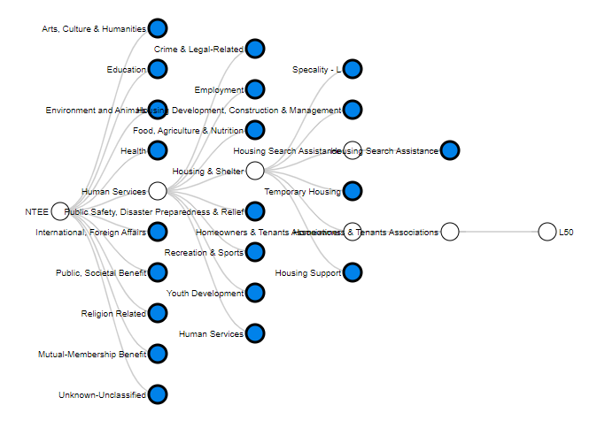
Mission Code: B24
Location: Atlanta
Annual Budget: $5m
Exclude: Rural nonprofits

Slide 5
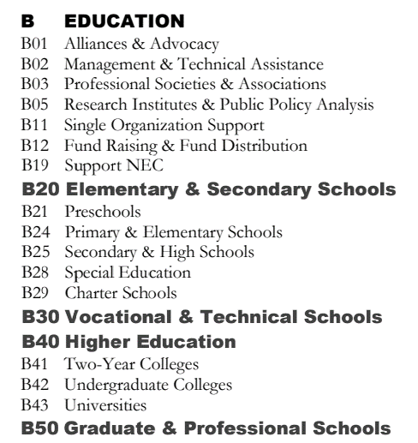

DISTANCE
$$\sum_{i}^{4}{α_{i}δ_{i}}$$
LEVEL 1
LEVEL 2
LEVEL 3
LEVEL 4
B25 vs B24
$$α_{1}∙1 + α_{2}∙1 + α_{3}∙1 + α_{4}∙0$$
level1
level2
level3
level4

Slide 6
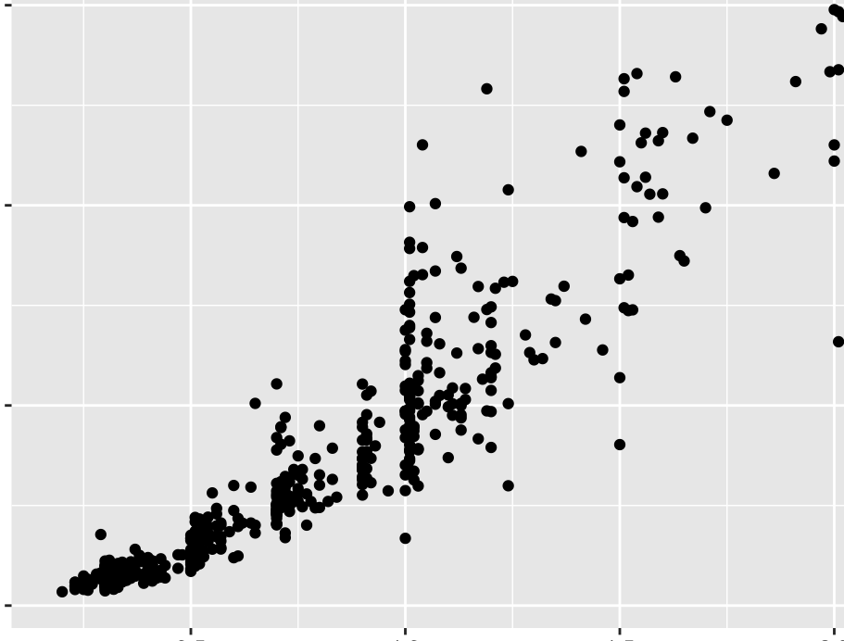
Mission Distance
Comparison Organizations
Geographic Distance

Slide 7
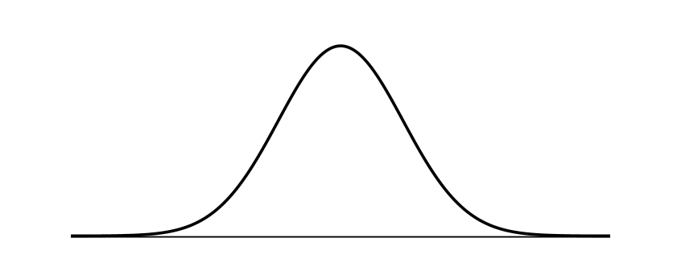
Mission Code: B24
Location: Atlanta
Annual Budget: $5m
$150k
$200k
$250k

Slide 8
Drill-Down and Segmentation

Slide 9
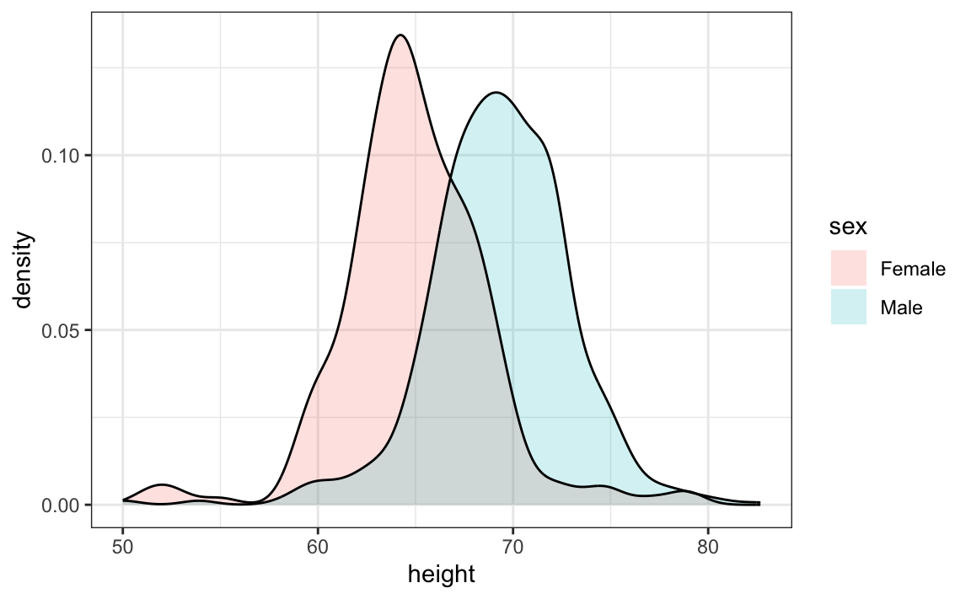
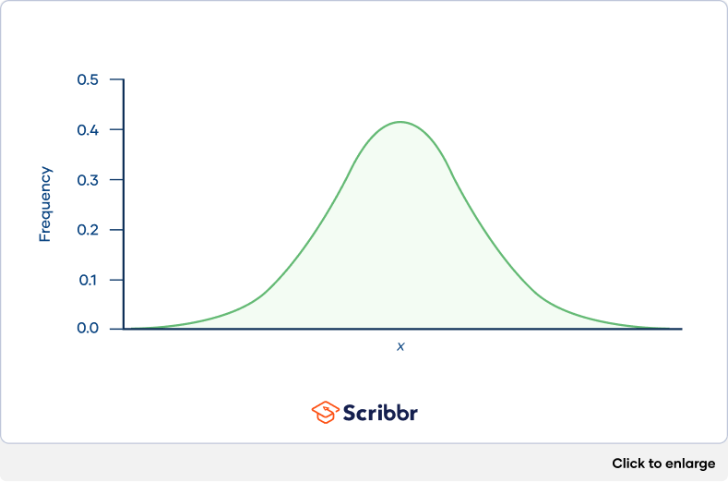
All Females
All Males
Gender Neutral
Distribution

Slide 10
About

Slide 11
Tabs within about section
Data sources
Raw Efile → processing
Taxonomy generation
Sample included in the tool
Size limits (censoring)
Drop transitions
Most recent non-transition year (inflation adjusted)
Mission codes
Geographic distances
Size differences
Total distance metrics

Slide 12
DISTANCE
$$\sum_{i}^{4}{α_{i}δ_{i}}$$
LEVEL 1
LEVEL 2
LEVEL 3
LEVEL 4
B25 vs B24
$$α_{1}∙1 + α_{2}∙1 + α_{3}∙1 + α_{4}∙0$$
level1
level2
level3
level4

Slide 13

Geographic Distances

Slide 14
What to report?
Predicted salary range for your org
For small orgs:
Proportion of CEOs in comparison set that are paid
How are we measuring full-time equivalent?
Distribution of hours reported for CEOs in size range
Graph of total hours versus total pay, and adjusted FTE versions
Distributions and correlation plots: (highlight your org in red)
Total assets: distribution of sample
Gross receipts: distribution of sample
Number of employees / volunteers per org?
Impute, or only visualize those with data?
Pivots?
University/hospital
State / Zip / Location type
Year of filing?

Slide 15
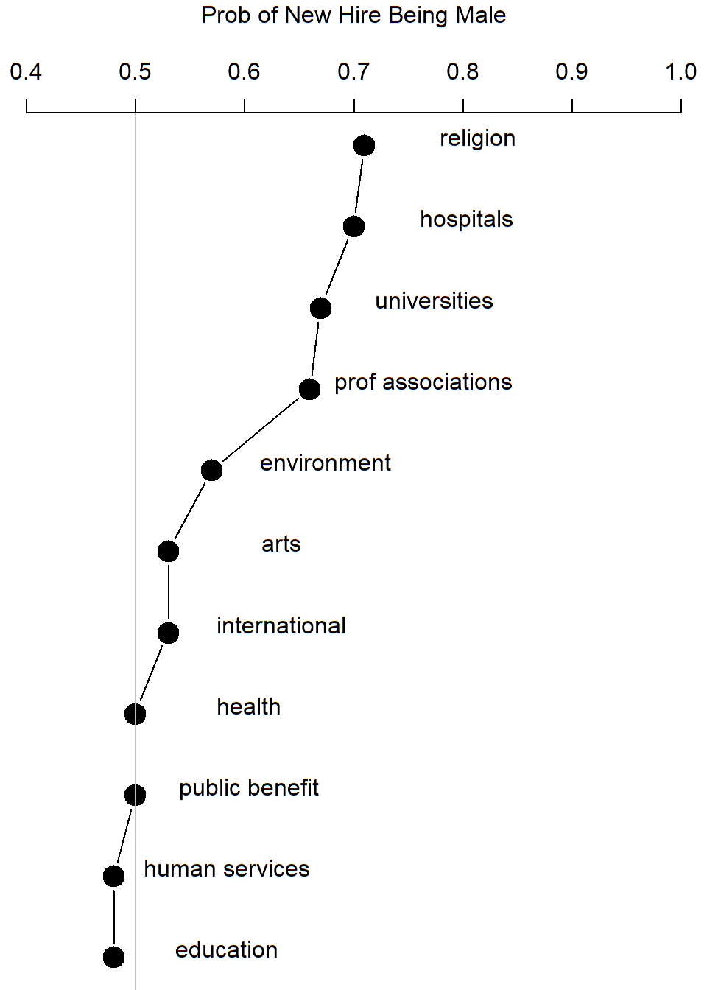

Slide 16
Inflation adjustment
Function that adjusts all data to given year
Arguments:
Table with year and inflation rate
Reference year

