Slide 1
501(c) Groups and Subgroups
Community and Societal Benefit
Mutual Membership Benefit
General
Corporation
3 – Regular Nonprofits
4 – Civic Leagues, Social Welfare Organizations, and Local Associations of Employees
6 – Business Leagues, Chambers of Commerce, Real Estate Boards
13 – Cemetery Companies
501k – Childcare Organizations
1 – Corporations Organized Under Act of Congress Federal Credit
2 – Title Holding Corporations for Exempt Organizations, Unions, and National Farm Assoc.
25 – Real Property Title-Holding Corporations or Trusts with Multiple Parents
Insurance
Political
9 – Voluntary Employee Beneficiary Associations
12 – Benevolent Life Insurance Associations, Mutual Ditch or Irrigation Companies, Mutual or Cooperative Telephone Companies, and Like Organizations
15 – Mutual Insurance Companies or Associations
17 - Supplemental Unemployment Benefit Trusts
21 – Black Lung Benefit Trusts
22 – Withdrawal Liability Payment Fund
26 – State-Sponsored Organization Providing Health Coverage for High-Risk Individuals
27 – State-Sponsored Workers’ Compensation Reinsurance Organization
29 – Qualified Nonprofit Health Insurance Issuers
4 – Civic Leagues, Social Welfare Organizations, and Local Associations of Employees
527 – Political Organizations
Community Ownership and Cooperative Operation
14 – State-Chartered Credit Unitions, Mutual Reserve Funds
16 – Cooperative Organizations to Finance Crop Operations
501(e) – Cooperative Hospital Service Organizations
501(f) – Cooperative Service Organizations of Operating Educational Organizations
501(n) – Charitable Risk Pools
521- Farmer Coops
Pension/Retirement/Incentivized Savings
11 – Teachers' Retirement Fund Associations
18 – Employee Funded Pension Trust (created before June 25, 1959)
28 – National Railroad Retirement Investment Trust
529 Plan – Qualified State-Sponsored Tuition Programs
Membership Association
7 – Social and Recreational Clubs
10 – Domestic Fraternal Societies and Associations
19 – Post or Organization of Past or Present Members of the Armed Forces
501(d) – Religious and Apostolic Associations
Special Interest MMB
5 – Labor, Agricultural and Horticultural Organizations
8 – Fraternal Beneficiary Societies and Associations
23 – Veterans Organizations
Defunct
20 – Group Legal Services Plan Organizations
24 – Section 4049 ERISA Trusts

Slide 2
Government Sponsored
Trust and Grantmaking
Membership
1 – corporations organized under act of of congress federal credit unions and national farm assoc.
21 - Black Lung Benefit Trusts
Membership Communities
24 - Section 4049 ERISA Trusts
7- Social and Recreational Clubs
25 - Real Property Title-Holding Corporations or Trusts with Multiple Parents
27 - State-Sponsored Workers' Compensation Reinsurance Organization
10 - Domestic Fraternal Societies and Associations
19 - Post or Organization of Past or Present Members of the Armed Forces
26 - State-Sponsored Organization Providing Health Coverage for High-Risk Individuals
2- title holding corporations for exempt organizations
14 - State-Chartered Credit Unions, Mutual Reserve Funds
Mutual Membership Benefit ( such as Insurance and Retirement Funds)
5 - Labor, Agricultural and Horticultural Organizations
17 - Supplemental Unemployment Benefit Trusts
529 plan – qualified state-sponsored tuition programs
8 - Fraternal Beneficiary Societies and Associations
18.- Employee Funded Pension Trust (created before June 25, 1959)
9 - Voluntary Employee Beneficiary Associations
20 - Group Legal Services Plan Organizations
11 - teachers' Retirement Fund Associations
22 - Withdrawal Liability Payment Fund
12 - Benevolent Life Insurance Associations, Mutual Ditch or Irrigation Companies, Mutual or Cooperative Telephone Companies, and Like Organizations
28 - National Railroad Retirement Investment Trust
29 - Qualified Nonprofit Health Insurance Issuers
13 - Cemetery Companies
23 - Veterans Organizations^{[c}
Cooperative or Community Ownership
16 - Cooperative Organizations to Finance Crop Operations
Societal Benefit
3 – regular nonprofits
Political Organizations
501(d) – Religious and apostolic associations
501(e) – Cooperative hospital service organizations
6- Business Leagues, Chambers of Commerce, Real Estate Boards
527 – political organizations
501(f) – Cooperative service organizations of operating educational organizations
4 - Civic Leagues, Social Welfare Organizations, and Local Associations of Employees
501(n) – Charitable risk pools
15 - Mutual Insurance Companies or Associations

Slide 3
Community and Societal Benefit
Mutual Membership Benefit
General
Corporation
3 – regular nonprofits
13 - Cemetery Companies
1 – corporations organized under act of of congress federal credit unions and national farm assoc.
25 - Real Property Title-Holding Corporations or Trusts with Multiple Parents
2- title holding corporations for exempt organizations
4 - Civic Leagues, Social Welfare Organizations, and Local Associations of Employees
501k – Child care orgs
Insurance
6- Business Leagues, Chambers of Commerce, Real Estate Boards
27 - State-Sponsored Workers' Compensation Reinsurance Organization
22 - Withdrawal Liability Payment Fund
Political
527 – political organizations
26 - State-Sponsored Organization Providing Health Coverage for High-Risk Individuals
29 - Qualified Nonprofit Health Insurance Issuers
4 - Civic Leagues, Social Welfare Organizations, and Local Associations of Employees
21 - Black Lung Benefit Trusts
12 - Benevolent Life Insurance Associations, Mutual Ditch or Irrigation Companies, Mutual or Cooperative Telephone Companies, and Like Organizations
9 - Voluntary Employee Beneficiary Associations
Community Ownership and Cooperative Operation
15 - Mutual Insurance Companies or Associations
16 - Cooperative Organizations to Finance Crop Operations
17 - Supplemental Unemployment Benefit Trusts
501(e) – Cooperative hospital service organizations
Pension/Retirement/Incentivized Savings
501(f) – Cooperative service organizations of operating educational organizations
529 plan – qualified state-sponsored tuition programs
501(n) – Charitable risk pools
11 - teachers' Retirement Fund Associations
521- farmer coops
14 - State-Chartered Credit Unions, Mutual Reserve Funds
18.- Employee Funded Pension Trust (created before June 25, 1959)
Membership Association
28 - National Railroad Retirement Investment Trust
Defunct
7- Social and Recreational Clubs
24 - Section 4049 ERISA Trusts
10 - Domestic Fraternal Societies and Associations
20 - Group Legal Services Plan Organizations
Special Interest MMB
19 - Post or Organization of Past or Present Members of the Armed Forces
23 - Veterans Organizations^{[c}
8 - Fraternal Beneficiary Societies and Associations
501(d) – Religious and apostolic associations
5 - Labor, Agricultural and Horticultural Organizations

Slide 4
Cross Tabs with Urban’s BMF

Slide 5
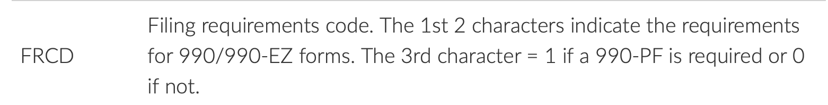
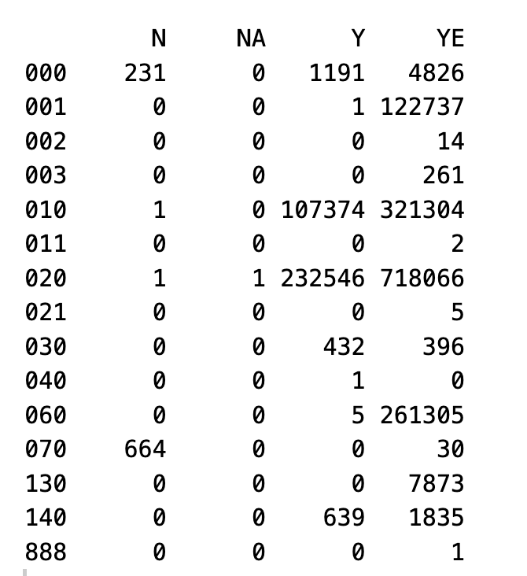
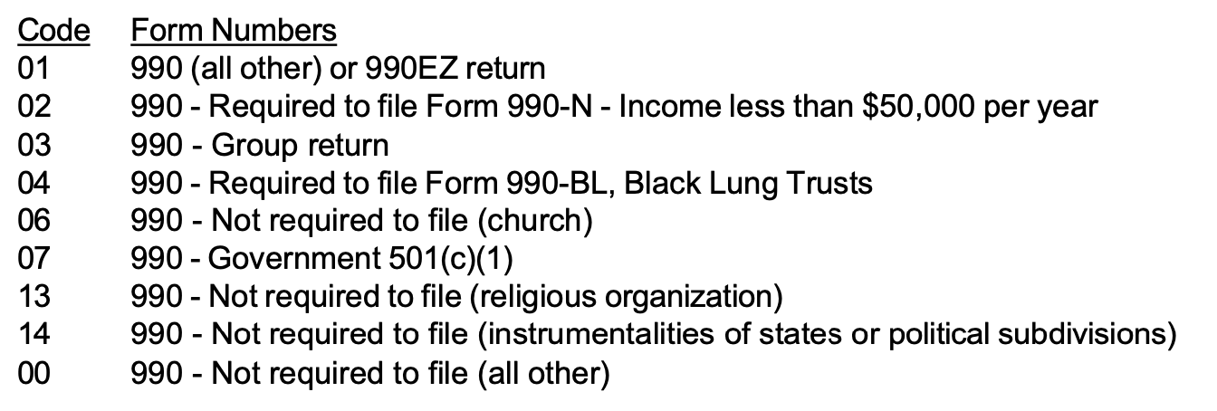
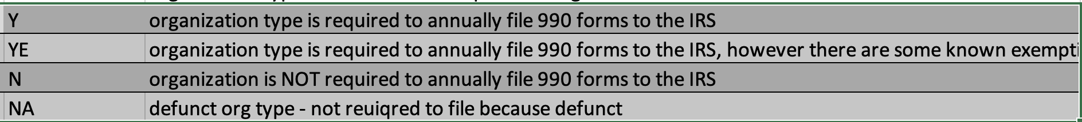
BMF: FRCD vs Ours: Required_990
Bmf: FRCD
Ours: Required_990
Red box is where our codes should be
Conclusion: Most of these are classified as they should be

Slide 6


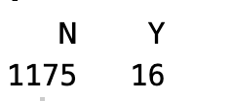
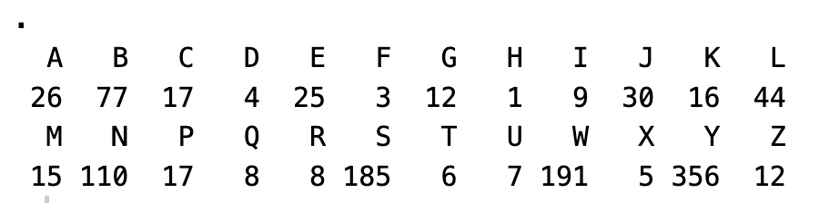
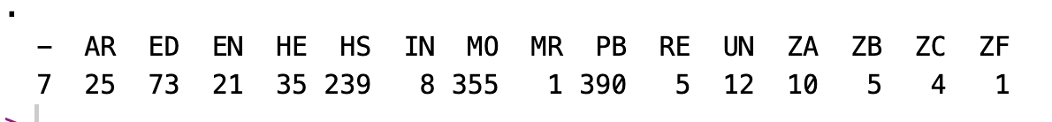



BMF: FRCD vs Ours: Required_990
Level 2:
Level 1:
SUBSECCD:
Filer:
NTEE1:
Level3:
Tax_exempt_subgroup:
Govt_established:
Supporting:
Red box is where our codes should be

Slide 7

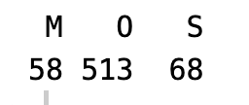
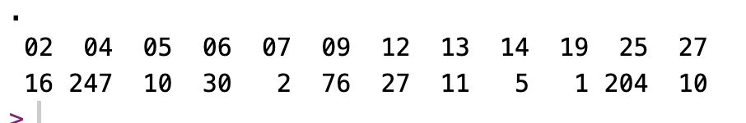
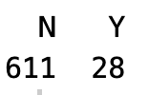
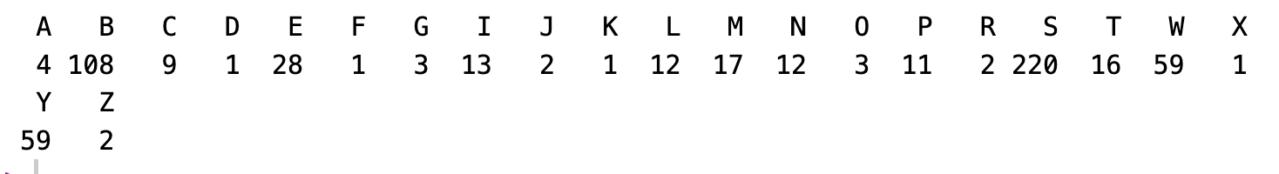
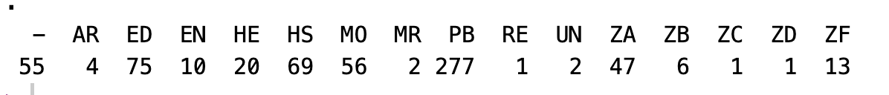
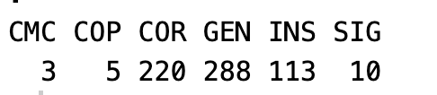
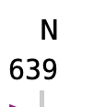
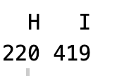
BMF: FRCD vs Ours: Required_990
Level 1:
Level 2:
SUBSECCD:
Filer:
NTEE1:
Level3:
Tax_exempt_subgroup:
Govt_established:
Supporting:
Red box is where our codes should be

Slide 8
Cross Tabs with IRS’s BMF

Slide 9
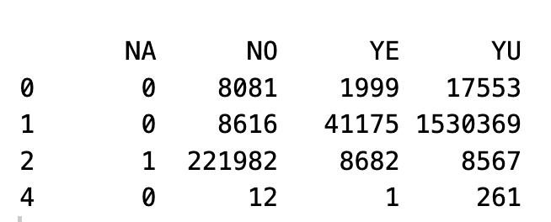
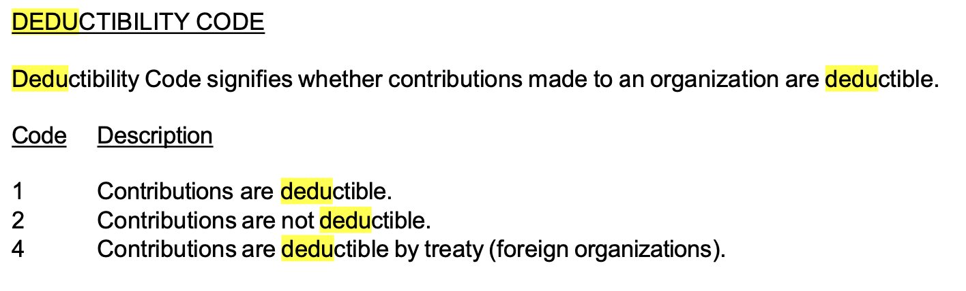
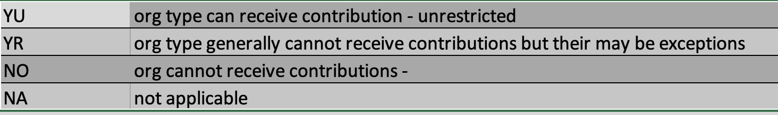
IRSBMF:DEDUCTIBILITY vs. Ours: Donations_deductible
IRS:
Red box is where our codes should be
Ours:
Conclusion: This is good! Most things are classified correctly under our system.

Slide 10
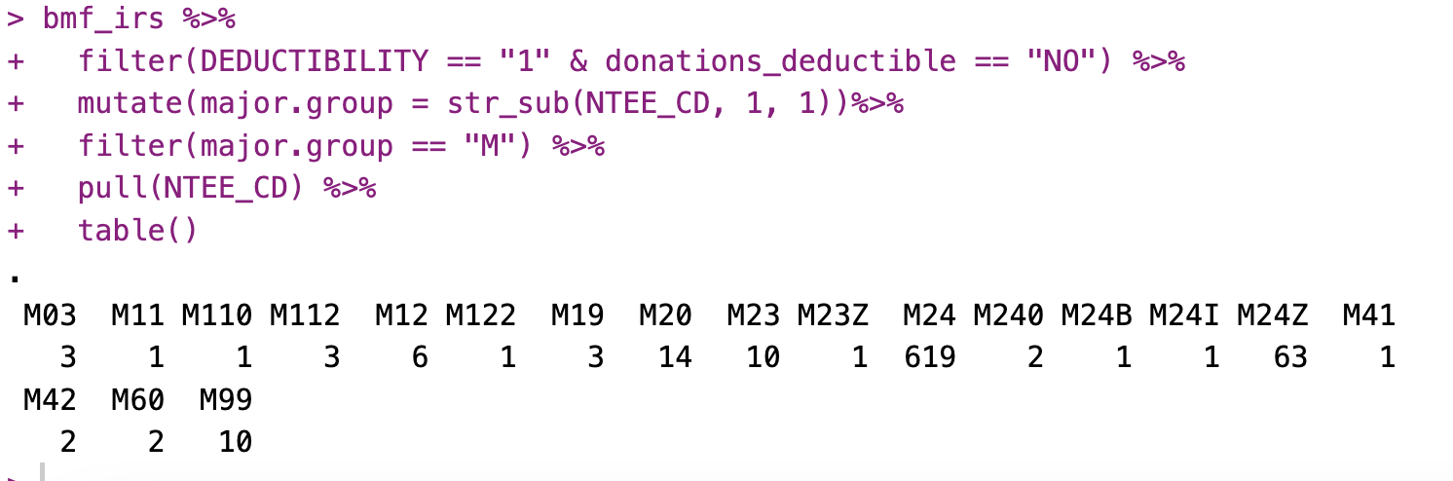
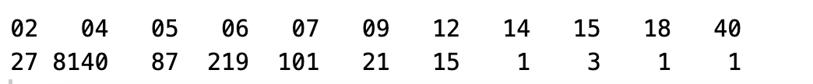
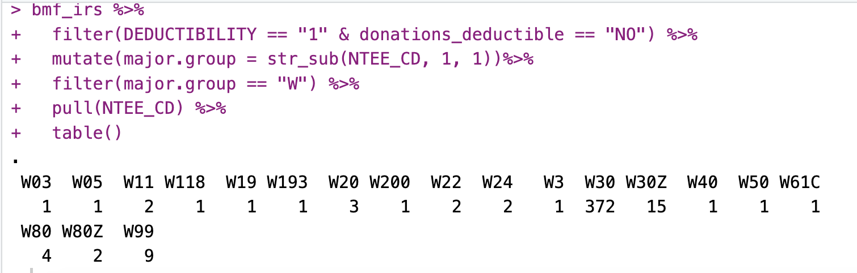
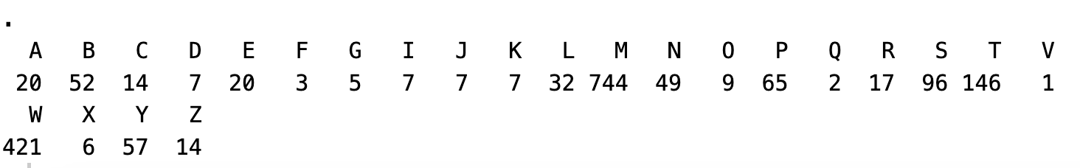
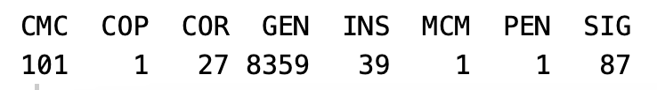
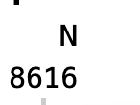
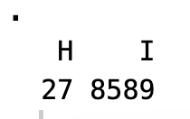
IRSBMF:DEDUCTIBILITY vs. Ours: Donations_deductible
Level 2:
Level 1:
SUBSECTION:
Filer:
Red box is where our codes should be
NTEE1:
Level3:
Tax_exempt_subgroup:
Govt_established:
Supporting:

Slide 11
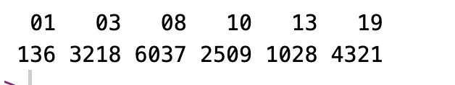
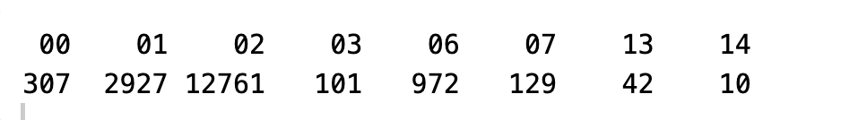
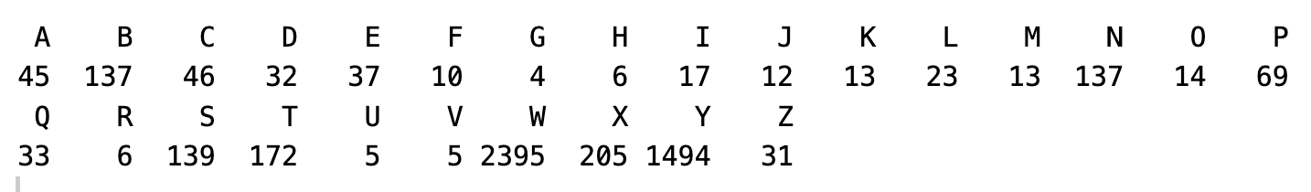
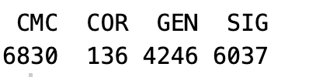
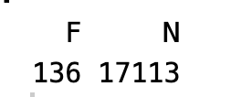
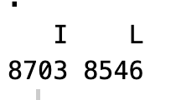
IRSBMF:DEDUCTIBILITY vs. Ours: Donations_deductible
SUBSECTION:
Filing Requirement:
Red box is where our codes should be
Red box is where our codes should be
NTEE1:
Tax_exempt_subgroup:
Govt_established:
Supporting

Slide 12
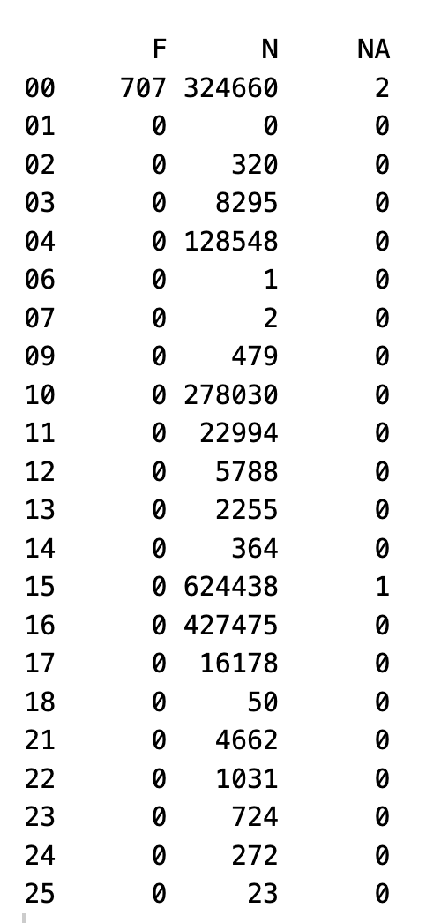
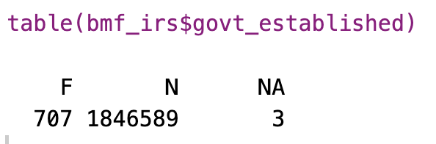
IRSBMF: FOUNDATION vs. Our Govt_Established
This is good. All federally established organizations are non-501c3s

Slide 13
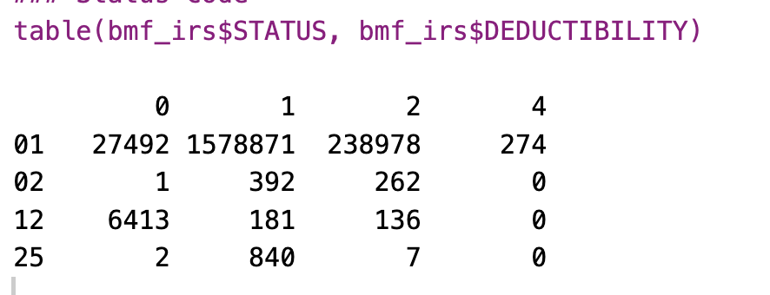
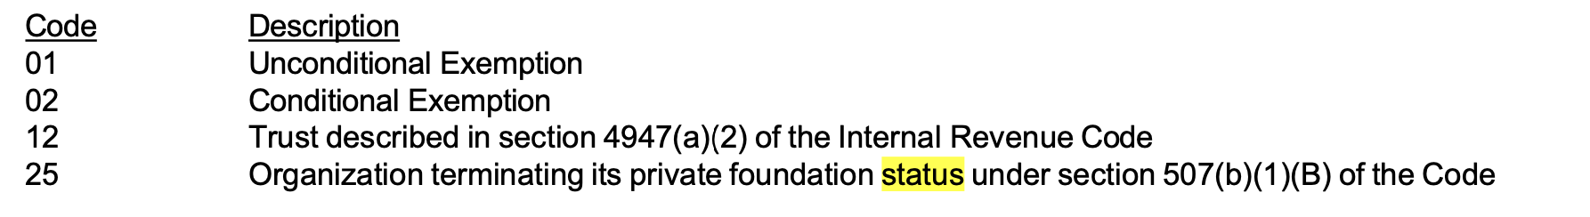
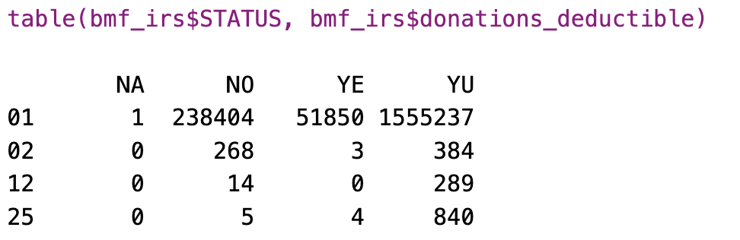
IRS Status & Deductibility vs Our deductible
IRS STATUS
IRS DUDUCTIBILITY
Our Donations_deductible
We can’t verify anything when IRS DEDUCTIBILITY == 0

Slide 14
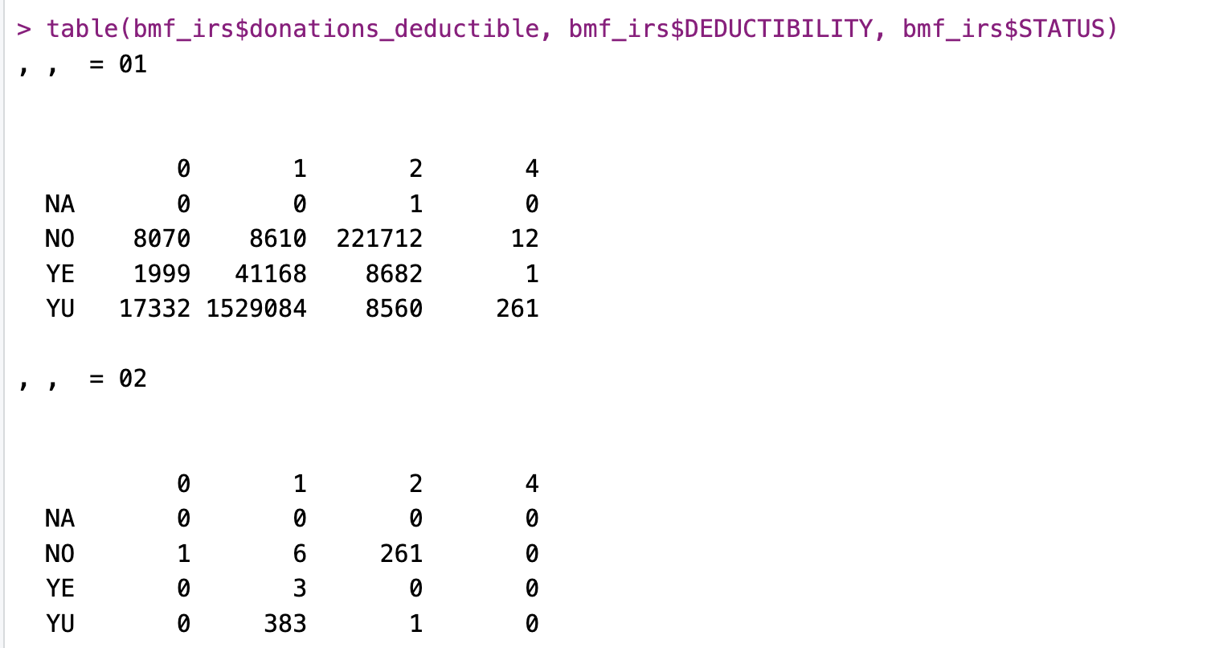
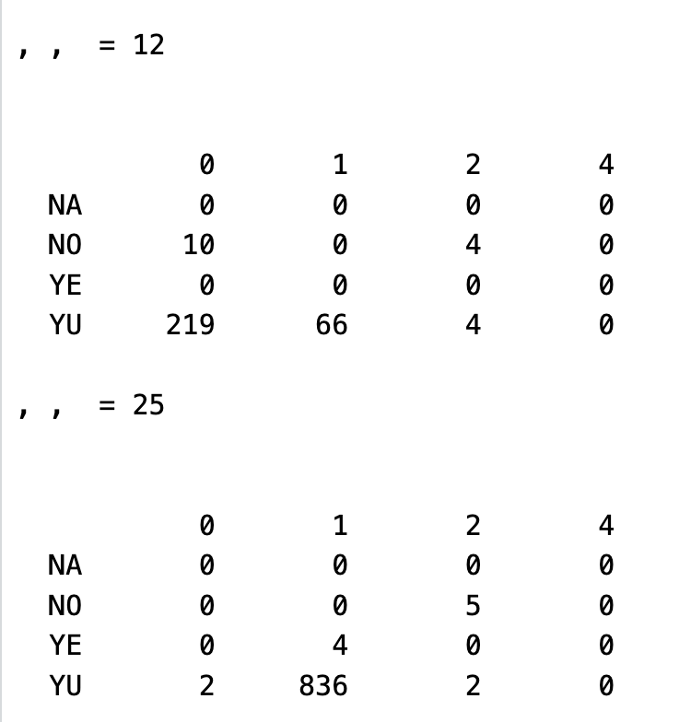
We can’t verify anything when IRS DEDUCTIBILITY == 0. Most of the misclassifications are coming from this case.

