Slide 1

NP COMPDAT
Open data built from:
IRS 990 Part VII: Directors, Trustees, and Key Employees
IRS 990 Schedule J: Compensation Information

Slide 2
Overview

Slide 3
Nonprofit Compensation Dataset (COMPDAT):
Leveraged new IRS E-File database since it contains all data, not just small selection of financials.
E-filing started in 2010 (about 40% of all filers) to 2021 (about 70% of all filers) and mandatory for nonprofits moving forward
Includes 990(PC), 990-EZ, and 990-PF filers (excludes 990-N postcard filers)
990 forms include disclosure on key employees and leadership (managers, directors, key employees) including names and salaries – these are combined to form a compensation dataset
Schedule J has additional information broken out in more granularity, but only a small subset of organizations file it and only a subset of Part VII employees are listed
Names and titles are raw text fields – extremely noisy and error-prone
peopleparser package is used to standardize names
titleparser package being created to standardize titles
Currently have over 35 million observations

Slide 4
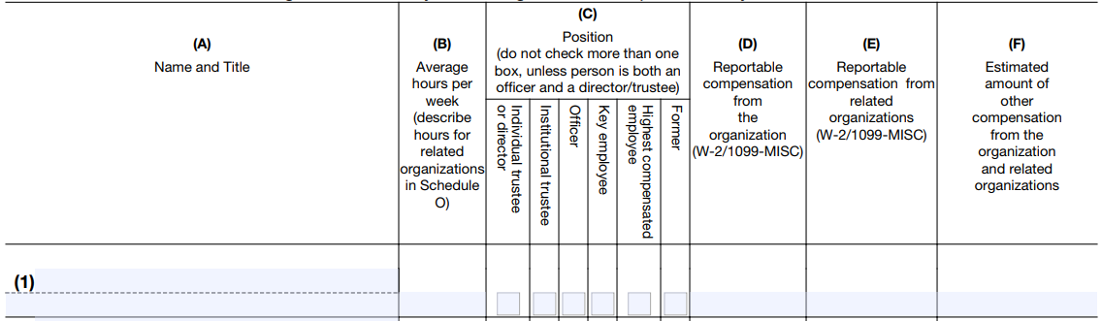
FORM 990(PC) Part VII

Slide 5
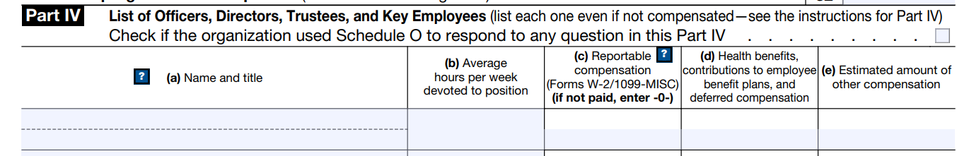
FORM 990-EZ Part IV
Limited fields for 990-EZ filers

Slide 6
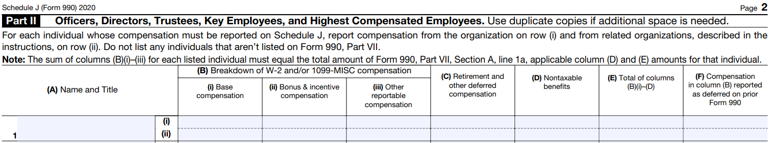
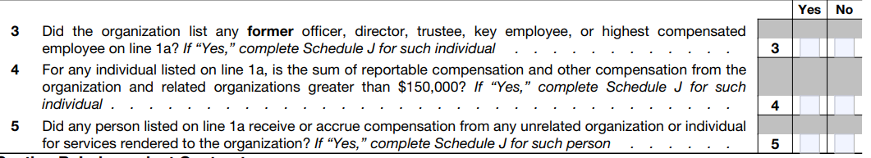
FORM 990 SCHEDULE J
From
Form 990
Part VII:

Slide 7
Development of a Custom Title Taxonomy and Recoding Process

Slide 8
FORM 990(PC) Part VII

Slide 9
From the 990 INSTRUCTIONS for Part VII:
Complete this table for all persons required to be listed. Report compensation for the calendar year ending with or within the organization’s tax year (tax year = filing year -1 unless December).
List all of the organization’s current officers, directors, trustees (whether individuals or organizations), regardless of amount of compensation. Enter -0- in columns (D), (E), and (F) if no compensation was paid.
List all of the organization’s current key employees, if any. See instructions for definition of “key employee.”
List the organization’s five current highest compensated employees (other than an officer, director, trustee, or key employee) who received reportable compensation of more than $100,000 from the organization and any related organizations (Box 5 of Form W-2 and/or Box 7 of Form 1099-MISC).
List all of the organization’s former officers, key employees, and highest compensated employees who received more than $100,000 of reportable compensation from the organization and any related organizations.
List all of the organization’s former directors or trustees that received, in the capacity as a former director or trustee of the organization, more than $10,000 of reportable compensation from the organization and any related organizations.
List persons in the following order: individual trustees or directors; institutional trustees; officers; key employees; highest compensated employees; and former such persons

Slide 10
Official Positions (990 check-boxes)
Board Member Individual
Director / Trustee
Board leadership (not a separate check-box): president, VP, treasurer, secretary
Board Member Institutional
Organization that sits on the board
Officer (board leadership + top management + top finance)
Top management
Can include president / VP / treasurer / secretary – so ambiguous with board but must be in charge of daily operations
Key Employees
Upper Management
Can NOT be an officer (top management position)
Highly-Compensated Employees (top 5 reported)
Highly-Paid Professionals
Does not meet key employee criteria for responsibility, but has pay over $100k
These are problematic because they are rarely filled out correctly so data has errors
Trustee
Management
Board Member
Officer
Highly-Compensated Employee
Pres/VP Secretary Treasurer
Key Employee
Top MGMT
Individ vs
Institutional

Slide 11
POSITIONS:
Director or trustee. A “director or trustee” is a member of the organization's governing body, but only if the member has voting rights. A director or trustee that served at any time during the organization's tax year is deemed a current director or trustee. Members of advisory boards that don't exercise any governance authority over the organization aren't considered directors or trustees. An “institutional trustee” is a trustee that isn't an individual or natural person but an organization. For instance, a bank or trust company serving as the trustee of a trust is an institutional trustee.
Officer. An officer is a person elected or appointed to manage the organization's daily operations. An officer that served at any time during the organization's tax year is deemed a current officer. The officers of an organization are determined by reference to its organizing document, bylaws, or resolutions of its governing body, or as otherwise designated consistent with state law, but, at a minimum, include those officers required by applicable state law. Officers can include a president, vice president, secretary, treasurer, and, in some cases, a Board Chair.
In addition, for purposes of Form 990, including Part VII, Section A, and Schedule J (Form 990), treat as an officer the following persons, regardless of their titles.
Top management official. The person who has ultimate responsibility for implementing the decisions of the governing body or for supervising the management, administration, or operation of the organization; for example, the organization's president, CEO, or executive director.
Top financial official. The person who has ultimate responsibility for managing the organization's finances; for example, the organization's treasurer or chief financial officer. If ultimate responsibility resides with two or more individuals (for example, co-presidents or co-treasurers), who can exercise such responsibility in concert or individually, then treat all such individuals as officers.
Trustee
Management
Officer
Highly-Compensated Employee
Board Member
Pres/VP Secretary Treasurer
Key Employee
Top MGMT

Slide 12
POSITIONS:
Key employee. For purposes of Form 990, a current key employee is an employee of the organization (other than an officer, director, or trustee) who meets all three of the following tests, applied in the following order.
$150,000 Test: Receives reportable compensation from the organization and all related organizations in excess of $150,000 for the calendar year ending with or within the organization's tax year.
Responsibility Test: At any time during the calendar year ending with or within the organization's tax year:
Has responsibilities, powers, or influence over the organization as a whole that is similar to those of officers, directors, or trustees;
Manages a discrete segment or activity of the organization that represents 10% or more of the activities, assets, income, or expenses of the organization, as compared to the organization as a whole; or
Has or shares authority to control or determine 10% or more of the organization's capital expenditures, operating budget, or compensation for employees.
Top 20 Test: Is one of the 20 employees other than officers, directors, and trustees who satisfy the $150,000 Test and Responsibility Test with the highest reportable compensation from the organization and related organizations for the calendar year ending with or within the organization's tax year.
If the organization has more than 20 individuals who meet the $150,000 Test and Responsibility Test, report only the 20 individuals who have the highest reportable compensation from the organization and related organizations as key employees … The organization's top management official and top financial official are deemed officers rather than key employees.
Trustee
Management
Officer
Highly-Compensated Employee
Board Member
Pres/VP Secretary Treasurer
Key Employee
Top MGMT

Slide 13
POSITIONS:
Five highest compensated employees. The organization is required to enter its current five highest compensated employees whose reportable compensation combined from the organization and related organizations is greater than $100,000 for the calendar year ending with or within the organization's tax year and who aren't also current officers, directors, trustees, or key employees of the organization. Such individuals are the “current” five highest compensated employees.
These can include persons who meet some but not all of the tests for key employee status. The organization isn't required to enter more than the top five such persons, ranked by amount of reportable compensation.
Use the calendar year ending with or within the organization's tax year for determining the organization's current five highest compensated employees.
Trustee
Management
Board Member
Officer
Highly-Compensated Employee
Pres/VP Secretary Treasurer
Key Employee
Top MGMT
Individ vs
Institutional

Slide 14
List of sanity checks:
Board members CANNOT be both an individual trustee and institutional trustee.
Key employees CANNOT be officers OR directors.
Highly-compensated individuals CANNOT be officers, trustees, or key employees.
990-EZ filers do not complete the position check-boxes so we only have titles, hours, and comp.
Ambiguity:
Officers are “responsible for daily operations” but board members don’t manage directly unless they have official titles like president of the board? For example, board members typically list hours as 10 or less a week, so they are not FT. This distinction is very vague and confusing.
“President” is a title used by a CEO as well as president of the board
“Director” is a legal term used for a trustee in some contexts, and a top management position in others (executive director).
The top executive can also be a trustee and hold a board officer position.
Board members are rarely compensated (though possible), unless they are on the board AND a manager.
Someone can be a board member (uncompensated) but paid by a related entity, so their total comp is high on the form.

Slide 15
Custom Taxonomy
Each person receives a POSITION, can have 0-3 ROLES, and has a TITLE

Slide 16


(CURRENT AS IMPLEMENTED)
TITLE
Other Staff
Board
Leadership
C-Level/
Officer
Mgmt
HPP
Trustee
Interim
Former
President & CEO
Physician
Camp counselor
POSITIONS
ROLES
( domains of responsibility? e.g. dev, finance, marketing )
( & purpose? )
( & responsibility? )

Slide 17
Some Key
Employees
Categorize: CEO CFO
COO
Officer: top mgmt
Key
Employees
Officers
Staff
TITLE
Board
Leader
C-Level
Mgmt
Trustee
Mgmt
HPP
Other
Current
Interim
Former
President & CEO
Physician
Camp counselor
POSITION:
ROLE
HIERARCHY
STATUS
(break into new mutually-exclusive positions,
though one person can hold multiple at a time)
TOPICAL FUNCTION?
COMPARABLES: (not yet implemented) create categories where people holding those positions are generally comparable across orgs – main purpose is for developing study samples:
Highly-Paid Professionals (HPP’s from ROLE): categories for professions such as doctor, lawyer, professor, fundraiser, military brass – professions (not positions) that are stable and comparable across orgs. Match with NAICS or other codes for comparability with for-profits?
Domains (internal org domains): development, finance, marketing, programs, legal, accounting, IT, public relations – identify titles that belong in only one internal domain. Useful to measure specialization and capacity in key organizational areas

Slide 18
Ambiguity:
Someone that is a former board officer and current or interim CEO could have both a former and current or interim status if they describe different positions
Should people with multiple positions be coded multiple times, one for each position?
This would be cleanest, though data users would have to know to drop duplicate IDs before aggregating to not double-count salaries
A highest-compensated employee can NOT be a key employee as well, but they can still have managerial responsibilities, just not significant responsibility
Some nonprofits include title or status info in the name field and not the title field

Slide 19
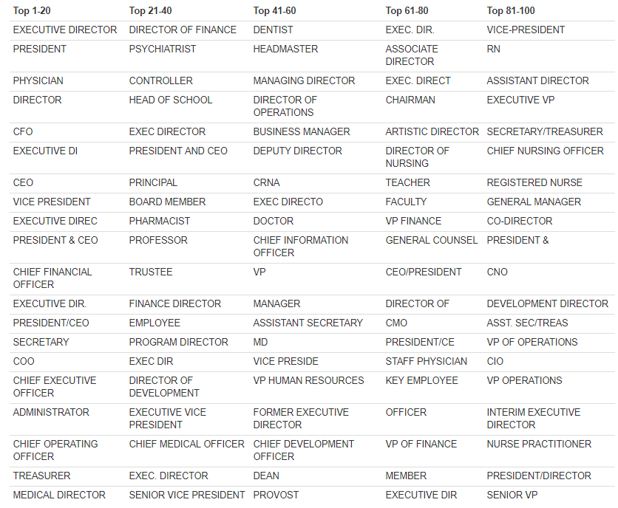
Top 100 Titles

Slide 20
ROLES
Management
Board Member
Highly-Paid Professional
Executive Management
Board Officer
HIERARCHY

Slide 21
Board
Management
Board Officer (Pres, VP, Secretary, Treasurer, Chair)
Exec. Management (Top Mgmt Officer OR C-Level Position)
Highly-Paid Professional
President & CEO
HCE with no mgmt. responsibilities

Slide 22
Board
Management
Board Officer (Pres, VP, Secretary, Treasurer, Chair)
Executive Management
Highly-Paid Professional
FTE employee officer on the board
(accountant?)

Slide 23
C-Level Management,
Regular Board Member
Management
Board Member
Highly-Paid Professional
Executive Management
Board Officer
FTE employee, mgmt title, on the board, no officer position

Slide 24
Regular FTE employee,
no mgmt. title, board officer
Other Employee
Management
Board Member
Highly-Paid Professional
Executive Management
Board Officer
Can be an HCE or key employee but no mgmt title and not an HPP
Regular FTE employee,
no mgmt title,
on the board

Slide 25
Other Employee
Board Member
Management
Executive Management
Highly-Paid Professional
Board Officer
Alternative schema with HPP the subset of other that can be assigned to specific profession?

Slide 26
Management Positions
Typically:
C-level managers
Program director
Administrator
Can Include:
Vice-President
Deputy Director
Dean / Provost
Key employees MUST BE managers because of responsibility test:
Key Employee test requires: (1) compensation in excess of $150k, (2) significant responsibility, AND (3) a top 20 employee
Can it be a Highly-Paid Professional with a management title be a manager? YES
If they are HPP they meet criteria (1) of key employees, so do we assume they don’t meet criteria 2?
Is significant responsibility the same as management position (oversee other employees)?

Slide 27
Executive Management Role
Chief … Officer:
CEO, COO, CIO/CTO, CFO
Principal / Head of School / Chancellor (domain-specific names for CEO)
NOT chief of staff, executive assistant, etc.
Rule: FTE “Officers” are executive managers according to IRS definitions
Rule: Executives can technically NOT be key employees on the IRS forms:
Key Employee test requires: (1) compensation in excess of $150k, (2) significant responsibility, AND (3) a top 20 employee
Ambiguous Positions
Executive Vice-President (YES?)
Vice-President (NO?)
Deputy Director (NO?)
Head of Human Resources (VP of HR, etc.)
Chief of Staff / Executive Assistant (NO)
Provost (YES?)
Chief Nursing Officer (?)
Director of Development (YES?) – would they be invited to the most important meetings? I think so.
Head of Medicine or Chair of … ?

Slide 28
Highly-Paid Professional Position
Most important thing is to differentiate highly-paid professionals (doctors, professors, lawyers) from management positions.
They are paid for their trade (surgeon, financial analyst), not their leadership within the organization
Some upper management may not meet Key Employee criteria, but would still be managers, not HPPs.
Ambiguous Roles:
Director of Development (HPP or Executive?)
Financial directors are managers, accountants are HPPs?

Slide 29
Sanity Checks
Key employees cannot be top management or board members
Highly-compensated individuals cannot be key employees
Do we have 3 or 4 leadership positions accounted for on the board?
Do we have at least one top manager?
Board members work fewer hours, typically no pay (but sometimes so do managers in small nonprofits)

Slide 30
Names and Gender:

Slide 31
Form 990 – Part VII: Board & Managers
TRUJILLO, PAT
SZABAT ESQ, SANDY
MS. SUSAN ARMENDARIZ
DR. BRIAN PARKHILL
REV. CLINT SINGLEY JR.
LCDR RONALD MCCAMPBELL
1 KIM MORRISON PhD
2 SAMUEL HERNANDEZMORENO
Examples of raw data in files – names in no particular order (first, middle, last) and may contain additional info

Slide 32
Name Disambiguation
salutation | first_name | middle_name | last_name | suffix
MR | MICHAEL | JOHN | LIVINGSTON | III
Humans could do this task easily using context – how can we train a computer to do it?
livingston III, Mr. MICHAEL JOHN9

Slide 33
suffixes <- c("JR","II", "III", "IV", "SR")
prefixes <- c("MR", "DR", "MISS", "MS", "MRS", "REV", "MD", "JD", "SENATOR", "COMMISSIONER", "DELEGATE", "PHD", "PhD", "CFA", "CPA", "CMPE", "CMA-A", "CMAA", "FACS", "SH1", "SH2", "EN1", "LCRD" )

Slide 34
Name Disambiguation w “peopleparser” R package
livingston
III
Mr
MICHAEL
JOHN
Probabilistic Match
Removed in Preprocessing
Removed in Preprocessing
Probabilistic Match
Probabilistic Match

Slide 35
name first_name last_name
1: CRAGIN 0 570
2: CRAGLE 0 561
3: CRAGO 0 1621
4: CRAGUE 0 120
5: CRAGUN 0 812
6: CRAHAN 0 256
7: CRAIB 0 195
CRAIG 295,044 92,507
9: CRAIGE 0 322
10: CRAIGEN 0 453
11: CRAIGER 0 278
12: CRAIGG 0 196
13: CRAIGHEAD 0 2809
14: CRAIGHILL 0 154
Social Security Administration birth certificate data used to identify first_name and last_name frequencies
76%
24%

Slide 36
name male female first_name last_name
1: CRAGIN 0 0 0 570
2: CRAGLE 0 0 0 561
3: CRAGO 0 0 0 1621
4: CRAGUE 0 0 0 120
5: CRAGUN 0 0 0 812
6: CRAHAN 0 0 0 256
7: CRAIB 0 0 0 195
8: CRAIG 295044 0 295044 92507
9: CRAIGE 0 0 0 322
10: CRAIGEN 0 0 0 453
11: CRAIGER 0 0 0 278
12: CRAIGG 0 0 0 196
13: CRAIGHEAD 0 0 0 2809
14: CRAIGHILL 0 0 0 154
15: CRAIGHTON 0 0 0 126
16: CRAIGIE 0 0 0 454
17: CRAIGLOW 0 0 0 186
18: CRAIGMILE 0 0 0 211
19: CRAIGMILES 0 0 0 240
20: CRAIGMYLE 0 0 0 240
21: CRAIGO 0 0 0 641

Slide 37
Name Disambiguation w “peopleparser”
livingston
MICHAEL
JOHN
LAST NAME
FIRST NAME
FIRST NAME

Slide 38
Name Disambiguation w “peopleparser”
devtools::install_github( "Nonprofit-Open-Data-Collective/peopleparser" )
library( peopleparser )
x <- 'livingston III, Mr. MICHAEL JOHN9'
parse.name(x)
# [1] "MR|MICHAEL|JOHN|LIVINGSTON|III|M|99.6"
x <- "THOMAS H VON KAMECKE"
parse.name(x)
# [1] "|THOMAS|H|VON-KAMECKE||M|99.8"

Slide 39
Name Disambiguation w “peopleparser”
devtools::install_github( "Nonprofit-Open-Data-Collective/peopleparser" )
library( peopleparser )
x <- get_example_names( n=10 )
parse.names(x)
name salutation first_name middle_name last_name suffix gender gender_confidence
1 Karen H Green KAREN H GREEN F 100
2 ED MARKS ED MARKS M 100
3 MATTHEW BERSHADKER MATTHEW BERSHADKER M 99.7
4 LINDA L SCHOELKOPF LINDA L SCHOELKOPF F 100
5 JAMES ROWAN JAMES ROWAN M 99.7
6 R Blincoe R BLINCOE U 50.0
7 DENNIS PAGLIOTTI DENNIS PAGLIOTTI M 99.5
8 HAFER JR EDMUND L AIA HAFER EDMUND L AIA JR M 100
9 LESLIE CARNES LESLIE CARNES F 66.8
10 ALEXANDER PFEFFER ALEXANDER PFEFFER M 98.4

Slide 40
Name Disambiguation w “peopleparser”
livingston
MICHAEL
JOHN
LAST NAME
get_gender( “MICHAEL” )
FIRST NAME
FIRST NAME

Slide 41
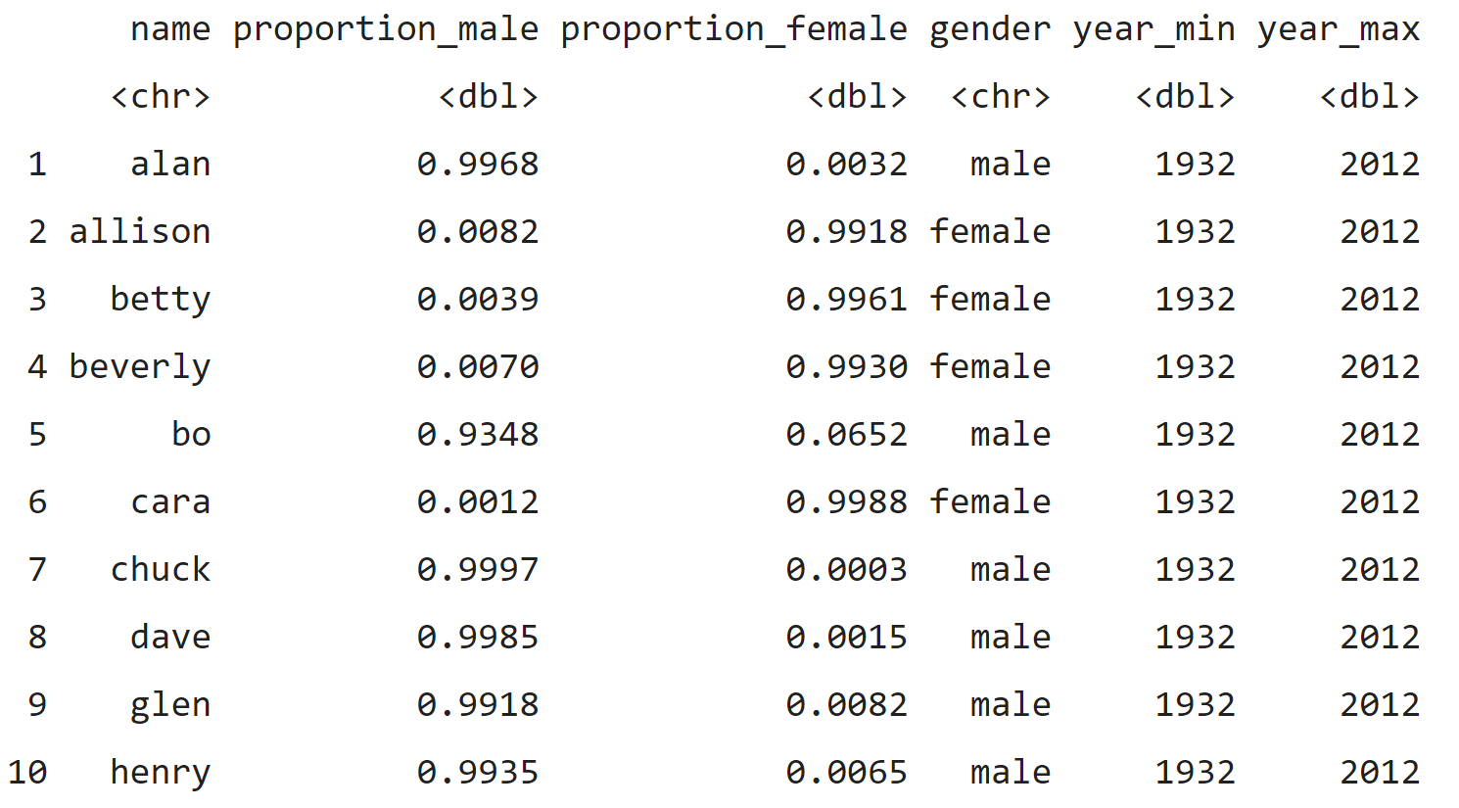
Gender Package in R

Slide 42
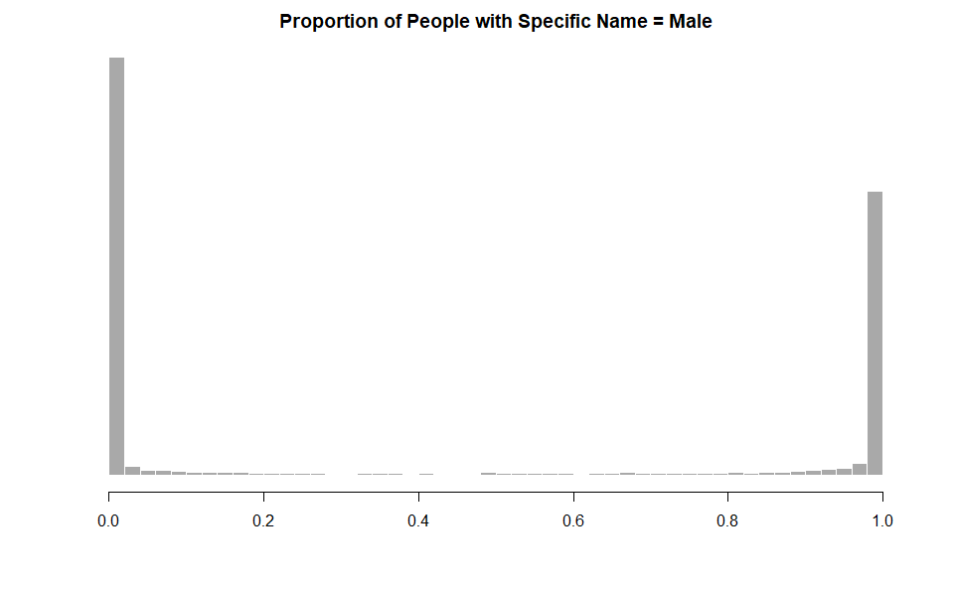
99% of Lindas are female
99% of Simons are male
Devon and Lindsey are more ambiguous, but they make up a small part of the data
female
male

Slide 43
Summer 2022 Projects [download project descriptions]
New Dashboard for the Nonprofit Sector in Brief
Nonprofit Sampling Tool
Mission Match Tool (R package)
Sector Density and Growth Dashboard
Competition and Life-Cycle Dashboard
Executive Pay Appraisal Tool
Web Scraping R Package
NCCS Data Packages

Slide 44
Welcome NCCS Summer 2022 Interns
Olivia Louise Beck
PhD in Statistics
Penn State University
Christian Maino Vieytes
PhD in Nutritional Sciences
University of Illinois at Urbana-Champaign
Akila Forde
Master’s Computational Analysis & Public Policy
University of Chicago
Vincent Liu
Master’s Computational Analysis & Public Policy
University of Chicago
Surbhi Trivedi
Masters in Interdisciplinary Data Science
Duke University
Pradhyumna Wagle
Master’s in Applied Economics and Management
Cornell University
Blake Robert Mills
BA in Political Science-Statistics
Columbia University

Slide 45
Identity Disambiguation

Slide 46
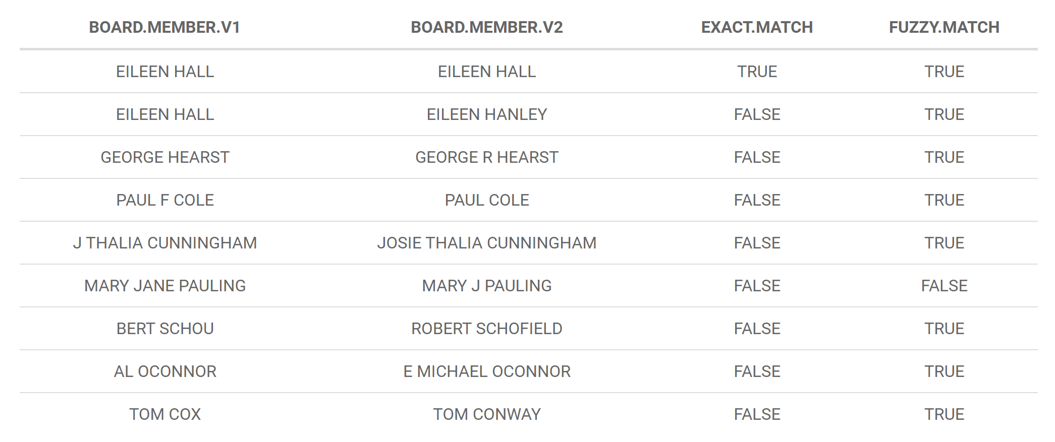
Final step is building a classifier to determine if two non-identical names are the same person to create synthetic IDs
Synthetic employee IDs

Slide 47
Synthetic employee IDs
25 million x 25 million =
625,000,000,000,000
10 comparisons a second
would take 1,981,862 years
It’s a challenging classification problem because of the use of initials, nicknames and abbreviations, identical names shared by two or more people (for example, India and Vietnam use a small number of last names), name changes (after marriage), and misspellings of names.
It’s a challenging computational problem because pair-wise comparisons do not scale well, especially fuzzy-match algorithms.

Slide 48
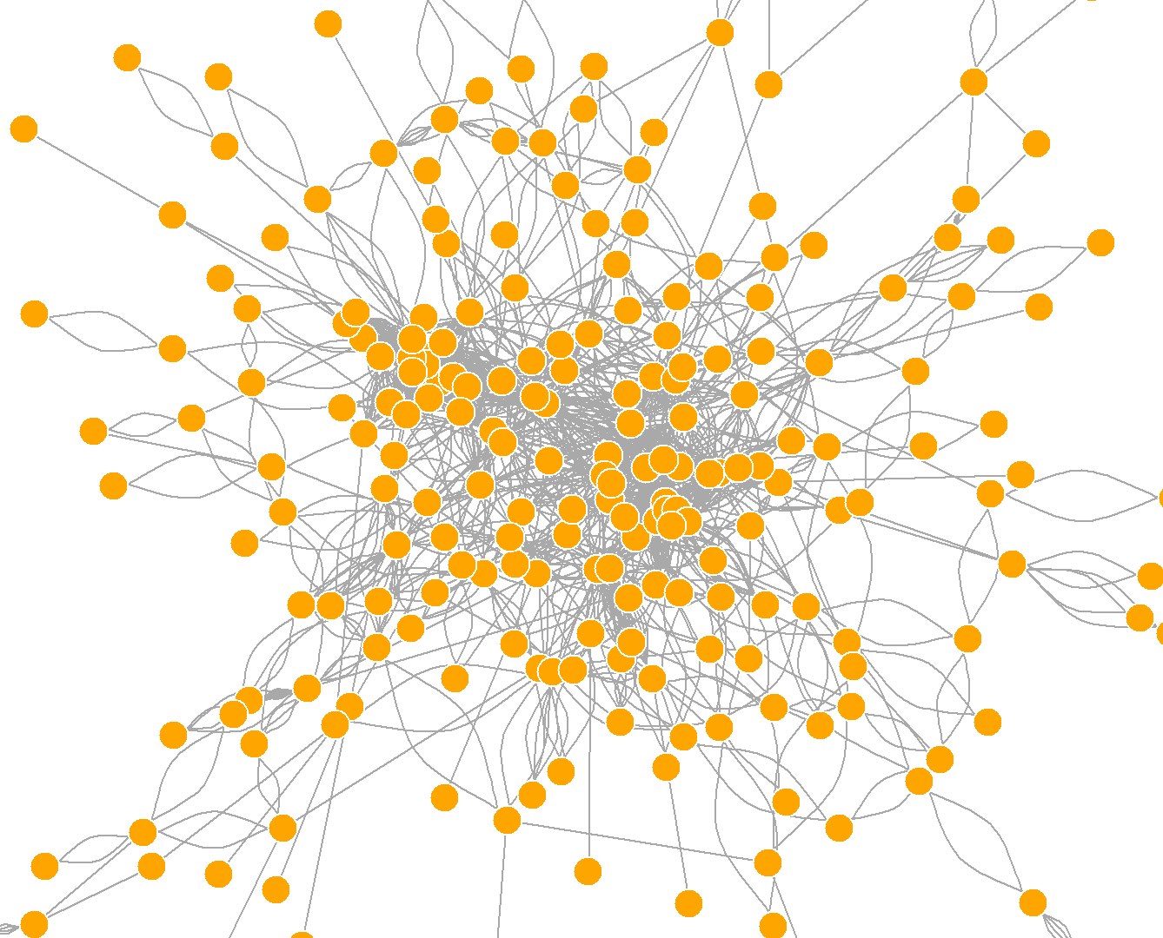
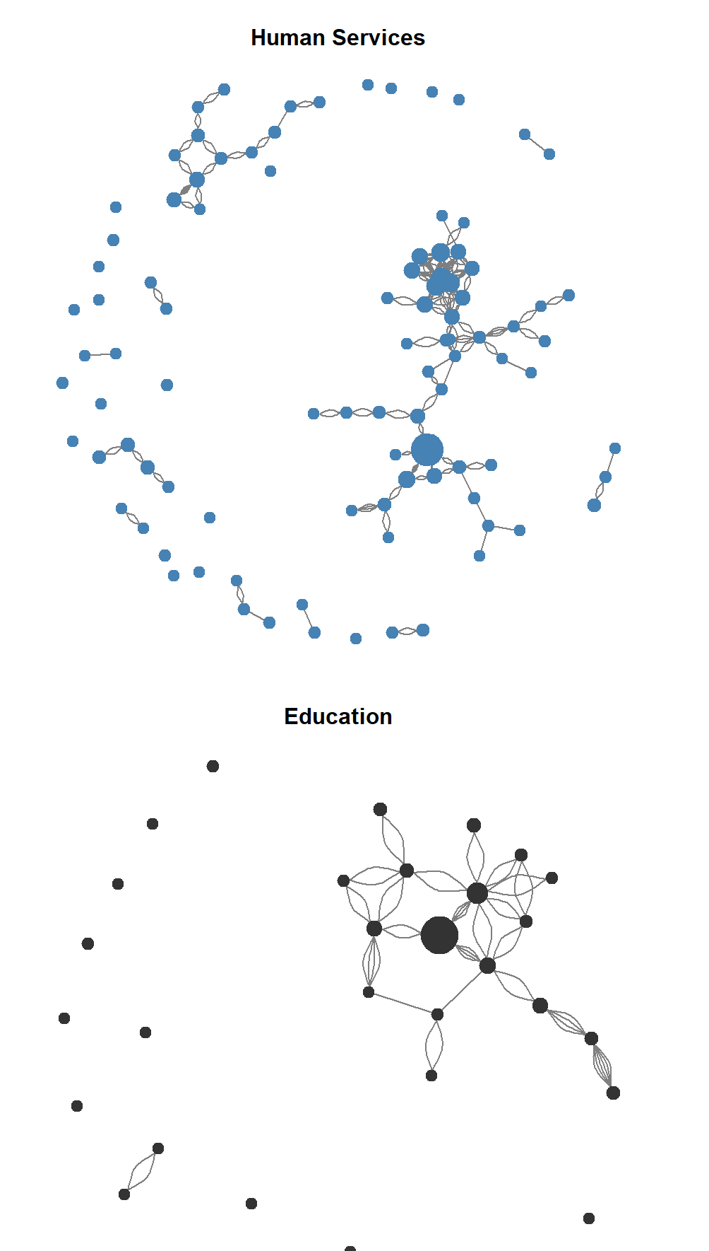
Potential Uses: board interlock, career paths

Slide 49
Open Data By-Products
Clean names
New title taxonomy
Synthetic Employee IDs

Slide 50
ran out of
legitimate
ideas and
useful tricks
start of every research project
YOU ARE HERE
point of
no return

Slide 51


