Slide 1
Preview of text analysis
∙ Jesse Lecy ∙

Slide 2
Text as Data
pre-processing
tokenization
feature selection
modeling

Slide 3
THE CORPORATION’S SPECIFIC PURPOSE IS TO SUPPORTS AFFORDABLE HOUSING, COMMUNITY DEVELOPMENT AND ECONOMIC DEVELOPMENT OF THE CITY AND COUNTY OF SAN FRANCISCO’S ECONOMICALLY DISADVANTAGED INDIVIDUALS AND COMMUNITIES, BY LENDING TO, INVESTING IN, AND DIRECTLY ACQUIRING SUCH AFFORDABLE HOUSING AND RELATED COMMUNITY DEVELOPMENT REAL ESTATE ASSETS.

Slide 4
the corporation specific purpose is to support affordable_housing, community development and economic_development of the city and county of san_francisco economically disadvantaged individuals and communities by lending to investing in and directly acquiring such affordable_housing and related community development real_estate assets
Remove punctuation
Delete words with little information value (“stop words” in quanteda)
Identify compound constructs (apply “dictionary”)

Slide 5
Stemming
lend
lending
relate
related

Slide 6

DISAMBIGUATION
George W. Bush
George Bush Jr.
President Bush
GW_BUSH

Slide 7
DISAMBIGUATION
PLACE
New York City
New York University
New Yorker
New York
THING
STATE oF MIND
STATE

Slide 8
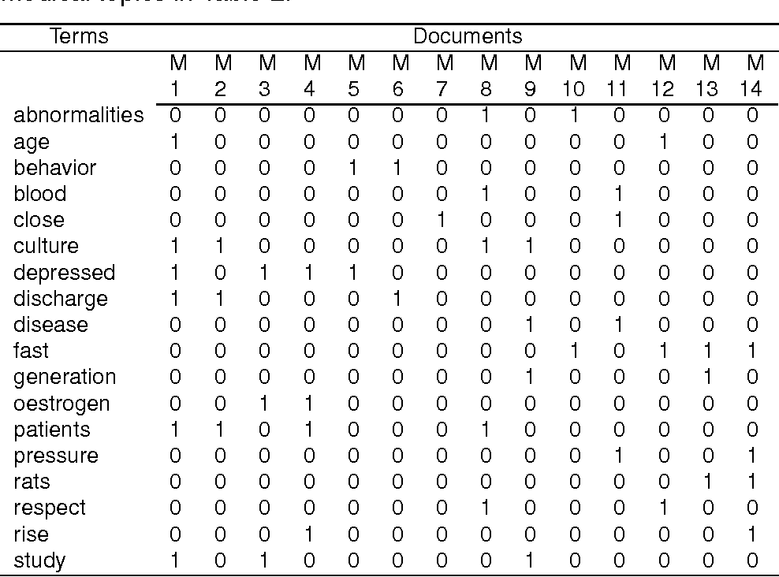
Document frequency matrix (DFM): final output of pre-processing steps in quanteda

Slide 9
Machine Learning
( classification )

Slide 10

7ext a5 4ata:
Text is a useful input for many machine learning models for prediction and trend analysis

Slide 11


Netflix provided a training data set of 100,480,507 ratings that 480,189 users gave to 17,770 movies, graded from 1 to 5 stars. The test set of 1,408,789 ratings is used by the jury to determine potential prize winners. In 2009 the grand prize of $1,000,000 was given to the BellKor's Pragmatic Chaos team which improved Netflix's own algorithm by 10%
The Netflix Prize

Slide 12
Religion
Environment
salvation
stewardship
recycling
Distinctive
constructs
I. Arts, Culture, and Humanities II. Education III. Environment and Animals IV. Health V. Human Services VI. International, Foreign Affairs VII. Public, Societal Benefit VIII. Religion Related
Shared
constructs

Slide 13
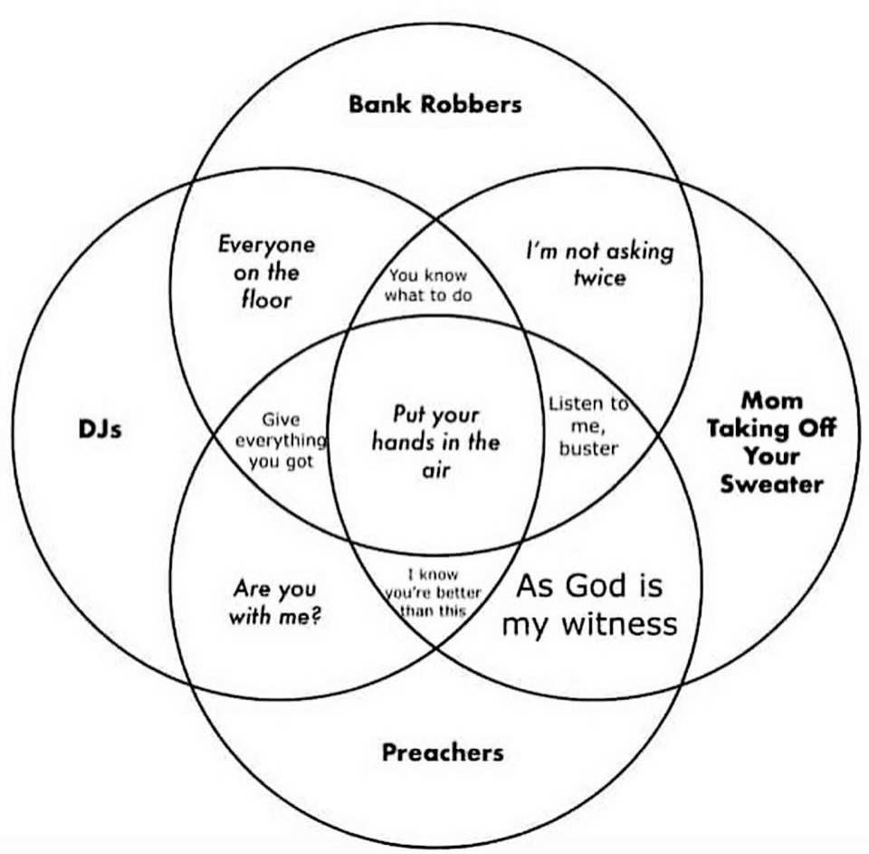
Information theory
HIGH Signal to Noise Ratio
(eliminates half of possible sources)
LOW Signal to Noise Ratio
(does not distinguish any actors)

Slide 14
To educate, train and assist in providing emergency medical service for the community.
"educ" "train" "assist" "provid" "emerg" "medic" "servic" "communiti"
Semantic Networks
provid
communiti
educ
medic
emerg
train
servic
assist

Slide 15
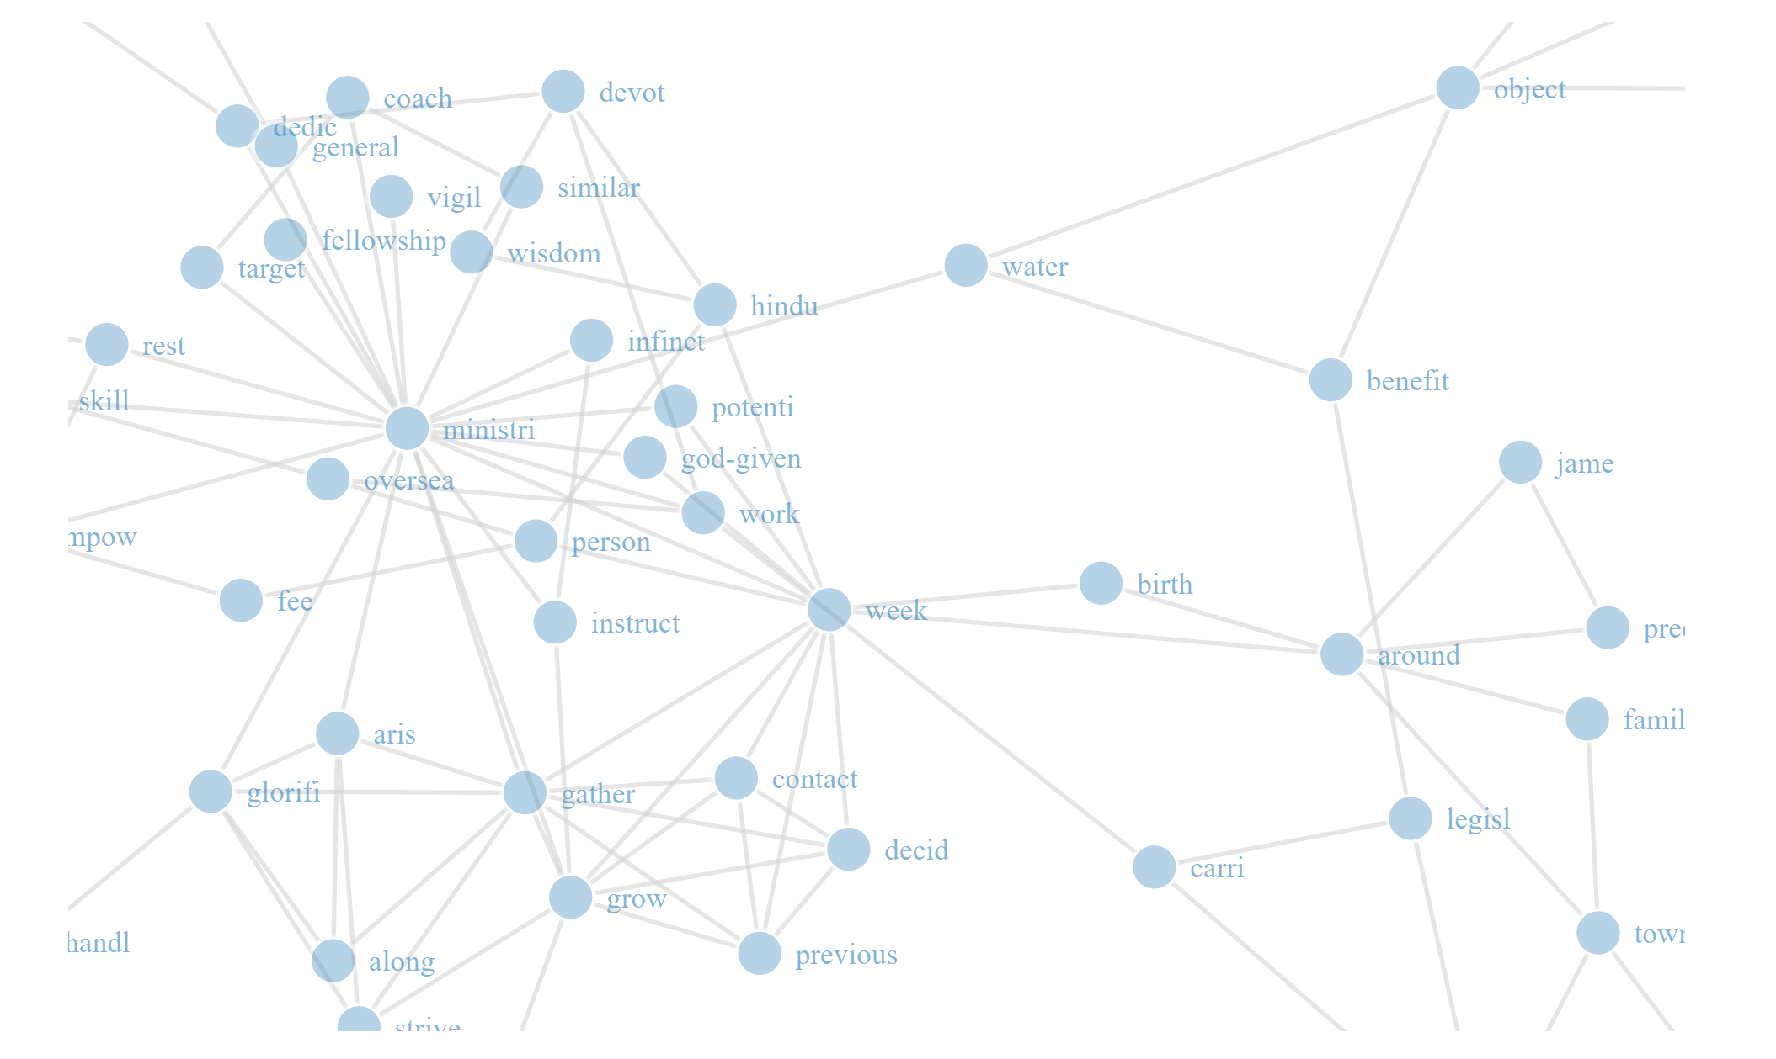

Slide 16
Union (all statement) and Intersection
Mission
Statement 1
Mission
Statement 2
D
D
A
B
B
A
B
C
C
C
H
H
E
F
G
E
E
F
G
Intersection represents components of mission statements common to all nonprofits.

Slide 17
Analyzing Missions by Types of Nonprofits
Mission Statement Components Unique to Org 1:
A-B
A-C
B-D
D
H-E
G-E
E-F
Mission Statement Components Unique to Org 2
A
B
C
H
E
F
G
Doesn’t work well with dense weighted graphs!

Slide 18
Data structure of a weighted network:
Freq ALL | Freq GROUP | Term 1 | Term 2
10 | 5 | econ | dev
7 | 4 | self | reliance
5 | 3 | dev | con
5 | 2 | globla | econ
4 | 2 | local | econ
4 | 1 | soc | econ
3 | 2 | econ | socialism
3 | 3 | finance | global
3 | 2 | global | finance
3 | 2 | global | impsm
3 | 1 | impsm | global
3 | 1 | impsm | invasion
Is it significant that economic development was mentioned 5 times by a specific type of organization?

Slide 19
D
A
B
B
C
C
H
H
DEV
F
DEV
F
ECON
ECON
N=10
n=5
How often will a random sample from the full weighted network produce the observed number of “statements” (semantic network ties)?

Slide 20
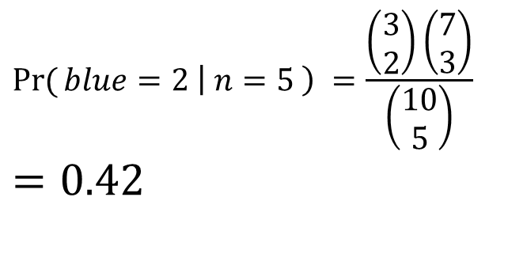
D
Is it significant that Org Statement significant?
What is the probability of selecting 2 blue balls from a sample of 5 balls?
A
B
C
H
E
F
G
N=3
$$\operatorname{Pr}{(}blue=2 \left| n=5 \right) =\frac{\left(\begin{matrix}3 \\ 2\end{matrix}\right)\left(\begin{aligned}7 \\ 3\end{aligned}\right)}{\left(\begin{matrix}10 \\ 5\end{matrix}\right)} \\ =0.42$$
B
C
H
E
F
G
n=2

Slide 21
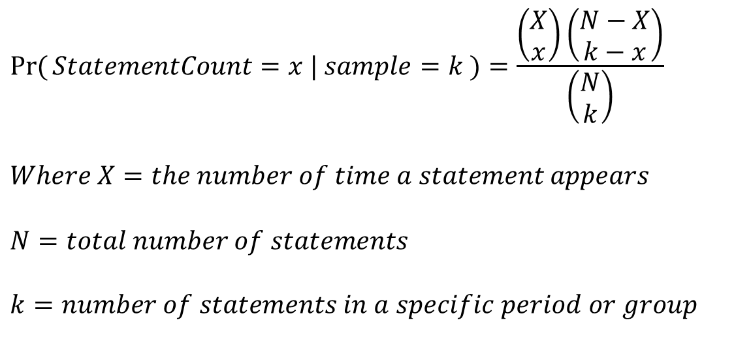
Generalized:
D
A
B
C
$$\operatorname{Pr}{(}StatementCount=x | sample=k )=\frac{\left(\begin{matrix}X \\ x\end{matrix}\right)\left(\begin{matrix}N−X \\ k−x\end{matrix}\right)}{\left(\begin{matrix}N \\ k\end{matrix}\right)}$$ $$Where X=the number of time a statement appears$$ $$N=total number of statements$$ $$k=number of statements in a specific period or group$$
H
E
F
G
X=3, N=10
B
C
H
E
F
G
x=2, k=5

Slide 22
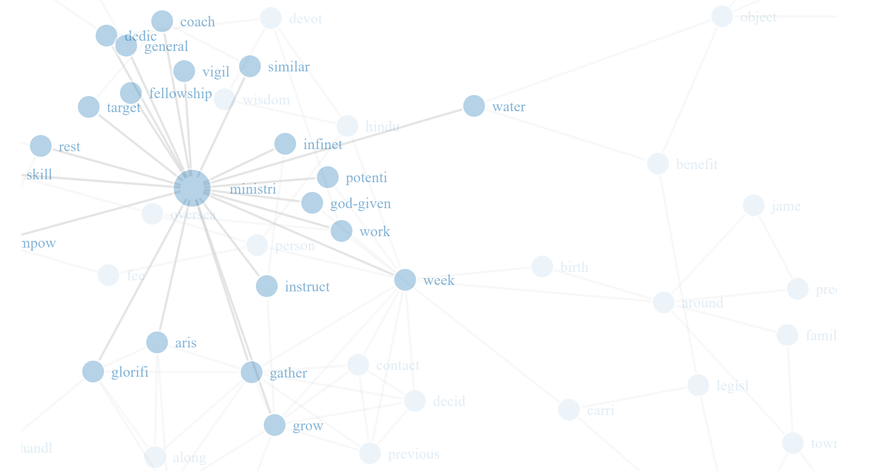
Unique word structures used by a specific type

