Slide 1
String Processing
Working with Text in R
Jesse Lecy

Slide 2
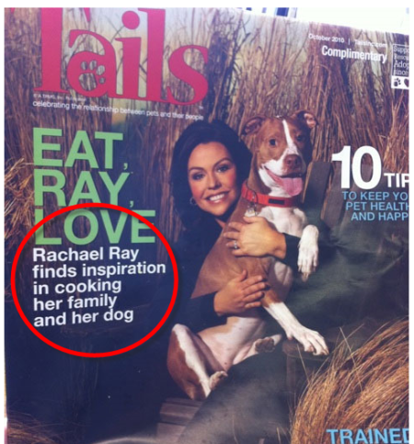
Text is hard to analyze…
because language is fickle.

Slide 3
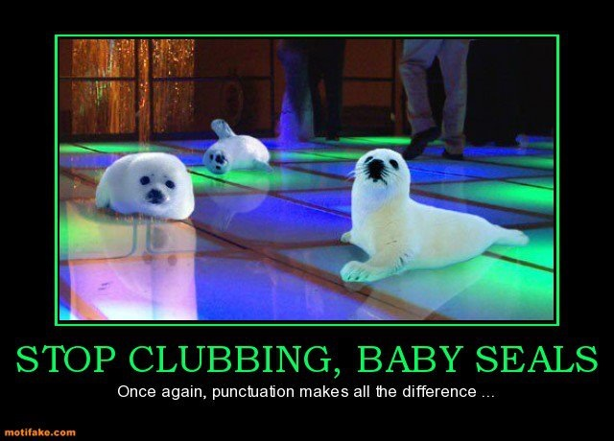

Slide 4


Slide 5


Slide 6
strings

Slide 7
strings

Slide 8
functions

Slide 9
*GREP: Globally search for a Regular Expression and Print

Slide 10
Regular expressions

Slide 12
quantifiers

Slide 14
position

Slide 16
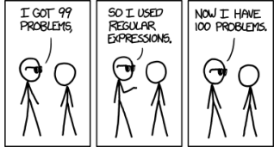

Slide 17
Regex in the wild: advanced examples for inspiration
http://code.tutsplus.com/tutorials/8-regular-expressions-you-should-know--net-6149

Slide 18
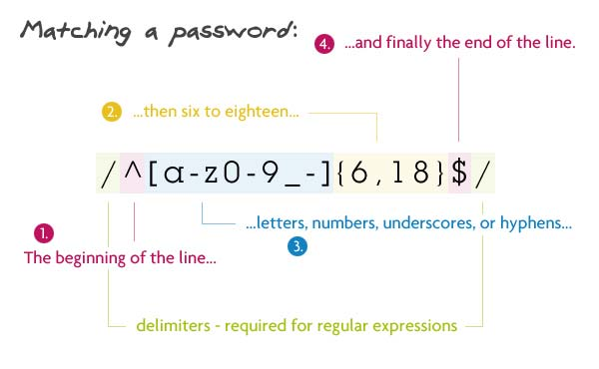

Slide 19
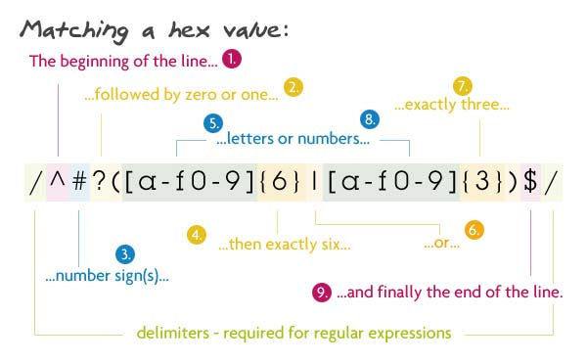

Slide 20
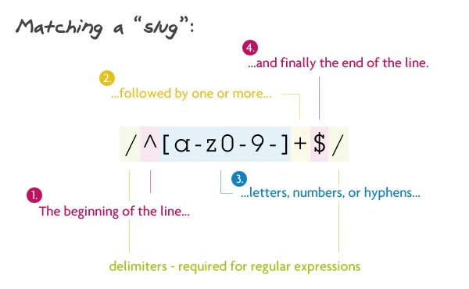

Slide 21
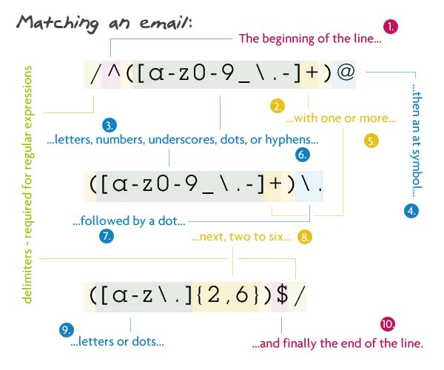

Slide 22
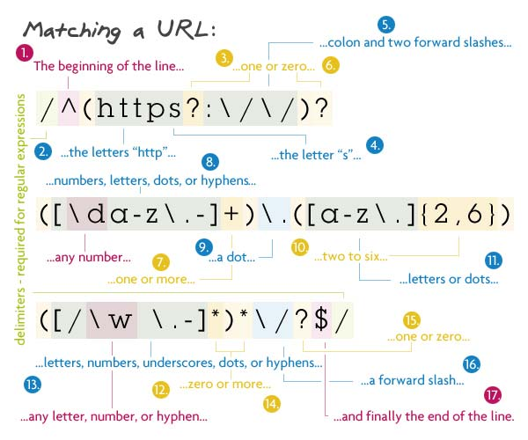

Slide 23
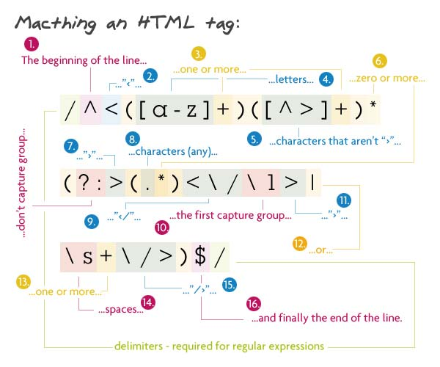

Slide 24
fuzzy matching
agrep()

Slide 25
Are two words the same?
George Bush George W. Bush
Plane Plain
Bureaucracy Bureacracy

Slide 26
Intention vs. execution

Slide 27
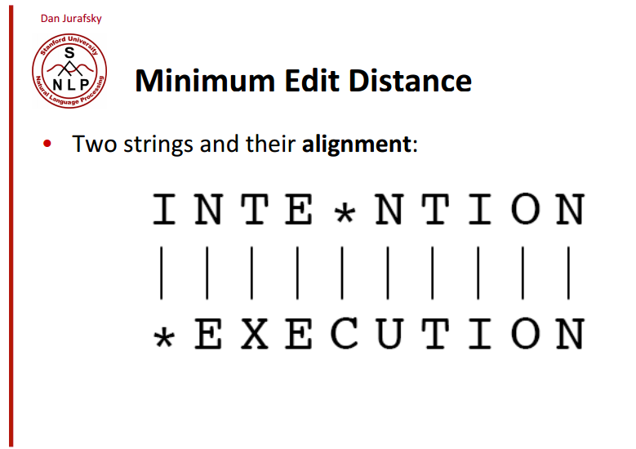

Slide 28
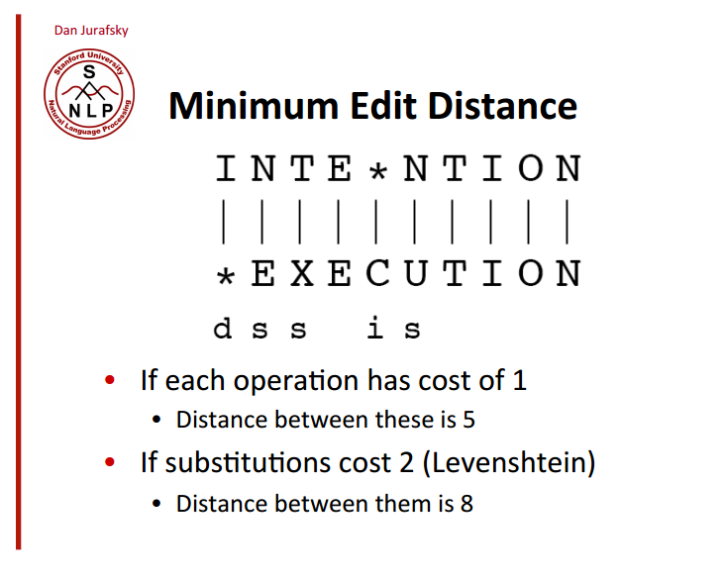

Slide 29
Calculate edit distance
> adist( "intention", "execution" )
[,1]
[1,] 5
> adist( "intention", "execution",
costs=c(insertions=1, deletions=1, substitutions=2) )
[,1]
[1,] 8

Slide 30
Return word with edit distance < 10%
> agrep("lazy", c("daisy", "lasy", "fazed"), value = TRUE )
[1] "lasy“
“grep” stands for “globally search a regular expression and print”
“a” stands for approximate matching

Slide 31
practice

Slide 32
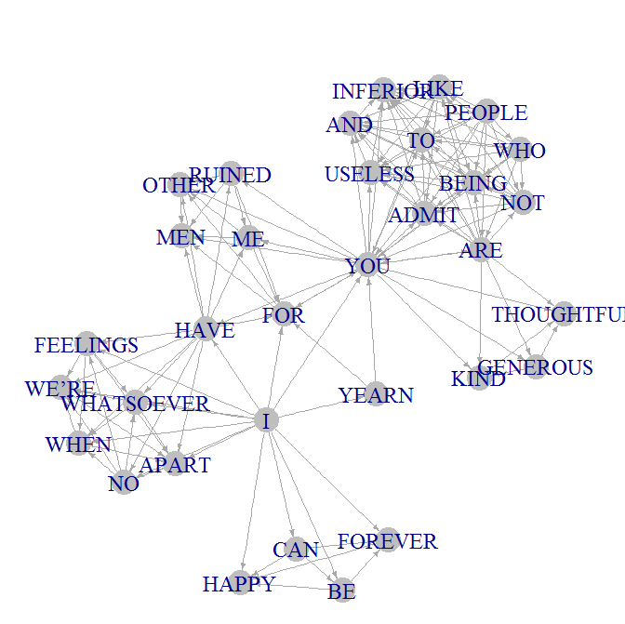

Slide 33
Dear John:
I want a man who knows what love is all about. You are generous, kind, thoughtful. People who are not like you admit to being useless and inferior. You have ruined me for other men. I yearn for you. I have no feelings whatsoever when we’re apart. I can be forever happy.
Will you let me be yours?
Gloria
Dear John:
I want a man who knows what love is. All about you are generous, kind, thoughtful people, who are not like you. Admit to being useless and inferior. You have ruined me. For other men, I yearn. For you, I have no feelings whatsoever. When we’re apart, I can be forever happy. Will you let me be?
Yours,
Gloria

Slide 34
instructions
Import text
Standardize letter case
Remove commas, quote marks, special characters
Delete empty lines
Split the text into sentences
Build a network based upon all words in each sentence

Slide 35
functions
Import Text File:
readLines( “filename.txt” )
Uppercase / Lowercase
toupper( x= ), tolower( x= ) # where x is a character vector
Find and Replace All:
gsub( pattern=, replacement=, x= ) # pattern = what to replace
# replacement = new text
# x = character vector
Split Text by Delimiter:
strsplit( x=, split= ) # x = character vector
# split = delimiter where splits occur

Slide 36
Load text file
setwd( “…" )
x <- readLines("Dear John 1.txt", warn=FALSE)

Slide 37
Standardize case
x <- toupper( x )

Slide 38
Remove special characters
x <- gsub( ",", "", x )
x <- gsub( "we’re", "we are", x )
x <- gsub( "\\:", "", x )
x <- gsub( "\\?", "", x )

Slide 39
Remove blank lines
grep( "^$", x )
x <- x[ - grep( "^$", x ) ]

Slide 40
Split into sentences
strsplit( x, split="\\.")

Slide 41
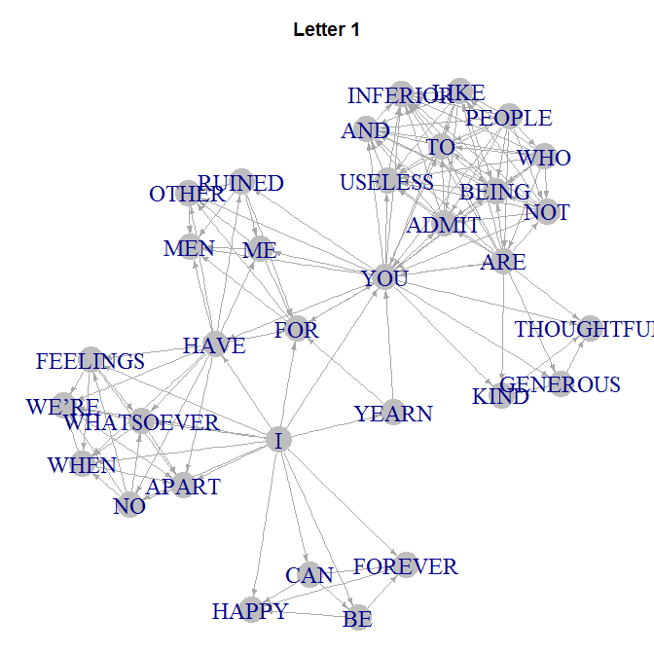
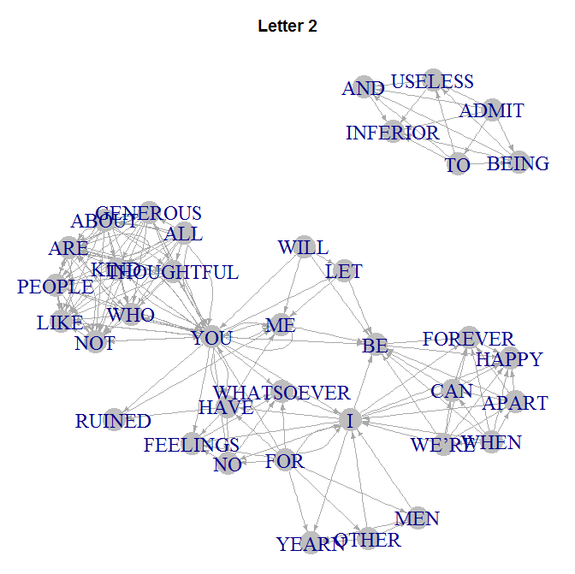

Slide 42
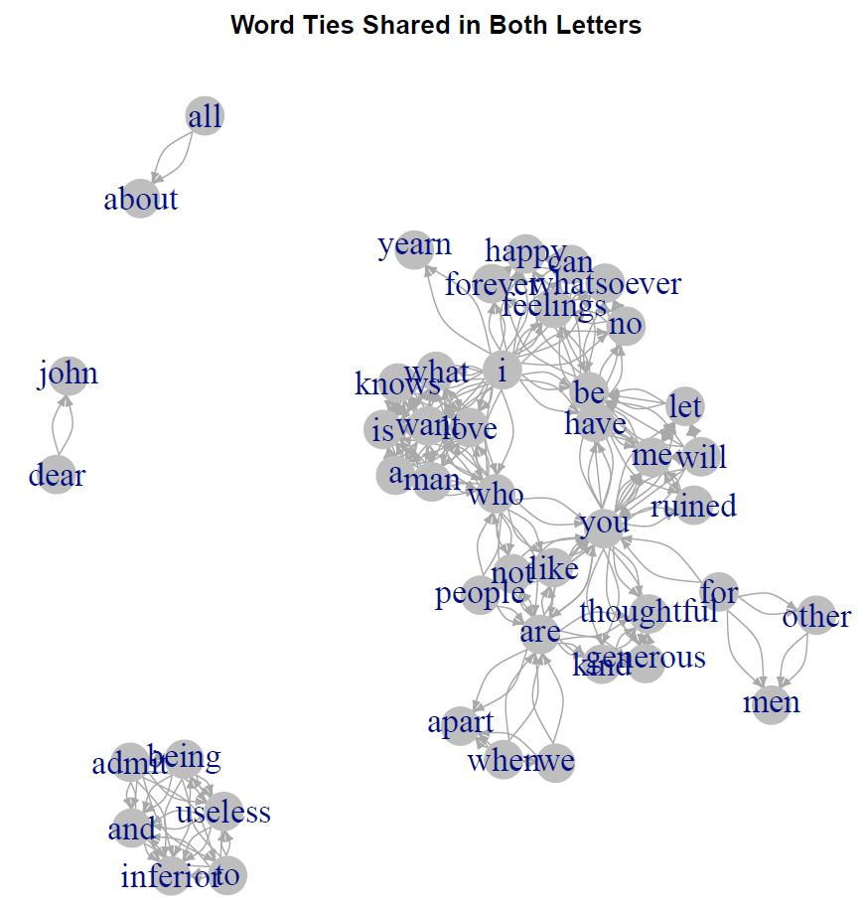

Slide 43
