Slide 1
Community Hub Marketplace
Bridging Economic Gaps to Improve Healthcare Access
St. Helena Parish, Louisiana | Census Tract 22091 951100
AUC Data Challenge 2026
Team DataRx
"In communities with an IGS below 45, how do economic conditions affect healthcare access, and how can small businesses help improve outcomes?"
1/11

Slide 2
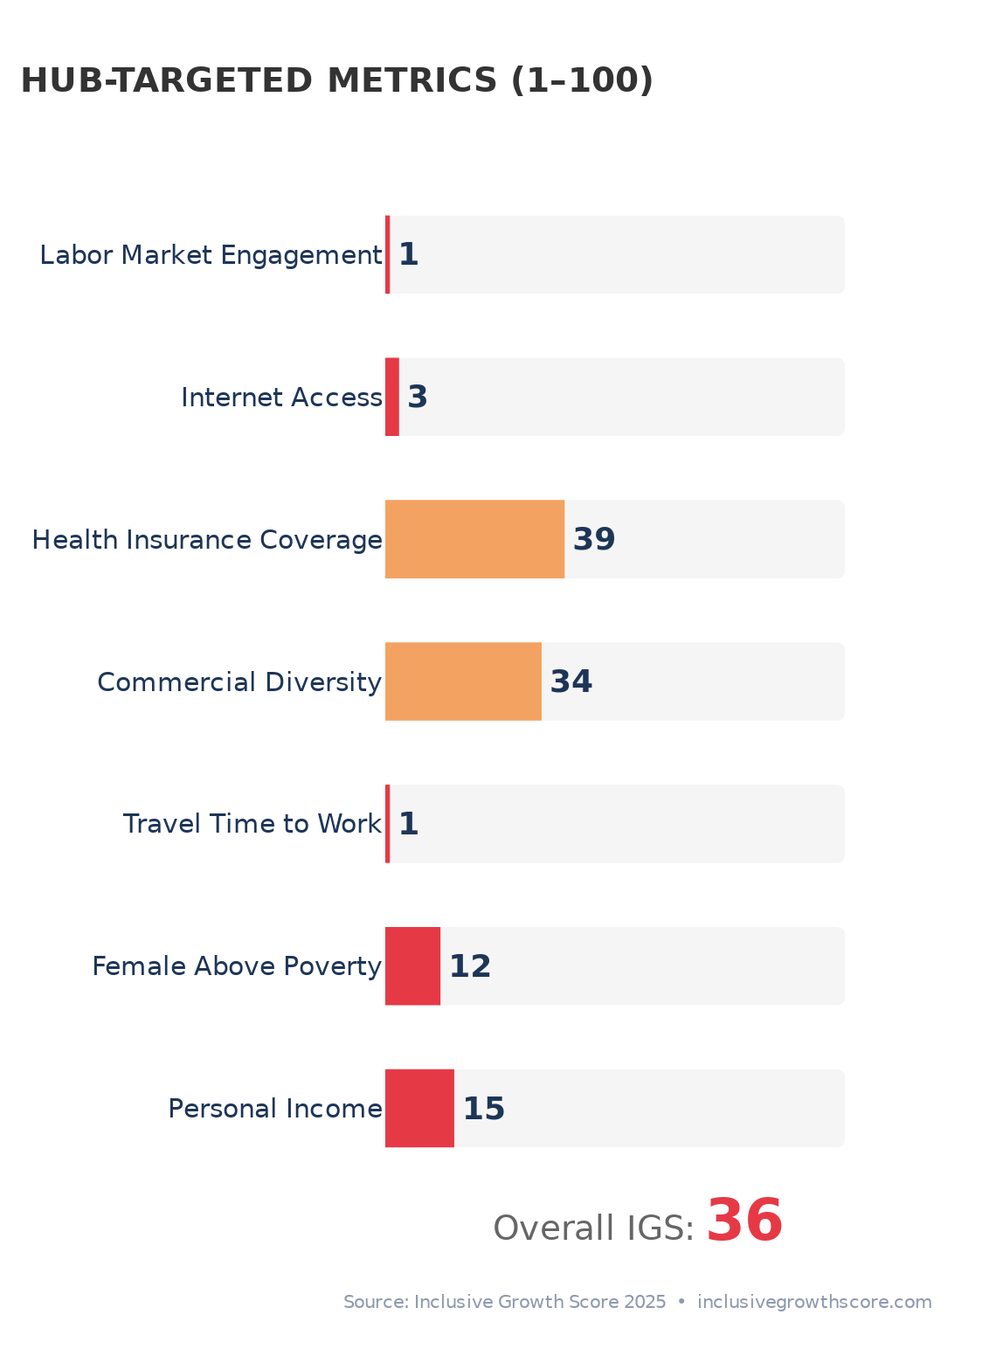
Objective & Problem Statement
The Challenge:
St. Helena Parish has an Inclusive Growth Score of just 36 -- well below the 45 threshold. This rural community of ~10,000 faces compounding economic and health crises.
No local jobs: 62% of working-age adults not employed
Worker exodus: 90% commute out of parish for work
No insurance: only 7.9% have employer coverage (vs 55% nationally)
Healthcare desert: zero pharmacies, 1 dentist, 2 PCPs for 10,000 people
No internet: 3rd percentile nationally for internet access
Deep poverty: 33.7% poverty rate (2.7x the national rate)
Our Solution: Community Hub Marketplace
A physical and digital center that creates local jobs with employer insurance, brings healthcare services, provides broadband, incubates small businesses, and keeps spending local. One intervention, multiple IGS levers.
2/11

Slide 3
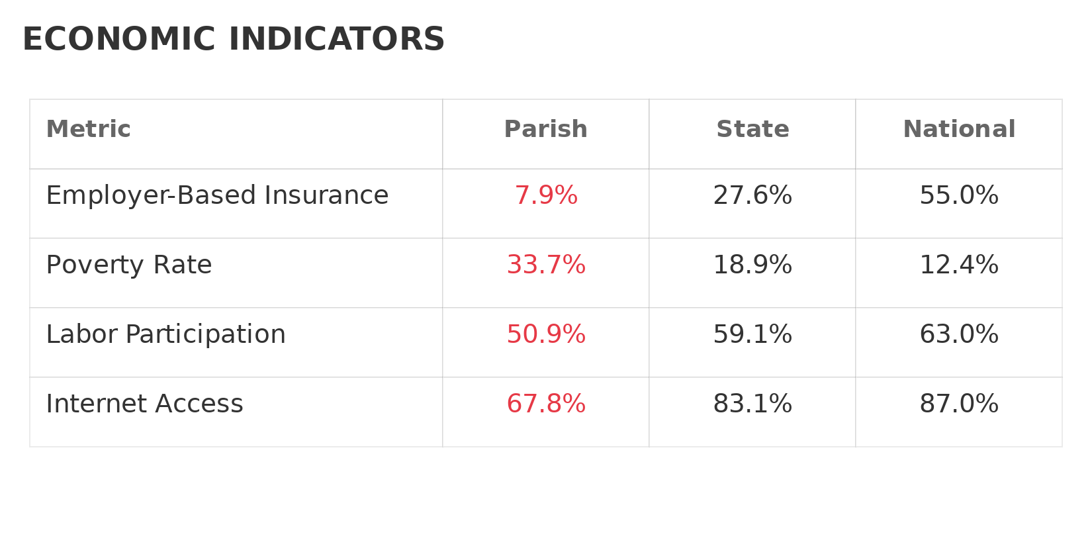
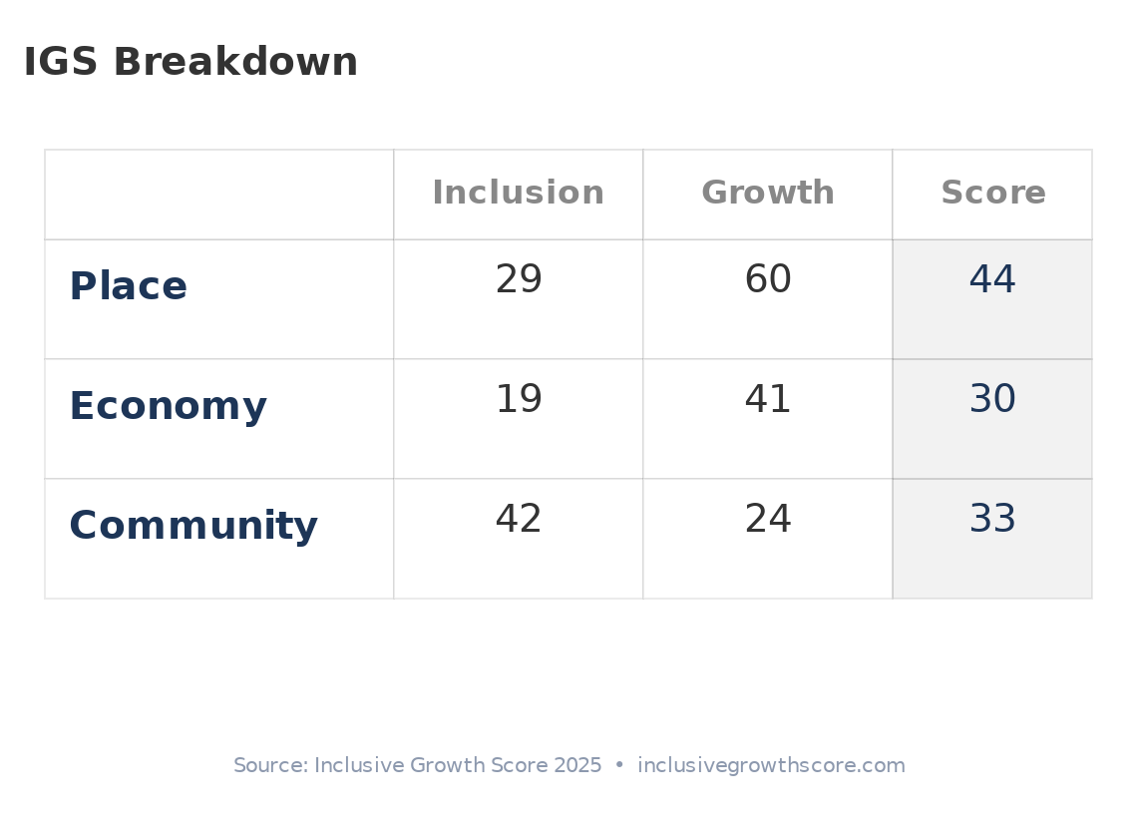
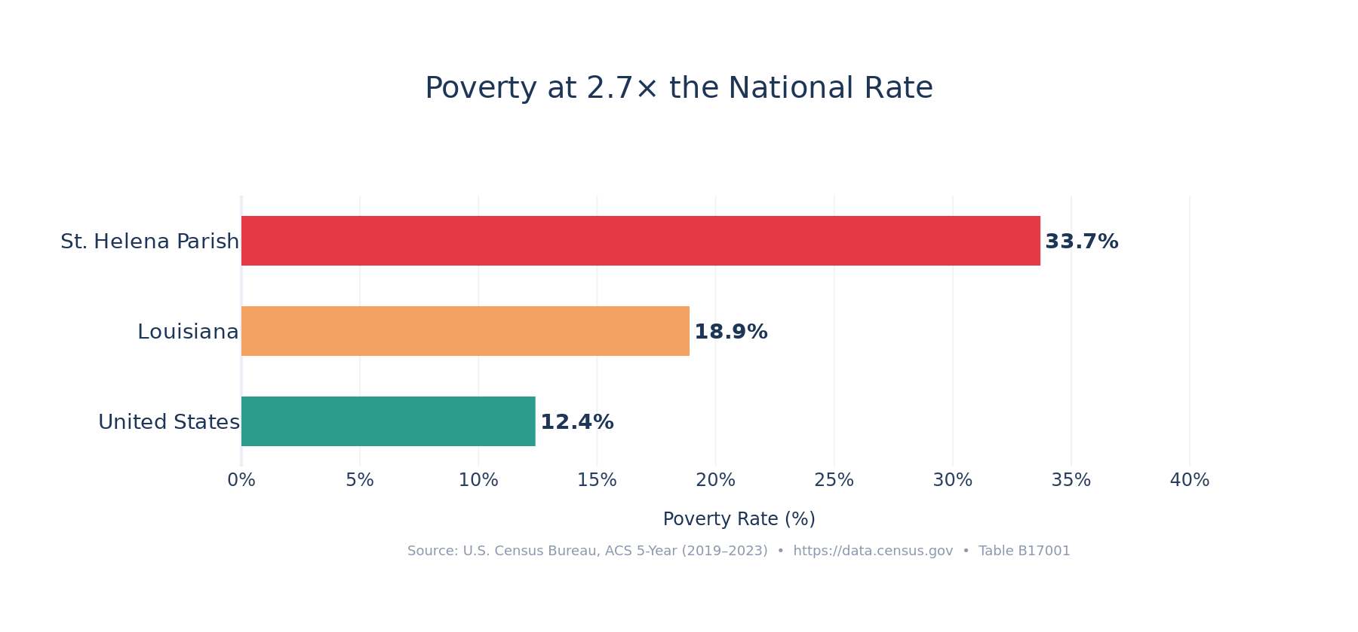
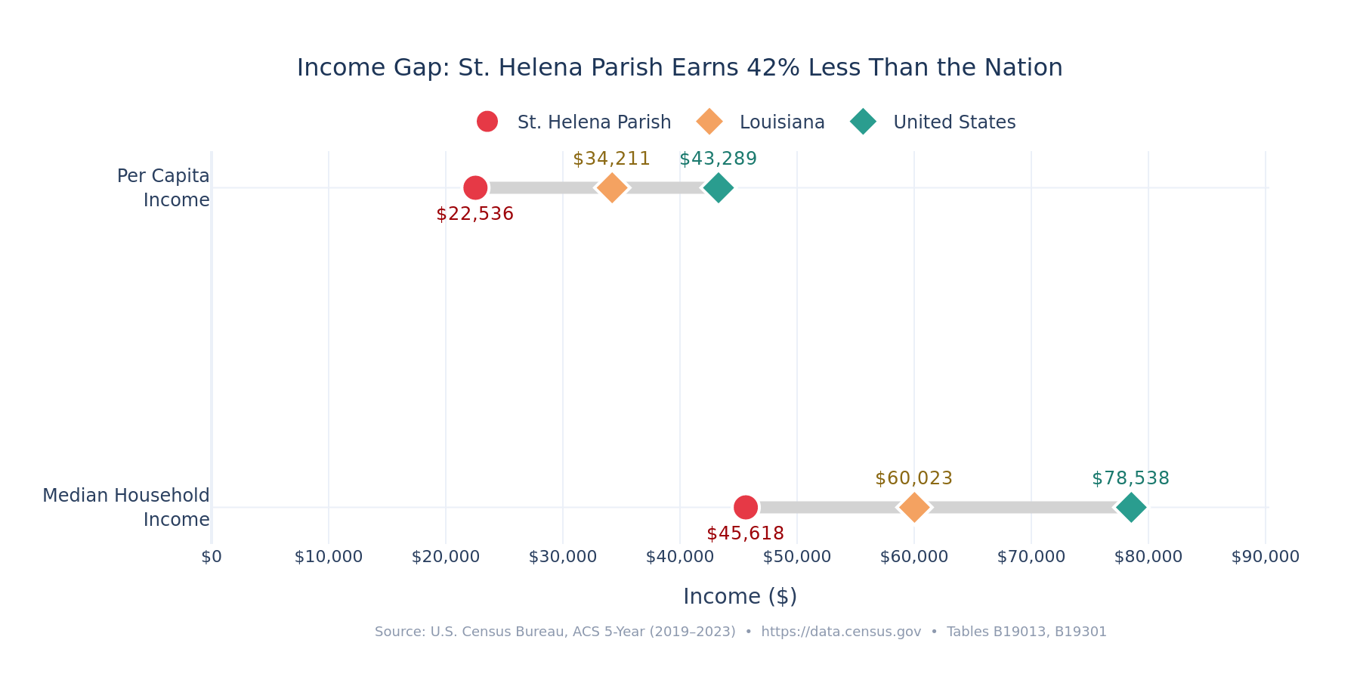
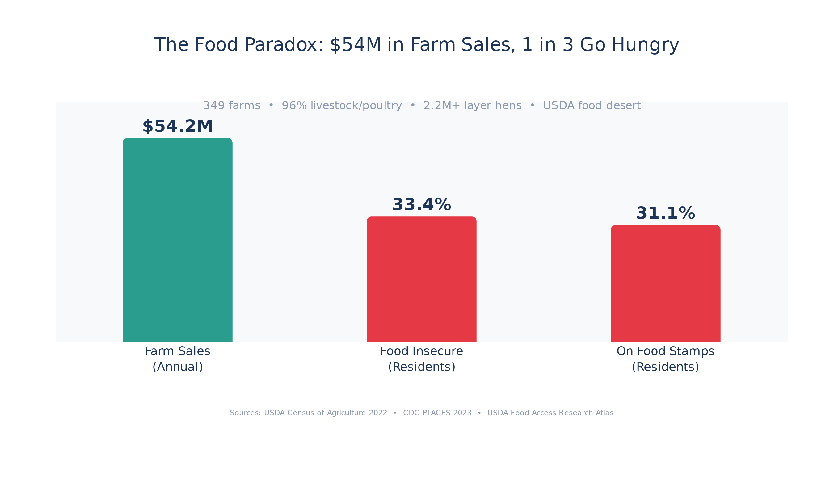
Community Overview
Demographics, Economic Conditions & Social Metrics
Source: U.S. Census ACS 2023, Inclusive Growth Score 2025 | api.census.gov | inclusivegrowthscore.com
3/11

Slide 4
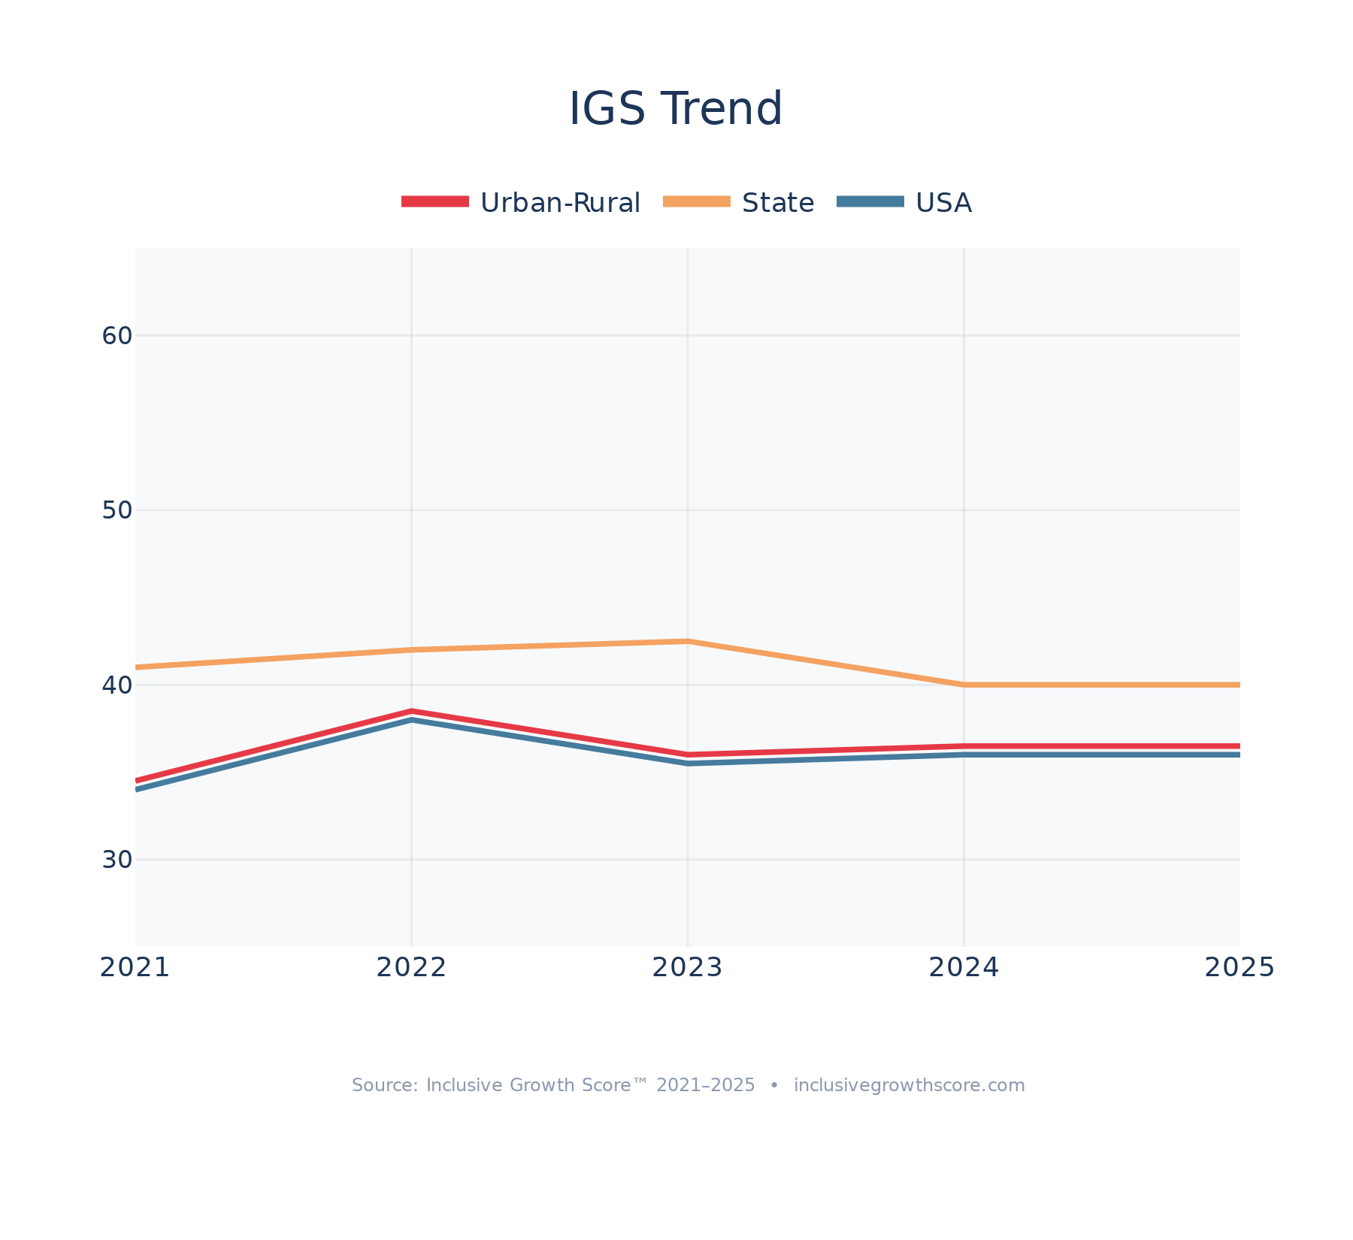
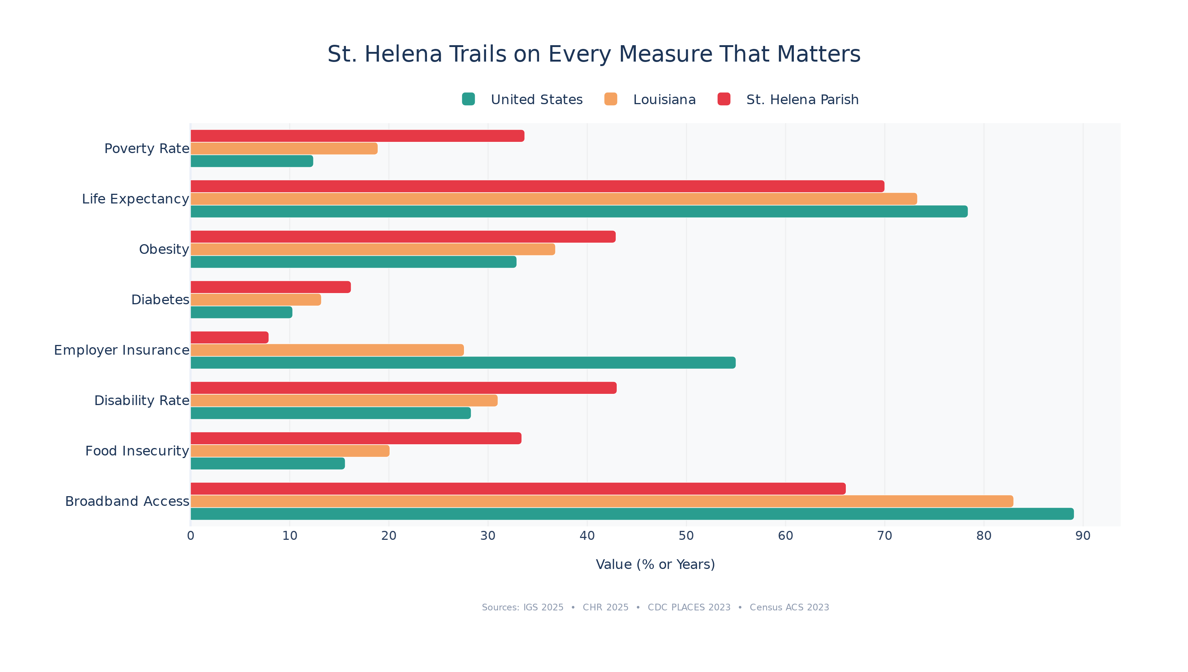
Benchmarking
IGS Ranking vs State and National Averages
Source: Inclusive Growth Score 2017-2025 | inclusivegrowthscore.com
4/11

Slide 5
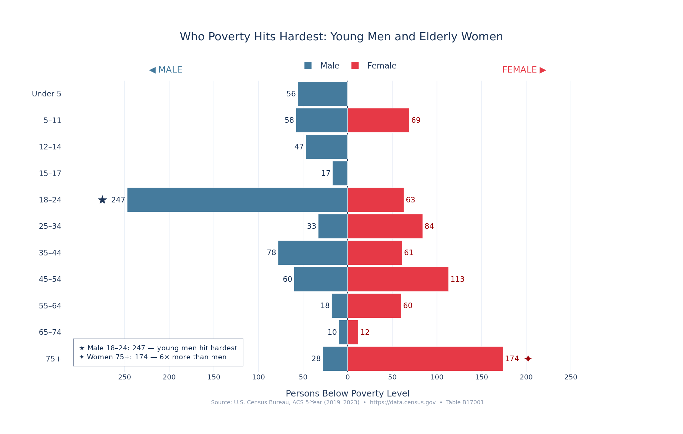
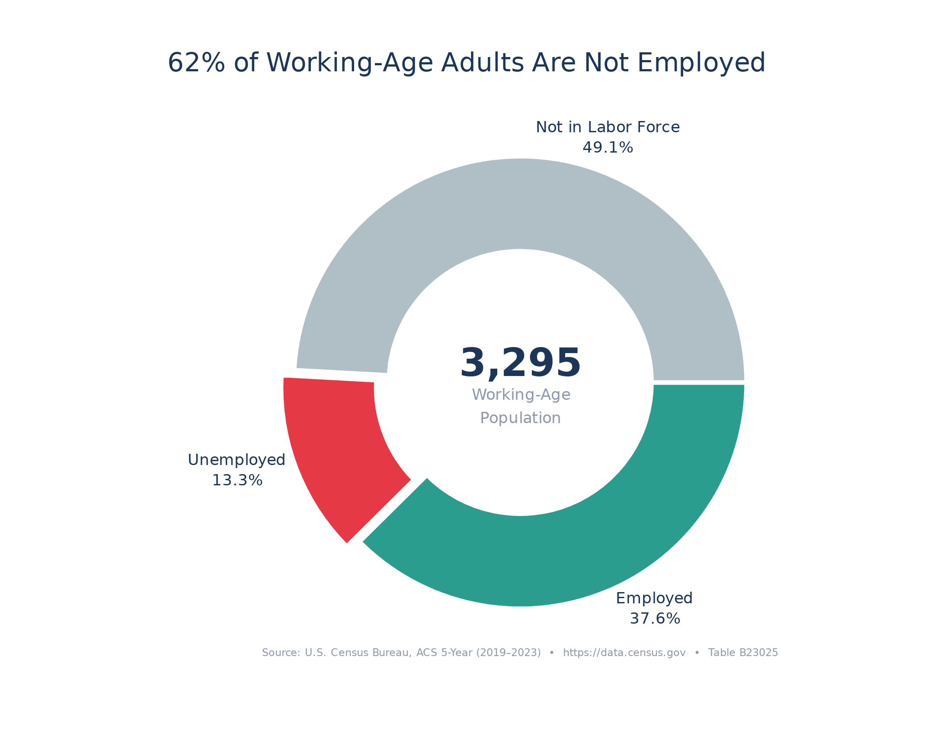
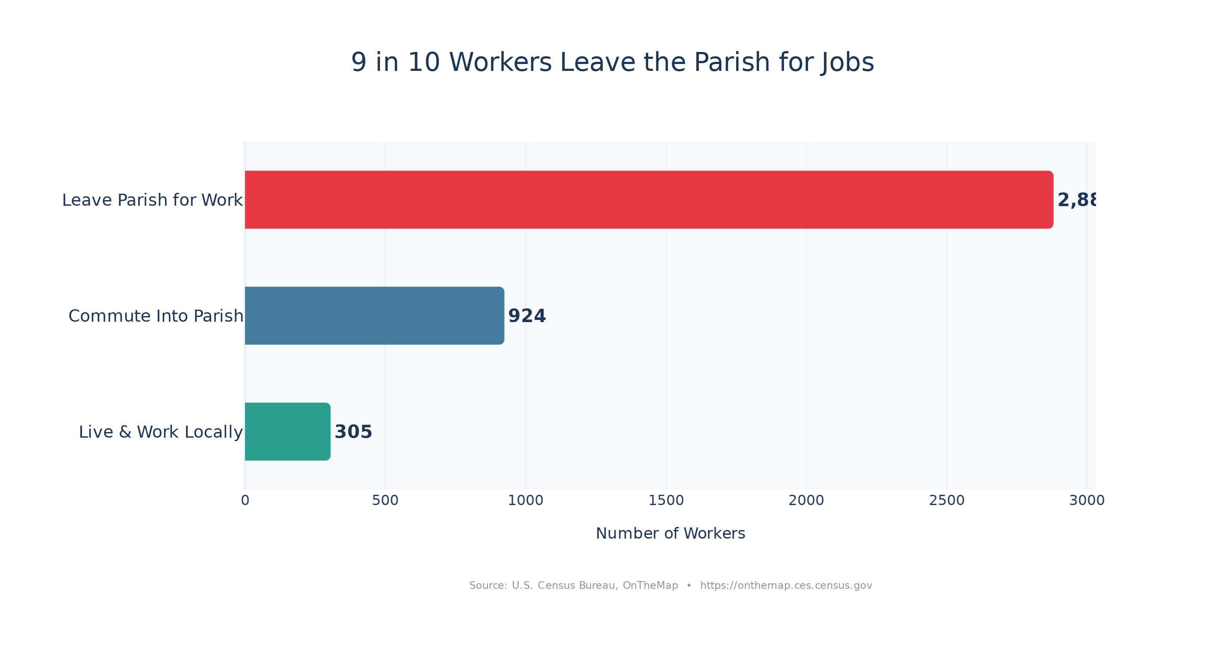
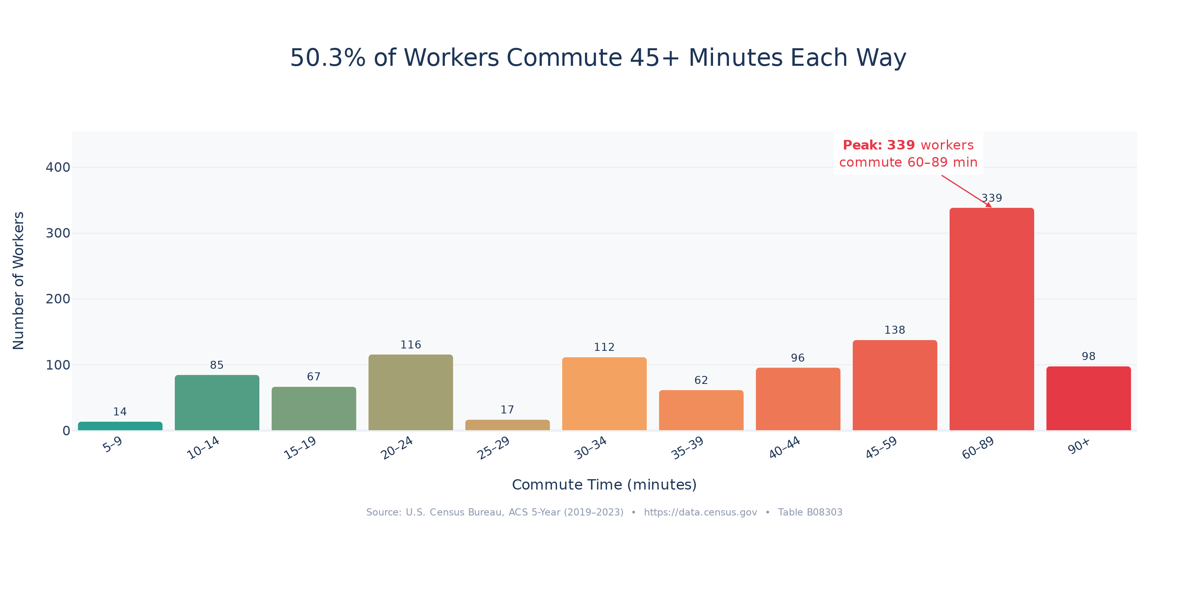
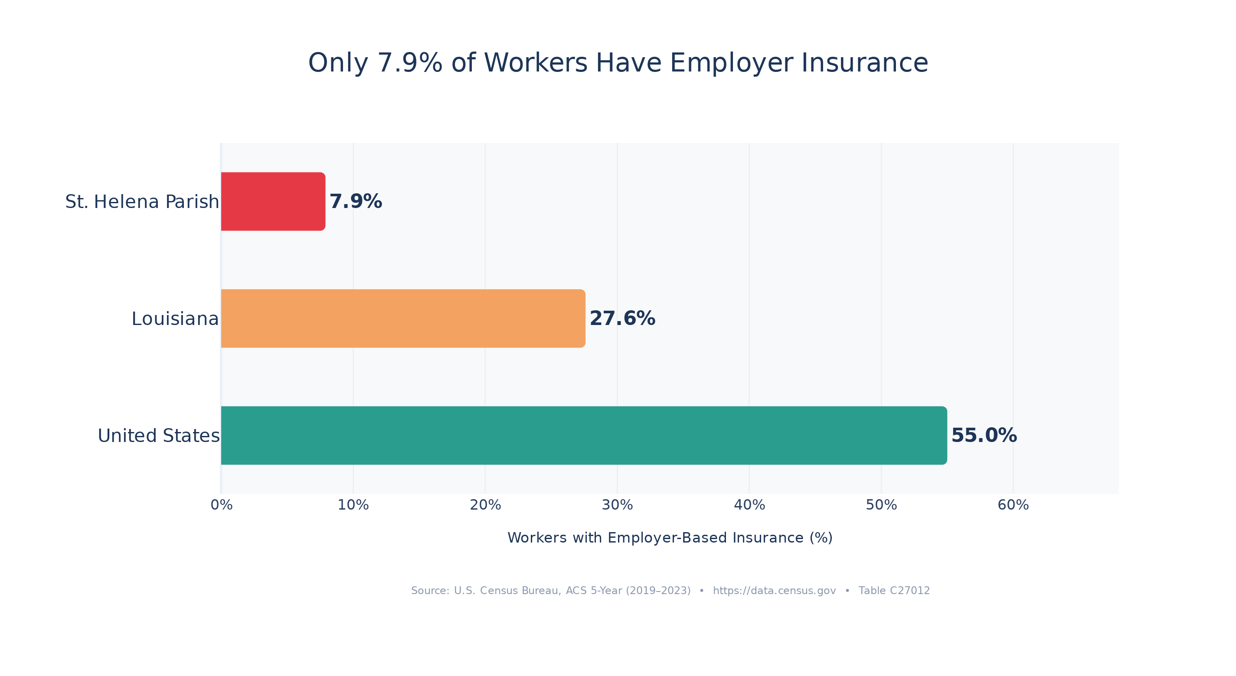
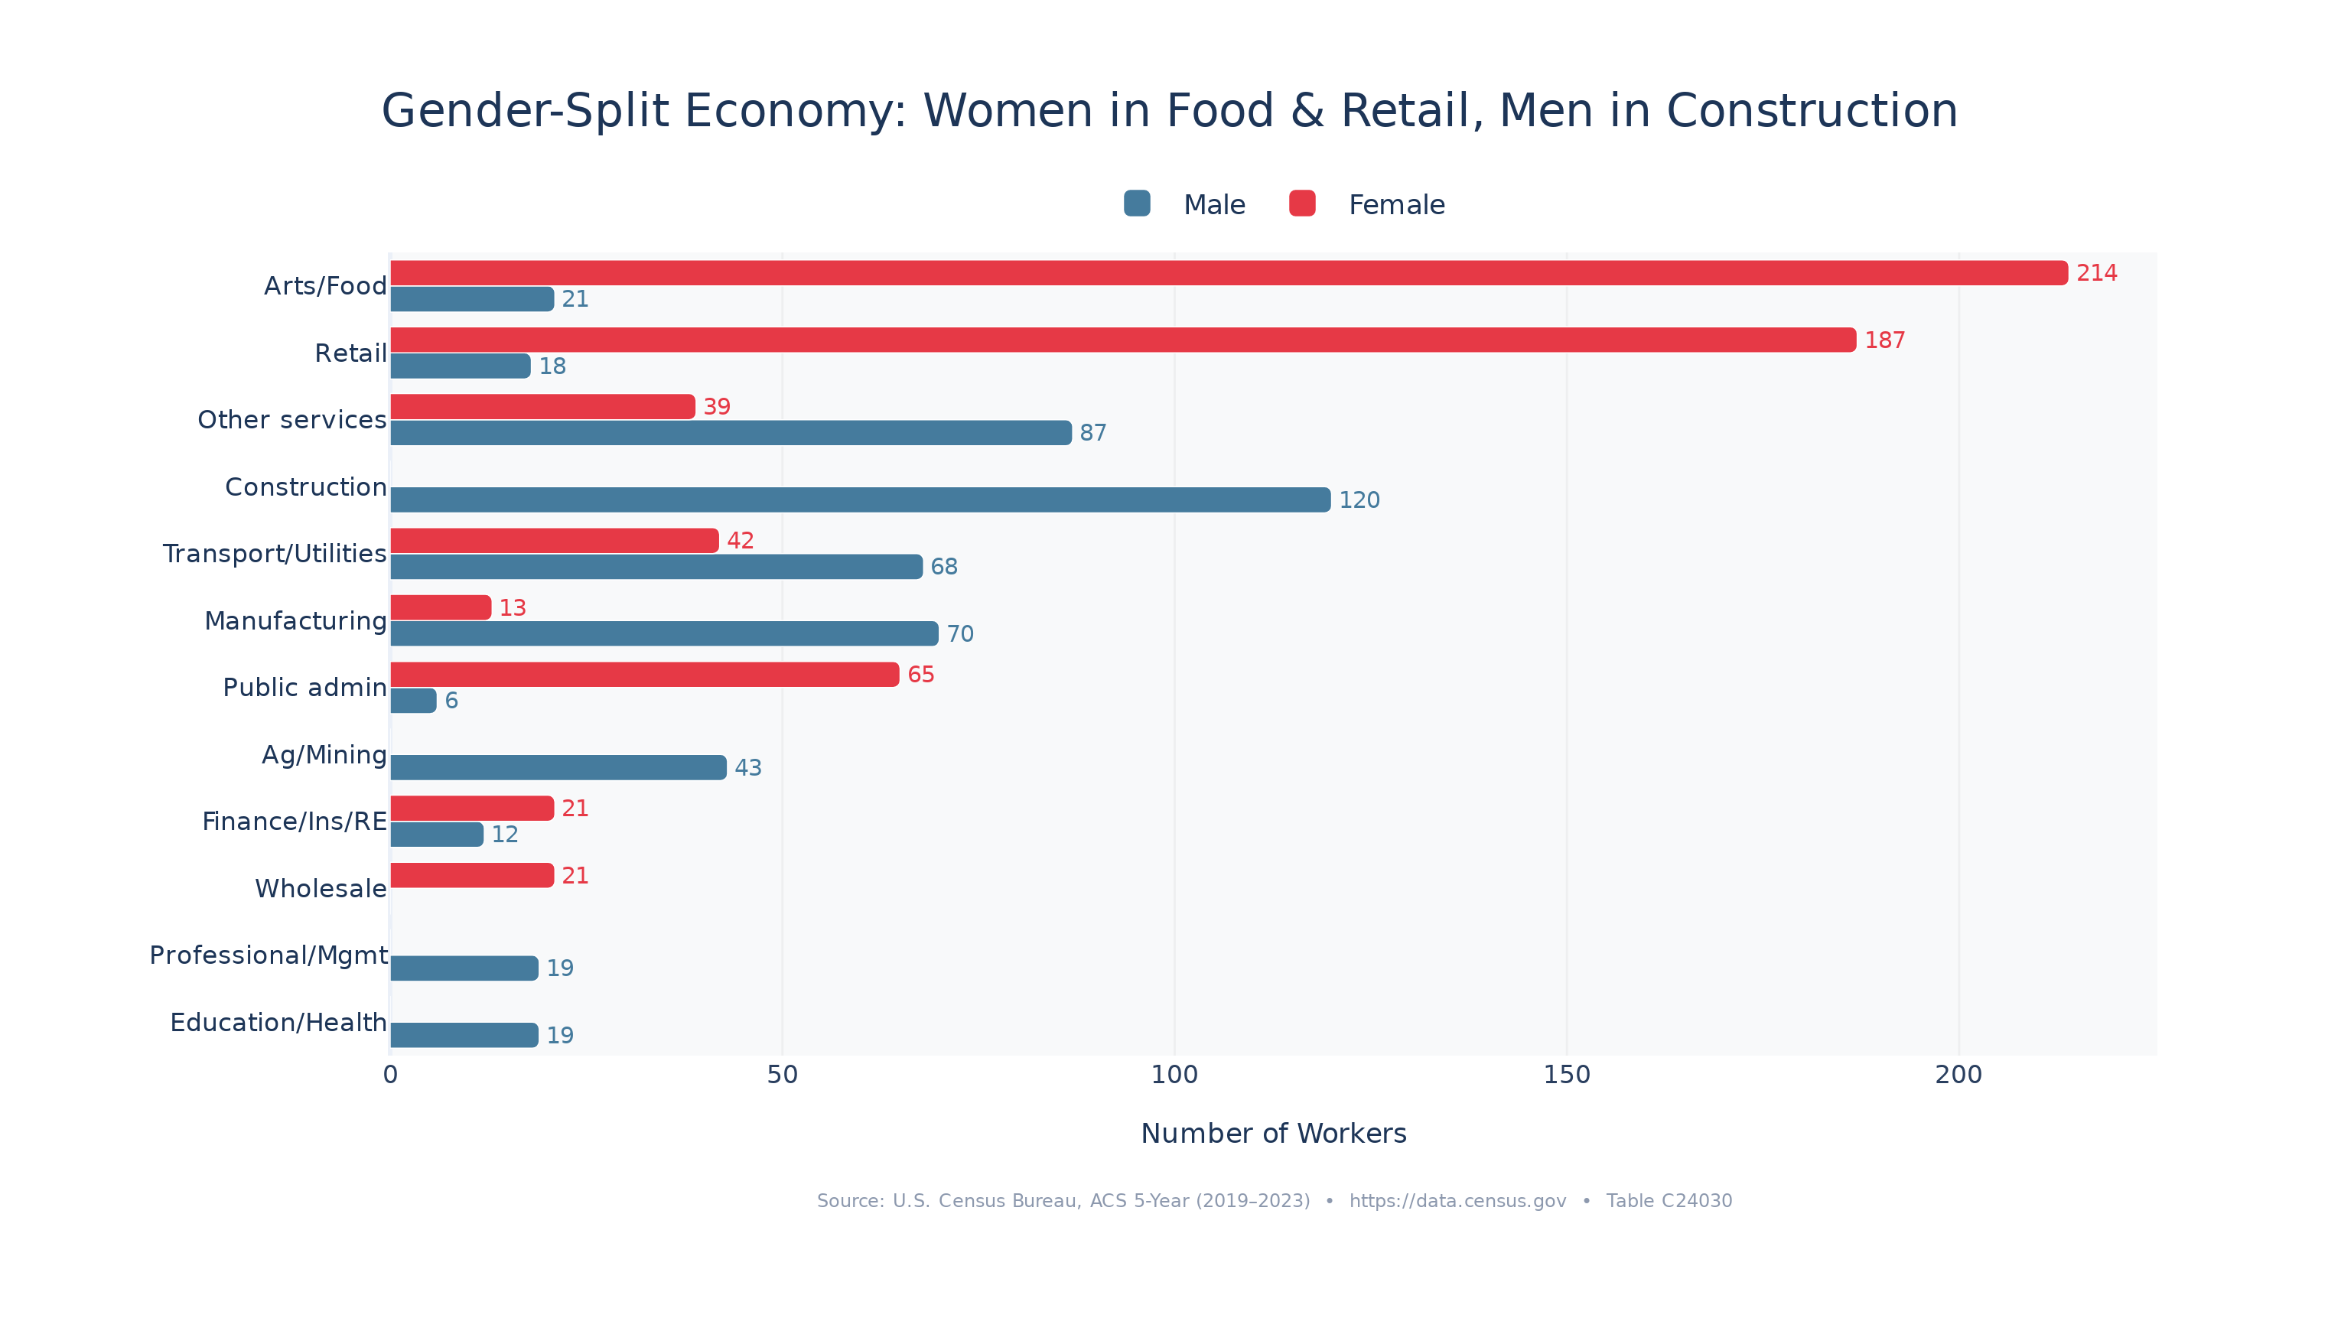
Key Findings: Economic Crisis
Poverty, Employment & the Worker Exodus
5/11

Slide 6
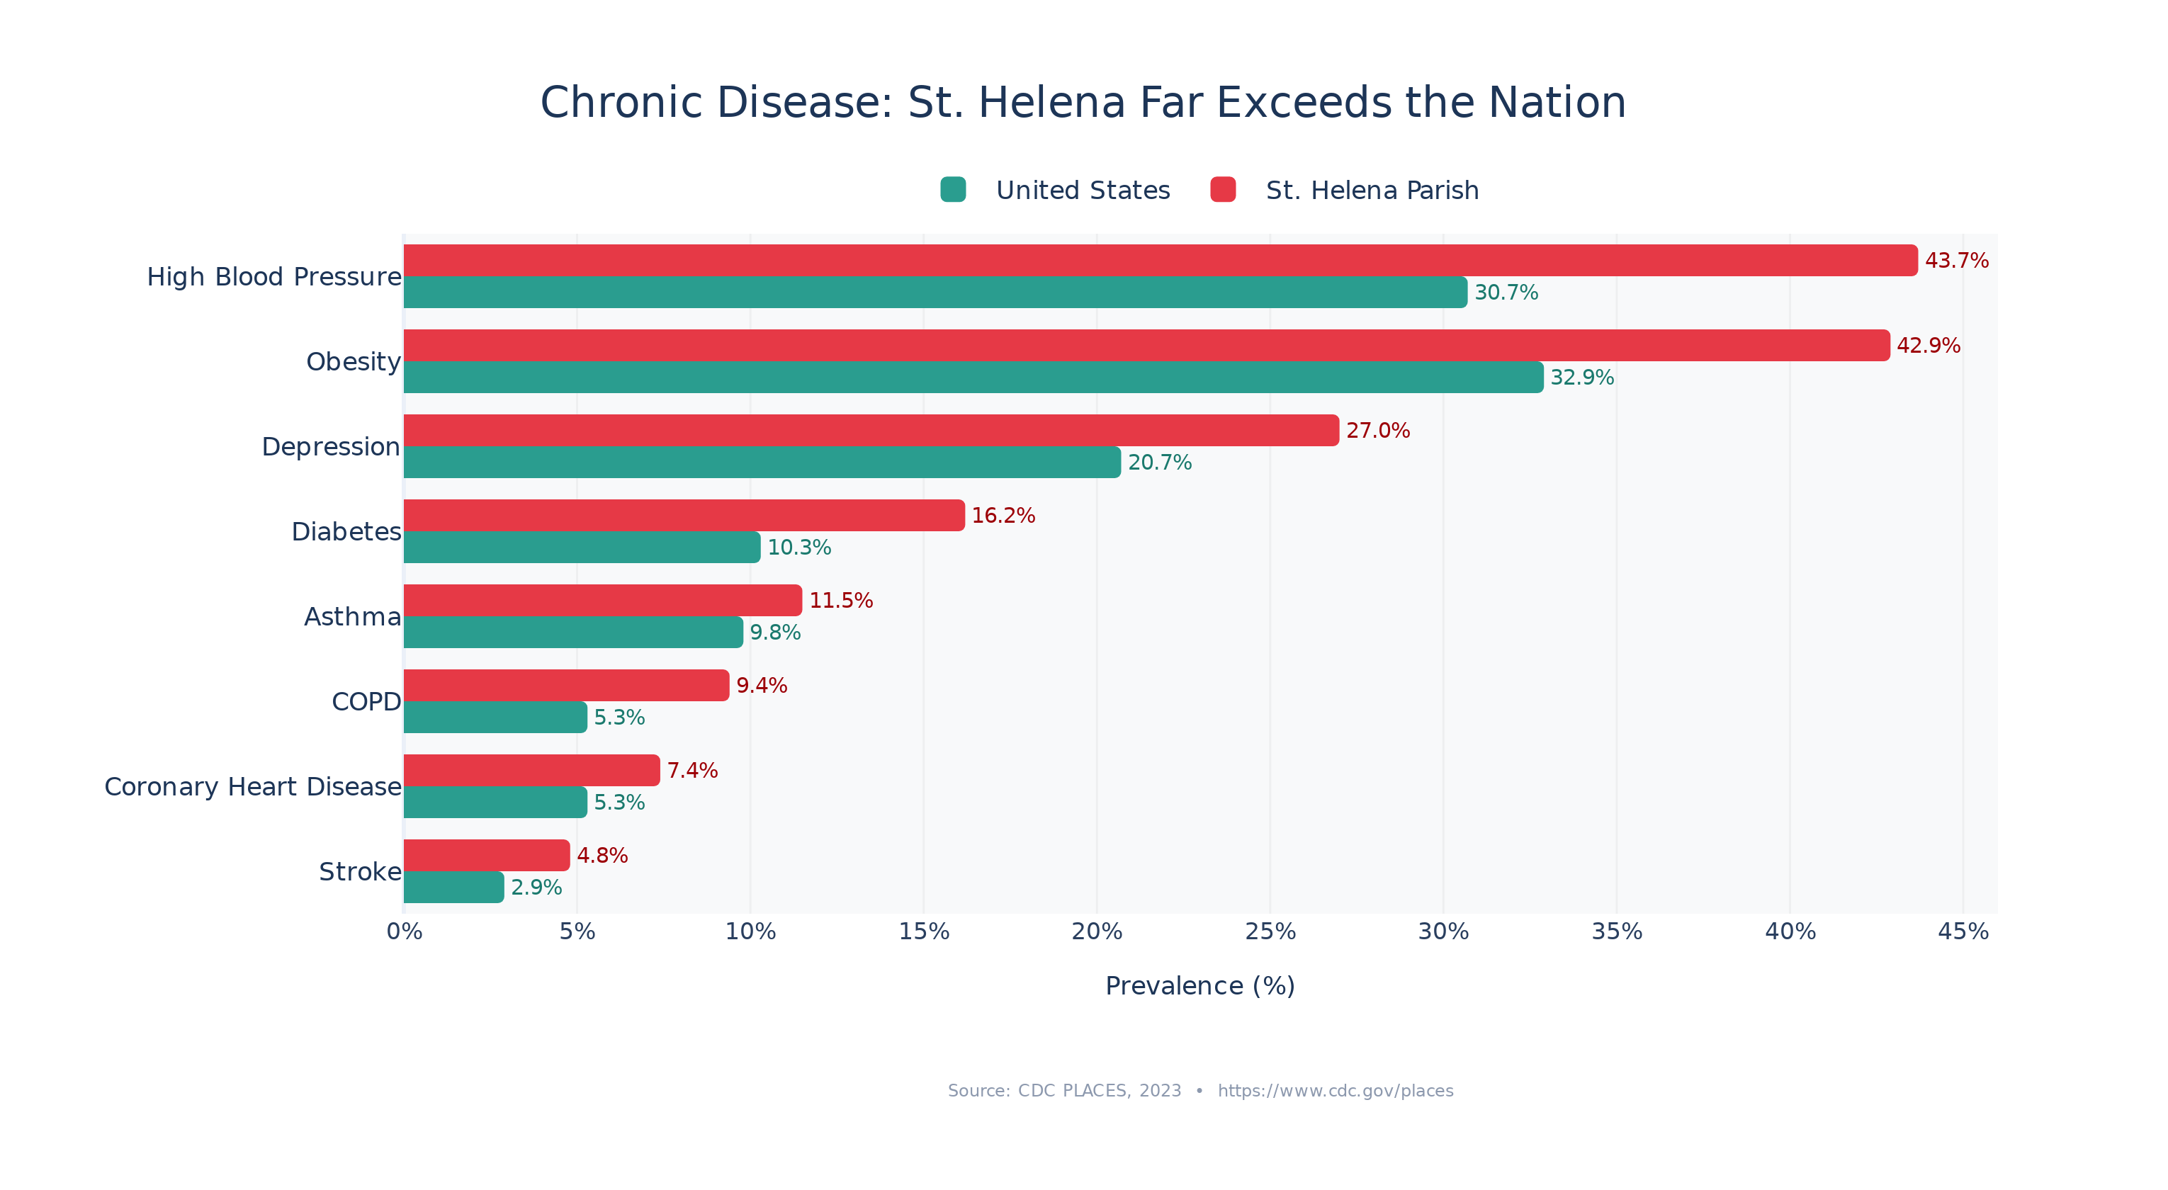
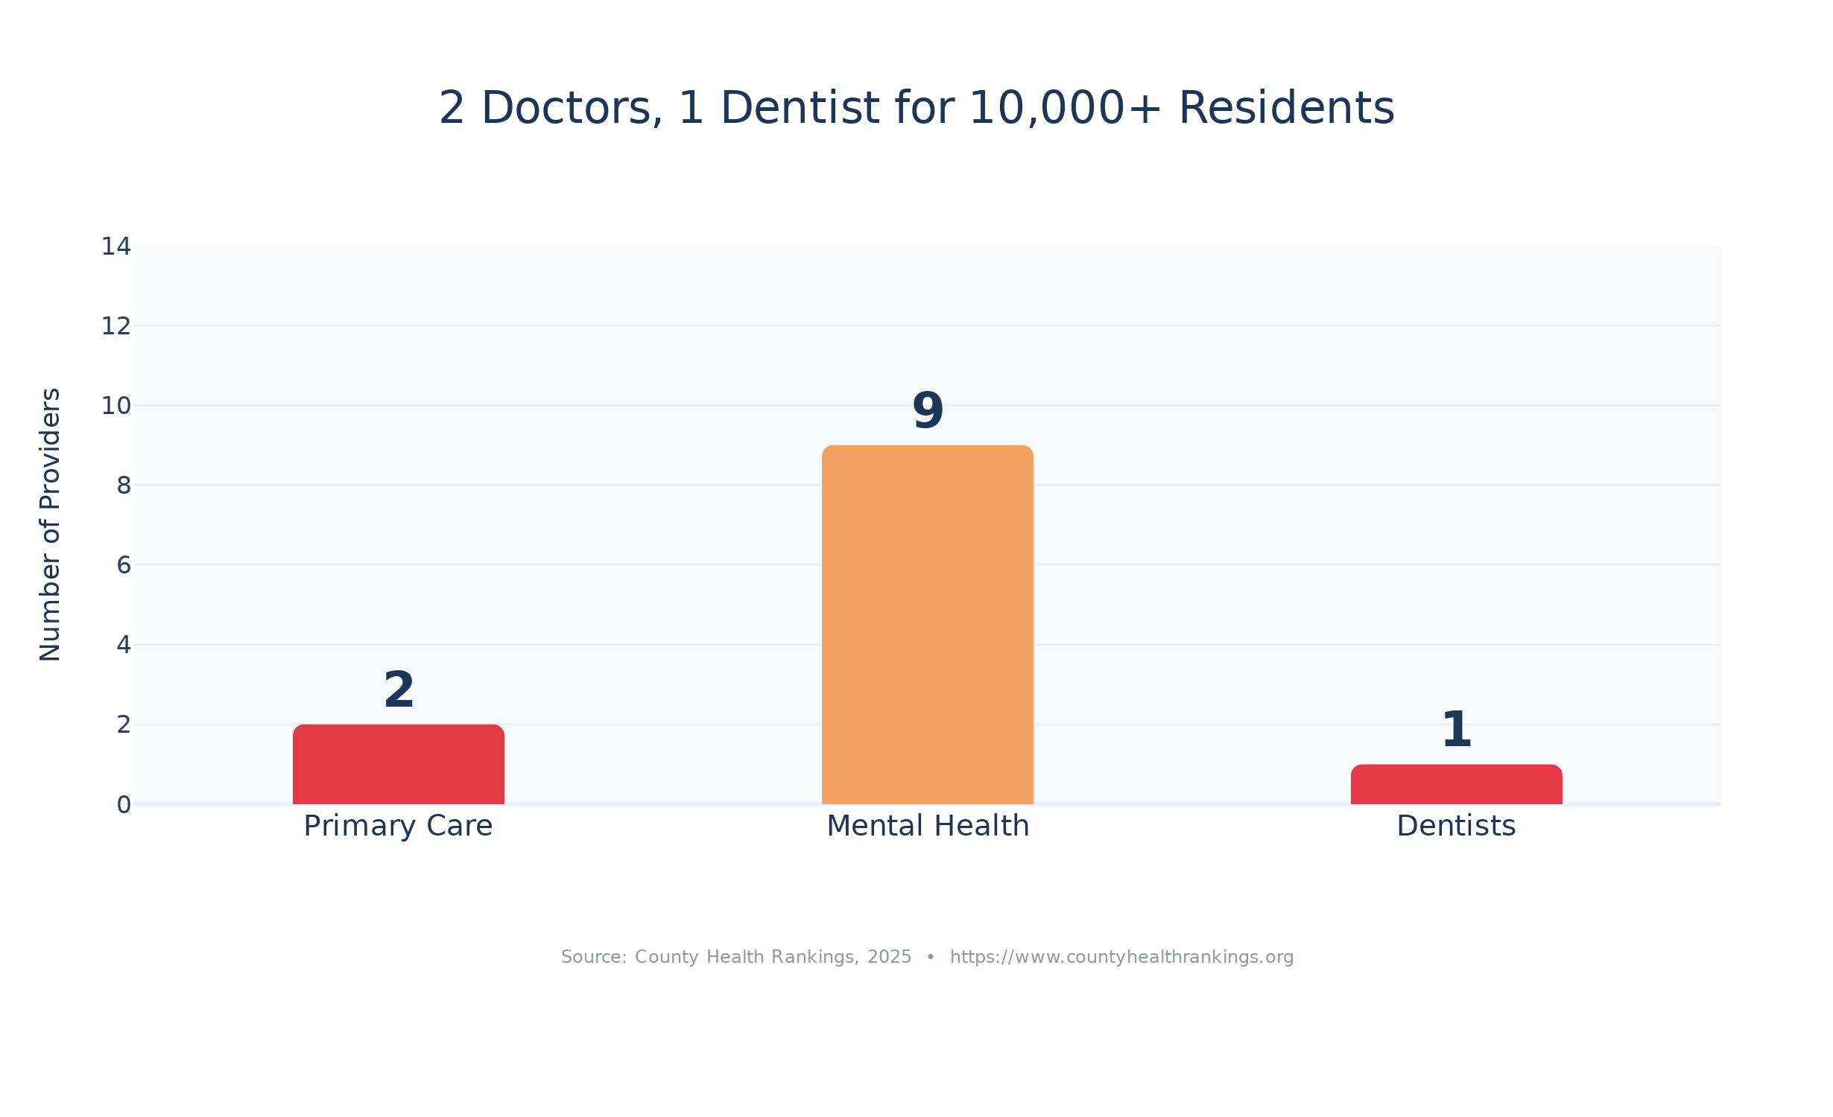
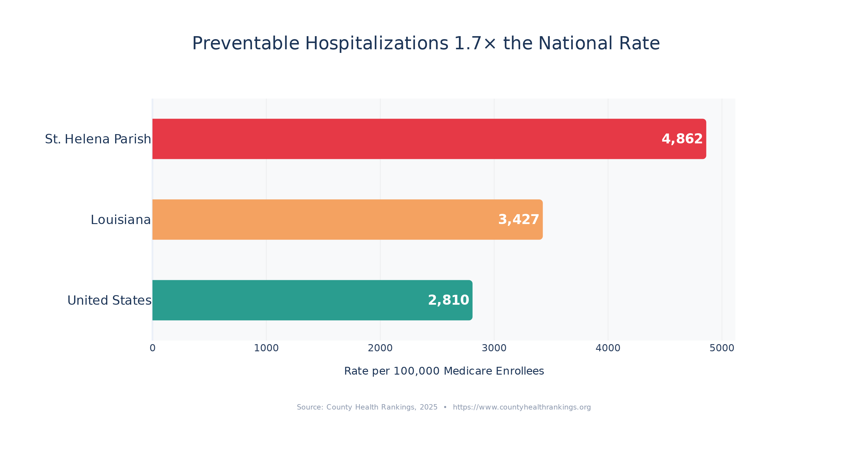
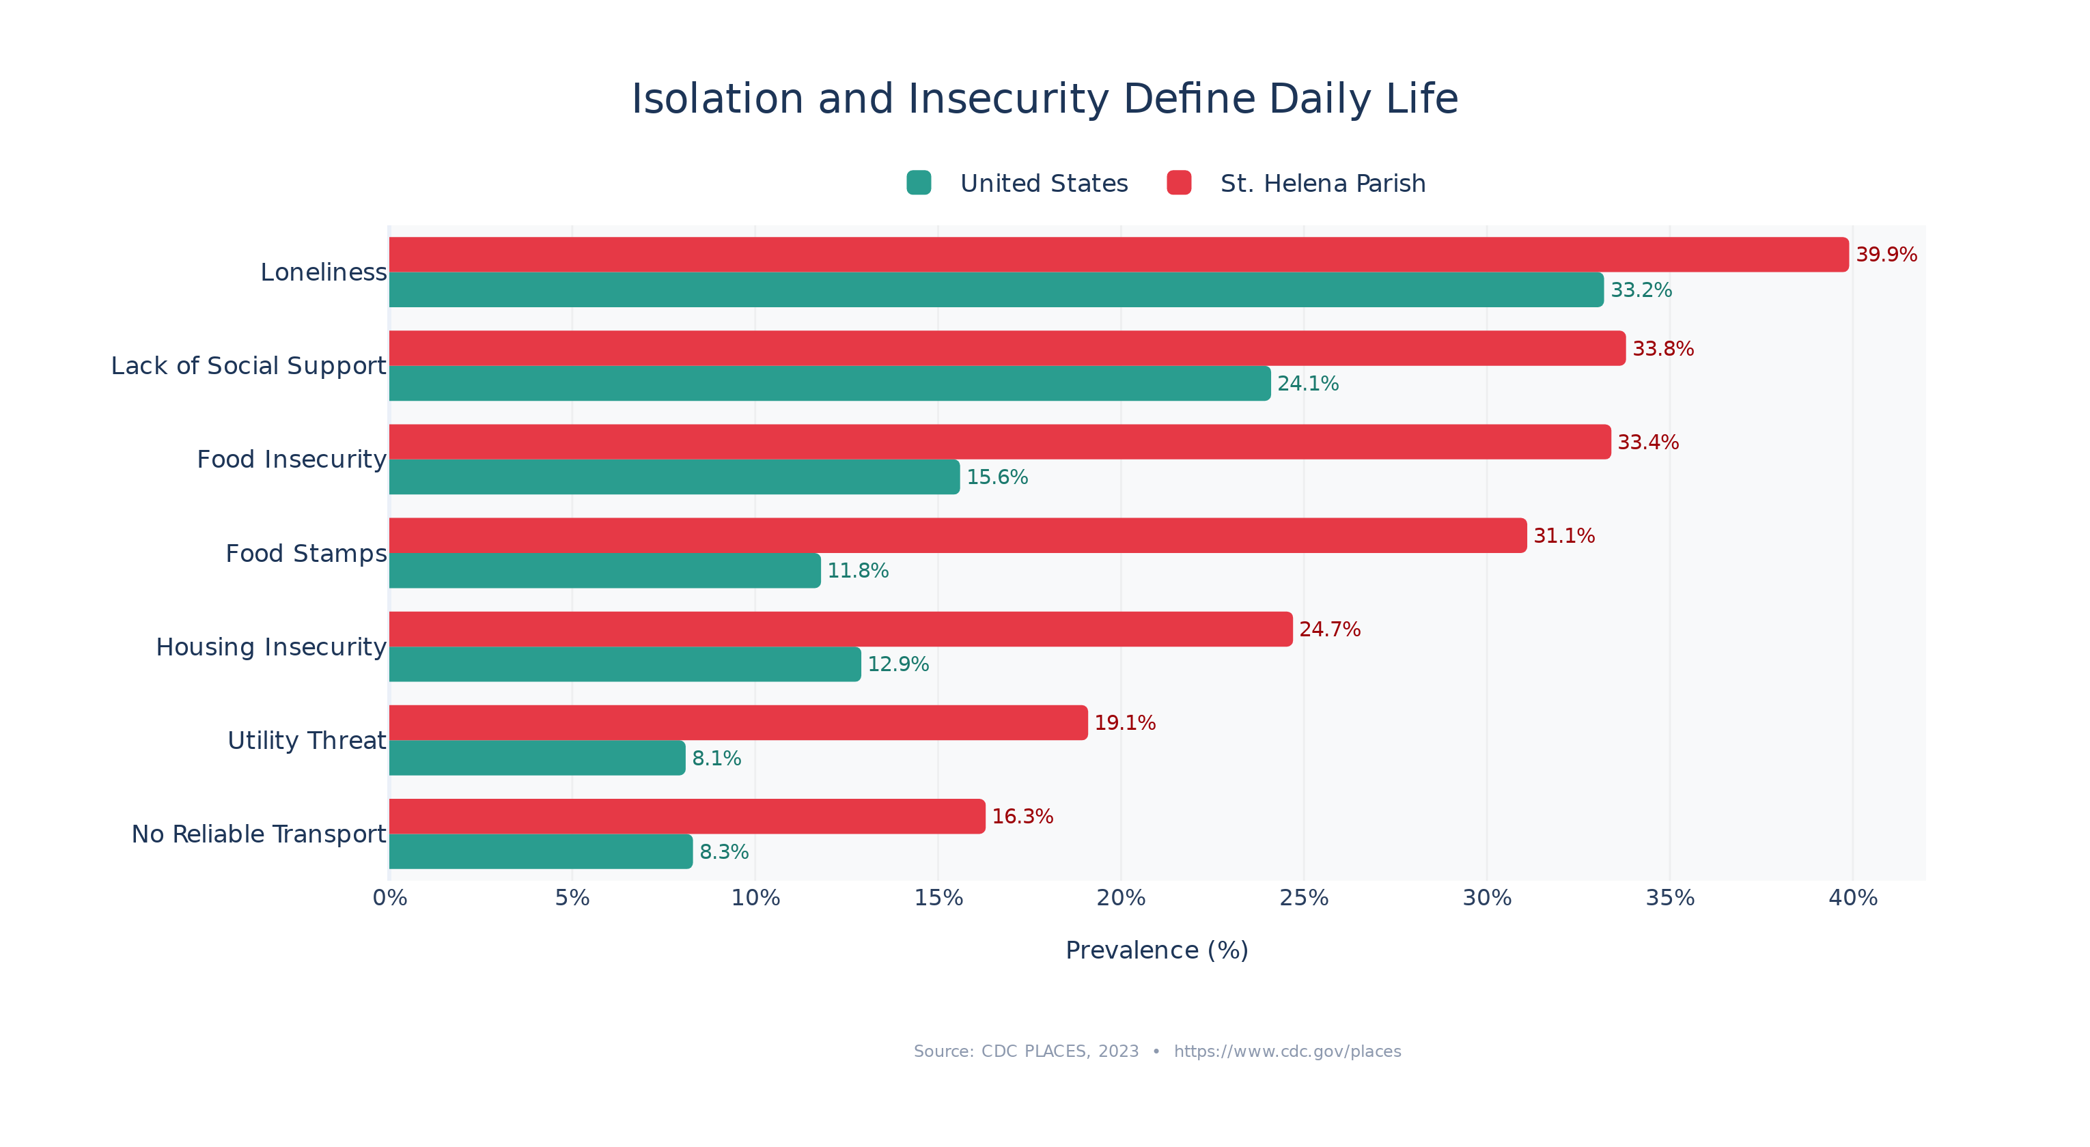
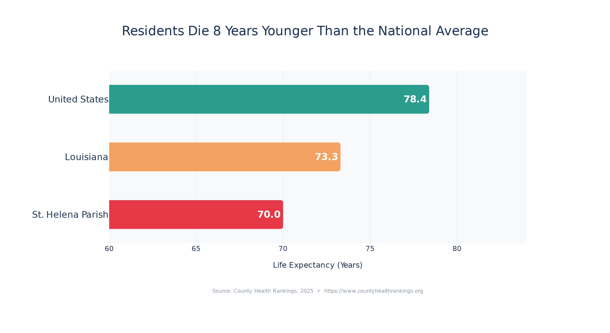
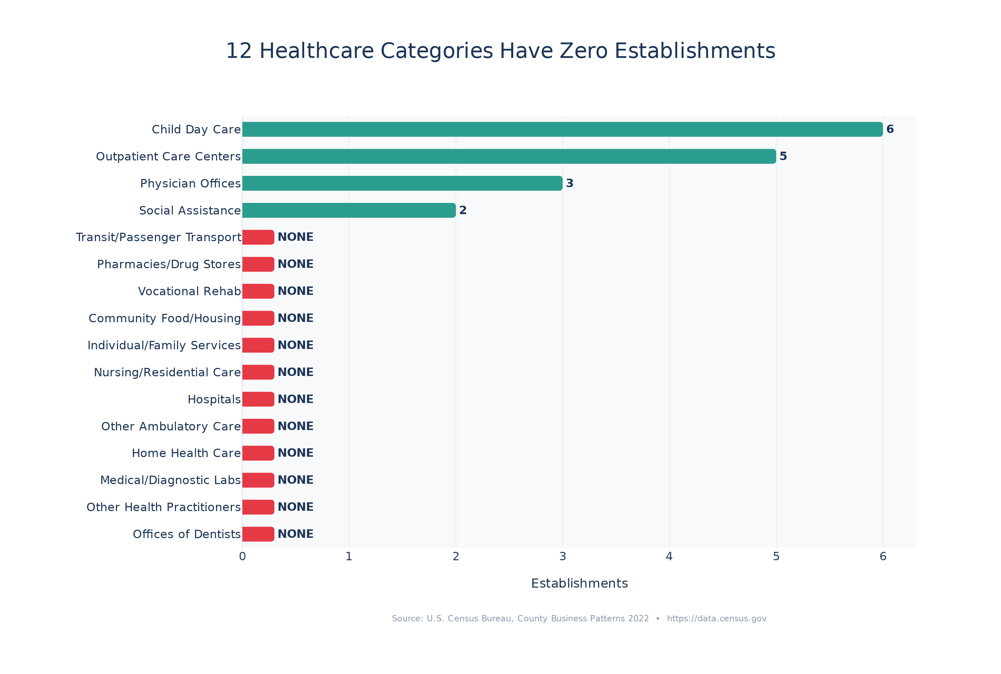
Key Findings: Healthcare Desert
Disease Burden, Provider Shortages & Preventable Hospitalizations
6/11

Slide 7
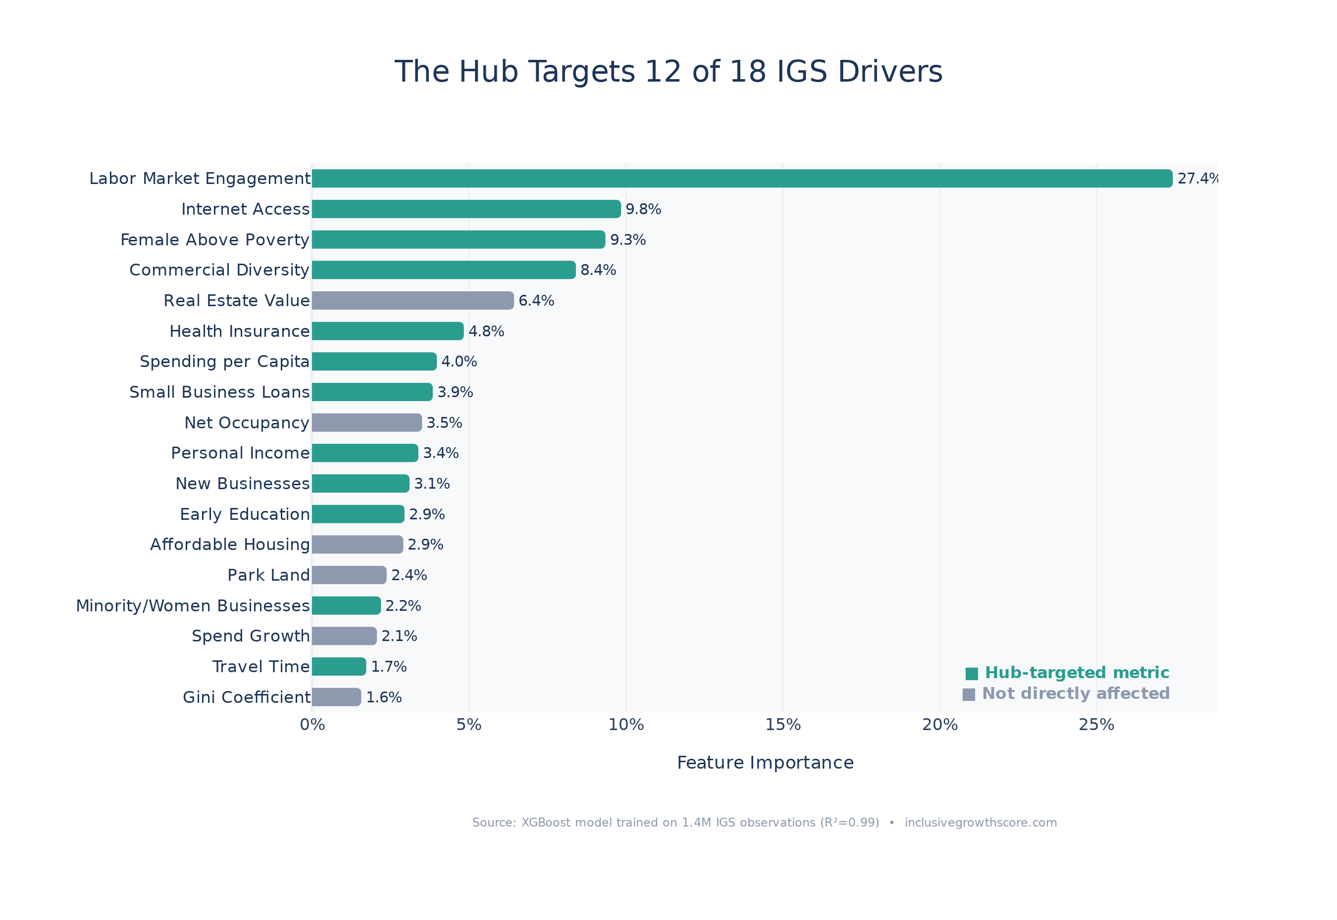
Proposed Solution: Community Hub Marketplace
One Hub. Multiple IGS Levers.
Local Jobs: Create 25-50 jobs with employer-sponsored health insurance
Broadband Center: Free WiFi + computer lab (internet: 3rd to 23rd percentile)
Pharmacy & Clinic: First pharmacy in parish; telehealth clinic referrals
Small Business Incubator: Vendor stalls, shared kitchen, SBA loan help
Fresh Food Market: Local produce combating 33.4% food insecurity
Daycare & After-School: Enabling workforce participation for parents
Digital Services: Job portal, government kiosk, financial literacy
The Hub targets 12 of 18 IGS drivers
Source: XGBoost model feature importance trained on 1.4M IGS observations
7/11

Slide 8
Implementation Plan
Year 1: Foundation
Year 2-3: Growth
Year 4-5: Scale
Secure facility (repurpose vacant commercial building)
Launch broadband center + digital services kiosk
Open fresh food market with local produce
Partner with FQHCs for telehealth clinic
Begin SBA loan outreach for vendors
Recruit pharmacy operator
Expand to 15-20 vendor stalls
Launch daycare / after-school program
Employer insurance for all Hub employees
Digital literacy & job training programs
Hub reaches 40-50 employees with benefits
Second location or mobile Hub
Mentor businesses to independent storefronts
Community health worker program
Target: IGS above 45 threshold
Key Stakeholders
St. Helena Parish Government | SBA | USDA Rural Development | FQHCs | Mastercard Center for Inclusive Growth
Risks & Mitigations
Low foot traffic: mitigate with anchor tenants + essential services
Funding gaps: mitigate with USDA grants + New Market Tax Credits
Workforce readiness: mitigate with on-site training programs
8/11

Slide 9
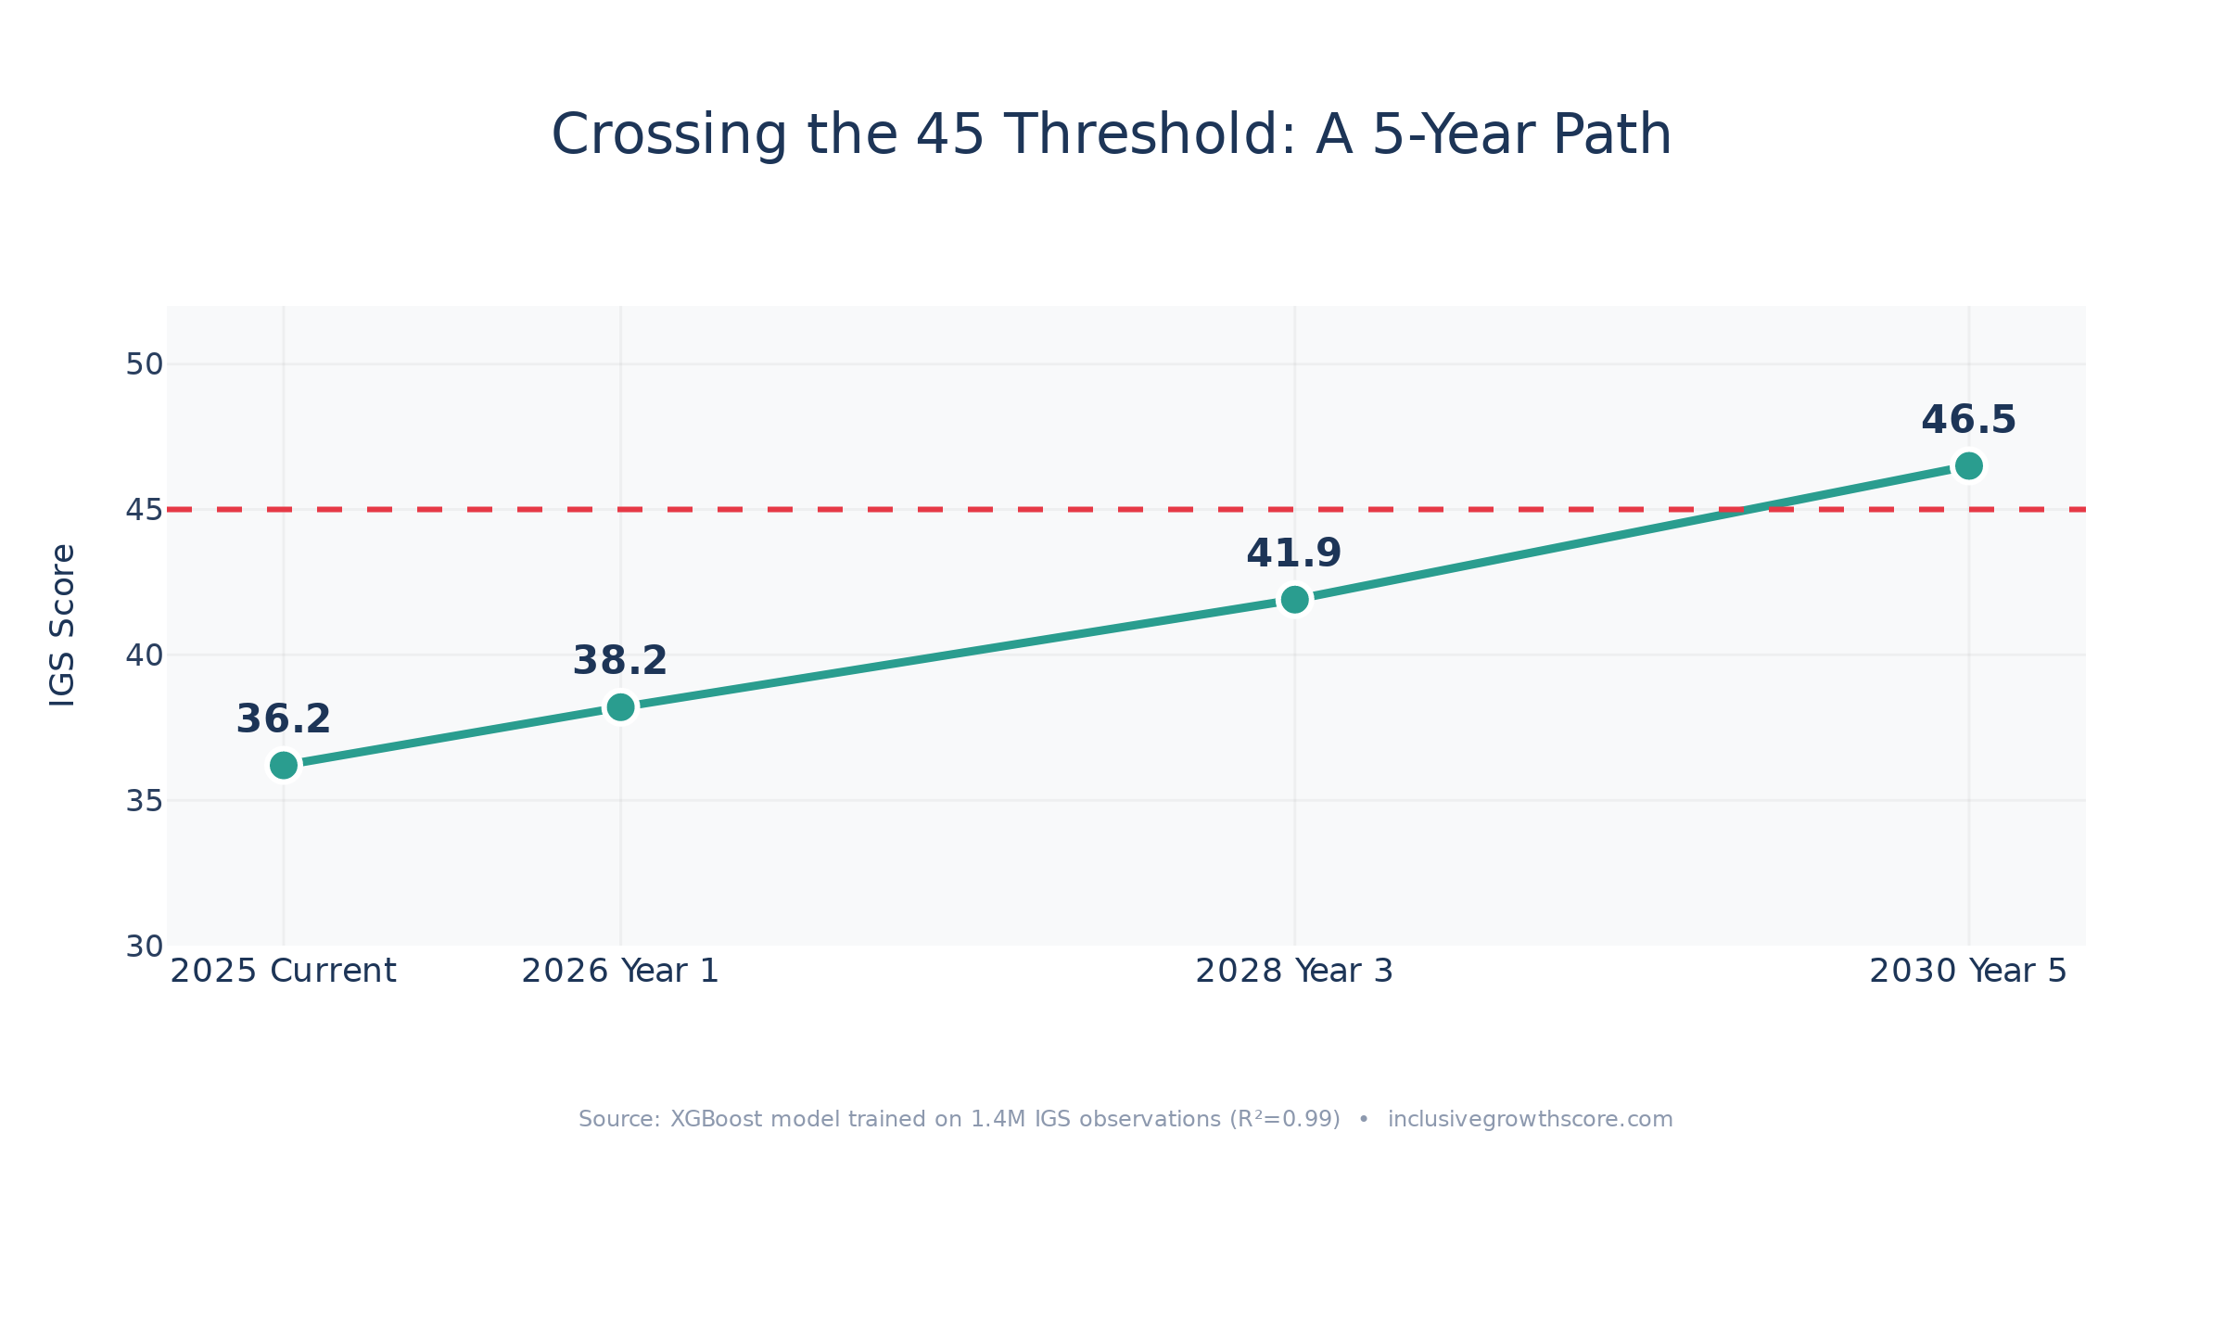
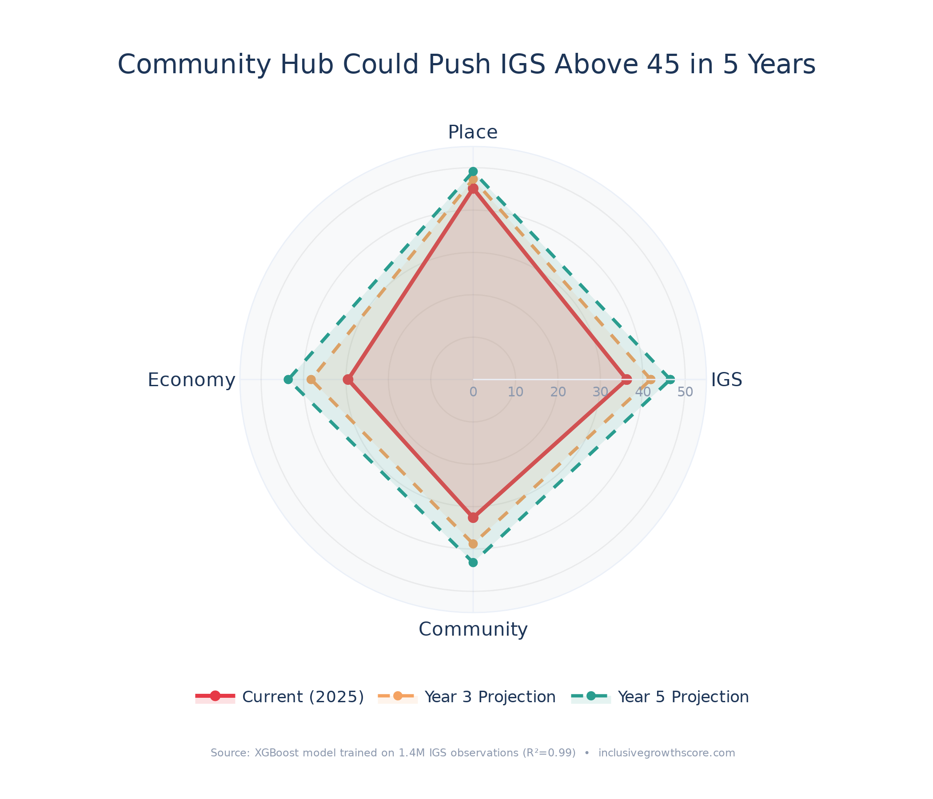
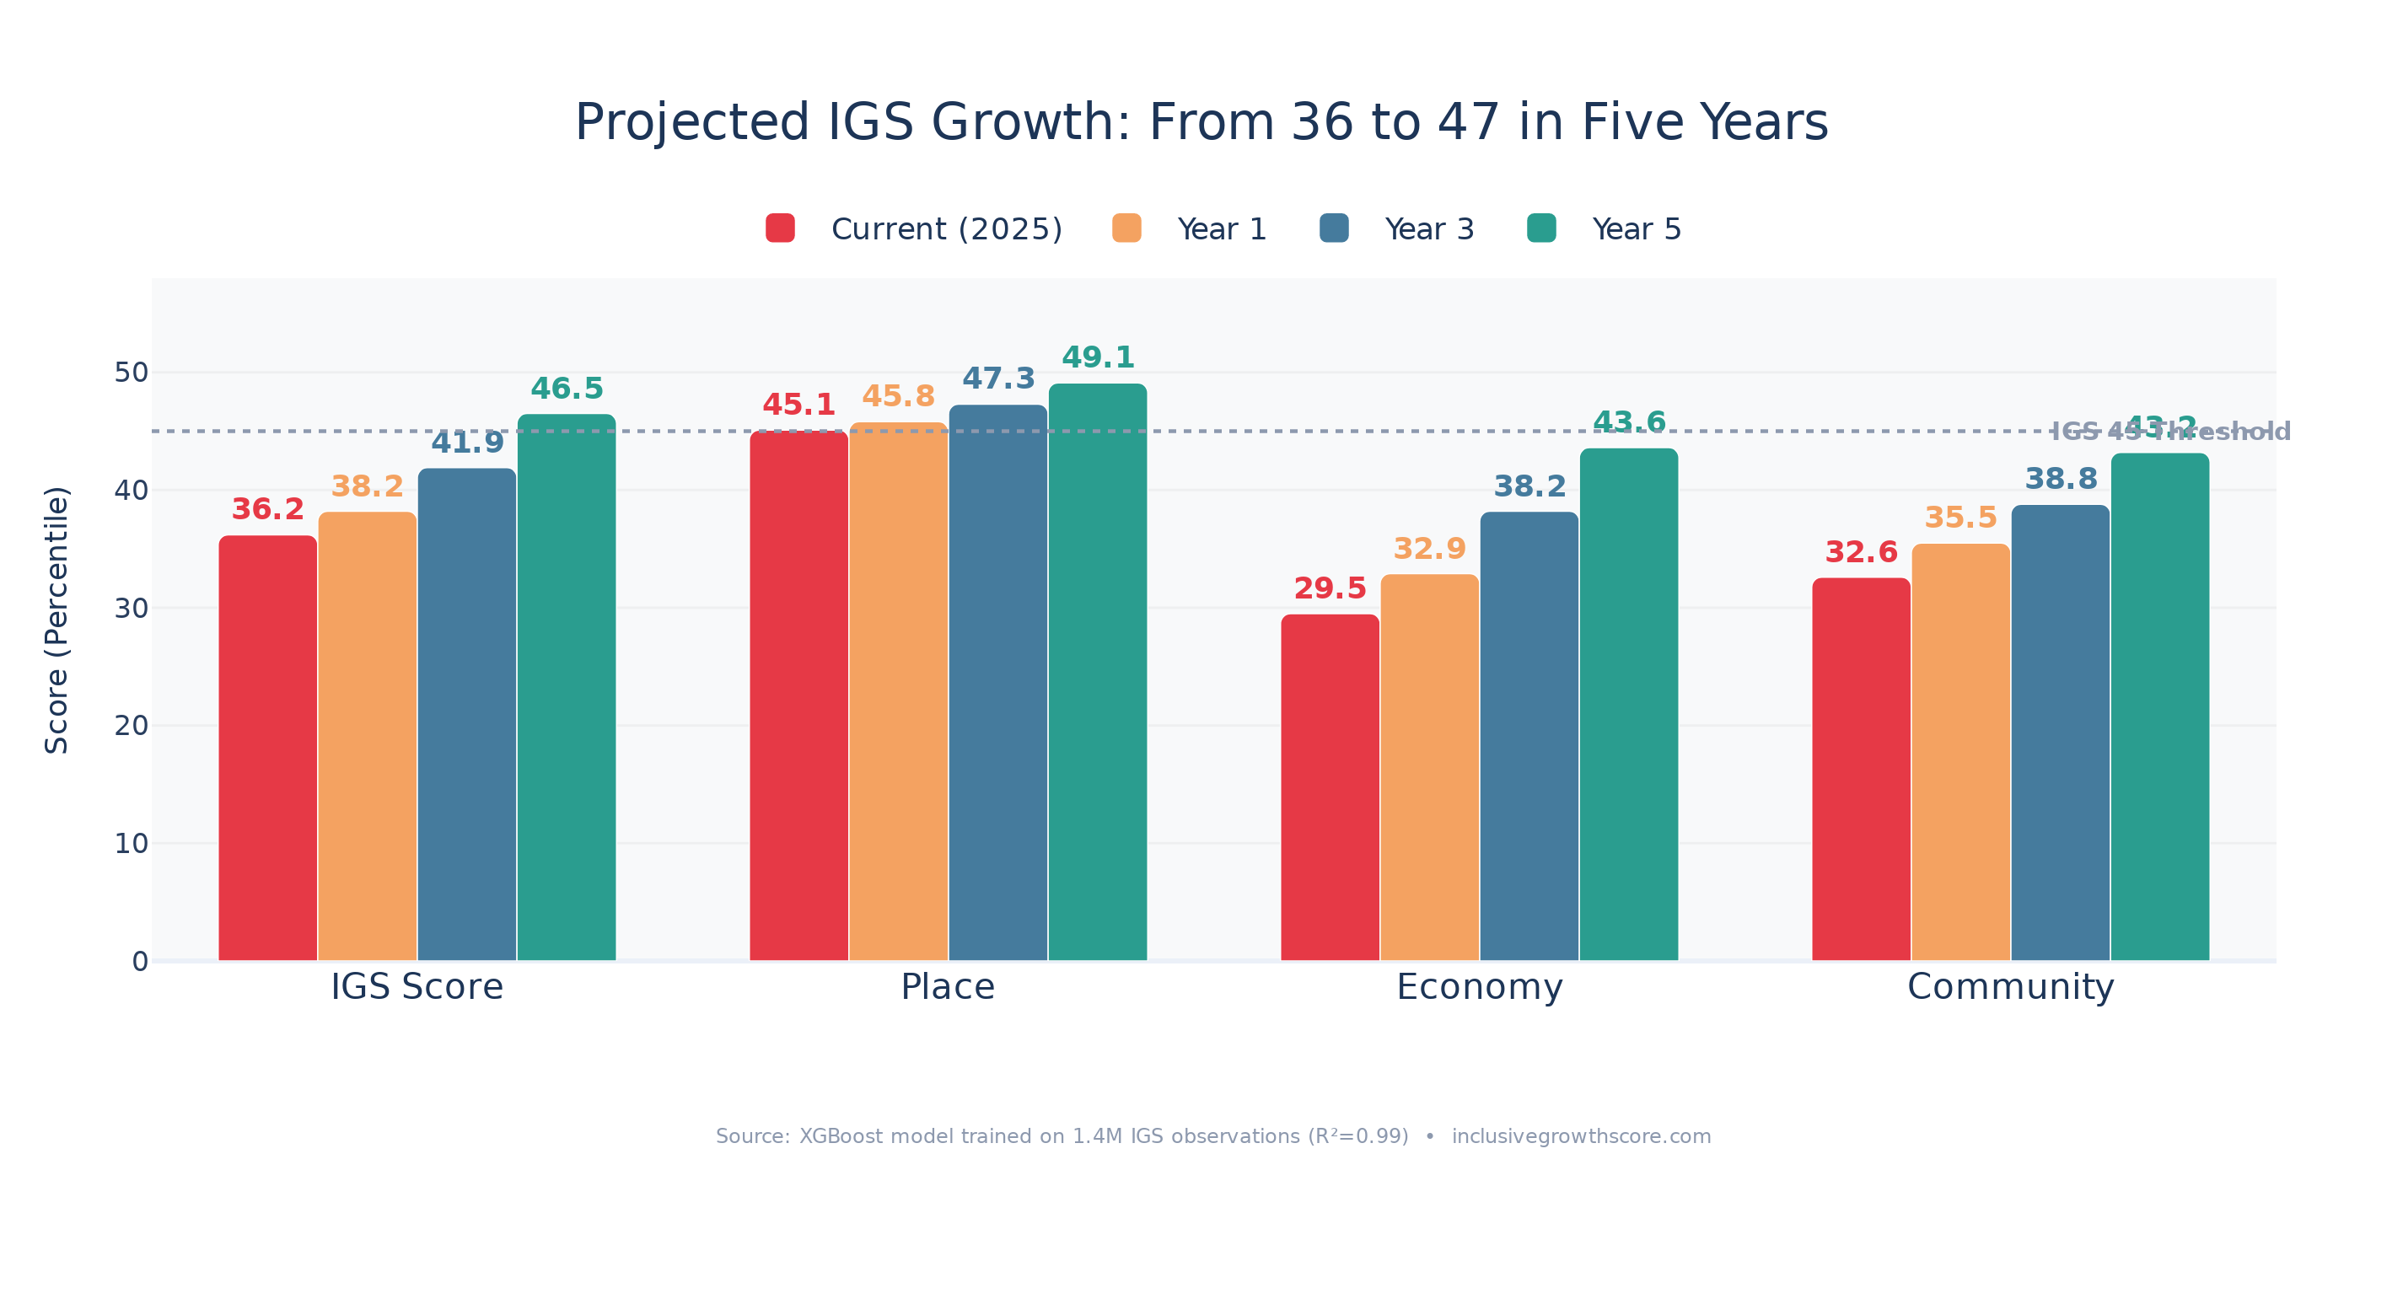
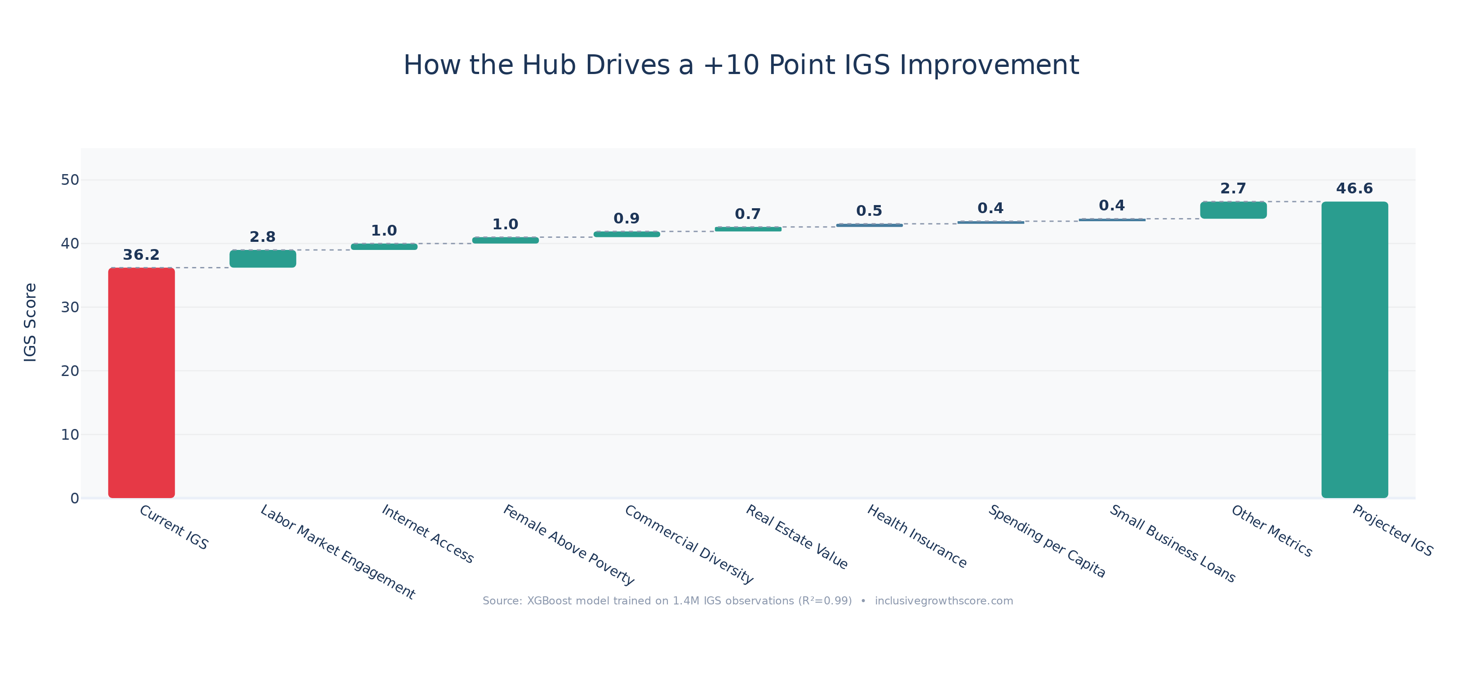
Predicted Outcomes
XGBoost Model (R-squared=0.99) trained on 1.4M IGS observations across 85K tracts
9/11

Slide 10
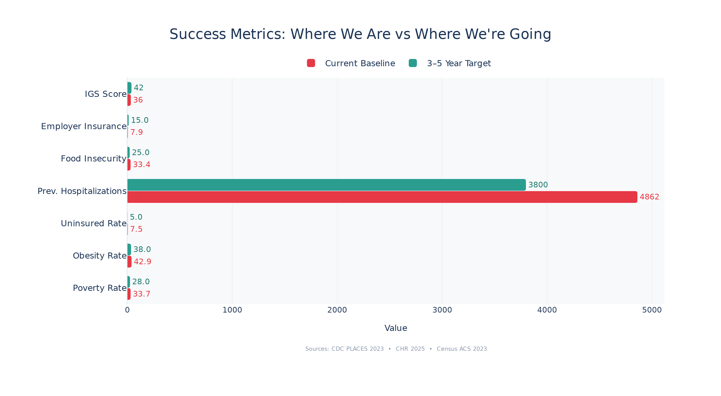
Metrics for Success
Indicators to Track Long-Term Impact
IGS Score: 36 to 45+ (primary outcome, model-validated)
Employer Insurance Rate: 7.9% to 25% (Hub jobs with benefits)
Labor Participation: 50.9% to 60% (local job creation)
Internet Access: 3rd to 25th percentile (broadband center)
Commercial Diversity: 34th to 54th percentile (new business sectors)
Preventable Hospitalizations: 4,862 to 3,500 per 100K (local healthcare)
Food Insecurity: 33.4% to 20% (fresh food market)
Source: XGBoost simulation + Census ACS + CDC PLACES + County Health Rankings
10/11

Slide 11
Conclusion
St. Helena Parish does not need charity -- it needs infrastructure. The Community Hub Marketplace is that infrastructure.
One intervention targeting 12 of 18 IGS drivers simultaneously
XGBoost model (R-squared=0.99) projects IGS from 36 to 46.5 in 5 years
Crossing the 45 threshold -- answering the challenge question directly
Employer insurance alone could 3x coverage (7.9% to 25%)
10 real Louisiana tracts already at our Year 3 target -- this is achievable
Every dollar spent locally recirculates -- the Hub creates a virtuous cycle
Team DataRx
AUC Data Challenge 2026 | St. Helena Parish, Louisiana
11/11

