Slide 1
Pattern Recognition and Machine Learning assignment
January 2025
Group 40
Fotiadis Konstantinos
Bakoulas Epameinondas

Slide 2
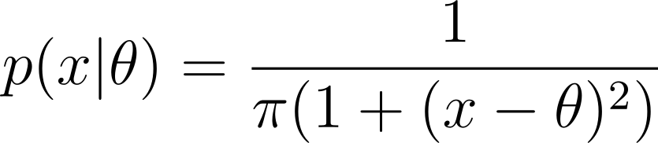
Part A - A1
Our goal is to build a Maximum Likelihood Classifier (MLE) to estimate the θ parameters of the pdf function
for each class ω1 (no stress) and ω2 (stress) given the samples D1 and D2.

Slide 3
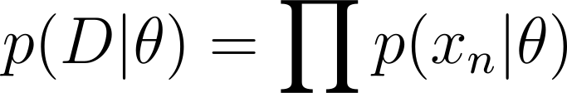

Part A - A1
The likelihood is given as
but since the logarithm is a monotonically increasing function, we will use the log-likelihood which is given as

Slide 4
Part A - A1
In order to find the θ value that maximizes the log-likelihood (and the likelihood), we will pass a large range of theta values and return the one that maximizes the log-likelihood.
We follow this approach since calculating the gradient of the log-likelihood is computationally difficult.
We need to select a range of theta values that will likely maximize the log-likelihood. Since our data (D1, D2) range from [-4.5, 4.1], we are going to select a slightly bigger range [-6, 6] to make sure that the theta value that maximizes the log-likelihood is included.

Slide 5
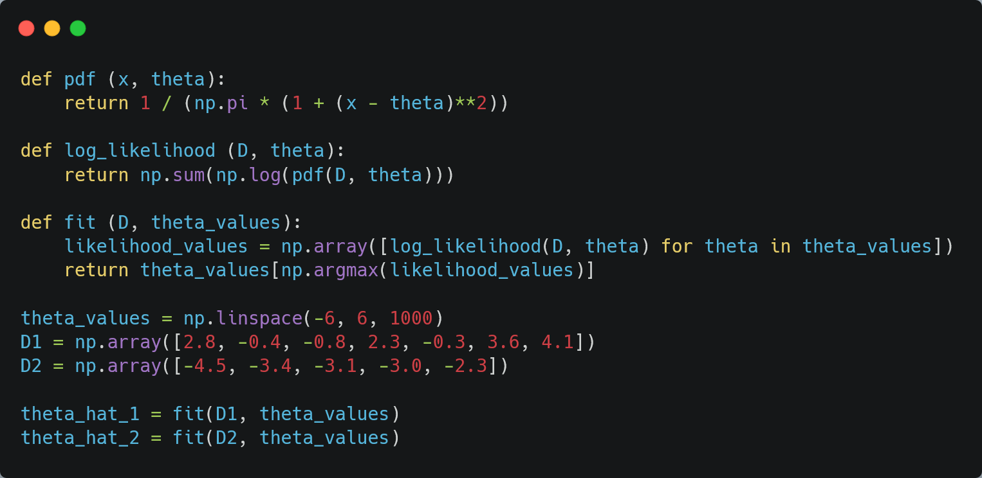
Part A - A1 Code

Slide 6
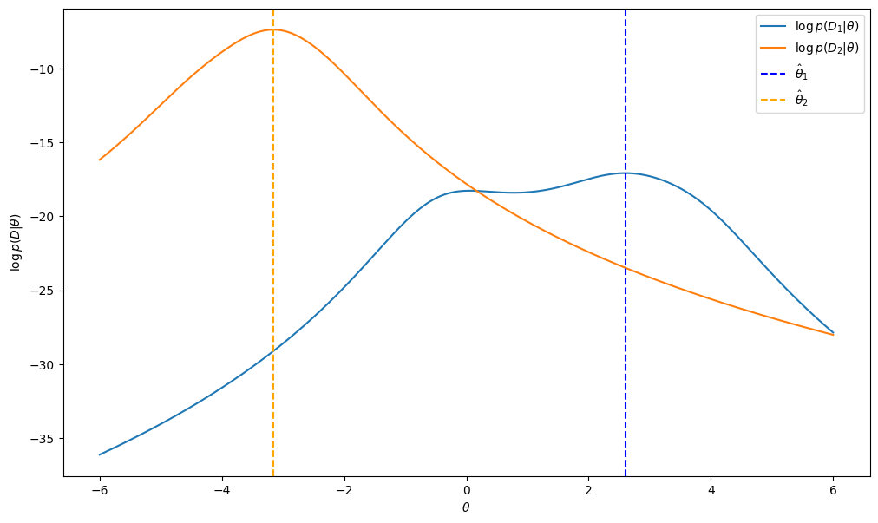
Part A - A1
Now we can plot the log-likelihood for each class and for different θ values, as well as the θ1 and θ2 values that maximizes the log-likelihoods.

Slide 7
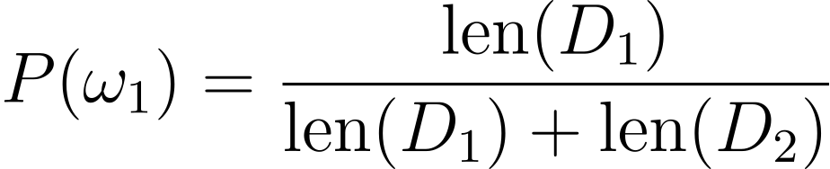
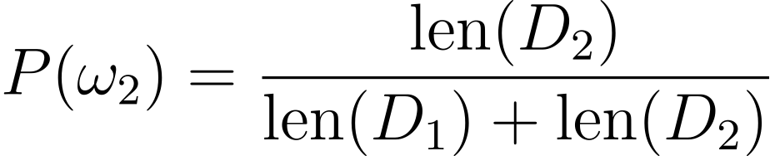
Part A - A2
Now we’re tasked with using the linear discriminant function
to classify the 2 datasets.
We will first calculate the a-priori probabilities for each class. We have 7 samples in class ω1 and 5 samples in class ω2 (12 total), so the a-priori probabilities are calculated as:

Slide 8
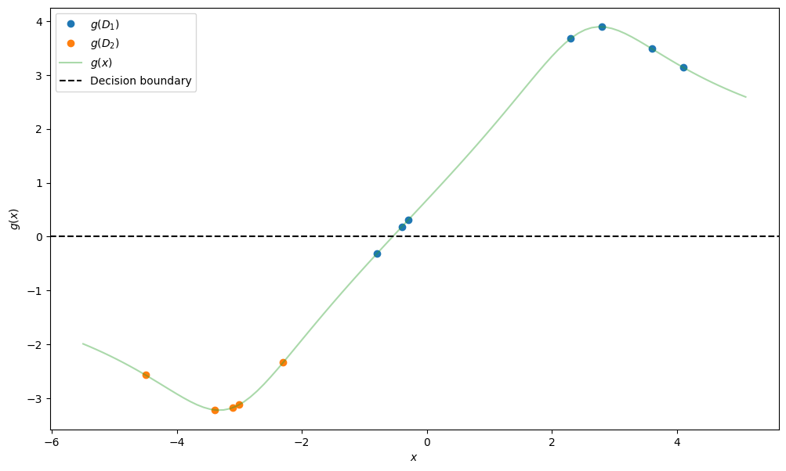
Part A - A2
We can now calculate all of the g values and plot them. The decision boundary is g(x) = 0

Slide 9
Part A - A2
For the classification to be correct we need to:
- Assign x in class ω1 (no stress) if g(x) > 0
- Assign x in class ω2 (stress) if g(x) < 0
while the decision boundary is g(x) = 0.
We can clearly see that the classification is fairly accurate, since 11 out of 12 points are classified correctly. Only one point from class ω1 is not classified correctly.
We could try to change the discriminant function so it achieves perfect classification of our samples, but this might lead to overfitting which is not desirable since the model might not generalize well and thus perform poorly on different sample data.

Slide 10
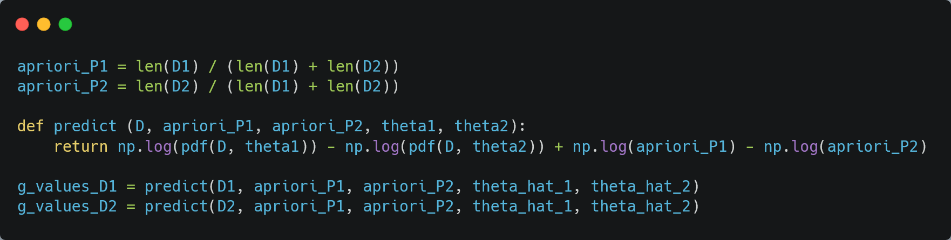
Part A - A2 Code

Slide 11
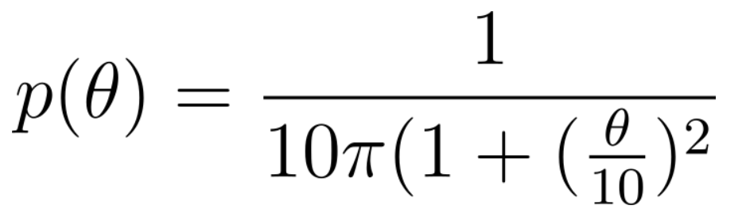
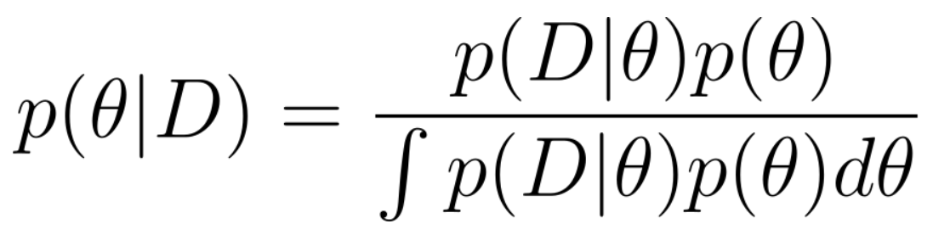
Part B - B1
In this part we will make a Bayesian estimator. Firstly we calculate the posterior and the prior probabilities.
Prior Posterior

Slide 12
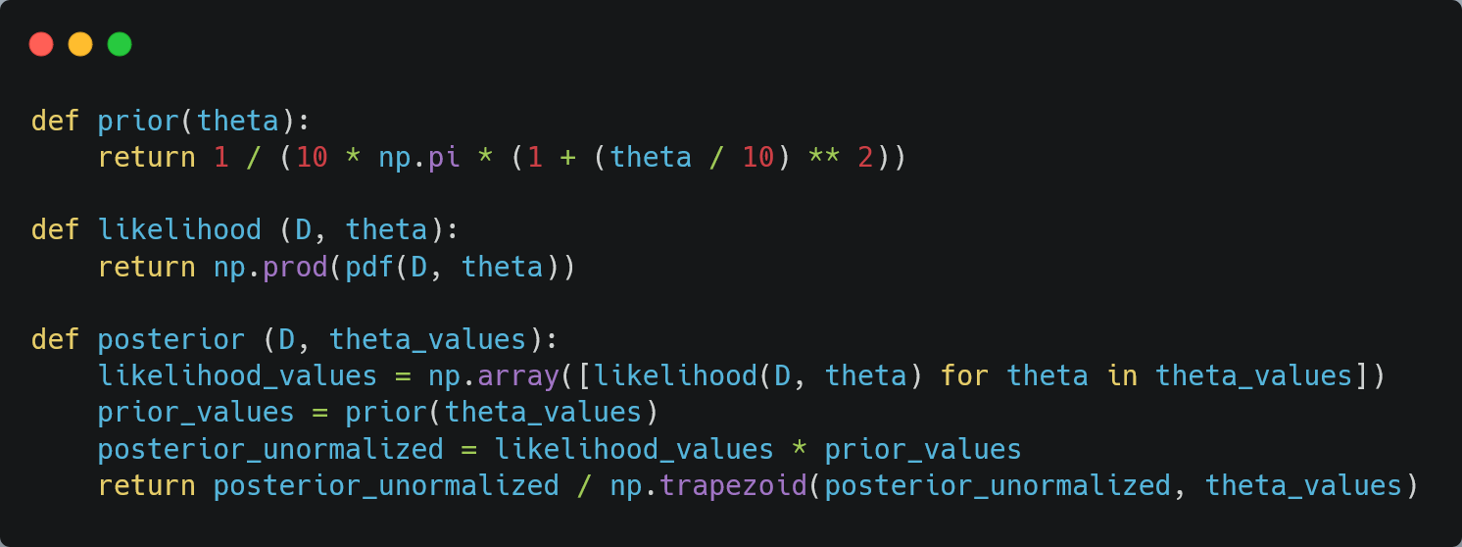
Part B - B1 Code

Slide 13
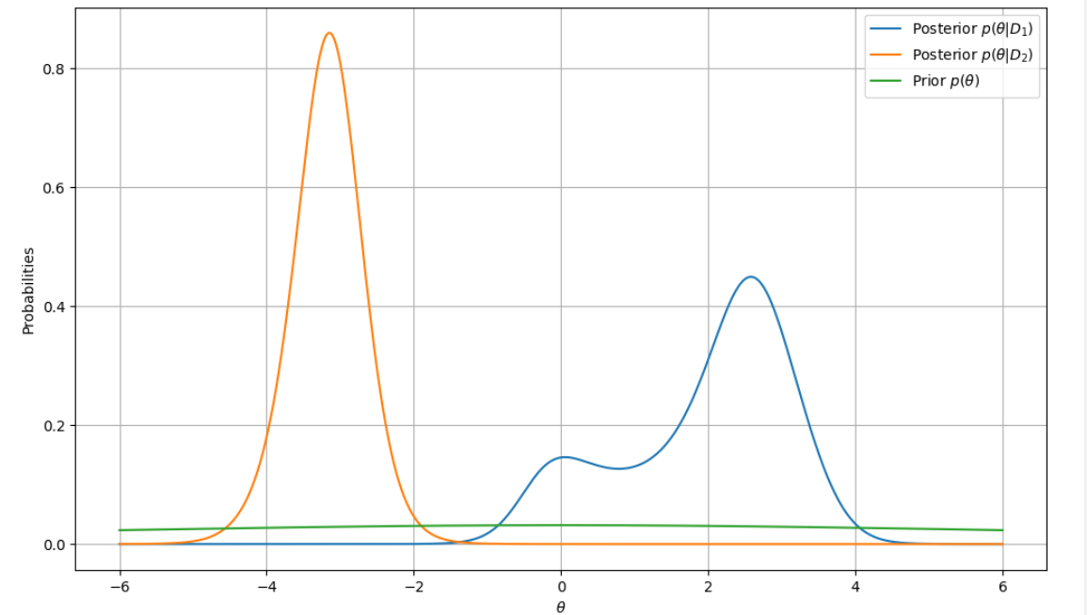
Part B - B1
Now we can plot the the prior and posterior probabilities.

Slide 14
Part B - B1
We can clearly see that the prior pdf p(θ) is spread out compared to the posterior distributions. This is due to the fact that it is less informed and shows no preference to a specific θ value.
Comparatively, the posterior distributions show clear peaks (at 2.5 for D1 and -3.2 for D2), which means that our sample data D1 and D2 influence our decision on selecting the optimal θ values.

Slide 15

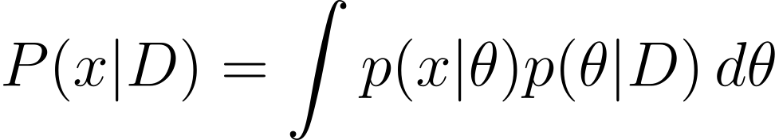
Part B - B2
We will now implement the predict function which is given as:
where is calculated by the integral:

Slide 16
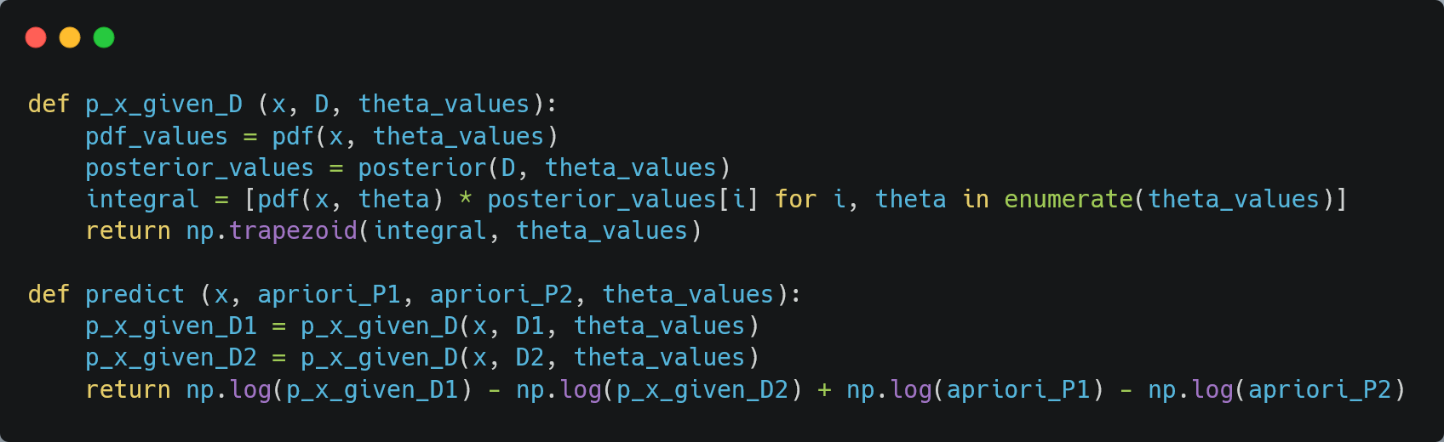
Part B - B2 Code

Slide 17
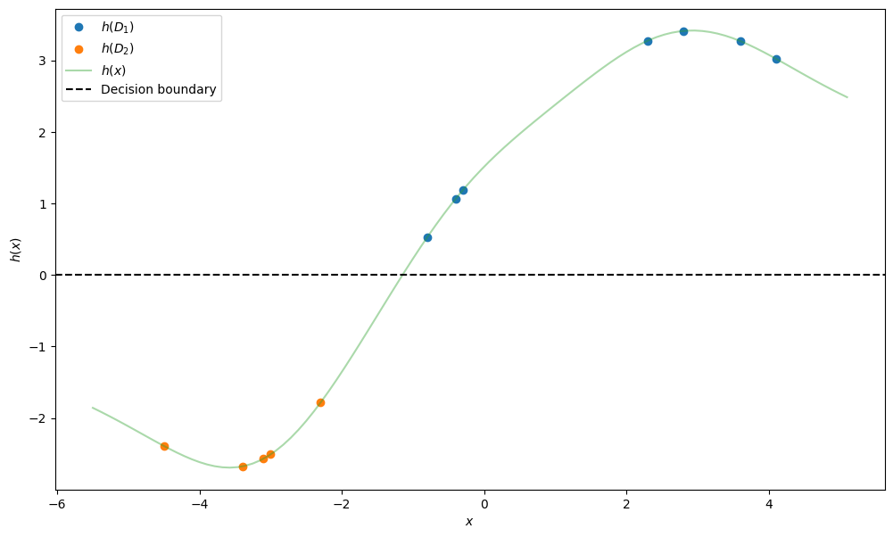
Part B - B2
We can now plot the predict function h(x). The decision boundary
is again at h(x) = 0.

Slide 18
Part B - B2
This time the classification achieves 100% accuracy, since for each point in the dataset D1 we have h(x)>0 and for the points in dataset D2 we have h(x)<0.
The Bayesian Estimation seems like the better approach since it incorporates the prior knowledge about the parameter θ through the prior distribution p(θ), leading to better parameter estimations. In contrast, the MLE only relies on our dataset and tries to maximize the likelihood p(D|θ), without taking into account any information about the prior distribution of our parameter θ.

Slide 19
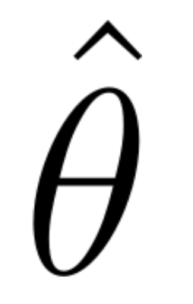
Part B - B2
The BE accounts for all possible values of θ compared to MLE that estimates a single point that maximizes the likelihood.
It's important to note that the BE is a lot more computationally complex and expensive compared to MLE, so even though BE leads to better results, it might not be worth implementing in practice (especially for bigger multi-dimensional problems).

Slide 20
Part C - C1.1
In this section we will train the Decision Tree Classifier algorithm with the first half of the first 2 features from the Iris dataset and then use it to classify the other half.
We will first iterate over the depth values [1,15] in order to find optimal depth that provides the best accuracy. The depth and accuracy values are saved in an array to plot them later on.
For each depth, we create a new DecisionTreeClassifier and we fit the training data. Then, the model predicts the labels for the test dataset and calculates the accuracy using the accuracy_score function. If the accuracy is higher than the previous best accuracy, we update best_accuracy and best_depth with the new values.

Slide 21
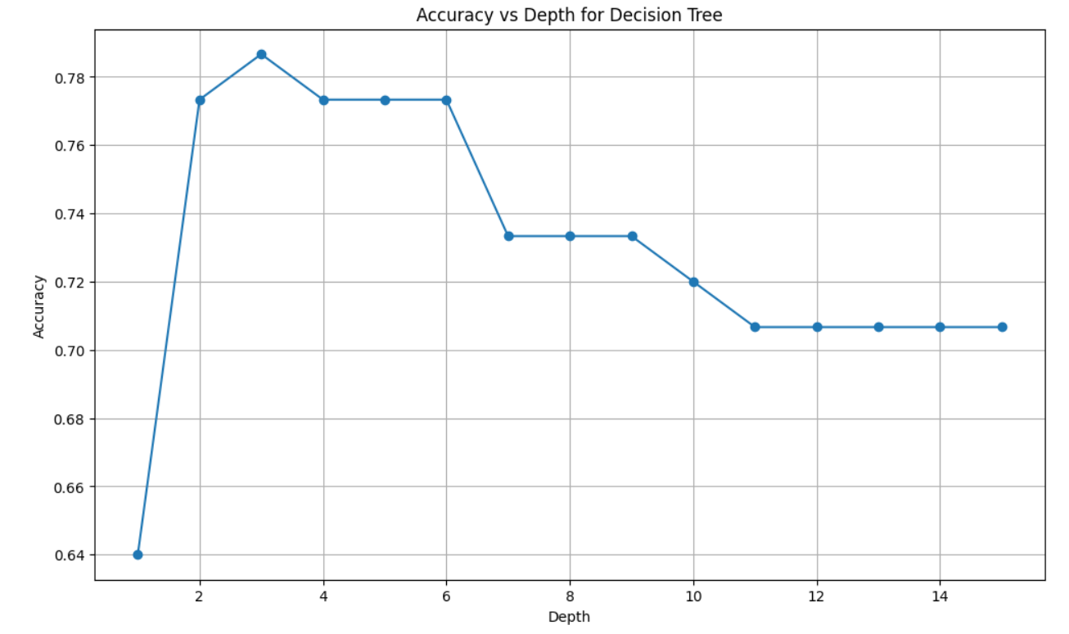
Part C - C1.1
Now we are going to plot the accuracy for each depth value.

Slide 22
Part C - C1.1
We can clearly see that the highest accuracy is for depth=3 with a value of 0.7866. The accuracy has a significant drop at depth=7, indicating that there's overfitting and the model fails to generalize. Thus, it is unable to perform well on unseen data.
In our case the training set is relatively small (150 samples) so large depth values are not suitable. Keeping the depth to low values between 2−5 is great option if we want to avoid both overfitting and underfitting.

Slide 23
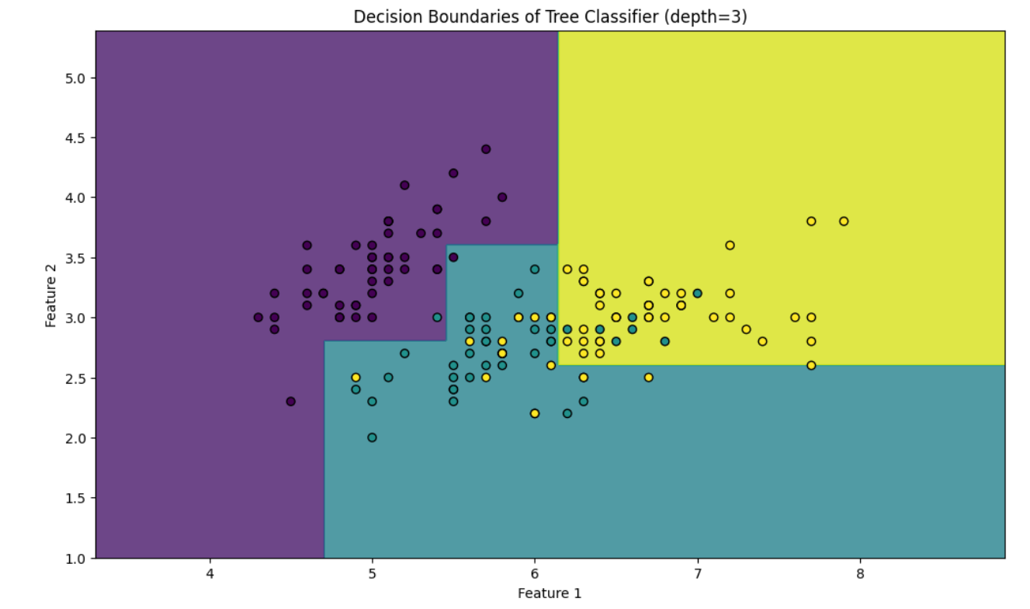
Part C - C1.2
Displaying the decision boundaries for our best depth (=3) and the points from both the training and test sets, we can see that the model is neither overfitting or underfitting.

Slide 24
Part C - C2.1
In this section we are using Random Forest Classifier with bootstrap enabled, that creates 100 trees using 50% of the training points.
Just like before, we're going to iterate over the depth values [1,15] and for each one create a random forest with γ=0.5. Our aim is to find the depth with the highest accuracy.

Slide 25
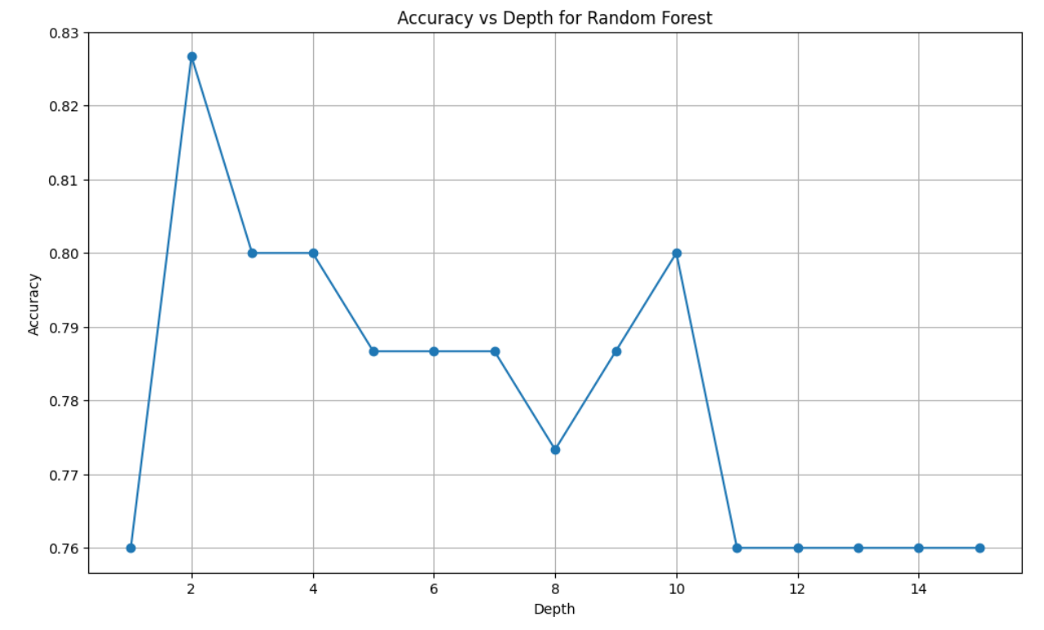
Part C - C2.1
We plot again the accuracy for each depth value.
The highest accuracy achieved with the Random Forest Classifier is 0.8266 with depth=2. From the plot we can see for higher depth values the accuracy drops since we're overfitting. For depth=1 we have underfitting since the depth is too small.

Slide 26
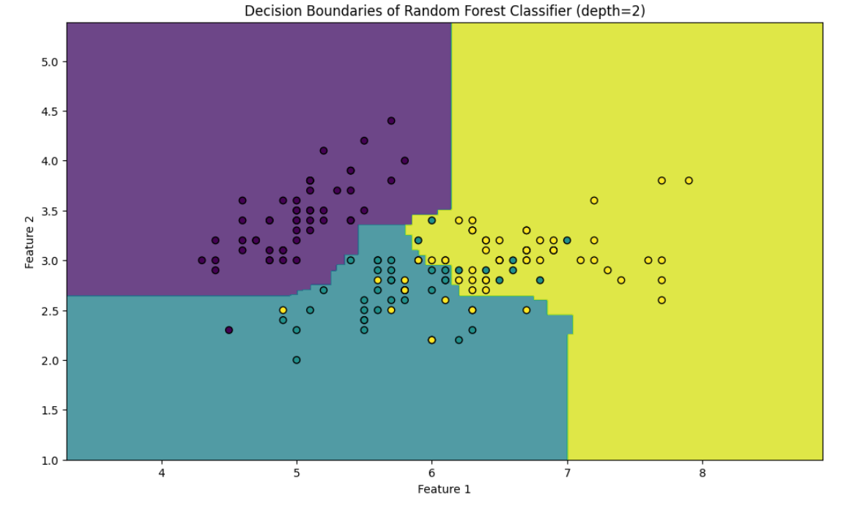
Part C - C2.2
We display again the decision boundaries for the best depth (=2).

Slide 27
Part C - C2.3
Comparing the 2 decision boundaries we can conclude that the random forest classifier with γ = 0.5 achieves higher accuracy than the single decision tree classifier.
The decision tree produces more rectangular boundaries while the random forest, by combining multiple trees, generates smoother and more flexible boundaries, better capturing complex patterns in the data. Using γ=0.5 ensures a balance between diversity and accuracy by training each tree on 50% of the data. This configuration avoids overfitting while maintaining a sufficient amount of information for accurate predictions.

Slide 28
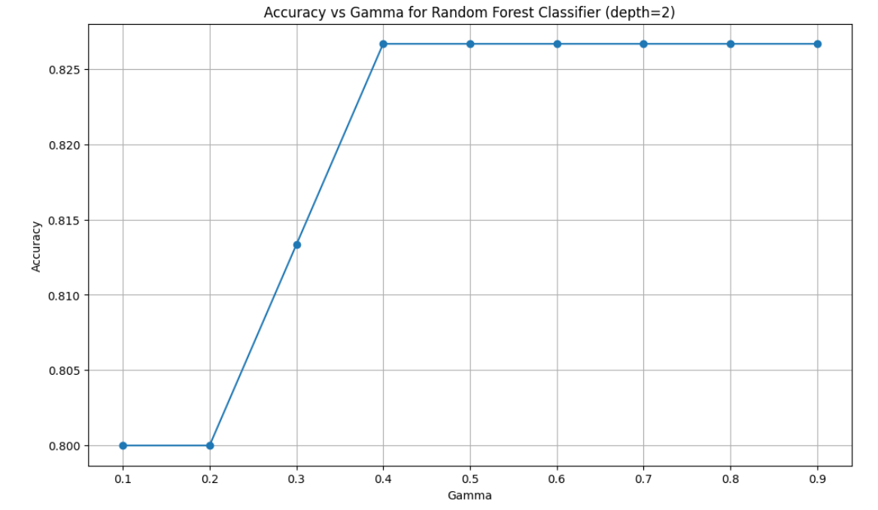
Part C - C2.3
Lastly, we're going to test the effect of γ for a specific depth value (e.g. 3) by printing the accuracy for various γ.

Slide 29
Part C - C2.3 - Effect of gamma
In our case the accuracy fluctuates between 0.8 and 0.8266, reaching its peak at γ = 40%. The accuracy stays constant after that, indicating no real preference for a specific γ value.
In general, a small γ value may lead to underfitting since we're not using a lot of samples to train the individual trees. On the other hand, we expect good results with a large γ value since we're using a lot of samples with bootstrapping. The bootstrap sampling helps maintain diversity among trees, which is key to preventing overfitting. In fact, using a larger fraction of samples often leads to more stable individual trees.

Slide 30
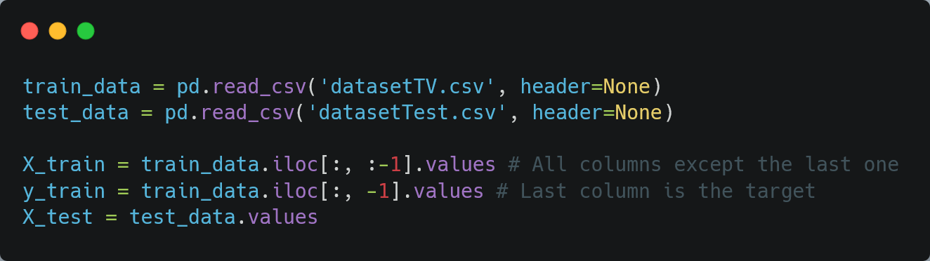
Part D
Our goal in this assignment is to train our own model in order to accurately predict the labels from a test set.
We first import the datasets into our project

Slide 31
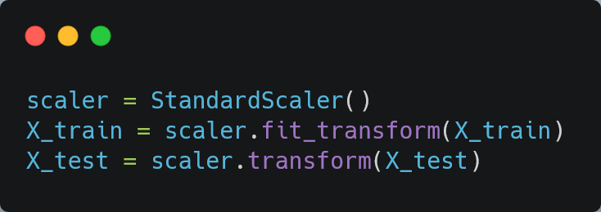
Part D
After importing, we transform the values of the features using StandardScaler to ensure that the model is not biased towards any feature. The main idea behind it is to transform our data such that its distribution will have a mean value 0 and standard deviation of 1.

Slide 32
Part D
Before we start training our models, we will do some hyperparameter tuning to find the best hyperparameters for each model.
We will use GridSearchCV for this purpose. It performs an exhaustive search over specified parameter values for an estimator. The accuracy of the model is calculated using 5-fold cross-validation.

Slide 33
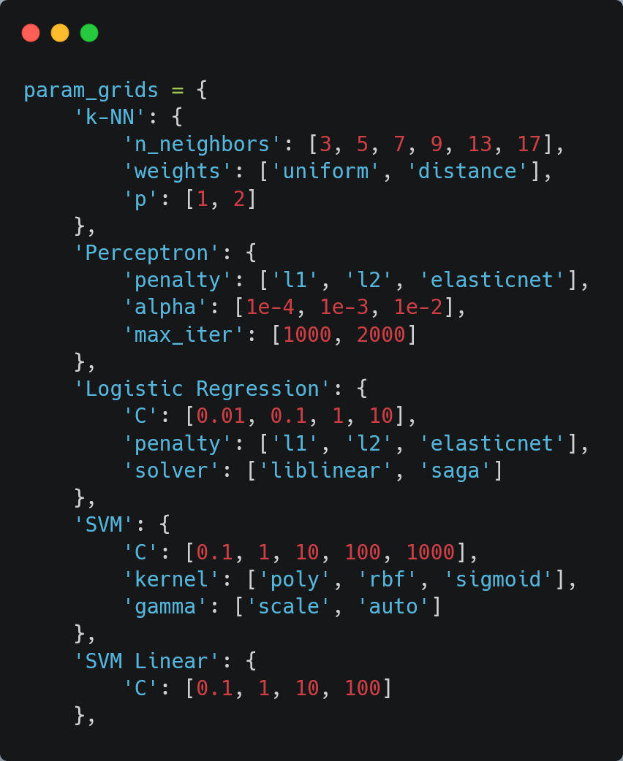
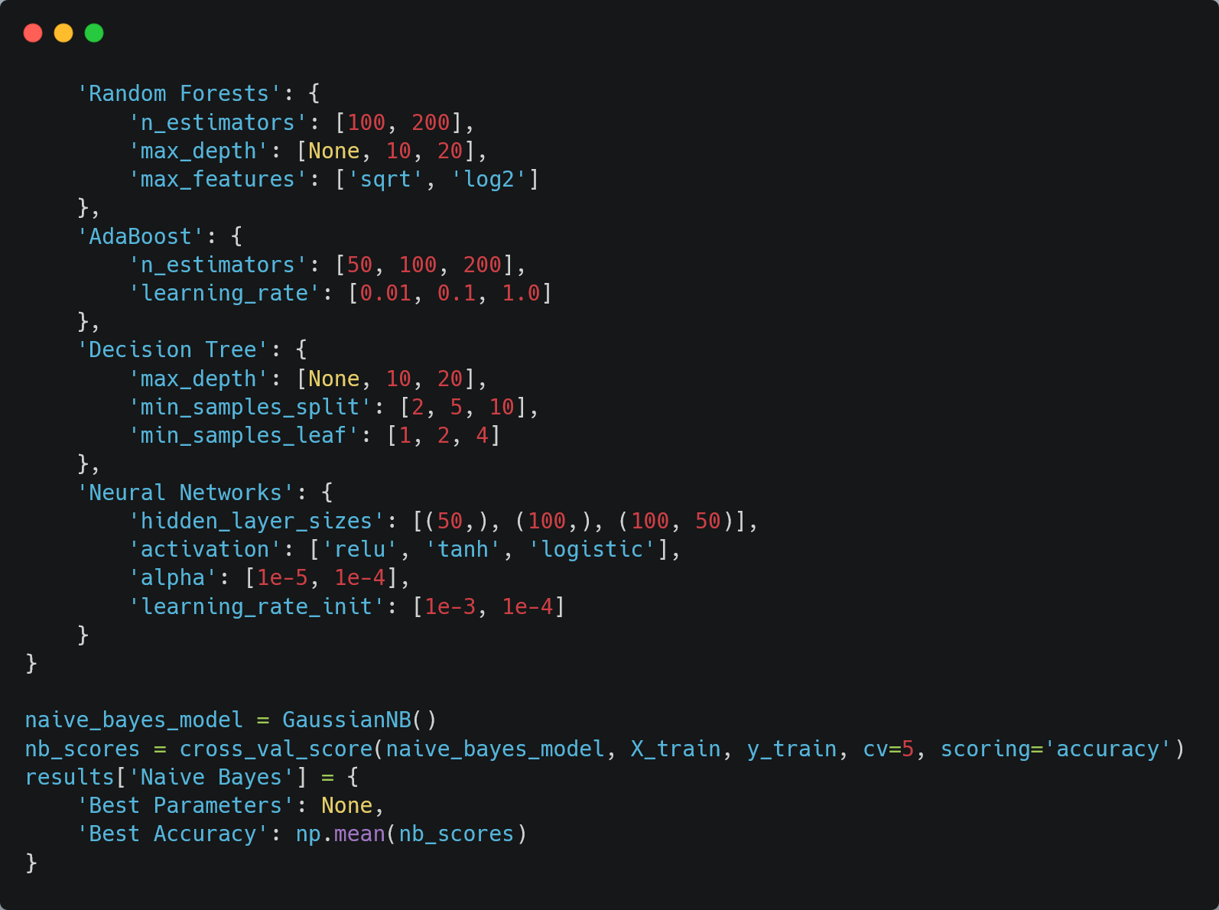
Part D

Slide 34
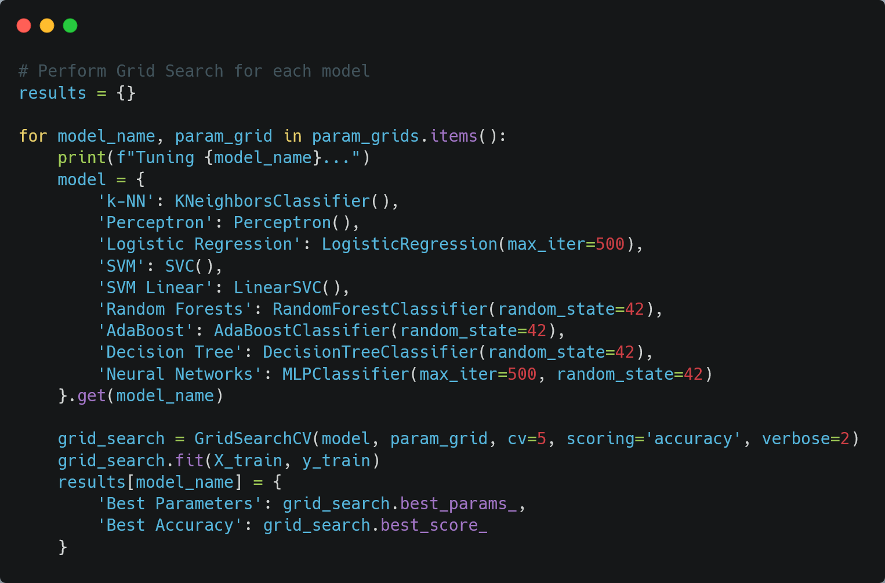
Part D

Slide 35
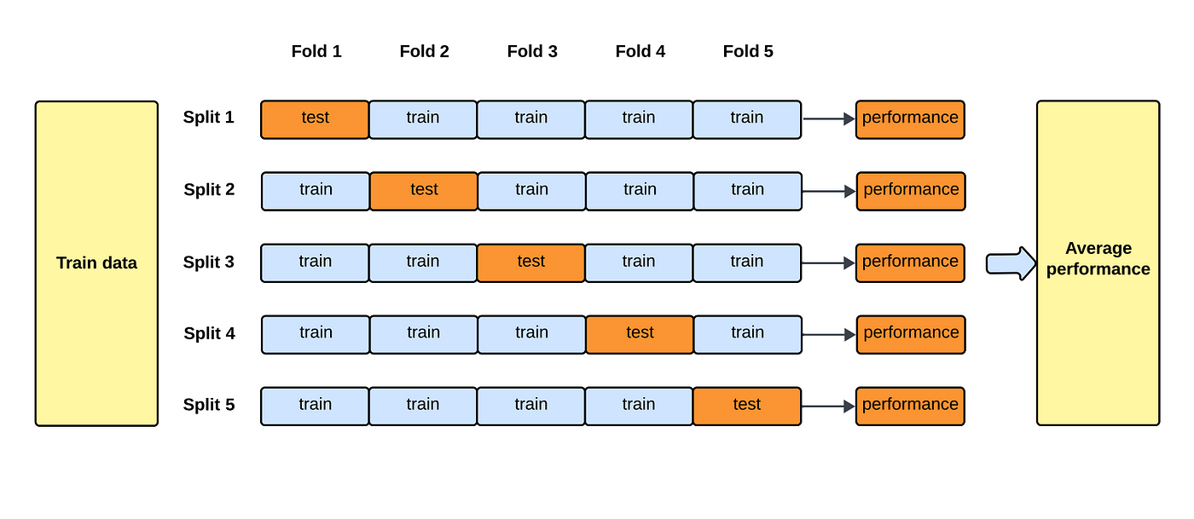
Part D - 5 fold cross validation

Slide 36
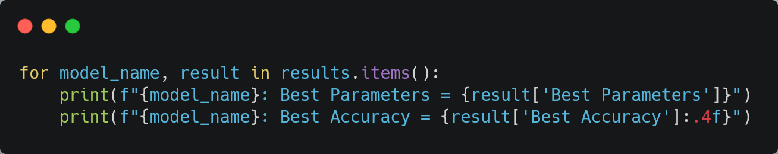
Part D
The hyperparameter tuning took a total 1.5 hours, which is worth noting. Now we can print the training results

Slide 37
Part D - Hyperparameter Tuning results
Naive Bayes:
Best Parameters: None
Best Accuracy: 0.7026
k-NN:
Best Parameters:
Number of Neighbors: 9,
Distance Metric Parameter: 2
Weight Function: distance
Best Accuracy: 0.8220
Perceptron:
Best Parameters:
Regularization Parameter: 0.0001
Maximum Iterations: 1000
Penalty Type: l1
Best Accuracy: 0.7057

Slide 38
Part D - Hyperparameter Tuning results
Logistic Regression:
Best Parameters:
Inverse Regularization Strength (C): 0.01
Penalty Type: l2
Optimization Algorithm: saga
Best Accuracy: 0.7811
SVM:
Best Parameters:
Regularization Parameter (C): 10
Kernel Coefficient (gamma): auto
Kernel Type: rbf
Best Accuracy: 0.8534
SVM Linear:
Best Parameters:
Regularization Parameter (C): 0.1
Best Accuracy: 0.7634

Slide 39
Part D - Hyperparameter Tuning results
Random Forests:
Best Parameters:
Maximum Depth: 20
Number of Features Considered for Splits: sqrt
Number of Trees: 200
Best Accuracy = 0.8140
AdaBoost:
Best Parameters:
Learning Rate: 1.0
Number of Estimators: 200
Best Accuracy = 0.6609
Decision Tree:
Best Parameters:
Maximum Depth: 10
Minimum Samples per Leaf: 4
Minimum Samples for Splits: 10
Best Accuracy = 0.6390
Neural Networks:
Best Parameters:
Activation Function: relu
Regularization Parameter (alpha): 1e-05
Hidden Layer Sizes: (100,)
Initial Learning Rate: 0.001
Best Accuracy = 0.8279

Slide 40
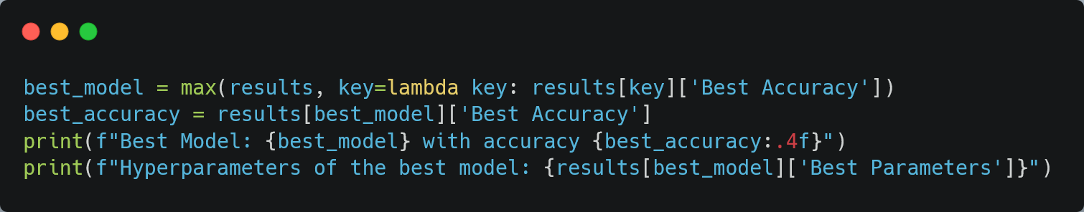
Part D
We will select the model with the best accuracy, using the optimal hyperparameters
Best Model: SVM with accuracy 0.8534
Hyperparameters of the best model:
Regularization Parameter (C): 10
Kernel Coefficient (gamma): auto
Kernel Type: rbf

Slide 41
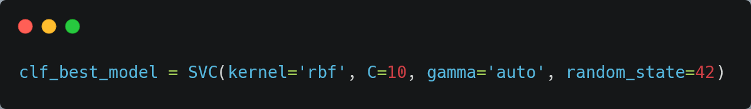
Part D - Best model
The model with the highest accuracy is SVM (Support Vector Machine) with hyperparameters shown below. We will use this model to make predictions on the test dataset

Slide 42
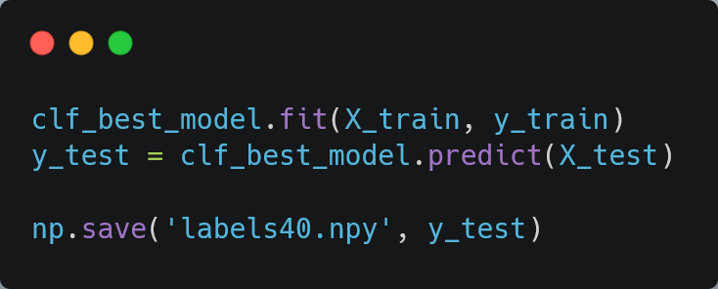
Part D
Now we're going to train the model on the entire dataset, and then make predictions on the test dataset. We will then save the predictions to a numpy file.

Slide 43
Thank you for your time!

