Slide 1

Bright Coffee Sales Analysis
Presentation to CEO
Junior Data Analyst: Nontokozo Dladla

Slide 2
Dataset Overview
Dataset Overview
Objective
Analyse sales data to uncover trends and insights that support revenue growth and product performance.
• Daily transaction data
• Product categories
• Time of purchase
• Revenue and order details

Slide 3

Key Business Questions
Which products generate the most revenue?
What time of day performs best?
What are the sales trends?
How can we improve performance?
Key Metrics
Total Revenue
Total Orders
Average Order Value
Top Products

Slide 4
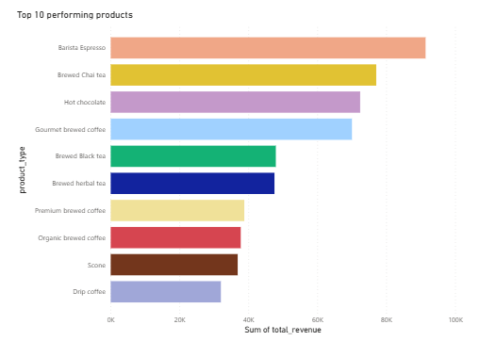
Top Seller: Barista Espresso
Double Click here to view the dashboard on Power BI

Slide 5
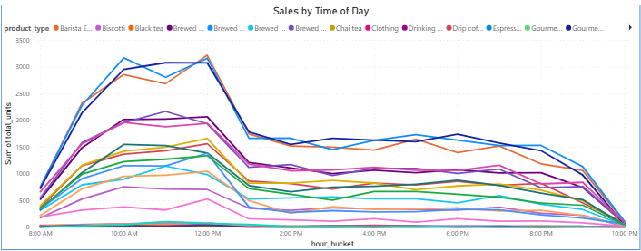
Sales by Time of Day
SALES PEAK TIME: 10AM – 12AM

Slide 6
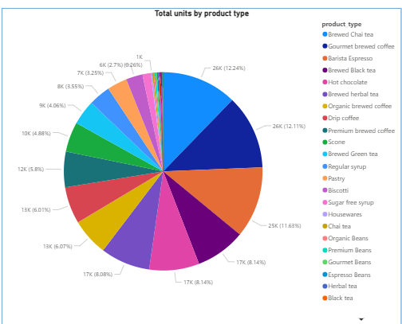
Category Performance

Slide 7
Key Insights
Morning peak sales
Strong weekend performance
Coffee dominates revenue

Slide 8
Next Steps
Dataset Overview
Recommendations
• Introduce afternoon promotions
• Bundle products
• Promote low performers
• Loyalty programs
• Automate daily sales reporting
• Monitor KPIs
• Continuous analysis

