Slide 1


Generative Deep Neural Networks for Dialogue: A Short Review
Département d'informatique et de recherche opérationnelle
Université de Montréal
Iulian Vlad Serban

Slide 2
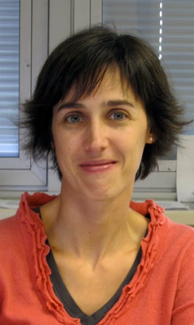
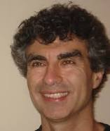

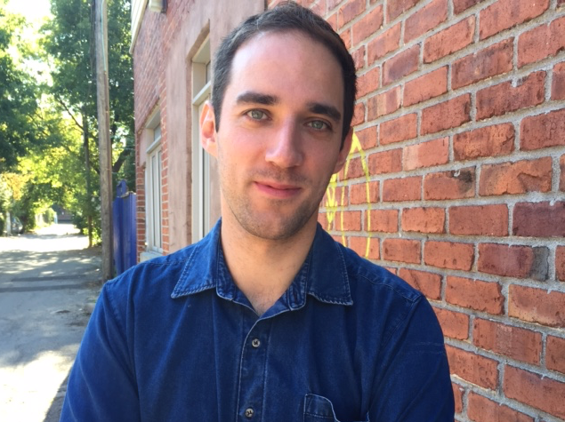

Collaborators (UdeM / McGill)
Yoshua Bengio Aaron Courville Joelle Pineau Laurent Charlin Alessandro Sordoni

Slide 3
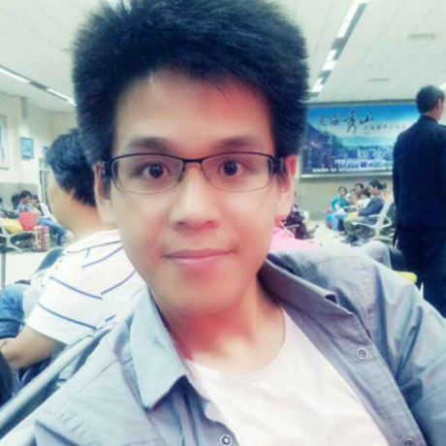


Collaborators (UdeM / McGill)
Ryan Lowe Nissan Pow Michael Noseworthy
Chia-Wei Liu (Casper)

Slide 4




Collaborators (IBM)
Tim Klinger Gerald Tesauro Kartik Talamadupula Bowen Zhou

Slide 5
Background

Slide 6

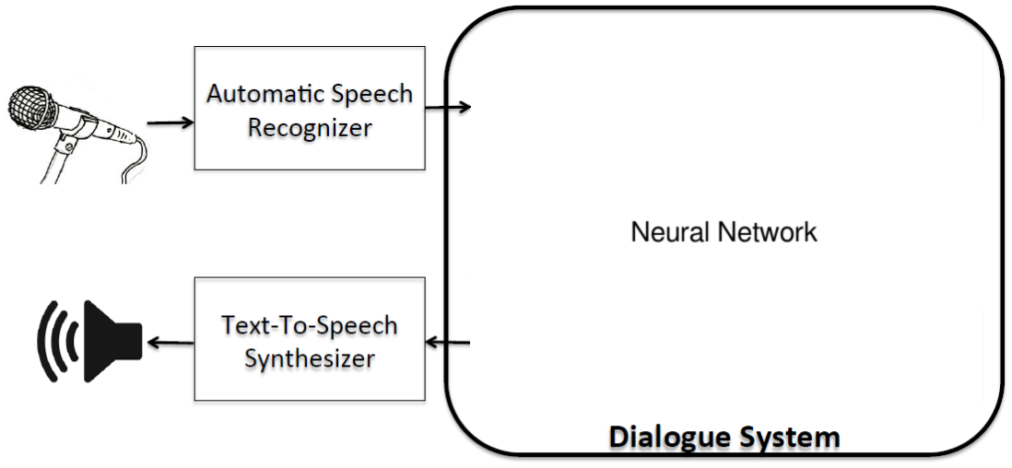
Dialogue Modeling
Knowledge Database
Actions

Slide 7
Dialogue Modeling
Dialogue Context
Neural Network
Response
State
Model (Policy)
Action

Slide 8
Dialogue Modeling
Ubuntu Task:
goal-driven; users resolve technical problems
~0.5M dialogues
Lowe et al., 2015. The Ubuntu Dialogue Corpus: A Large Dataset for Research in Unstructured Multi-Turn Dialogue Systems. SIGDIAL 2015.

Slide 9
Example
User
Expert

Slide 10

Example
User
Expert
Hello! Recently I updated to ubuntu 12.04
LTS and I am unsatisfied by its performance.
I am facing a bug since the upgrade to
12.04 LTS. Can anyone help??????????

Slide 11
Example
User
Expert
Hello! Recently I updated to ubuntu 12.04
LTS and I am unsatisfied by its performance.
I am facing a bug since the upgrade to
12.04 LTS. Can anyone help??????????
You need to give more details on the issue.

Slide 12
Example
User
Expert
Hello! Recently I updated to ubuntu 12.04
LTS and I am unsatisfied by its performance.
I am facing a bug since the upgrade to
12.04 LTS. Can anyone help??????????
You need to give more details on the issue.
Every time I login it gives me "System Error" pop up. It is happing since I upgraded to 12.04.

Slide 13
Example
User
Expert
Hello! Recently I updated to ubuntu 12.04
LTS and I am unsatisfied by its performance.
I am facing a bug since the upgrade to
12.04 LTS. Can anyone help??????????
You need to give more details on the issue.
Every time I login it gives me "System Error" pop up. It is happing since I upgraded to 12.04.
Send a report, or cancel it.

Slide 14
Example
User
Expert
Hello! Recently I updated to ubuntu 12.04
LTS and I am unsatisfied by its performance.
I am facing a bug since the upgrade to
12.04 LTS. Can anyone help??????????
You need to give more details on the issue.
Every time I login it gives me "System Error" pop up. It is happing since I upgraded to 12.04.
Send a report, or cancel it.
I have already done that but after few min, it pops up again...

Slide 15
Dialogue Modeling
How can we learn the model?
Unsupervised Learning (Generative Models)
Maximize likelihood w.r.t. words
Supervised Learning:
Maximize likelihood w.r.t. annotated labels
Reinforcement Learning
Learning from real users, learning from simulated users, learning with given reward function

Slide 16
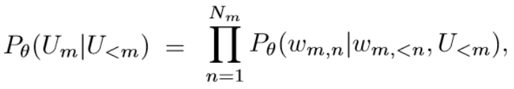
Generative Dialogue Modeling
Conditional response model:
Agent policy as the conditional model:
Possible to condition on other information, such as knowledge bases and user profiles

Slide 17
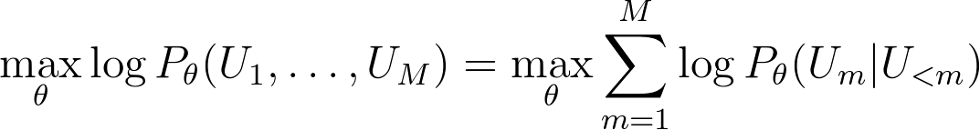
Generative Dialogue Modeling
Maximizing likelihood on fixed corpora
Imitating human dialogues:

Slide 18
Generative Dialogue Modeling
Advantages:
Learning from massive unlabelled datasets
End-to-end trainable (when model is differentiable)
Robust, low-variance learning signal => powerful framework for Deep Learning models

Slide 19
Generative Dialogue Modeling
Disadvantages:
Likelihood optimizes compression (not task goal)
Imitating sub-optimal agents (humans)
Learning off-policy

Slide 20
Generative Models

Slide 21
Generative Models
We propose models with three inductive biases:
Long-term memory
High-level compositional structure
Representing uncertainty and ambiguity

Slide 22
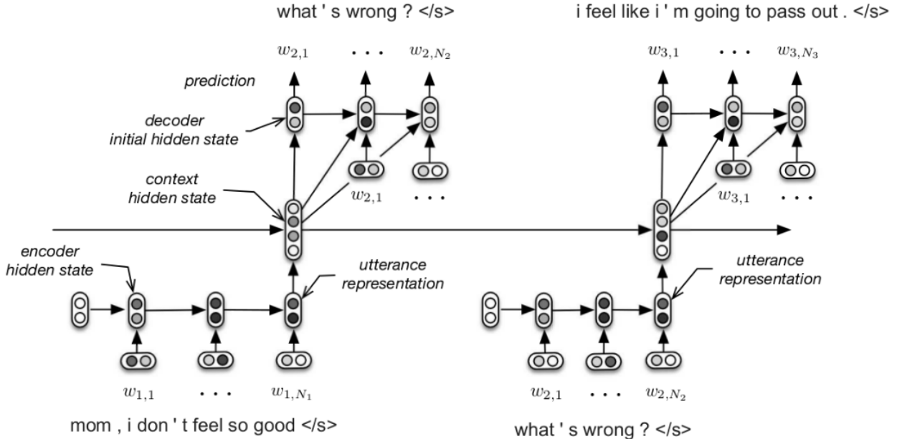
Hierarchical Recurrent Encoder-Decoder (HRED)
Serban et al., 2016. Building End-To-End Dialogue Systems Using Generative Hierarchical Neural Network Models. AAAI 2016.

Slide 23
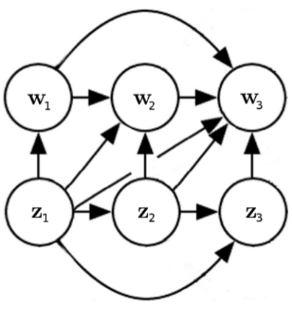
Multiresolution Recurrent Neural Network (MrRNN)
Modeling compositional structure in two-level RNN:
Natural Language RNN
High-level
RNN
Serban et al., 2016. Multiresolution Recurrent Neural Networks: An Application to Dialogue Response Generation. AAAI 2017. (In Press)
(Inference Network)

Slide 24
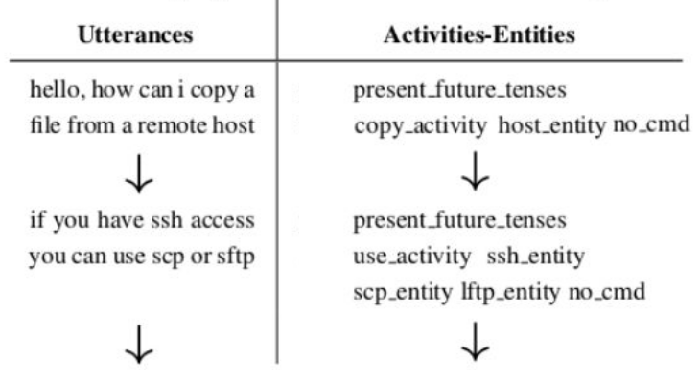
Multiresolution Recurrent Neural Network (MrRNN)
Activity-Entity Representation
Actions - install, update, download, reboot..
Entities - programs, websites commands...

Slide 25
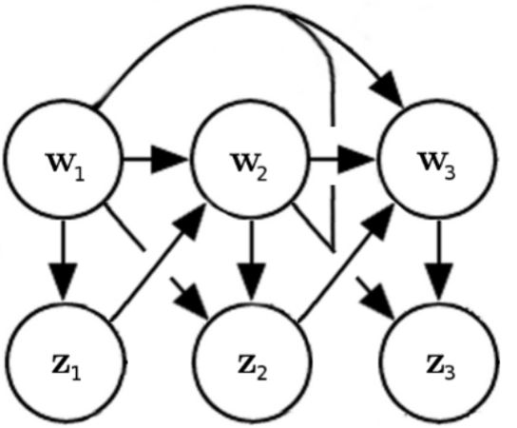
Latent Variable Recurrent Encoder-Decoder (VHRED)
Modeling uncertainty and ambiguity with latent variables:
Serban et al., 2016. A Hierarchical Latent Variable Encoder-Decoder Model for Generating Dialogues. AAAI 2017. (In Press)

Slide 26
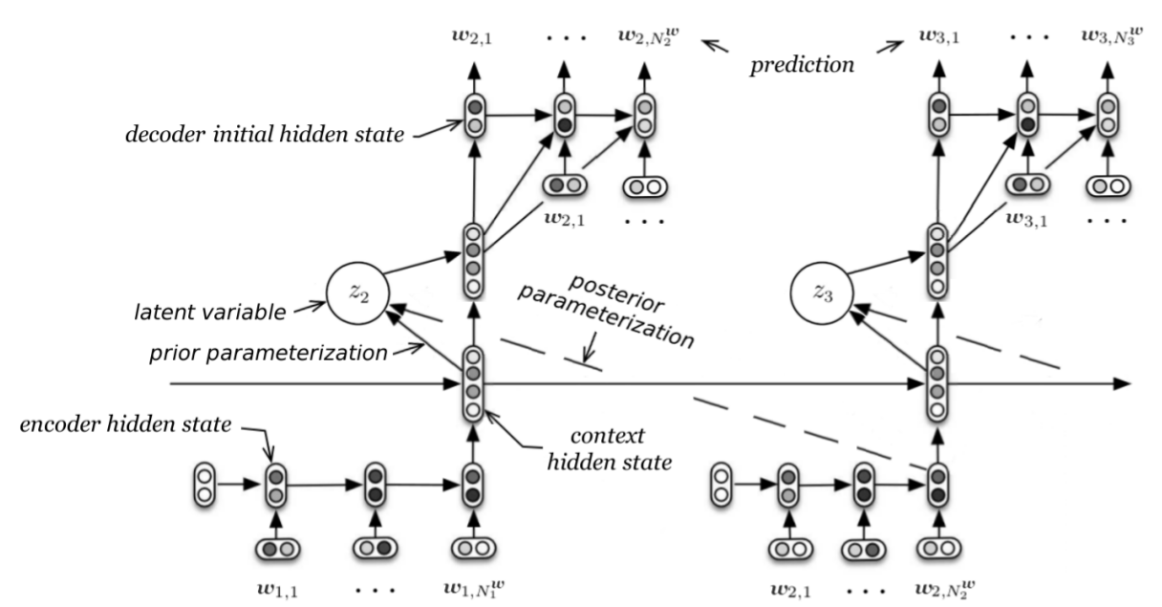
VHRED

Slide 27
VHRED
dialogue
state
dialogue
state

Slide 28
Experiments

Slide 29
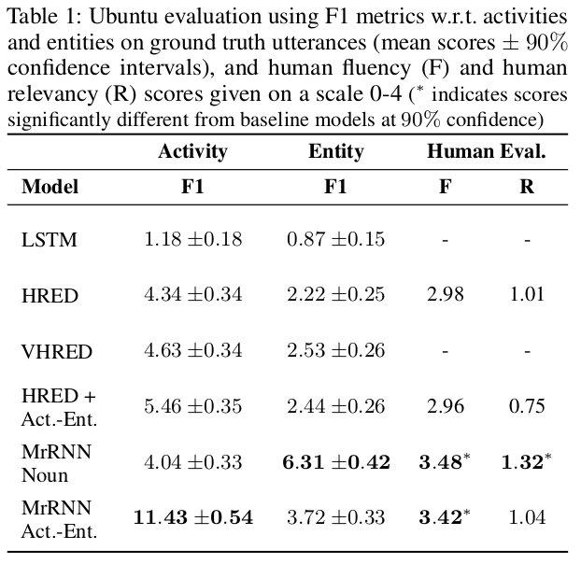
Experiments

Slide 30
Experiments

Slide 31
Experiments

Slide 32
Experiments

Slide 33
Experiments

Slide 34
Experiments

Slide 35
Experiments

Slide 36
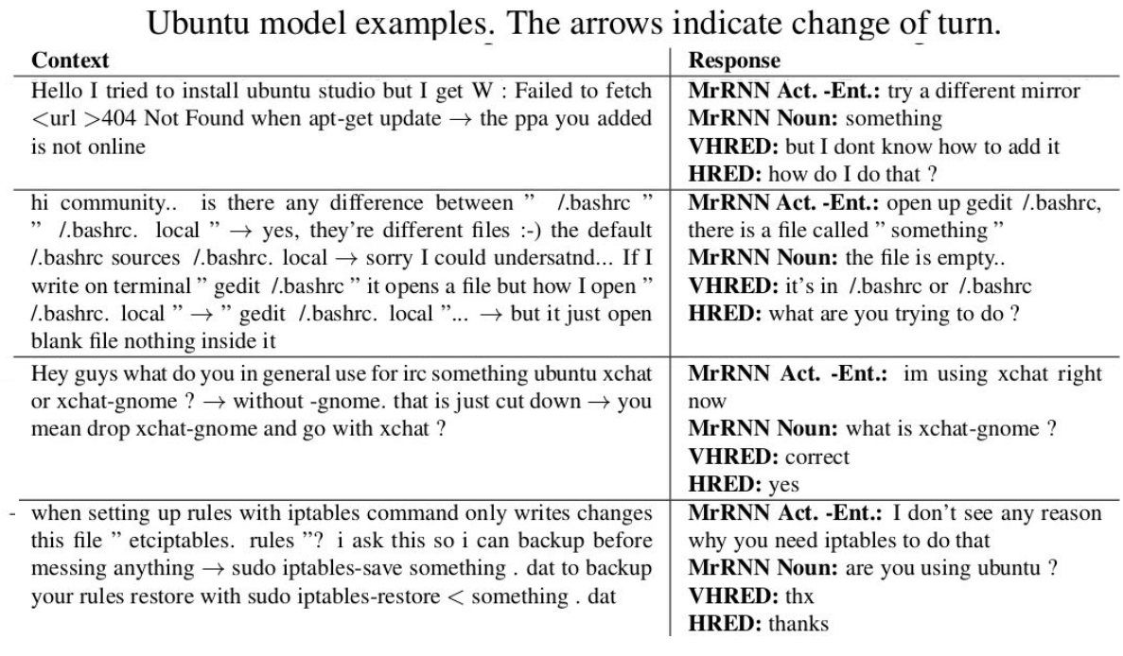

Slide 37
The Big Picture

Slide 38


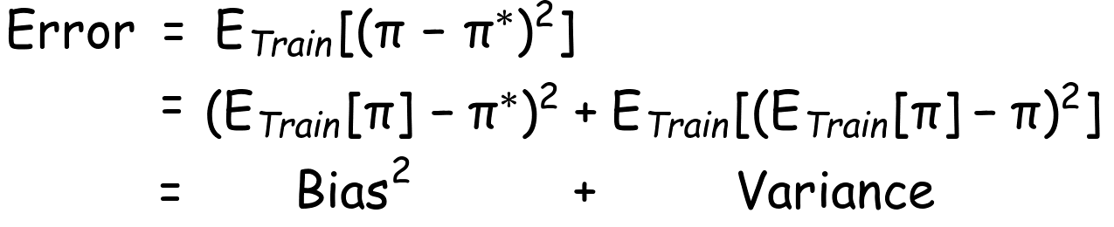
Bias-variance Tradeoff
Let be the oracle policy and be the model policy
Generalization error w.r.t. training dataset:
Manning et al., 2008. Introduction to Information Retrieval. Cambridge University Press,

Slide 39
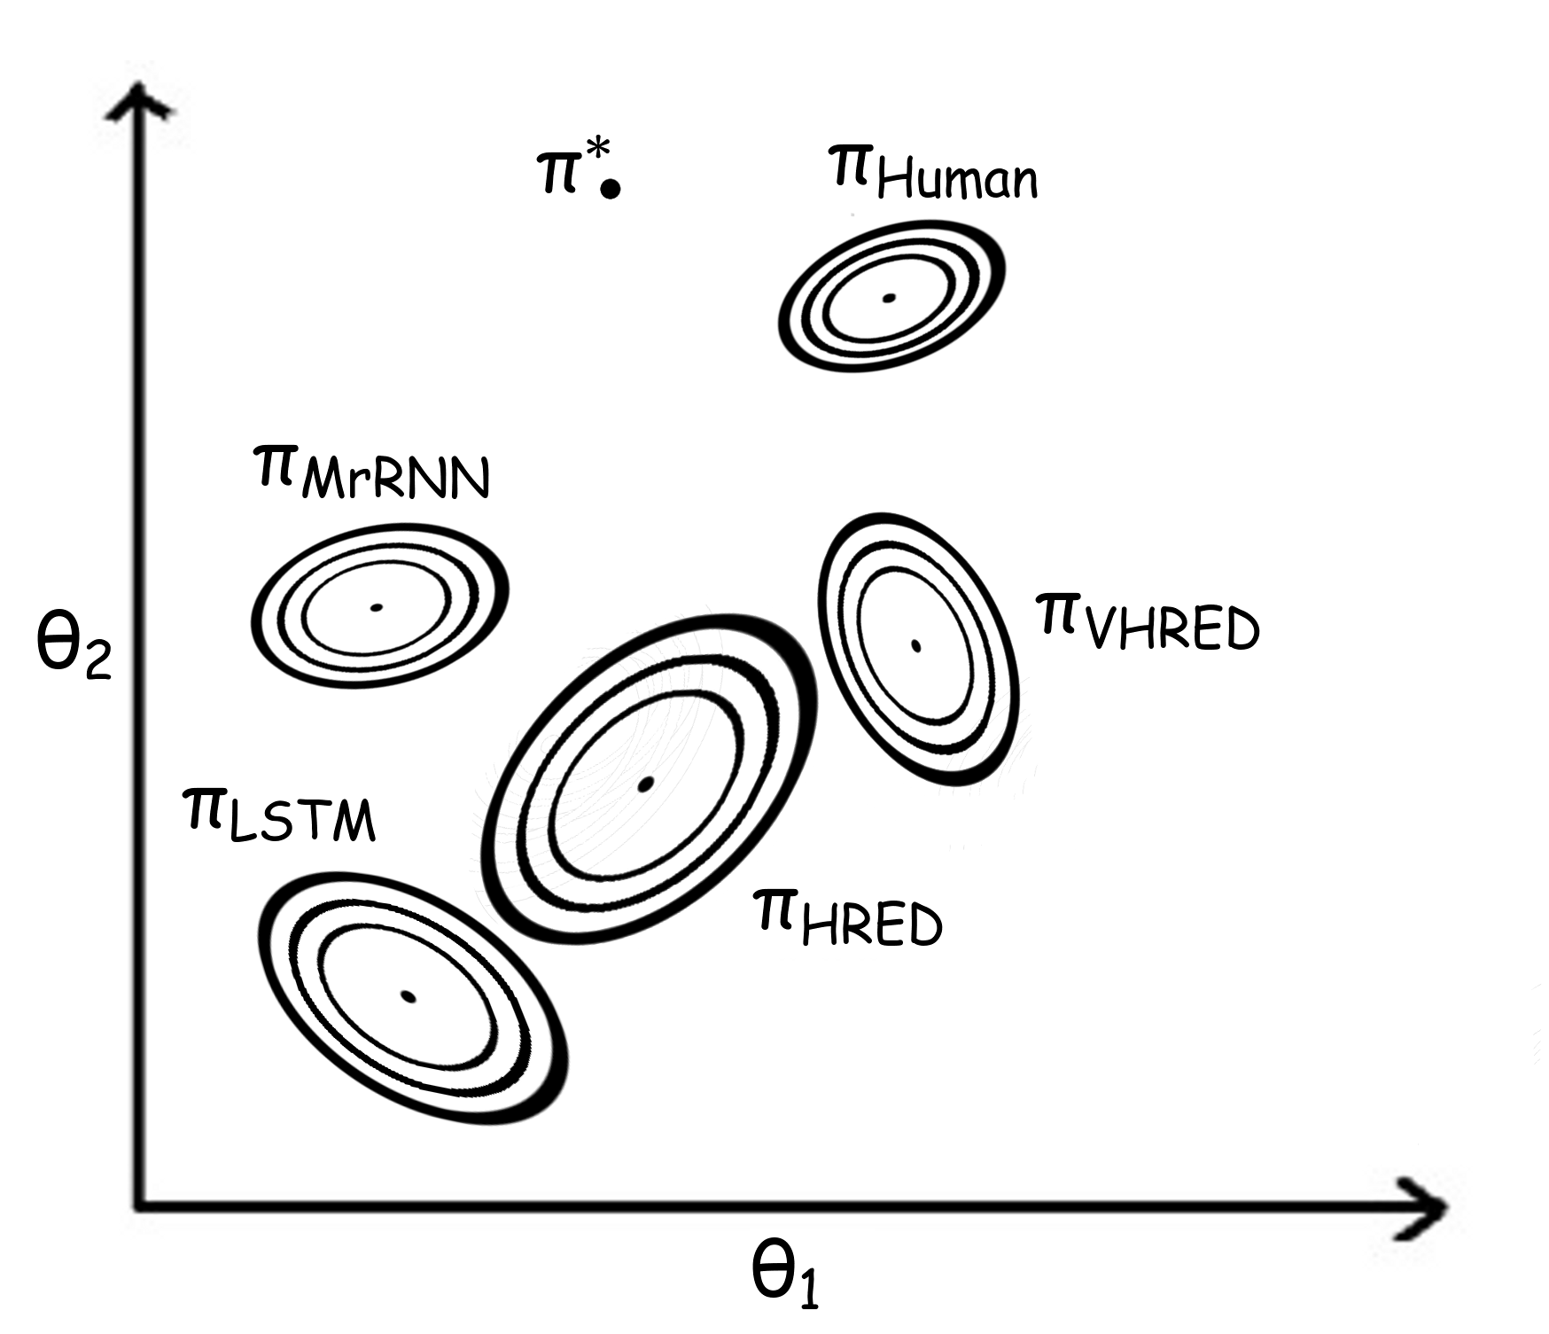

Slide 42
Modeling long-term memory

Slide 44
Modeling high-level compositional structure

Slide 46
Modeling uncertainty and ambiguity

Slide 48
Thank you!
Questions?

