Slide 1

AMAZON PHONES
Sales Intelligence Dashboard
A Power BI Final Project — Data Cleaning, DAX Modeling & Dashboard Design
Nour Eldin
Computer Science — AAST | Power BI Final Project, 2025-2026

Slide 2




Project Overview & Objectives
Turning raw Amazon listing data into actionable retail insight
The Dataset
340 Amazon phone listings scraped via the Phone Search dataset — covering pricing, ratings, offers, sales volume, and product badges (Prime, Best Seller, Amazon Choice, Climate Pledge Friendly).
The Goal
Build a clean, modeled, and fully interactive Power BI report that answers core retail questions: how are phones priced, how do they sell, and which product badges actually correlate with performance.
Why It Matters
Pricing and badge data sit at the center of how shoppers compare phones on Amazon — this report turns that noisy listing data into a model that's easy to query and trust.
Clean the Data
Model with DAX
Fix types, parse text fields, handle nulls in Power Query
Calculated columns + 13 measures for KPIs
Visualize Clearly
Enable Exploration
Match each metric to the right chart type
Slicers for live, cross-filtered analysis

Slide 3
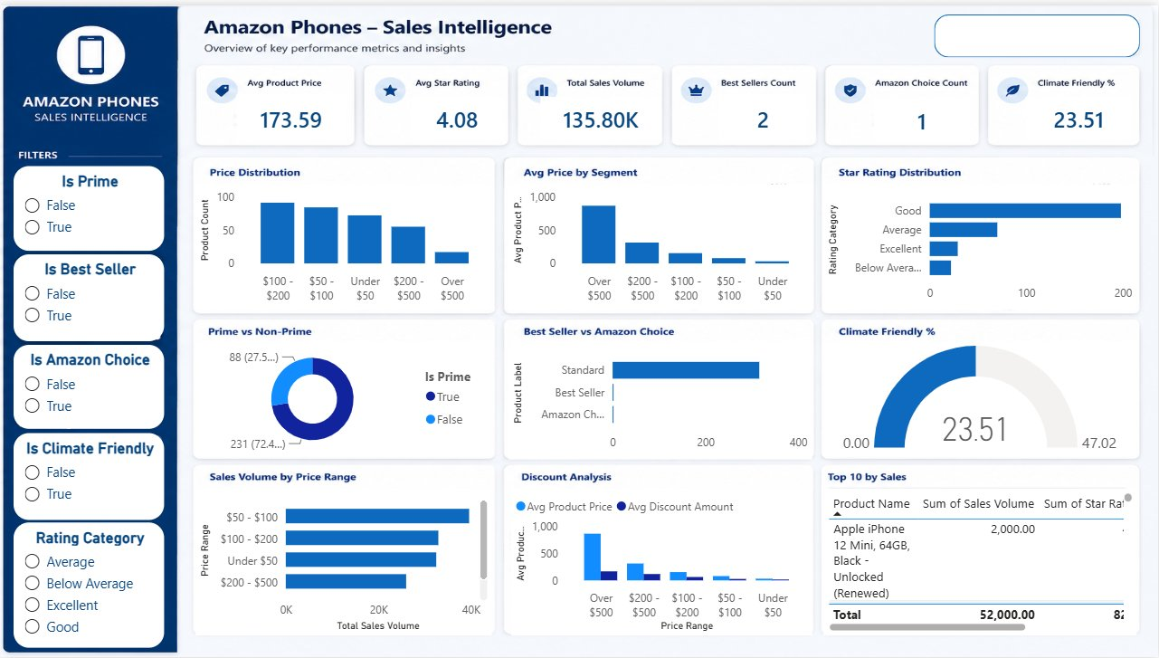
The Final Dashboard
One page, six KPIs, nine visuals, six live slicers

Slide 4



Reading the Dashboard
How the KPI cards and charts work together
Avg Product Price
Avg Star Rating
Total Sales Volume
$173.59
4.08 ★
135.80K
1
Pricing & Distribution
2
Quality & Categories
3
Sales & Top Performers
Price Distribution, Avg Price by Segment, and Discount Analysis show how 340 phones spread across price tiers — most listings cluster under $200.
Star Rating Distribution, Prime vs Non-Prime, and Best Seller vs Amazon Choice reveal that the catalog is rating-strong but badge-sparse.
Sales Volume by Price Range and the Top 10 by Sales table pinpoint exactly which products and price bands drive real purchase volume.
Why this layout works: every KPI card is backed by at least one chart below it, so a viewer can move from headline number to underlying detail without leaving the page.

Slide 5



Key Insights from the Data
What the 340-product catalog actually tells us
Badges are rare, not the norm
Prime dominates the catalog
Only 2 Best Sellers and 1 Amazon Choice product exist among 340 listings — these badges are exceptions, not reliable quality signals at scale.
72.4% of products are Prime-eligible, confirming Prime shipping has become a baseline customer expectation rather than a differentiator.
Mid-range price wins on volume
Climate-friendly is a growing niche
The $50–$200 price band drives the highest total sales volume, well above premium ($500+) and budget (<$50) segments.
23.51% of products carry the Climate Pledge Friendly badge — a meaningful share, but still a minority positioning.

Slide 6

Methodology at a Glance
From raw CSV to a measured, modeled data set
01
02
03
04
Power Query
Calculated Columns
DAX Measures
Dashboard Build
Corrected data types, stripped currency symbols, parsed sales volume text, handled nulls across price & availability fields.
Discount Amount, Discount %, Price Range, Product Label, Rating Category — derived per-row fields.
13 measures: avg price, avg rating, total sales volume, best seller/Amazon choice counts, climate-friendly %, and more.
6 KPI cards + 9 visuals + 6 slicers, themed in a consistent blue palette with full cross-filtering enabled.

Slide 7
Conclusion & Recommendations
What the dashboard delivers, and where it could go next
What This Project Achieves
Recommendations for Future Iterations
A fully cleaned, type-correct dataset ready for analysis
1
Track sales volume over time once historical snapshots are available, to show trend rather than a single point in time.
13 DAX measures answering every required business question
2
Expand the badge sample (Best Seller, Amazon Choice) by pulling a larger product set, since current counts are too small to generalize from.
A single-page report combining KPIs, 9 visuals, and live slicers
Cross-filtered, interactive exploration of 340 Amazon listings
3
Add a brand/manufacturer dimension to compare pricing and rating performance across competitors.
4
Layer in review text sentiment to complement the numeric star rating with qualitative customer feedback.

