Slide 1
Facial Verification Services in Banking Apps

Slide 2
AIM
Project Summary:- Facial recognition is one of numerous ways banks can decrease friction in their customers’ experience and increase efficiency and accessibility.People don’t need banks anymore, what they need is banking. And if banks understand that, I think that’s where everyone is going, and if they provide that I think that is going to be one of the biggest differentiators.

Slide 3
Successful project:-
On-location Security: Preventing unauthorized personnel from gaining entry to certain areas of a bank and catching suspicious behavior on camera.
Identity Verification and Account Withdrawals: Allowing customers to make withdrawals from their bank accounts at ATMs.
Using mobile banking apps: Authenticating customers to make payments and net banking and other services.

Slide 4
Security Issues/ RIsks:-
Privacy matters. Privacy refers to any rights you have to control your personal information and how it’s used — and that can include your faceprint.
So, what are the issues? Here are some:
Security. Your facial data can be collected and stored, often without your permission. It’s possible hackers could access and steal that data.
Prevalence. Facial recognition technology is becoming more widespread. That means your facial signature could end up in a lot of places. You probably won’t know who has access to it.
Ownership. You own your face — the one atop your neck — but your digital images are different. You may have given up your right to ownership when you signed up on a banking mobile app.
Safety. Facial recognition could lead to online harassment and stalking. How? For example, someone uses facial recognition software to find out exactly who you are.
Mistaken identity. Say, for instance, Banking sector uses facial recognition to try to identify someone who was indulged in fraudulent activity.. Facial recognition systems may not be 100 percent accurate. What if the bank thinks the suspect is you?
Basic freedoms. Banking agencies and others could have the ability to track you. What you do and where you go might no longer be private. It could become impossible to remain anonymous.

Slide 5
Core User Experience Consideration
Privacy and Confidentiality
Efficiency
Shifting the mindset
personalized experiences
1
2
3
4

Slide 6
Rough guide to the team and their roles
AI developers with deep learning skills;
UI designers;
Web developers with Node.js skills;
Android developers with Java skills;
iOS developers with experience in Swift;
Testers;
DevOps engineers.

Slide 7
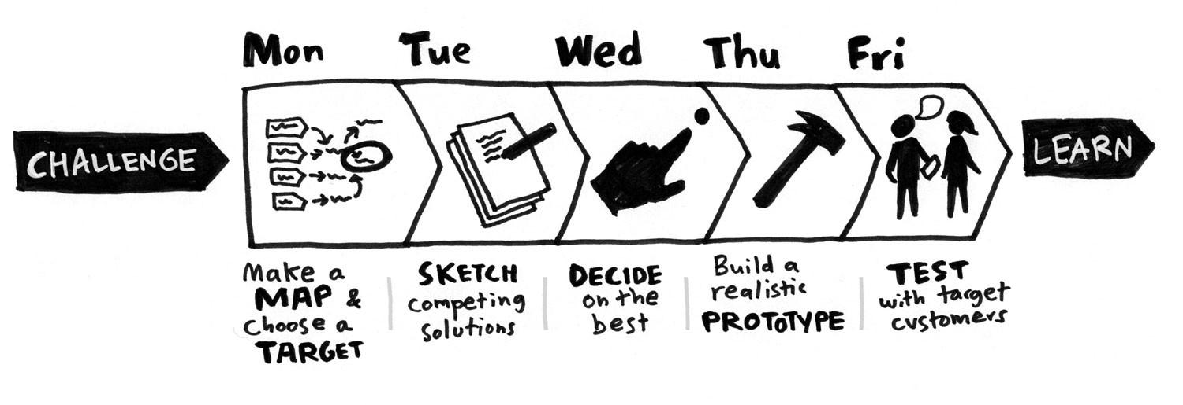
Design Sprint

Slide 8
There are various flavors of facial recognition technology, however, they generally work as follows: Software Development Cycle
It captures your image from a picture or a video.
When it finds a match, the software then uses this information to perform further activities, e.g., authenticate you to use a computer system.
The software reads the geometry of your face, e.g., the distance between eyes, the distance from forehead to chin, etc.
A database of facial signatures might have many such records, and the software will use deep learning algorithms to find a match in this database.
It also identifies facial landmarks, and it stores all these data as your facial signature

Slide 9
Stakeholders
Banking
Customer
Government
Community at large

