Slide 1
Team AnalyticAlliance Idea brief:
Our project, "hack2skill_trading_system", is an innovative algorithmic trading solution designed to harness the power of artificial intelligence to optimize trading decisions.
The system focuses on generating trading signals using technical indicators such as Bollinger Bands and the Relative Strength Index (RSI). By analyzing historical and real-time stock data, the system identifies and learns from profitable trading patterns. When these patterns recur, the system promptly alerts users, enabling them to capitalize on potential profit opportunities.
Cloud integration plays a pivotal role in this process, as it enhances the system’s ability to analyze large datasets, detect complex patterns, and predict future market movements at real-time .

Slide 2
Uniqueness:
What sets the "hack2skill_trading_system" apart from other trading algorithms is its integration of Cloud for advanced performance and real-time notifications.
Traditional trading systems rely on static algorithms that do not adapt to new market data. In contrast, our system continually evolves by learning from new data, thereby improving its predictive accuracy over time.
Additionally, the system’s comprehensive backtesting feature allows users to evaluate multiple trading strategies against historical data, providing detailed profitability statistics and performance summaries.
This dynamic adaptability and AI-driven precision make our system uniquely effective and reliable.

Slide 3
Potential Impact:
The potential impact of the "hack2skill_trading_system" is substantial, particularly in the realm of retail trading and investment.
By providing sophisticated trading tools that were once exclusive to institutional investors, our system democratizes access to advanced financial strategies.
This empowerment can lead to increased profitability and more informed decision-making for individual traders. Furthermore, the system’s real-time alert feature ensures that users can respond quickly to market opportunities, minimizing the risk of missed trades.
The continuous learning capability of the AI also means that the system remains relevant and effective, even as market conditions change, thereby supporting sustained financial growth for users.

Slide 4
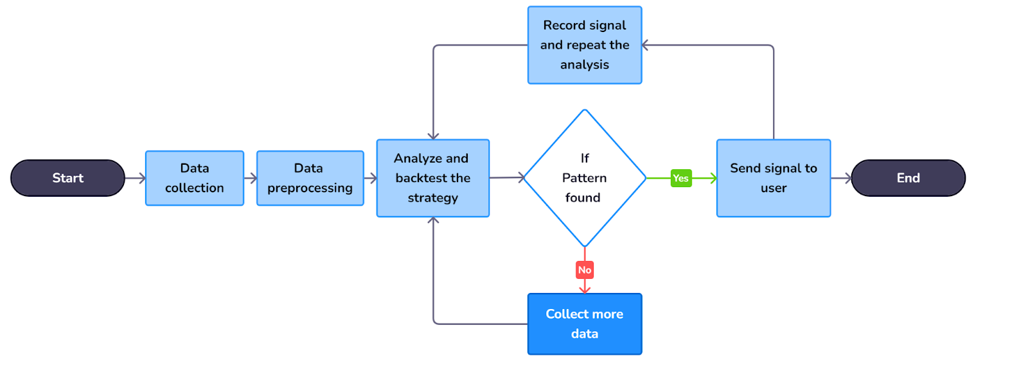
Process Flow Diagram/Use Case Diagram:

Slide 5
Process Flow Diagram/Use Case Diagram:
1. Data Collection: The system gathers historical and real-time stock data from reliable financial data providers.
2. Data Preprocessing: The collected data is cleaned, formatted, and stored for analysis.
3. Data Analysis: Bollinger Bands and RSI indicators are applied to the preprocessed data to identify trading signals.
4. Pattern Recognition: algorithms analyze the data to detect recurring patterns and predict future price movements.
5. Signal Generation: Based on the detected patterns and analysis, the system generates trading signals.
6. Backtesting: The system backtests various trading strategies against historical data to evaluate their performance.
7. Profitability Analysis: A comprehensive summary and profitability statistics of each strategy are provided to the user.
8. User Notification: The system sends real-time alerts to users about potential trading opportunities based on the identified patterns.

Slide 6
Technologies Used:
The "hack2skill_trading_system" leverages a combination of advanced tools and platforms to deliver its innovative features: - Artificial Intelligence: Utilized for sophisticated pattern recognition and predictive analysis, enhancing the system’s ability to identify profitable trading opportunities.
- Python: The primary programming language for developing the algorithmic trading system.
- pandas: A powerful library for data manipulation and analysis, crucial for handling large datasets.
- NumPy: Used for numerical computations and efficient data processing.
- Plotly: For creating interactive and visually appealing data visualizations to help users understand market trends and patterns.
- pandas-ta: A technical analysis library that provides various indicators like Bollinger Bands and RSI.
- backtesting.py: A library for strategy backtesting and performance evaluation, enabling users to assess the effectiveness of their trading strategies.
- AWS/GCP/Azure: Cloud platforms used for scalable data processing, storage, and real-time analysis capabilities.

Slide 7
Conclusion:
The "hack2skill_trading_system" is a cutting-edge solution that exemplifies the integration of technology and Finance to push the boundaries of algorithmic trading.
We aim to create a innovative trading system that promises to transform trading practices, making advanced financial tools accessible to a broader audience and delivering significant financial benefits to its users.
Our system not only enhances trading efficiency but also empowers traders with data-driven insights, ensuring they can make informed decisions and maximize their profitability.

Slide 8
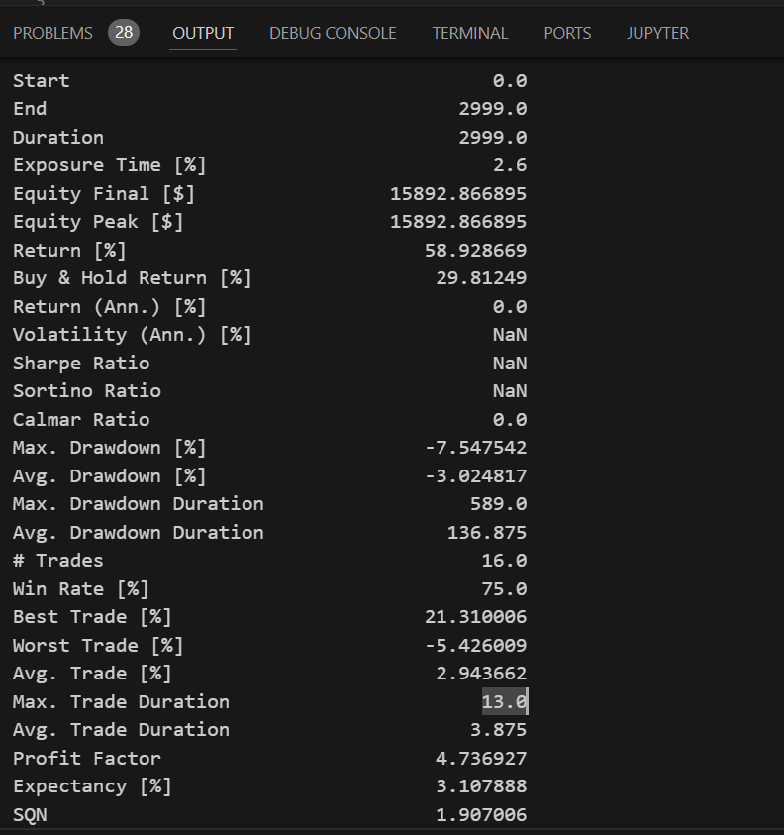
SNAPSHOTS:
1.Backtest results

Slide 9
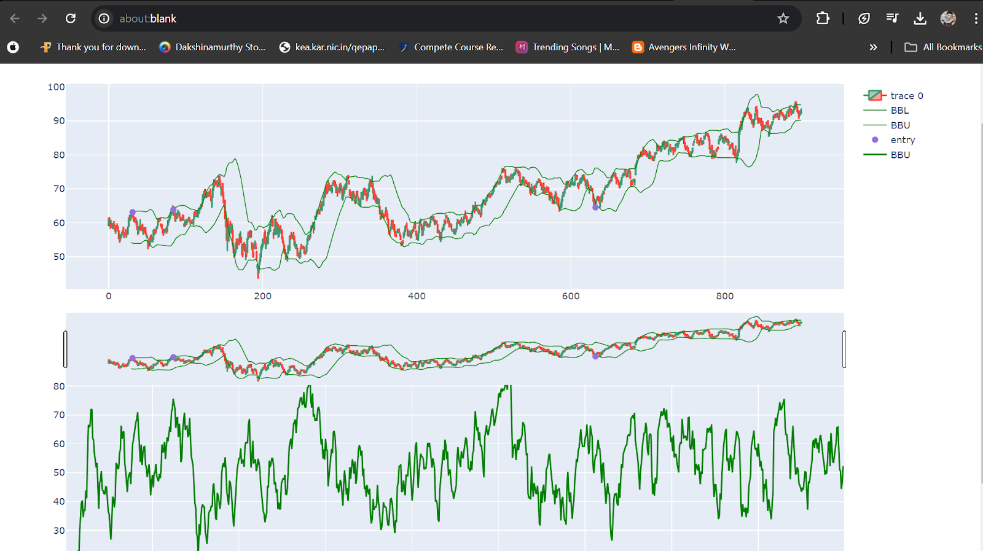
2.Generated Signals.

Slide 10
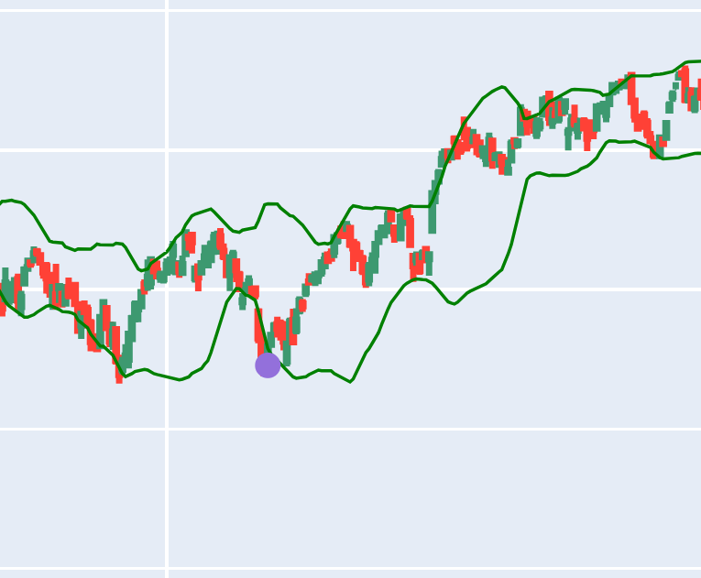
Buy signals: The purple dot below denotes the buy signal which is generated by analyzing the bollinger bands and RSI by our trading system, at that particular point the user will be notified to buy a stock which can increase his chances of profitability.

Slide 11
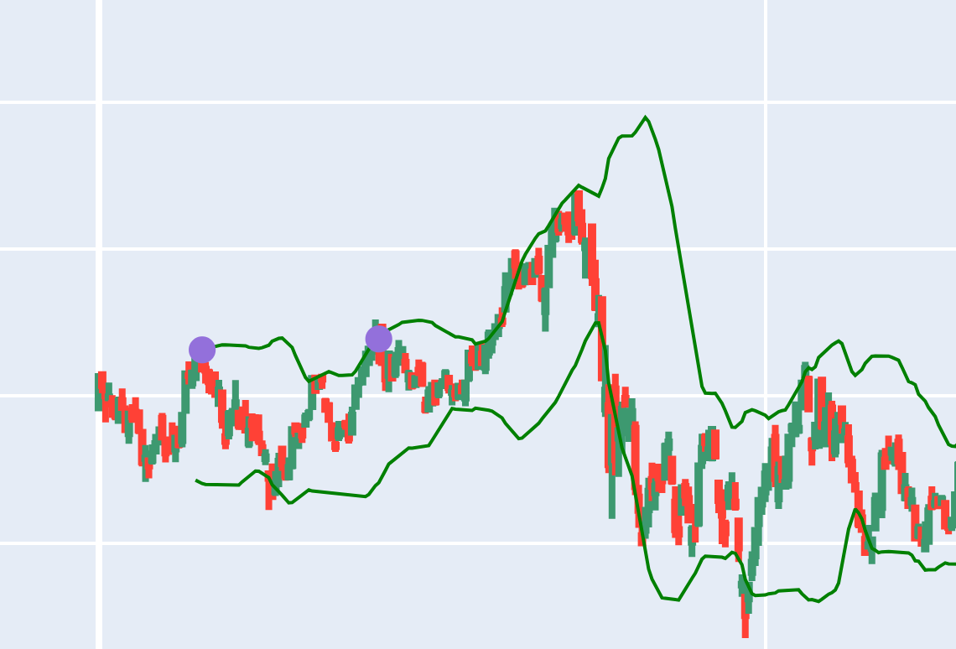
Sell signals: The purple dot above denotes the sell signal which is generated by analyzing the bollinger bands and RSI by our trading system, at that particular point user will be notified to sell a stock which can increase his chances of profitability by shorting(sell first and buy later).

