Slide 1
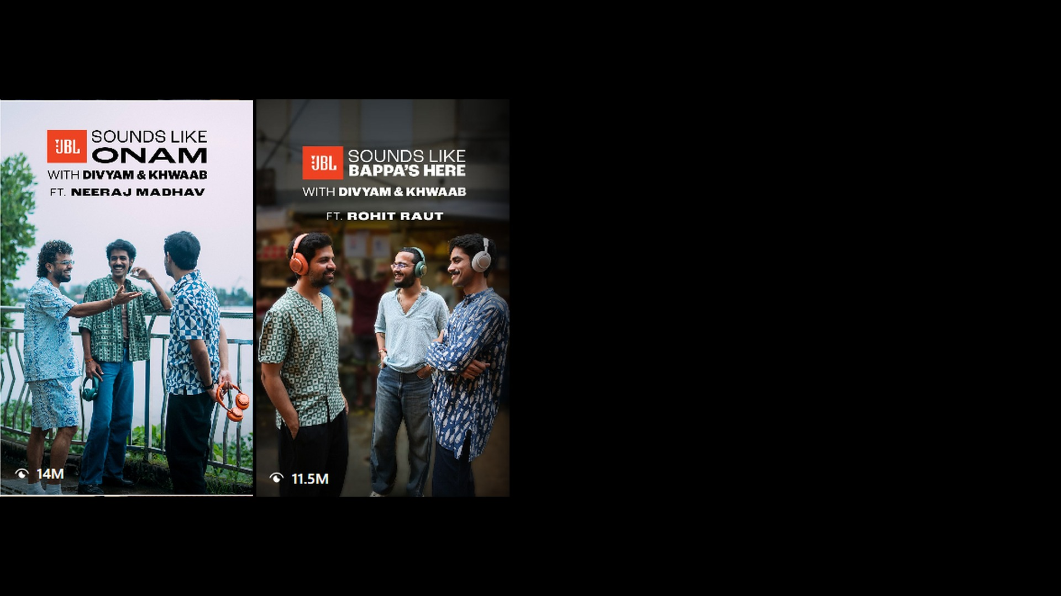
JBL INDIA
SOUNDS LIKE
FESTIVE
Havas India gave every Indian festival its own JBL sound, from Onam to Diwali, with regional films, creators and tech reviews on digital, and 137 OOH placements across 25 cities, 5 airports and the Mumbai Metro, through the biggest sale weeks of the year.
The result? 56.7 Mn reached on digital plus 250 Mn+ est. OOH impressions, JBL.com orders up 135% and revenue up 149% vs Festive 2025, and Amazon DSP sales up 12% at 7.37x ROAS.
Sounds Like Festive — Case Study
JBL × Havas Creative India
Notes:
JBL festive case, slide 1. Lead with the idea: every festival gets its own sound. Results are from the JBL Festive 2026 report (26 Sep – 2 Nov) and the 5 Nov marketing dashboard; Diwali week was still live at the time of reporting. OOH figures are from the JBL offline plan status (Rest of India and Airport + Maharashtra + DOOH tabs); OOH impressions are vendor estimates for static sites only and are kept separate from digital reach.

Slide 2
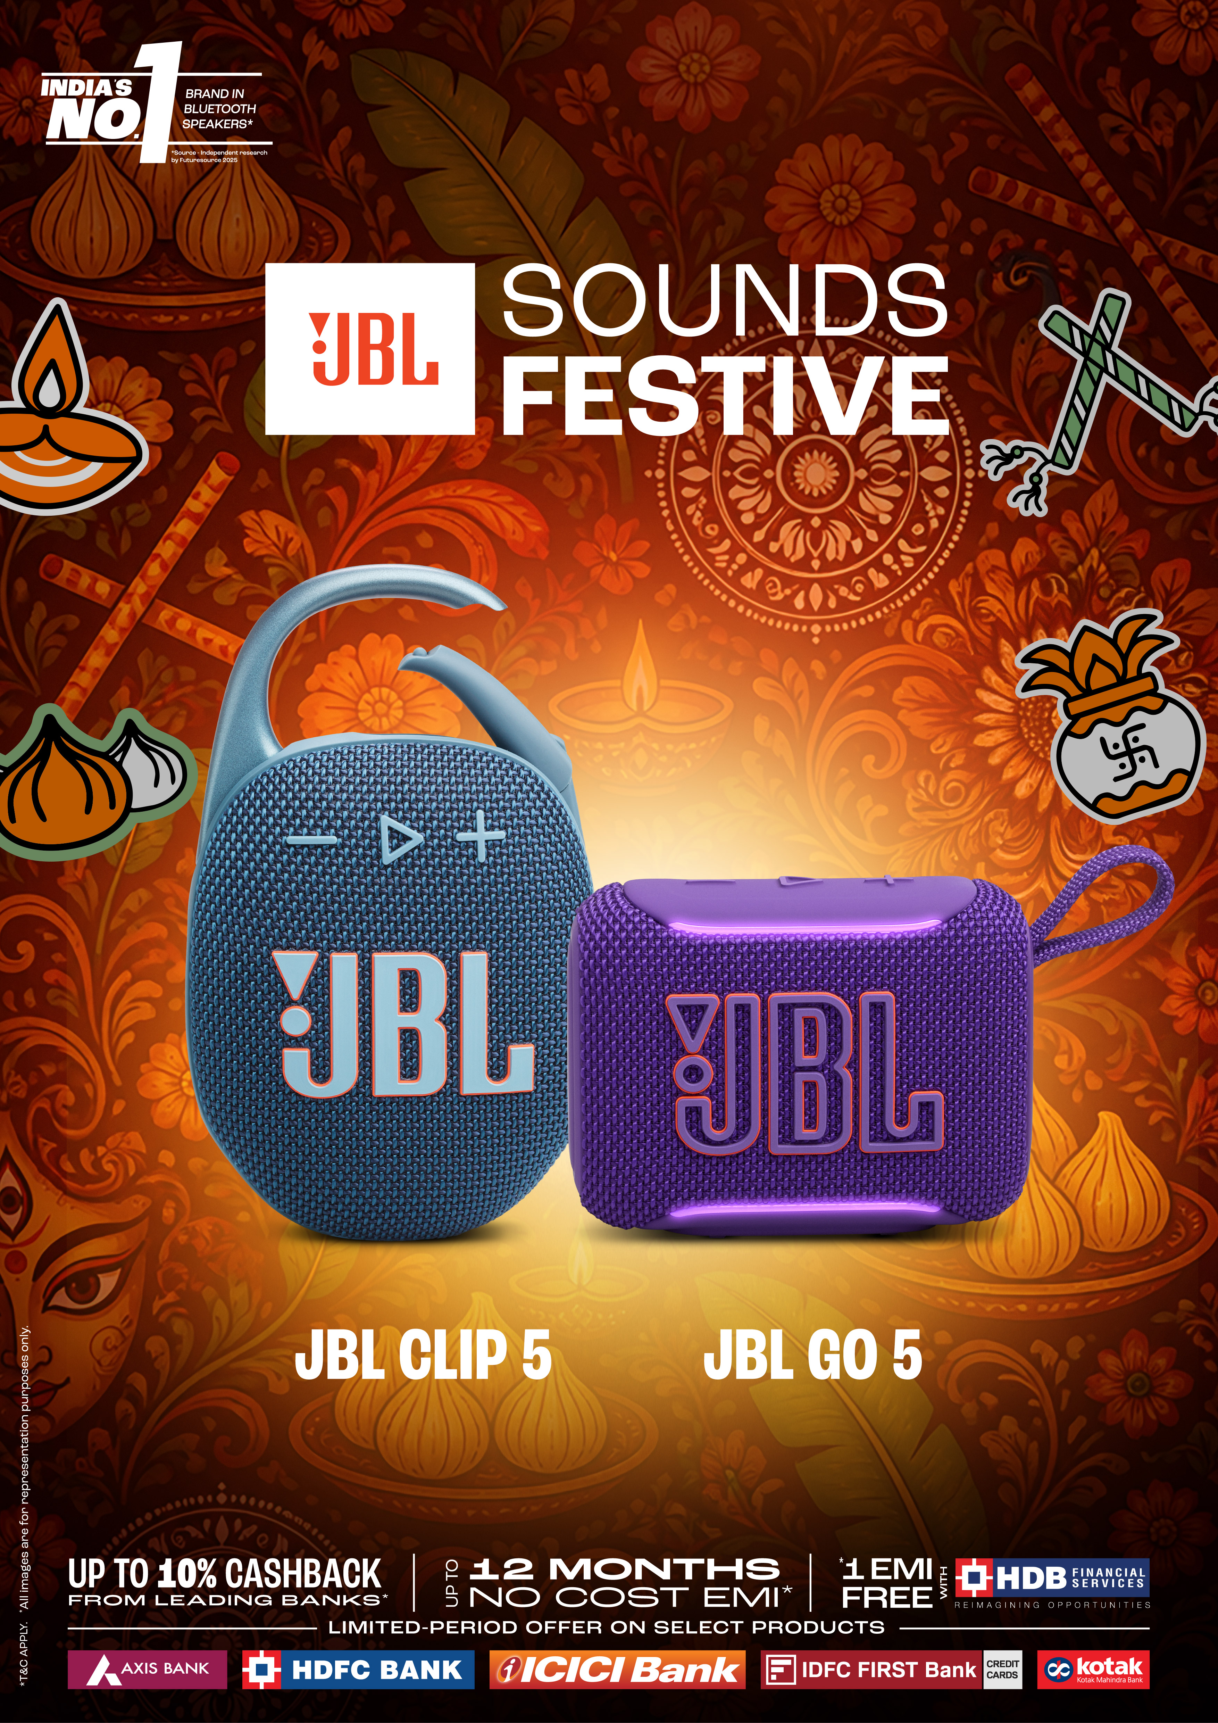
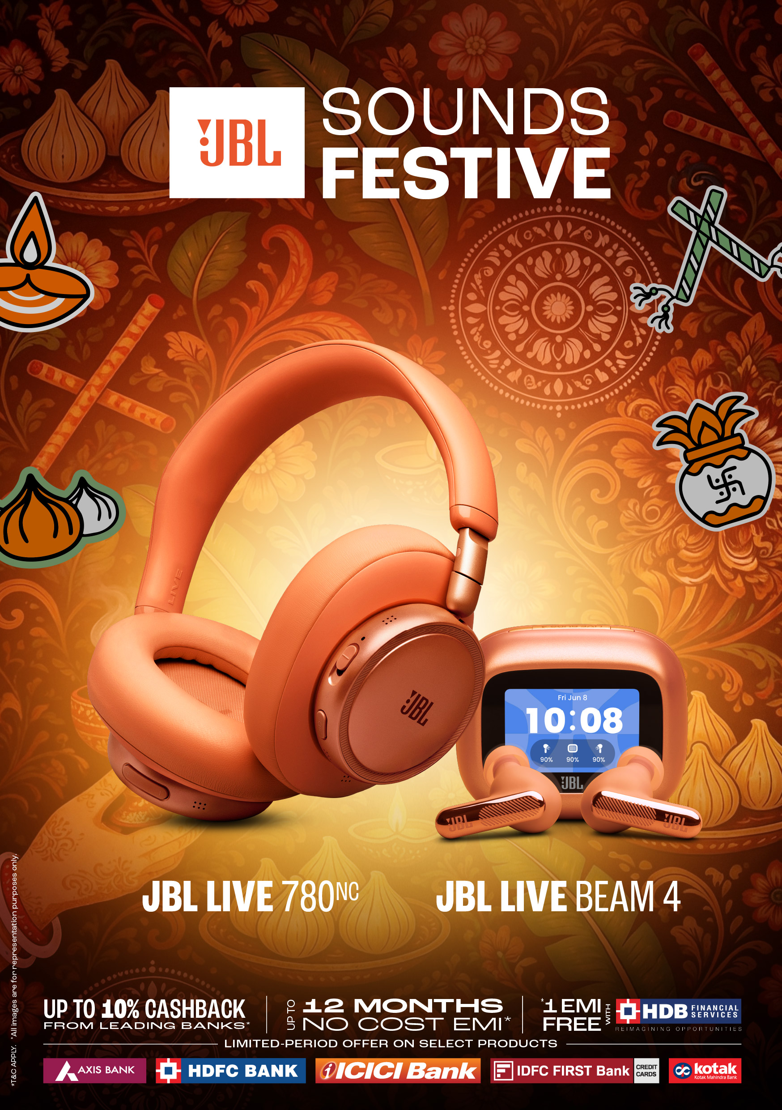
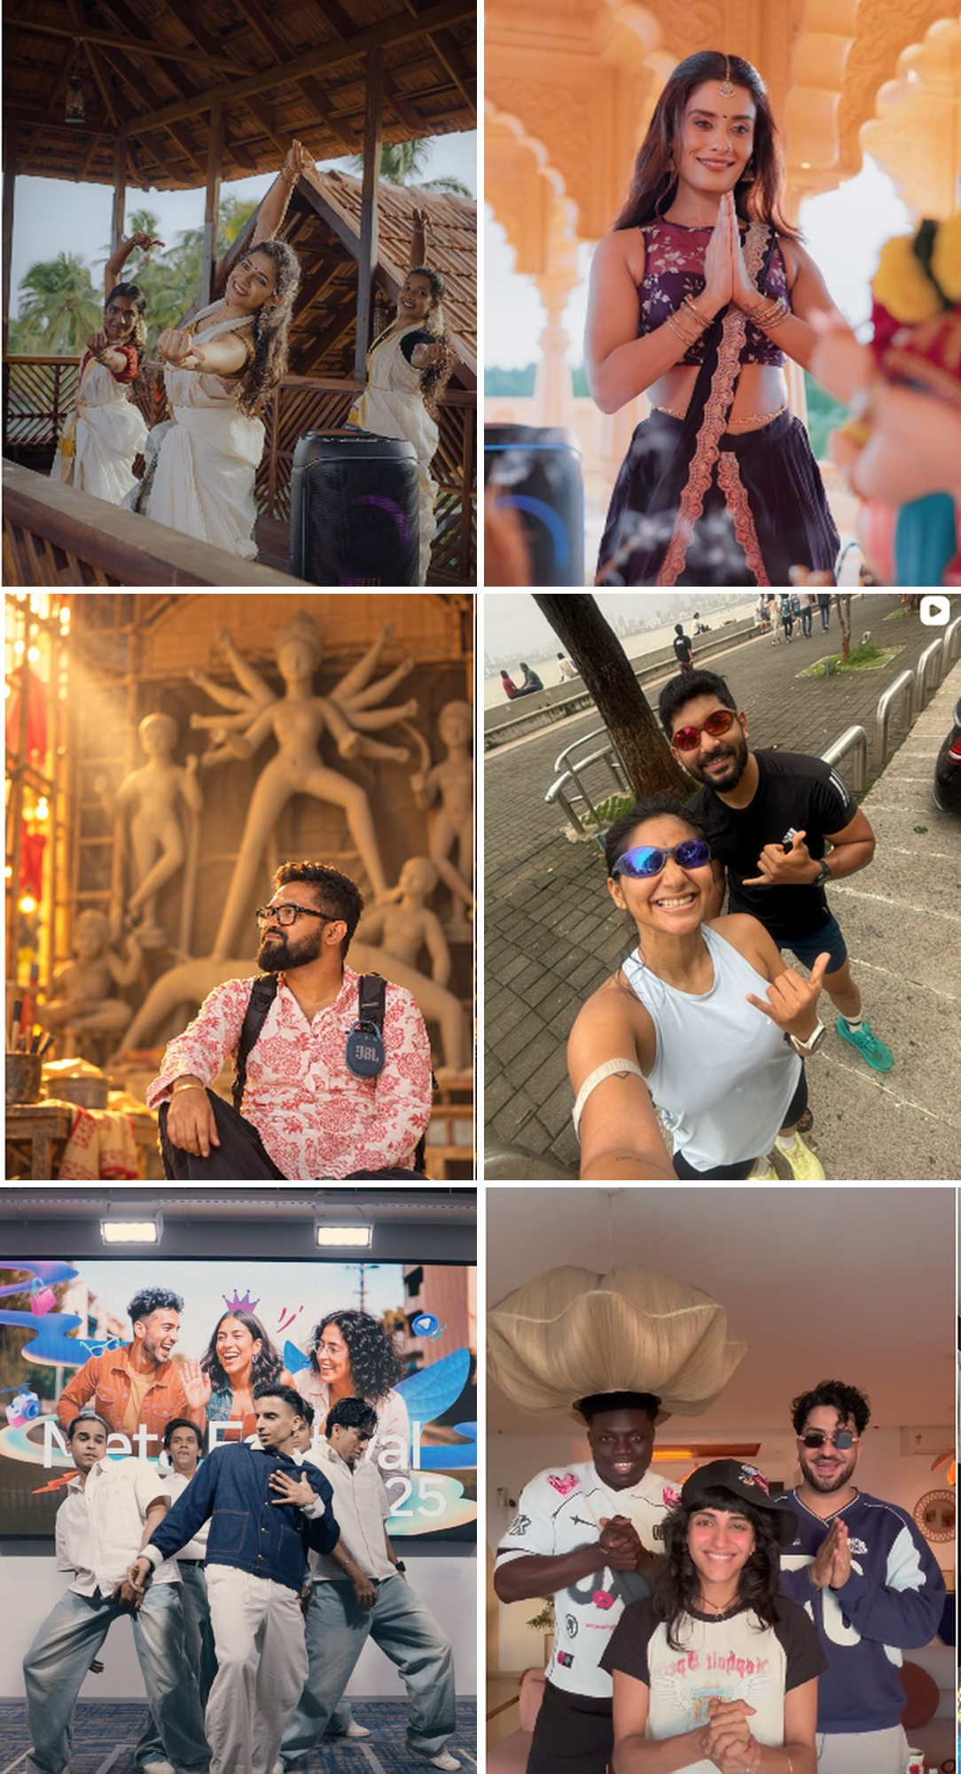
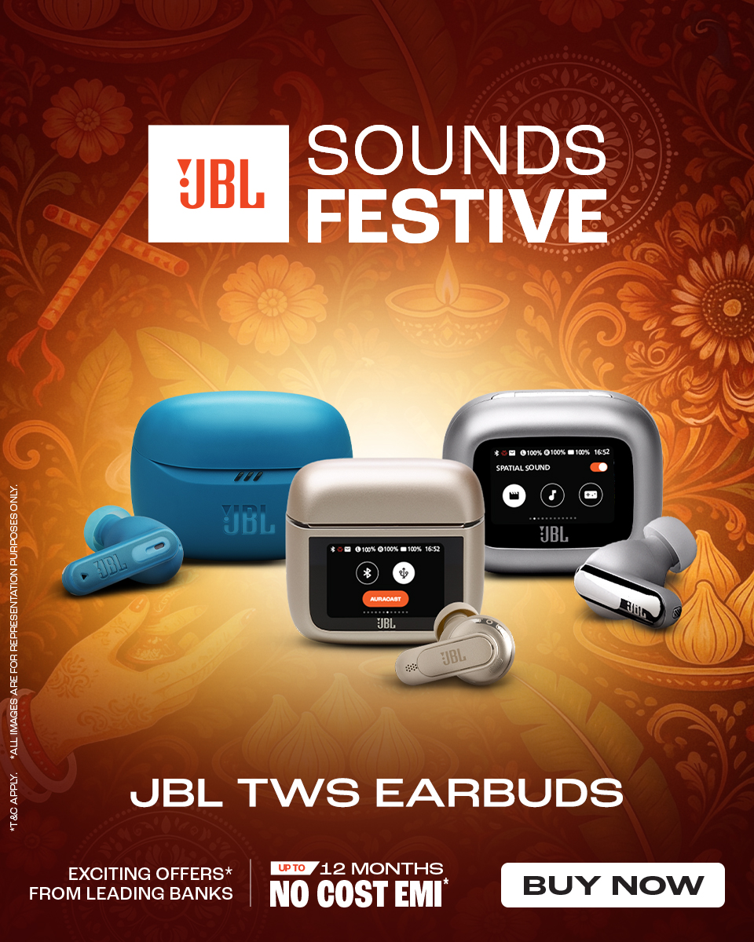
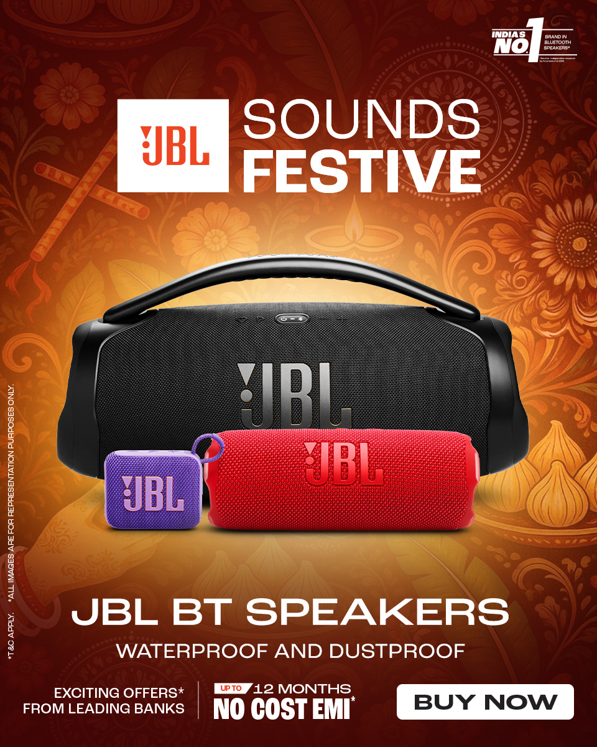
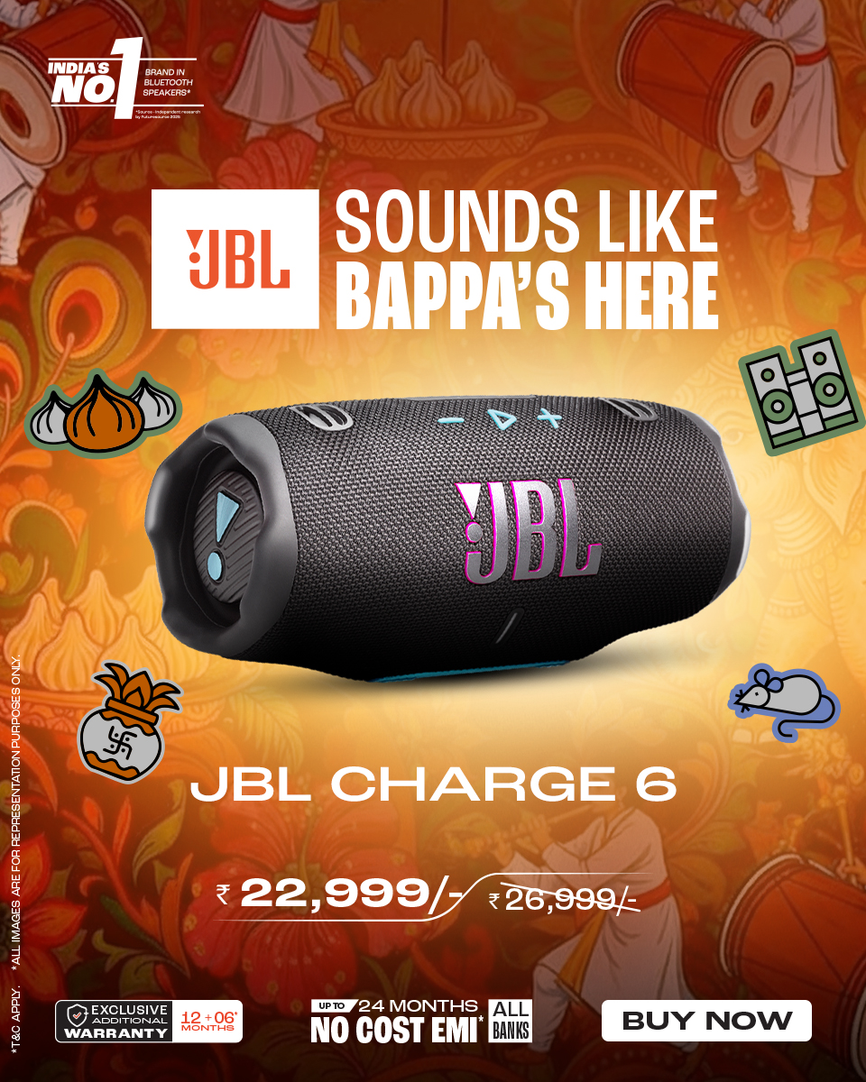
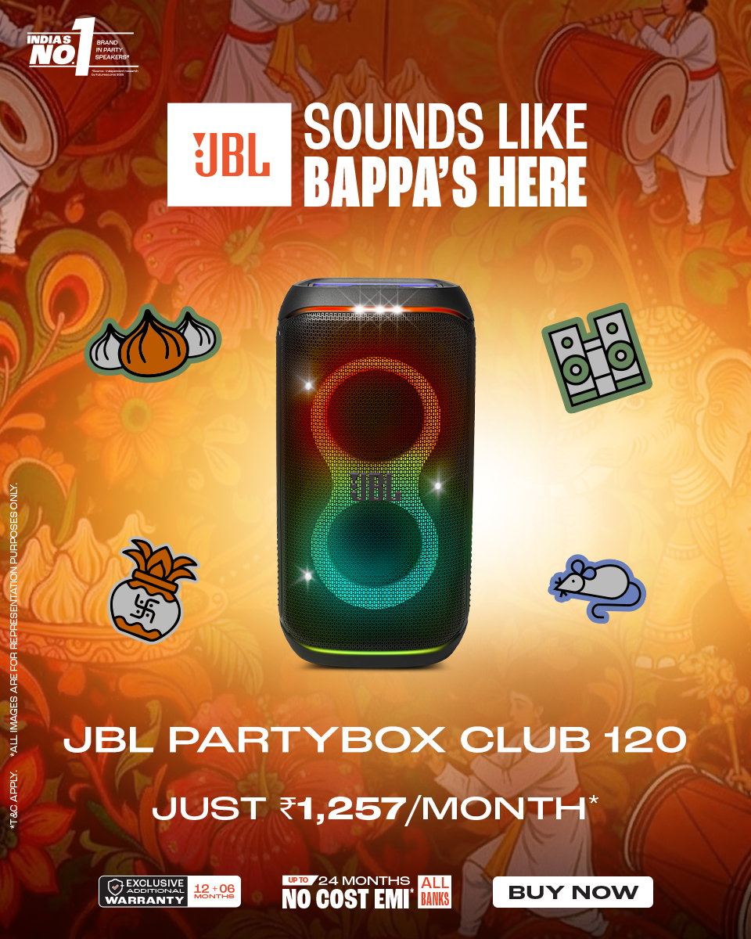
THE
CHALLENGE
REFRAMING
THE BRAND
Festive season is audio's most crowded window: every brand discounts on the same sale days, and marketplaces bid up JBL's own search terms.
The brief: drive consideration and sales across Tune, Live, PartyBox and Bar 1300 MK2 on JBL.com, Amazon and Flipkart, from Onam to Diwali.
The insight: every Indian festival has its own soundscape, and one national festive ad can’t speak to all of them.
Havas reframed JBL's role: from a brand running sale ads to the sound inside each celebration, told through regional musicians and creators, then caught at the moment of purchase with tech reviews and sale-day media.
DESIRABLE
BRAND IDEA
Sounds Like Festive became the desirable brand idea: one line that flexed for every festival (Sounds Like Onam, Sounds Like Bappa’s Here, Sounds Like Pujo). The rollout: 4 thematic films with regional musicians, 14 creator pieces across Kerala, Maharashtra, West Bengal and Punjab, 9 tech reviews plus 7 Amazon reviewers, #SoundsFestive giveaways, six-phase digital to Diwali eve, and OOH across 25 cities, 5 airports and the Mumbai Metro.
JBL × Havas Creative India
Notes:
JBL festive case, slide 2. Walk challenge, reframe, idea. Content counts are from the 5 Nov dashboard (4 films, 14 experiential pieces, 9 brand-owned tech reviews, 7 Amazon reviewers).

Slide 3
ONE IDEA. ONLINE AND ON THE STREET.
Every festival burst online was matched by OOH in the same markets, so audiences met one idea on their feeds and on their streets, from Ganpati to Diwali.
SOUNDS LIKE BAPPA’S HERE
SOUNDS LIKE PUJO
SOUNDS LIKE PUNJAB
SALE SEASON TO DIWALI
MAHARASHTRA & GOA
WEST BENGAL & ASSAM
LUDHIANA & CHANDIGARH
PAN-INDIA
DIGITAL
Bappa’s Here film with Divyam & Khwaab ft. Rohit Raut (11.5M views), plus Maharashtra creator pieces.
DIGITAL
Pujo film and West Bengal creator content in the run-up to the pandals.
DIGITAL
Punjab creator pieces as part of the 14-piece regional creator wave.
DIGITAL
9 tech reviews, 7 Amazon reviewers and six-phase media through Sale Wave 1 (8–31 Oct) to Diwali eve.
OOH
29 placements across Mumbai, Pune, Nagpur and Goa from 7 Sep, incl. Mumbai Metro and Laxmi Road by Dagadusheth Ganpati, Pune.
OOH
12 placements in Kolkata, Siliguri and Guwahati: a 100 x 31 ft LED at Deshapriya Park, Kolkata airport videowalls and city billboards.
OOH
13 placements across Ludhiana and Chandigarh tricity through October, incl. 5 market LED screens and the Sector 17 and ISBT 43 bus stands.
OOH
83 placements across 16 more cities, incl. Delhi, Bangalore, Hyderabad and Chennai airports and Ahmedabad’s riverfront anamorphic LED.
Source: JBL Festive 2026 report (till 2 Nov), JBL marketing dashboard (5 Nov 2026), JBL offline plan status (OOH)
JBL × Havas Creative India

Slide 4
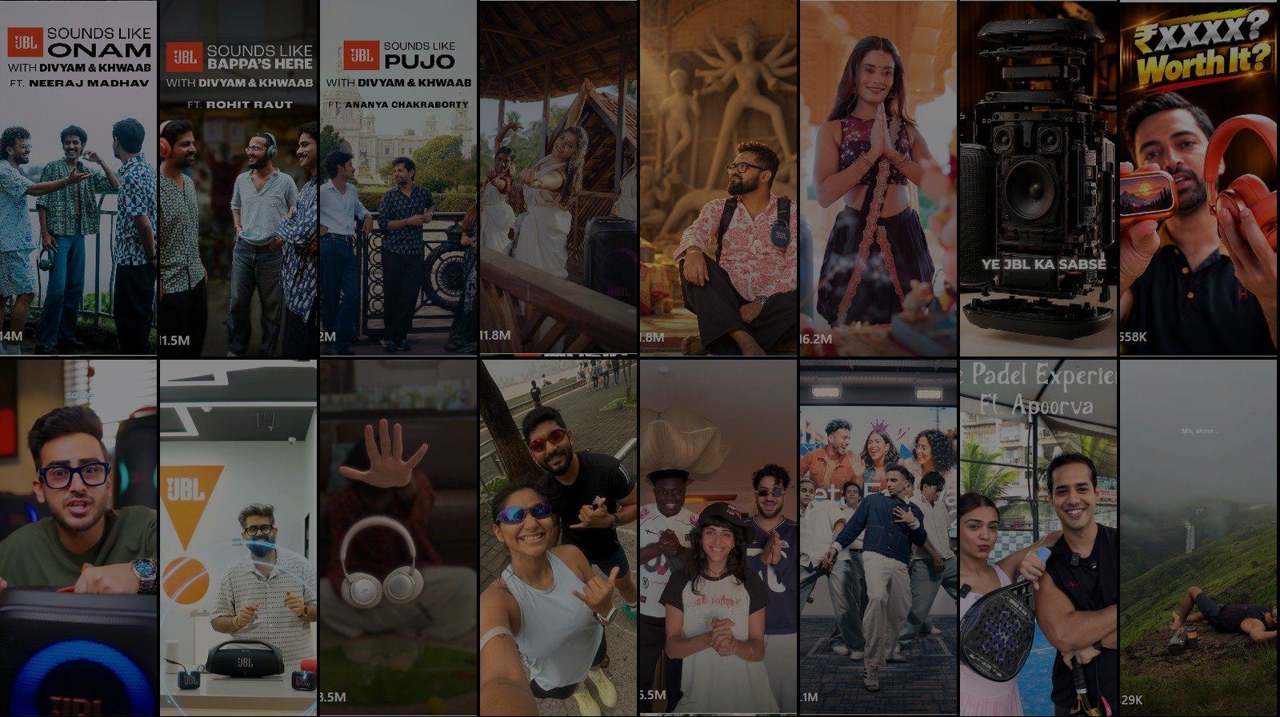
DRIVING GROWTH
TURNING FESTIVE BUZZ INTO ORDERS
When every festival gets its own sound, brands move from noise to relevance, and relevance turns sale-day traffic into orders.
410 Mn
CREATOR IMPRESSIONS
24 Mn
VIDEO VIEWS
Six-phase media put 56.7 Mn reach and 24.2 L clicks behind the festive range. JBL.com orders rose 135% to 353 and revenue 149% to ₹41.4 L vs Festive 2025, 80% of it from Soundbar and PartyBox.
#SoundsFestive
Notes:
JBL festive case, slide 3. Orders and revenue are GA-tracked JBL.com, 26 Sep – 2 Nov, vs Festive 2025. Creator figures are paid influencer delivery Aug – 2 Nov (festive plan, 22 of 23 assets live).

Slide 5
TAKING THE SOUND
TO THE STREETS
WEST
NORTH & CENTRAL
50 placements
47 placements
OOH ran 7 Sep – 23 Nov alongside digital: Ganpati in Maharashtra first, then Pujo in the East, then the sale weeks and Diwali across metros and fast-growing tier-2 cities.
Ahmedabad 16 · Mumbai 11 · Pune 8 · Nagpur 5 · Goa 5 · Surat 5
Chandigarh 8 · Lucknow 7 · Kanpur 5 · Varanasi 5 · Jaipur 5 · Dehradun 5 · Ludhiana 5 · Bhopal 5 · Delhi 2
25
CITIES
across 15 states
137
PLACEMENTS
static, DOOH, airport, metro
SOUTH
EAST
28 placements
12 placements
180+
DIGITAL SCREENS
incl. 140 pods at Delhi T2/T3
250 Mn+
EST. IMPRESSIONS
from 94 static sites alone
Bangalore 5 · Coimbatore 5 · Vijayawada 5 · Visakhapatnam 5 · Mangalore 5 · Hyderabad 2 · Chennai 1
Siliguri 5 · Guwahati 5 · Kolkata 2
Source: JBL offline plan status: Rest of India and Airport + Maharashtra + DOOH plans. Impressions are vendor estimates.
JBL × Havas Creative India

Slide 6
BIG STAGES FOR THE BIG SEASON
Premium formats put JBL where festive travellers and shoppers gather: airport terminals, the Mumbai Metro and landmark LED screens.
5
2
25
AIRPORTS · 152 SCREENS
MUMBAI METRO LINES
CITY DOOH SCREENS
Delhi T2 & T3: 140 digital mast-head pods
Hyderabad: exclusive anamorphic LED + domestic security screen
Bangalore: rotating LED in the check-in hall
Chennai & Kolkata: videowalls at security and boarding gates
Line 1 (Ghatkopar–Versova): exterior train wrap + in-train branding
Aqua Line: in-train branding + T2 station videowall and platform package
Andheri & Ghatkopar station videowalls
Ahmedabad: riverfront anamorphic LED + 10 city LED screens
Malls: Nexus Koramangala (Bangalore), Select City Walk (Delhi)
Landmarks: Deshapriya Park (Kolkata), Jog Flyover (Mumbai), MG Road (Bangalore)
Chandigarh: 5 market LED screens
Source: JBL offline plan status: Rest of India and Airport + Maharashtra + DOOH plans. Impressions are vendor estimates.
JBL × Havas Creative India

Slide 7
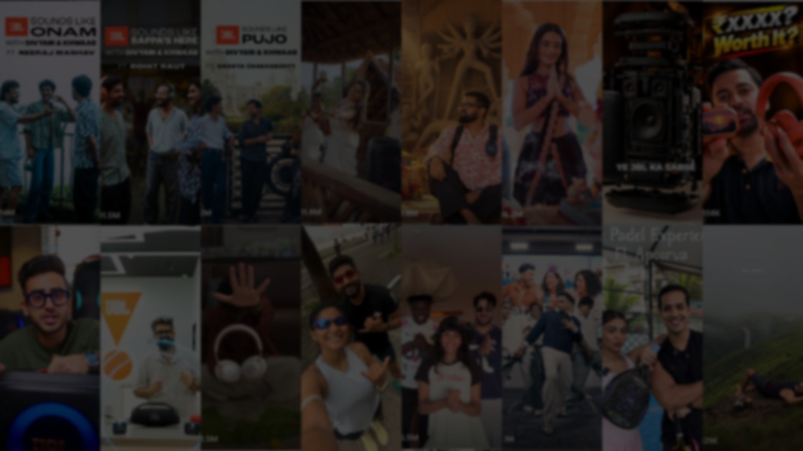
THIS FESTIVE SEASON SOUNDED LIKE GROWTH…
DIGITAL
56.7 Mn
NET REACH
102% of plan
24.2 L
CLICKS
0.52% CTR vs 0.24% plan
+135%
JBL.COM ORDERS
353 vs 150 in Festive 2025
+149%
JBL.COM REVENUE
₹41.4 L vs ₹16.6 L
OOH
25
CITIES
across 15 states
137
PLACEMENTS
180+ digital screens
5
AIRPORTS
+ Mumbai Metro, 2 lines
250 Mn+
EST. IMPRESSIONS
static sites, 7 Sep – 23 Nov
SALE WAVE 1 · 8–31 OCT 2026 vs FESTIVE 2025
JBL.com revenue ₹3.93 Cr, +27% YoY, with average order value up 30% · Amazon DSP sales ₹3.73 Cr, +12% YoY, 7.37x ROAS on the same spend
Source: JBL Festive 2026 report (till 2 Nov), JBL marketing dashboard (5 Nov 2026), JBL offline plan status (OOH est. impressions, static sites) · JBL × Havas Creative India

