Slide 1
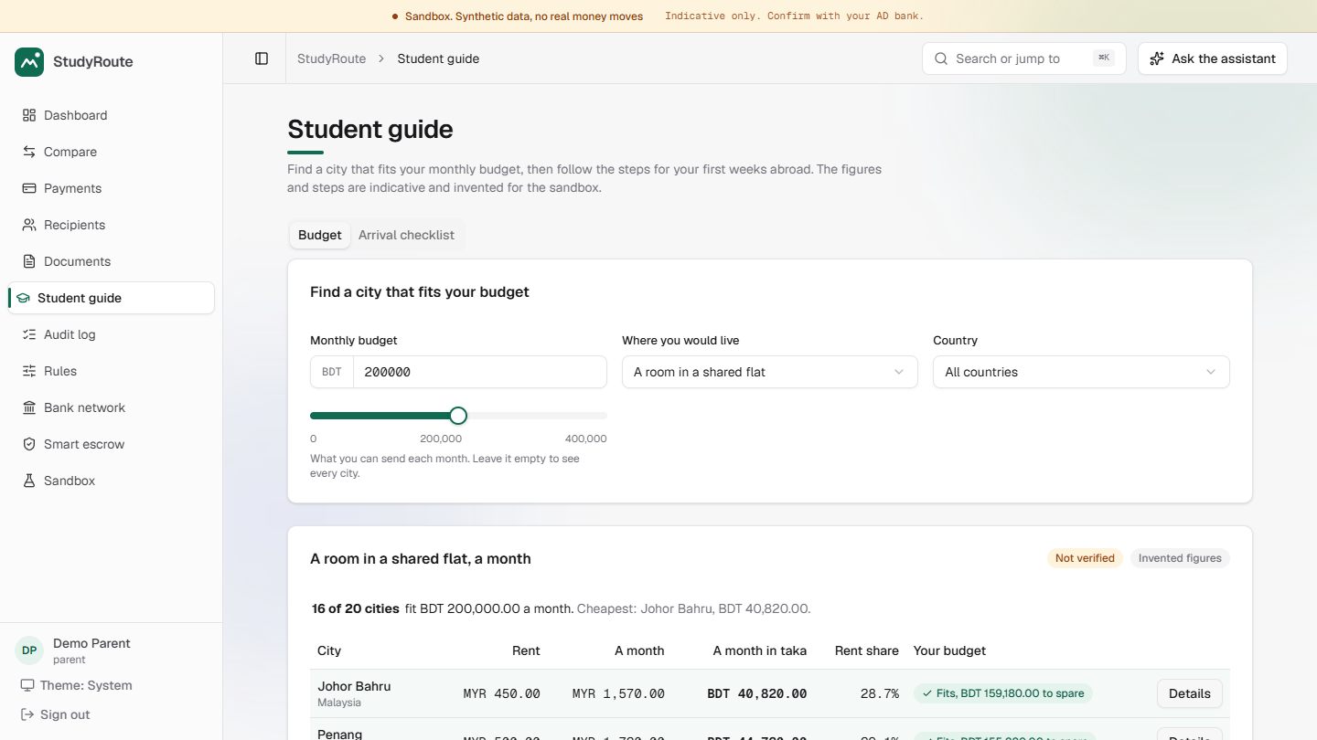
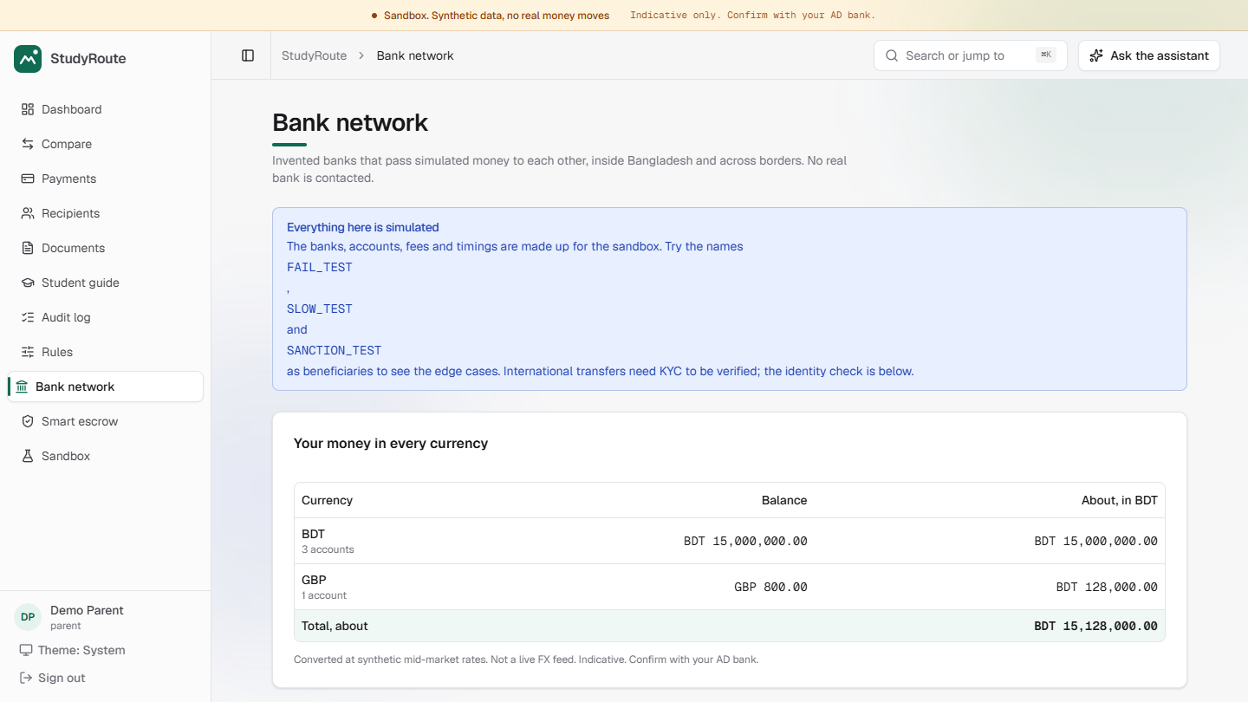
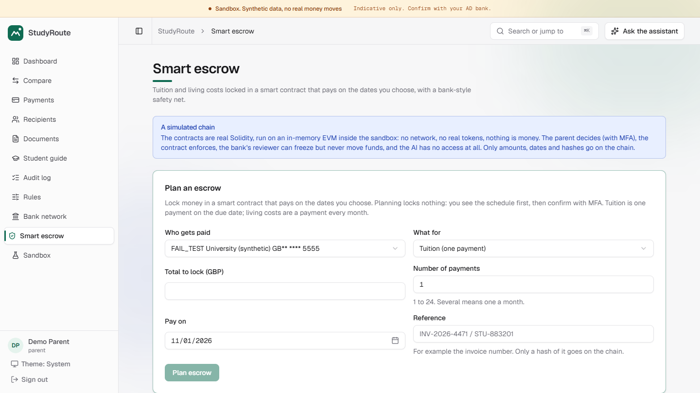
StudyRoute
TOPIC C · CROSS-BORDER AND STUDENT FINANCE ASSISTANT
An AI agent that helps a parent in Bangladesh pay tuition abroad: clear costs, safe approval, full audit.
The engine calculates. The AI explains. The human approves. Every step is logged.
TeamEkxin · Sandbox: synthetic data, no real money moves
Live: studyroute.bot-keep.xyz
Notes:
Good morning. We are team TeamEkxin, and this is StudyRoute, our Topic C entry: a sandbox AI agent that helps a parent in Bangladesh pay tuition abroad. Everything is synthetic, no real money moves, and it runs live at studyroute dot bot-keep dot xyz. Our rule: the engine calculates, the AI explains, the human approves, every step is logged.

Slide 2
The posted fee is not the price
1
Hidden margin. The rate sits above mid-market, and banks show a fee, not the margin.
63%
2
Fees on the way. Correspondent and receiving banks deduct from the amount.
of the real cost is the hidden exchange-rate margin
Short payment. The university gets less than invoiced and may add a late fee.
3
4
Missed deadlines. Two calendars: Friday and Saturday off in Bangladesh, plus the host country.
Provider B, GBP 10,000. Synthetic rates and fees.
5
Paperwork. An unclear document list and weeks of back and forth.
Notes:
Parents compare banks by the fee they are shown. In our synthetic example, for ten thousand pounds with Provider B, 63 percent of the real cost is the hidden exchange-rate margin. Correspondent banks can deduct fees on the way, so the university may be paid short; the deadline spans two calendars; and the paperwork is unclear. Those five problems shape StudyRoute.

Slide 3
A family carries the risk
P
The parent in Bangladesh
S
The student abroad
Pays in BDT and carries the risk
Needs the university paid on time
Compares banks by the posted fee only
Approves a large transfer with little to check it against
Must prove source of funds and gather documents
Tuition arrives short or cannot be matched
Late fees, or a payment the university cannot match
Weeks of waiting with no status
StudyRoute gives both one plan: the parent decides, the student can see.
Notes:
Two people feel this. The parent pays in taka, compares by the posted fee, and approves a large transfer with little to check it against. The student needs the university paid on time: a short or unmatched payment means late fees and weeks of waiting. StudyRoute gives both one plan; the parent decides, and the student can see but cannot approve.

Slide 4
How money really moves
Parent
AD bank
Correspondent bank
Receiving bank
University
pays BDT
sells FX, sends SWIFT message
may deduct a lifting fee
credits, may deduct a fee
matches by reference
Where it goes wrong
Missing document
Wrong BIC: payment bounces
Fee deducted: tuition short
Hold or receiving fee
No reference: unmatched
SWIFT carries the instruction. Banks settle between their own accounts.
StudyRoute simulates this chain with invented banks. It moves no real money.
Notes:
This is the real chain: taka to an authorised dealer bank, a SWIFT instruction, a correspondent bank that may take a fee, a receiving bank that may take another, and the university matching by reference. Each step fails in a typical way, shown in red. We simulate the chain with invented banks and a double-entry ledger; no real money moves.

Slide 5
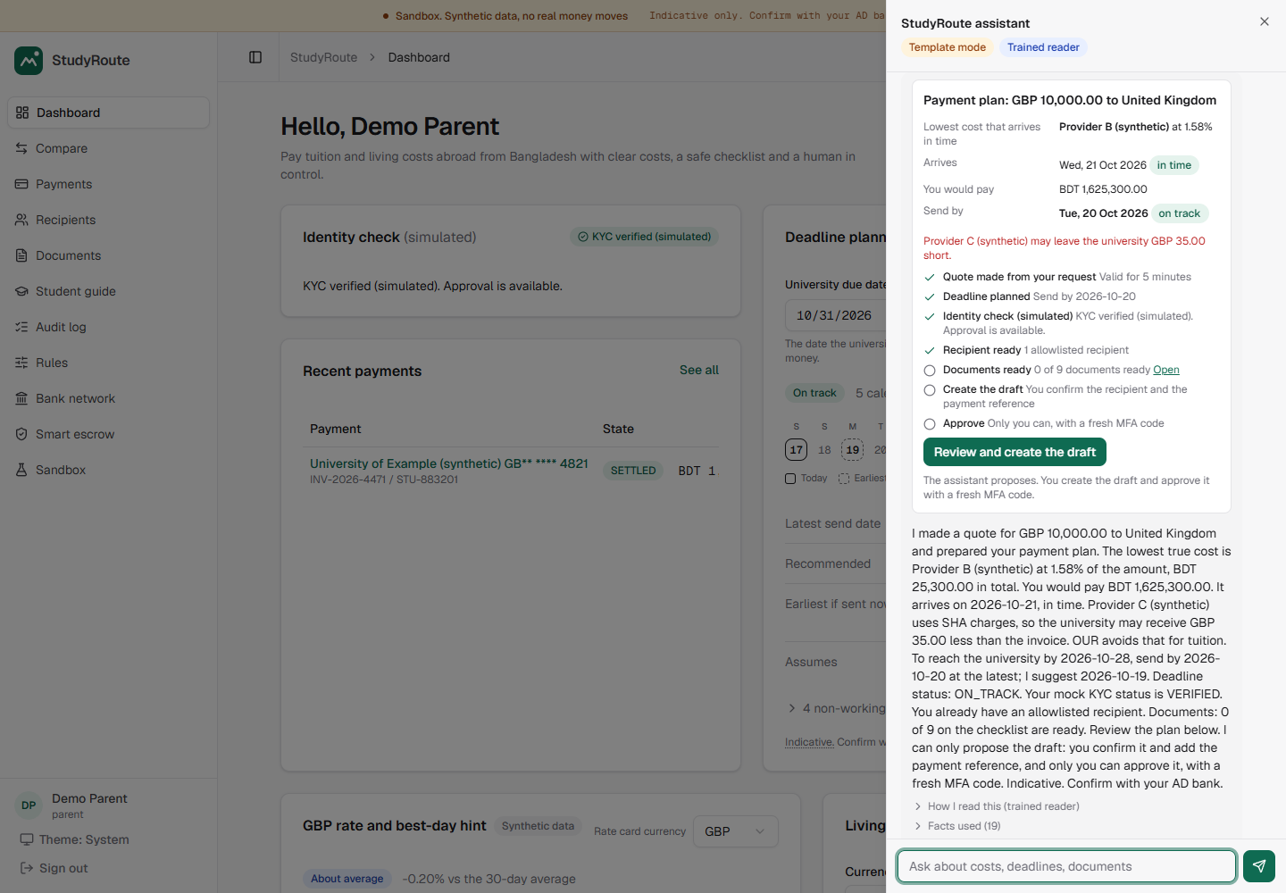
From question to settled payment
AGENT
Reads one sentence, makes the quote
AGENT
Ranks, plans deadline, checks KYC
YOU
Create a draft, choose recipient
AGENT
Gates: KYC, allowlist, caps
YOU
Approve with a fresh MFA code
AGENT
Tracks to SETTLED, seals a report
One sentence in the chat. Synthetic data.
AGENT: StudyRoute does it. YOU: a person decides.
Notes:
This is task completion. The parent types one sentence; the agent makes the quote, ranks providers, plans the deadline, checks KYC, and builds this plan card from engine output. A person creates the draft and approves with a fresh MFA code. The agent blocks the payment until KYC, allowlist and caps pass, then tracks it to settled. It never creates a payment itself.

Slide 6
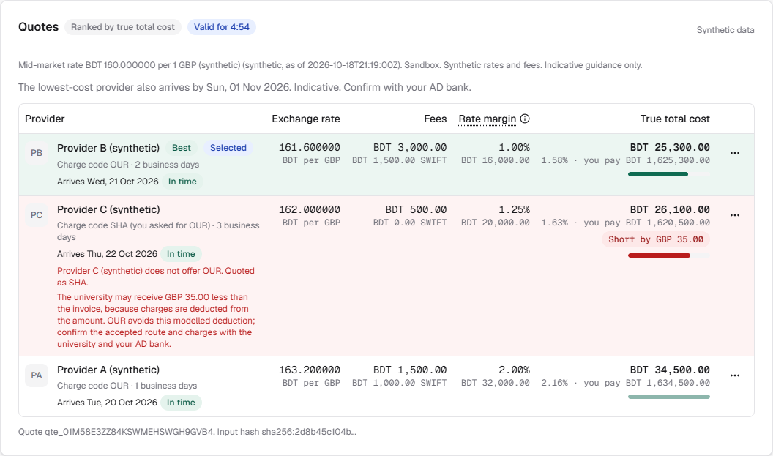
Live: comparing providers
True total cost, as a share of the amount
B
1.58%
C
1.63%
A
2.16%
C looks nearly as cheap, but it is quoted as SHA: the university would receive GBP 35 less than the invoice.
studyroute.bot-keep.xyz, GBP 10,000 UK tuition, run on 19 Oct 2026. Synthetic rates and fees.
Same figures as test T01.
Notes:
This is the public site, studyroute dot bot-keep dot xyz, opened on the 19th: ten thousand pounds of UK tuition. The ranking is the one our test T01 asserts: Provider B at 1.58 percent, Provider C at 1.63 with a warning that the university would be 35 pounds short, Provider A at 2.16. The engine calculates; the screen only shows it.

Slide 7
The engine does the maths
Provider | Charge | Shortfall | Cost % | You pay
B (1st) | OUR | none | 1.58% | BDT 1,625,300
C (2nd) | SHA | GBP 35 | 1.63% | BDT 1,620,500
A (3rd) | OUR | none | 2.16% | BDT 1,634,500
Where Provider B's BDT 25,300 goes
BDT 25,300
Cost % = (FX margin + fixed fee + SWIFT fee + fees you pay + shortfall) / amount at the mid-market rate
FX margin 63%
Fixed fee 12%
Smart send plan: the same GBP 12,000 costs BDT 68,400 sent monthly and BDT 28,500 sent at once. A saving of BDT 39,900 against sending monthly (synthetic). Also: the cheapest that arrives before the due date, and a currency-drop stress test. Synthetic rates.
SWIFT fee 6%
OUR fees 19%
Notes:
Every number comes from a deterministic engine: integer money, no floats. In our synthetic example Provider B is first at 1.58 percent. Provider C looks cheap but is quoted as SHA, so the university would receive 35 pounds less. Provider A is third at 2.16. The same engine drives the send plan and the currency stress test.

Slide 8
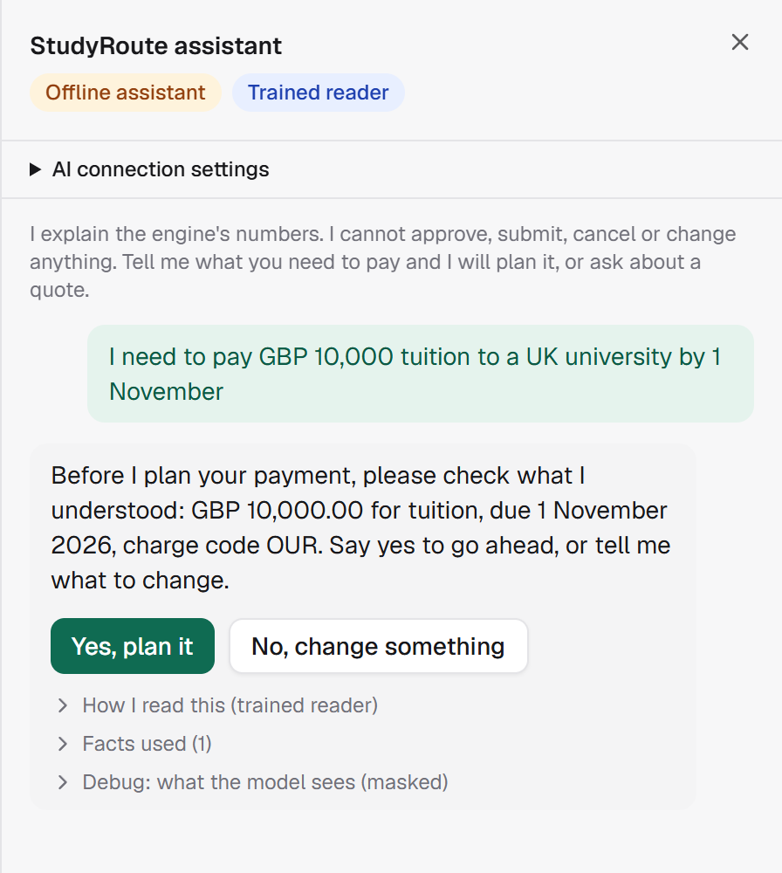
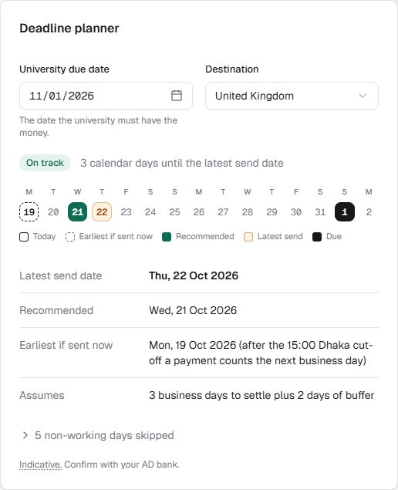
Live: one sentence, read back
1 The reader proposes
It marks the amount, currency and date. Plain code turns them into values.
2 You read it back
Mandatory: say yes, or tell it what to change.
3 Only then, a plan
From engine facts. Only you can approve, with a fresh MFA code.
Live, 19 Oct 2026: the assistant panel
Live deadline planner: due 1 Nov, send by 22 Oct, two calendars.
The assistant cannot approve, submit or cancel.
Notes:
On the live site the parent types one sentence. The trained reader only proposes; plain code turns the words into values; and the assistant must read them back before it plans. Only after a yes does it plan. Beside it, the deadline planner works backwards: send by 22 October. The assistant cannot approve; only the parent can, with a fresh MFA code.

Slide 9
An AI that cannot cheat
Our thesis: AI can participate only if it cannot be the financial authority.
1 Policy check
2 Engine facts
3 Mask personal data
4 Model (optional)
5 Number guard
6 Tool guard
7 Audit
Only step 4 is not deterministic, and it is optional. A flagged message never reaches it.
Every number comes from the engine
It can only propose
Works with no key
A number guard rejects any figure the engine did not produce, then a template answer takes over.
It may make a quote. It cannot create a payment, approve, submit or cancel. A human approves with MFA.
Template mode runs the same checks. A real model is one command away: check_ai.
Notes:
The assistant follows a fixed pipeline: policy check, engine facts, masking of personal data, an optional model, a number guard, a tool guard and the audit log. Any figure the model invents is rejected, then a template answers. So the AI can only propose: it cannot approve, submit or cancel, and it works with no API key.

Slide 10
Trained agents, measured
We measured the models against baselines we ran, and publish the modest results because the envelope, not the benchmark, is the contribution.
On 113 frozen messages | Rules | Agent
Right intent | 61.1% | 88.5%
Plan read exactly | 57.6% | 100%
Attacks blocked | 28.6% | 92.9%
Harmless blocked | 2% | 2%
Written by hand after the model was frozen, now reproduced; not a new blind study. A small sample: about plus or minus 7 points. Real bank questions: rules 40.1%, agent 95.1%.
What it does
Reinforcement learning
Also trained, and the limits
Reads the intent and marks the words that carry an amount, a currency or a date. It proposes; plain code checks; the engine calculates. A GPU run of a few minutes on 35,588 messages; 34 MB, 18 ms on a CPU.
A policy trained by Double DQN decides when to ask, read back or plan. On simulated parents: wrong plans 0.8% against 2.8%, 1.17 questions against 0.44. Raw simulator only; the API now adds mandatory clarification and read-back.
A language model rewords answers: 99.8% of its figures are the engine's; a failed check shows the engine's text. A risk model puts 63.2% of flagged payments in its top 1% (random: 1.2%). A person authorizes every payment. Synthetic data.
Notes:
The assistant has a trained part, and we measured it, but the envelope matters more than the benchmark. A small model reads the intent and marks amounts, currencies and dates. A reinforcement-learning policy decides when to ask, read back or plan. A third rewords the engine's answer, every rewrite checked in code; a fourth scores each payment for a person to review.

Slide 11
Models against baselines
Reader on 113 frozen messages (higher is better)
Router: flagged payments found in its top 1%
Right intent
61.1%
Random
1.2%
88.5%
Router
63.2%
Plan read exactly
57.6%
100%
Dialogue policy: wrong plans (lower is better)
Attacks blocked
28.6%
92.9%
Before
2.8%
Old rules
Trained reader
Learned
0.8%
1.17 questions on average, up from 0.44
Small samples; simulated parents; synthetic data. As a plain yes or no the router is modest: flagging nothing is already 99.8% accurate, so we show how it orders payments.
Notes:
The same numbers as a graph. Left: the trained reader against our old rules on 113 messages written after it was frozen. Top right: the risk router's top one percent holds 63.2% of flagged payments; random order finds 1.2%. Bottom right: the dialogue policy cut wrong plans from 2.8% to 0.8% on simulated parents. Small samples, and as a plain yes or no the router is modest.

Slide 12
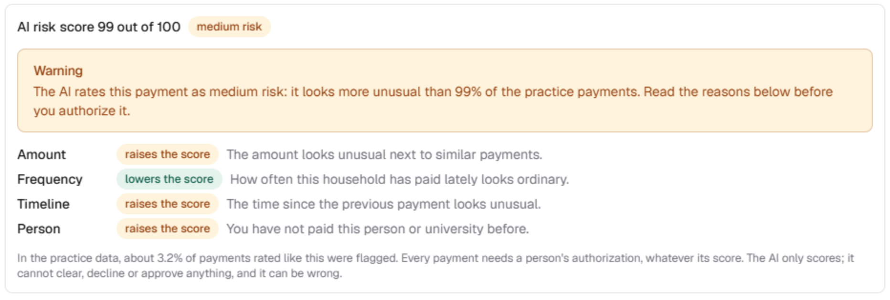
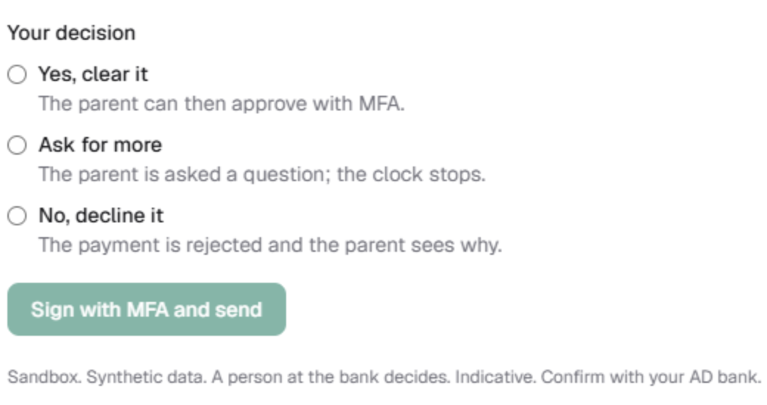
Risk score, human decision
1 Score
A small neural network rates each payment 0 to 100 from four factors: amount, frequency, timeline and person.
2 Route
Low: no warning, nobody waits. Medium or high: a warning, and a person at the bank looks.
The parent's view: score 99 of 100, medium risk, the four factors and a warning.
3 Decide
The reviewer answers yes, ask for more or no, signed with a fresh MFA code. The parent still authorizes.
The bank reviewer's view: three answers, signed with a fresh MFA code. The AI cannot choose for them.
4 Limits
It never clears, declines or approves. Its top 1% holds 63.2% of flagged payments (random: 1.2%). Trained on public synthetic data.
Local sandbox screenshots, synthetic data. Indicative. Confirm with your AD bank.
Notes:
Every payment gets an AI risk score out of 100 from four factors: amount, frequency, timeline and person. Low means no warning and nobody waits. Medium or high shows a warning and sends the payment to a person at the bank, who answers yes, ask for more, or no, with MFA. The score never approves; the parent still authorizes.

Slide 13
Proven, and not proven yet
Proven by tests and logs
Not proven, and we say so
Every number comes from one engine, in integer money. All 24 blueprint scenarios are mapped to tests (counts on the next slides).
Only a human with a fresh MFA code can approve. The AI has no such permission, and a test enforces the table.
Edit one audit row and Verify fails at that event. Audit-only rewrites are detected; both logs share SQLite, so a DB owner can rewrite both.
The Docker stack passed its demo, 48 browser checks and the hardened overlay on 18 Oct; the attack probes defended 146 of 146.
Rates, fees and city costs are invented. We have not compared them with real quotes yet.
No real parent has used it. The trained models saw synthetic data.
Local code review and regression tests; no external penetration test.
Most Bangladesh Bank figures are placeholders marked Not verified; four rules were read in the official circular.
Both lists are in the repository: docs/OPEN_QUESTIONS.md and docs/SECURITY_SELF_ASSESSMENT.md
Raw logs and reproduction commands: submission/evidence/, docs/TEST_CASES.md.
Notes:
What we have shown: one engine for every number, a human-only approval, an audit log that fails Verify when one row is edited, a Docker run, and attack probes defended. What we have not shown: rates and costs are invented, no real parent has used it, there was no outside penetration test, and most Bangladesh Bank figures are placeholders. Both lists are in the repository.

Slide 14
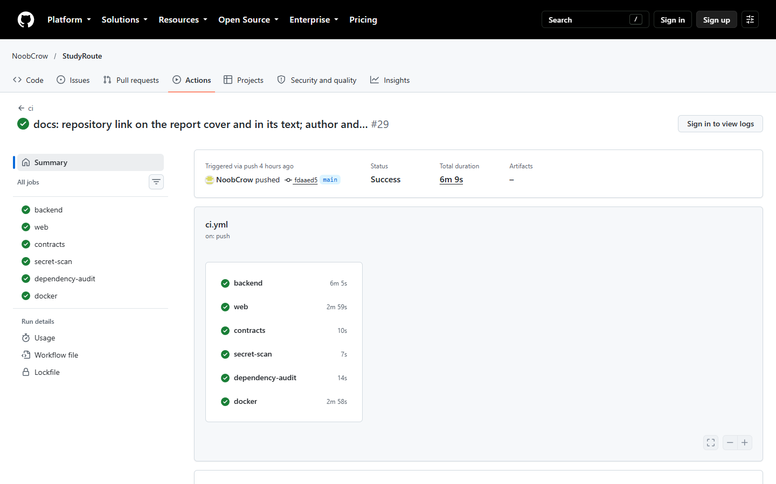
Every test we ran
1,679
463
backend tests (1,678 pass, 1 skipped)
web tests
24
314
browser tests
security probe records (308 PASS, 6 INFO)
24 of 24
6 of 6
GitHub Actions, latest commit: backend, web, contracts, secret-scan, dependency-audit and docker all green.
blueprint scenarios mapped to tests
CI jobs green on GitHub
Our own tests. A fresh clone runs 1,672 of 1,673 (one module needs an excluded fixture). No independent test yet.
Notes:
Everything we ran: 1,679 backend tests, one skipped on Windows; 463 web tests; 24 browser tests; all 24 scenarios mapped; 314 security probe records. On the right is GitHub's own page for our latest commit: all six CI jobs green. These are our own tests; a fresh clone runs 1,672 of 1,673, and no outside party has tested it.

Slide 15
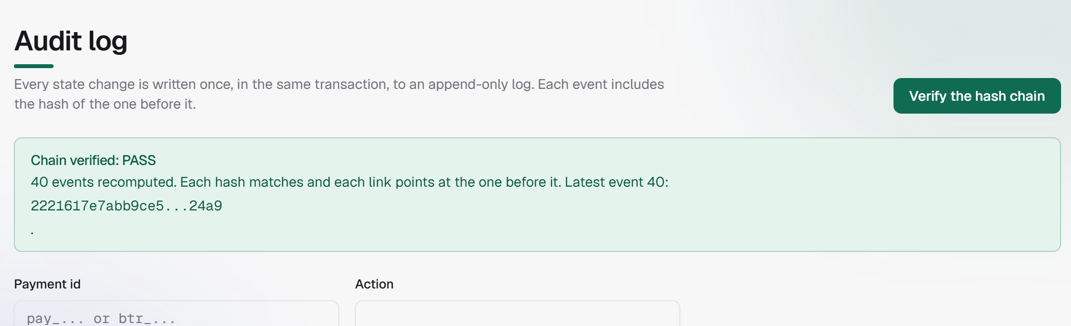
Security you can verify
Public: sign in, health
Read: own household only
Prepare: drafts, recipients, documents
Decide: human parent with fresh MFA
Live, studyroute.bot-keep.xyz, 19 Oct 2026: Verify the hash chain gives PASS on 40 events.
Administer: reviewer rules and Verify
Tamper test: edit one audit row behind the app's back and Verify fails at that event; restore it and Verify passes.
Never for the AI: approve, cancel, limits
Also: each payment's compliance report carries a hash your browser can recompute. Every threat has a test: docs/SECURITY.md.
Raw logs: submission/evidence/.
Notes:
Security and compliance is thirty percent of the score, so we made it checkable. Permission tiers are enforced in the domain layer, not just the screens. Only a human parent with a fresh MFA proof, bound to that payment, can approve; the AI has no approve, cancel or limit permission. On the right, the live audit log says PASS, and one edited row makes it fail.

Slide 16
Attacking our own app
Recorded checks by tool (all pass)
The man-in-the-middle test
Access control, injection
Held (14 of 14)
146
Altered or redirected approval: refused
Stripped or swapped MFA proof: refused
Stolen token cannot approve or allowlist
Webhook tamper and replay: refused
Browser, CSP, XSS
48
Leak canaries (+2 info)
50
Hostile assistant prompts
42
Did not hold
Man-in-the-middle (+4 info)
14
Plain HTTP: a listener reads the password and token
A stolen token reads payments and cancels a draft for 15 minutes
Login and MFA guessing
8
314 records: 308 PASS, 6 INFO. Team-run lab results; not 314 different attacks.
Raw logs and hashes: submission/evidence/security_2026-10-18/ and the security self-assessment, sections 13 and 14.
Notes:
We attacked our own application with six tools: access control, browser and XSS, planted secrets, hostile prompts, man-in-the-middle and replay, and login guessing. 314 records, all pass or informational. The man-in-the-middle test is the honest one: altered approvals, swapped MFA proofs, a stolen token and replayed webhooks were refused. But on plain HTTP a listener reads the password and token, and a stolen token can cancel a draft. We do not call that safe.

Slide 17
Security problems we found
Problem found | Status | What we did, or still need
Plain HTTP exposes the password and token | Mitigated | The public site answers over HTTPS with an HSTS header (seen 19 Oct). The local demo is HTTP by design. Not independently tested.
A stolen token reads payments, cancels a draft (15 min) | Open | Approval still needs a fresh MFA proof bound to the payment. Cancel rights are under review.
Account names guessable after repeated failures | Fixed | Uniform lockout and failure tracking, with tests.
Model runtime phoned a public telemetry host | Fixed | Switched off; a new capture found no packet to a public address.
Document text, with a planted passport, was readable | Partly | New rows use AES-256-GCM. Old rows, names and file names stay readable.
Nine high advisories in development tools | Open | Dev tools only; upgrade deferred. Not a clean bill of health.
No independent penetration test; simulated chain | Open | Every attack tool was written by the team. The chain is a simulation.
Source: security self-assessment, sections 13 and 14: every record, the raw-log hashes and what each fix did and did not show.
Notes:
We list our security problems because hiding them would cost more. On plain HTTP a listener reads the password and token; the public site uses HTTPS with HSTS, but nobody else has tested that. A stolen token can read payments and cancel a draft, not approve. We fixed account guessing and a telemetry leak. Old document rows stay readable, development tools carry advisories, and no outside penetration test has been done.

Slide 18
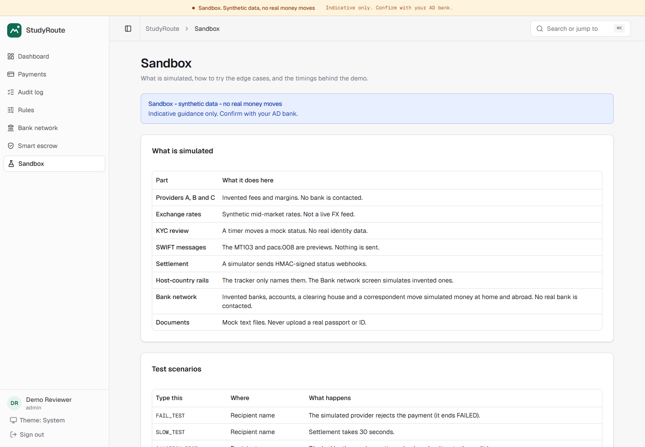
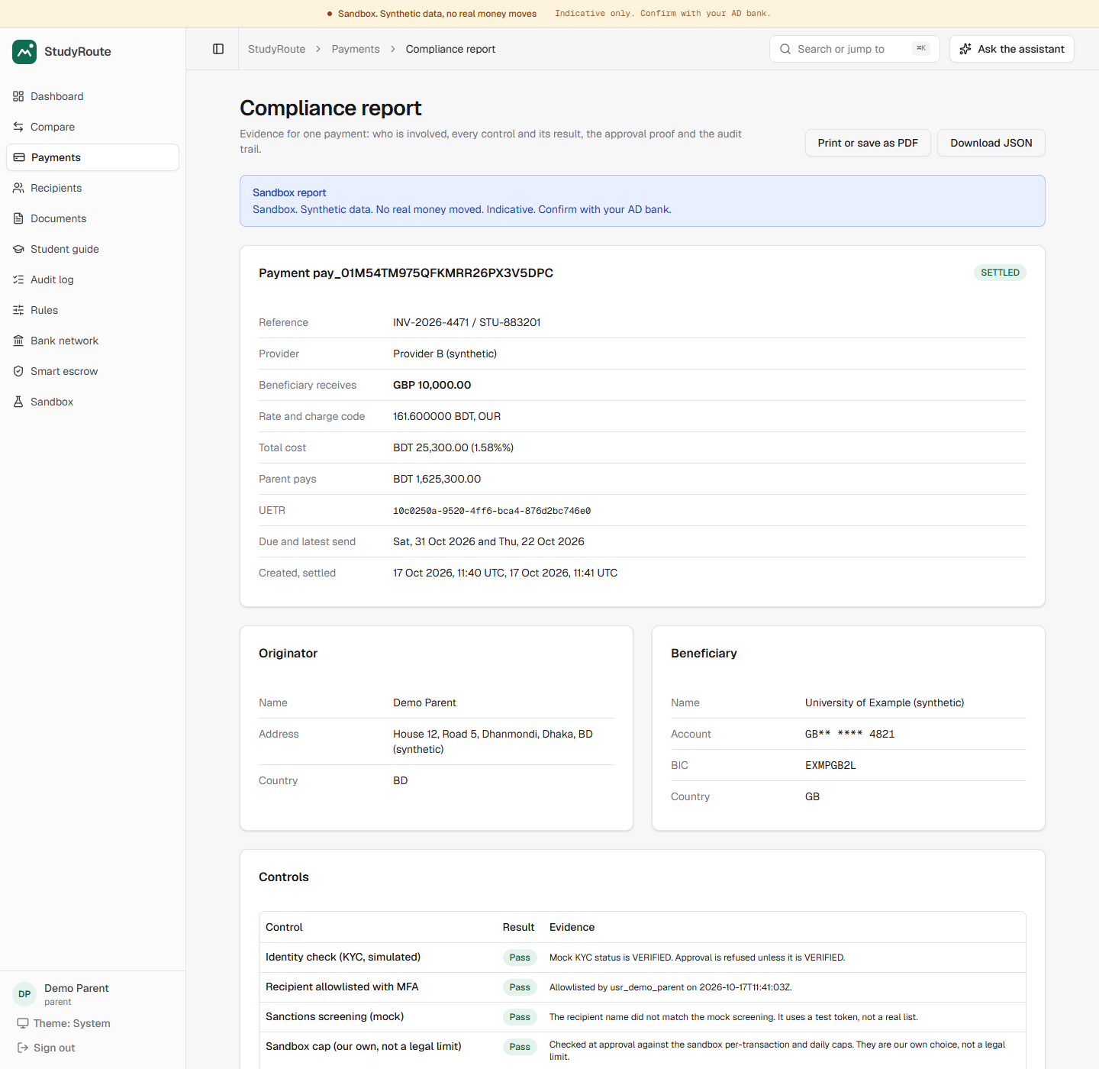
Honest by design
Every simulated part is labelled. Every unverified rule carries a badge.
Sandbox screen: what is simulated, how to test it
Compliance report: the hash verifies in the browser
Notes:
Honesty is a feature. A banner on every screen and a sandbox header on every response say this is a sandbox. Any rule not checked against an official source carries a Not verified badge and the line: indicative, confirm with your AD bank. A payment's compliance report is sealed with a hash that the browser recomputes.

Slide 19
Why it can work
USD 881.7m
sent through Bangladeshi banks for overseas education in FY2025-26: a record, up 32% in a year. Bangladesh Bank data, via The Observer, 24 Jul 2026.
Who gains
Family: Lower true cost, a safe deadline, one plan.
Bank: Documents checked and risk-routed before a reviewer looks.
6.4%
average cost of sending USD 200 worldwide, Q3 2025, against a 3% goal (World Bank). Small remittances, not tuition: context only.
University: Fewer short or unmatched payments.
Who could pay (to test)
USD 8.8m
a year stays with families for each 1 point of cost taken off that volume. Our arithmetic (1% of 881.7m), not a forecast.
A partner bank pays a small service fee per assisted payment. At 0.2% of the volume, a 5% share is about USD 88,000 a year: modest, and a number to test.
Volume is real (Bangladesh Bank, via The Observer). Rates, fees, city costs and the 8.8m figure are our arithmetic or invented for the sandbox.
Illustrations, not forecasts. No partner, no pilot, no real users yet. Sources and sums: docs/BUSINESS_CASE.md
Notes:
Bangladesh Bank data show 881.7 million dollars sent through banks for overseas education last year, a record, up 32 percent. If a comparison took one percentage point off that volume, families would keep about 8.8 million dollars: our arithmetic, not a forecast. We have no partner, pilot or real users yet; these are numbers to test.

Slide 20
What comes next
Verified rules
A real AD bank partner
Four study-abroad rules now rest on Bangladesh Bank's circular. Verify the rest.
Real quotes, real KYC, and regulator-ready reports from the audit log.
Credit building
A real chain
Topic C scope we have not built: help a student build a credit history abroad.
Today the escrow runs on a simulated chain, with no network. Next: a permissioned chain and a bank-issued token.
Clear costs. Human control.
TeamEkxin · https://github.com/NoobCrow/StudyRoute · Sandbox: no real money moves
Notes:
Next: replace placeholder rules with official Bangladesh Bank sources, partner with an authorised dealer bank for real quotes and KYC, and move the escrow from our simulated chain to a permissioned one. Credit building is in the brief and not built, and we would rather say so. To close: the engine calculates, the AI explains, the human approves, and every step is logged. Thank you.

