Slide 1
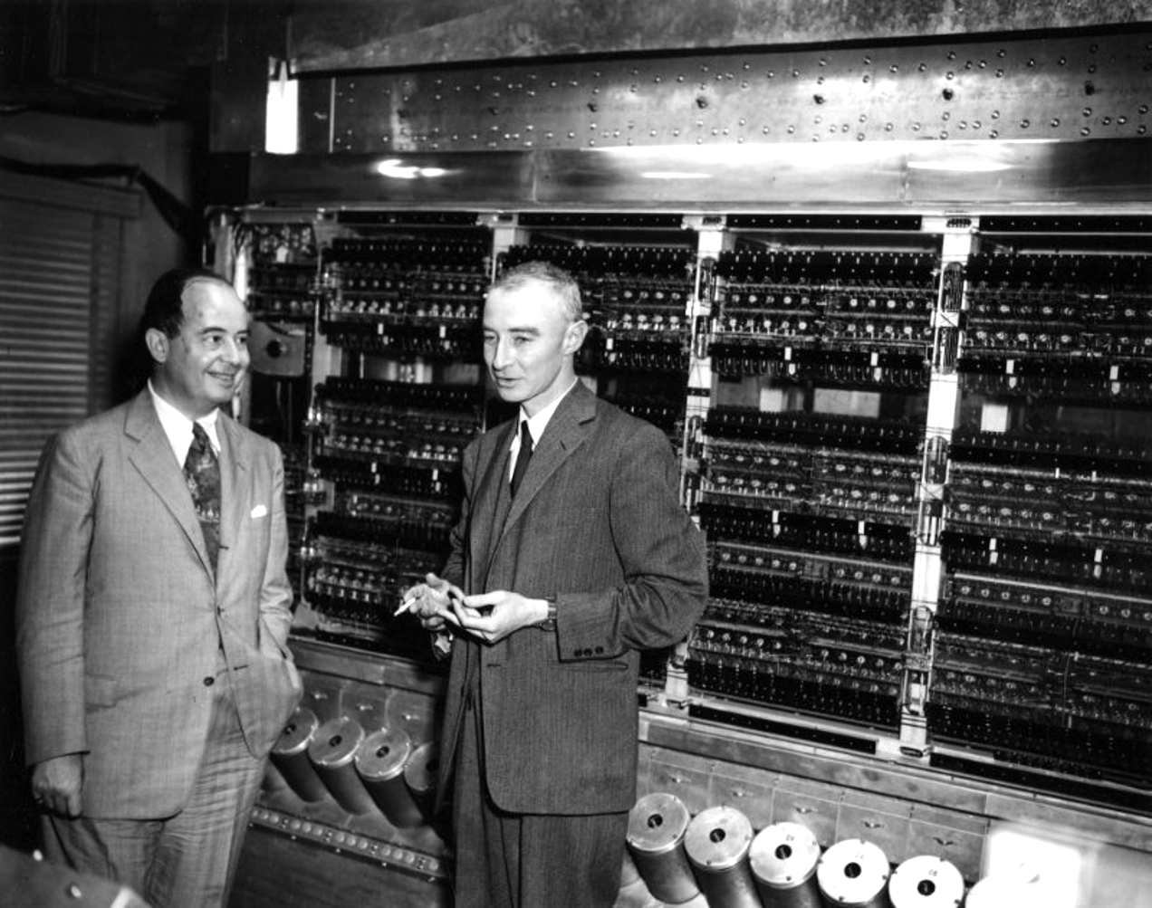

Slide 2
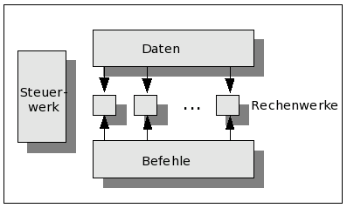
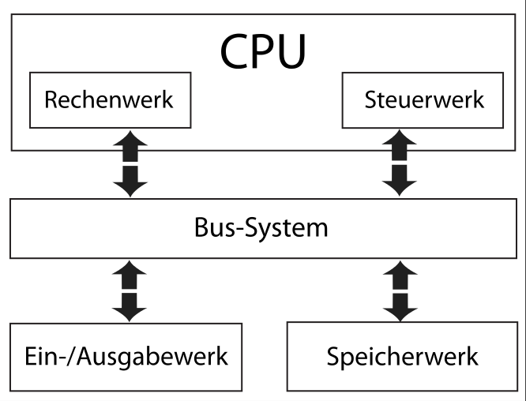
Harvard
Von-Neumann

Slide 3
Von-Neumann-Zyklus
(Bsp: A + B)
FETCH
(00010101)
WRITE BACK
(= C)
DECODE
(01010101 = +)
EXECUTE
(A + B)
FETCH
OPERANDS
(A B)

Slide 4
Assembler
mov eax, DWORD PTR [rbp-12] | 100010110100010111110100
Compiler
return c; | 100010110100010111110100
Compreter (Just-In-Time)
return c | IL_0006: ret | 100010110100010111110100

