Slide 1
Impact of Social Backgrounds on Student Alcohol Consumption
Boyang Meng, Ding Sun, Leanne Ye,
Manyi Liu, Sheng Horng, Yu-Han Lai

Slide 2
Introduction
Problem: Serious alcohol abuse in U.S. college campus
Our project intends find the relationship between
the students' family situation
academic situation
alcohol use.
Goal:
Classification model that predicts the student's overall alcohol consumption level
Important element that impacts student's overall alcohol consumption

Slide 3
Literature Review
College students with higher socioeconomic status (SES) are most likely to consume more alcohol than those with lower SES, because they have a higher purchasing power.
College students with lower SES are more likely to be burdened with negative alcohol-related consequences than those with higher SES.
Alcohol consumption is encouraged through role models, peer attitudes, mass media, and the community's attitude in general.

Slide 4
Dataset Description
Our dataset has a total number of 1044 samples, and a total of 33 attributes, of which Dalc and Walc are the ones we want to predict.
The alcohol consumption level on working days ranges from 1 to 5:
Level 1— 727 samples
Level 2 – 196 samples
Level 3 – 69 samples
Level 4 – 26 samples
Level 5 – 26 samples
The alcohol consumption level on weekend ranges from 1 to 5:
Level 1 – 398 samples
Level 2 – 235 samples
Level 3 – 200 samples
Level 4 – 138 samples
Level 5 – 73 samples

Slide 5
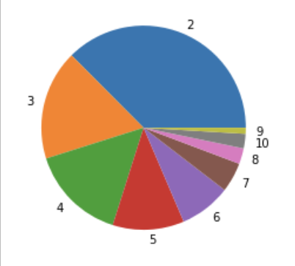
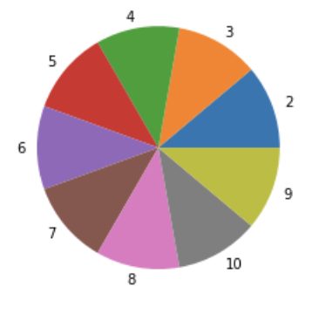
Feature Selection: Alc and Oversampling
Targets the Overall alcohol consumption
Combine the Dalc and Walc into Alc
Oversampling
Uneven observations across different level of alcohol consumptions
Oversample the dataset to make the model unbiased

Slide 6
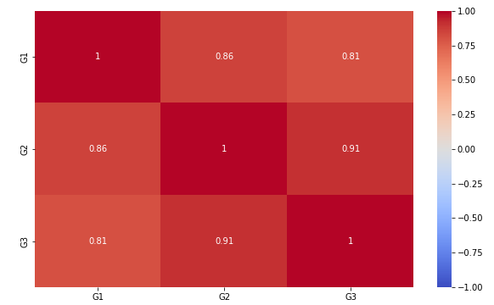
Feature Selection
Removed G1, G2, and keeps G3
High correlation between G1, G2, and G3
High-correlated attributes will impact the model as we use RBF kernel
Using Randomforest Model to sort the importance of each features, select the features above the average importance

Slide 7
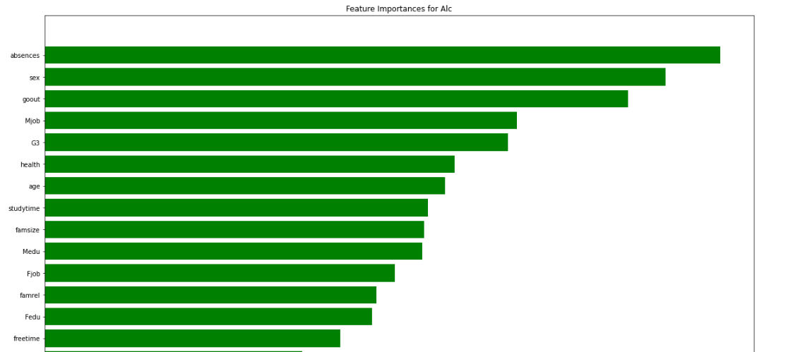
Feature Selection: Random Forest

Slide 8
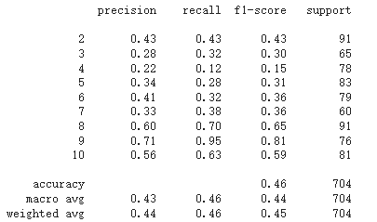
Model: Logistic Regression
Logistic model performed badly
Possible reason
Non-linearity
Need models that can capture non-linear relationships

Slide 9
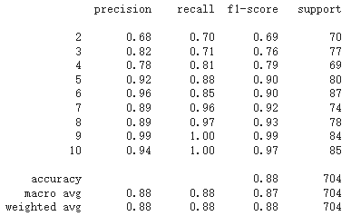
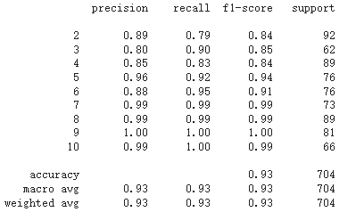
Model: Random Forest
Selected Features
All features

Slide 10
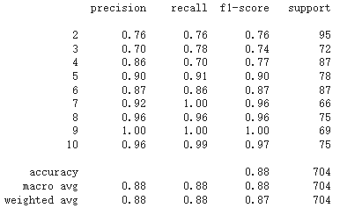
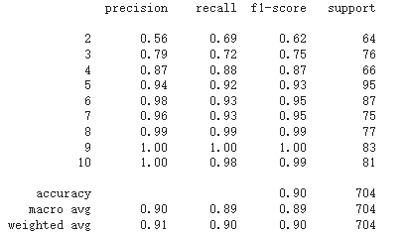
Model: SVM
Selected Features
All Features

Slide 11
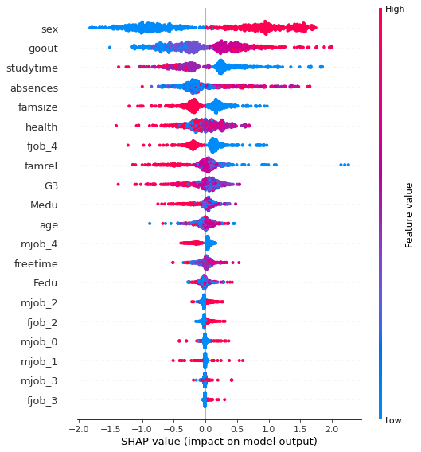
Feature Importance
Color indicates the value of the feature
Groups on the right: Positive impact
Groups on the left: Negative impact

Slide 12
Role of Team members
Boyang Meng: Coding, Presentation
Ding Sun: Presentation, Report
Leanne Ye: Demo, Report
Manyi Liu: Report
Sheng Horng: Coding, Presentation
Yu-Han Lai: Report

Slide 13
Demo

Slide 14
Reference
Bergh, Adrienne. “A Machine Learning Approach to Predicting Alcohol Consumption in Adolescents from Historical Text Messaging Data.” Chapman University Digital Commons, https://digitalcommons.chapman.edu/cads_theses/2/.
Bi, J., Sun, J., Wu, Y., Tennen, H., & Armeli, S. “A machine learning approach to college drinking prediction and risk factor identification.” ACM Transactions on Intelligent Systems and Technology (TIST), 4(4), 1-24. 2013. https://dl.acm.org/doi/10.1145/2508037.2508053
Collins, Susan E. “Associations Between Socioeconomic Factors and Alcohol Outcomes.” Alcohol research : current reviews vol. 38,1 (2016): 83-94. https://www.ncbi.nlm.nih.gov/pmc/articles/PMC4872618/
Lorant, V., Nicaise, P., Soto, V.E. et al. Alcohol drinking among college students: college responsibility for personal troubles. BMC Public Health 13, 615 (2013). https://doi.org/10.1186/1471-2458-13-615

