Slide 1

Basic Electronics Project Autonomous car model
COLLEGE OF ENGINEERING
Work Report
Instructor: M.s Tran Le Trung Chanh
Student: Nguyen Thien Quang

Slide 2
Week 3
Introduction
In recent years, the outbreak of technology has brought humans into a new era, enormous amount of vehicles, and machines have been manufactured to assist and work for humans to increase productivity, and quality and minimize the risk for labor. Along with that development, automation vehicles are a field that has expanded at all speeds. Some typical representative vehicles such as drones, UAVs, and cars have been developed to fully control by themselves and restrict human control.

Slide 3
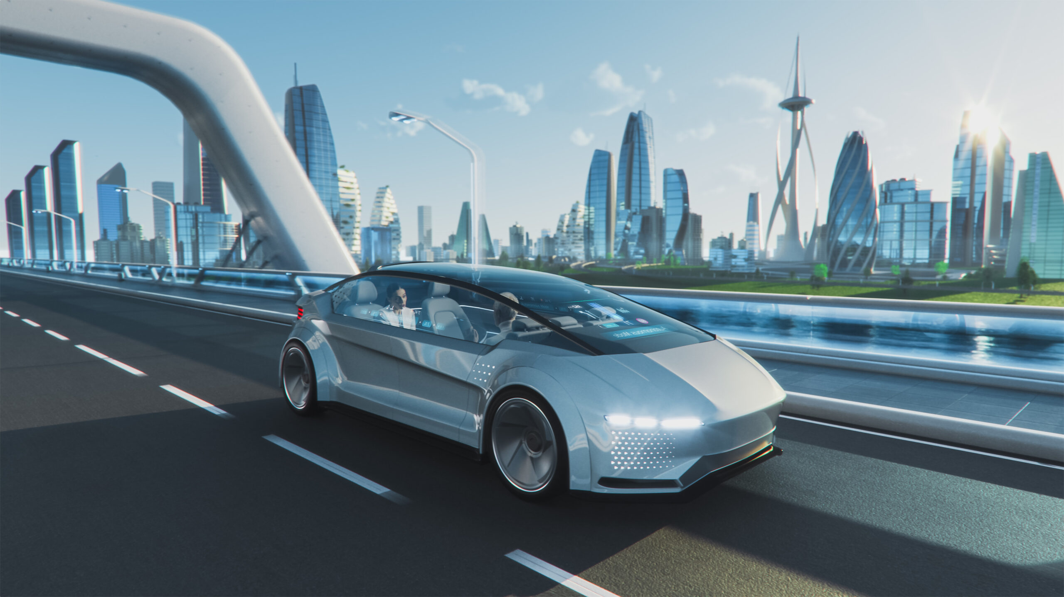
Autonomous car
An autonomous car is a vehicle capable of sensing its environment and operating with restriction or without human involvement. A human passenger may not be required to take control of the vehicle. An autonomous car can go anywhere a traditional car goes and can do almost things that an experienced human driver does.

Slide 4
Instructor’s request
Content:
Design an autonomous car model ( 4 wheels).
The wheels are omni wheels.
Using encoder motors and an obstacle detection sensor.
The car can be controlled by a wireless controller.
Using microcontrollers except for Arduino ecosystem.

Slide 5
Idea
With the requires above, the autonomous car model can be designed and implemented as follow:
About the material and components
The frame is made from acrylic sheets.
Obstacle detection sensor is HC-SR04.
Wheels are omni wheels.
Motors are DC 180 motor 5v.
Using TH119 encoder.
Power source is 2 18650 batteries.
TP4056 Battery charger to charge the pins.
Micontrollers are stm32f103c8t6 (for controller) and stm32f411CEU6 (for car)
Transceivers are 2 nRF24l01 module with one module is transmitter and the other is receiver.
Joystick to control the directions of the car.
Sg90 servo to help the obstacle sensor collect data.
About the function
The car can be controlled by controller to drive the car or can be operated and obstacle objects automatically.

Slide 6
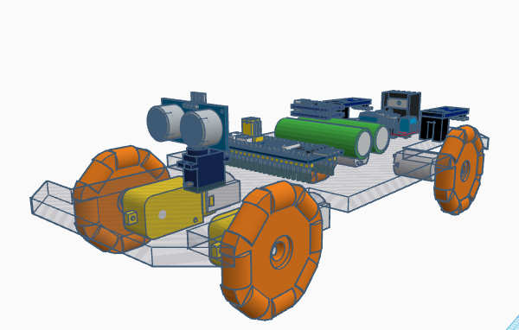
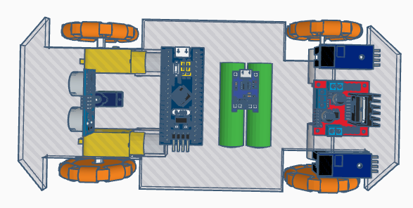
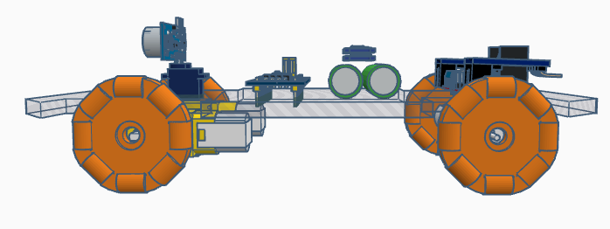
Sketch
Designed by TinkerCAD

Slide 7
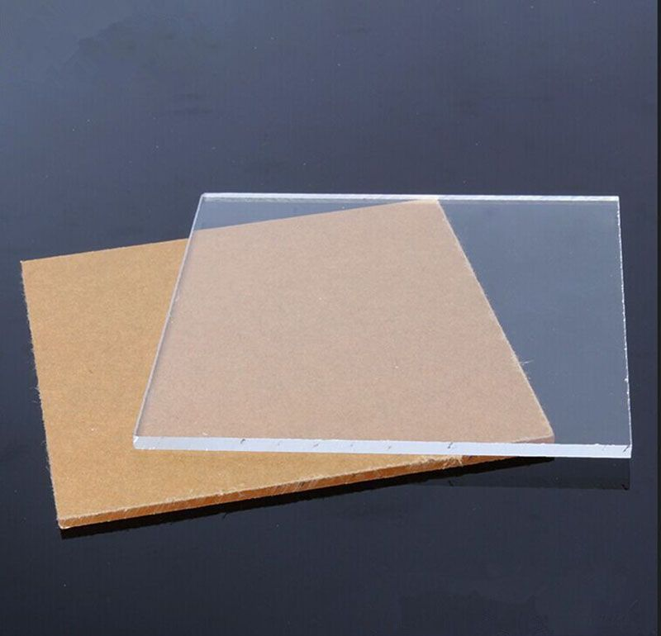
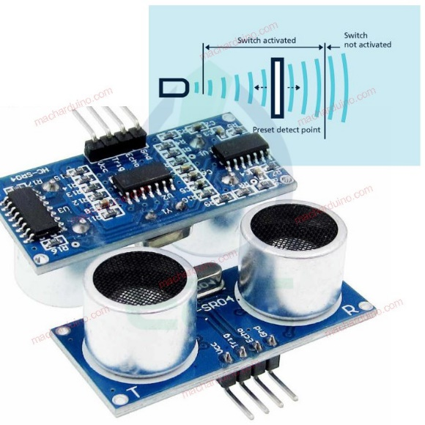
Materials and components
Acrylic sheet
HC-SR04 sensor
Brief Description:
Acrylic is a transparent plastic material with outstanding strength, stiffness, and optical clarity. Acrylic sheet is easy to fabricate, bonds well with adhesives and solvents, and is easy to thermoform.
Brief Description:
The HC-SR04 Ultrasonic Distance Sensor is a sensor used for detecting the distance to an object using sonar. It's ideal for any robotics projects which require avoid objects.

Slide 8
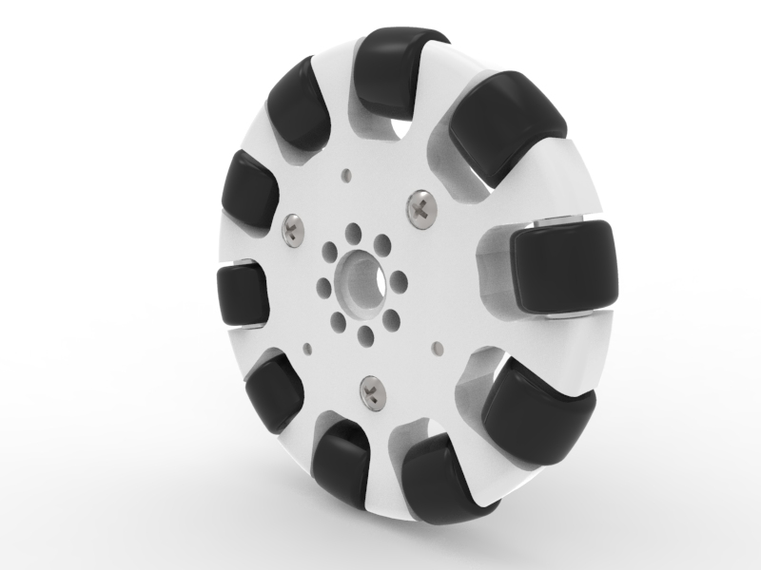
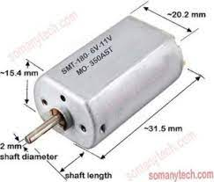
Materials and components
Omni wheel
180 DC motor
Brief Description:
Omni wheels are wheels with small discs (called rollers) around the circumference which are perpendicular to the turning direction. The effect is that the wheel can be driven with full force, but will also slide laterally with great ease. These wheels are often employed in holonomic drive systems.
Brief Description:
15,5 * 20,3 MM
Height: 32 mm, shaft: 2,0 MM
Length of shaft: 11,5 MM
Voltage: 6 V
Current: 0.5A (no load)
Speed: 25000 rpm

Slide 9
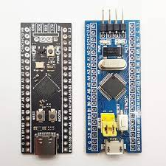
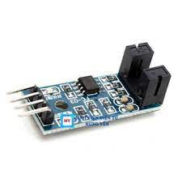
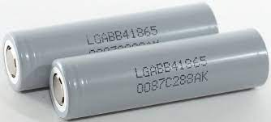
Materials and components
STM32 controllers
TH119 encoder
18650 battery
Brief Description:
STM32 is a family of 32-bit microcontroller integrated circuits by STMicroelectronics. The STM32 chips are grouped into related series that are based around the same 32-bit ARM processor core: Cortex-M0, Cortex-M0+, Cortex-M3, Cortex-M4, Cortex-M7, Cortex-M33. Internally, each microcontroller consists of ARM processor core(s), flash memory, static RAM, debugging interface, and various peripherals.
Brief Description:
Trench width: 5mm
Led show the reading state
HIGH output when be covered, LOW when not be covered
Current output 15mA
Operation voltage: 3.3V-5V
Size: 3.2cm x 1.4cm
Brief Description:
Model :18650
Capacity :1200mAh - 3500mAh
Nominal Voltage :3.7V
Weight (battery cell) :approx 48g
Cycle life :500 times

Slide 10
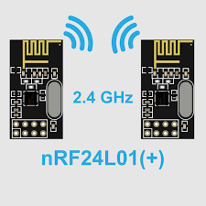
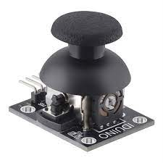
Materials and components
nRF24l01 module
Joystick
Brief Description:
Power Supply：5V
Analog output：X, Y, 2 Axis analog output
Digital output：Z, digital key output
The X and Y readings in the original state have a voltage of 2.5 V. When pressed in the direction of the arrow, the voltage increases to a maximum of 5 V. In the opposite direction of the arrow, the voltage value decreases to a minimum of 0 V.
Brief Description:
The nRF24L01 is a single chip 2.4GHz transceiver with an embedded baseband protocol engine (Enhanced ShockBurst™), designed for ultra low power wireless applications. The nRF24L01 is designed for operation in the world wide ISM frequency band at 2.400 - 2.4835GHz.

Slide 11
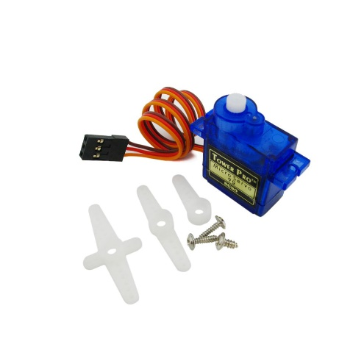
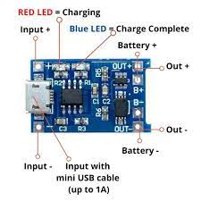
Materials and components
Sg90 Servo motor
TP4056 battery charger
Brief Description:
SG90 is a popular micro servo motor commonly used in hobbyist and DIY projects. It is a small, low-cost servo motor that can rotate 180 degrees with a maximum torque of 1.8 kg-cm. It operates at 4.8-6V and has a weight of approximately 9 grams, making it ideal for small-scale robotics and model control applications.
Brief Description:
The TP4056 is a complete constant-current/constant-voltage linear charger for single cell lithium-ion batteries. Its SOP package and low external component count make the TP4056 ideally suited for portable applications. Furthermore, the TP4056 can work within USB and wall adapter.

Slide 12
Resources and references

Slide 13
END OF PRESENTATION

