Slide 1

BASIC ELECTRONICS PROJECT AUTONOMOUS CAR MODEL
COLLEGE OF ENGINEERING
Work Report
Instructor: M.s. Tran Le Trung Chanh
Student: Nguyen Thien Quang

Slide 2
Week 5
Works
Test sensor and motor.
Program for wireless controller.
Program for modules and actuators.

Slide 3
Test sensor and motor
For HC-SR04
Testing sensor is straightforward because the specifications and steps to implement code is available. This … is representing the testing of HC-SR04 sonicwave sensor.

Slide 4
Test sensor and motor
For motor
In this … the motor was operating well and angle velocity is estimated around ~ 5000 rpm with no load.

Slide 5
Test sensor and motor
Problem: Something went wrong when applying load to the motor
Description: With no load at the shaft of the motor, it operated normally but when the wheels is added to the motor (load) the motor took time to run from slow to fast and when it is tested to run the car (more load), it completely halted and the motor made some noises.
Analyze: the motor is 180 DC motor with max speed can get up to 25000 rpm but not be able to make a car move or when load is apply it operate from slow to fast gradually because of the touque of the motor is not adequate to make the car moves. Also the wheels are fairly heavy (around 50g) and the car’s weight in total at the test time is arounf 400g so the motor can acquire the load it takes.

Slide 6
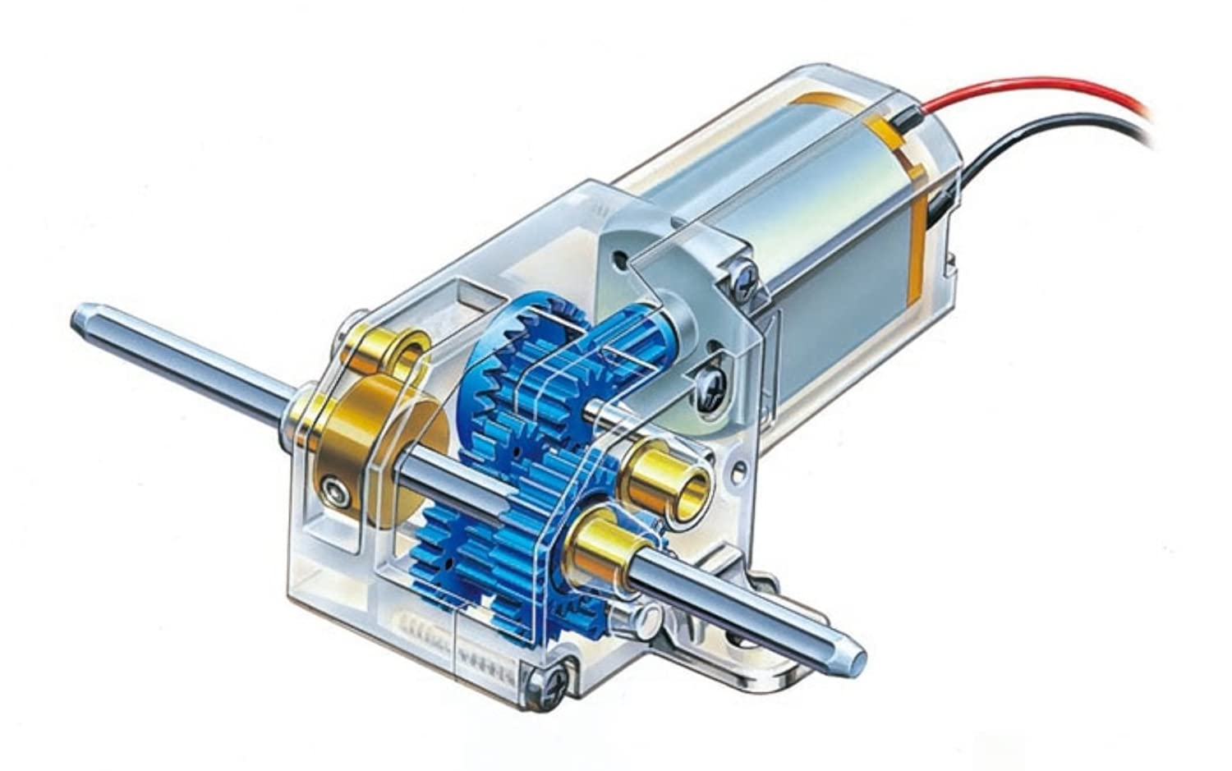
Test sensor and motor
Solution
The problem can be solved by apply a gear box reducer to reduce the speed of the motor but it can make the torque of the motor becomes higher to assure the car is able to move.

Slide 7
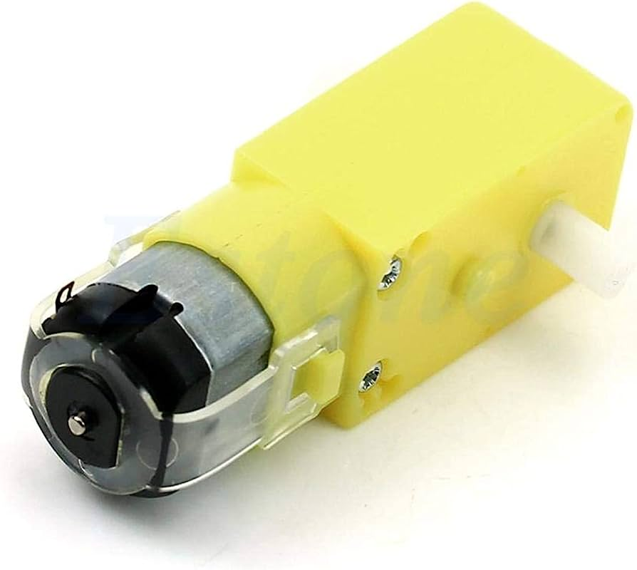
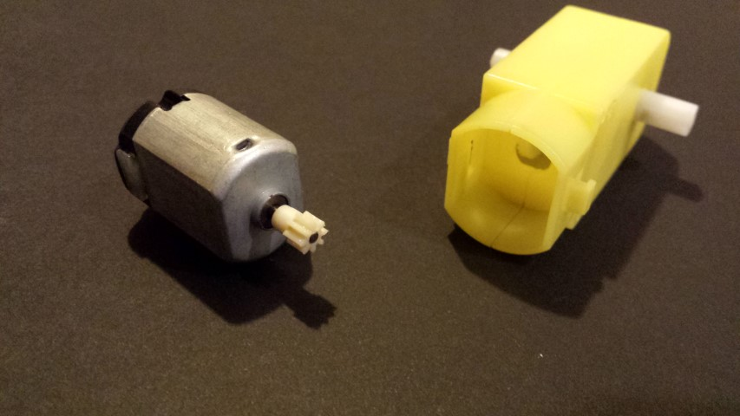
Test sensor and motor
Solution
With the shape of the DC 180 motor, the gearbox reducer can be get from Yellow DC motor 3-12V because the DC 180 motor will have similar shape with the motor integrated in the gearbox.

Slide 8
Program for wireless controller
Idea
The controller will handle 2 mode: one is turn mode 1 on and other is turn mode 2 on
Mode 1: the car will be controlled via the wireless controller through the joystick in it. When the joystick push to left, the car will turn left and when turn to right it will turn to right.
Mode 2: the car will operate autonomously. It will run and auto detect and evade objects.

Slide 9
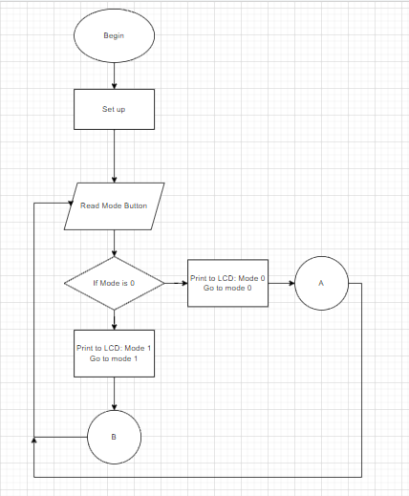
Program for wireless controller
Diagram

Slide 10
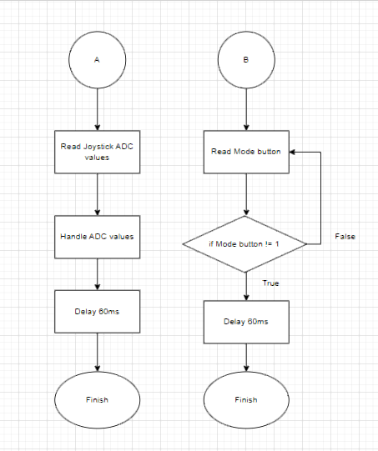
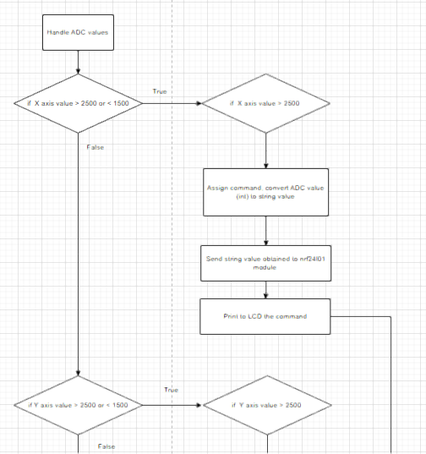
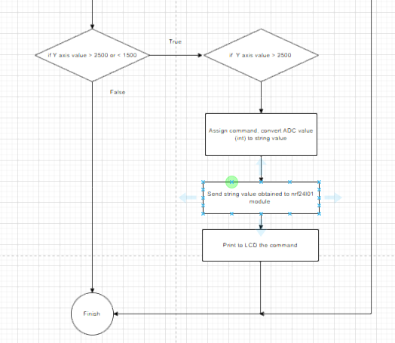
Program for wireless controller

Slide 11

Program for wireless controller
Programing
The toolchain to program the microcontrollers include STM32CubeMX, ARM none eabi compiler, keil u Vision 5.

Slide 12
Program for wireless controller
Source code for wireless controller

Slide 13
Program for wireless controller
Demo

Slide 14
Program for modules and actuators
Module: nrf24l01
Actuator: Servo Sg90

Slide 15
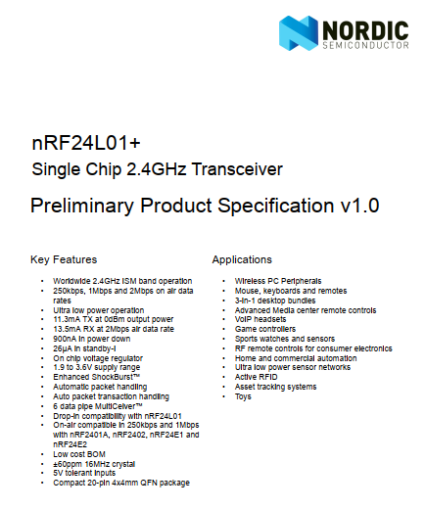
Program for modules and actuators
For module nrf24l01
The module can be programmed by using datasheet attach to and using the other code examples (the datasheet didn’t instruct the configuration for specific mode).

Slide 16
Program for modules and actuators
Source code for nrf24l01

Slide 17
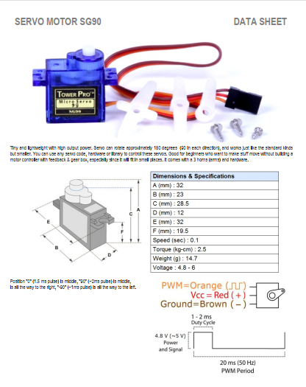
Program for modules and actuators
For servo SG90
By using timer PWM in the stm32 microcontroller and datasheet of SG90 servo the motor can be controlled and handled the angle.

Slide 18
Program for modules and actuators
Source code for SG90 servo motor

Slide 19
Resources and references

Slide 20
END OF PRESENTATION

