Slide 1
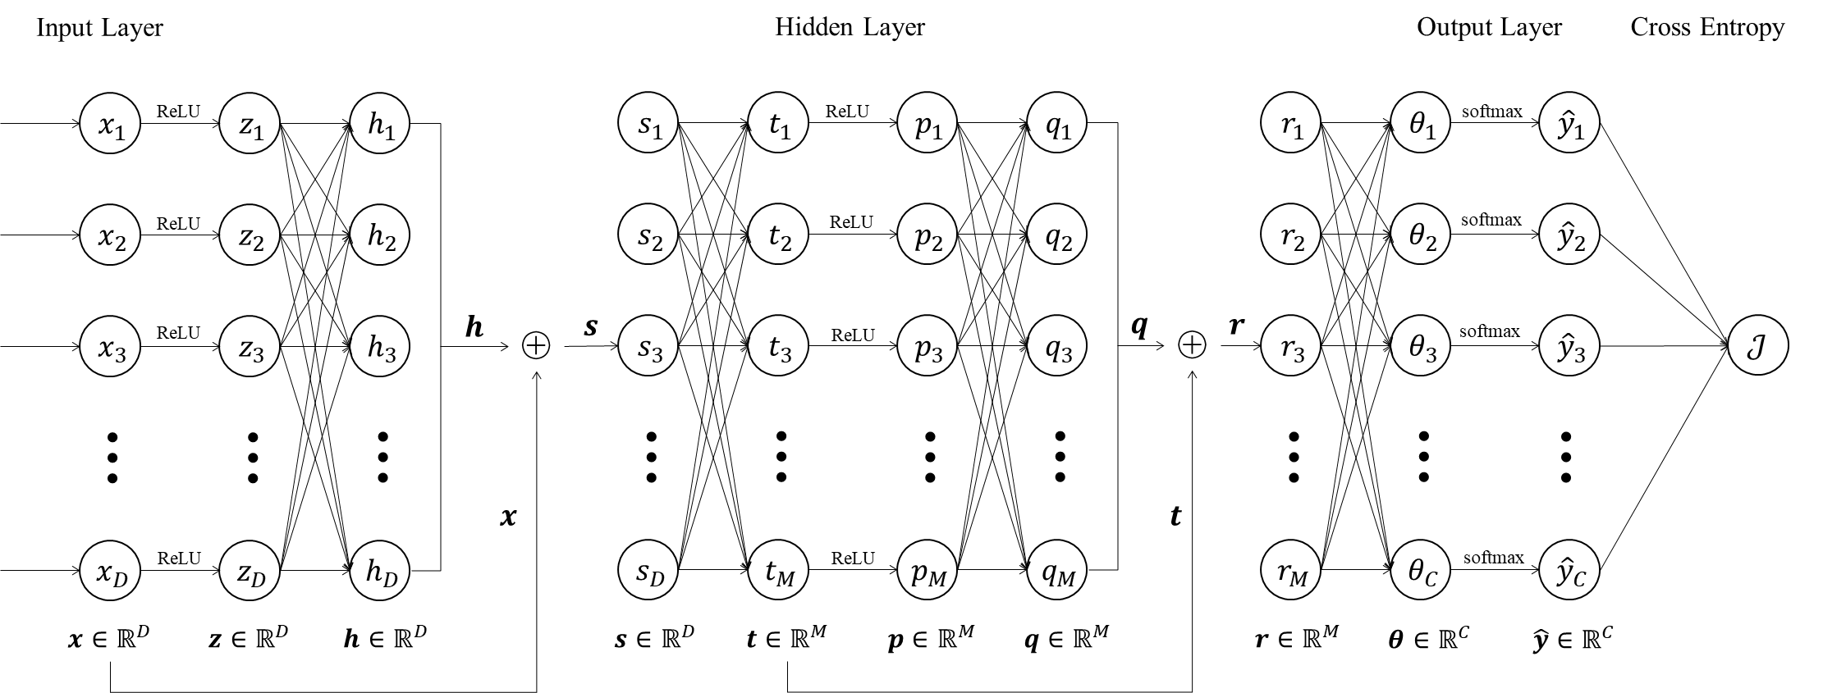

Slide 2






























































Input Layer
Hidden Layer
Output Layer
Cross Entropy
$$W_{1}$$
$$W_{2}$$
$$W_{3}$$
$$W_{4}$$
$${ x}_{1}$$
ReLU
$${ z}_{1}$$
$$h_{1}$$
$${ s}_{1}$$
$$t_{1}$$
ReLU
$${ p}_{1}$$
$${ q}_{1}$$
$${ r}_{1}$$
$${ θ}_{1}$$
softmax
$${ \hat{y}}_{1}$$
$${ x}_{2}$$
ReLU
$${ z}_{2}$$
$${ h}_{2}$$
$${ s}_{2}$$
$${ t}_{2}$$
ReLU
$${ p}_{2}$$
$${ q}_{2}$$
$${ r}_{2}$$
$${ θ}_{2}$$
softmax
$${ \hat{y}}_{2}$$
$${ x}_{3}$$
ReLU
$${ z}_{3}$$
$${ h}_{3}$$
$$h$$
$$s$$
$${ s}_{3}$$
$${ t}_{3}$$
$${ p}_{3}$$
$${ q}_{3}$$
$$q$$
$$r$$
$${ r}_{3}$$
$${ θ}_{3}$$
softmax
$${ \hat{y}}_{3}$$
$$𝒥$$
⊕
ReLU
⊕
…
…
…
…
…
…
…
…
…
…
$$x$$
$$t$$
$${ x}_{D}$$
ReLU
$${ z}_{D}$$
$${ h}_{D}$$
$${ s}_{D}$$
$${ t}_{M}$$
ReLU
$${ p}_{M}$$
$${ q}_{M}$$
$${ r}_{M}$$
$${ θ}_{C}$$
softmax
$${ \hat{y}}_{C}$$
$$x∈ℝ^{D}$$
$$z∈ℝ^{D}$$
$$h∈ℝ^{D}$$
$$s∈ℝ^{D}$$
$$t∈ℝ^{M}$$
$$p∈ℝ^{M}$$
$$q∈ℝ^{M}$$
$$r∈ℝ^{M}$$
$$θ∈ℝ^{C}$$
$$\hat{y}∈ℝ^{C}$$

Slide 3
Input Layer
Hidden Layer
Output Layer
Cross Entropy
$$W_{1}$$
$$W_{2}$$
$$W_{3}$$
$$W_{4}$$
$${ x}_{1}$$
ReLU
$${ z}_{1}$$
$$h_{1}$$
$${ s}_{1}$$
$$t_{1}$$
ReLU
$${ p}_{1}$$
$${ q}_{1}$$
$${ r}_{1}$$
$${ θ}_{1}$$
softmax
$${ \hat{y}}_{1}$$
$${ x}_{2}$$
ReLU
$${ z}_{2}$$
$${ h}_{2}$$
$${ s}_{2}$$
$${ t}_{2}$$
ReLU
$${ p}_{2}$$
$${ q}_{2}$$
$${ r}_{2}$$
$${ θ}_{2}$$
softmax
$${ \hat{y}}_{2}$$
$${ x}_{3}$$
ReLU
$${ z}_{3}$$
$${ h}_{3}$$
$$h$$
$$s$$
$${ s}_{3}$$
$${ t}_{3}$$
$${ p}_{3}$$
$${ q}_{3}$$
$$q$$
$$r$$
$${ r}_{3}$$
$${ θ}_{3}$$
softmax
$${ \hat{y}}_{3}$$
$$𝒥$$
⊕
ReLU
⊕
…
…
…
…
…
…
…
…
…
…
$$x$$
$$t$$
$${ x}_{D}$$
ReLU
$${ z}_{D}$$
$${ h}_{D}$$
$${ s}_{D}$$
$${ t}_{M}$$
ReLU
$${ p}_{M}$$
$${ q}_{M}$$
$${ r}_{M}$$
$${ θ}_{C}$$
softmax
$${ \hat{y}}_{C}$$
$$x∈ℝ^{D}$$
$$z∈ℝ^{D}$$
$$h∈ℝ^{D}$$
$$s∈ℝ^{D}$$
$$t∈ℝ^{M}$$
$$p∈ℝ^{M}$$
$$q∈ℝ^{M}$$
$$r∈ℝ^{M}$$
$$θ∈ℝ^{C}$$
$$\hat{y}∈ℝ^{C}$$

Slide 4




























$${ W}_{3}$$
$$y$$
$$q$$
$${ W}_{2}$$
$${ W}_{1}$$
$$𝒥$$
$${ W}_{4}$$
$$p$$
$$t$$
$$h$$
$$\hat{y}$$
$$θ$$
$$s$$
$$z$$
$$x$$
$$r$$
$$x$$
$${ W}_{2}$$
$${ W}_{1}$$
$$t$$
$$h$$
$$y$$
$$s$$
$$z$$
$$x$$
$$𝒥$$
$$x$$
$$\hat{y}$$

