Slide 1
Mathematics for AI
Adams Wai Kin Kong
School of Computer Science and Engineering
Nanyang Technological University, Singapore
adamskong@ntu.edu.sg
A part of the notes is under the copyright of Cengage Learning.

Slide 2
Vectors

Slide 3
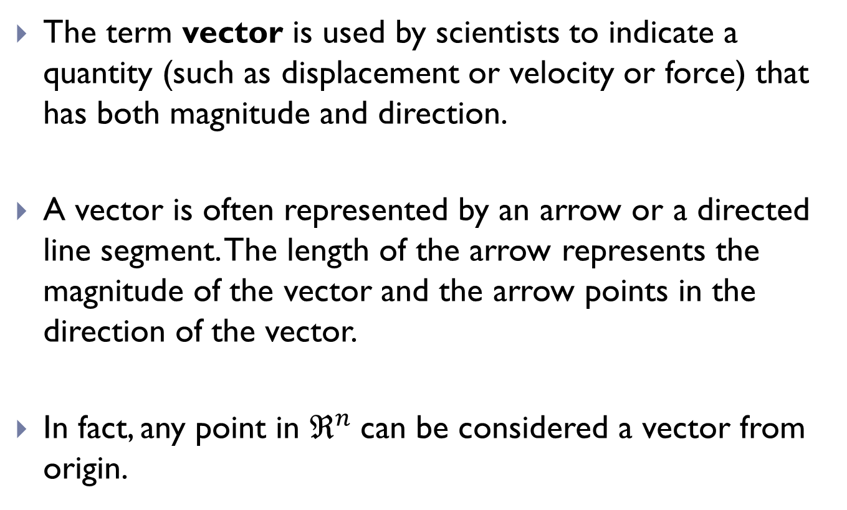
Vectors
The term vector is used by scientists to indicate a quantity (such as displacement or velocity or force) that has both magnitude and direction.
A vector is often represented by an arrow or a directed line segment. The length of the arrow represents the magnitude of the vector and the arrow points in the direction of the vector.
In fact, any point in $ℜ^{n}$can be considered a vector from origin.

Slide 4
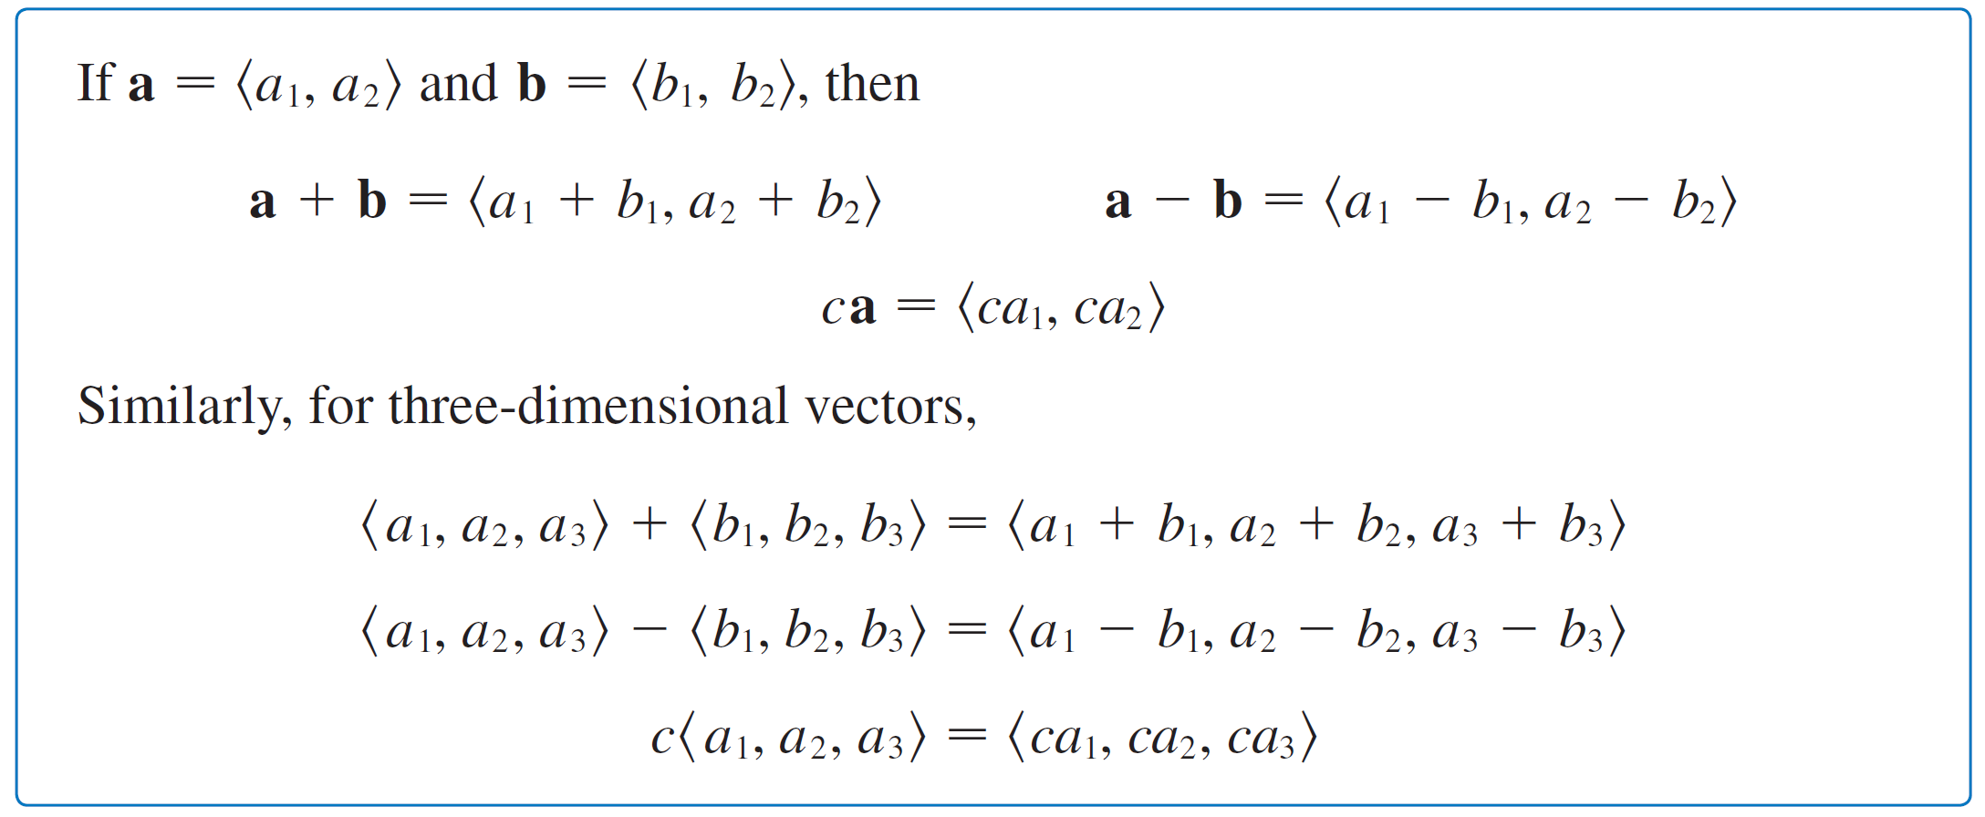
Vectors

Slide 5
Vectors
More generally, we will consider the set V_{n} of all n-dimensional vectors.
An n-dimensional vector is an ordered n-tuple:
a = ⟨a₁, a₂, . . . , a_{n}⟩
where a₁, a₂, . . . , a_{n} are real numbers that are called the components of a.

Slide 6
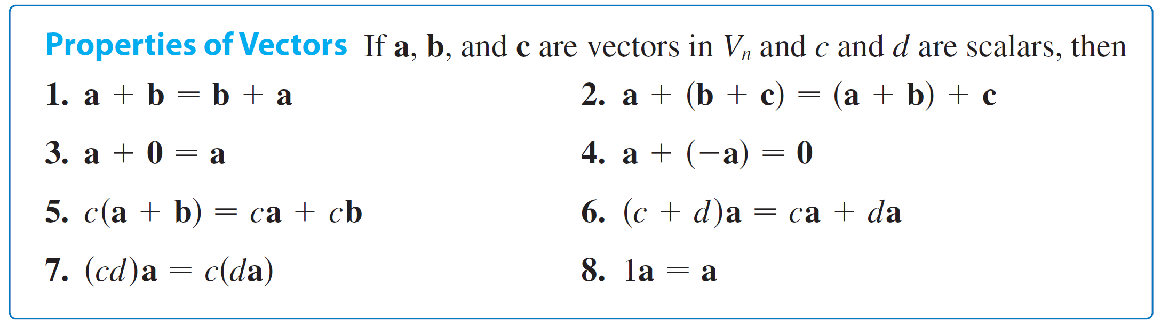
Components
Addition and scalar multiplication are defined in terms of components just as for the cases n = 2 and n = 3.
Note that 0 is the zero vector <0, 0, …., 0 >

Slide 7
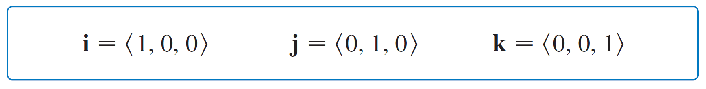
Components
Three vectors in V₃ play a special role. Let
These vectors i, j, and k are called the standard basis vectors.
They have length 1 and point in the directions of the positive x-, y-, and z-axes.

Slide 8
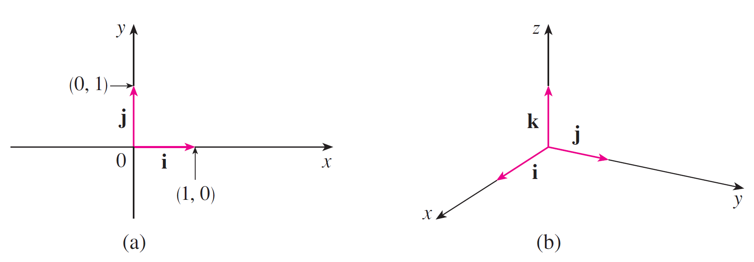
Components
Similarly, in two dimensions we define i = ⟨1, 0⟩ and j = ⟨0, 1⟩.

Slide 9
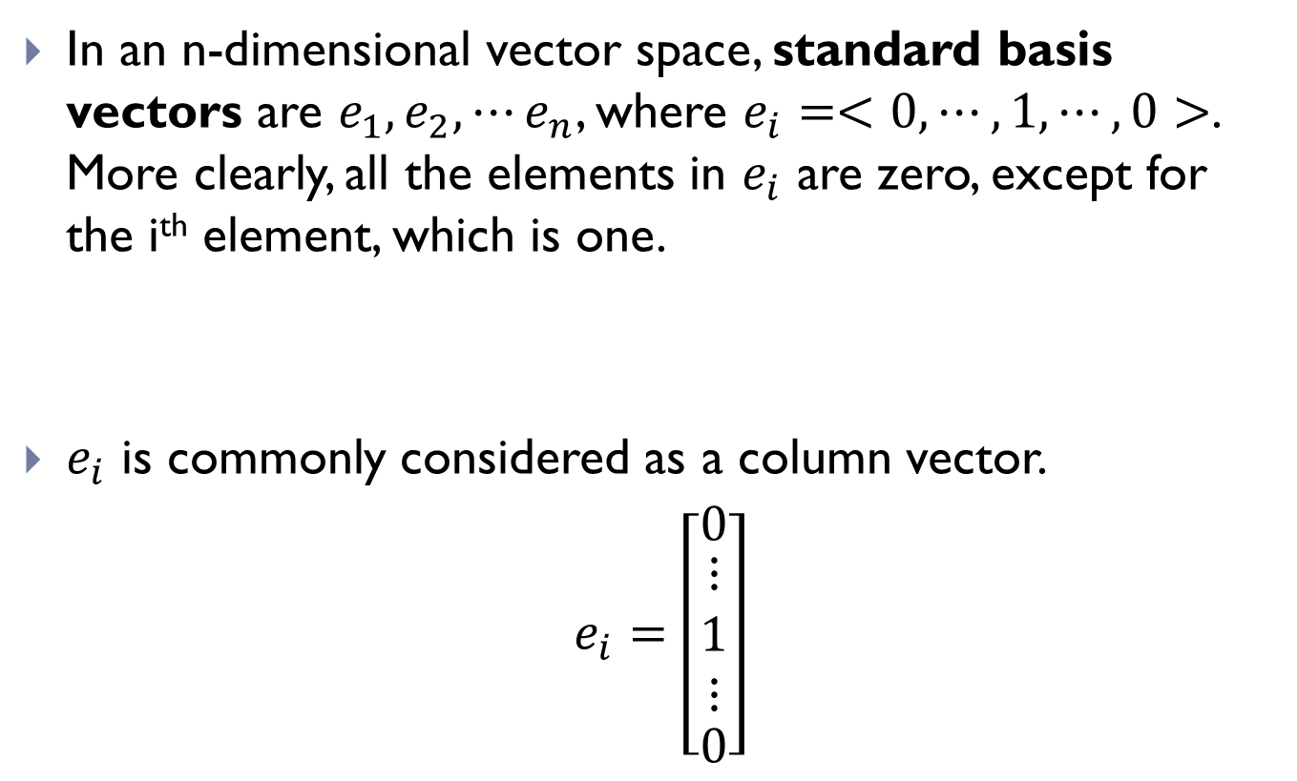
Components
In an n-dimensional vector space, standard basis vectors are $e_{1},e_{2},⋯e_{n}$, where $e_{i}=<0, ⋯,1,⋯,0>$. More clearly, all the elements in $e_{i}$ are zero, except for the i^{th} element, which is one.
$e_{i}$ is commonly considered as a column vector.
$e_{i}=\left[\begin{matrix}0 \\ \begin{matrix}⋮ \\ 1 \\ ⋮\end{matrix} \\ 0\end{matrix}\right]$

Slide 10
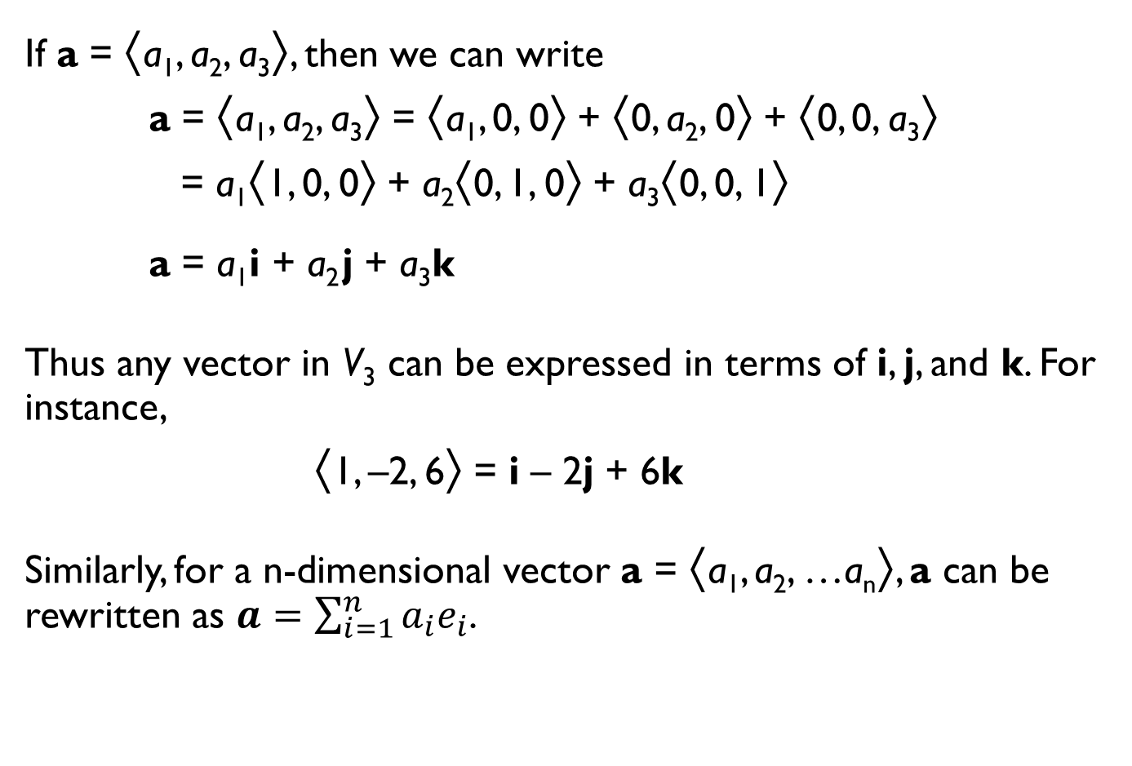
Components
If a = ⟨a₁, a₂, a₃⟩, then we can write
a = ⟨a₁, a₂, a₃⟩ = ⟨a₁, 0, 0⟩ + ⟨0, a₂, 0⟩ + ⟨0, 0, a₃⟩
= a₁⟨1, 0, 0⟩ + a₂⟨0, 1, 0⟩ + a₃⟨0, 0, 1⟩
a = a₁i + a₂ j + a₃k
Thus any vector in V₃ can be expressed in terms of i, j, and k. For instance,
⟨1, –2, 6⟩ = i – 2j + 6k
Similarly, for a n-dimensional vector a = ⟨a₁, a₂, …a_{n}⟩, a can be rewritten as $a=\sum_{i=1}^{n}{a_{i}e_{i}}$.

Slide 11
Components
Figure 18

Slide 12
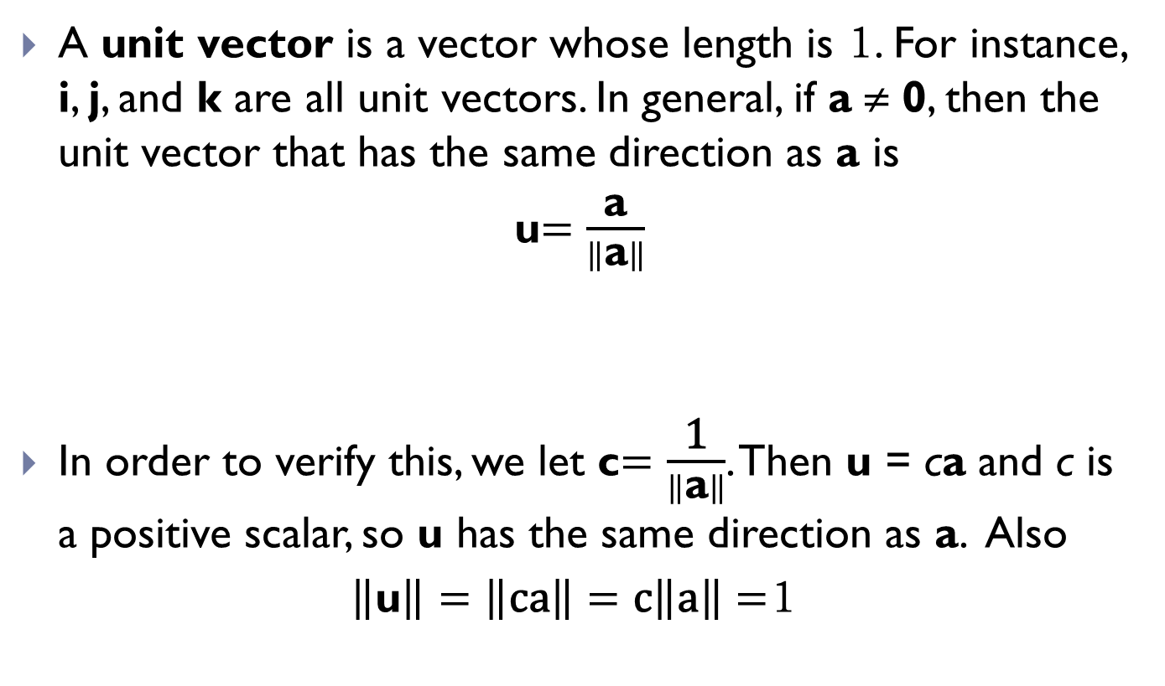
Unit vector
A unit vector is a vector whose length is 1. For instance, i, j, and k are all unit vectors. In general, if a ≠ 0, then the unit vector that has the same direction as a is
u$=\frac{\text{a}}{\left\|\text{a}\right\|}$
In order to verify this, we let c$=\frac{\text{1}}{\left\|\text{a}\right\|}$. Then u = ca and c is a positive scalar, so u has the same direction as a. Also
$\left\|\text{u}\right\|=\left\|\text{ca}\right\|=\text{c}\left\|\text{a}\right\|=$1

Slide 13
Applications
A 100-lb weight hangs from two wires as shown in Figure 19. Find the tensions (forces) T₁ and T₂ in both wires and the magnitudes of the tensions.

Slide 14
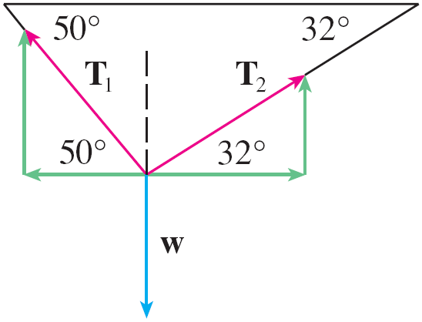
Applications
We first express T₁ and T₂ in terms of their horizontal and vertical components. From the figure we see that
T₁ = –| T₁ | cos 50° i + | T₁ | sin 50° j
T₂ = | T₂ | cos 32° i + | T₂ | sin 32° j
The resultant T₁ + T₂ of the tensions counterbalances the weight w = –100 j and so we must have
T₁ + T₂ = –w = 100 j

Slide 15
Applications
Thus
(–| T₁ | cos 50° + | T₂ | cos 32°) i+ (| T₁ | sin 50° + | T₂ | sin 32°) j
= 100 j
Equating components, we get
–|T₁|cos 50° + |T₂| cos 32° = 0
|T₁|sin 50° + |T₂|sin 32° = 100

Slide 16
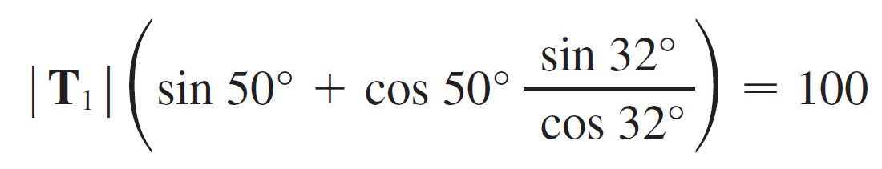
Applications
Solving the first of these equations for | T₂ | and substituting into the second, we get
So the magnitudes of the tensions are
and

Slide 17




Applications
Considering an image as a vector $I$, what does the equation below do?
$I_{r}=aI+b𝕝$
where $a, b∈ℜ$ and $𝕝=<1, 1, ⋯1>$.
= 1.2 ×
$$+100𝕝$$

Slide 18
The Dot Product

Slide 19
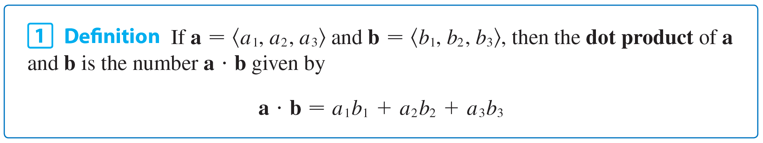
The Dot Product
So far we have added two vectors and multiplied a vector by a scalar. The question arises: Is it possible to multiply two vectors so that their product is a useful quantity? One such product is the dot product, whose definition follows.
Thus, to find the dot product of a and b, we multiply corresponding components and add.

Slide 20
Example
⟨ 2, 4⟩  ⟨3, –1⟩ = 2(3) + 4(–1) = 2
⟨–1, 7, 4⟩  ⟨6, 2, -1/2⟩ = (–1)(6) + 7(2) + 4(-1/2) = 6
(i + 2j – 3k)  (2j – k) = 1(0) + 2(2) + (–3)(–1) = 7

Slide 21
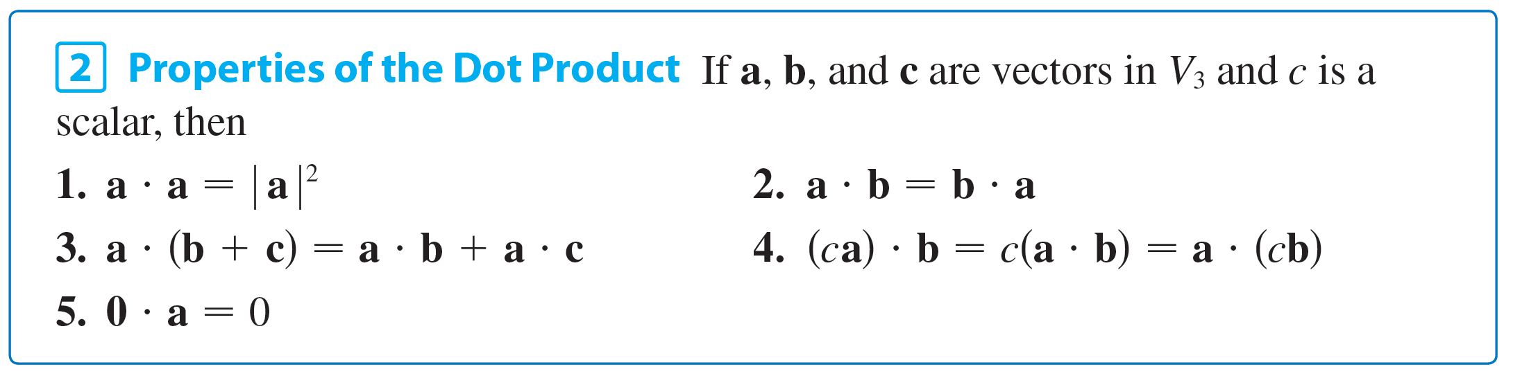
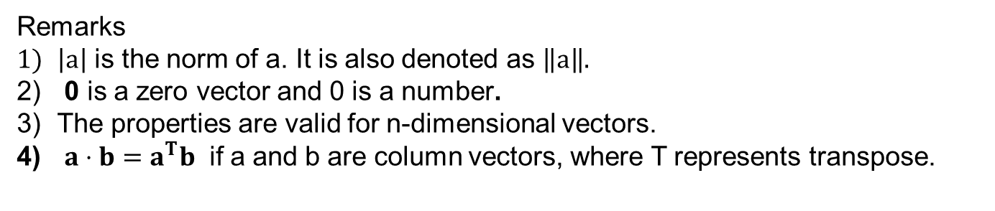
The Dot Product
The dot product obeys many of the laws that hold for ordinary products of real numbers. These are stated in the following theorem.
Remarks
$\left|a\right|$ is the norm of a. It is also denoted as $\left\|a\right\|.$
0 is a zero vector and 0 is a number.
The properties are valid for n-dimensional vectors.
$a⋅b=a^{T}b$ if a and b are column vectors, where T represents transpose.

Slide 22
The Dot Product
These properties are easily proved using Definition 1. For instance, here are the proofs of Properties 1 and 3:
3. a  (b + c) = ⟨a₁, a₂, a₃⟩  ⟨b₁ + c₁, b₂ + c₂, b₃ + c₃⟩
= a₁(b₁ + c₁) + a₂(b₂ + c₂) + a₃(b₃ + c₃)
= a₁b₁ + a₁c₁ + a₂b₂ + a₂c₂ + a₃b₃ + a₃c₃
= (a₁b₁ + a₂b₂ + a₃b₃) + (a₁c₁ + a₂c₂ + a₃c₃)
= a  b + a  c

Slide 23
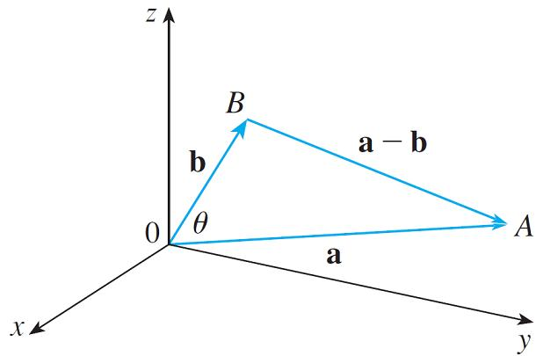
The Dot Product
The dot product a  b can be given a geometric interpretation in terms of the angle θ between a and b, which is defined to be the angle between the representations of a and b that start at the origin, where 0 ≤ θ ≤ π.
In other words, θ is the angle between the line segments OA and OB in Figure 1. Note that if a and b are parallel vectors, then θ = 0 or θ = π.
Figure 1

Slide 24
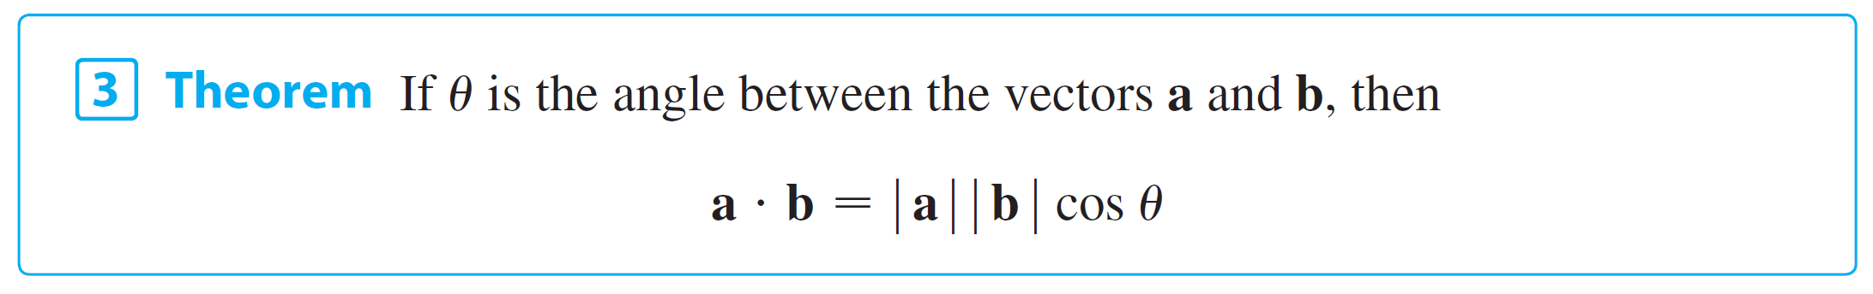
The Dot Product
The formula in the following theorem is used by physicists as the definition of the dot product
Example: If the vectors a and b have lengths 4 and 6, and the angle between them is π /3,
a  b = | a | | b | cos(π /3) = 4  6 1/2=12

Slide 25
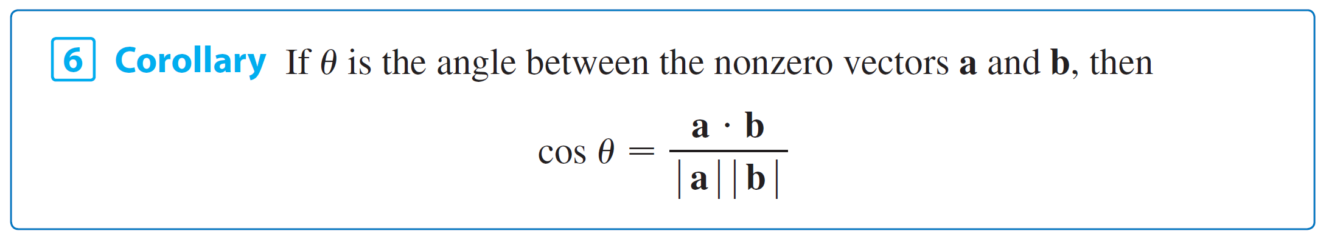
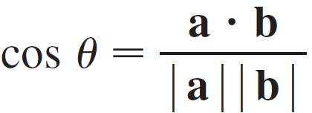
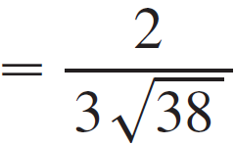
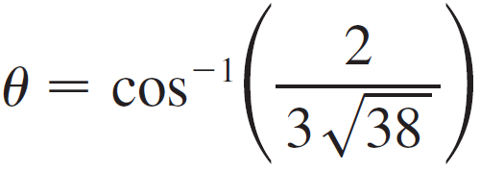
The Dot Product
The formula in Theorem 3 also enables us to find the angle between two vectors.
Example: Find the angle between the vectors a = ⟨2, 2, –1⟩ and b = ⟨5, –3, 2⟩.
Since , ,
and a  b = 2(5) + 2(–3) + (–1)(2) = 2

Slide 26
The Dot Product
Two nonzero vectors a and b are called perpendicular or orthogonal if the angle between them is θ = π /2. Then Theorem 3 gives
a  b = | a | | b | cos(π /2) = 0
and conversely if a  b = 0, then cos θ = 0, so θ = π /2. The zero vector 0 is considered to be perpendicular to all vectors.
Therefore we have the following method for determining whether two vectors are orthogonal.

Slide 27
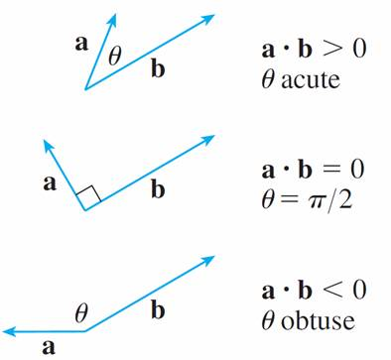
The Dot Product
Because cos θ > 0 if 0 ≤ θ < π /2 and cos θ < 0 if π /2 < θ ≤ π, we see that a  b is positive for θ < π /2 and negative for θ > π /2. We can think of a  b as measuring the extent to which a and b point in the same direction. The dot product a  b is positive if a and b point in the same general direction, 0 if they are perpendicular, and negative if they point in generally opposite directions (see Figure 2).

Slide 28
The Dot Product
In the extreme case where a and b point in exactly the same direction, we have θ = 0, so cos θ = 1 and
a  b = | a | | b |
If a and b point in exactly opposite directions, then we have θ = π and so cos θ = –1 and a  b = –| a | | b |.

Slide 29
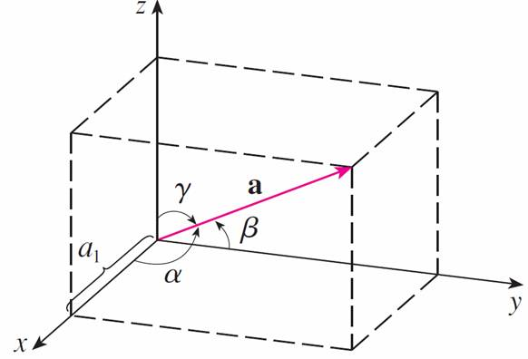
Direction Angles and Direction Cosines
The direction angles of a nonzero vector a are the angles α, β, and γ (in the interval [0, π ]) that a makes with the positive x-, y-, and z-axes, respectively. (See Figure 3.)
Figure 3

Slide 30
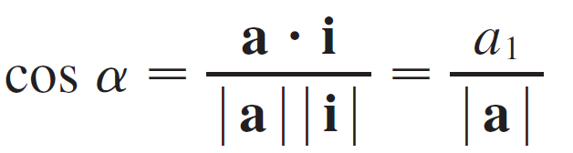

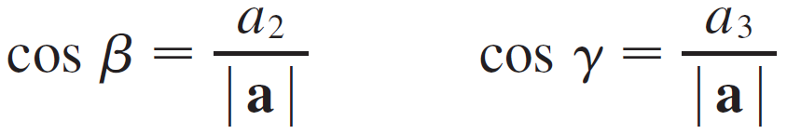

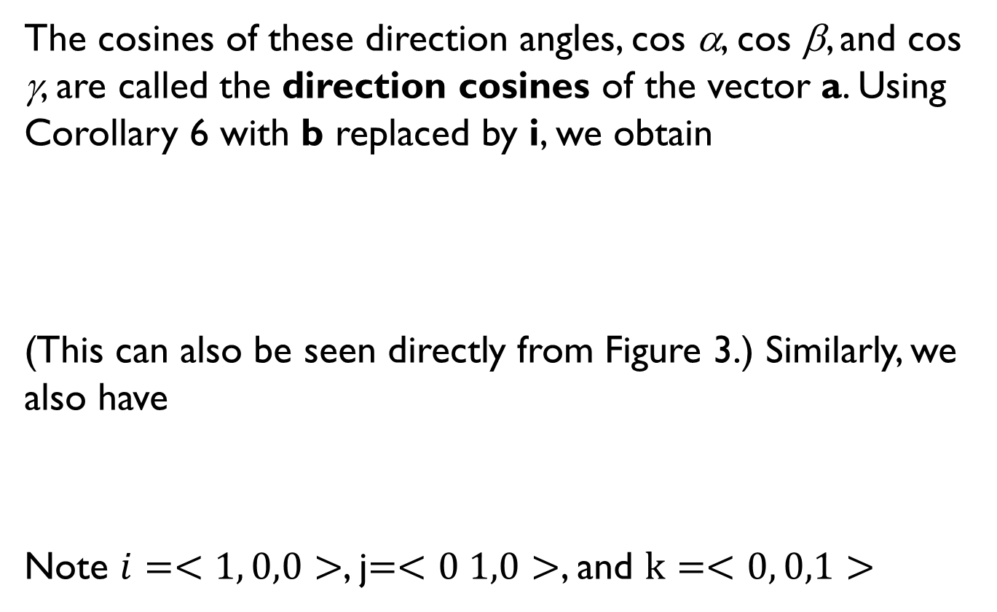
Direction Angles and Direction Cosines
The cosines of these direction angles, cos α, cos β, and cos γ, are called the direction cosines of the vector a. Using Corollary 6 with b replaced by i, we obtain
(This can also be seen directly from Figure 3.) Similarly, we also have
Note $i=<1, 0,0>$, j$=<0 1,0>$, and $k=<0, 0,1>$

Slide 31

Direction Angles and Direction Cosines
By squaring the expressions in Equations 8 and 9 and adding, we see that
cos²α + cos²β + cos²γ = 1
We can also use Equations 8 and 9 to write
a = ⟨a₁, a₂, a₃⟩ = ⟨| a | cos α, | a | cos β, | a | cos γ⟩
= | a | ⟨cos α, cos β, cos γ⟩

Slide 32
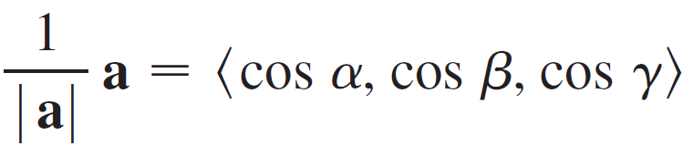

Direction Angles and Direction Cosines
Therefore
which says that the direction cosines of a are the components of the unit vector in the direction of a.

Slide 33

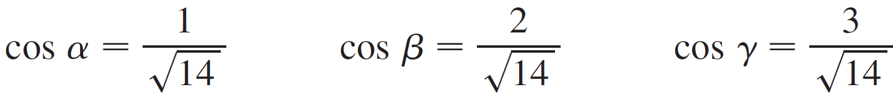
Example
Find the direction angles of the vector a = ⟨1, 2, 3⟩.
Solution:
Since Equations 8 and 9 give
and so

Slide 34
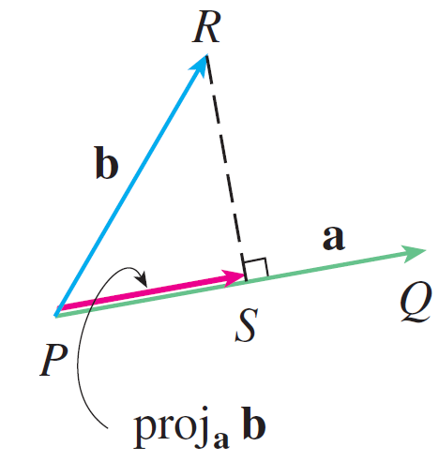
Projections
Figure 4 shows representations PQ and PR of two vectors a and b with the same initial point P. If S is the foot of the perpendicular from R to the line containing PQ, then the vector with representation PS is called the vector projection of b onto a and is denoted by proj_{a} b. (You can think of it as a shadow of b).
Vector projections
Figure 4

Slide 35
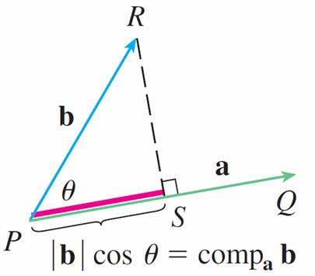
Projections
The scalar projection of b onto a (also called the component of b along a) is defined to be the signed magnitude of the vector projection, which is the number | b | cos θ, where θ is the angle between a and b. (See Figure 5.)
Scalar projection
Figure 5

Slide 36
Projections
This is denoted by comp_{a} b. Observe that it is negative if π /2 < θ ≤ π. The equation
a  b = | a | | b | cos θ = | a |(| b | cos θ)
shows that the dot product of a and b can be interpreted as the length of a times the scalar projection of b onto a. Since
the component of b along a can be computed by taking the dot product of b with the unit vector in the direction of a.

Slide 37
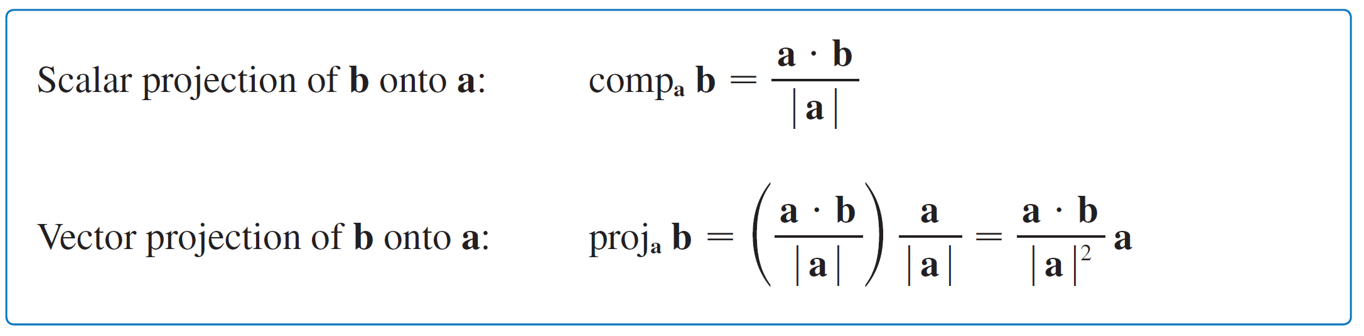
Projections
We summarize these ideas as follows.
Notice that the vector projection is the scalar projection times the unit vector in the direction of a.

Slide 38
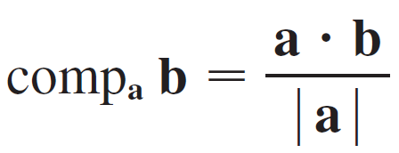
Example
Find the scalar projection and vector projection of b = ⟨1, 1, 2⟩ onto a = ⟨–2, 3, 1⟩.
Solution:
Since the scalar projection of b onto a is

Slide 39
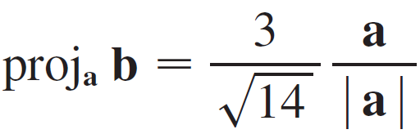
Example
The vector projection is this scalar projection times the unit vector in the direction of a:

Slide 40
Projections
The work done by a constant force F in moving an object through a distance d as W = Fd, but this applies only when the force is directed along the line of motion of the object. Suppose, however, that the constant force is a vector F = PR pointing in some other direction, as in Figure 6.
Figure 6

Slide 41

Projections
If the force moves the object from P to Q, then the displacement vector is D = PQ. The work done by this force is defined to be the product of the component of the force along D and the distance moved:
W = (| F | cosθ ) | D |
But then, from Theorem 3, we have
W = | F | | D | cos θ = F  D
Thus the work done by a constant force F is the dot product F  D, where D is the displacement vector.

Slide 42
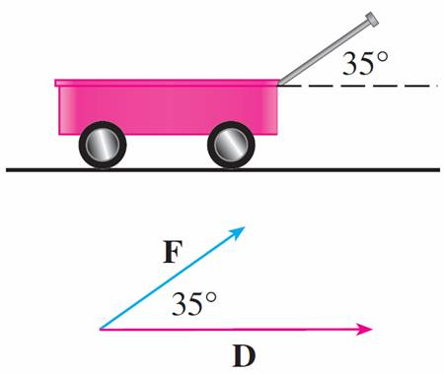
Example
A wagon is pulled a distance of 100 m along a horizontal path by a constant force of 70 N. The handle of the wagon is held at an angle of 35° above the horizontal. Find the work done by the force.
Solution: If F and D are the force and displacement vectors, as pictured in Figure 7, then the work done is
W = F  D
= | F | | D | cos 35°
Figure 7

Slide 43
Example
= (70)(100) cos 35°
≈ 5734 Nm
= 5734 J

Slide 44
Lines and Planes

Slide 45
Lines
A line in the xy-plane is determined when a point on the line and the direction of the line (its slope or angle of inclination) are given.
The equation of the line can then be written using the point-slope form.
Likewise, a line L in three-dimensional space is determined when we know a point P₀(x₀, y₀, z₀) on L and the direction of L. In three dimensions the direction of a line is conveniently described by a vector, so we let v be a vector parallel to L.

Slide 46
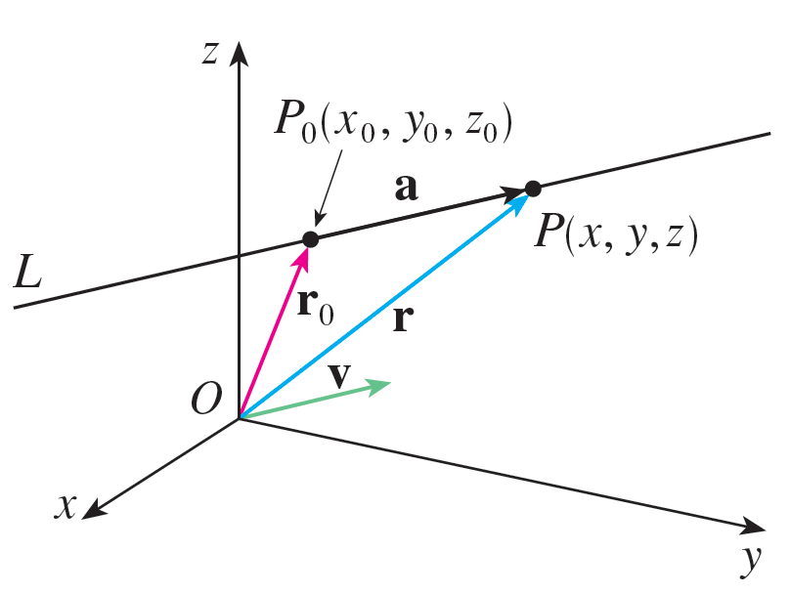
Lines
Let P(x, y, z) be an arbitrary point on L and let r₀ and r be the position vectors of P₀ and P (that is, they have representations and ).
If a is the vector with representation as in Figure 1, then the Triangle Law for vector addition gives r = r₀ + a.
Figure 1

Slide 47

Lines
But, since a and v are parallel vectors, there is a scalar t such that a = t v. Thus
which is a vector equation of L.
Each value of the parameter t gives the position vector r of a point on L. In other words, as t varies, the line is traced out by the tip of the vector r.

Slide 48
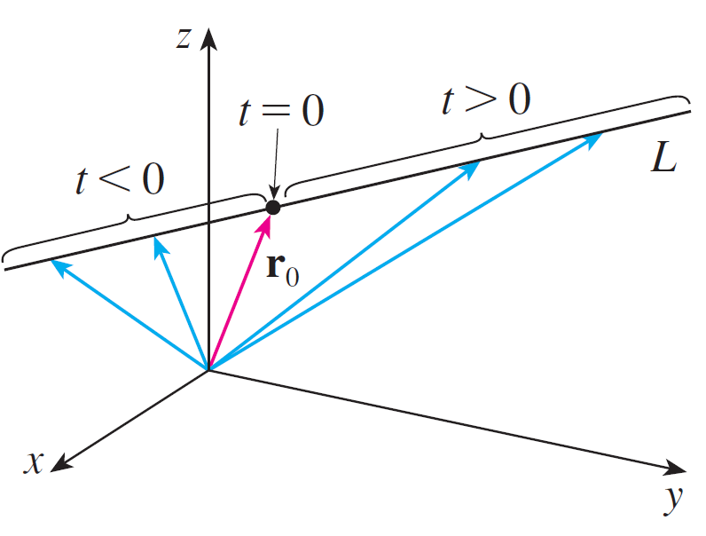
Lines
As Figure 2 indicates, positive values of t correspond to points on L that lie on one side of P₀, whereas negative values of t correspond to points that lie on the other side of P₀.
Figure 2

Slide 49
Lines
If the vector v that gives the direction of the line L is written in component form as v = ⟨a, b, c⟩, then we have t v = ⟨t a, t b, t c⟩.
We can also write r = ⟨x, y, z⟩ and r₀ = ⟨x₀, y₀, z₀⟩, so the vector equation (1) becomes
⟨x, y, z⟩ = ⟨x₀ + t a, y₀ + tb, z₀ + t c⟩
Two vectors are equal if and only if corresponding components are equal.

Slide 50
Lines
Therefore we have the three scalar equations:
where t ∈
These equations are called parametric equations of the line L through the point P₀(x₀, y₀, z₀) and parallel to the vector v = ⟨a, b, c⟩.
Each value of the parameter t gives a point (x, y, z) on L.

Slide 51
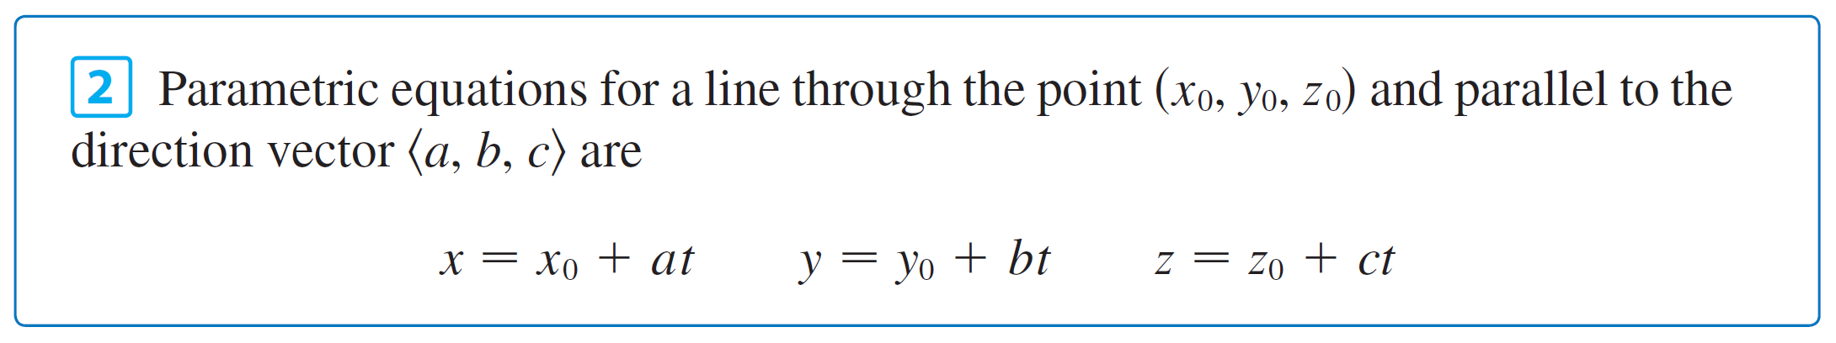
Lines

Slide 52
Example
(a) Find a vector equation and parametric equations for the line that passes through the point (5, 1, 3) and is
parallel to the vector i + 4j – 2k.
(b) Find two other points on the line.
Solution:
Here r₀ = ⟨5, 1, 3⟩ = 5i + j + 3k and v = i + 4j – 2k, so
the vector equation (1) becomes
r = (5i + j + 3k) + t(i + 4j – 2k)
or r = (5 + t) i + (1 + 4t) j + (3 – 2t) k

Slide 53
Example
Parametric equations are
x = 5 + t y = 1 + 4t z = 3 – 2t
(b) Choosing the parameter value t = 1 gives x = 6, y = 5, and z = 1, so (6, 5, 1) is a point on the line.
Similarly, t = –1 gives the point (4, –3, 5).

Slide 54
Lines
The vector equation and parametric equations of a line are not unique. If we change the point or the parameter or choose a different parallel vector, then the equations change.
For instance, if, instead of (5, 1, 3), we choose the point (6, 5, 1), then the parametric equations of the line become
x = 6 + t y = 5 + 4t z = 1 – 2t

Slide 55
Lines
Or, if we stay with the point (5, 1, 3) but choose the parallel vector 2i + 8j – 4k, we arrive at the equations
x = 5 + 2t y = 1 + 8t z = 3 – 4t
In general, if a vector v = ⟨a, b, c⟩ is used to describe the direction of a line L, then the numbers a, b, and c are called direction numbers of L.
Since any vector parallel to v could also be used, we see that any three numbers proportional to a, b, and c could also be used as a set of direction numbers for L.

Slide 56
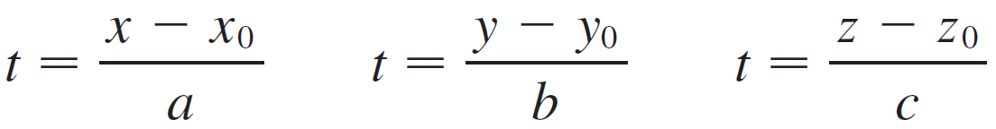
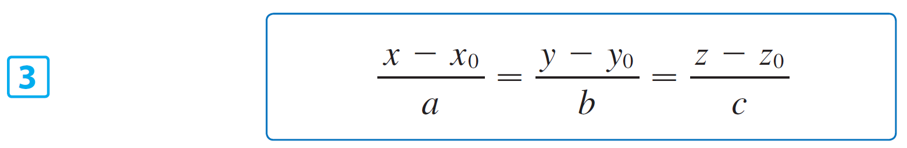
Lines
Another way of describing a line L is to eliminate the parameter t from Equation 2.
If none of a, b, or c is 0, we can solve each of these equations for t:
Equating the results, we obtain
These equations are called symmetric equations of L.

Slide 57
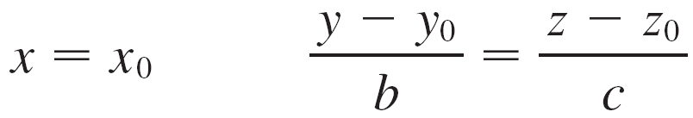
Lines
Notice that the numbers a, b, and c that appear in the denominators of Equations 3 are direction numbers of L, that is, components of a vector parallel to L.
If one of a, b, or c is 0, we can still eliminate t. For instance, if a = 0, we could write the equations of L as
This means that L lies in the vertical plane x = x₀.

Slide 58
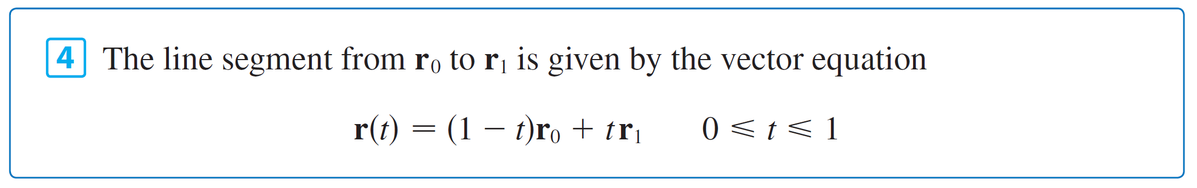
Lines
In general, we know from Equation 1 that the vector equation of a line through the (tip of the) vector r₀ in the direction of a vector v is r = r₀ + t v.
If the line also passes through (the tip of) r₁, then we can take v = r₁ – r₀ and so its vector equation is
r = r₀ + t(r₁ – r₀) = (1 – t)r₀ + tr₁
The line segment from r₀ to r₁ is given by the parameter interval 0 ≤ t ≤ 1.

Slide 59
Lines
The line equation r = r₀ + t v is valid for high dimensional space.
Although we can derive an equation similar Eq 3 for the high dimensional case, we don’t use it. We normally use the equation in vector form i.e., r = r₀ + t v.

Slide 60
Planes
Although a line in space is determined by a point and a direction, a plane in space is more difficult to describe.
A single vector parallel to a plane is not enough to convey the “direction” of the plane, but a vector perpendicular to the plane does completely specify its direction.
Thus a plane in space is determined by a point P₀(x₀, y₀, z₀) in the plane and a vector n that is orthogonal to the plane. This orthogonal vector n is called a normal vector.

Slide 61
Planes
Let P(x, y, z) be an arbitrary point in the plane, and let r₀ and r be the position vectors of P₀ and P. Then the vector r – r₀ is represented by (See Figure 6.)
Figure 6

Slide 62
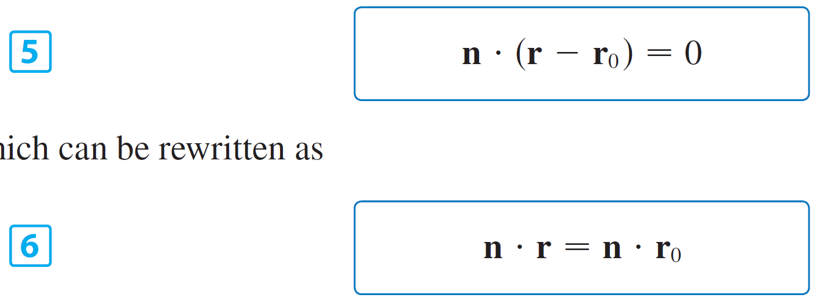
Planes
The normal vector n is orthogonal to every vector in the given plane. In particular, n is orthogonal to r – r₀ and so we have
which can be rewritten as
Either Equation 5 or Equation 6 is called a vector equation of the plane.

Slide 63
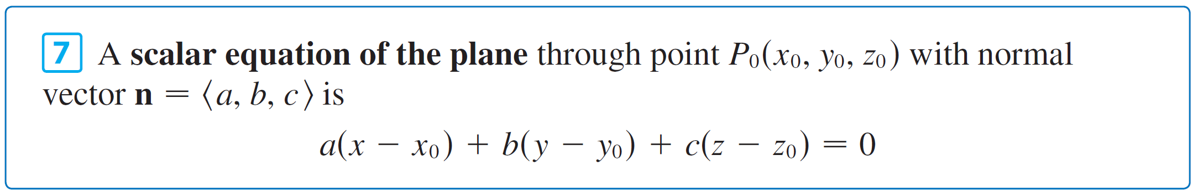
Planes
To obtain a scalar equation for the plane, we write
n = ⟨a, b, c⟩, r = ⟨x, y, z⟩, and r₀ = ⟨x₀, y₀, z₀⟩.
Then the vector equation (5) becomes
⟨a, b, c⟩ • ⟨x – x₀, y – y₀, z – z₀⟩ = 0
a(x – x₀) + b(y – y₀) + c(z – z₀) = 0

Slide 64
Example
Find an equation of the plane through the point (2, 4, –1) with normal vector n = ⟨2, 3, 4⟩. Find the intercepts and sketch the plane.
Solution:
Putting a = 2, b = 3, c = 4, x₀ = 2, y₀ = 4, and z₀ = –1 in Equation 7, we see that an equation of the plane is
2(x – 2) + 3(y – 4) + 4(z + 1) = 0
or 2x + 3y + 4z = 12
To find the x-intercept we set y = z = 0 in this equation and obtain x = 6.

Slide 65
Example
Similarly, the y-intercept is 4 and the z-intercept is 3. This enables us to sketch the portion of the plane that lies in the first octant (see Figure 7).
Figure 7

Slide 66

Planes
By collecting terms in Equation 7 as we did in Example 4, we can rewrite the equation of a plane as
where d = –(ax₀ + by₀ + cz₀).
Equation 8 is called a linear equation in x, y, and z. Conversely, it can be shown that if a, b, and c are not all 0, then the linear equation (8) represents a plane with normal vector ⟨a, b, c⟩.

Slide 67
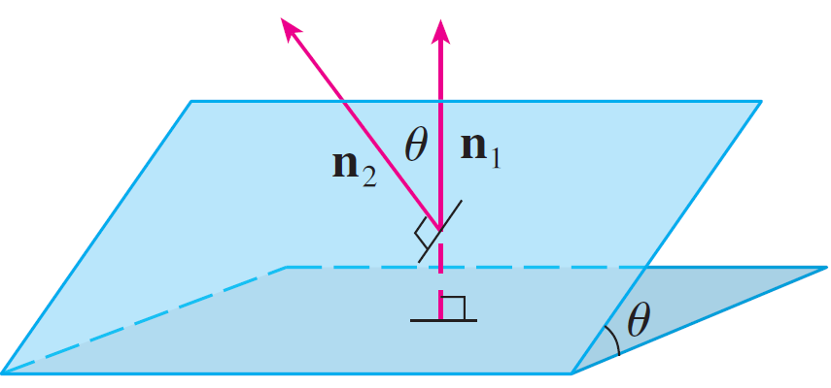
Planes
Two planes are parallel if their normal vectors are parallel.
For instance, the planes x + 2y – 3z = 4 and 2x + 4y – 6z = 3 are parallel because their normal vectors are n₁ = ⟨1, 2, –3⟩ and n₂ = ⟨2, 4, –6⟩ and n₂ = 2n₁.
If two planes are not parallel, then they intersect in a straight line and the angle between the two planes is defined as the acute angle between their normal vectors (see angle θ in Figure 9).
Figure 9

Slide 68
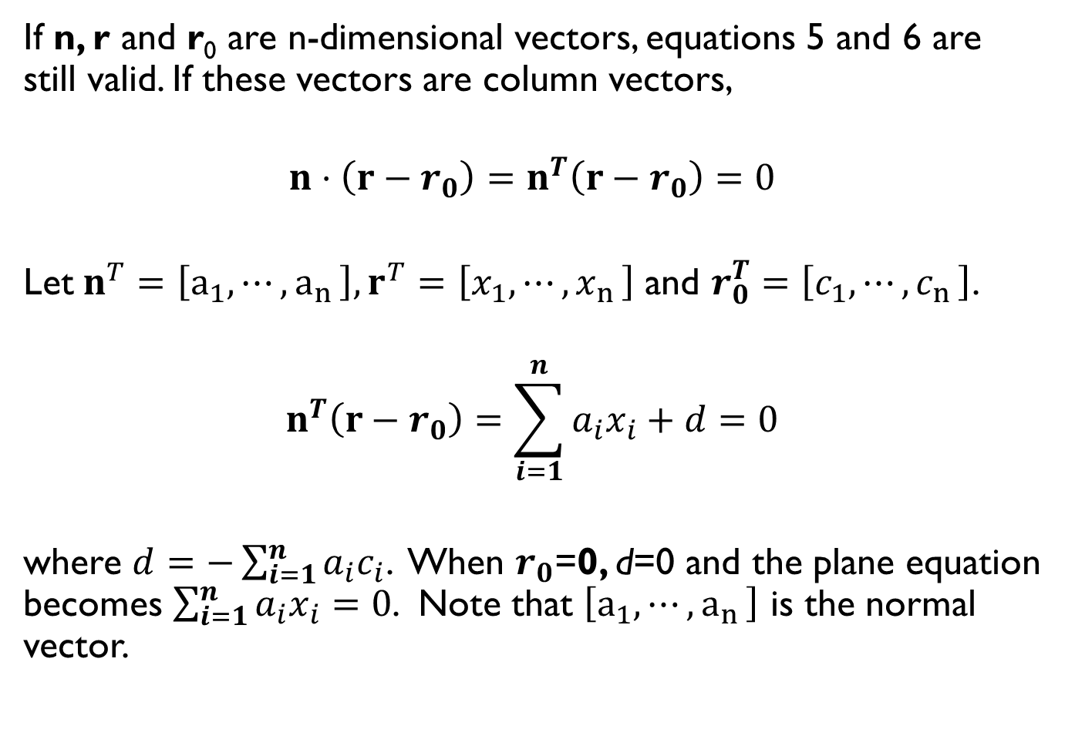
Hyperplanes
If n, r and r₀ are n-dimensional vectors, equations 5 and 6 are still valid. If these vectors are column vectors,
$$n⋅\left(r−r_{0}\right)=n^{T}\left(r−r_{0}\right)=0$$
Let$n^{T}=\left[a_{1},⋯{,a}_{n}\right], r^{T}=\left[x_{1},⋯{,x}_{n}\right]$ and $r_{0}^{T}=\left[c_{1},⋯{,c}_{n}\right]$.
$$n^{T}\left(r−r_{0}\right)=\sum_{i=1}^{n}{a_{i}x_{i}+d=0}$$
where $d=−\sum_{i=1}^{n}{a_{i}c_{i}}$. When $r_{0}$=0, d=0 and the plane equation becomes $\sum_{i=1}^{n}{a_{i}x_{i}=0}$. Note that $\left[a_{1},⋯{,a}_{n}\right]$ is the normal vector.

Slide 69

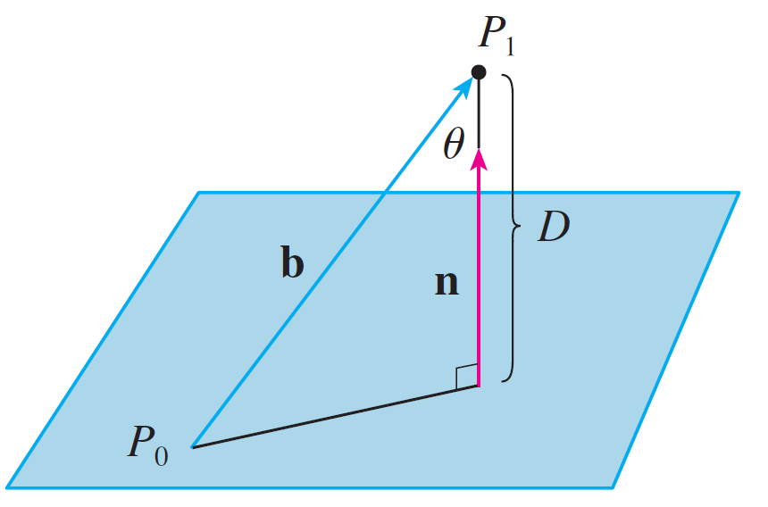
Example
Find a formula for the distance D from a point P₁(x₁, y₁, z₁) to the plane ax + by + cz + d = 0.
Solution:
Let P₀(x₀, y₀, z₀) be any point in the given plane and let b be the vector corresponding to Then
b = ⟨x₁ – x₀, y₁ – y₀, z₁ – z₀⟩
From Figure 12 you can see that the distance D from P₁ to the plane is equal to the absolute value of the scalar projection of b onto the normal vector n = ⟨a, b, c⟩.
Figure 12

Slide 70
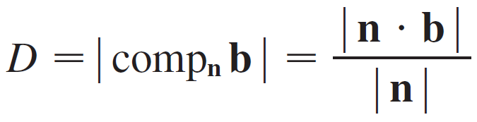
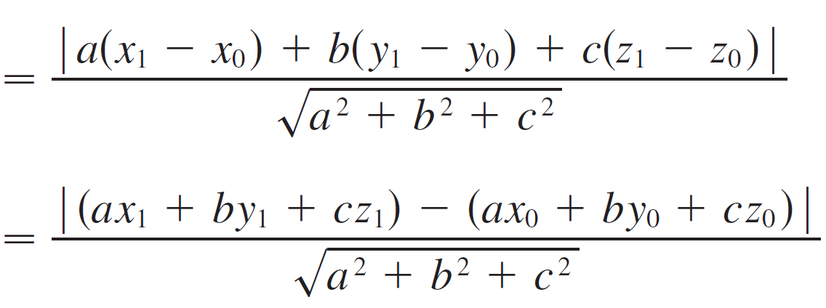
Example
Thus

Slide 71
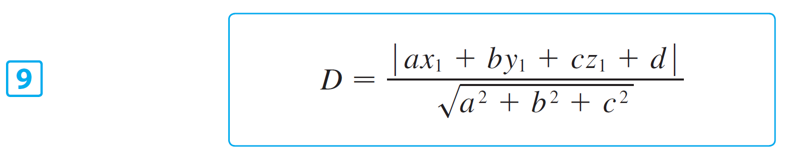
Example
Since P₀ lies in the plane, its coordinates satisfy the equation of the plane and so we have
ax₀ + by₀ + cz₀ + d = 0.
Thus the formula for D can be written as

