Slide 1
Mathematics for AI
Adams Wai Kin Kong
School of Computer Science and Engineering
Nanyang Technological University, Singapore
adamskong@ntu.edu.sg
Copyright © Cengage Learning. All rights reserved.

Slide 2
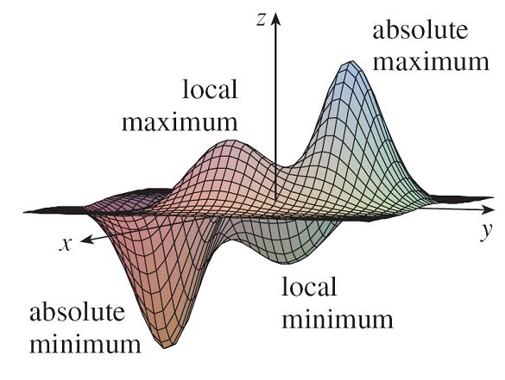
Maximum and Minimum Values
In this section we see how to use partial derivatives to locate maxima and minima of functions of two variables.
Look at the hills and valleys in the graph of f shown in Figure 1.
Figure 1

Slide 3
Maximum and Minimum Values
There are two points (a, b) where f has a local maximum, that is, where f (a, b) is larger than nearby values of f (x, y).
The larger of these two values is the absolute maximum.
Likewise, f has two local minima, where f (a, b) is smaller than nearby values.
The smaller of these two values is the absolute minimum.

Slide 4
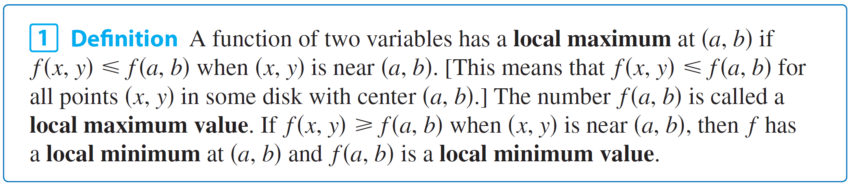
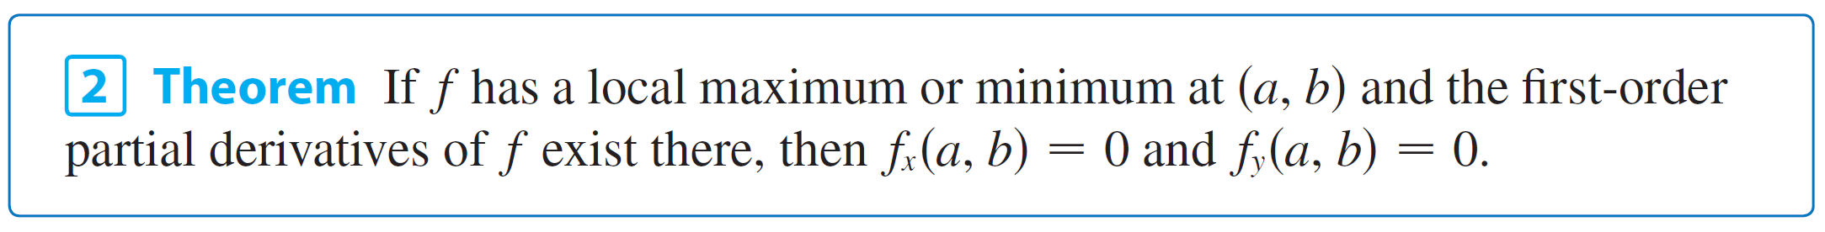
Maximum and Minimum Values
If the inequalities in Definition 1 hold for all points (x, y) in the domain of f, then f has an absolute maximum (or absolute minimum) at (a, b).

Slide 5
Maximum and Minimum Values
A point (a, b) is called a critical point (or stationary point) of f if f _{x} (a, b) = 0 and f _{y} (a, b) = 0, or if one of these partial derivatives does not exist.
Theorem 2 says that if f has a local maximum or minimum at (a, b), then (a, b) is a critical point of f.
However, as in single-variable calculus, not all critical points give rise to maxima or minima.
At a critical point, a function could have a local maximum or a local minimum or neither.

Slide 6
Example 1
Let f (x, y) = x² + y² – 2x – 6y + 14.
Then
f _{x} (x, y) = 2x – 2 f _{y} (x, y) = 2y – 6
These partial derivatives are equal to 0 when x = 1 and y = 3, so the only critical point is (1, 3).
By completing the square, we find that
f (x, y) = 4 + (x – 1)² + (y – 3)²

Slide 7
Example 1
Since (x – 1)² ≥ 0 and (y – 3)² ≥ 0, we have f (x, y) ≥ 4 for all values of x and y.
Therefore f (1, 3) = 4 is a local minimum, and in fact it is the absolute minimum of f.
This can be confirmed geometrically from the graph of f, which is the elliptic paraboloid with vertex (1, 3, 4) shown in Figure 2.
z = x² + y² – 2x – 6y + 14
Figure 2

Slide 8
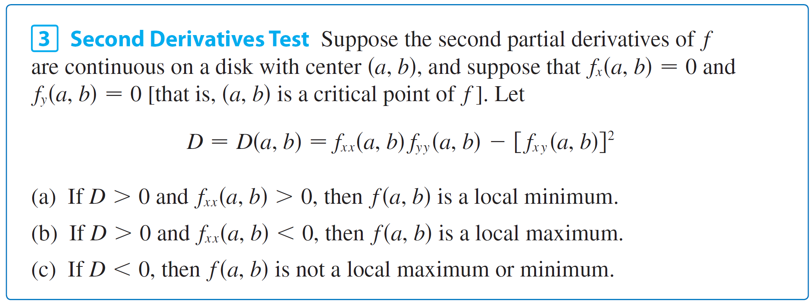
Maximum and Minimum Values
The following test, is analogous to the Second Derivative Test for functions of one variable.
In case (c) the point (a, b) is called a saddle point of f and the graph of f crosses its tangent plane at (a, b).

Slide 9
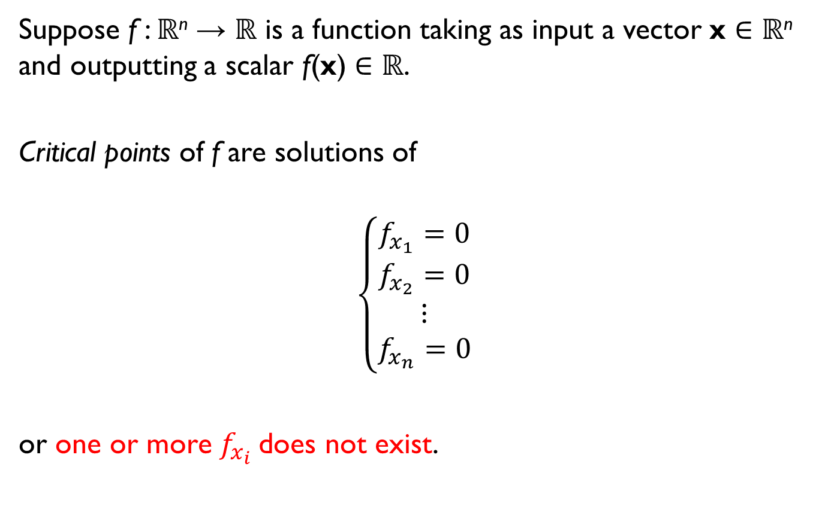
Second Derivative Test for Multivariable Functions
Suppose f : ℝ^{n} → ℝ is a function taking as input a vector x ∈ ℝ^{n} and outputting a scalar f(x) ∈ ℝ.
Critical points of f are solutions of
$$\left\{\begin{aligned}f_{x_{1}}=0 \\ f_{x_{2}}=0 \\ ⋮ \\ f_{x_{n}}=0\end{aligned}\right.$$
or one or more $f_{x_{i}}$does not exist.

Slide 10
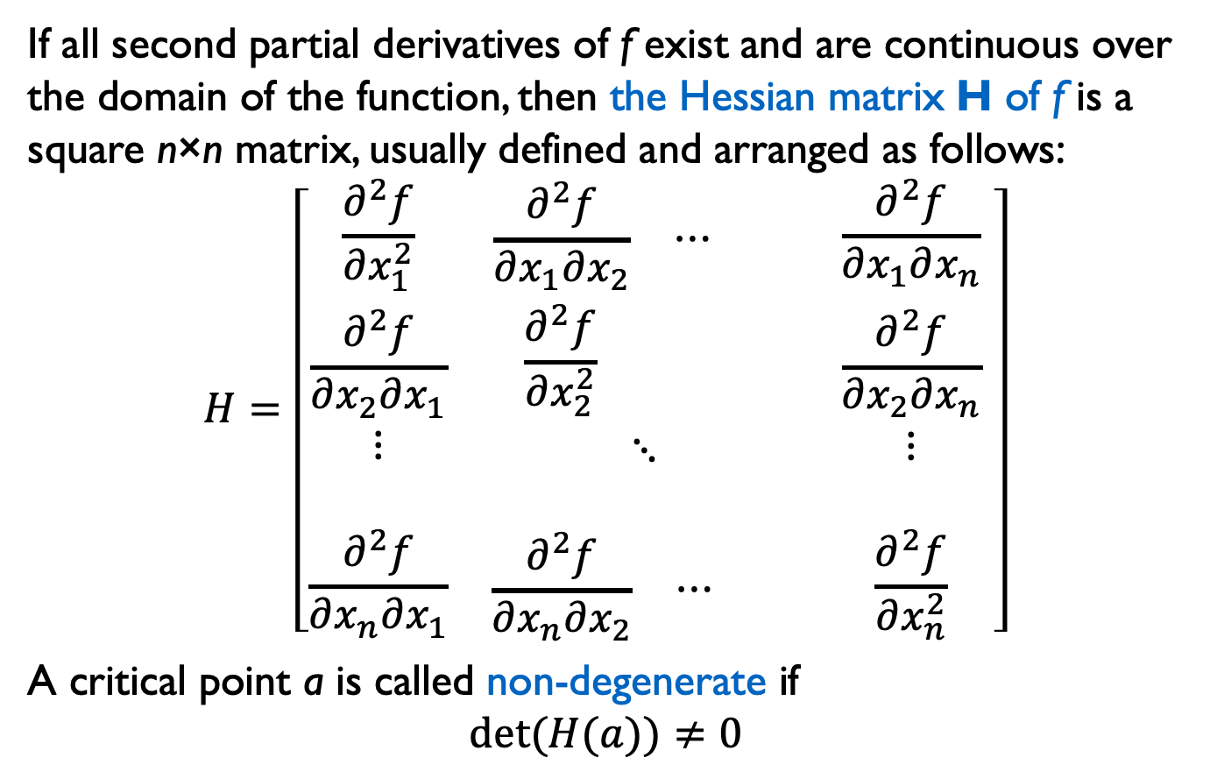
Second Derivative Test for Multivariable Functions
If all second partial derivatives of f exist and are continuous over the domain of the function, then the Hessian matrix H of f is a square n×n matrix, usually defined and arranged as follows:
$$H=\left[\begin{matrix}\frac{∂^{2}f}{∂x_{1}^{2}} & \begin{matrix}\frac{∂^{2}f}{∂x_{1}∂x_{2}} & ⋯ & \end{matrix} & \frac{∂^{2}f}{∂x_{1}∂x_{n}} \\ \begin{matrix}\frac{∂^{2}f}{∂x_{2}∂x_{1}} \\ ⋮ \\ \end{matrix} & \begin{matrix}\begin{matrix}\frac{∂^{2}f}{∂x_{2}^{2}} & & \end{matrix} \\ \begin{matrix} & ⋱ & \end{matrix} \\ \begin{matrix} & & \end{matrix}\end{matrix} & \begin{matrix}\frac{∂^{2}f}{∂x_{2}∂x_{n}} \\ ⋮ \\ \end{matrix} \\ \frac{∂^{2}f}{∂x_{n}∂x_{1}} & \begin{matrix}\frac{∂^{2}f}{∂x_{n}∂x_{2}} & ⋯ & \end{matrix} & \frac{∂^{2}f}{∂x_{n}^{2}}\end{matrix} \right]$$
A critical point a is called non-degenerate if
$$det⁡(H(a))≠0$$

Slide 11
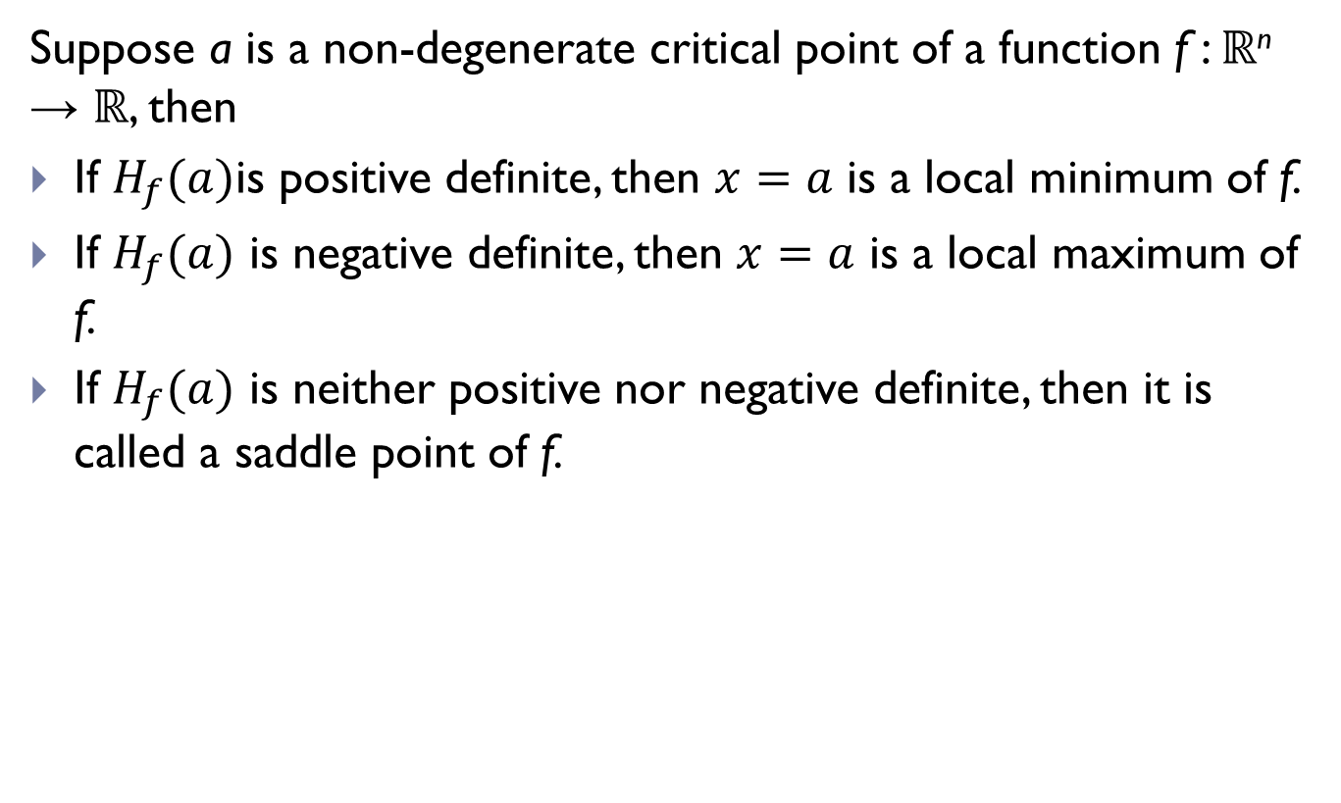
Second Derivative Test for Multivariable Functions
Suppose a is a non-degenerate critical point of a function f : ℝ^{n} → ℝ, then
If $H_{f}(a)$is positive definite, then $x=a$ is a local minimum of f.
If $H_{f}(a)$ is negative definite, then $x=a$ is a local maximum of f.
If $H_{f}(a)$ is neither positive nor negative definite, then it is called a saddle point of f.
https://en.wikipedia.org/wiki/Definiteness_of_a_matrix

Slide 12
Absolute Maximum and Minimum Values
For a function f of one variable, the Extreme Value Theorem says that if f is continuous on a closed interval [a, b], then f has an absolute minimum value and an absolute maximum value.
According to the Closed Interval Method, we found these by evaluating f not only at the critical numbers but also at the endpoints a and b.
There is a similar situation for functions of two variables. Just as a closed interval contains its endpoints, a closed set in is one that contains all its boundary points.

Slide 13
Absolute Maximum and Minimum Values
[A boundary point of D is a point (a, b) such that every disk with center (a, b) contains points in D and also points not in D.]
For instance, the disk
D = {(x, y)| x² + y² ≤ 1}
which consists of all points on or inside the circle x² + y² = 1, is a closed set because it contains all of its boundary points (which are the points on the circle x² + y² = 1).

Slide 14

Absolute Maximum and Minimum Values
But if even one point on the boundary curve were omitted, the set would not be closed. (See Figure 11.)
A bounded set in is one that is contained within some disk.
Closed sets
Sets that are not closed
Figure 11(a)
Figure 11(b)

Slide 15
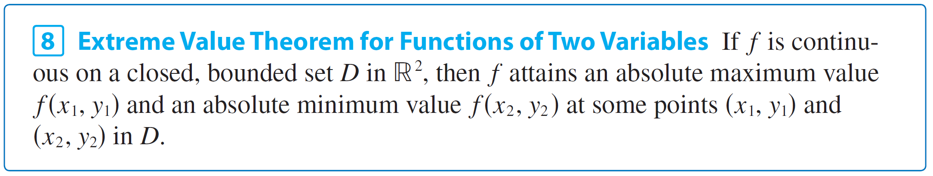
Absolute Maximum and Minimum Values
Then, in terms of closed and bounded sets, we can state the following counterpart of the Extreme Value Theorem in two dimensions.

Slide 16
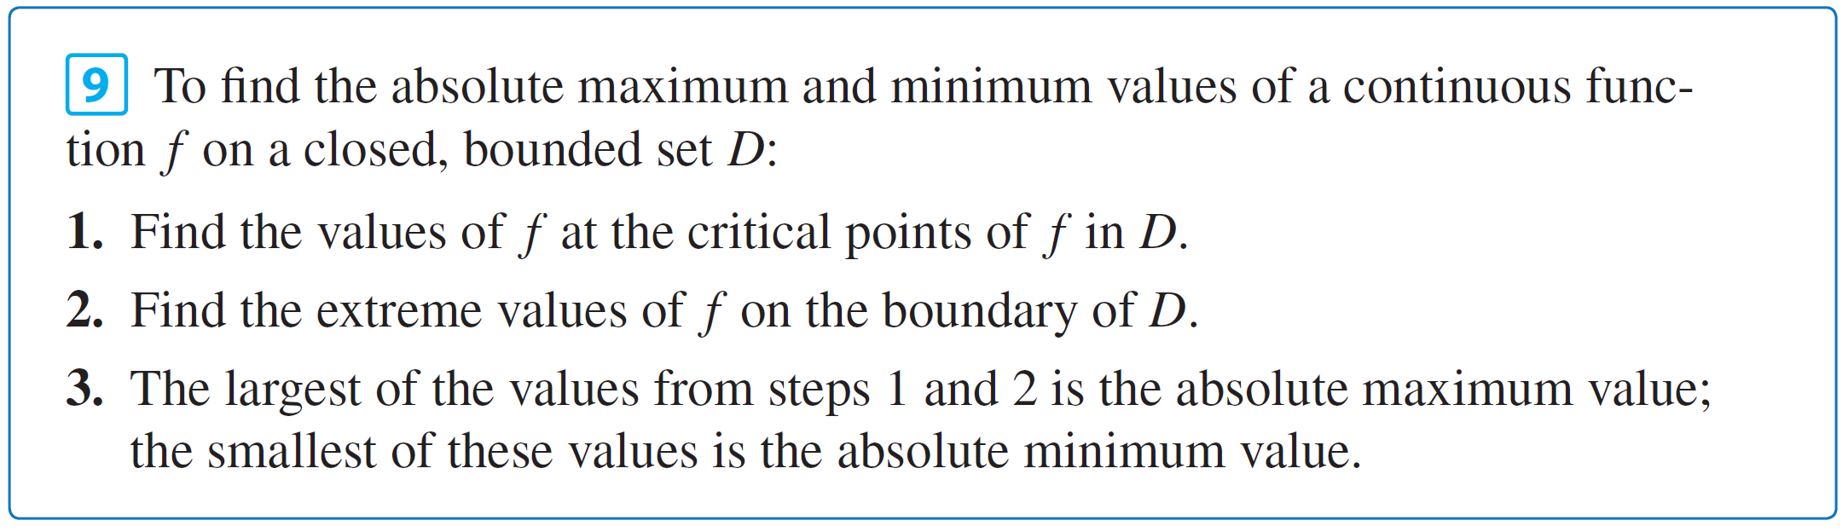
Absolute Maximum and Minimum Values
To find the extreme values guaranteed by Theorem 8, we note that, by Theorem 2, if f has an extreme value at (x₁, y₁), then (x₁, y₁) is either a critical point of f or a boundary point of D.
Thus we have the following extension of the Closed Interval Method.

Slide 17
Example 7
Find the absolute maximum and minimum values of the function f (x, y) = x² – 2xy + 2y on the rectangle D = {(x, y) | 0 ≤ x ≤ 3, 0 ≤ y ≤ 2}.
Solution: Since f is a polynomial, it is continuous on the closed, bounded rectangle D, so Theorem 8 tells us there is both an absolute maximum and an absolute minimum.
According to step 1 in (9), we first find the critical points. These occur when
f_{x} = 2x – 2y = 0 f_{y} = –2x + 2 = 0

Slide 18
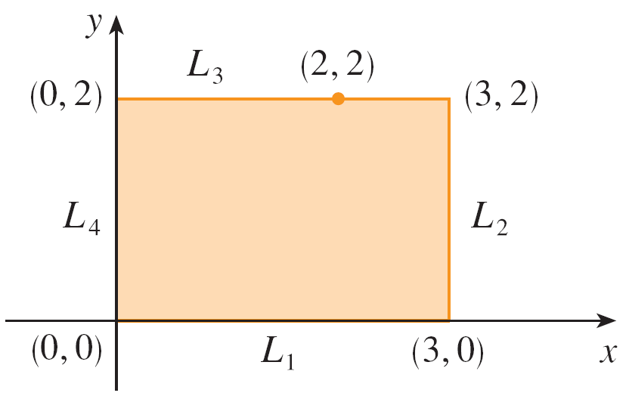
Example 7 – Solution
So the only critical point is (1, 1), and the value of f there is f (1, 1) = 1.
In step 2 we look at the values of f on the boundary of D, which consists of the four line segments L₁, L₂, L₃, L₄ shown in Figure 12.
Figure 12

Slide 19
Example 7 – Solution
On L₁ we have y = 0 and
f (x, 0) = x² 0 ≤ x ≤ 3
This is an increasing function of x, so its minimum value is f (0, 0) = 0 and its maximum value is f (3, 0) = 9.
On L₂ we have x = 3 and
f (3, y) = 9 – 4y 0 ≤ y ≤ 2
This is a decreasing function of y, so its maximum value is f (3, 0) = 9 and its minimum value is f (3, 2) = 1.

Slide 20
Example 7 – Solution
On L₃ we have y = 2 and
f (x, 2) = x² – 4x + 4 0 ≤ x ≤ 3
Simply by observing that f (x, 2) = (x – 2)², we see that the minimum value of this function is f (2, 2) = 0 and the maximum value is f (0, 2) = 4.

Slide 21
Example 7 – Solution
Finally, on L₄ we have x = 0 and
f (0, y) = 2y 0 ≤ y ≤ 2
with maximum value f (0, 2) = 4 and minimum value f (0, 0) = 0.
Thus, on the boundary, the minimum value of f is 0 and the maximum is 9.

Slide 22
Example 7 – Solution
In step 3 we compare these values with the value f (1, 1) = 1 at the critical point and conclude that the absolute maximum value of f on D is f (3, 0) = 9 and the absolute minimum value is f (0, 0) = f (2, 2) = 0.
Figure 13 shows the graph of f.
f (x, y) = x² – 2xy + 2y
Figure 13

Slide 23
Lagrange Multipliers
In this section we present Lagrange’s method for maximizing or minimizing a general function f (x, y, z) subject to a constraint (or side condition) of the form g(x, y, z) = k.
It’s easier to explain the geometric basis of Lagrange’s method for functions of two variables. So we start by trying to find the extreme values of f (x, y) subject to a constraint of the form g(x, y) = k.
In other words, we seek the extreme values of f (x, y) when the point (x, y) is restricted to lie on the level curve g(x, y) = k.

Slide 24
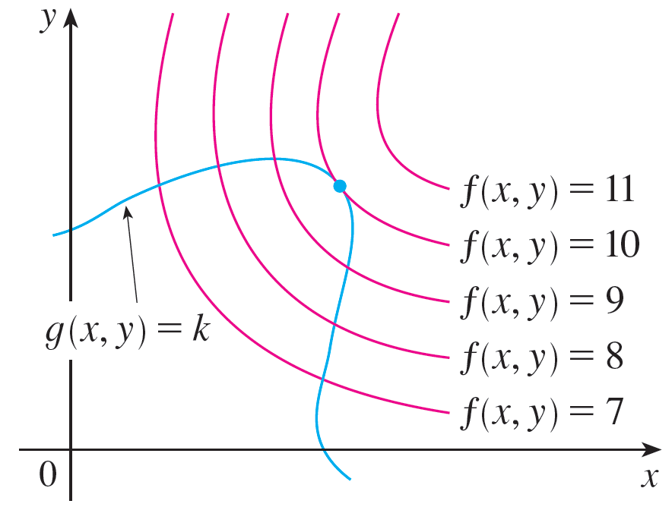
Lagrange Multipliers
Figure 1 shows this curve together with several level curves of f.
These have the equations f (x, y) = c, where c = 7, 8, 9, 10, 11.
Figure 1

Slide 25
Lagrange Multipliers
To maximize f (x, y) subject to g(x, y) = k is to find the largest value of c such that the level curve f (x, y) = c intersects g(x, y) = k.
It appears from Figure 1 that this happens when these curves just touch each other, that is, when they have a common tangent line. (Otherwise, the value of c could be increased further.)

Slide 26
Lagrange Multipliers
This means that the normal lines at the point (x₀, y₀) where they touch are identical. So the gradient vectors are parallel; that is, ∇f (x₀, y₀) = λ ∇g(x₀, y₀) for some scalar λ.
This kind of argument also applies to the problem of finding the extreme values of f (x, y, z) subject to the constraint g(x, y, z) = k.
Thus the point (x, y, z) is restricted to lie on the level surface S with equation g(x, y, z) = k.

Slide 27
Lagrange Multipliers
Instead of the level curves in Figure 1, we consider the level surfaces f (x, y, z) = c and argue that if the maximum value of f is f (x₀, y₀, z₀) = c, then the level surface f (x, y, z) = c is tangent to the level surface g(x, y, z) = k and so the corresponding gradient vectors are parallel.
Figure 1

Slide 28
Lagrange Multipliers
This intuitive argument can be made precise as follows. Suppose that a function f has an extreme value at a point P(x₀, y₀, z₀) on the surface S and let C be a curve with vector equation r(t) = ⟨x(t), y(t), z(t)⟩ that lies on S and passes through P.
If t₀ is the parameter value corresponding to the point P, then r(t₀) = ⟨x₀, y₀, z₀⟩.
The composite function h(t) = f (x(t), y(t), z(t)) represents the values that f takes on the curve C.

Slide 29
Lagrange Multipliers
Since f has an extreme value at (x₀, y₀, z₀), it follows that h has an extreme value at t₀, so h′(t₀) = 0. But if f is differentiable, we can use the Chain Rule to write
0 = h′(t₀)
= f_{x}(x₀, y₀, z₀)x′(t₀) + f_{y}(x₀, y₀, z₀)y ′(t₀) + f_{z}(x₀, y₀, z₀)z′(t₀)
= ∇f (x₀, y₀, z₀)  r′(t₀)
This shows that the gradient vector ∇f (x₀, y₀, z₀) is orthogonal to the tangent vector r′(t₀) to every such curve C. But we already know that the gradient vector of g, ∇g(x₀, y₀, z₀), is also orthogonal to r′(t₀) for every such curve.

Slide 30

Lagrange Multipliers
This means that the gradient vectors ∇f (x₀, y₀, z₀) and ∇g(x₀, y₀, z₀) must be parallel. Therefore, if ∇g(x₀, y₀, z₀) ≠ 0, there is a number λ such that
The number λ in Equation 1 is called a Lagrange multiplier.

Slide 31
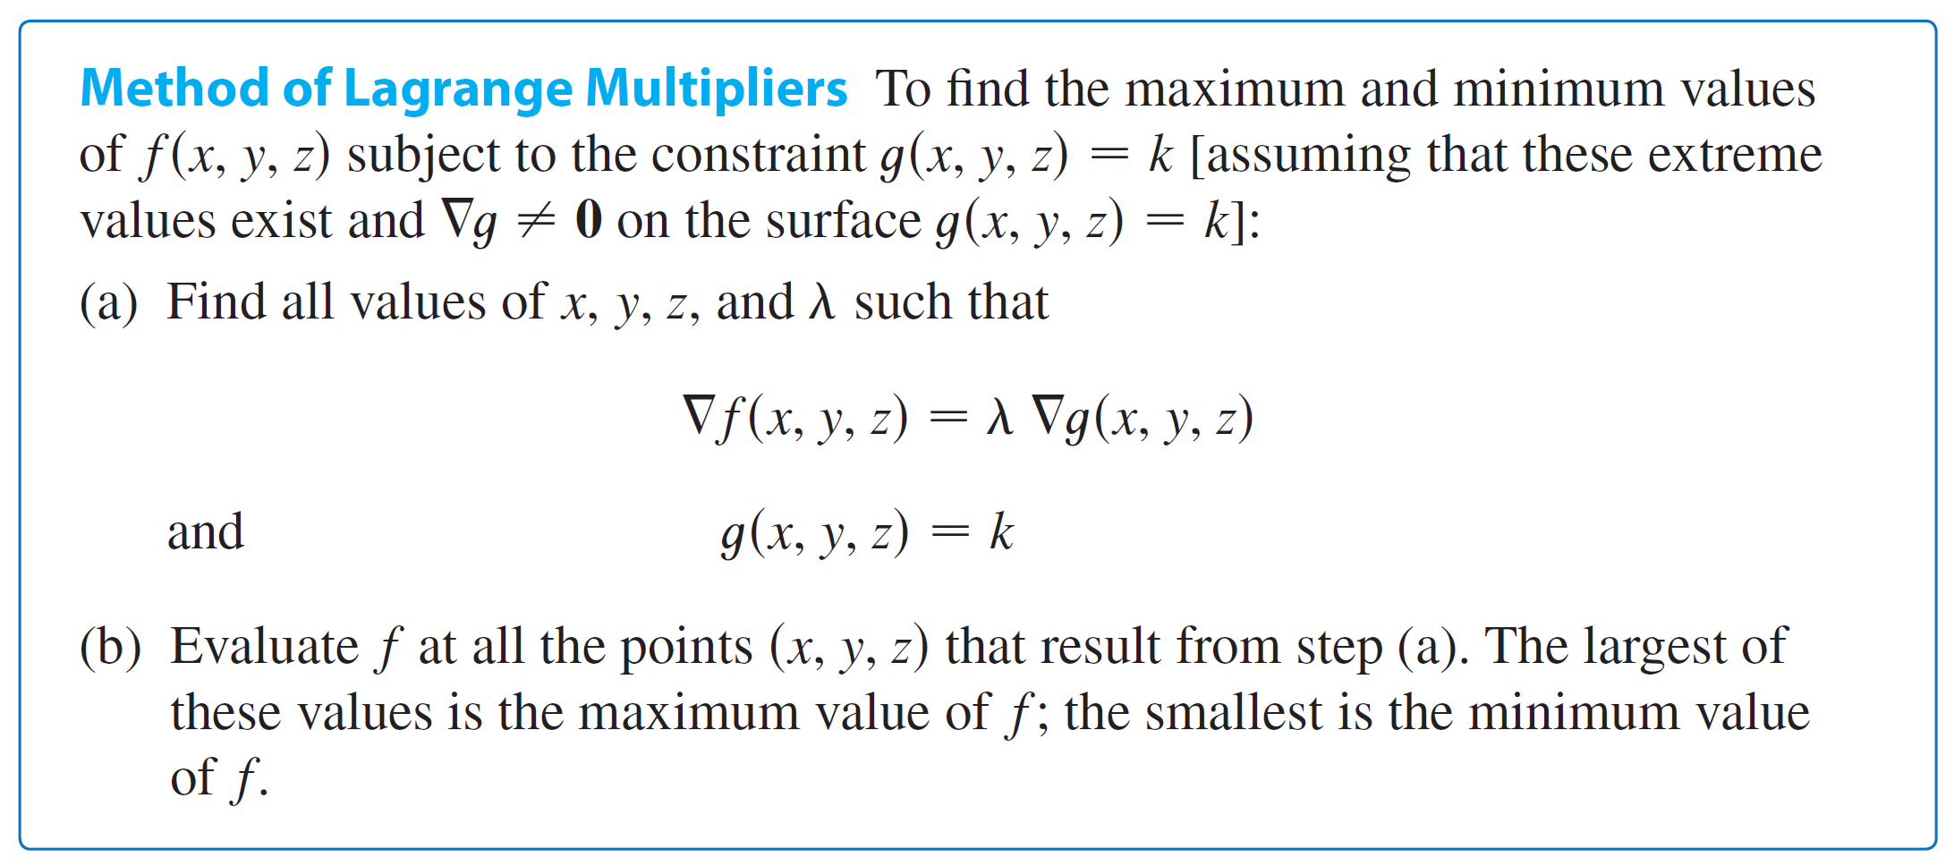
Lagrange Multipliers
The procedure based on Equation 1 is as follows.
https://en.wikipedia.org/wiki/Lagrange_multiplier

Slide 32
Lagrange Multipliers
If we write the vector equation ∇f = λ ∇g in terms of components, then the equations in step (a) become
f_{x} = λg_{x} f_{y} = λg_{y} f_{z} = λg_{z} g(x, y, z) = k
This is a system of four equations in the four unknowns x, y, z, and λ, but it is not necessary to find explicit values for λ.
For functions of two variables the method of Lagrange multipliers is similar to the method just described.

Slide 33
Lagrange Multipliers
To find the extreme values of f (x, y) subject to the constraint g(x, y) = k, we look for values of x, y, and λ such that
∇f (x, y) = λ ∇g(x, y) and g(x, y) = k
This amounts to solving three equations in three unknowns:
f_{x} = λg_{x} f_{y} = λg_{y} g(x, y) = k

Slide 34
Example 1
A rectangular box without a lid is to be made from 12 m² of cardboard. Find the maximum volume of such a box.
Solution: Let x, y, and z be the length, width, and height, respectively, of the box in meters.
Then we wish to maximize
V = xyz
subject to the constraint
g(x, y, z) = 2xz + 2yz + xy = 12

Slide 35
Example 1 – Solution
Using the method of Lagrange multipliers, we look for values of x, y, z, and λ such that ∇V = λ ∇g and g(x, y, z) = 12.
This gives the equations
V_{x} = λg_{x}
V_{y} = λg_{y}
V_{z} = λg_{z}
2xz + 2yz + xy = 12

Slide 36

Example 1 – Solution
Which become
yz = λ(2z + y)
xz = λ(2z + x)
xy = λ(2x + 2y)
2xz + 2yz + xy = 12

Slide 37

Example 1 – Solution
There are no general rules for solving systems of equations. Sometimes some ingenuity is required.
In the present example you might notice that if we multiply (2) by x, (3) by y, and (4) by z, then the left sides of these equations will be identical.
Doing this, we have
xyz = λ(2xz + xy)
xyz = λ(2yz + xy)
xyz = λ(2xz + 2yz)

Slide 38
Example 1 – Solution
We observe that λ ≠ 0 because λ = 0 would imply yz = xz = xy = 0 from (2), (3), and (4) and this would contradict (5).
Therefore, from (6) and (7), we have
2xz + xy = 2yz + xy
which gives xz = yz.
But z ≠ 0 (since z = 0 would give V = 0), so x = y.

Slide 39
Example 1 – Solution
From (7) and (8) we have
2yz + xy = 2xz + 2yz
which gives 2xz = xy and so (since x ≠ 0) y = 2z.
If we now put x = y = 2z in (5), we get
4z² + 4z² + 4z² = 12
Since x, y, and z are all positive, we therefore have z = 1 and so x = 2 and y = 2.

Slide 40
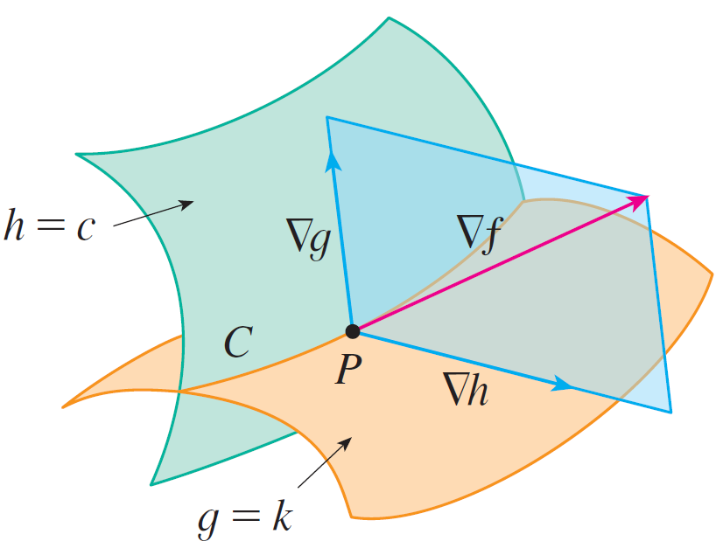
Two Constraints
Suppose now that we want to find the maximum and minimum values of a function f (x, y, z) subject to two constraints (side conditions) of the form g(x, y, z) = k and h(x, y, z) = c.
Geometrically, this means that we are looking for the extreme values of f when (x, y, z) is restricted to lie on the curve of intersection C of the level surfaces g(x, y, z) = k and h(x, y, z) = c. (See Figure 5.)

Slide 41
Two Constraints
Suppose f has such an extreme value at a point P(x₀, y₀, z₀). We know from the beginning of this section that ∇f is orthogonal to C at P.
But we also know that ∇g is orthogonal to g(x, y, z) = k and ∇h is orthogonal to h(x, y, z) = c, so ∇g and ∇h are both orthogonal to C.
This means that the gradient vector ∇f (x₀, y₀, z₀) is in the plane determined by ∇g(x₀, y₀, z₀) and ∇h(x₀, y₀, z₀). (We assume that these gradient vectors are not zero and not parallel.)

Slide 42
Two Constraints
So there are numbers λ and μ (called Lagrange multipliers) such that
In this case Lagrange’s method is to look for extreme values by solving five equations in the five unknowns x, y, z, λ, and μ.

Slide 43
Two Constraints
These equations are obtained by writing Equation 16 in terms of its components and using the constraint equations:
f_{x} = λg_{x} + μh_{x}
f_{y} = λg_{y} + μh_{y}
f_{z} = λg_{z} + μh_{z}
g(x, y, z) = k
h(x, y, z) = c

Slide 44
Example 5
Find the maximum value of the function f (x, y, z) = x + 2y + 3z on the curve of intersection of the plane x – y + z = 1 and the cylinder x² + y² = 1.
Solution:
We maximize the function f (x, y, z) = x + 2y + 3z subject to the constraints g(x, y, z) = x – y + z = 1 and h(x, y, z) = x² + y² = 1.

Slide 45

Example 5 – Solution
The Lagrange condition is ∇f = λ ∇g + μ ∇h, so we solve the equations
1 = λ + 2xμ
2 = –λ + 2yμ
3 = λ
x – y + z = 1
x² + y² = 1
Putting λ = 3 [from (19)] in (17), we get 2xμ = –2, so x = –1/μ. Similarly, (18) gives y = 5 /(2μ).

Slide 46

Example 5 – Solution
Substitution in (21) then gives
and so μ ² = , μ = .
Then x = y = and, from (20),
z = 1 – x + y = 1 .

Slide 47
Example 5 – Solution
The corresponding values of f are
Therefore the maximum value of f on the given curve is

Slide 48
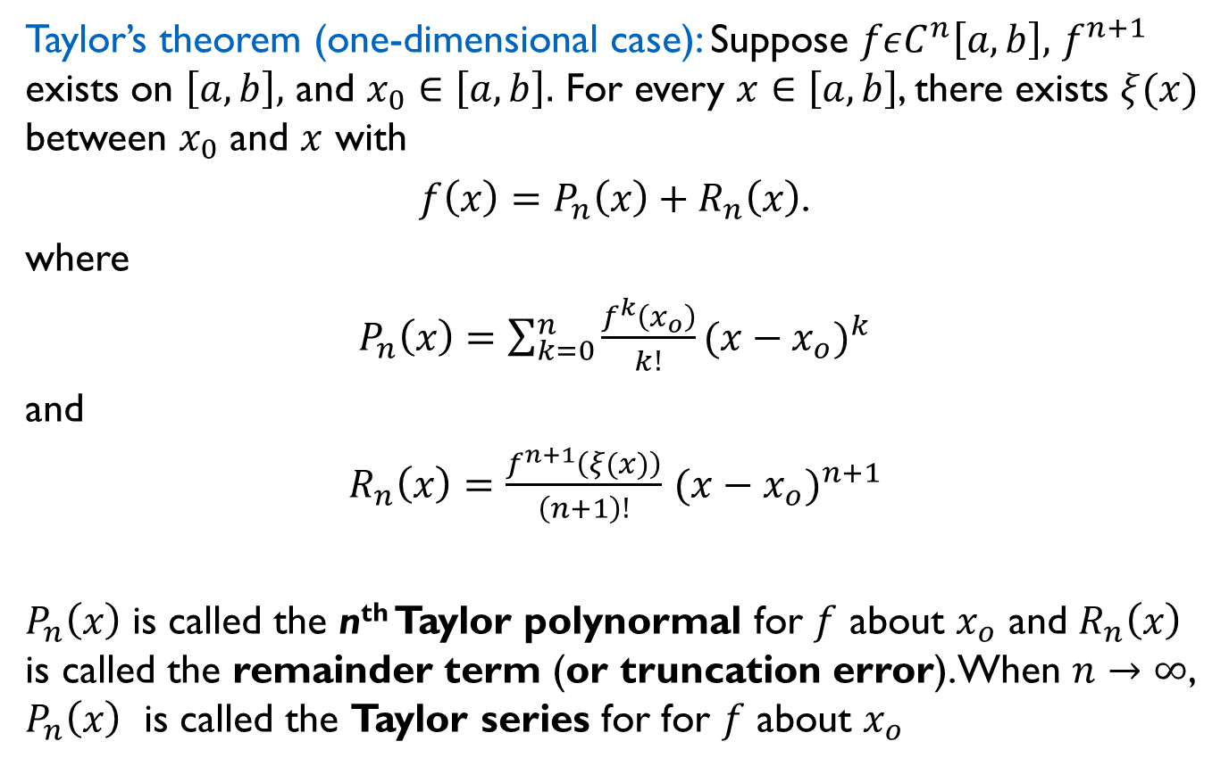
Taylor Series, one-dimensional case
Taylor’s theorem (one-dimensional case): Suppose $fεC^{n}\left[a, b\right],$ $f^{n+1}$ exists on $\left[a, b\right],$ and $x_{0}∈\left[a, b\right].$ For every $x∈\left[a, b\right]$, there exists $ξ(x)$ between $x_{0}$ and $x$ with
$f\left(x\right)=P_{n}\left(x\right)+R_{n}\left(x\right)$.
where
$P_{n}\left(x\right)=\sum_{k=0}^{n}{\frac{f^{k}\left(x_{o}\right)}{k!}}{(x−x_{o})}^{k}$
and
$R_{n}\left(x\right)=\frac{f^{n+1}\left(ξ(x)\right)}{\left(n+1\right)!}$ ${(x−x_{o})}^{n+1}$
$P_{n}\left(x\right)$ is called the n^{th} Taylor polynormal for $f$ about $x_{o}$ and $R_{n}\left(x\right)$ is called the remainder term (or truncation error). When $n→∞$, $P_{n}\left(x\right)$ is called the Taylor series for for $f$ about $x_{o}$

Slide 49
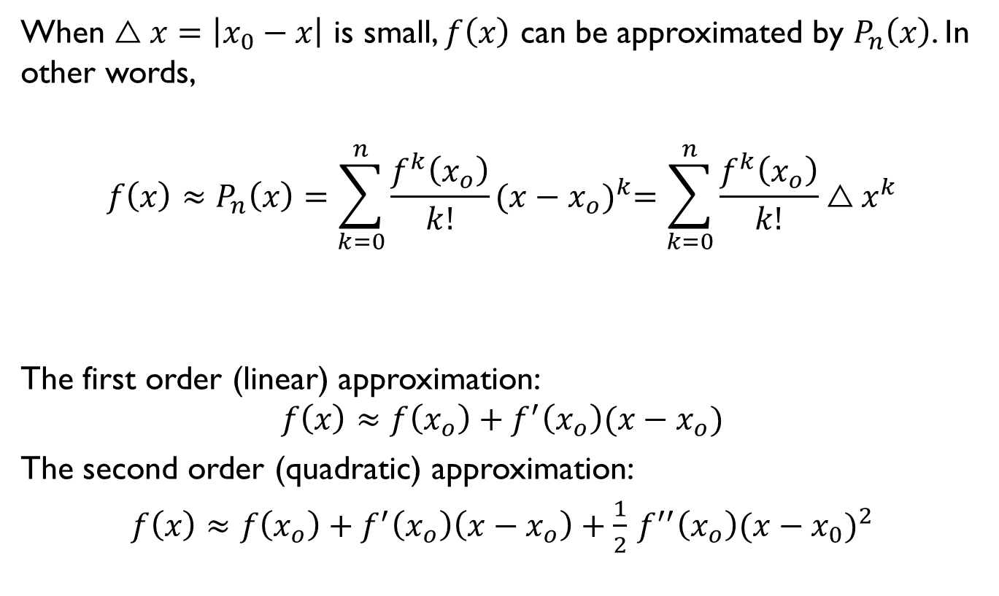
Taylor Series, one-dimensional case
When $△x=\left|x_{0}−x\right|$ is small, $f\left(x\right)$ can be approximated by $P_{n}\left(x\right)$. In other words,
$$f\left(x\right)≈P_{n}\left(x\right)=\sum_{k=0}^{n}{\frac{f^{k}\left(x_{o}\right)}{k!}}{(x−x_{o})}^{k}=\sum_{k=0}^{n}{\frac{f^{k}\left(x_{o}\right)}{k!}}{△x}^{k}$$
The first order (linear) approximation:
$$f\left(x\right)≈f\left(x_{o}\right)+f^{′}\left(x_{o}\right)(x−x_{o})$$
The second order (quadratic) approximation:
$f\left(x\right)≈f\left(x_{o}\right)+f^{′}\left(x_{o}\right)\left(x−x_{o}\right)+\frac{1}{2}$ $f^{′′}\left(x_{o}\right){(x−x_{0})}^{2}$

Slide 50
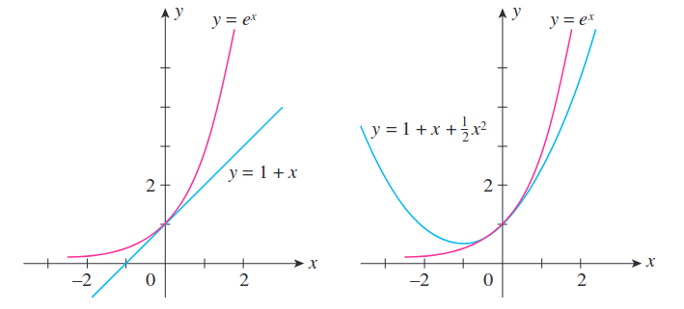
Taylor Series, one-dimensional case
Linear approximation
Quadratic approximation
Image taken from Applied Calculus for the Managerial, Life and Social Sciences 8th ed

Slide 51
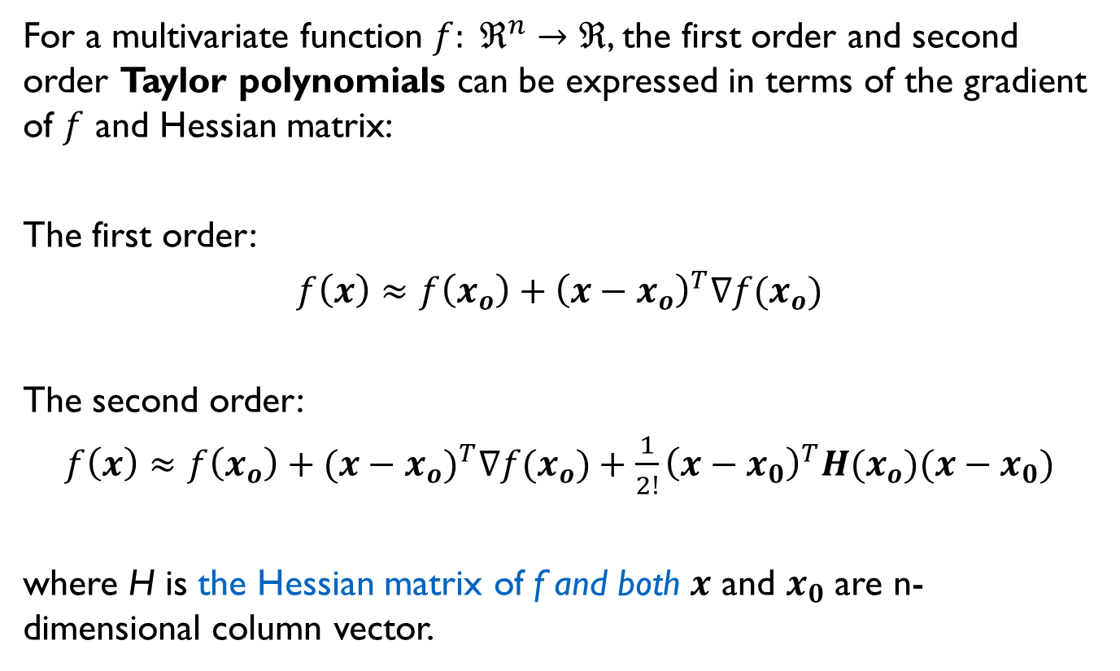
Taylor Series, high-dimensional case
For a multivariate function $f: ℜ^{n}→ℜ$, the first order and second order Taylor polynomials can be expressed in terms of the gradient of $f$ and Hessian matrix:
The first order:
$f\left(x\right)≈$ $f\left(x_{o}\right)+{\left(x−x_{o}\right)}^{T}∇f(x_{o})$
The second order:
$f\left(x\right)≈$ $f\left(x_{o}\right)+{(x−x_{o})}^{T}∇f{(x}_{o})+\frac{1}{2!}{\left(x−x_{0}\right)}^{T}H(x_{o})(x−x_{0})$
where H is the Hessian matrix of f and both $x$ and $x_{0}$ are n-dimensional column vector.

Slide 52

Taylor Series, high-dimensional case
Hessian matrix
$$H=\left[\begin{matrix}\frac{∂^{2}f}{∂x_{1}^{2}} & \begin{matrix}\frac{∂^{2}f}{∂x_{1}∂x_{2}} & ⋯ & \end{matrix} & \frac{∂^{2}f}{∂x_{1}∂x_{n}} \\ \begin{matrix}\frac{∂^{2}f}{∂x_{2}∂x_{1}} \\ ⋮ \\ \end{matrix} & \begin{matrix}\begin{matrix}\frac{∂^{2}f}{∂x_{2}^{2}} & & \end{matrix} \\ \begin{matrix} & ⋱ & \end{matrix} \\ \begin{matrix} & & \end{matrix}\end{matrix} & \begin{matrix}\frac{∂^{2}f}{∂x_{2}∂x_{n}} \\ ⋮ \\ \end{matrix} \\ \frac{∂^{2}f}{∂x_{n}∂x_{1}} & \begin{matrix}\frac{∂^{2}f}{∂x_{n}∂x_{2}} & ⋯ & \end{matrix} & \frac{∂^{2}f}{∂x_{n}^{2}}\end{matrix} \right]$$

Slide 53
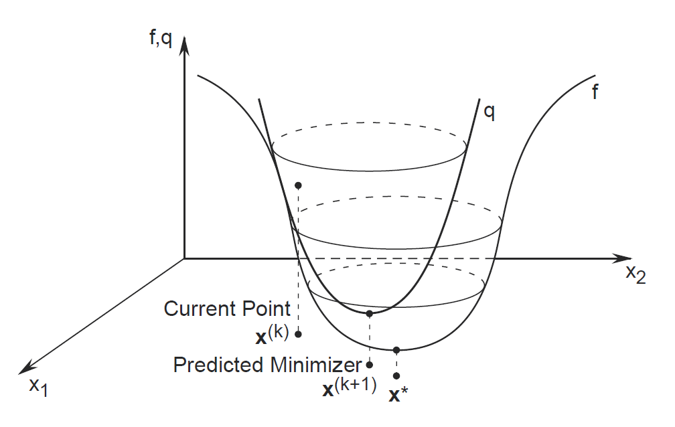
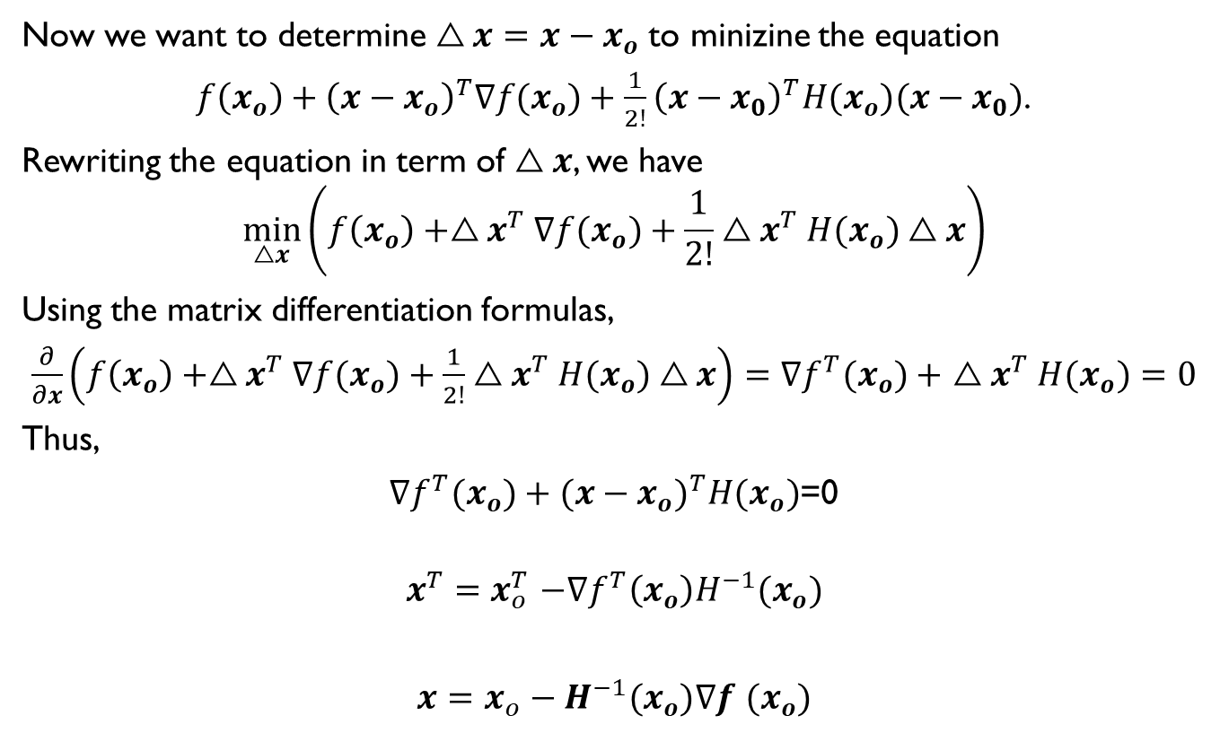
Newton’s Method
Now we want to determine $△x=$ $x−x_{o}$ to minizine the equation
$f\left(x_{o}\right)+{\left(x−x_{o}\right)}^{T}∇f(x_{o})+\frac{1}{2!}{\left(x−x_{0}\right)}^{T}H(x_{o})(x−x_{0})$.
Rewriting the equation in term of $△x$, we have
$$\min_{△x}\left(f\left(x_{o}\right)+{△x}^{T}∇f(x_{o})+\frac{1}{2!}{△x}^{T}H(x_{o})△x\right)$$
Using the matrix differentiation formulas,
$\frac{∂}{∂x}\left(f\left(x_{o}\right)+{△x}^{T}∇f(x_{o})+\frac{1}{2!}{△x}^{T}H(x_{o})△x\right)=$ ${∇f}^{T}(x_{o})+$ ${△x}^{T}H(x_{o})=0$
Thus,
${∇f}^{T}(x_{o})+{(x−x_{o})}^{T}H(x_{o})$=0
$${x^{T}{=x}_{o}^{T}−{∇f}^{T}\left(x_{o}\right)H}^{−1}(x_{o})$$
${x=x_{o}−H}^{−1}(x_{o})∇f$ $(x_{o})$
Image taken from: http://netlab.unist.ac.kr/wp-content/uploads/sites/183/2014/03/newton_method.png

Slide 54
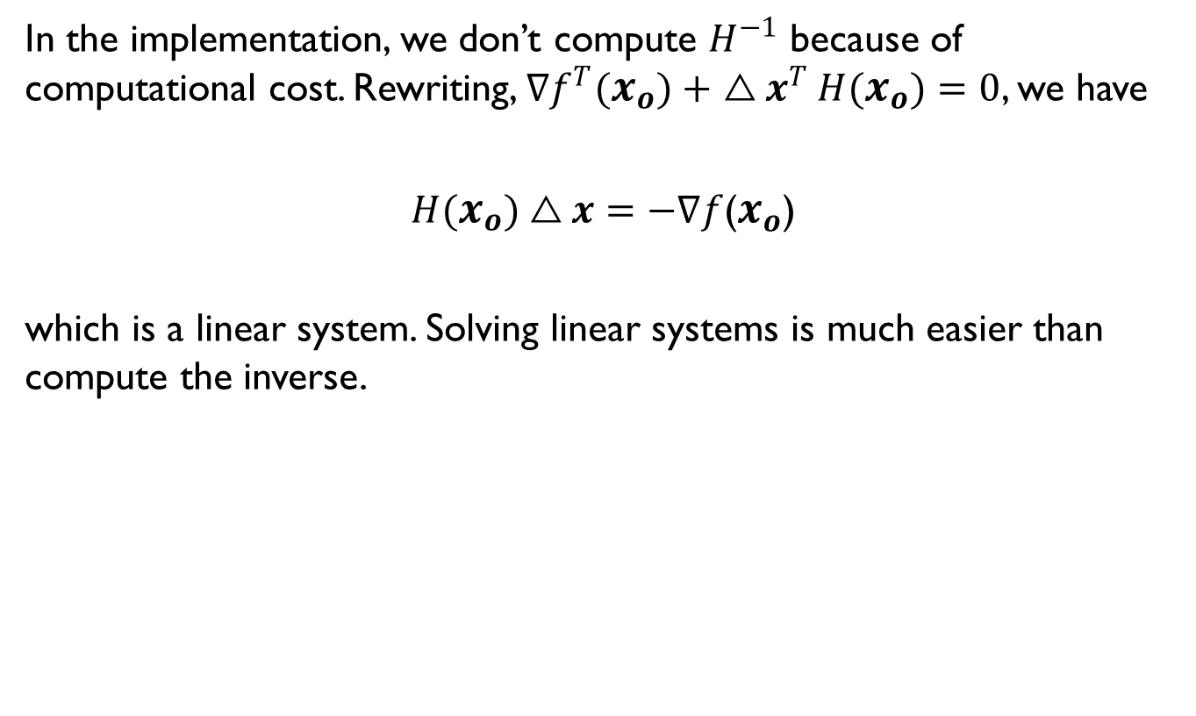
Newton’s Method
In the implementation, we don’t compute $H^{−1}$ because of computational cost. Rewriting, ${∇f}^{T}(x_{o})+$ ${△x}^{T}H(x_{o})=0$, we have
$H(x_{o})△x=−∇f$($x_{o}$)
which is a linear system. Solving linear systems is much easier than compute the inverse.

Slide 55
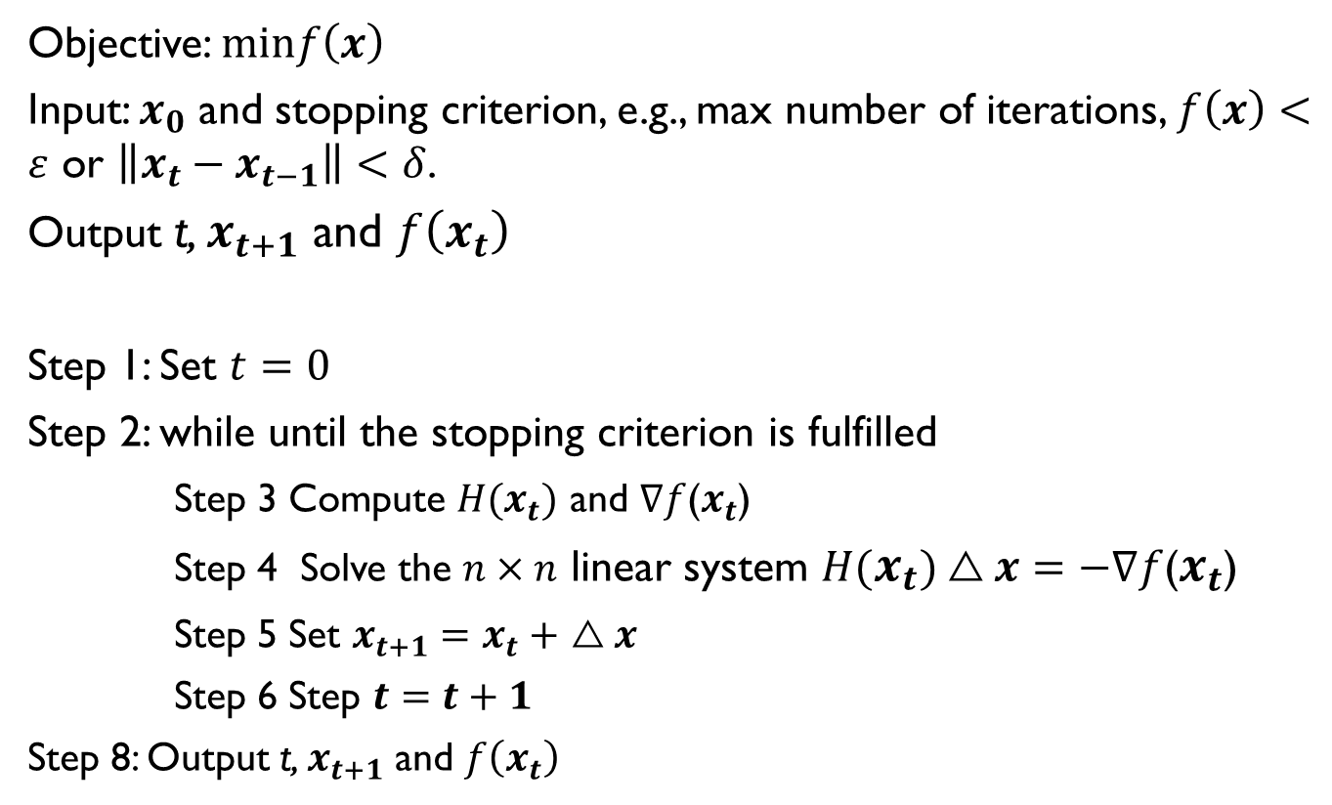
Newton’s Method
Objective: $minf\left(x\right)$
Input: $x_{0}$ and stopping criterion, e.g., max number of iterations, $f\left(x\right)<ε$ or $\left\|x_{t}−x_{t−1}\right\|<δ$.
Output t, $x_{t+1}$ and $f\left(x_{t}\right)$
Step 1: Set $t=0$
Step 2: while until the stopping criterion is fulfilled
Step 3 Compute $H(x_{t})$ and $∇f$($x_{t}$)
Step 4 Solve the $n×n$ linear system $H(x_{t})△x=−∇f$($x_{t}$)
Step 5 Set $x_{t+1}=$ $x_{t}+$ $△x$
Step 6 Step $t=t+1$
Step 8: Output t, $x_{t+1}$ and $f\left(x_{t}\right)$

Slide 56
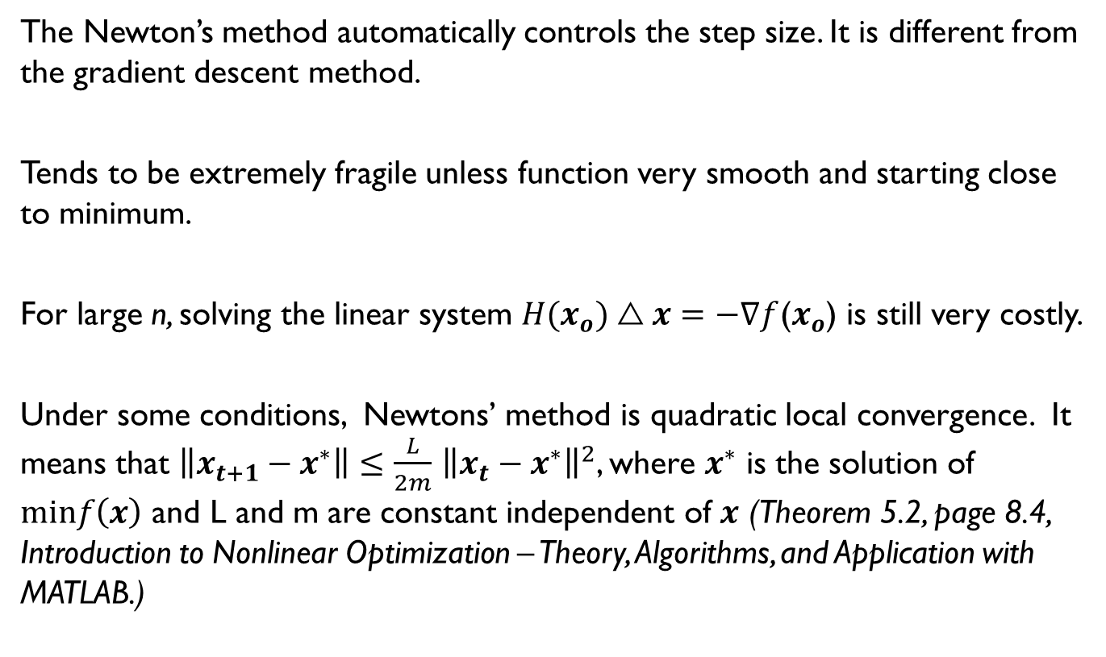
Newton’s Method
The Newton’s method automatically controls the step size. It is different from the gradient descent method.
Tends to be extremely fragile unless function very smooth and starting close to minimum.
For large n, solving the linear system $H(x_{o})△x=−∇f$($x_{o}$) is still very costly.
Under some conditions, Newtons’ method is quadratic local convergence. It means that $\left\|x_{t+1}−x^{∗}\right\|≤\frac{L}{2m}$ ${\left\|x_{t}−x^{∗}\right\|}^{2}$, where $x^{∗}$ is the solution of $minf\left(x\right)$ and L and m are constant independent of $x$ (Theorem 5.2, page 8.4, Introduction to Nonlinear Optimization – Theory, Algorithms, and Application with MATLAB.)

Slide 57
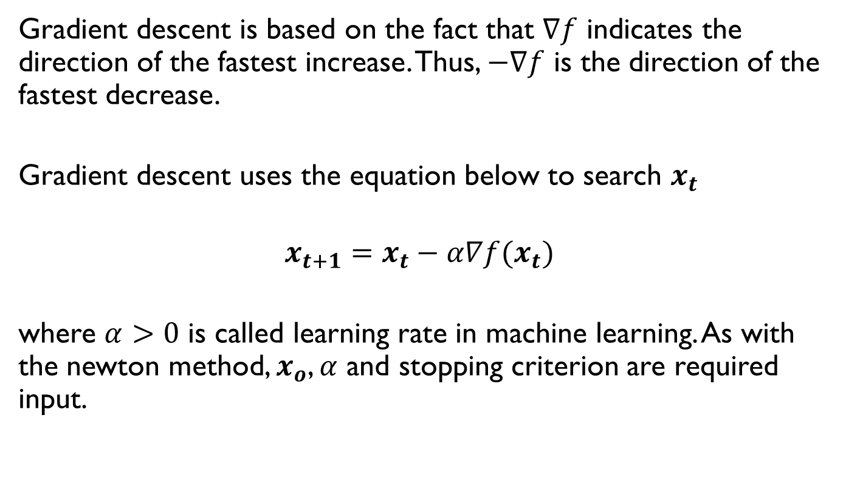
Gradient Descent
Gradient descent is based on the fact that $∇f$ indicates the direction of the fastest increase. Thus, $−∇f$ is the direction of the fastest decrease.
Gradient descent uses the equation below to search $x_{t}$
$$x_{t+1}=x_{t}−α∇f(x_{t})$$
where $α>0$ is called learning rate in machine learning. As with the newton method, $x_{o}$, $α$ and stopping criterion are required input.

Slide 58
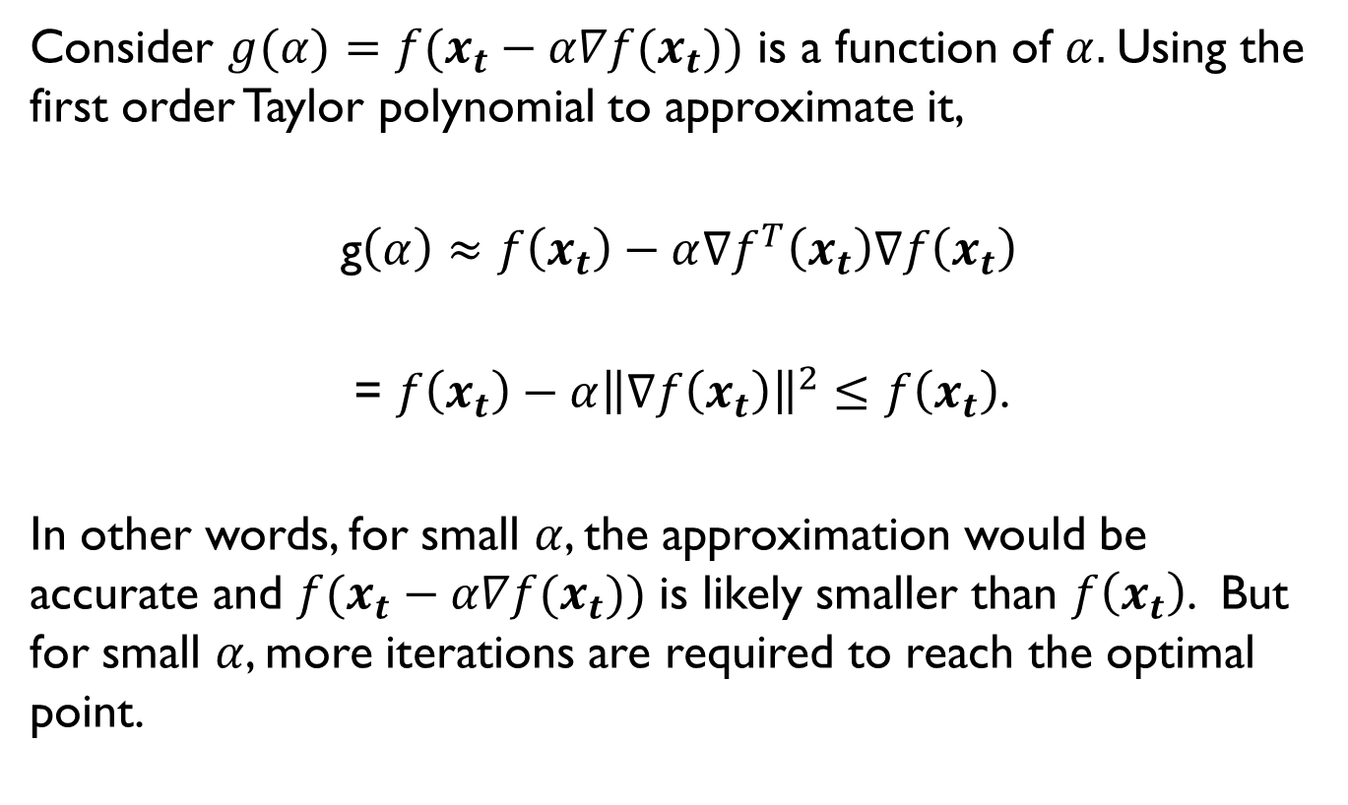
Gradient Descent
Consider $g(α)={f(x}_{t}−α∇f(x_{t}))$ is a function of $α.$Using the first order Taylor polynomial to approximate it,
g$\left(α\right)≈$ $f\left(x_{t}\right)−α∇f^{T}\left(x_{t}\right)∇f\left(x_{t}\right)$
= $f\left(x_{t}\right)−α{\left\|∇f\left(x_{t}\right)\right\|}^{2}≤f\left(x_{t}\right)$.
In other words, for small $α$, the approximation would be accurate and ${f(x}_{t}−α∇f(x_{t}))$ is likely smaller than $f\left(x_{t}\right)$. But for small $α$, more iterations are required to reach the optimal point.

Slide 59
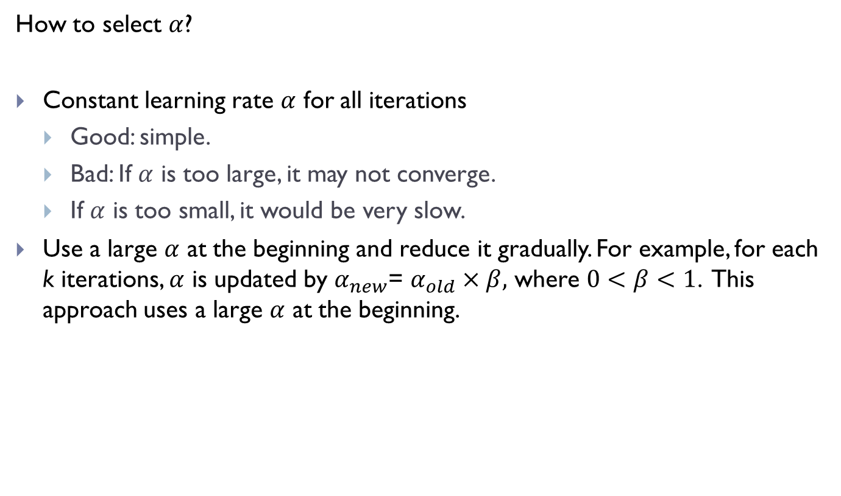
Gradient Descent
How to select $α$?
Constant learning rate $α$ for all iterations
Good: simple.
Bad: If $α$ is too large, it may not converge.
If $α$ is too small, it would be very slow.
Use a large $α$ at the beginning and reduce it gradually. For example, for each k iterations, $α$ is updated by $α_{new}$= $α_{old}×β,$ where $0<β<1$. This approach uses a large $α$ at the beginning.

