Slide 1
Mathematics for AI
Adams Wai Kin Kong
School of Computer Science and Engineering
Nanyang Technological University, Singapore
adamskong@ntu.edu.sg
Copyright © Cengage Learning. All rights reserved.

Slide 2
Systems of Linear Equations

Slide 3
Introduction to Systems of Linear Equations (1 of 3)
Definition
A linear equation in the n variables x₁, x₂, ..., x _{n} is an equation that can be written in the form
a₁x₁ + a₂x₂ + ... + a_{n}x_{n} = b
where the coefficients a₁, a₂, ..., a_{n} and the constant term b are constants.
A solution of a linear equation a₁x₁ + a₂x₂ + ... + a_{n}x_{n} = b is a vector [s₁, s₂, ..., s _{n}] whose components satisfy the equation when we substitute x₁ = s₁, x₂ = s₂, ... , x_{n} = s_{n}.

Slide 4
Introduction to Systems of Linear Equations (2 of 3)
A system of linear equations is a finite set of linear equations, each with the same variables. A solution of a system of linear equations is a vector that is simultaneously a solution of each equation in the system. The solution set of a system of linear equations is the set of all solutions of the system.
We will refer to the process of finding the solution set of a system of linear equations as “solving the system.”

Slide 5
Example 2.4
Solve the following systems of linear equations:
(a) x − y = 1
x + y = 3
(b) x − y = 2
2x − 2y = 4
(c) x − y = 1
x − y = 3
Solution:
(a) Adding the two equations together gives 2x = 4, so x = 2, from which we find that y = 1.

Slide 6
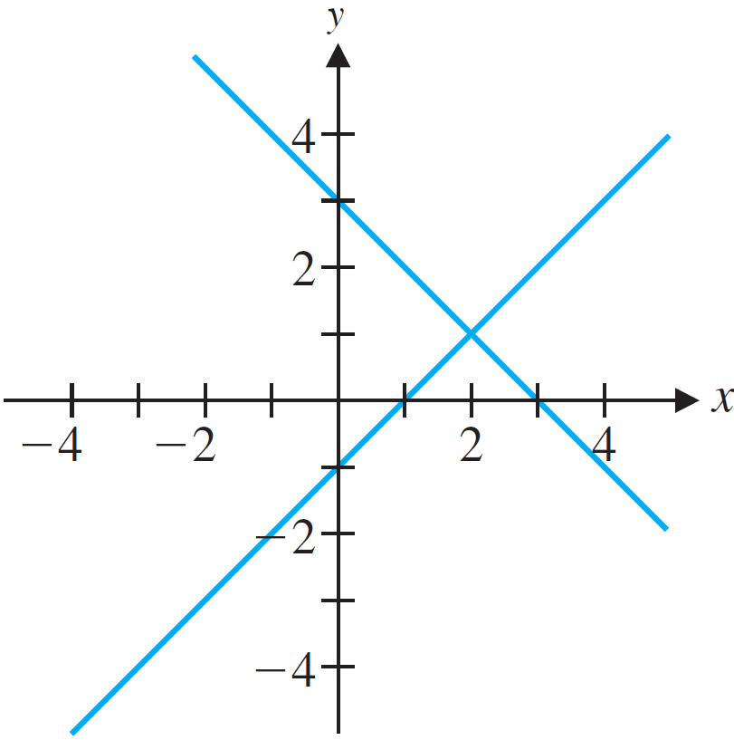
Example 2.4 – Solution (1 of 3)
That this is the only solution can be seen by observing that this solution corresponds to the (unique) point of intersection (2, 1) of the lines with equations x − y = 1 and x + y = 3, as shown in Figure 2.1(a). Thus, [2, 1] is a unique solution.
(a)
Figure 2.1

Slide 7
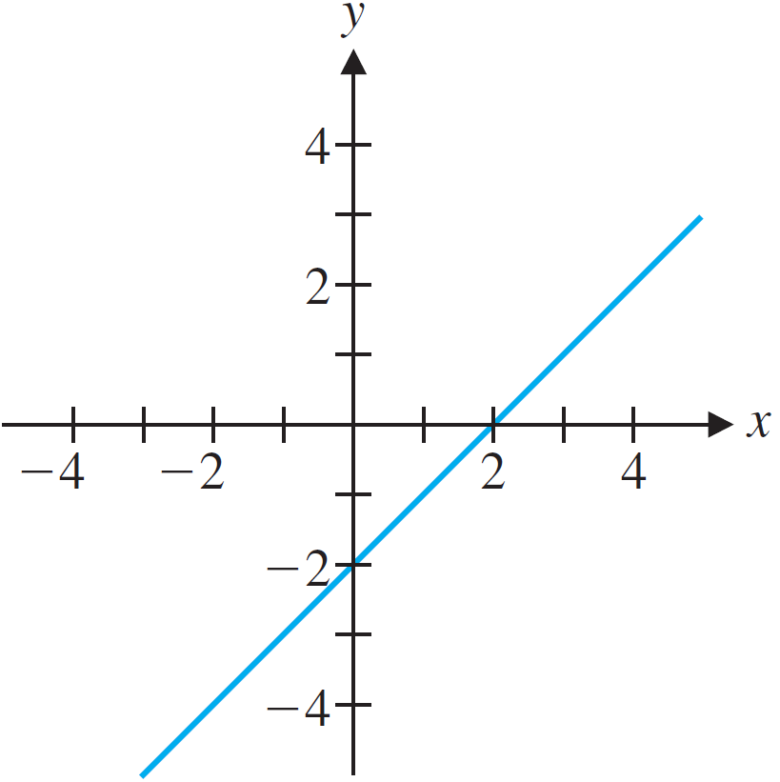
Example 2.4 – Solution (2 of 3)
(b) The second equation in this system is just twice the first, so the solutions are the solutions of the first equation alone—namely, the points on the line x − y = 2. These can be represented parametrically as [2 + t, t]. Thus, this system has in finitely many solutions [Figure 2.1(b)].
(b)
Figure 2.1

Slide 8
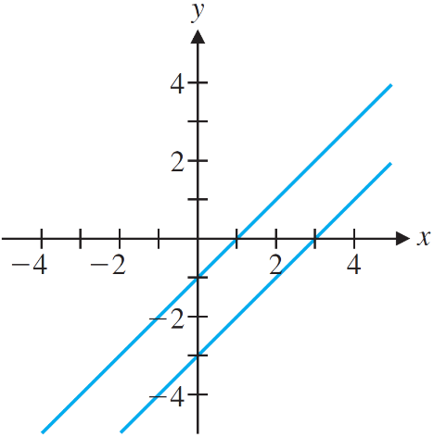
Example 2.4 – Solution (3 of 3)
(c) Two numbers x and y cannot simultaneously have a difference of 1 and 3. Hence, this system has no solutions. (A more algebraic approach might be to subtract the second equation from the first, yielding the absurd conclusion 0 = −2.) As Figure 2.1(c) shows, the lines for the equations are parallel in this case.
(c)
Figure2.1

Slide 9
Introduction to Systems of Linear Equations (3 of 3)
A system of linear equations is called consistent if it has at least one solution. A system with no solutions is called inconsistent.
A system of linear equations with real coefficients has either
(a) a unique solution (a consistent system) or
(b) infinitely many solutions (a consistent system) or
(c) no solutions (an inconsistent system).

Slide 10
Solving a System of Linear Equations (1 of 1)
Two linear systems are called equivalent if they have the same solution sets.

Slide 11
Example 2.6
Solve the system
x − y − z = 2
3x − 3y + 2z = 16
2x − y + z = 9
Solution:
To transform this system into one that exhibits the triangular structure of Example 2.5, we first need to eliminate the variable x from Equations 2 and 3. Observe that subtracting appropriate multiples of equation 1 from Equations 2 and 3 will do the trick.

Slide 12
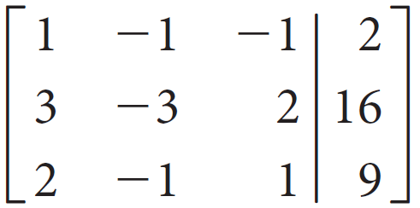
Example 2.6 – Solution (1 of 4)
Next, observe that we are operating on the coefficients, not on the variables, so we can save ourselves some writing if we record the coefficients and constant terms in the matrix
where the first three columns contain the coefficients of the variables in order, the final column contains the constant terms, and the vertical bar serves to remind us of the equal signs in the equations. This matrix is called the augmented matrix of the system.

Slide 13
Example 2.6 – Solution (2 of 4)
There are various ways to convert the given system into one with the triangular pattern we are after. The steps we will use here are closest in spirit to the more general method described in the next section. We will perform the sequence of operations on the given system and simultaneously on the corresponding augmented matrix. We begin by eliminating x from Equations 2 and 3.
x − y − z = 2
3x − 3y + 2z = 16
2x − y + z = 9

Slide 14
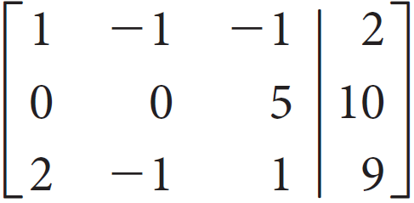
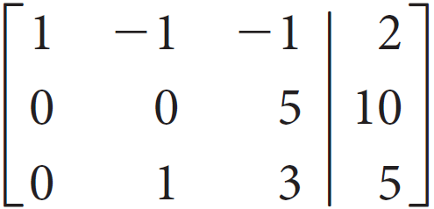
Example 2.6 – Solution (3 of 4)
Subtract 3 times the first equation from the second equation:
x − y − z = 2
5z = 10
2x − y + z = 9
Subtract 3 times the first row from the second row:
Subtract 2 times the first equation from the second equation:
x − y − z = 2
5z = 10
y + 3z = 5
Subtract 2 times the first row from the third row:

Slide 15
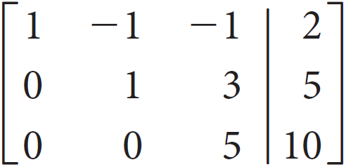
Example 2.6 – Solution (4 of 4)
Interchange Equations 2 and 3:
x − y − z = 2
y + 3z = 5
5z = 10
Interchange rows 2 and 3:
To solve the above system, we are starting from the last equation and working backward, we find successively that z = 2, y = 5 − 3(2) = −1, and x = 2 + (−1) + 2 = 3. So the unique solution is [3, −1, 2].

Slide 16
Direct Methods for Solving Linear Systems

Slide 17
Matrices and Echelon Form (1 of 1)
Definition
A matrix is in row echelon form if it satisfies the following
properties:
1. Any rows consisting entirely of zeros are at the bottom.
2. In each nonzero row, the first nonzero entry (called the leading entry) is in a column to the left of any leading entries below it.

Slide 18
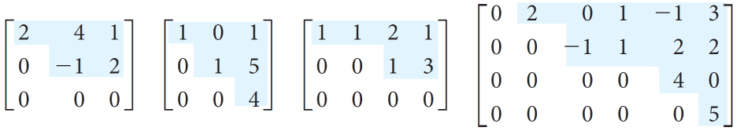
Example 2.8
Assuming that each of the following matrices is an augmented matrix, write out the corresponding systems of linear equations and solve them.
Solution:
We first remind ourselves that the last column in an augmented matrix is the vector of constant terms. The first matrix then corresponds to the system
2x₁ + 4x₂ = 1
−x₂ = 2

Slide 19


Example 2.8 – Solution (1 of 2)
Notice that we have dropped the last equation 0 = 0, or 0x₁ + 0x₂ = 0, which is clearly satisfied for any values of x₁ and x₂.) Back substitution gives x₂ = −2 and then
2x₁ = 1 − 4(−2) = 9, so x₁ =
The solution is
The second matrix has the corresponding system
x₁ = 1
x₂ = 5
0 = 4

Slide 20
Example 2.8 – Solution (2 of 2)
The last equation represents 0x₁ + 0x₂ = 4, which clearly has no solutions. Therefore, the system has no solutions. Similarly, the system corresponding to the fourth matrix has no solutions. For the system corresponding to the third matrix, we have
x₁ + x₂ + 2x₃ = 1
x₃ = 3
so x₁ = 1 − 2(3) − x₂ = −5 − x₂. There are infinitely many solutions, since we may assign x₂ any value t to get the parametric solution [−5 − t, t, 3].

Slide 21
Elementary Row Operations

Slide 22
Elementary Row Operations (1 of 2)
Definition
The following elementary row operations can be performed on a matrix:
1. Interchange two rows.
2. Multiply a row by a nonzero constant.
3. Add a multiple of a row to another row.
The process of applying elementary row operations to bring a matrix into row echelon form, called row reduction, is used to reduce a matrix to echelon form.

Slide 23
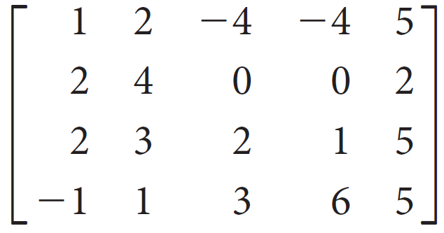
Example 2.9
Reduce the following matrix to echelon form:

Slide 24
Example 2.9 – Solution (1 of 5)
We work column by column, from left to right and from top to bottom. The strategy is to create a leading entry in a column and then use it to create zeros below it.
The entry chosen to become a leading entry is called a pivot, and this phase of the process is called pivoting. Although not strictly necessary, it is often convenient to use the second elementary row operation to make each leading entry a 1.

Slide 25
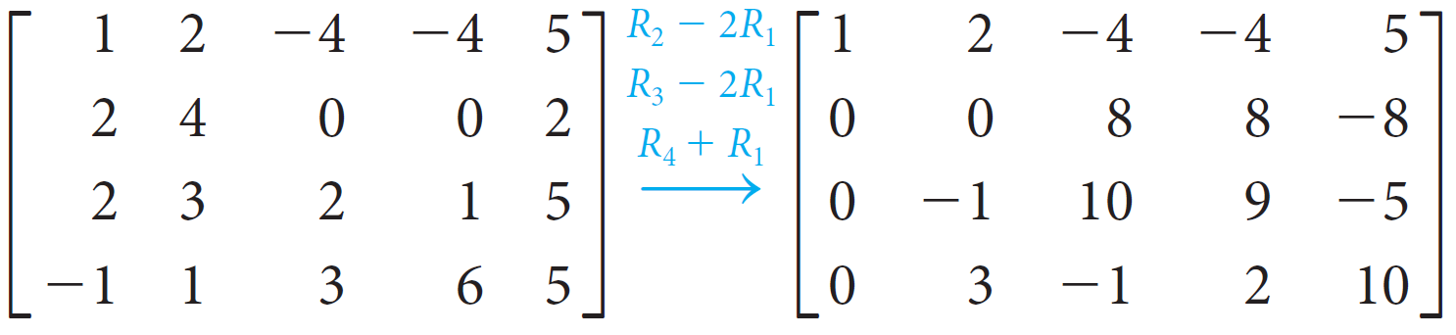
Example 2.9 – Solution (2 of 5)
We begin by introducing zeros into the first column below the leading 1 in the first row:
The first column is now as we want it, so the next thing to do is to create a leading entry in the second row, aiming for the staircase pattern of echelon form.

Slide 26
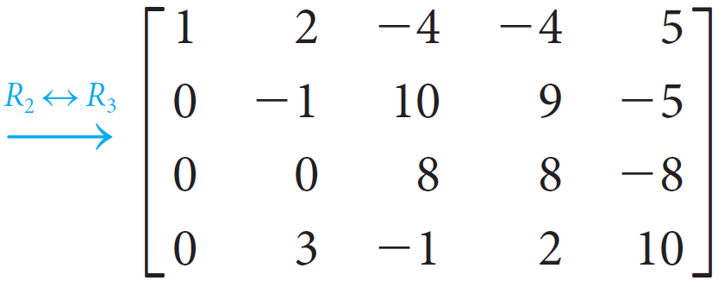
Example 2.9 – Solution (3 of 5)
In this case, we do this by interchanging rows. (We could also add row 3 or row 4 to row 2.)
The pivot this time was −1.

Slide 27
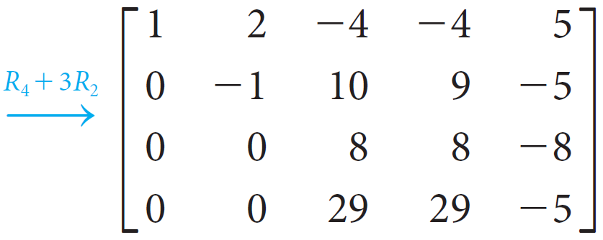
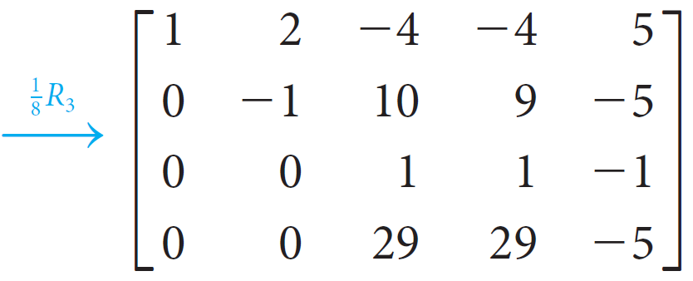
Example 2.9 – Solution (4 of 5)
We now create a zero at the bottom of column 2, using the leading entry −1 in row 2:
Column 2 is now done. Noting that we already have a leading entry in column 3, we just pivot on the 8 to introduce a zero below it. This is easiest if we first divide row 3 by 8:

Slide 28
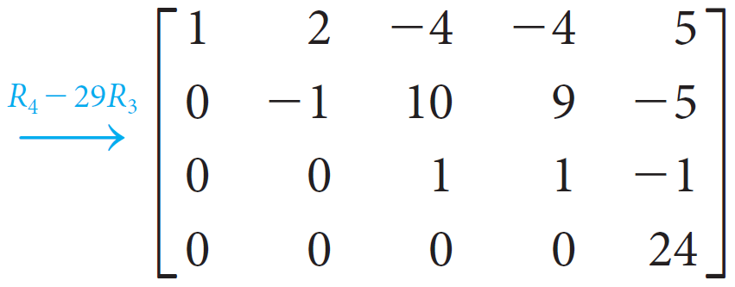
Example 2.9 – Solution (5 of 5)
Now we use the leading 1 in row 3 to create a zero below it:
With this final step, we have reduced our matrix to echelon form.

Slide 29
Elementary Row Operations (2 of 2)
Definition
Matrices A and B are row equivalent if there is a sequence of elementary row operations that converts A into B.
Theorem 2.1
Matrices A and B are row equivalent if and only if they can be reduced to the same row echelon form.

Slide 30
Gaussian Elimination

Slide 31
Gaussian Elimination (1 of 2)
Gaussian Elimination
1. Write the augmented matrix of the system of linear equations.
2. Use elementary row operations to reduce the augmented matrix to row echelon form.
3. Using back substitution, solve the equivalent system that corresponds to the row-reduced matrix.

Slide 32
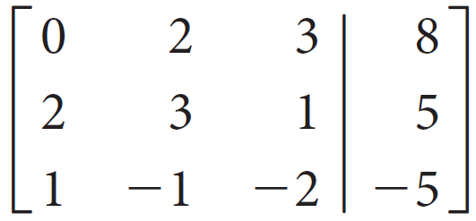
Example 2.10
Solve the system
2x₂ + 3x₃ = 8
2x₁ + 3x₂ + x₃ = 5
x₁ − x₂ − 2x₃ = −5
Solution:
The augmented matrix is

Slide 33
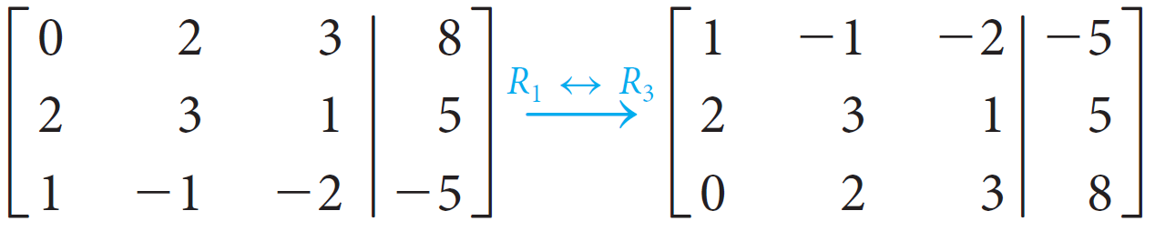
Example 2.10 – Solution (1 of 4)
We proceed to reduce this matrix to row echelon form, following the guidelines given for step 2 of the process. The first nonzero column is column 1. We begin by creating a leading entry at the top of this column; interchanging rows 1 and 3 is the best way to achieve this.

Slide 34
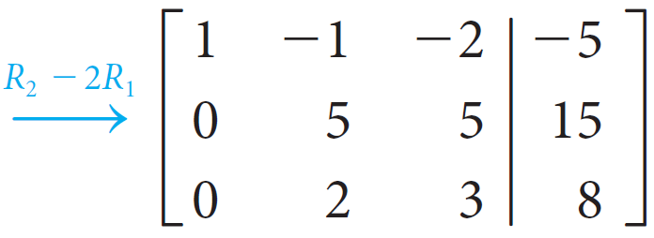
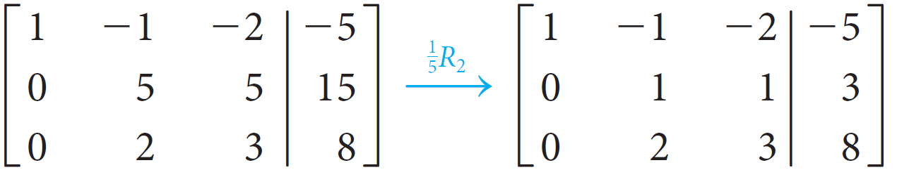

Example 2.10 – Solution (2 of 4)
We now create a second zero in the first column, using the leading 1:
We now cover up the first row and repeat the procedure. The second column is the first nonzero column of the submatrix. Multiplying row 2 by
will create a leading 1.

Slide 35
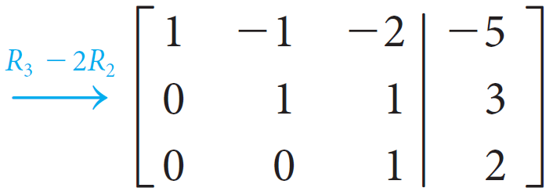
Example 2.10 – Solution (3 of 4)
We now need another zero at the bottom of column 2:
The augmented matrix is now in row echelon form, and we move to step 3.

Slide 36
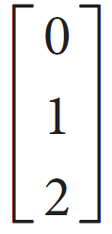
Example 2.10 – Solution (4 of 4)
The corresponding system is
x₁ − x₂ − 2x₃ = 25
x₂ + x₃ = 3
x₃ = 2
and back substitution gives x₃ = 2, then x₂ = 3 − x₃ = 3 − 2 = 1, and finally x₁ = −5 + x₂ + 2x₃ = −5 + 1 + 4 = 0. We write the solution in vector form as

Slide 37
Gaussian Elimination (2 of 2)
Definition
The rank of a matrix is the number of nonzero rows in its row echelon form.
Theorem 2.2
The Rank Theorem
Let A be the coefficient matrix of a system of linear equations with n variables. If the system is consistent, then
number of free variables = n − rank(A)

Slide 38
Gauss-Jordan Elimination

Slide 39
Gauss-Jordan Elimination (1 of 2)
Definition
A matrix is in reduced row echelon form if it satisfies the following properties:
1. It is in row echelon form.
2. The leading entry in each nonzero row is a 1 (called a leading 1).
3. Each column containing a leading 1 has zeros everywhere else.

Slide 40
Gauss-Jordan Elimination (2 of 2)
Gauss-Jordan Elimination
1. Write the augmented matrix of the system of linear equations.
2. Use elementary row operations to reduce the augmented matrix to reduced row echelon form.
3. If the resulting system is consistent, solve for the leading variables in terms of any remaining free variables.

Slide 41
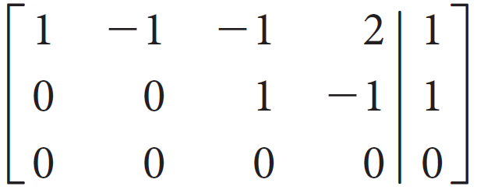
Example 2.13
Solve the system
w − x − y + 2z = 1
2w − 2x − y + 3z = 3
−w + x − y = −3
by Gauss-Jordan elimination.
Solution:
The reduction proceeds until we reach the echelon form:

Slide 42
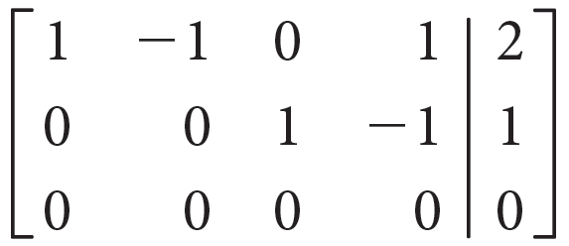
Example 2.13 – Solution (1 of 2)
We now must create a zero above the leading 1 in the second row, third column. We do this by adding row 2 to row 1 to obtain
The system has now been reduced to
w − x + z = 2
y − z = 1

Slide 43
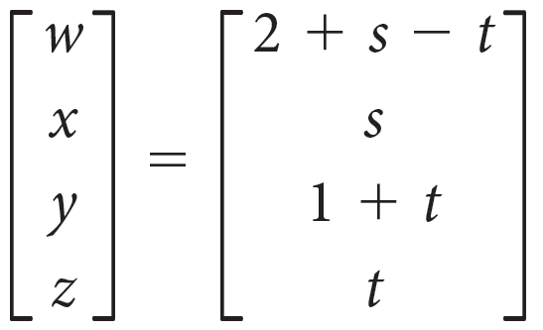
Example 2.13 – Solution (2 of 2)
It is now much easier to solve for the leading variables:
w = 2 + x − z and y = 1 + z
If we assign parameters x = s and z = t as before, the solution can be written in vector form as

Slide 44

Homogeneous Systems (1 of 1)
Definition
A system of linear equations is called homogeneous if the constant term in each equation is zero.
Theorem 2.3
If
homogeneous system of m linear equations with n variables, is a where m < n, then the system has infinitely many solutions.

Slide 45
Spanning Sets and Linear Independence

Slide 46
Spanning Sets of Vectors

Slide 47



Spanning Sets of Vectors (1 of 1)
Theorem 2.4 A system of linear equations with augmented
is consistent if and only if b is a linear combination of the columns of A.
Definition
If S = {v₁, v₂, . . . , v _{k}} is a set of vectors in
then
the set of all linear combinations of v₁, v₂, ..., v _{k} is called the span of v₁, v₂, ..., v _{k} and is denoted by span (v₁, v₂, ..., v _{k}) or span(S). If span(S) =
then S is called a spanning set for

Slide 48
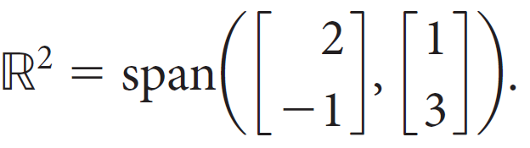
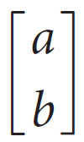
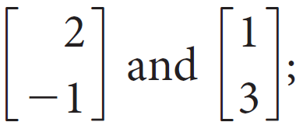
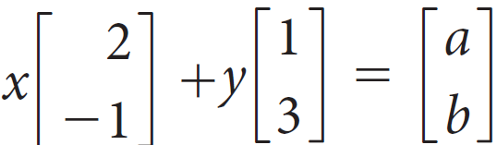
Example 2.19
Show that
Solution:
We need to show that an arbitrary vector
can be
written as a linear combination of
that is,
we must show that the equation
can always be solved for x and y (in terms of a and b), regardless of the values of a and b.

Slide 49
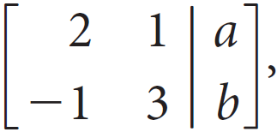
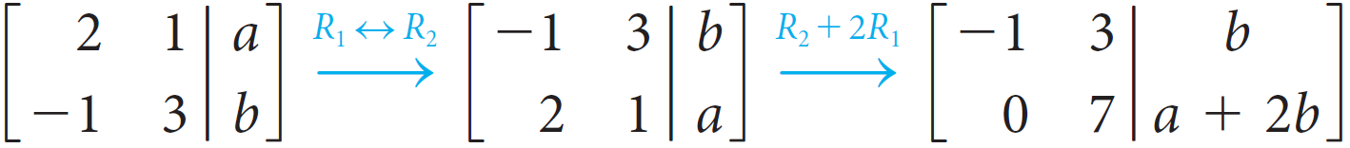
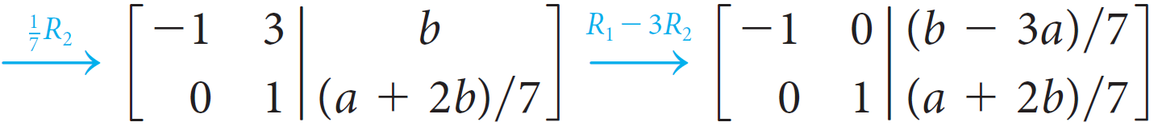
Example 2.19 – Solution (1 of 2)
The augmented matrix is
and row reduction
produces
at which point it is clear that the system has a (unique) solution. (Why?) If we continue, we obtain

Slide 50
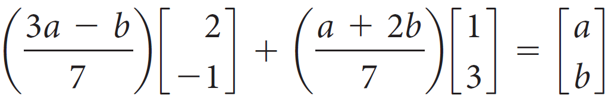
Example 2.19 – Solution (2 of 2)
From which we see that x = (3a − b) ∕ 7 and y = (a + 2b) ∕ 7. Thus, for any choice of a and b, we have

Slide 51
Linear Independence

Slide 52
Linear Independence (1 of 5)
Definition A set of vectors v₁, v₂, ..., v _{k} is linearly dependent if there are scalars c₁, c₂, ..., c _{k}, at least one of which is not zero, such that
c₁v₁ + c₂v₂ +...c_{k}v_{k} = 0
A set of vectors that is not linearly dependent is called linearly independent.

Slide 53

Linear Independence (2 of 5)
Theorem 2.5 Vectors v₁, v₂, ..., v _{m} in
are linearly dependent if and only
if at least one of the vectors can be expressed as a linear combination of the others.

Slide 54
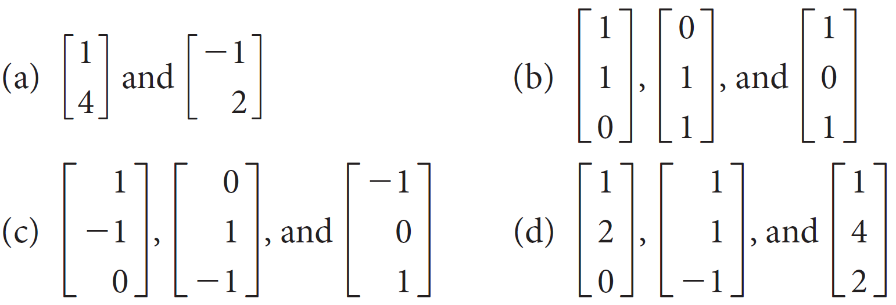
Example 2.23
Determine whether the following sets of vectors are linearly independent:

Slide 55
Example 2.23 – Solution (1 of 8)
In answering any question of this type, it is a good idea to see if you can determine by inspection whether one vector is a linear combination of the others. A little thought may save a lot of computation!
(a) The only way two vectors can be linearly dependent is if one is a multiple of the other. (Why?) These two vectors are clearly not multiples, so they are linearly independent.

Slide 56
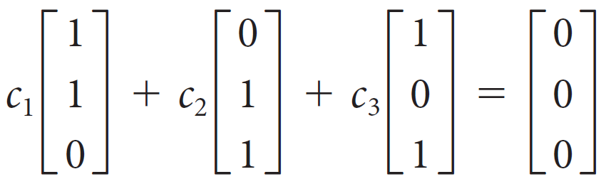
Example 2.23 – Solution (2 of 8)
(b) There is no obvious dependence relation here, so we try to find scalars c₁, c₂, c₃ such that
The corresponding linear system is
c₁ + c₃ = 0
c₁ + c₂ = 0
c₂ + c₃ = 0

Slide 57
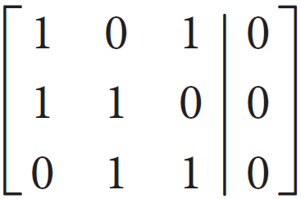
Example 2.23 – Solution (3 of 8)
The augmented matrix is
Once again, we make the fundamental observation that the columns of the coefficient matrix are just the vectors in question!

Slide 58
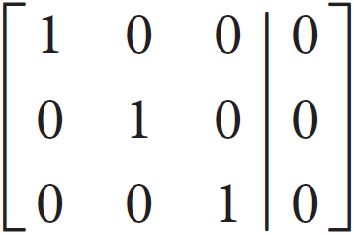
Example 2.23 – Solution (4 of 8)
The reduced row echelon form is
(check this), so c₁ = 0, c₂ = 0, c₃ = 0.
Thus, the given vectors are linearly independent.

Slide 59
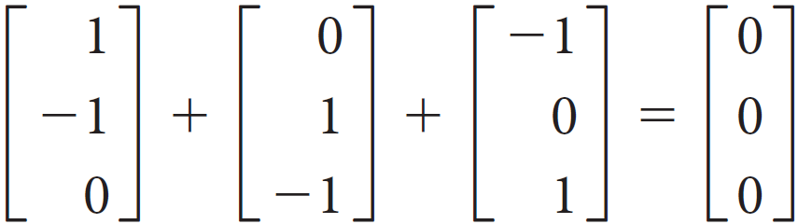
Example 2.23 – Solution (5 of 8)
(c) A little reflection reveals that
so the three vectors are linearly dependent. [Set up a linear system as in part (b) to check this algebraically.]

Slide 60
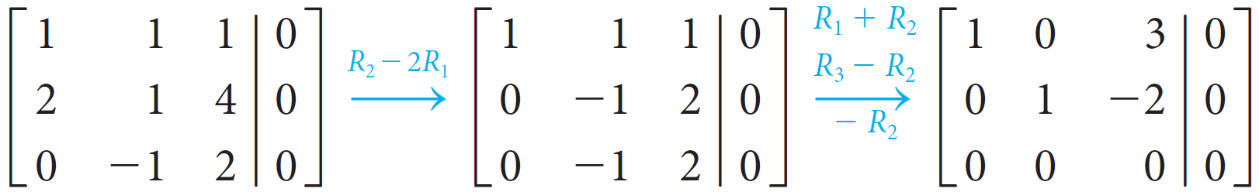
Example 2.23 – Solution (6 of 8)
(d) Once again, we observe no obvious dependence, so we proceed directly to reduce a homogeneous linear system whose augmented matrix has as its columns the given vectors:

Slide 61
Example 2.23 – Solution (7 of 8)
If we let the scalars be c₁, c₂, and c₃, we have
c₁ + 3c₃ = 0
c₂ − 2c₃ = 0
from which we see that the system has infinitely many solutions.
In particular, there must be a nonzero solution, so the given vectors are linearly dependent.

Slide 62
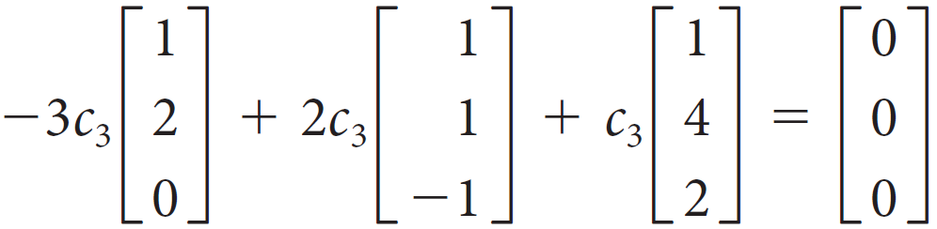
Example 2.23 – Solution (8 of 8)
If we continue, we can describe these solutions exactly:
c₁ = −3c₃ and c₂ = 2c₃.
Thus, for any nonzero value of c₃, we have the linear dependence relation

Slide 63


Linear Independence (3 of 5)
Theorem 2.6
Let v₁, v₂, ..., v _{m} be (column) vectors in
and let A be the n × m matrix [v₁ v₂ ... v _{m}] with these vectors as its columns. Then v₁, v₂, ..., v _{m} are linearly dependent if and only if the homogeneous linear system with augmented matrix
has a nontrivial solution.

Slide 64
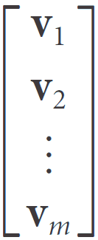
Linear Independence (4 of 5)
Theorem 2.7 Let v₁, v₂, ..., v _{m} be (row) vectors in
and let
A be the m × n matrix
with these vectors as its rows.
Then v₁, v₂, ..., v _{m} are linearly dependent if and only if rank(A) < m.

Slide 65
Linear Independence (5 of 5)
Theorem 2.8 Any set of m vectors in
is linearly dependent if m > n .

