Slide 1
Mathematics for AI
Adams Wai Kin Kong
School of Computer Science and Engineering
Nanyang Technological University, Singapore
adamskong@ntu.edu.sg
Copyright © Cengage Learning. All rights reserved.

Slide 2
Introduction to Eigenvalues and Eigenvectors

Slide 3
Introduction to Eigenvalues and Eigenvectors (1 of 2)
Definition
Let A be an n × n matrix. A scalar λ is called an eigenvalue of A if there is a nonzero vector x such that Ax = λx. Such a vector x is called an eigenvector of A corresponding to λ.

Slide 4
Introduction to Eigenvalues and Eigenvectors (2 of 2)
Definition
Let A be an n × n matrix and let λ be an eigenvalue of A. The collection of all eigenvectors corresponding to λ, together with the zero vector, is called the eigenspace of λ and is denoted by E_{λ}.

Slide 5
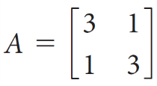
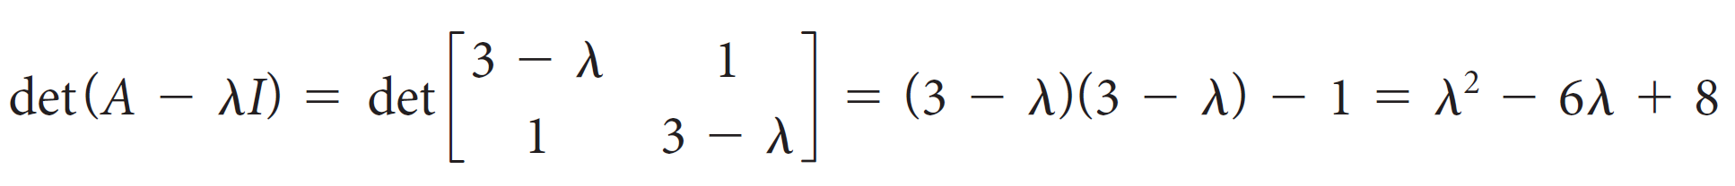
Example 4.5
Find all of the eigenvalues and corresponding eigenvectors of the matrix
.
Solution:
The preceding remarks show that we must find all solutions λ of the equation det(A − λI ) = 0. Since

Slide 6

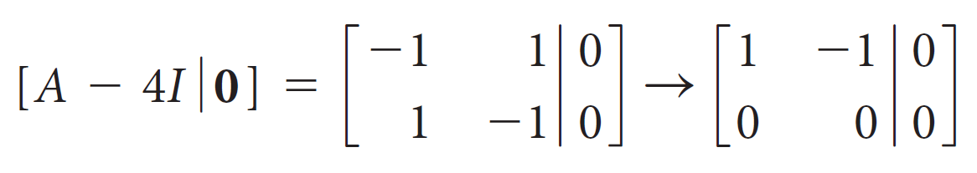
Example 4.5 – Solution (1 of 4)
We need to solve the quadratic equation
The solutions to this equation are easily found to be λ = 4 and λ = 2. These are therefore the eigenvalues of A.
To find the eigenvectors corresponding to the eigenvalue λ = 4, we compute the null space of A − 4I. We find
Remarks: $x$ is in the null space of $B$, it means that $Bx=0.$

Slide 7
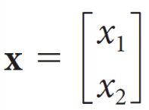
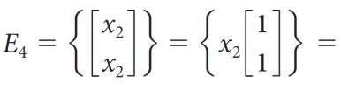

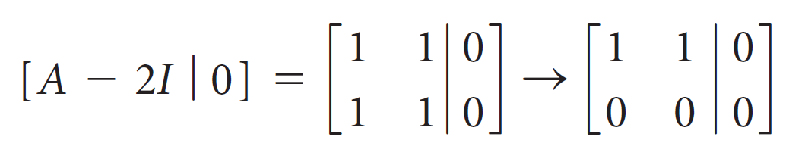
Example 4.5 – Solution (2 of 4)
is an eigenvector corresponding to λ = 4 if and only if x₁ − x₂ = 0 or x₁= x₂. Hence, the eigenspace
from which it follows that
Similarly, for λ = 2, we have

Slide 8
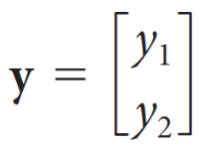
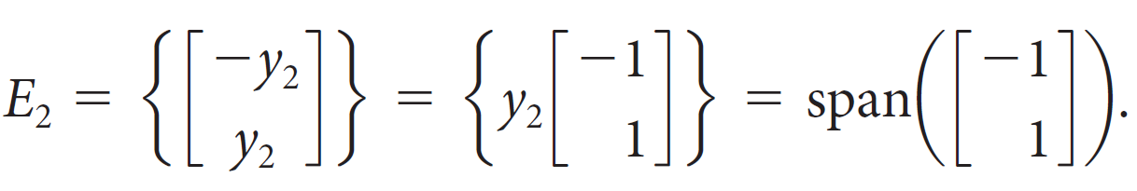
Example 4.5 – Solution (3 of 4)
is an eigenvector corresponding to λ = 2 if and only if y₁ + y₂ = 0 or y₁ = −y₂. Thus, the eigenspace
so

Slide 9
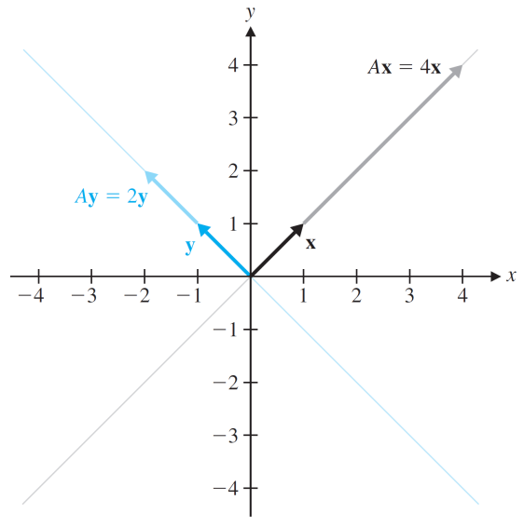
Example 4.5 – Solution (4 of 4)
Figure 4.8 shows graphically how the eigenvectors of A are transformed when multiplied by A: an eigenvector x in the eigenspace E₄ is transformed into 4x, and an eigenvector y in the eigenspace E₂ is transformed into 2y.
How A transforms eigenvectors
Figure 4.8

Slide 10
Determinants

Slide 11
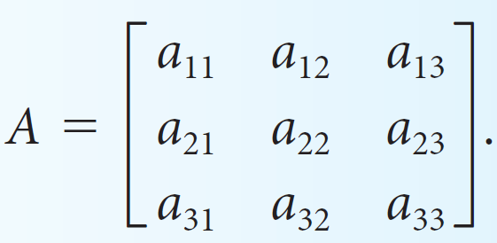
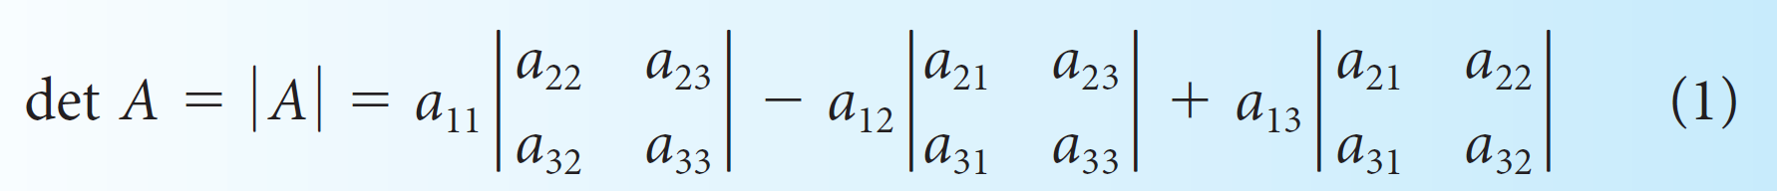
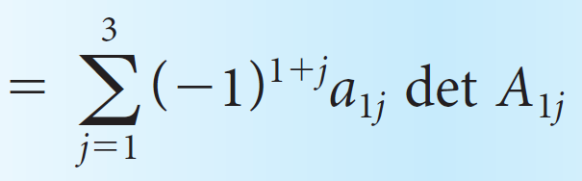
Determinants (1 of 3)
Definition
Let
Then the determinant of A is the
scalar
det A = a₁₁ det A₁₁ − a₁₂ det A₁₂ + a₁₃ det A₁₃
For any square matrix A, det A_{ij} is called the (i, j)-minor of A.

Slide 12
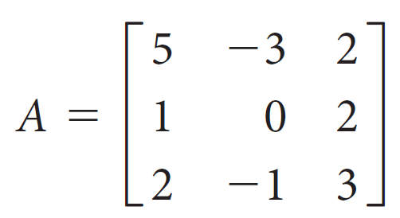
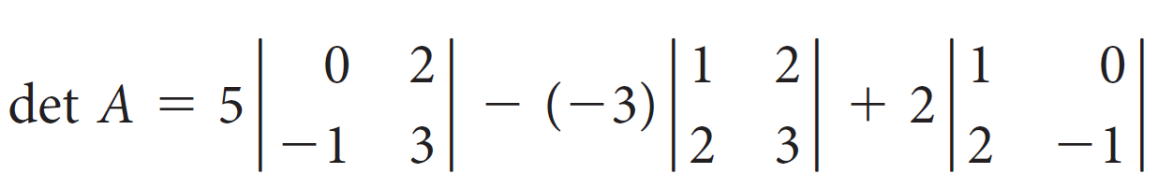
Example 4.8
Compute the determinant of
Solution:
We compute
= 5(0 − (−2)) + 3(3 − 4) + 2(−1 − 0)
= 5(2) + 3(−1) + 2(−1) = 5

Slide 13
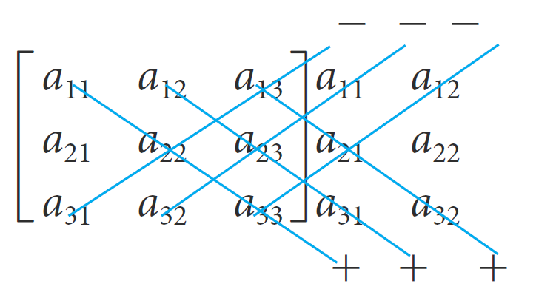
Determinants (2 of 3)
Another method for calculating the determinant of a 3 × 3 matrix is analogous to the method for calculating the determinant of a 2 × 2 matrix. Copy the first two columns of A to the right of the matrix and take the products of the elements on the six diagonals shown below. Attach plus signs to the products from the downward-sloping diagonals and attach minus signs to the products from the upward-sloping diagonals.
(2)

Slide 14
Determinants (3 of 3)
This method gives
a₁₁a₂₂a₃₃ + a₁₂a₂₃a₃₁ + a₁₃a₂₁a₃₂ − a₃₁a₂₂a₁₃ − a₃₂a₂₃a₁₁ − a₃₃a₂₁a₁₂

Slide 15
Determinants of n × n Matrices

Slide 16
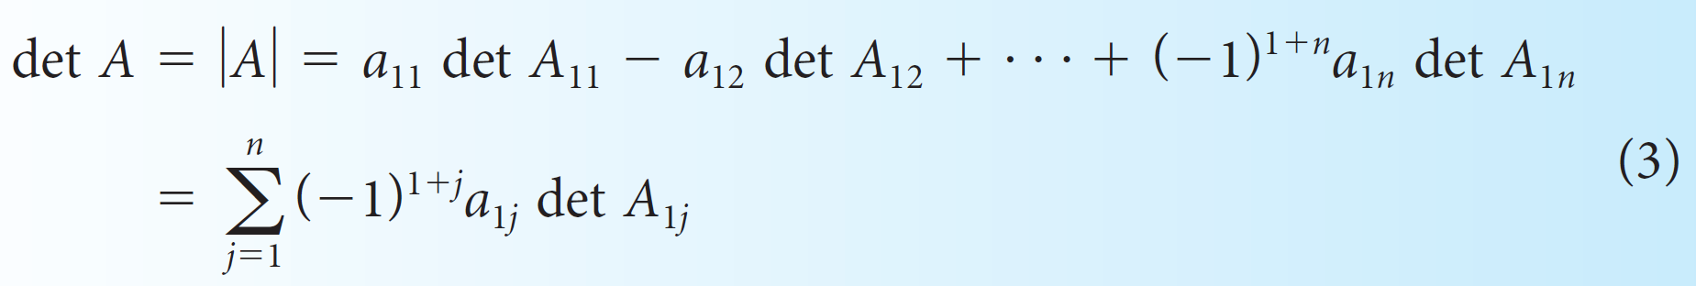
Determinants of n × n Matrices (1 of 5)
Definition
Let A = [a_{ij}] be an n × n matrix, where n ≥ 2. Then the determinant of A is the scalar
It is convenient to combine a minor with its plus or minus sign.

Slide 17
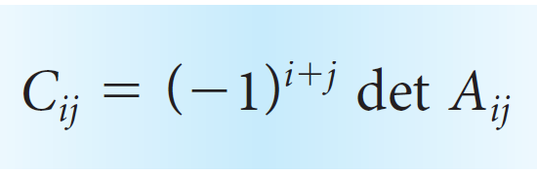
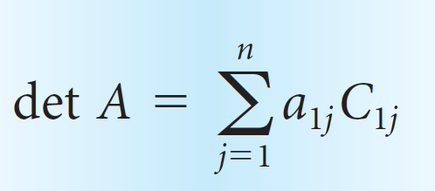
Determinants of n × n Matrices (2 of 5)
To this end, we define the (i, j)-cofactor of A to be
With this notation, definition (3) becomes
(4)
This definition is often referred to as cofactor expansion along the first row.

Slide 18
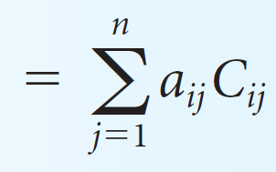
Determinants of n × n Matrices (3 of 5)
Theorem 4.1
The Laplace Expansion Theorem
The determinant of an n × n matrix A = [a_{ij}], where n ≥ 2, can be computed as
det A = a_{i1}C_{i1} + a_{i2}C_{i2} + ... + a_{in}C_{in}
(5)
(which is the cofactor expansion along the ith row) and also as

Slide 19
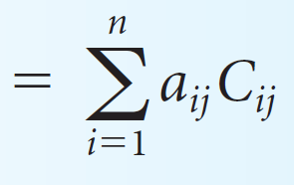
Determinants of n × n Matrices (4 of 5)
det A = a_{1j}C_{1j} + a_{2j}C_{2j} + ... + a_{nj}C_{nj}
(6)
(the cofactor expansion along the jth column).

Slide 20
Example 4.10
Compute the determinant of the matrix
by (a) cofactor expansion along the third row and (b) cofactor expansion along the second column.

Slide 21
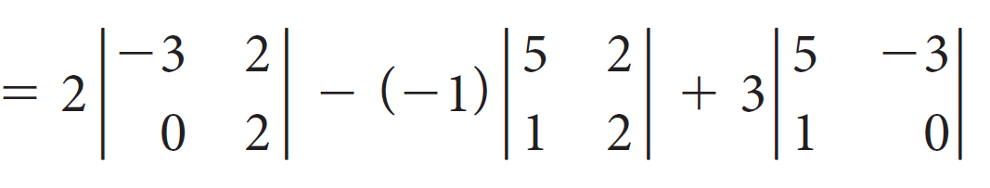

Example 4.10 – Solution (1 of 2)
We compute
det A = a₃₁C₃₁ + a₃₂C₃₂ + a₃₃C₃₃
= 2($−$6) + 8 + 3(3)
= 5

Slide 22
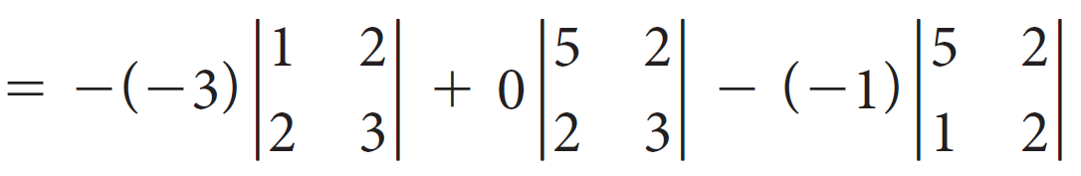
Example 4.10 – Solution (2 of 2)
(b) In this case, we have
det A = a₁₂C₁₂ + a₂₂C₂₂ + a₃₂C₃₂
= 3(−1) + 0 + 8
= 5

Slide 23
Determinants of n × n Matrices (5 of 5)
Theorem 4.2
The determinant of a triangular matrix is the product of the entries on its main diagonal. Specifically, if A = [a_{ij}] is an n × n triangular matrix, then
det A = a₁₁a₂₂ ... a_{nn}

Slide 24
Eigenvalues and Eigenvectors of n × n Matrices

Slide 25
Eigenvalues and Eigenvectors of n × n Matrices (1 of 10)
The eigenvalues of a square matrix A are precisely the solutions λ of the equation
det(A − λI) = 0
When we expand det(A − λI), we get a polynomial in λ, called the characteristic polynomial of A. The equation det(A − λI) = 0 is called the characteristic equation of A.

Slide 26
Eigenvalues and Eigenvectors of n × n Matrices (2 of 10)
The procedure we will follow to find the eigenvalues and eigenvectors (eigenspaces) of a matrix.
Let A be an n × n matrix.
1. Compute the characteristic polynomial det(A − λI) of A.
2. Find the eigenvalues of A by solving the characteristic equation det(A − λI) = 0 for λ.
3. For each eigenvalue λ, find the null space of the matrix A − λI. This is the eigenspace E_{λ}, the nonzero vectors of which are the eigenvectors of A corresponding to λ.
4. Find a basis for each eigenspace.

Slide 27
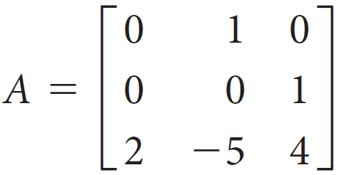
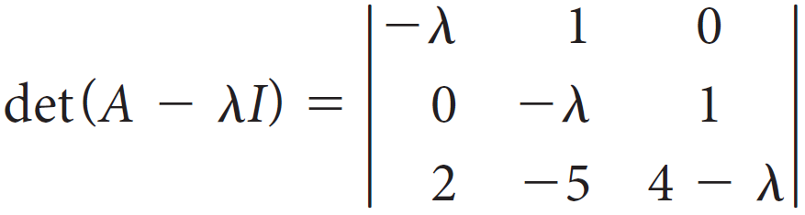
Example 4.18
Find the eigenvalues and the corresponding eigenspaces of
Solution:
We follow the procedure outlined previously. The characteristic polynomial is

Slide 28
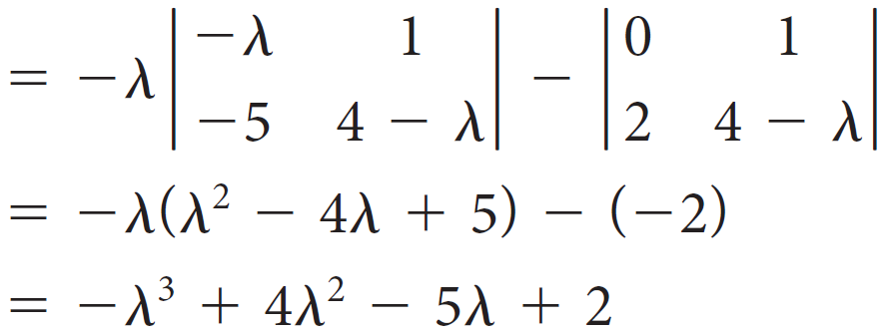


Example 4.18 – Solution (1 of 5)
To find the eigenvalues, we need to solve the characteristic equation det(A − λI) = 0 for λ. The characteristic polynomial factors as
Thus, the characteristic equation is
which clearly has solutions λ = 1 and λ = 2.

Slide 29
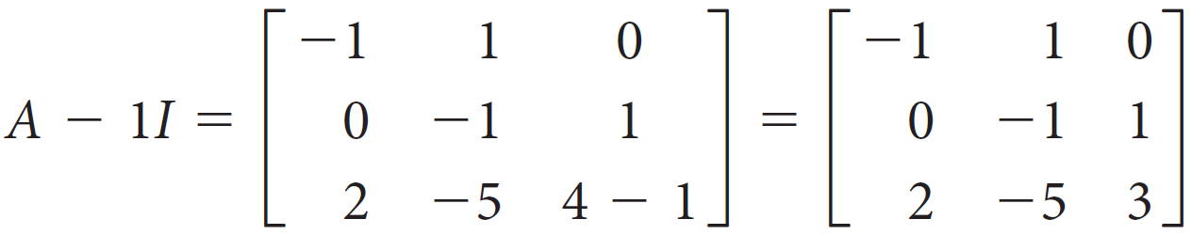
Example 4.18 – Solution (2 of 5)
Since λ = 1 is a multiple root and λ = 2 is a simple root, let us label them λ₁ = λ₂ = 1 and λ₃ = 2.
To find the eigenvectors corresponding to λ₁ = λ₂ = 1, we find the null space of

Slide 30
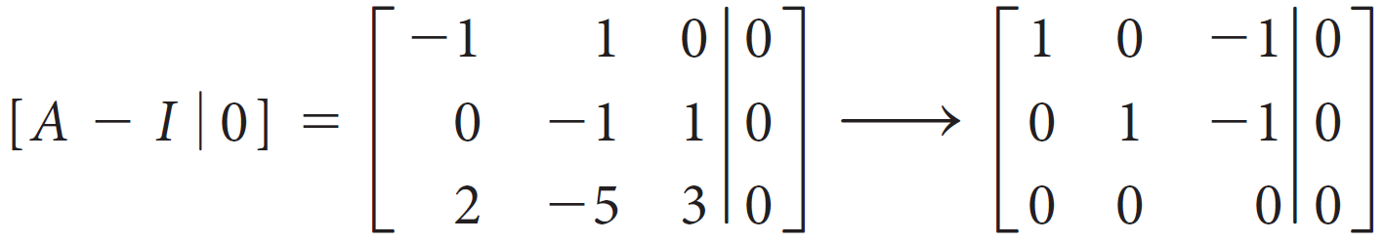
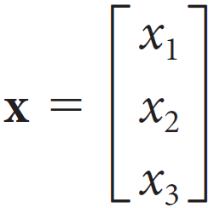
Example 4.18 – Solution (3 of 5)
Row reduction produces
Thus,
is in the eigenspace E₁ if and only if x₁ − x₃ = 0
and x₂ − x₃ = 0.

Slide 31
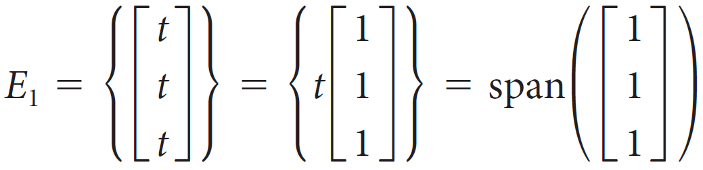
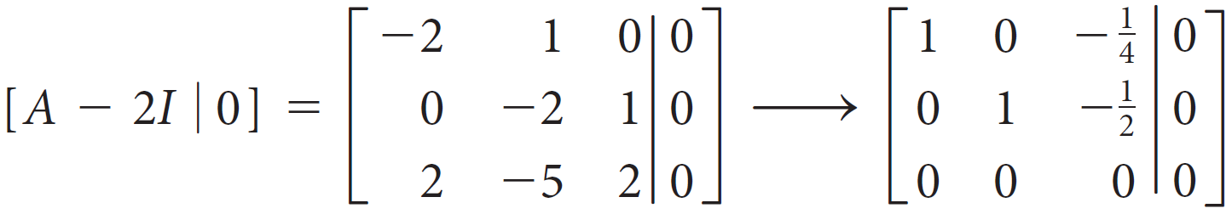
Example 4.18 – Solution (4 of 5)
Setting the free variable x₃ = t, we see that x₁ = t and x₂ = t, from which it follows that
To find the eigenvectors corresponding to λ₃ = 2, we find the null space of A − 2I by row reduction:

Slide 32

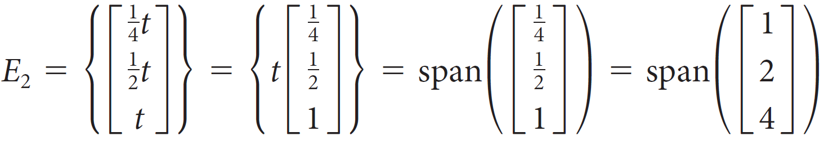
Example 4.18 – Solution (5 of 5)
So
is in the eigenspace E₂ if and only if
Setting the free variable x₃ = t, we have
where we have cleared denominators in the basis by multiplying through by the least common denominator 4.

Slide 33
Eigenvalues and Eigenvectors of n × n Matrices (3 of 10)
Let us define the algebraic multiplicity of an eigenvalue to be its multiplicity as a root of the characteristic equation. Thus, λ = 1 has algebraic multiplicity 2 and λ = 2 has algebraic multiplicity 1.
In other words, the algebraic multiplicity of an eigenvalue λ of a matrix A is the number of times λ appears as a root of the characteristic equation.
Let us define the geometric multiplicity of an eigenvalue λ to be dim E_{λ}, the dimension of its corresponding eigenspace.

Slide 34
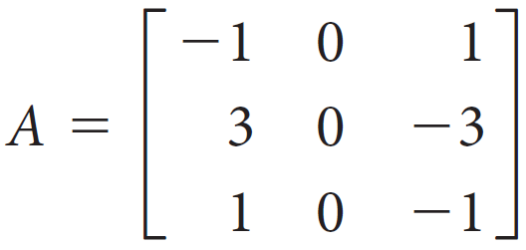
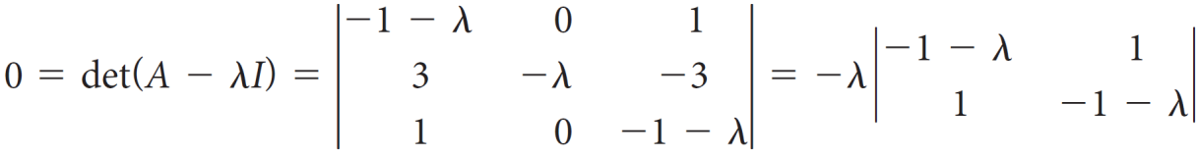
Example 4.19
Find the eigenvalues and the corresponding eigenspaces of
Solution:
The characteristic equation is

Slide 35
Example 4.19 – Solution (1 of 4)
Hence, the eigenvalues are λ₁ = λ₂ = 0 and λ₃ = −2. Thus, the eigenvalue 0 has algebraic multiplicity 2 and the eigenvalue −2 has algebraic multiplicity 1.

Slide 36
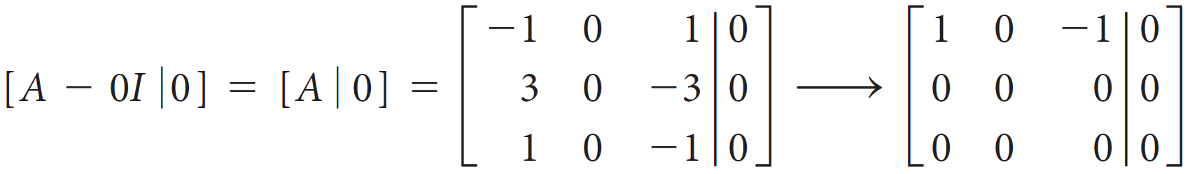
Example 4.19 – Solution (2 of 4)
For λ₁ = λ₂ = 0, we compute
from which it follows that an eigenvector
in E₀
satisfies x₁ = x₃. Therefore, both x₂ and x₃ are free.

Slide 37
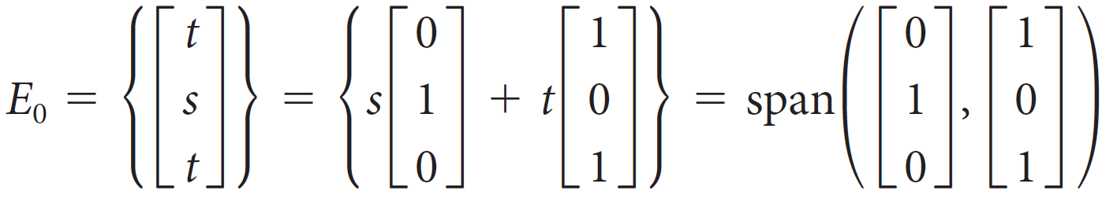
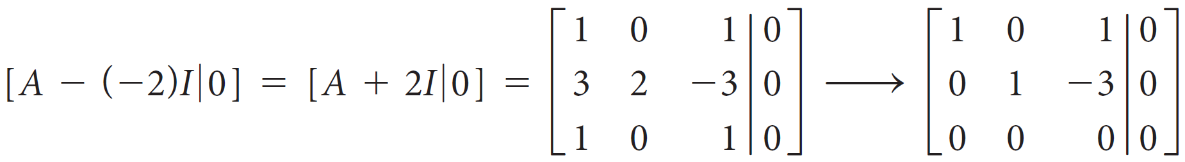
Example 4.19 – Solution (3 of 4)
Setting x₂ = s and x₃ = t, we have
For λ₃ = −2,
so x₃ = t is free and x₁ = −x₃ = − t and x₂ = 3x₃ = 3t.

Slide 38
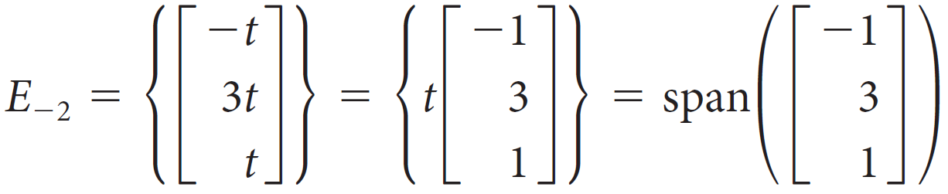
Example 4.19 – Solution (4 of 4)
Consequently,
It follows that λ₁ = λ₂ = 0 has geometric multiplicity 2 and λ₃ = −2 has geometric multiplicity 1.
Note that the algebraic multiplicity equals the geometric multiplicity for each eigenvalue.

Slide 39
Eigenvalues and Eigenvectors of n × n Matrices (4 of 10)
Theorem 4.15
The eigenvalues of a triangular matrix are the entries on its main diagonal.

Slide 40
Eigenvalues and Eigenvectors of n × n Matrices (5 of 10)
Theorem 4.16
A square matrix A is invertible if and only if 0 is not an eigenvalue of A.
Theorem 4.17
The Fundamental Theorem of Invertible Matrices: Version 3
Let A be an n × n matrix. The following statements are equivalent:
a. A is invertible.

Slide 41

Eigenvalues and Eigenvectors of n × n Matrices (6 of 10)
b. Ax = b has a unique solution for every b in
c. Ax = 0 has only the trivial solution.
d. The reduced row echelon form of A is I_{n}.
e. A is a product of elementary matrices.
f. rank(A) = n
g. nullity(A) = 0
h. The column vectors of A are linearly independent.

Slide 42
Eigenvalues and Eigenvectors of n × n Matrices (7 of 10)
i. The column vectors of A span
j. The column vectors of A form a basis for
k. The row vectors of A are linearly independent.
l. The row vectors of A span
m. The row vectors of A form a basis for
n. det A ≠ 0
o. 0 is not an eigenvalue of A.

Slide 43



Eigenvalues and Eigenvectors of n × n Matrices (8 of 10)
Theorem 4.18
Let A be a square matrix with eigenvalue λ and corresponding eigenvector x.
a. For any positive integer n,
is an eigenvalue of
with corresponding eigenvector x.
b. If A is invertible, then 1 ∕ λ is an eigenvalue of
with corresponding eigenvector x.
c. If A is invertible, then for any integer n,
is an eigenvalue of
with corresponding eigenvector x.

Slide 44
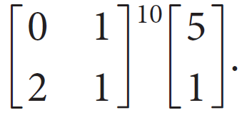
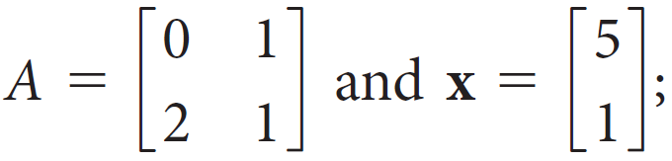

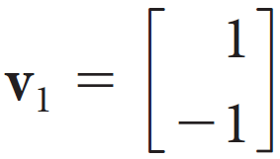
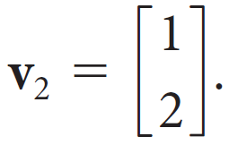
Example 4.21
Compute
Solution:
Let
then what we want to find is
The eigenvalues of A are λ₁ = −1 and λ₂ = 2, with
corresponding eigenvectors
and

Slide 45


Example 4.21 – Solution (1 of 2)
That is,
Av₁ = −v₁ and Av₂ = 2v₂
(Check this.) Since {v₁, v₂} forms a basis for
, we can write x as a linear combination of v₁ and v₂. Indeed, as is easily checked, x = 3v₁ + 2v₂.
Therefore, using Theorem 4.18(a), we have

Slide 46
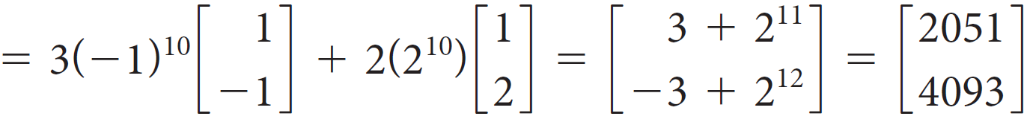

Example 4.21 – Solution (2 of 2)
This is certainly a lot easier than computing
first; in fact, there are no matrix multiplications at all!

Slide 47

Eigenvalues and Eigenvectors of n × n Matrices (9 of 10)
Theorem 4.19
Suppose the n × n matrix A has eigenvectors v₁, v₂, ... , v_{m} with corresponding eigenvalues λ₁, λ₂, ... , λ_{m}. If x is a vector in
that can be expressed as a linear combination of these eigenvectors—say,
x = c₁v₁ + c₂v₂ + ... + c_{m}v_{m}
then, for any integer k,

Slide 48
Eigenvalues and Eigenvectors of n × n Matrices (10 of 10)
Theorem 4.20
Let A be an n × n matrix and let λ₁, λ₂, ... , λ_{m} be distinct eigenvalues of A with corresponding eigenvectors v₁, v₂, ... , v_{m}. Then v₁, v₂, ... , v_{m} are linearly independent.

Slide 49
Similar Matrices

Slide 50


Similar Matrices (1 of 3)
Definition
Let A and B be n × n matrices. We say that A is similar to B if there is an invertible n × n matrix P such that
If A is similar to B, we write

Slide 51
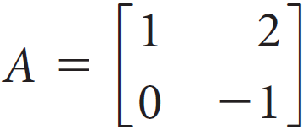
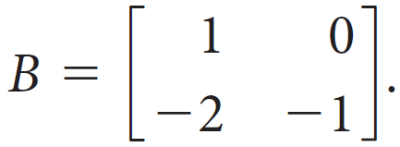

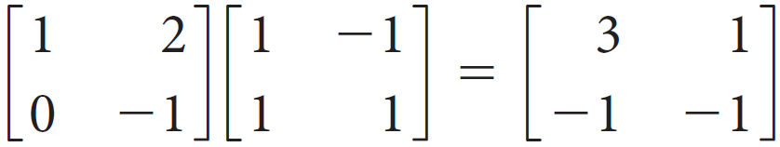
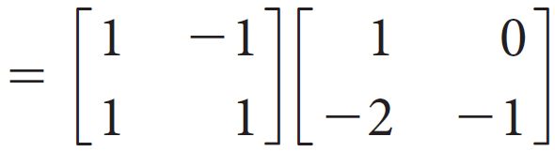
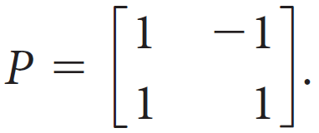
Example 4.22
Let
and
Then
since
Thus, AP = PB with

Slide 52
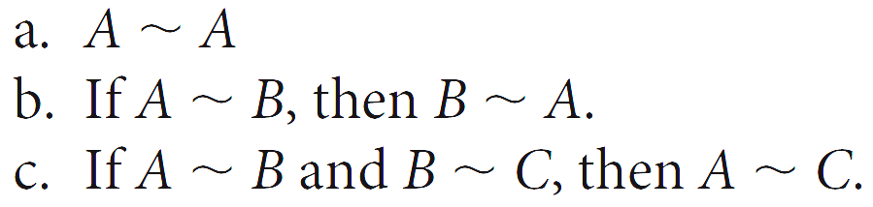
Similar Matrices (2 of 3)
Theorem 4.21
Let A, B, and C be n × n matrices.

Slide 53


Similar Matrices (3 of 3)
Theorem 4.22
Let A and B be n × n matrices with
Then
a. det A = det B
b. A is invertible if and only if B is invertible.
c. A and B have the same rank.
d. A and B have the same characteristic polynomial
f.
for all integers m ≥ 0.
g. If A is invertible, then
for all integers m.

Slide 54
Diagonalization

Slide 55

Diagonalization (1 of 6)
Definition
An n × n matrix A is diagonalizable if there is a diagonal matrix D such that A is similar to D—that is, if there is an invertible n × n matrix P such that

Slide 56

Diagonalization (2 of 6)
Theorem 4.23
Let A be an n × n matrix. Then A is diagonalizable if and only if A has n linearly independent eigenvectors. More precisely, there exist an invertible matrix P and a diagonal matrix D such that
if and only if the columns of P are n linearly independent eigenvectors of A and the diagonal entries of D are the eigenvalues of A corresponding to the eigenvectors in P in the same order.

Slide 57
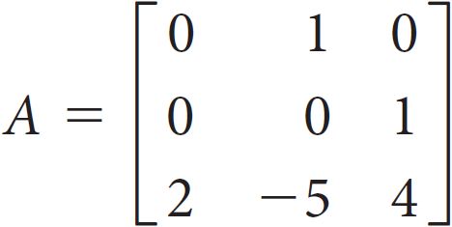
Example 4.25
If possible, find a matrix P that diagonalizes
Solution:
We studied this matrix in the previous section, where we discovered that it has eigenvalues λ₁ = λ₂ = 1 and λ₃ = 2.

Slide 58
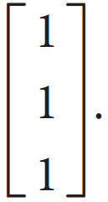
Example 4.25 – Solution
The eigenspaces have the following bases:
For λ₁ = λ₂ = 1, E₁ has basis
For λ₃ = 2, E₂ has basis
Since all other eigenvectors are just multiples of one of these two basis vectors, there cannot be three linearly independent eigenvectors. By Theorem 4.23, therefore, A is not diagonalizable.

Slide 59
Diagonalization (3 of 6)
Theorem 4.24
Let A be an n × n matrix and let λ₁, λ₂, ... , λ_{k} be distinct eigenvalues of A. If ℬ_{i} is a basis for the eigenspace E_{λi} then ℬ = ℬ₁∪ ℬ₂∪. . . ∪ℬ_{k} (i.e., the total collection of basis vectors for all of the eigenspaces) is linearly independent.

Slide 60
Diagonalization (4 of 6)
Theorem 4.25
If A is an n × n matrix with n distinct eigenvalues, then A is diagonalizable.

Slide 61
Diagonalization (5 of 6)
Lemma 4.26
If A is an n × n matrix, then the geometric multiplicity of each eigenvalue is less than or equal to its algebraic multiplicity.

Slide 62
Diagonalization (6 of 6)
Theorem 4.27
The Diagonalization Theorem
Let A be an n × n matrix whose distinct eigenvalues are λ₁, λ₂, ... , λ_{k}. The following statements are equivalent:
a. A is diagonalizable.
b. The union ℬ of the bases of the eigenspaces of A contains n vectors.
c. The algebraic multiplicity of each eigenvalue equals its geometric multiplicity.

Slide 63



Example 4.29
Compute
Solution:
We found that this matrix has eigenvalues λ₁ = −1 and λ₂ = 2,
with corresponding eigenvectors
and

Slide 64



Example 4.29 – Solution (1 of 4)
It follows that A is diagonalizable and
where
Solving for A, we have
and, by Theorem 4.22(f),
for all n ≥ 1.

Slide 65



Example 4.29 – Solution (2 of 4)
Since
We have

Slide 66


Example 4.29 – Solution (3 of 4)
Since we were only asked for
this is more than we needed.

Slide 67


Example 4.29 – Solution (4 of 4)
But now we can simply set n = 10 to find

Slide 68
Quadratic Forms

Slide 69

Quadratic Forms (1 of 12)
An expression of the form
is called a quadratic form in x and y. Similarly,
is a quadratic form in x, y, and z.

Slide 70


Quadratic Forms (3 of 12)
We can expand a quadratic form in n variables
Thus, if i ≠ j, the coefficient of x_{i}x_{j} is 2a_{ij}.

Slide 71




Quadratic Forms (4 of 12)
be a quadratic form in n variables, with A a symmetric n × n matrix. By the Spectral Theorem, there is an orthogonal matrix Q that diagonalizes A; that is,
Let
where D is a diagonal matrix displaying the eigenvalues of A. We now set
x = Qy or, equivalently,
Substitution into the quadratic form yields

Slide 72


Quadratic Forms (5 of 12)
which is a quadratic form without cross-product terms, since D is diagonal. Furthermore, if the eigenvalues of A are λ₁, ..., λ_{n}, then Q can be chosen so that
If
then, with respect to these new variables, the quadratic form becomes

Slide 73

Quadratic Forms (6 of 12)
This process is called diagonalizing a quadratic form.

Slide 74





Quadratic Forms (7 of 12)
Theorem 5.21
The Principal Axes Theorem
Every quadratic form can be diagonalized. Specifically, if A is the n × n symmetric matrix associated with the quadratic form
and if Q is an orthogonal matrix such that
is a diagonal matrix, then the change of variable x = Qy transforms the quadratic form
into the quadratic form
which has no cross-product terms. If the eigenvalues of A are λ₁, ... , λ_{n} and
then

Slide 75


Example 5.23
Find a change of variable that transforms the quadratic form
into one with no cross-product terms.
Solution:
The matrix of f is

Slide 76



Example 5.23 – Solution (1 of 2)
with eigenvalues λ₁ = 6 and λ₂ = 1. Corresponding unit eigenvectors are
(Check this.) If we set
then
The change of variable x = Qy, where

Slide 77


Example 5.23 – Solution (2 of 2)
converts f into

Slide 78

Quadratic Forms (8 of 12)
Definition
A quadratic form
is classified as one of the following:
1. positive definite if f (x) > 0 for all x ≠ 0
2. positive semidefinite if f (x) ≥ 0 for all x
3. negative definite if f (x) < 0 for all x ≠ 0
4. negative semidefinite if f (x) ≤ 0 for all x
5. indefinite if f (x) takes on both positive and negative values

Slide 79

Quadratic Forms (9 of 12)
A symmetric matrix A is called positive definite, positive semidefinite, negative definite, negative semidefinite, or indefinite if the associated quadratic form
has the corresponding property.

Slide 80

Quadratic Forms (10 of 12)
Theorem 5.22
Let A be an n × n symmetric matrix. The quadratic form
is
a. positive definite if and only if all of the eigenvalues of A are positive.
b. positive semidefinite if and only if all of the eigenvalues of A are nonnegative.
c. negative definite if and only if all of the eigenvalues of A are negative.

Slide 81
Quadratic Forms (11 of 12)
d. negative semidefinite if and only if all of the eigenvalues of A are nonpositive.
e. indefinite if and only if A has both positive and negative eigenvalues.

Slide 82


Quadratic Forms (12 of 12)
Theorem 5.23
Let
be a quadratic form with associated n × n symmetric matrix A. Let the eigenvalues of A be λ₁ ≥ λ₂ ≥ ... ≥ λ_{n}. Then the following are true, subject to the constraint
a. λ₁ ≥ f (x) ≥ λ_{n}
b. The maximum value of f (x) is λ₁, and it occurs when x is a unit eigenvector corresponding to λ₁.
c. The minimum value of f (x) is λ_{n}, and it occurs when x is a unit eigenvector corresponding to λ_{n}.

Slide 83


Example 5.25
Find the maximum and minimum values of the quadratic form f (x₁, x₂) =
subject to the constraint
and determine values of x₁ and x₂ for which each of these occurs.
Solution:
In Example 5.23, we found that f has the associated eigenvalues λ₁ = 6 and λ₂ = 1, with corresponding unit eigenvectors

Slide 84



Example 5.25 – Solution
and x₂ =
Therefore, the maximum value of f is 6 when x₁ =
and x₂ =
The minimum value of f is 1 when x₁ =
Observe that these extreme values occur twice—in opposite directions—since −q₁ and −q₂ are also unit eigenvectors for λ₁ and λ₂, respectively.

