Slide 1

Explore whether the state-of-the-art pre-trained
models in NLP can achieve general reading and
reasoning abilities
presented by
Junyu Yin
19 April 2022

Slide 2
Outline
Introduction
Related Work
Machine Reading Comprehension
Logical Reasoning in NLP
Pre-trained Language Model
Methodology
Formal Description
Solution
Results
Conclusions

Slide 3
Introduction
Motivation
Construct an intelligent agent which is capable of understanding text as people
Machine reading comprehension (MRC) is a useful benchmark to evaluate natural language understanding
Large-scale pre-training models have shown saturated performance on most of the existing simple MRC datasets.
Logical reasoning ability is a significant component of human intelligence
Main Work
Conduct experiments on two highly challenging datasets, ReClor and LogiQA
Examine the logical reasoning ability of the state-of-the-art pre-trained models

Slide 4
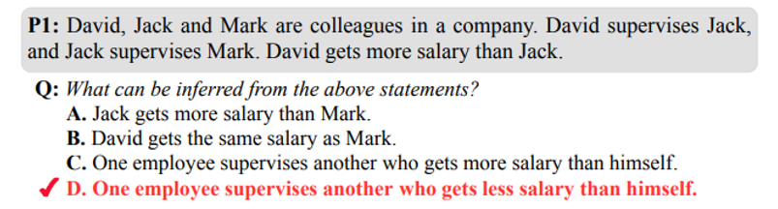
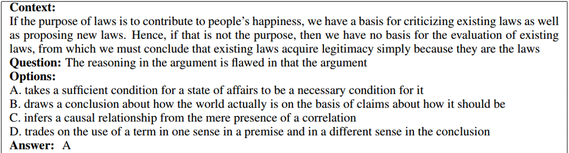

Slide 5
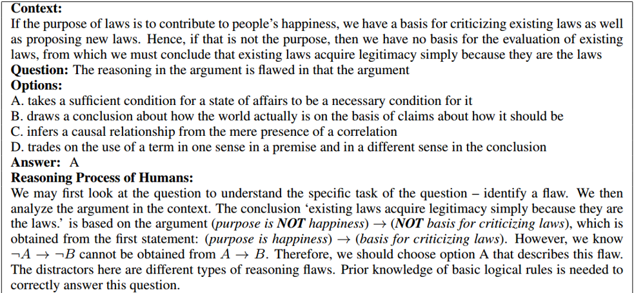

Slide 6
Related Work
Machine Reading Comprehension
A long-standing goal in NLP
Early: rule-based methods
Bag-of-words approaches, manually generated rules
Now: deep neural networks, especially large-scale pre-trained models
Pre-train + fine-tune framework
Stimulate the research progress towards human cognition and real-world applications

Slide 7
Related Work
Logical Reasoning in NLP
One of the main research topics of early AI
Early tasks: natural language inference, argument reasoning comprehension, …
Limited to only a few logical relationships, only sentence-level reasoning
Recent tasks: question answering, especially multiple-choice question answering
Passage-level reasoning, complicated diverse reasoning types

Slide 8
Related Work
Pre-trained Language Model
Language modeling is the foundation for natural language processing
Early methods: static embedding, Word2Vec and GloVe, …
Represent a word without using its context, no complete sentence-level context
Recent method: ELMo, GPT, BERT, …
Capture the complete sentence-level context
Pre-trained with huge unlabeled data
Transformer-based architecture for better feature quality

Slide 9
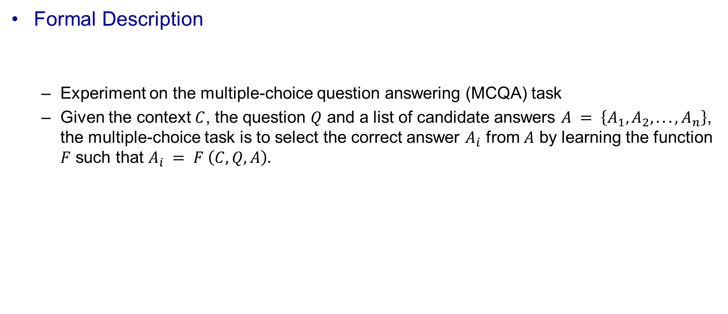
Methodology
Formal Description
Experiment on the multiple-choice question answering (MCQA) task
Given the context $C$, the question $Q$ and a list of candidate answers $A = \left\{A_{1}, A_{2}, . . . , A_{n}\right\}$, the multiple-choice task is to select the correct answer $A_{i}$ from $A$ by learning the function $F$ such that $A_{i} = F \left(C, Q, A\right).$

Slide 10
Methodology
Solution
A combination of a pre-trained model and a softmax classification layer
Detail:
Concatenate the context, the question and each option as the input
Given four options, four concatenated sequences are constructed
Feed the sequences to pre-trained model to get four hidden vectors of the [CLS] token
Feed the hidden vectors into a linear layer to get four scores
Normalize the scores by a softmax layer and take the highest one as the answer

Slide 11































softmax
Linear
Linear
Linear
Linear
BERT (PTM)
$$C$$
$$T_{1}$$
…
$$T_{N}$$
$$T_{[SEP]}$$
$$T_{1}^{′}$$
…
$$T_{M}^{′}$$
BERT (PTM)
$$C$$
$$T_{1}$$
…
$$T_{N}$$
$$T_{[SEP]}$$
$$T_{1}^{′}$$
…
$$T_{M}^{′}$$
BERT (PTM)
$$C$$
$$T_{1}$$
…
$$T_{N}$$
$$T_{[SEP]}$$
$$T_{1}^{′}$$
…
$$T_{M}^{′}$$
BERT (PTM)
$$C$$
$$T_{1}$$
…
$$T_{N}$$
$$T_{[SEP]}$$
$$T_{1}^{′}$$
…
$$T_{M}^{′}$$
$$E_{[CLS]}$$
$$E_{1}$$
…
$$E_{N}$$
$$E_{[SEP]}$$
$$E_{1}^{′}$$
…
$$E_{M}^{′}$$
$$E_{[CLS]}$$
$$E_{1}$$
…
$$E_{N}$$
$$E_{[SEP]}$$
$$E_{1}^{′}$$
…
$$E_{M}^{′}$$
$$E_{[CLS]}$$
$$E_{1}$$
…
$$E_{N}$$
$$E_{[SEP]}$$
$$E_{1}^{′}$$
…
$$E_{M}^{′}$$
$$E_{[CLS]}$$
$$E_{1}$$
…
$$E_{N}$$
$$E_{[SEP]}$$
$$E_{1}^{′}$$
…
$$E_{M}^{′}$$
[CLS]
Tok1
…
TokN
[SEP]
Tok1
…
TokM
[CLS]
Tok1
…
TokN
[SEP]
Tok1
…
TokM
[CLS]
Tok1
…
TokN
[SEP]
Tok1
…
TokM
[CLS]
Tok1
…
TokN
[SEP]
Tok1
…
TokM
context
question + answer

Slide 12
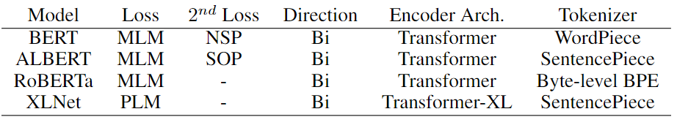

Slide 13
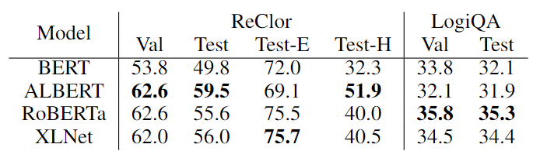
Results
Evaluated on two datasets, ReClor and LogiQA
ReClor from GMAT and LSAT
LogiQA from the National Civil Servants Examination of China
Experiment with four pre-trained models
BERT-large, ALBERT-xxlargev2, RoBERTa-large, XLNet-large
Experimental Results (Accuracy)

Slide 14
Conclusion
A significant gap between powerful transformer-based pre-trained models and human ceiling performance.
Better than random guess
A long way to equip deep learning models with real logical reasoning abilities.
A potentially promising research direction
Combine symbolic logic and neural model
Use GNN to capture fine-grained relations

Slide 15
Thanks for your listening!

