Slide 1
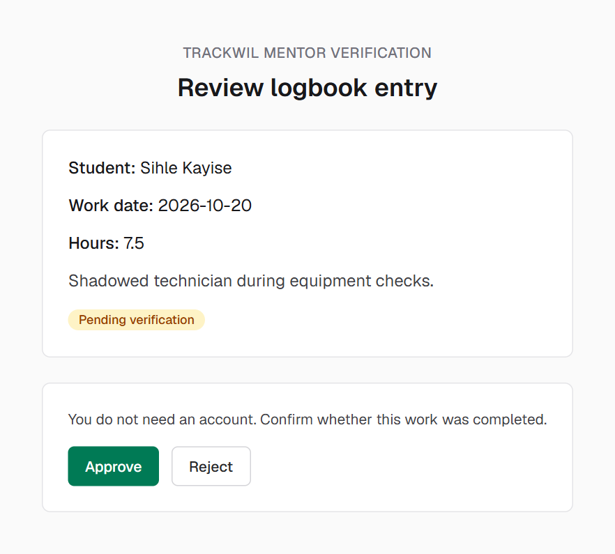

GROUP 3 · CAPE CAMPUS · SPM622 SOFTWARE ENGINEERING 2
TrackWIL
Work-Integrated Learning logbooks, verified by workplace mentors without an account
Willem (Gedion) Basson · Moegammad Green
Dylan Shepard · Sihle Kayise
Client and supervisor: Ms Amenda Raganya · 29 October 2026
github.com/Noobey32/TrackWIL
Notes:
GEDION (0:30)
Good afternoon, Ms Raganya and members of the panel. We are Group 3 from the Cape campus: Dylan Shepard, Moegammad Green, Sihle Kayise, and I am Gedion Basson.
We built TrackWIL, a web application that replaces paper and email Work-Integrated Learning logbooks. Students record their daily work and keep their WIL documents for each placement. Workplace mentors verify that work from a link, without needing an account. Coordinators and lecturers can see straight away who is on track and who is falling behind.

Slide 2







The problem: paper and email logbooks
Documents get lost
Who is affected
Daily forms travel by email, paper and PDF, and are misplaced, deleted or returned late.
Students
keep track of every document
Sign-offs are slow
Workplace mentors
Students wait for the mentor to sign each document and send it back.
busy host staff, not CTU employees
Coordinators
No live view of progress
check many students' records
Staff have to chase each student to find out who is falling behind.
Lecturers
need to know who is behind
Notes:
GEDION (1:00)
Today, a WIL student completes a daily document, sends it to their workplace mentor to sign, and then waits for it to come back. This happens by email, on paper or as separate PDF files.
That causes three problems. First, documents get lost, deleted or returned late. Second, sign-offs are slow, so the student's record falls behind. Third, coordinators and lecturers have no live view of progress. To find out who is behind, they have to chase each student.
Four groups are affected. Students, who must keep track of every document. Coordinators, who must check many students' records. Lecturers, who need to know who is falling behind. And workplace mentors, who are busy staff at a host company, not CTU employees. Asking them to sign forms or create yet another account adds work and causes more delay.

Slide 3

Aim, objectives and research questions
Aim Design, develop and evaluate TrackWIL: one web application where students record daily work and evidence, mentors verify it through a secure link, and staff monitor progress.
1
2
3
4
5
Analyse
Design
Develop
Store
Evaluate
the current process and its challenges
a logbook with one-time-link mentor verification
the student logbook, mentor page and shared dashboard
every entry with its status and timestamps
TrackWIL against its requirements
RQ1 What challenges do the four user groups face?
RQ2 How can a one-time link improve verification?
RQ3 How can role-specific views support each group?
RQ4 How does a central database improve monitoring?
RQ5 To what extent are the requirements met?
Notes:
GEDION (1:00)
Our aim was to design, develop and evaluate TrackWIL: a central web application where students record daily work and evidence, mentors verify it through a secure link, and staff monitor progress.
We set five objectives. One: analyse the current process and its challenges. Two: design a logbook where mentors verify each entry through a one-time link with no account. Three: develop the student logbook, the mentor page and a shared staff dashboard. Four: store every entry in a database with its status and timestamps. Five: test and evaluate the system against its requirements.
Each objective is linked to one research question. For example, objective two asks how a one-time link can improve verification, and objective five asks to what extent TrackWIL meets its requirements. We will come back to these in the conclusion.
Dylan will now show what already exists.

Slide 4
What exists already, and the gap
InPlace
Sonia Online
Mahara / PebblePad
PLACEMENT MANAGEMENT
PLACEMENT MANAGEMENT
EPORTFOLIO AND ASSESSMENT
Institution-wide placements, timesheets, compliance and reporting
Placement information and paperwork for students and host organisations
Evidence collection, reflection and review by assessors
For TrackWIL: Keep the workflow small and focused on daily logbooks
For TrackWIL: Keep paperwork in one organised place
For TrackWIL: Link each piece of evidence to a dated, verified entry
The gap A focused, lightweight workflow: students log each day's work with evidence, a mentor outside the institution verifies it without creating an account, and staff see who is behind in one view.
Compared from public product information: InPlace Software (n.d.), Sonia Online (n.d.), Mahara Project (n.d.), PebblePad (2026).
Notes:
DYLAN (1:00)
Thank you, Gedion. Before we built anything, we looked at what already exists. We compared three systems from their public product information.
InPlace is a full placement-management platform. It handles placements, timesheets, compliance and reporting across a whole institution.
Sonia Online is a placement system that keeps placement information and paperwork for students and host organisations in one place.
Mahara and PebblePad are ePortfolio tools. They are strong at collecting evidence and letting assessors review it.
So the gap is not that no digital tools exist. These systems are broad and set up by the institution, and the mentor usually needs an account. Our gap is a focused, lightweight workflow: students log each day's work with evidence, a mentor outside the institution verifies it without creating an account, and staff see who is behind in one view.
Sihle will now take you through how we turned that into requirements.

Slide 5
Requirements and method
18
7
What the requirements cover
Sign-up, sign-in and role-based access
WIL placements, daily entries, evidence and documents
One-time mentor link; staff dashboard and profiles
Targets: pages under 2 s, hashed passwords, 375 px phones
functional requirements
non-functional requirements
prioritised and testable
each with a measurable target
Hybrid Agile (Scrum): four one-week sprints, each ending on a Friday submission
Sprint 0 · 2–8 Oct
Sprint 1 · 9–15 Oct
Sprint 2 · 16–22 Oct
Sprint 3 · 23–29 Oct
Proposal, scope and requirements
Logbook core: sign-in, entries, evidence
Verification, dashboard, SQLite database
Testing, defect fixes, placements, documents
Waterfall rejected: requirements kept changing and all testing would have come at the end.
Notes:
SIHLE (1:00)
Thank you, Dylan. From that gap we wrote eighteen functional requirements and seven measurable non-functional requirements, each with a priority and a way to test it.
The functional requirements cover sign-up and role-based access, WIL placements with their own required hours, daily entries with evidence, the WIL documents, the one-time mentor link, the staff dashboard, student profiles, and locking a placement once its hours are complete.
The non-functional requirements are measurable. For example: every page must load within 2 seconds, passwords are stored only as salted hashes, and the system must work on a 375-pixel phone screen.
For the method, we used a hybrid Agile approach based on Scrum. We ran four one-week sprints, each ending on a Friday submission date, so every submission acted as a sprint review with our supervisor. We rejected Waterfall because our requirements kept changing and it would have left all testing until the end.
Moe will now take you through the design.

Slide 6



Design: one application, three layers, five tables
Architecture
SQLite database
Mentor verification
Browser
student · staff · mentor
users
1
Student submits an entry
Pages
React screens per role
wil_placements
2
Server creates a random token: 7 days, one use
3
Student sends the link to the mentor
Server actions
forms + role checks on the server
logbook_entries
placement_documents
4
Mentor approves or rejects, no account
Repository
the only layer that uses the database
verification_tokens
5
Token use + new status saved in one transaction
Each line is one-to-many. Constraints reject an unknown status, more than 24 hours a day and a second copy of a document.
SQLite + uploads folder
data and evidence files on disk
A used or expired link changes nothing
Notes:
MOE (1:30)
Thank you, Sihle. Here is how we designed TrackWIL.
First, the architecture. TrackWIL is a single Next.js application written in TypeScript, in three layers. The pages show the screens. The server actions handle every form and check the user's role on the server. The repository layer is the only part that talks to the database. Because it runs as one application with a local database, it needs no network during the demo.
Second, the database. We use SQLite with five tables: users; WIL placements, so a student can have more than one placement, each with its own required hours; logbook entries; verification tokens; and placement documents. Constraints in the database reject bad data, such as an unknown status or more than 24 hours in a day.
Third, the verification sequence, which is the heart of the system. When a student submits an entry, the server creates a long random token and gives the student a link. The link is valid for seven days and can be used only once. When the mentor clicks Approve or Reject, the status change and the use of the token are saved in one transaction. So either both are saved, or neither is. A used or expired link changes nothing.
Now let me show you it working.
(Full ERD and sequence diagram are on the backup slides at the end.)

Slide 7






Live demonstration
One entry, from the student's logbook to the lecturer's dashboard
Student logs a day
Submits for checking
Mentor approves
Hours go up
Lecturer monitors
Sihle's WIL 1: new entry, 6 hours, PDF evidence
Status: Pending verification, 7-day link
Private window, no sign-in; the link then stops working
6 → 12 of 200 verified hours
Dashboard statuses and Sihle's profile
Moe
Moe
Gedion
Moe
Gedion
Synthetic demo data · runs locally, no Wi-Fi needed · backup: recorded walkthrough and the screenshots on the backup slides
Notes:
DEMO (5:00) - MOE then GEDION
Before: npm run db:reset, npm run build, npm start; open http://localhost:3000 in a normal window and a private window.
MOE: "I will sign in as a student, Sihle, using our synthetic demo data. Everything you will see runs on this laptop."
- student2@ctucareer.co.za / student123, open WIL 1 (6 of 200 verified hours)
- Upload a PDF as the Commencement Letter; show a non-PDF is refused
- New entry: today, short description, 6 hours, mentor@host.co.za, attach a PDF -> Draft
- Try 30 hours: "Hours for one day cannot be more than 24."
- Submit for verification, Copy link
MOE: "The student has copied the link. Gedion will now play the workplace mentor."
GEDION: "Thanks, Moe. I am now the workplace mentor. I have no account. I just open the link the student sent me."
- Paste link in the private window, Approve, refresh: "This link was already used (approved)."
MOE: back in the student window, WIL 1 shows Verified, 12 of 200 hours
GEDION: sign in as lecturer@ctucareer.co.za / lecturer123; dashboard statuses; click Sihle Kayise -> profile
(If time) MOE: student3@ctucareer.co.za / student123 -> Lerato's WIL completed and locked
GEDION to close: "That is the full journey, from a student's entry to the mentor's approval to the lecturer's dashboard. Dylan will now show how we tested it."

Slide 8

Testing: 80 of 81 test cases passed
81
80
0
1
test cases
passed
failed
blocked
Blocked: TC-149, the timed usability test with students, waits for written campus permission.
62 of 62 automated tests pass
npm run test:system checks the response and the database; final run 26 Oct 2026 on Next.js 16.4.3
Security tested on its own
Forged cookies, other students' files and blocked pages are all refused
Chrome and Edge, phone and desktop
Every main screen fits a 375-pixel phone; the mentor page needs no sideways scrolling
Target: under 2,000 ms. Every page answers hundreds of times faster (measured on the test computer).
Notes:
DYLAN (1:30)
Thank you, Moe and Gedion. You have just seen the system working. Now I will show you how we know it works.
We followed a written test plan and recorded 81 test cases in our Test Cases and Results workbook. 80 passed, none failed, and one is blocked: the timed usability test with real students, which needs written campus permission first.
We combined manual testing with an automated test suite. The script sends the same requests as the browser and then checks both the response and the database. It covers every functional requirement, the security rules, the database constraints and response times. In the final regression run, on Next.js 16.4.3, all 62 automated tests passed.
For performance, our target was 2 seconds per page. We loaded each main page ten times, and the average was between 3 and 5 milliseconds on the test computer.
For compatibility, every main screen works in Chrome and Edge, and on a 375-pixel phone screen. That matters most for the mentor page, because mentors usually open the link on their phone.

Slide 9


Defects found, fixed and retested
DEF-01 Forgeable cookie
Critical
DEF-07 Data in redirects
Critical
Editing the cookie opened the coordinator dashboard without a password.
A blocked page still sent every student's details in the redirect response.
Fixed: Cookie is signed; forged ones rejected · TC-121 passes
Fixed: Role checked on the server on every page · TC-171 passes
DEF-02 Expired link stuck
DEF-03 Phone tables cut off
An entry whose mentor link expired could never be resubmitted.
At 375 pixels, tables widened the page and cut off columns.
Fixed: The student can resubmit with a new link · TC-137 passes
Fixed: Tables scroll inside their card · TC-145 passes
Lesson: every functional test passed before DEF-01 was fixed, so security has to be tested on its own.
Notes:
DYLAN (1:00)
Testing also found real problems. Here are the four most important.
DEF-01 was critical. The session cookie held the user ID without a signature, so anyone could edit the cookie and open the coordinator dashboard without a password. We now sign the cookie, and a test checks that forged cookies are rejected.
DEF-07 was also critical. A blocked page redirected the browser, but the page data was still sent in the redirect response. We now check the role on the server on every page, and the tests check that the data is not in the response.
DEF-02: an entry whose mentor link had expired could never be resubmitted. Now the student can resubmit it.
DEF-03: on a phone, the tables cut off columns. That is fixed and retested in Chrome and Edge.
The lesson for us is that every functional test passed before DEF-01 was fixed. Security has to be tested on its own. Sihle will now conclude.

Slide 10


Conclusion and future work
18 / 18
6 / 7
Limitations
Future work
functional requirements met
non-functional met
Synthetic data only, until campus permission is granted
Usability not yet measured with users
Response times measured locally, not on a hosted server
Written mentor feedback
Coordinator review of documents
Email notifications
Mentor access to evidence
Hosted deployment with HTTPS
1 Analyse the current process
2 Design account-free verification
3 Build logbook, mentor page, dashboard
4 Store entries with status and time
5 Test and evaluate
Objective 5 is largely achieved: usability with real users is still to be measured.
Main contribution: account-free mentor verification combined with automatic progress monitoring.
Notes:
SIHLE (1:00)
Thank you, Dylan. To conclude.
All eighteen functional requirements are met, and six of the seven non-functional requirements are met. Objectives one to four are achieved, and objective five is largely achieved.
We are honest about our limitations. We tested only with synthetic data, because we may not use real student data before written campus permission is granted. For the same reason, usability with real users has not been measured yet. And our response times were measured locally, not on a hosted server.
For future work, we would add written mentor feedback, coordinator review of uploaded documents, email notifications, secure mentor access to evidence, and a hosted deployment with HTTPS.
In short, TrackWIL shows that a small, focused web application can replace paper and email logbooks with a secure, traceable workflow. Our main contribution is account-free mentor verification combined with automatic progress monitoring.

Slide 11

Team and Git evidence
Willem (Gedion) Basson
Moegammad Green
Dylan Shepard
Sihle Kayise
GROUP LEAD
DEVELOPMENT LEAD
TESTING AND QA
GROUP MEMBER
Proposal, SRS and document revisions
SQLite database, placements and documents
Security fixes and automated tests
Repository set-up
Next.js app: sign-in, logbook, verification, dashboard
System design diagrams
Literature review and references
Test lead in the Test Plan
Document reviews and formatting
Chapter 1 and 3 drafts
First Test Plan and Chapter 5 draft
Manual test cases TC‑001 to TC‑014
Cyber-4
Noobey32
FyreGH
sihle588
github.com/Noobey32/TrackWIL · a branch per task · 17 merged pull requests · see the Individual Contribution Forms
Notes:
ALL (0:30) - one sentence each, in this order
GEDION: I am Gedion Basson, the group lead. I wrote the proposal and the SRS, moved the data to an SQLite database, fixed the security defects, wrote the automated tests, and compiled our submissions.
MOE: I am Moegammad Green, the development lead. I set up the repository and built the Next.js application: sign-in, the logbook, mentor verification and the dashboard. I also drew the system design diagrams.
DYLAN: I am Dylan Shepard, the QA and testing lead. I wrote the literature review and the reference list, and I led the test plan and the document reviews.
SIHLE: I am Sihle Kayise. I drafted Chapters 1 and 3, wrote the first test plan and Chapter 5 draft, and ran the manual test cases.

Slide 12
Thank you
Questions?
Willem (Gedion) Basson · Moegammad Green · Dylan Shepard · Sihle Kayise
github.com/Noobey32/TrackWIL
Notes:
SIHLE: That brings us to the end of our presentation. Thank you for your time. We are happy to take your questions.
Each member answers questions on their own work. Backup slides with screenshots and the full diagrams follow this slide.

Slide 13
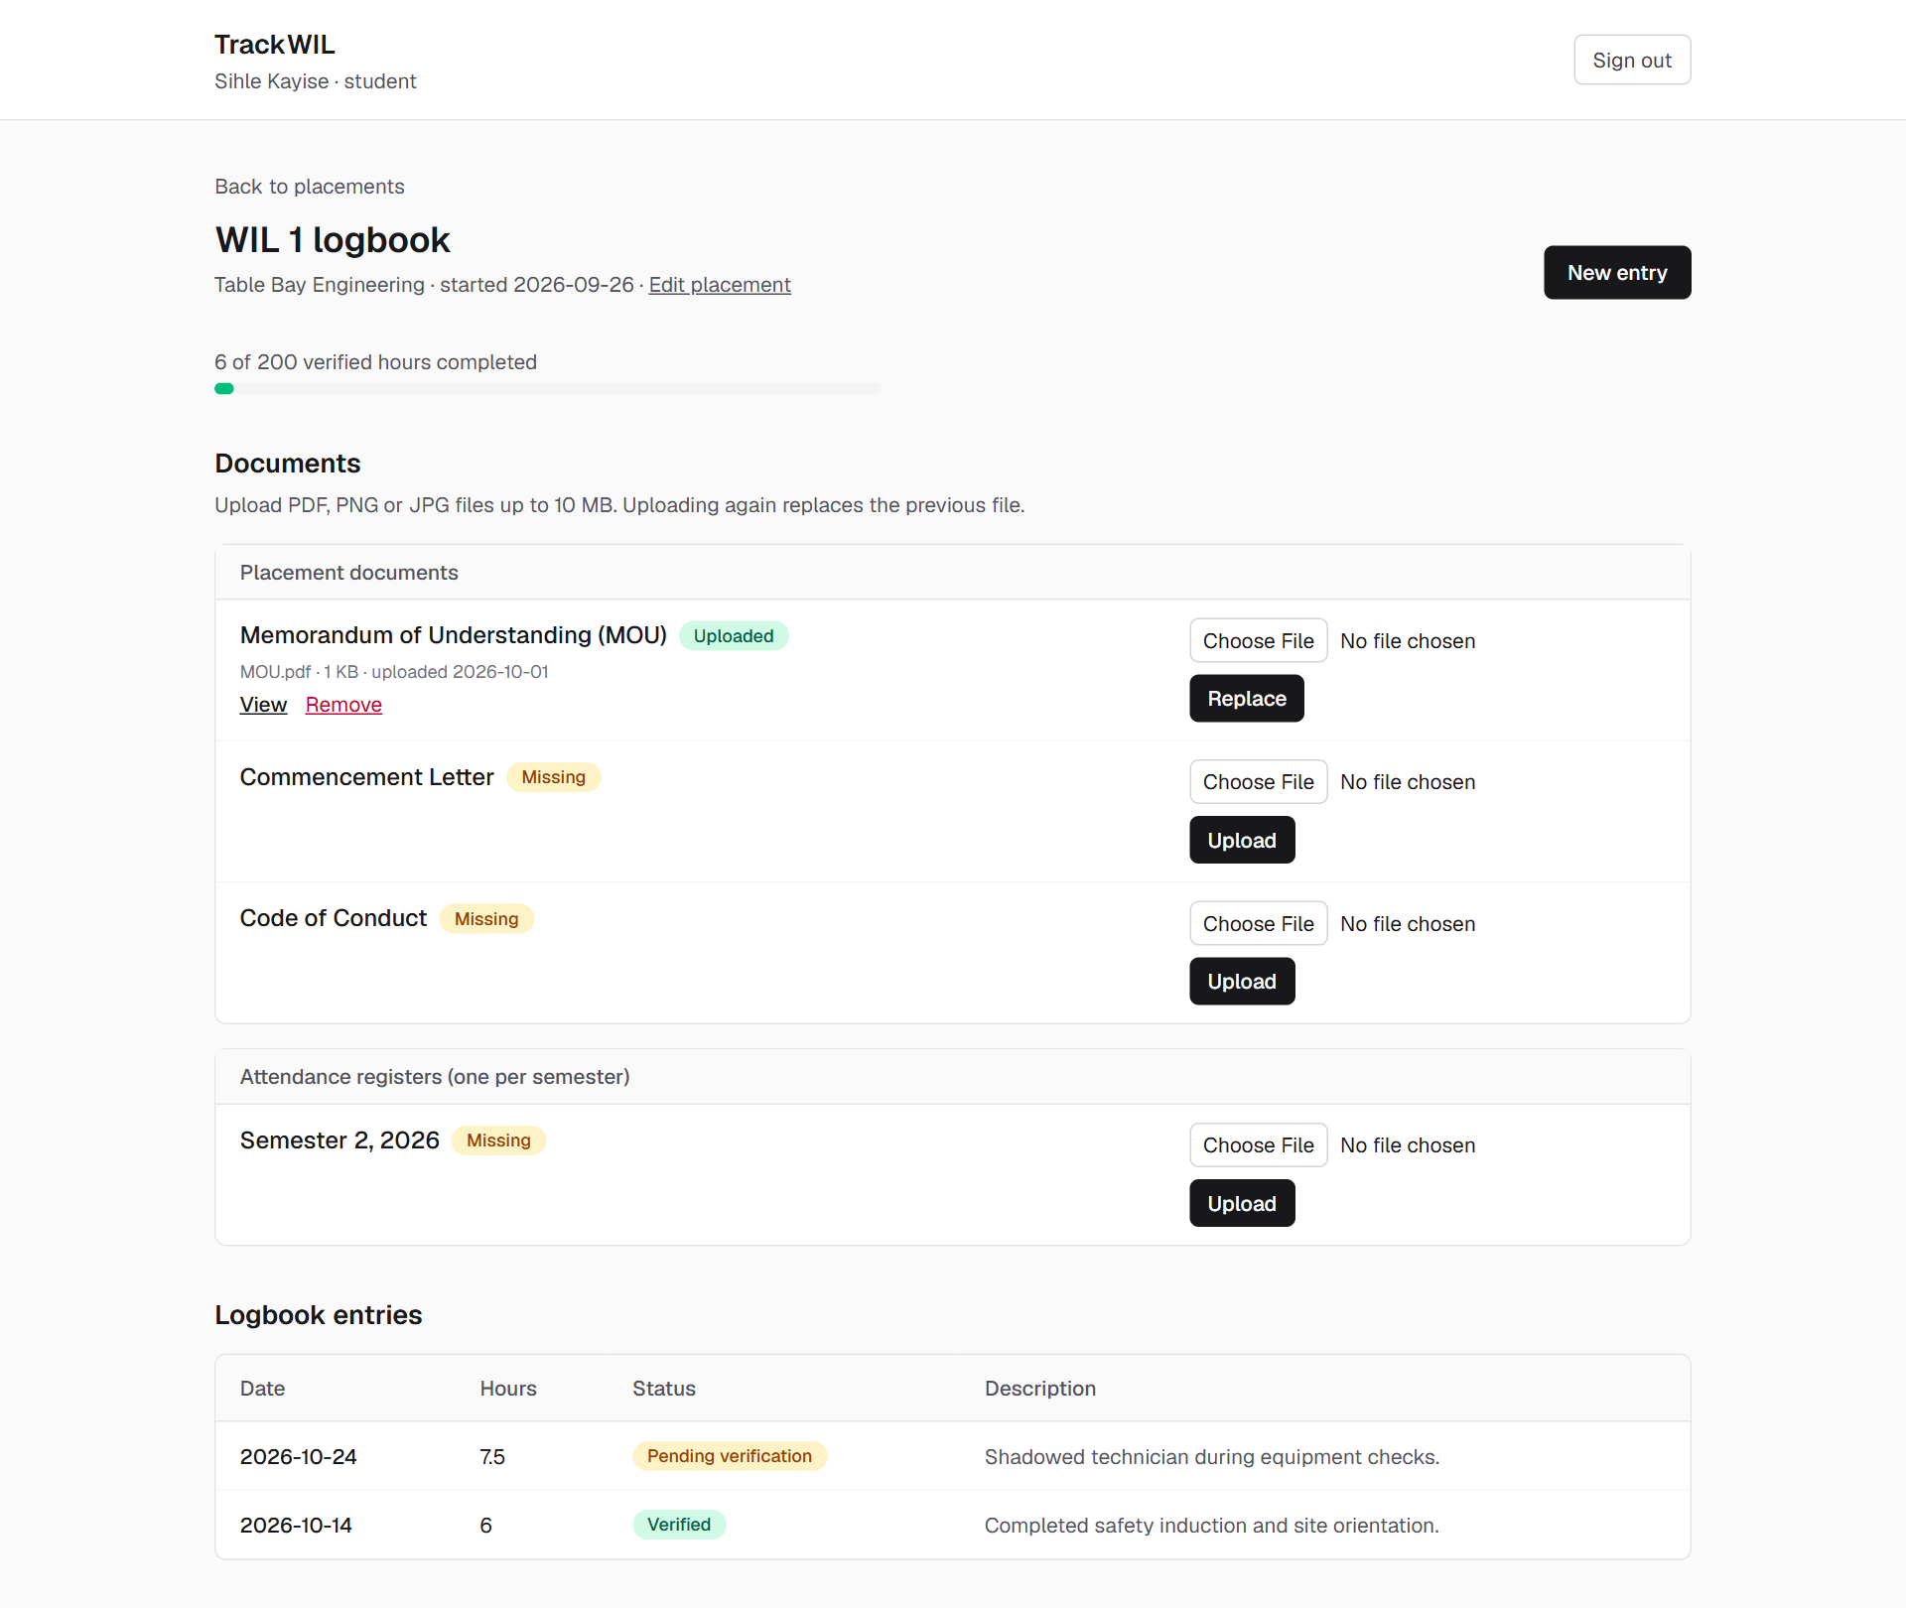
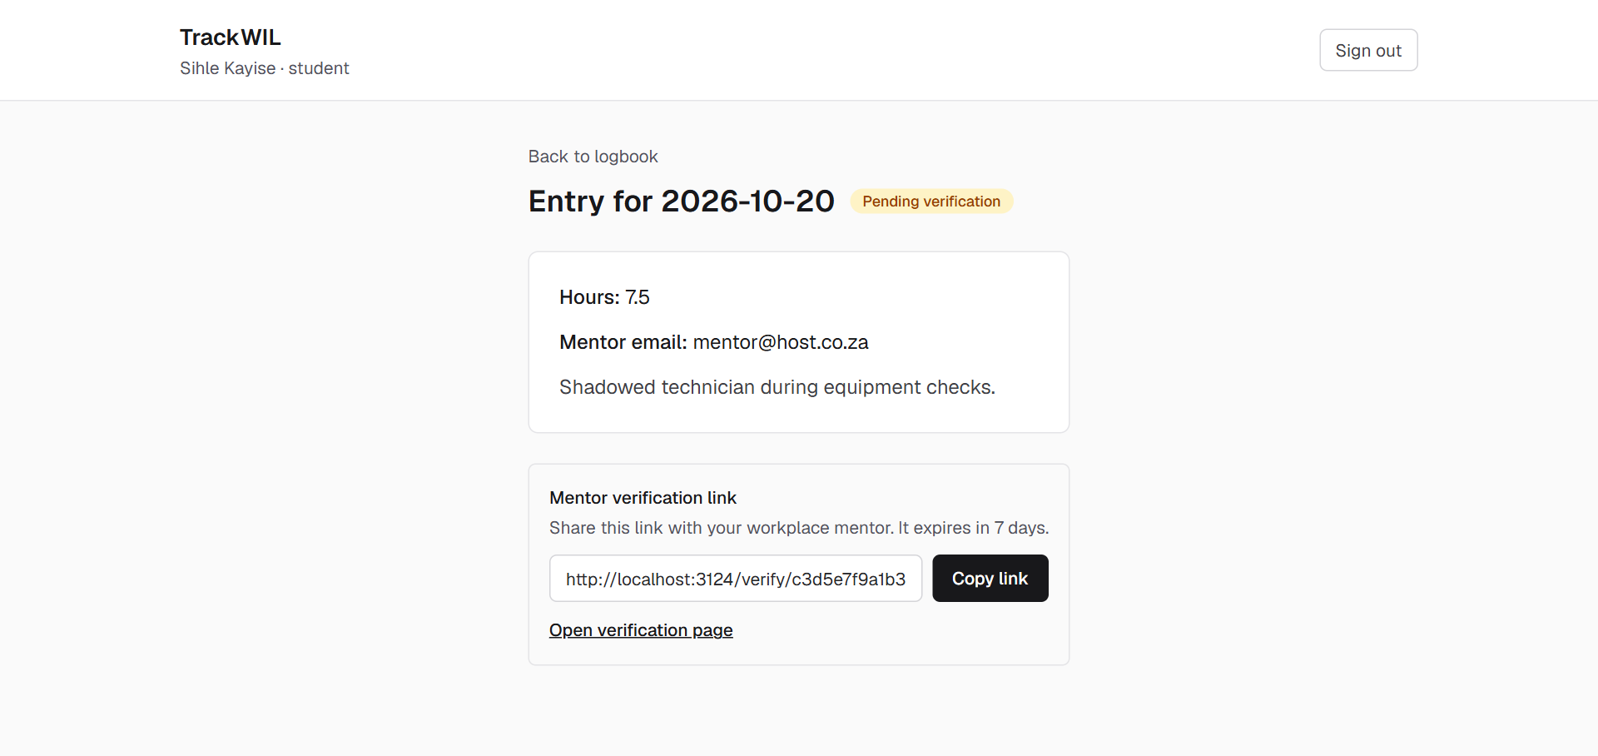
Backup Student logbook and new entry
The student copies the link and sends it to the mentor.
Notes:
Demo backup: Sihle's WIL 1 logbook (6 of 200 hours, documents) and the entry pending verification with its 7-day link.

Slide 14
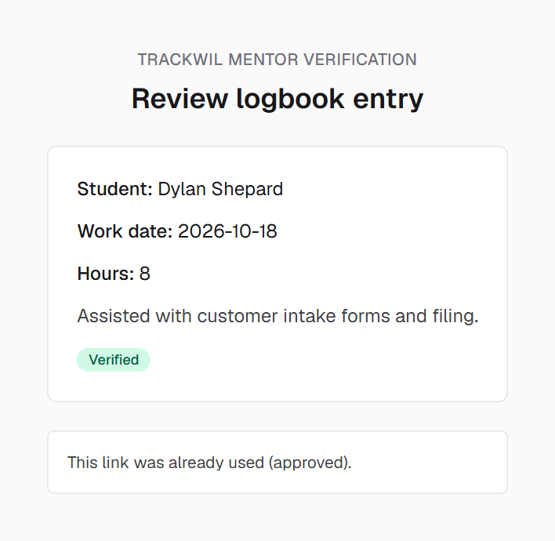
Backup Mentor verification, no account
Second visit: the link was already used, nothing changes.
Notes:
Demo backup: the mentor page from the link, and the message when the link is opened again.

Slide 15
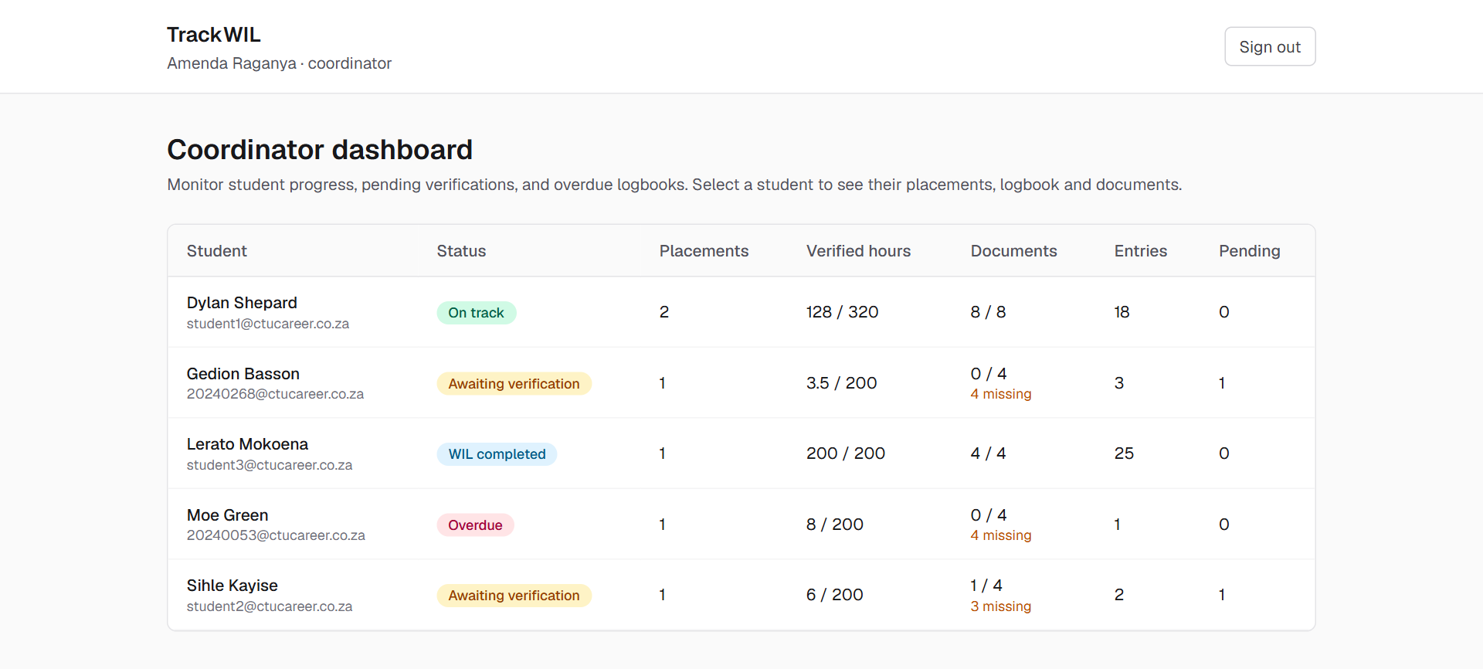
Backup Coordinator and lecturer dashboard
Notes:
Demo backup: dashboard statuses (On track, Awaiting verification, Overdue, WIL completed).

Slide 16
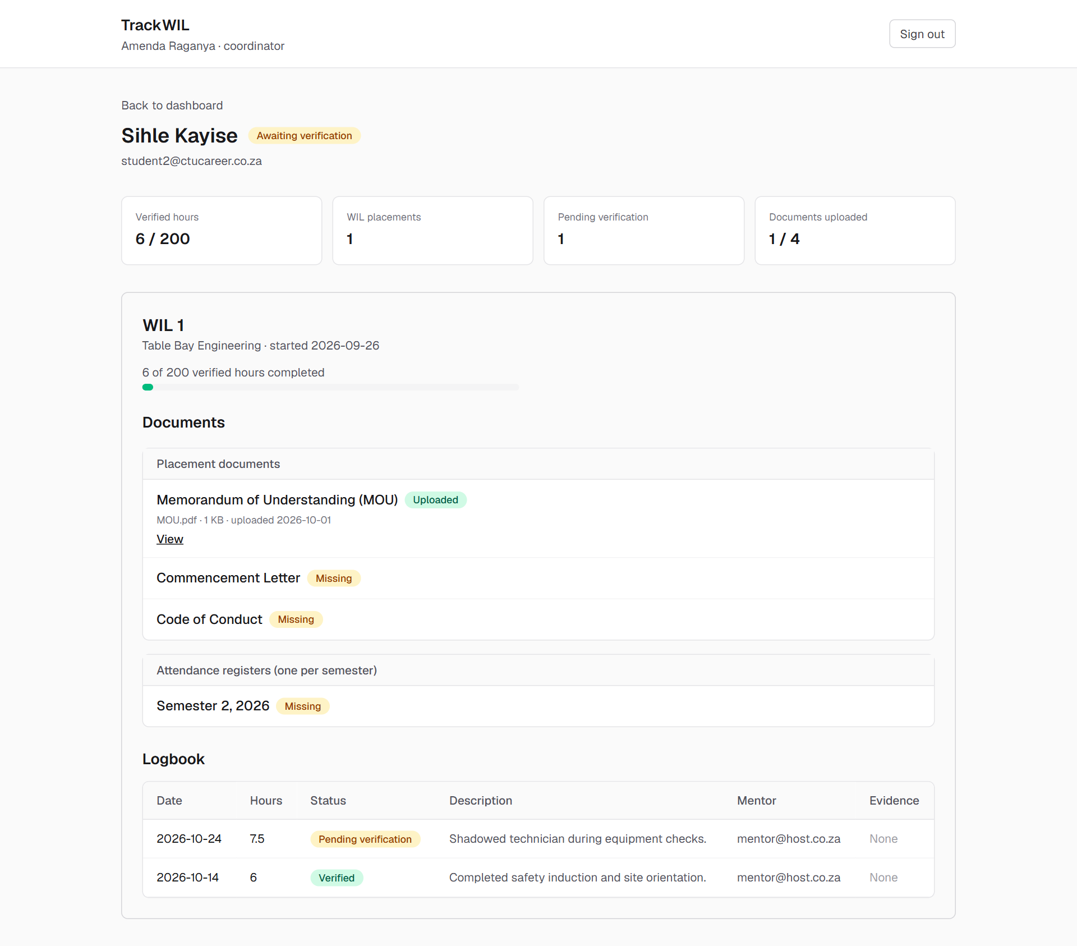
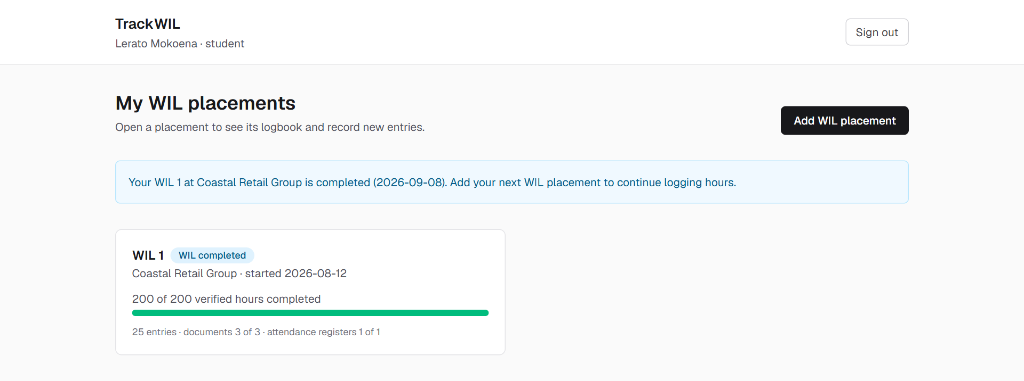
Backup Student profile and WIL completed
At 200 of 200 verified hours the placement is completed and locked.
Notes:
Demo backup: the student profile a coordinator or lecturer opens, and a completed, locked placement.

Slide 17
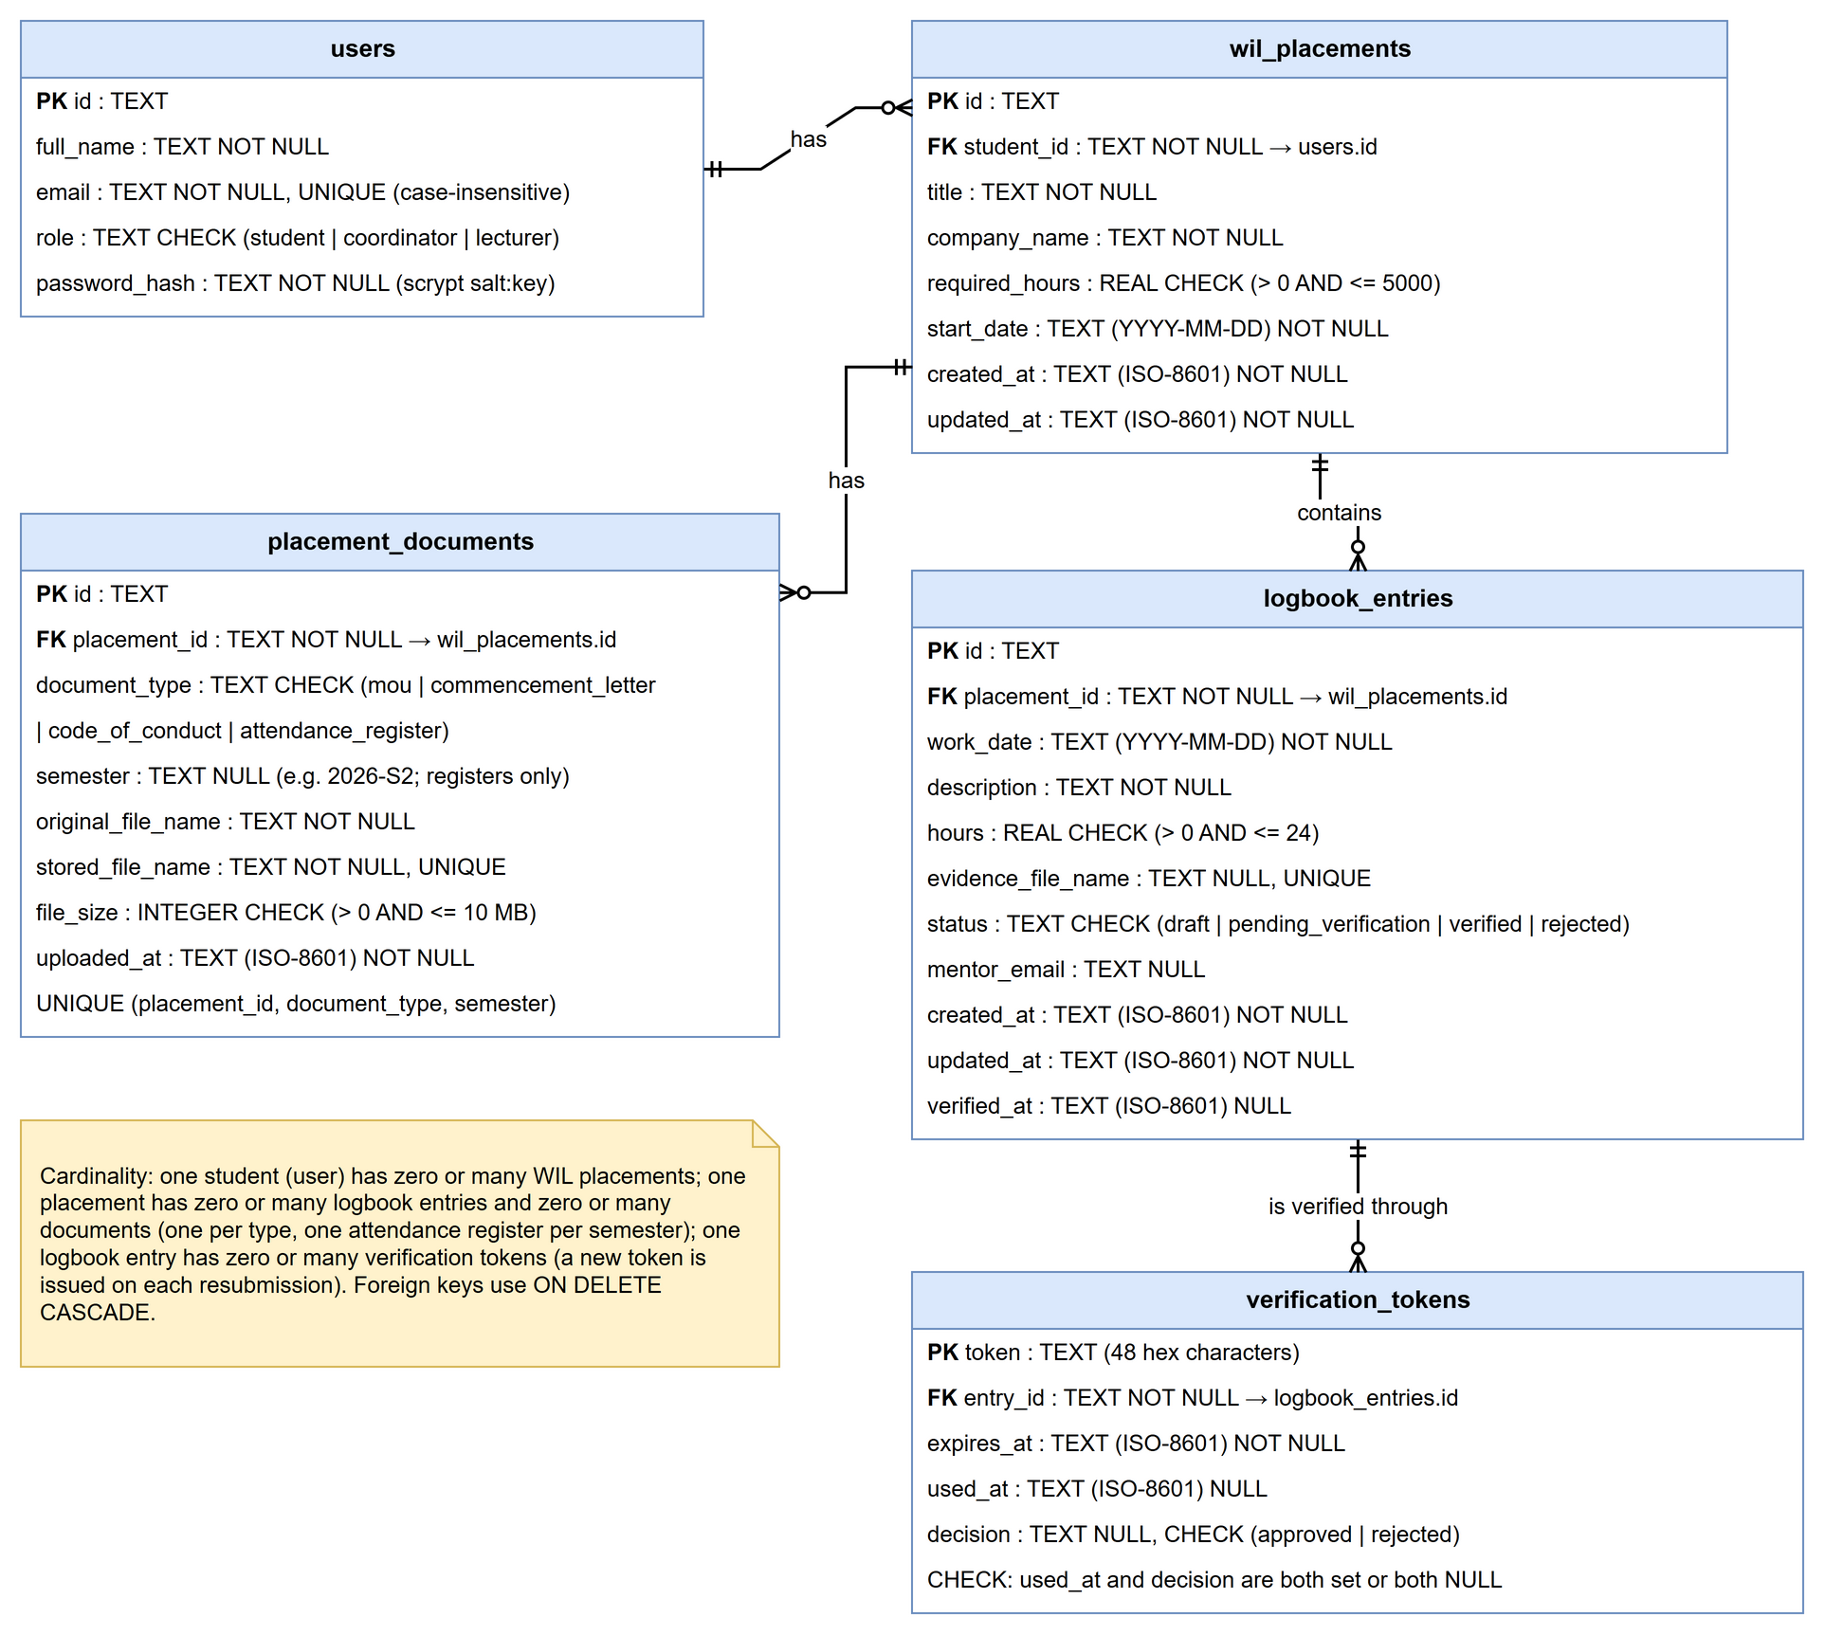
Backup Entity-relationship diagram
Notes:
Five tables: users, wil_placements, logbook_entries, verification_tokens, placement_documents.

Slide 18
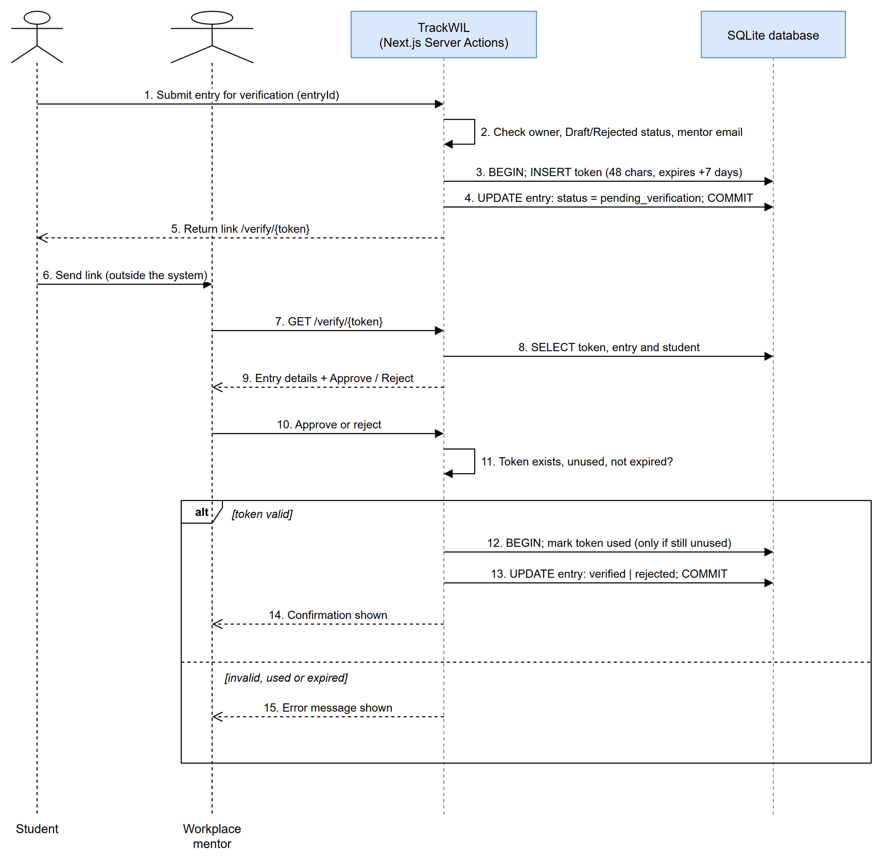
Backup Verification sequence
Notes:
Token created and entry updated in one transaction; on approval the token is marked used only if it is still unused.

