Slide 1


DoCC FINAL ACADEMIC SUBMISSION
Launching a Sustainable Basmati
Rice Brand for MVS
Ashish Satpathy | Janardhan Reddy Bogireddy
SPJIMR · Development of Corporate Citizenship · 2026 · with Manav Vikas Sansthan
Notes:
Good morning. We are Ashish Satpathy and Janardhan Reddy Bogireddy, and this is our final submission for the Development of Corporate Citizenship programme. Our project with Manav Vikas Sansthan was titled "Launching a Sustainable Basmati Rice Brand for MVS". What you see on the screen is Sangat, the brand we proposed, with its tagline Sanjhi Soch, Sunehra Kal. But the brand is where our story ends, not where it begins. Over the next few minutes we want to take you through the journey that led us to it: the people, places and conversations that shaped our thinking.

Slide 2
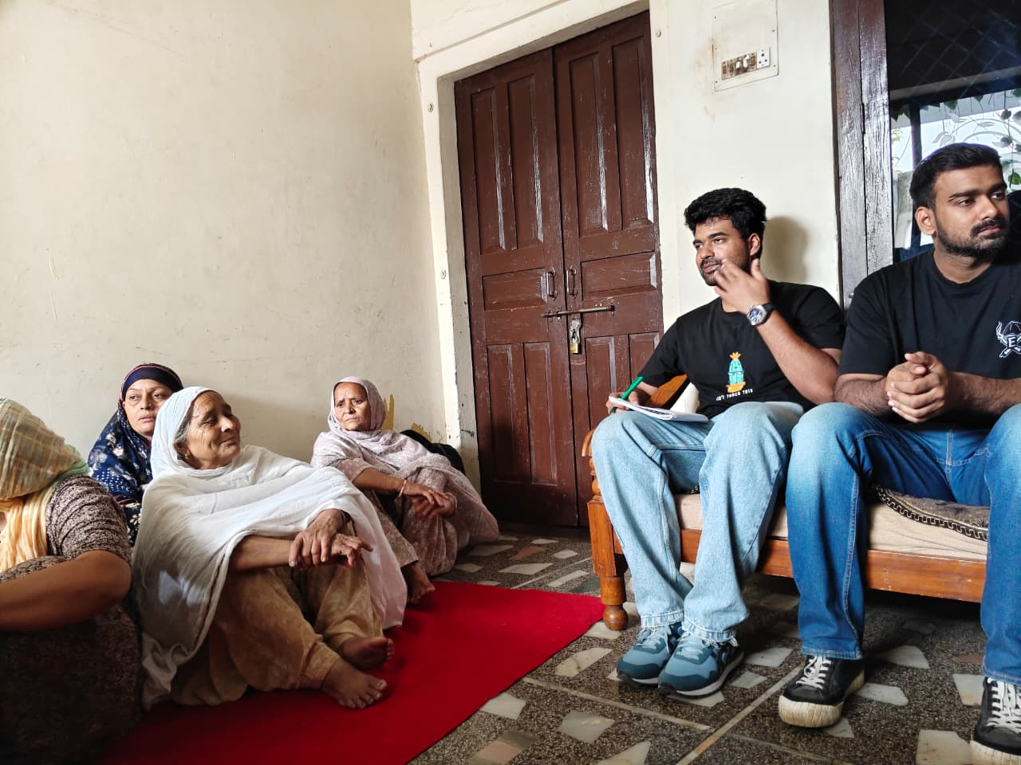
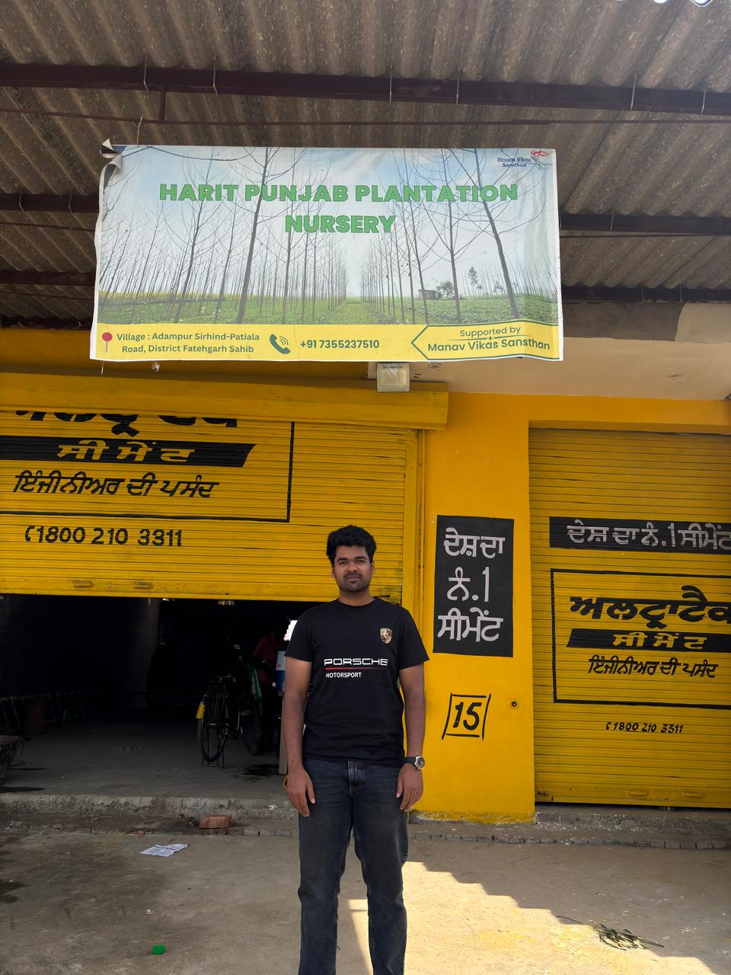
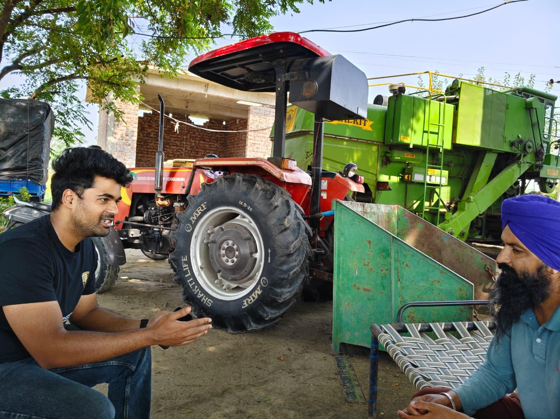
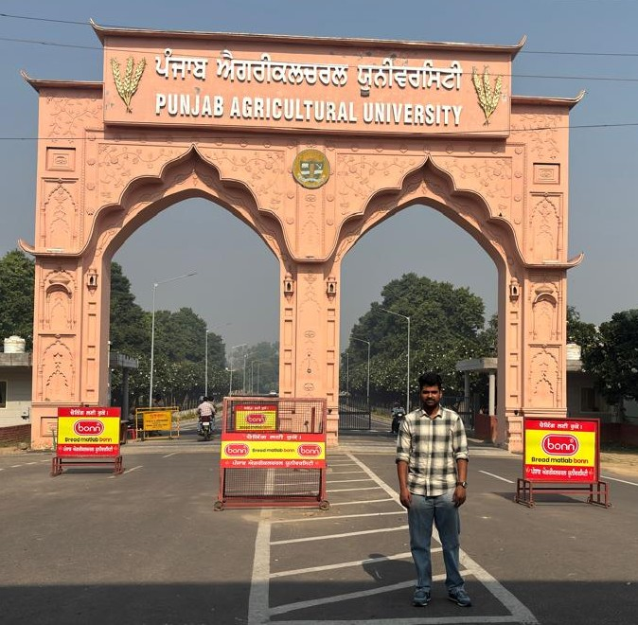
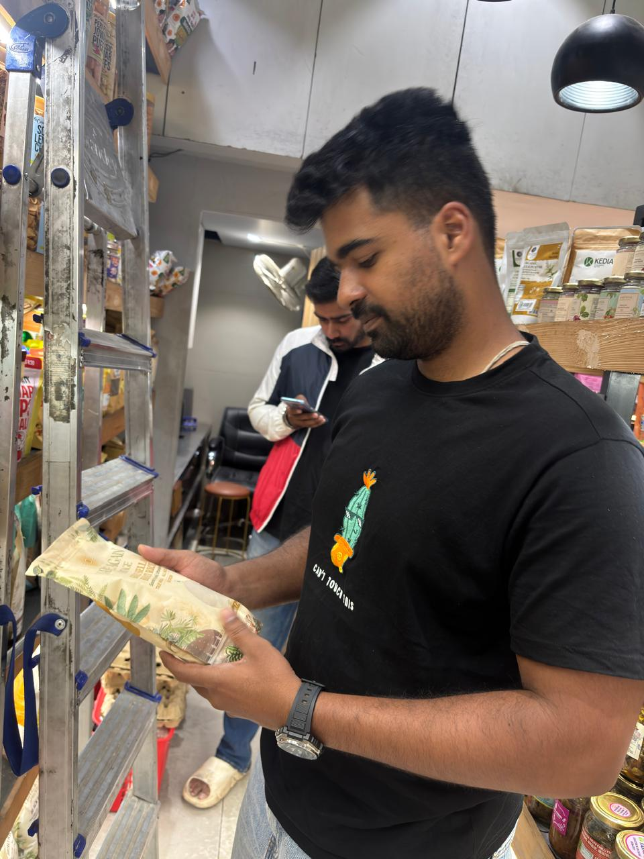
ACT I · THE DoCC JOURNEY
From understanding communities to building
a market-linked opportunity.
ACT I
ACT II · THE GROUND
ACT III · THE MARKET
ACT IV · SANGAT
ACT V · PATHWAY
01
02
03
04
05
06
07
Organisational
immersion
Field
immersion
Institutional
exposure
Problem
discovery
Market
research
Brand
development
Implementation
blueprint
MVS, its programmes
and field teams
Chandpur, Fatehgarh
Sahib, farmers
Punjab Agricultural
University visit
Linking field insight
to a market problem
Stores, shoppers,
retailers and rivals
Name, identity,
packaging, QR story
GTM, operating model
and pilot roadmap
FROM THE FIELD
Village household visit
Poplar nursery, Fatehgarh Sahib
Conversation with a farmer
Punjab Agricultural University
Retail and competitor study
Sangat · DoCC 2026 · SPJIMR × Manav Vikas Sansthan
02 / 22
Notes:
Our internship moved through seven stages, which we have grouped into five acts. We began by understanding MVS as an organisation. We then went into the field, in Chandpur and Fatehgarh Sahib, meeting farmers and community members, and visited Punjab Agricultural University. Those experiences helped us discover the real problem, which we then tested in the market through store visits, consumer and retailer conversations and competitor study. Only after that did we build the brand and, finally, an implementation blueprint. The photographs along the bottom are from those field visits. The order matters: the brand came last, and understanding came first.

Slide 3
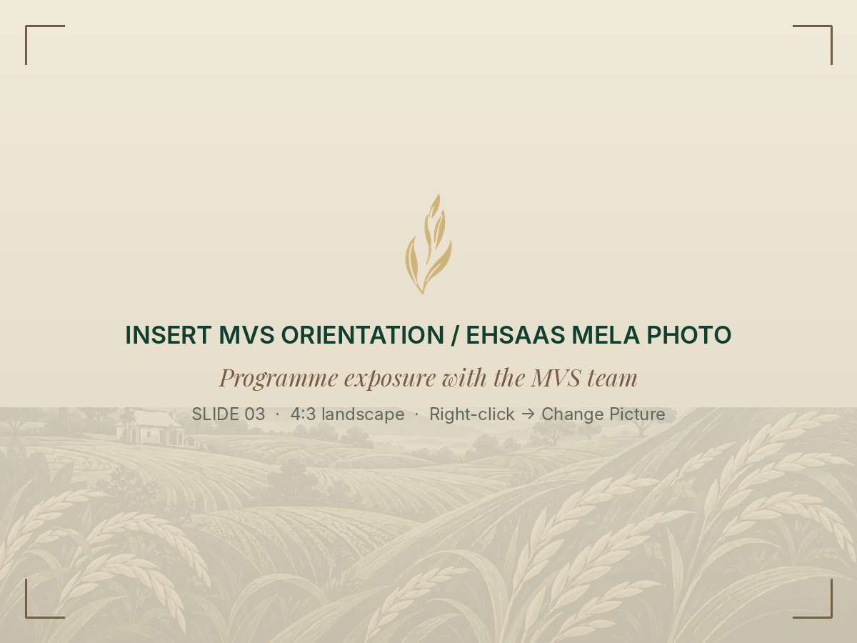
ACT I · ENTERING THE DEVELOPMENT ECOSYSTEM
MVS: an ecosystem,
not just an organisation.
1996
5
Founded as a non-profit
States: Punjab, Himachal Pradesh, Haryana,
Uttarakhand and Meghalaya
WHERE MVS WORKS
Women empowerment · sustainable agriculture · water
conservation · climate resilience · education · rural
development — with farmers, rural households and SHGs.
PRANA and PRERANA
PRERANA strengthens women-led institutions and farm and non-farm
livelihoods; both programme teams facilitated our field interactions.
HOW OUR UNDERSTANDING EVOLVED
Orientation and programme exposure with the
MVS team
An NGO profile
Its programmes
Its people
We learned most from the relationships field teams have built with farmers and women.
Source: MVS project report, §2 and Acknowledgement
03 / 22
Notes:
Act one is about entering the development ecosystem. MVS was founded in 1996 as a non-profit and works across Punjab, Himachal Pradesh, Haryana, Uttarakhand and Meghalaya, on women's empowerment, sustainable agriculture, water conservation, climate resilience, education and rural development. It works with farmers, rural households and self-help groups. Through PRERANA it supports farm and non-farm livelihoods for rural women and strengthens women-led institutions, and the PRANA and PRERANA field and programme teams facilitated our interactions. Our understanding evolved in three steps: from an NGO profile, to its programmes, to its people. The relationships those field teams have built turned out to be the real foundation any brand would need.

Slide 4

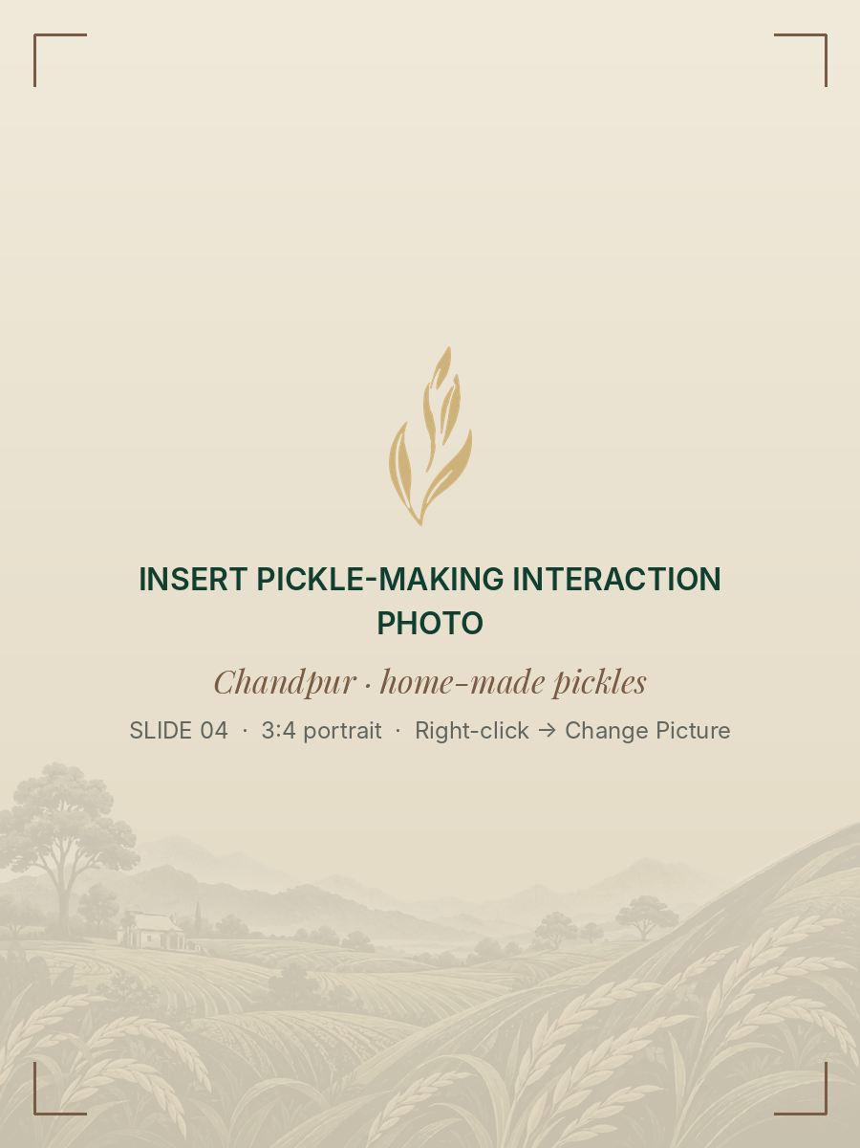
ACT II · LEARNING FROM THE GROUND · CHANDPUR
Chandpur: the skills are there —
market access is the gap.
A beauty-parlour owner
A local service business run from
the village: women’s entrepreneurship
and income generation already at work.
A grandmother and pickle-maker
Highly skilled; her pickles have been
supplied for corporate events. Skill like
this needs steady market access to last.
WHAT CHANDPUR TAUGHT US
Capability is not the constraint — the link between
skills, markets and steady income is.
Field immersion: conversations in a village home, beyond formal meetings
Team field observations, Chandpur
04 / 22
Notes:
Act two is about learning from the ground, and it started in Chandpur. We deliberately looked beyond formal meetings and spent time in village homes and with local entrepreneurs. We met the owner of a local beauty parlour, a service business that showed us women's entrepreneurship and income generation already at work. We also met a grandmother who is highly skilled at pickle-making and whose pickles have been supplied for corporate events. What these encounters taught us is that capability is not the constraint. The gap lies in the link between skills, access to markets and steady income. That idea comes back later in the deck.

Slide 5
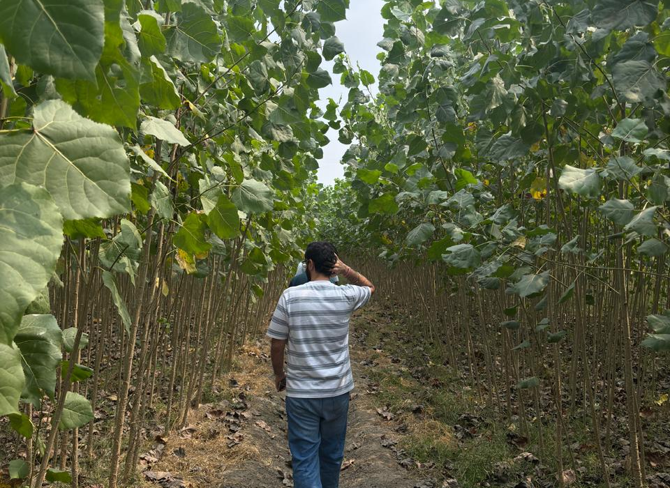
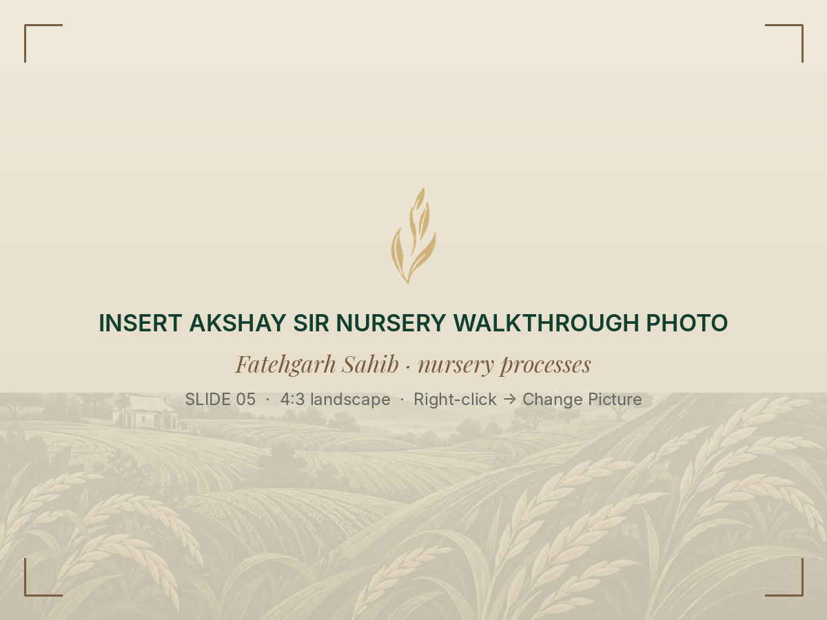
ACT II · FATEHGARH SAHIB
Fatehgarh Sahib:
entering the
agricultural
ecosystem.
At the Harit Punjab Plantation Nursery,
Akshay Sir walked us through nursery
processes, the initiatives under way, the
stakeholders involved and their outcomes.
Walking the poplar plantation rows
FIRST EXPOSURE TO
01
Nursery processes, saplings and inputs
02
Farming practices on the ground
03
MVS’s role alongside farmers
Long before a grain is sold, many hands
and decisions have already shaped it.
Harit Punjab Plantation Nursery
Nursery walkthrough with Akshay Sir
Team field visit, Fatehgarh Sahib
05 / 22
Notes:
In Fatehgarh Sahib we entered the agricultural ecosystem itself. At the Harit Punjab Plantation Nursery, Akshay Sir walked us through nursery processes, the initiatives under way, the stakeholders involved and the outcomes they track. We walked through the poplar plantation rows and had our first real exposure to farming practices, inputs and MVS's role alongside farmers. The lesson for us was simple: long before a single grain reaches a shop, many hands and many decisions have already shaped it.

Slide 6
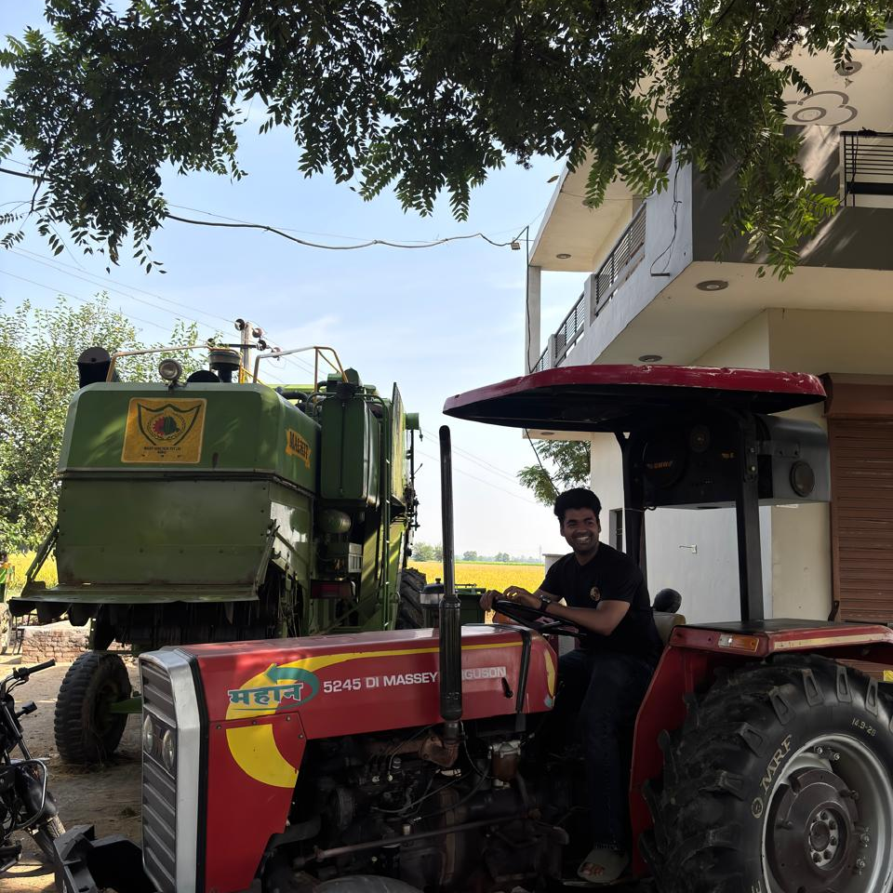
ACT II · THE FARMER’S PERSPECTIVE
Gurdeep Singh:
farming as an
enterprise.
~15
~5
acres of basmati, on owned
and leased land
years working with MVS
₹60 lakh
Leases
invested in agricultural
machinery
machinery to other
farmers in the area
WHAT WE TOOK AWAY
Has progressively adopted sustainable
farming practices over his years
of working with MVS.
Sustainable adoption sits
inside a business: land,
machinery, investment, risk.
Approximate, farmer-reported figures shared during
field discussions; not independently verified.
Discussion with a basmati farmer · farm machinery
Field discussion, Punjab
06 / 22
Notes:
This is where the work became personal. We spent time with Gurdeep Singh, a basmati farmer who has worked with MVS for around five years. He told us he cultivates roughly fifteen acres of basmati on owned and leased land, has invested around sixty lakh rupees in agricultural machinery, and leases that machinery to other farmers. Over his years with MVS he has progressively adopted sustainable practices. These are figures he shared with us in conversation, not audited numbers. What we took away is that sustainable adoption sits inside a business, with land, machinery, investment and risk all in play.

Slide 7
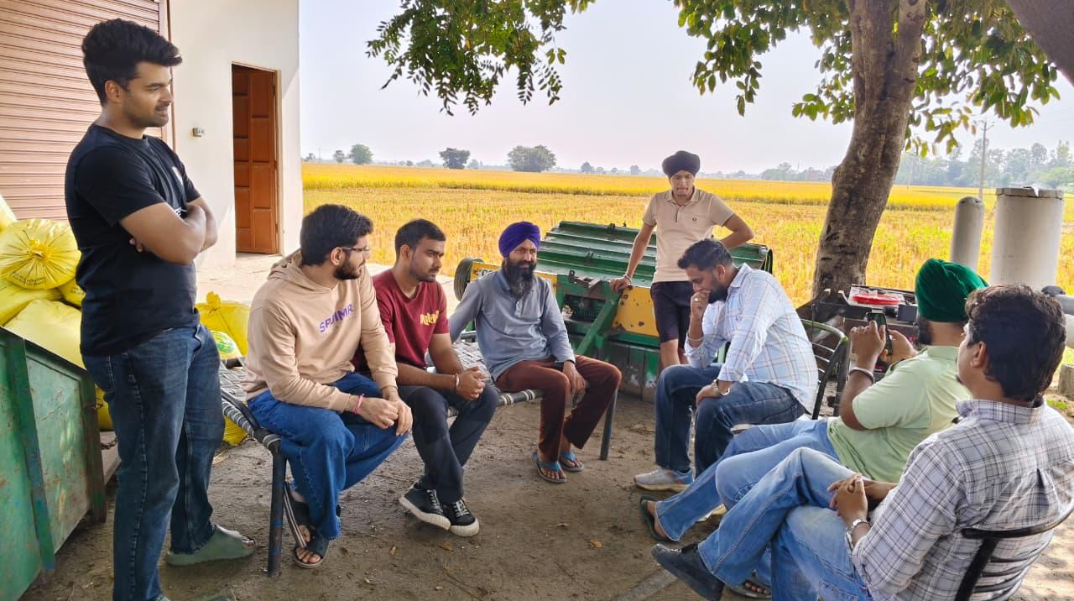
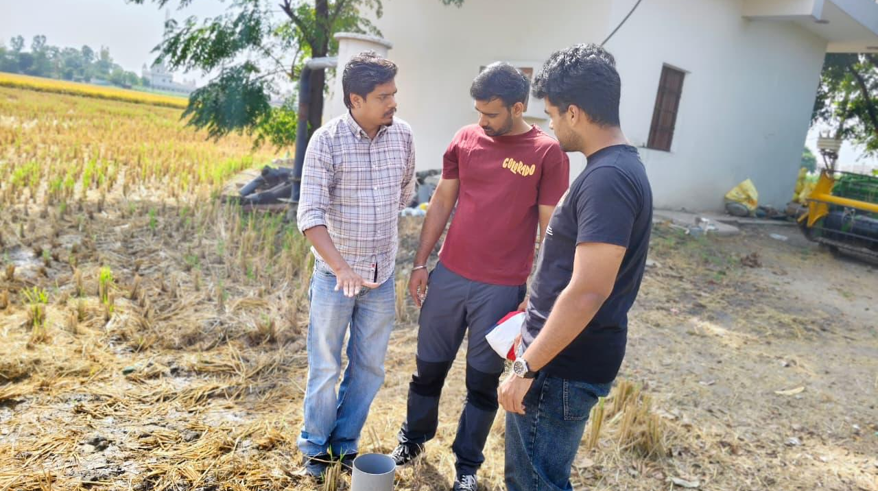
ACT II · THE ECONOMICS BEHIND CULTIVATION
Sustainable practice has to pay for the farmer.
WHAT FARMERS WEIGH
MVS DATA · SRP vs NON-SRP, PER ACRE
Basmati or Parmal
SRP practice
Non-SRP
Which paddy to grow, and its yield
Irrigations
−15.1%
Input and lease costs
14.6
17.2
Cost of cultivating, and of leased land
Pesticide use
Cost of cultivation
−7.5%
Group discussion with basmati farmers
How much is applied, and at what cost
₹14,477
₹15,653
Price uncertainty
Fertiliser cost
−23.6%
No MSP for basmati; market-led price
₹2,545
₹3,331
Arthiyas
Dependence on commission agents
Net return
+9.7%
Risk of changing practice
₹60,130
₹54,807
Whether a new method pays off
Source: MVS SRP vs non-SRP comparison. Season, location and
number of farms not stated — read as directional.
Understanding sustainable cultivation practices
Practices must be environmentally responsible and economically viable.
Themes from farmer discussions are qualitative; MVS figures are per acre
07 / 22
Notes:
So what do farmers actually weigh? In our group discussions, the themes that came up were the choice between basmati and Parmal and their yields, input and lease costs, pesticide use, price uncertainty because basmati has no minimum support price, dependence on arthiyas, and the risk of changing practice. On the right is a comparison MVS shared with us of SRP and non-SRP practice per acre. It shows fewer irrigations, lower cultivation and fertiliser costs, and a net return about nine to ten percent higher. The document does not state the season, location or number of farms, so we read it as directional. The central insight is that sustainable practice has to be environmentally responsible and also economically viable for the farmer.

Slide 8
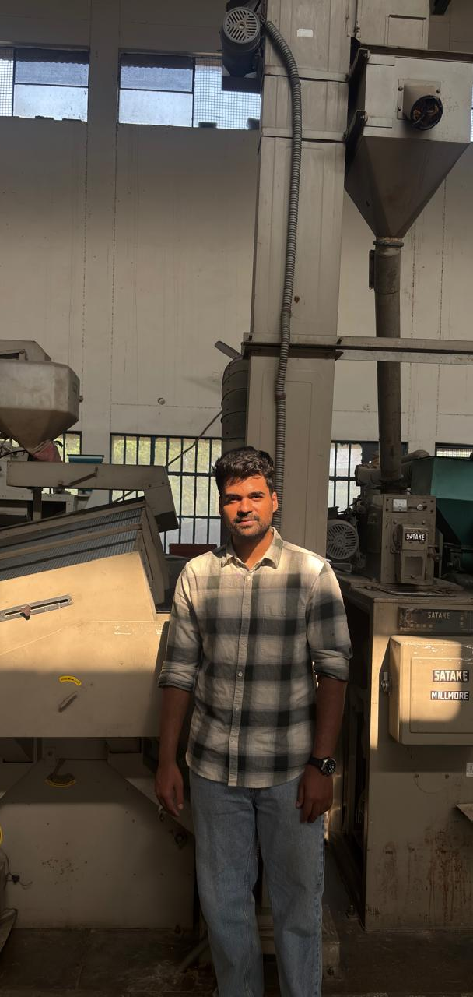
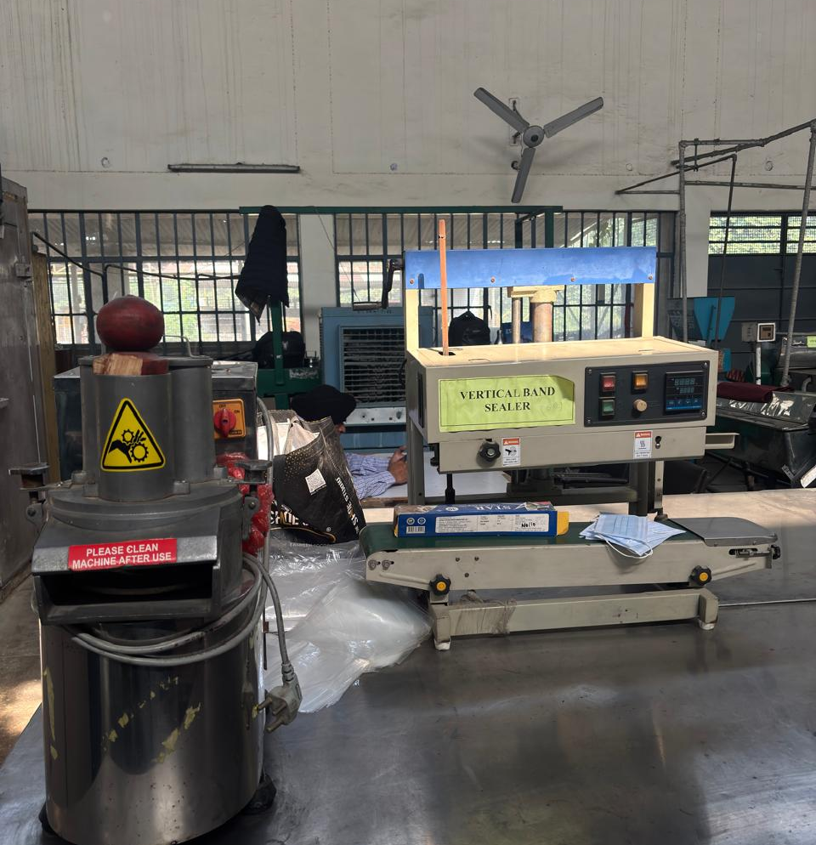
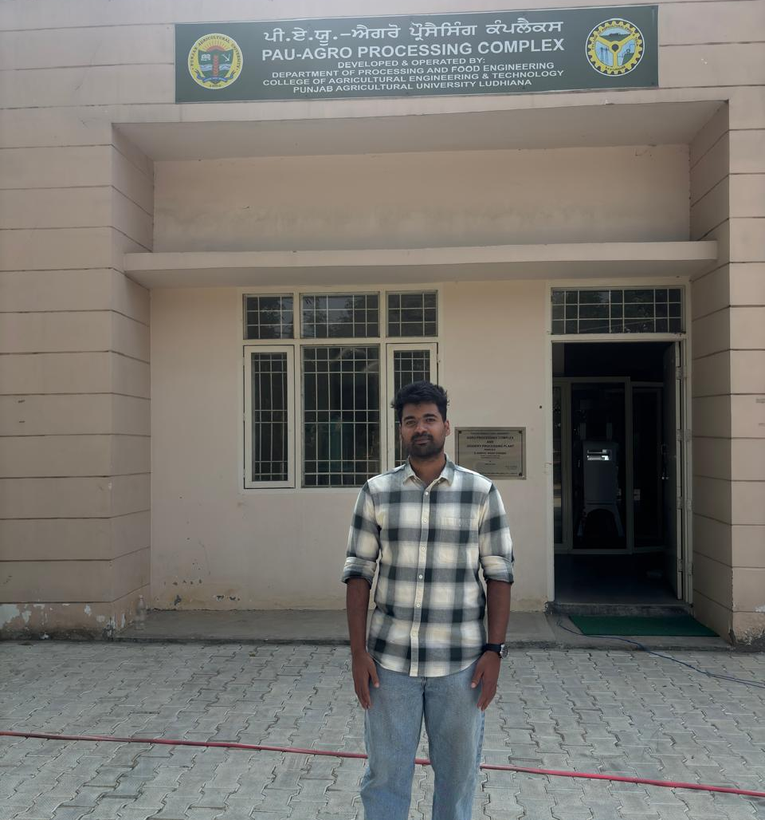
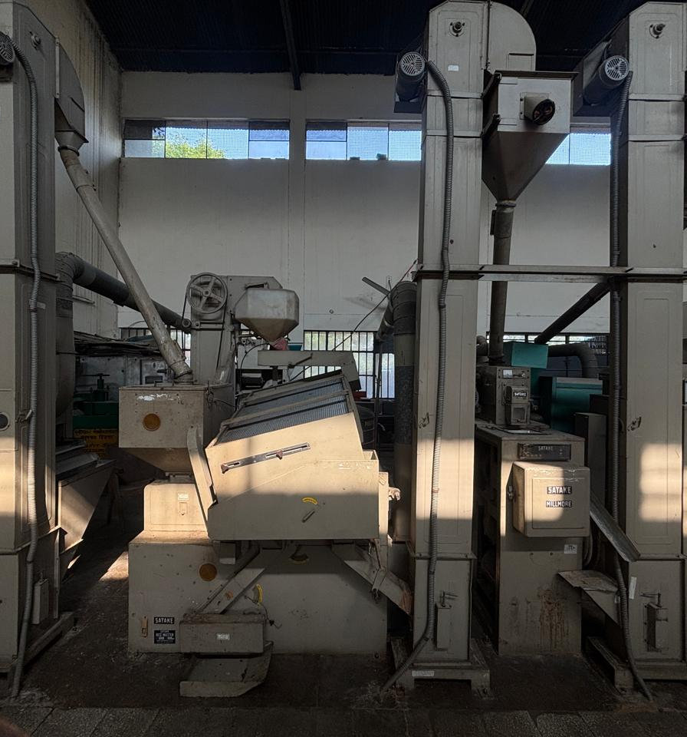
ACT II · INSTITUTIONAL EXPOSURE
Punjab Agricultural
University: where
research meets
the field.
PAU campus, Ludhiana
Rice packaging
Facilitated by the MVS project coordinator,
the visit showed us MVS-related projects,
agricultural equipment and operations —
rice milling, processing and packing.
WHY IT MATTERED FOR SANGAT
Milling, grading and packing are the
steps a consistent branded rice relies on.
Agro-processing complex
Rice milling equipment
Milling line
HOW THE PIECES CONNECT · OUR READING
Agricultural research
Institutional support
Field-level adoption
Farmer livelihoods
Knowledge and technology
Infrastructure, equipment, guidance
What farmers can actually use
Income and resilience
Team visit to Punjab Agricultural University, facilitated by MVS
08 / 22
Notes:
The visit to Punjab Agricultural University gave us the institutional layer. It was facilitated by the MVS project coordinator, and we were exposed to MVS-related projects, agricultural equipment and operations, including rice milling equipment, a milling line, packaging machinery and the agro-processing complex. Our reading of how the pieces connect runs from agricultural research to institutional support, then field-level adoption and finally farmer livelihoods. For Sangat this mattered directly, because milling, grading and packing are exactly the steps a consistent branded rice depends on.

Slide 9
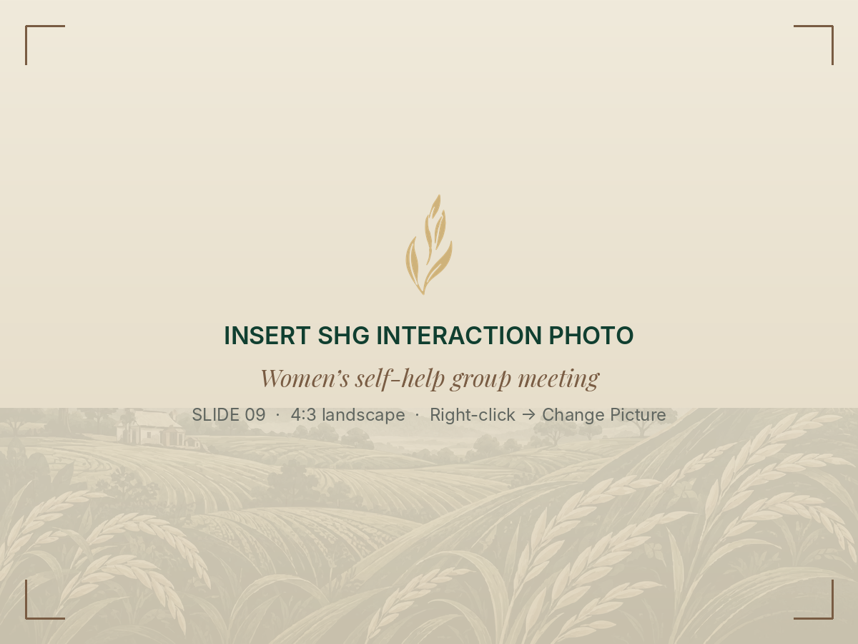

ACT II · COMMUNITY LIVELIHOODS AND WOMEN’S PARTICIPATION
Women’s livelihoods: from skills
to sustained income.
WHAT OUR INTERACTIONS SHOWED
01
Entrepreneurial skills already exist
Service and food-making skills are already earning, as in Chandpur.
02
Income generation is the hard part
Turning a skill into regular earnings remains a challenge.
03
Access to markets
Reach to buyers shapes what a skill can earn.
SHG interaction
Women’s livelihoods
04
Collective institutions
SHGs and women-led groups give individual effort scale.
THE LEARNING
THE CONVERSION PATH · OUR READING
Skill development alone may not be
enough without market access and
economic opportunity.
Skills
SHGs
Markets
Livelihood
Individual capability
Collective institution
Market linkage
Sustained income
Team interactions with SHG members and women in the communities
09 / 22
Notes:
Our interactions with self-help group members and women in the communities reinforced what we first saw in Chandpur. Entrepreneurial skills already exist, but turning them into regular income is the hard part. Access to markets shapes what a skill can earn, and collective institutions like SHGs give individual effort scale. Our reading of the path is from skills, through collective institutions and market linkage, to a sustained livelihood. The learning we carried forward is that skill development alone may not be enough without market access and economic opportunity.

Slide 10
ACT III · DISCOVERING THE MARKET OPPORTUNITY
An existing farmer ecosystem.
An opportunity to build a consumer-facing proposition.
WHAT THE FIELD SHOWED
THREE REQUIREMENTS
Agricultural sustainability
THE PROBLEM WE WORKED ON
Product reliability
Nursery, farms, PAU
How can MVS translate its
engagement with farmers and
sustainable cultivation into a
credible premium basmati
brand — with product,
sourcing story, operating
model and proposition aligned?
Can the same quality be supplied
across batches?
Farmer economics
Farmer discussions
Supply-chain coordination
Evidence and communication
Milling and packing at PAU
Can the cultivation story be backed by
farm, season and sourcing records?
Consumer trust
Store and consumer visits
Product consistency
Operating viability
The premium buyer’s first test
Can supply, processing, packing and
selling costs support the price?
Market access
Problem statement, MVS project report §1.2
Chandpur and SHG interactions
A brand can make MVS’s farming work visible — but only if product, evidence and operations align.
Synthesis of field immersion; problem and requirements from MVS project report §1.2 and §5.2
10 / 22
Notes:
This brings us to act three. When we put the field insights side by side, covering sustainability, farmer economics, supply-chain coordination, consumer trust, product consistency and market access, the original brief became much clearer. The question became how MVS could translate its engagement with farmers and sustainable cultivation into a credible premium basmati brand, with the product, the sourcing story, the operating model and the proposition all aligned. That breaks down into three requirements: product reliability, evidence for every claim, and operating viability. A brand can make MVS's farming work visible, but only if all three hold.

Slide 11
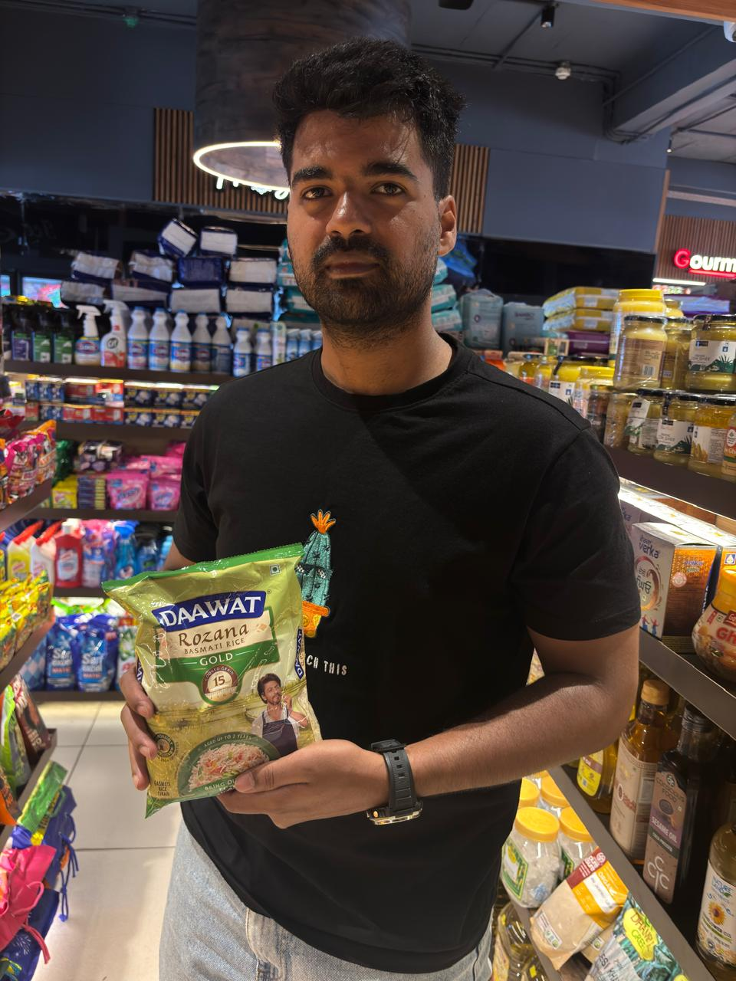
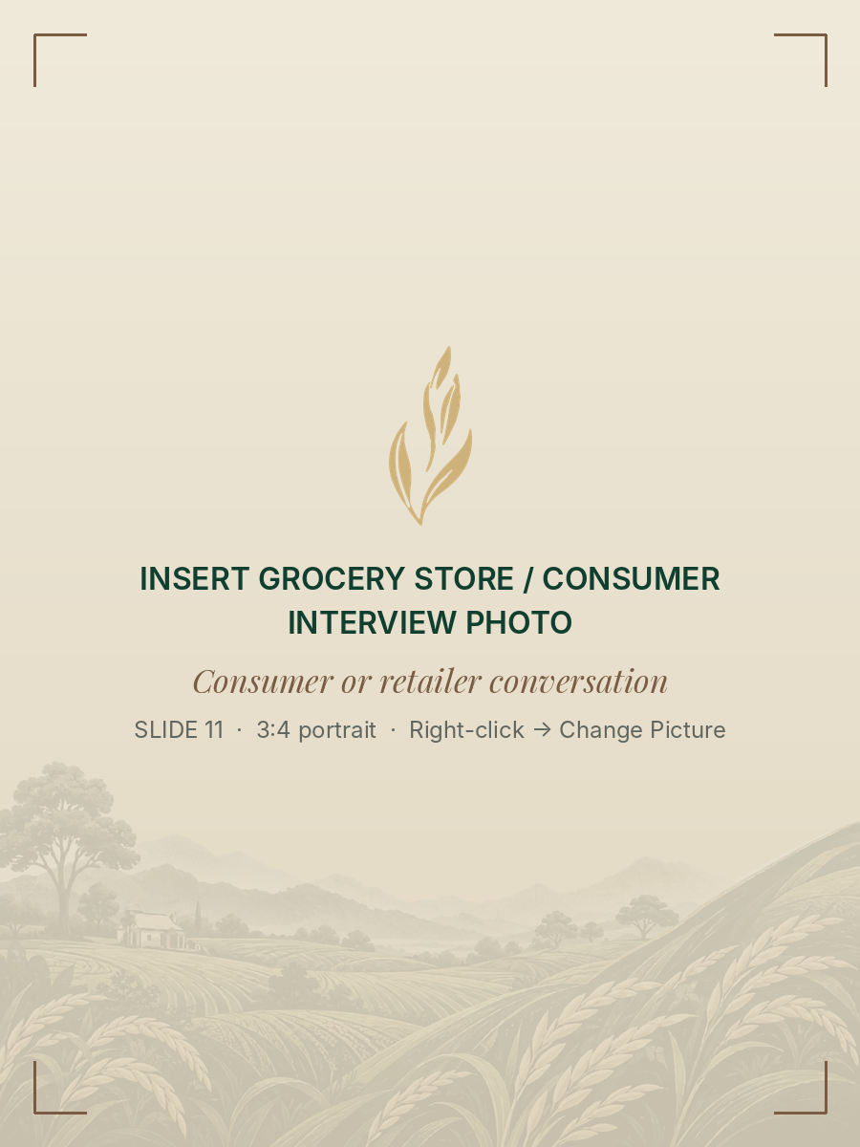
ACT III · UNDERSTANDING THE CONSUMER
Buyers choose the cooking outcome first —
the story comes second.
THE SWITCHING PROBLEM
A household that already buys premium basmati
knows how its rice will cook. A new brand is a small
but real risk when guests are coming or a family
meal depends on it. Product confidence is the barrier.
WHAT BUYERS JUDGE FIRST
Aroma
Grain length and quality
Texture after cooking
Shelf and pack study
Premium retail models
Consumer conversations
Cooking consistency
Price
Trust in the brand
WHAT WE DID
Grocery and premium-store visits; a study of competitor
products, packs and premium positioning; conversations
with consumers and retailers on how they buy basmati and
how they see sustainably grown food.
IMPLICATION FOR SANGAT
Meet the category’s quality cues first —
then invite buyers to learn how the
rice is grown.
Exploratory market research; MVS project report §6
11 / 22
Notes:
We then went to the market: grocery and premium stores, competitor packs and positioning, and conversations with consumers and retailers. The most important thing we learned is the switching problem. A household that already buys premium basmati knows how its rice will cook, and trying a new brand is a real risk when guests are coming. Buyers judge aroma, grain, texture, cooking consistency, price and trust first. So Sangat must meet those quality cues first, and then invite people to learn how the rice is grown. The story supports the product; it cannot replace it.

Slide 12
ACT III · SEGMENTATION, TARGETING AND POSITIONING
Start with buyers who already pay
for premium basmati.
SEGMENT
MAIN NEED
ROLE FOR SANGAT
PILOT GEOGRAPHY
Informed Providers
Reliable aroma and texture with
credible cultivation information
Primary target hypothesis;
cooks at home, asks about origin
Chandigarh
Assured Regulars
Consistent results across repeated
home meals
Core premium pool; hard to win
from trusted incumbents
Mohali
Panchkula
Gathering Hosts
Confidence for biryani, pulao,
festivals and guests
Secondary, occasion-led
trial segment
Chosen for feasibility: the team had local
access and could learn closely. Not a claim
that these cities hold the largest demand.
Organic Purists
A product meeting an explicit
organic specification
Not targeted unless the product
meets that specification
Next: Delhi NCR, once quality, repeat
purchase and service feasibility are shown.
Everyday Value
Lowest acceptable cost per kg
Not targeted at premium launch
Buyers
PROPOSED POSITIONING · CONDITIONAL ON A WRITTEN SPEC AND COOKING TESTS
For households that already buy premium basmati and care how their food is grown, Sangat is the premium basmati from farming
communities, developed with MVS, that delivers dependable aroma, grain and cooking results — and lets you see how the rice was grown.
MVS project report §7; segments are behavioural hypotheses, not sized markets
12 / 22
Notes:
We segmented households by behaviour and the benefits they seek. Our primary target hypothesis is Informed Providers: people who already buy premium basmati, cook it at home and ask about origin once they are satisfied on quality. Gathering Hosts, who buy for biryani, pulao and guests, are a secondary, occasion-led segment. We do not target Organic Purists or Everyday Value Buyers at launch. We propose piloting in Chandigarh, Mohali and Panchkula because we had local access there, not because those cities have the largest demand, with Delhi NCR to follow once quality and repeat purchase are shown. The positioning stays conditional until a written specification and cooking tests are in place.

Slide 13

ACT IV · BUILDING SANGAT
Sangat: a name rooted in togetherness.
NAME PREFERENCE · n = 20 (12 CONSUMERS, 8 RETAILERS)
Sangat
12 · 60%
Mehak
4 · 20%
Sanjha
3 · 15%
Sajora
1 · 5%
Sangat led with consumers (7 of 12) and retailers (5 of 8).
TAGLINE PREFERENCE · n = 20
THE IDEA
Sanjhi Soch, Sunehra Kal
Sangat — company, togetherness:
farmers, MVS and households, connected
through the food they grow and cook.
13 · 65%
Punjab Se, Bharose Ke Saath
4 · 20%
Achhi Fasal, Behtar Kal
Sanjhi Soch, Sunehra Kal — shared thinking
for a brighter tomorrow.
3 · 15%
Exploratory: a small sample without recruitment details. It supports the
working name and tagline; it does not establish purchase intent or
willingness to pay.
Uses the broad meaning of togetherness; no religious iconography.
Naming and tagline research, MVS project report §8.3–8.5; cultural note §9.3
13 / 22
Notes:
Act four is building Sangat. Sangat means company or togetherness, connecting farmers, MVS and households through the food they grow and cook. We screened twelve names and tested four with twenty respondents, twelve consumers and eight retailers. Sangat was preferred by twelve, or sixty percent, and led in both groups. For the tagline, Sanjhi Soch, Sunehra Kal, meaning shared thinking for a brighter tomorrow, was chosen by thirteen of twenty. This was exploratory. It supports the working name, but it does not establish purchase intent or willingness to pay. Because Sangat also has religious associations in Punjab, the identity uses the broad meaning of togetherness and avoids religious iconography.

Slide 14
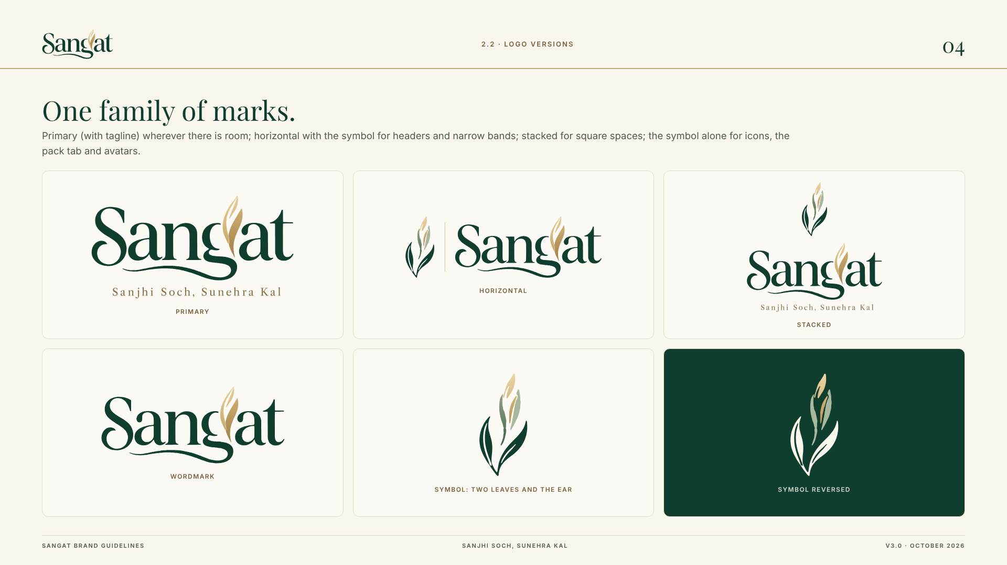

ACT IV · VISUAL IDENTITY
One identity system:
forest, ivory and a
golden ear of rice.
A customised Playfair-style wordmark with a
golden rice-ear motif and a sweeping underline,
in primary, horizontal, stacked, wordmark and
symbol-only versions.
BRAND VALUES
Togetherness
COLOUR
Farmers, MVS and households
Care
Respect people and resources; no pity stories
Forest Green #0F3D2E
Ivory #F9F6EE
Sunehra Gold #C9A96B
Earth Brown #8B6F47
Craft and consistency
TYPOGRAPHY
Specification, cooking, pack quality
Aa
Playfair Display
Aa
Inter
Honesty
Expressive brand moments
Information and utility
Say only what records support
Forest anchors, ivory breathes, gold is a restrained accent.
MVS project report §8.6, §9; Sangat brand guidelines
14 / 22
Notes:
The identity is one system. The wordmark is a customised Playfair-style design with a golden rice-ear motif and a sweeping underline, and it comes in primary, horizontal, stacked, wordmark and symbol versions. Forest green anchors the system, ivory gives it space, and gold is used sparingly as an accent. Playfair Display carries expressive brand moments and Inter carries information. Underneath sit four values: togetherness, care, craft and consistency, and honesty, which means saying only what records can support.

Slide 15



ACT IV · PACKAGING DESIGN
Packs that lead with
the product —
and invite
the story.
FRONT PANEL
Wordmark, tagline and descriptor lead;
a landscape illustration links to
cultivation; net quantity sits at the base.
BACK PANEL
A short brand story, the QR invitation
and space for product and statutory
information.
TWO FORMATS, ONE HIERARCHY
A 1 kg trial pack and a 5 kg family pack
keep the same information order.
1 kg trial pack · front
5 kg family pack · front
Back panel with QR story
Premium basmati first; the farming story on the back and the QR.
Concepts: specifications and the QR code are
placeholders until MVS confirms them.
MVS project report §10.1–10.2; packaging concepts v3
15 / 22
Notes:
On the pack, the front leads with the product: the wordmark, tagline and descriptor, a landscape illustration that connects to cultivation, and the net quantity at the base. The back carries a short brand story, the QR invitation and space for product and statutory information. We propose a one-kilogram trial pack and a five-kilogram family pack that share one hierarchy, so the brand is recognisable at either size. These are concepts, and the specifications and QR code remain placeholders until MVS confirms them.

Slide 16
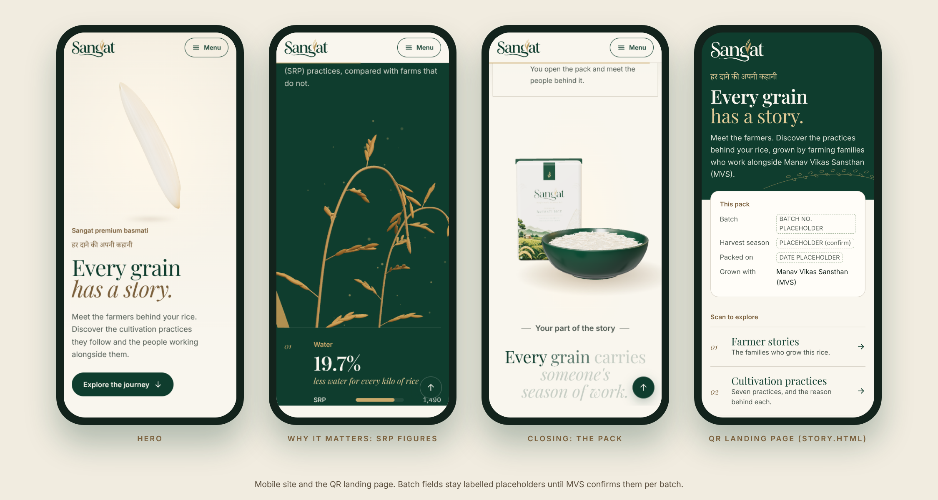
ACT IV · DIGITAL STORYTELLING AND QR CONCEPT
A QR story that says only
what records support.
THE CONSUMER JOURNEY · CONCEPT
Scan the pack
Story page
What is known
QR area on the
back panel
Mobile-first page:
what MVS does
Documented practices;
product or batch facts
It links buyers to MVS’s work and the journey behind the rice.
Website and QR landing-page direction — prototype design
WHAT WE DESIGNED
WHAT IT IS NOT — YET
A design concept and website direction
Not an operational traceability system
A mobile story page that explains MVS’s work and the
practices that are documented, in plain language. The
QR code in the concept is a placeholder, to be replaced
with a tested HTTPS destination before printing.
A programme-level farmer story does not prove that a
named farmer grew the rice in a given packet. Farm-level
traceability can be promised only if chain-of-custody
records support it.
MVS project report §10.3
16 / 22
Notes:
The QR concept leads to a mobile-first story page that explains what MVS does, which practices are documented and what is known about the product or batch. We want to be clear about what this is. It is a design concept and a website direction, not an operational traceability system. A programme-level farmer story does not prove that a named farmer grew the rice in a particular packet, and farm-level traceability can only be promised if chain-of-custody records support it.

Slide 17
ACT IV · GO-TO-MARKET STRATEGY
Go-to-market: prove the rice first,
then build trust in the story.
01
Product
A written specification — grain length, ageing period, moisture, broken grain and purity limits —
with processing and batch controls held constant across batches, plus cooking guidance for the
dishes buyers actually make.
02
Price
Indicative range from point-in-time retail listings, which vary by platform, city and pack size.
Stay at competitor level: the same quality at the same price. Recheck listings before fixing
the price.
~₹180–₹220 per kg
03
Place
Pilot in Chandigarh, Mohali and Panchkula: selected premium grocery and modern trade;
e-commerce and quick-commerce where feasible; direct ordering through the website or messaging;
early sampling through MVS’s community networks. General trade later.
04
Promotion
Cooking demonstrations and blind sampling; retailer education; recipe-led content for
biryani and pulao; the QR story; hoardings, banners and leaflets in popular areas. The front of
pack stays focused on the product.
Recommendations, MVS project report §11; prices are directional and time-sensitive
17 / 22
Notes:
Our go-to-market logic is to prove the rice first and then build trust in the story. For product, that means a written specification covering grain length, ageing, moisture, broken grain and purity, with batch controls and cooking guidance. On price, current listings suggest roughly 180 to 220 rupees per kilogram, and we recommend matching competitors on quality and price while rechecking before fixing anything. For place, the pilot uses premium grocery, modern trade, online channels where feasible, direct ordering and sampling through MVS's networks. For promotion, we propose cooking demonstrations, blind sampling, retailer education, recipe content and the QR story.

Slide 18
ACT V · CONNECTING THE ECOSYSTEM
A brand is a chain of people
that must work together.
MVS · COORDINATION, GOVERNANCE AND BRAND OVERSIGHT
Programme coordination · evidence governance · brand oversight · claim approvals · grievance escalation · clear ownership
01
02
03
04
05
06
07
08
Farmers
Farmer groups /
arthiyas
Processors /
millers
Quality lead /
laboratory
Packaging
vendor
Logistics
partner
Retailers /
online channels
Consumers
Cultivation, field
records, agreed
practices
Aggregation,
volumes, lot IDs,
primary records
Milling, grading,
sorting, batch
consistency
Testing and
release checks to
a written standard
Food-contact packs,
approved artwork,
quality checks
Storage and
movement of
finished packs
Availability,
display, feedback,
sell-through data
Buy, cook and
judge — and decide
whether to repeat
What the shopper sees as one pack is a sequence of hand-offs that must connect reliably.
Each hand-off needs clear guidance, written specifications, lot identification and reconciliation — the coordination MVS would own.
Proposed operating framework, MVS project report §12
18 / 22
Notes:
Act five translates the work into a development pathway. What a shopper sees as one pack is really a chain of eight hand-offs: farmers, farmer groups or arthiyas, processors and millers, a quality lead or laboratory, a packaging vendor, a logistics partner, retailers and online channels, and finally consumers. Each one needs clear guidance, written specifications, lot identification and reconciliation. We see MVS's role as the layer above the chain, responsible for coordination, evidence governance, brand oversight, claim approvals and grievance escalation. This is a proposed operating framework, not one that is running today.

Slide 19
ACT V · FROM BLUEPRINT TO PILOT
The next step is not to communicate louder —
it is to validate more carefully.
01 · BEFORE LAUNCH
02 · IN THE PILOT
03 · THE NUMBERS
04 · DECISION
Prove the product
Prove the proposition
Prove the model
Product specification and
batch consistency
Consumer comprehension
of the message
Supply volumes and
landed cost
DECISION GATE
Go · adjust · stop
Farm, season and sourcing
records
Paid trial, including
cooking parity
Fulfilment cost and
retailer margin
SRP status and approved
claim wording
Repeat behaviour
Working-capital
requirement
Go — build on the foundation;
Delhi NCR could follow
Packaging compliance;
every placeholder replaced
Retailer acceptance
Contribution margin
Adjust — let the pilot show
what needs to change
Stop — if the evidence does
not support the proposition
IMMEDIATE PRIORITY
Appoint one accountable brand owner and a small cross-functional working group.
Bounded pilot in Chandigarh–Mohali–Panchkula; record negative as well as positive feedback · MVS project report §13–15
19 / 22
Notes:
As our report concludes, the next step is not to communicate louder but to validate more carefully. Before launch, MVS needs to prove the product: specification and consistency, sourcing records, SRP status with approved wording, and packaging compliance. In the pilot, it needs to prove the proposition through comprehension, paid trial, repeat purchase and retailer acceptance. It also needs to prove the model through landed cost, margins, working capital and contribution margin. All of this feeds a go, adjust or stop decision. The immediate priority is one accountable brand owner with a small working group.

Slide 20
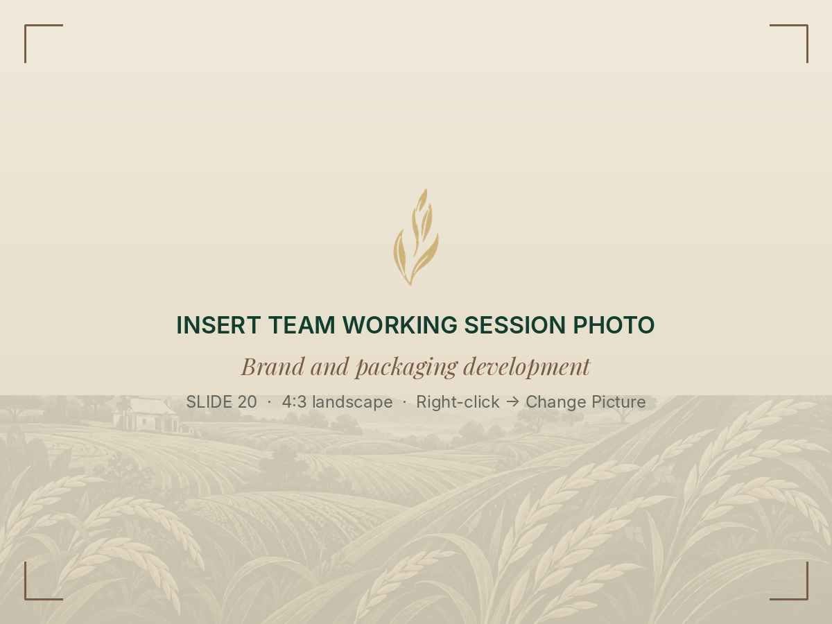
ACT V · WHAT WE DELIVERED
Ten outputs for MVS — and what comes next.
01
Brand identity
06
QR storytelling concept
Name, tagline, purpose, values, voice
Back-panel QR and story page
02
STP strategy
07
Website direction
Five segments; primary and secondary
Mobile-first prototype design
03
Exploratory naming research
08
GTM recommendations
20 respondents; names and taglines
4Ps and pilot channel mix
04
Logo and visual identity
09
Stakeholder coordination model
Team working session: brand and pack design
Wordmark, rice-ear symbol, palette
Eight roles under MVS oversight
NOT YET DONE — AND NOT CLAIMED
Commercial launch or retail distribution
Consumer validation or repeat purchase
Verified farm-to-pack traceability
SRP product verification
05
Packaging concepts
10
Implementation roadmap
1 kg and 5 kg; front and back panels
Validation sequence, decision gate
A foundation for linking MVS’s farmer ecosystem to a market — once validated.
MVS project report, Executive Summary and §13
20 / 22
Notes:
Here is what we leave with MVS: ten outputs, from the brand identity and STP strategy to the naming research, visual identity, packaging concepts, QR concept, website direction, go-to-market recommendations, stakeholder model and implementation roadmap. We are equally clear about what we have not done. There has been no commercial launch, no consumer validation, no verified traceability and no SRP product verification. Together, these outputs give MVS a foundation for linking its farmer ecosystem to a market, once the proposition has been validated.

Slide 21
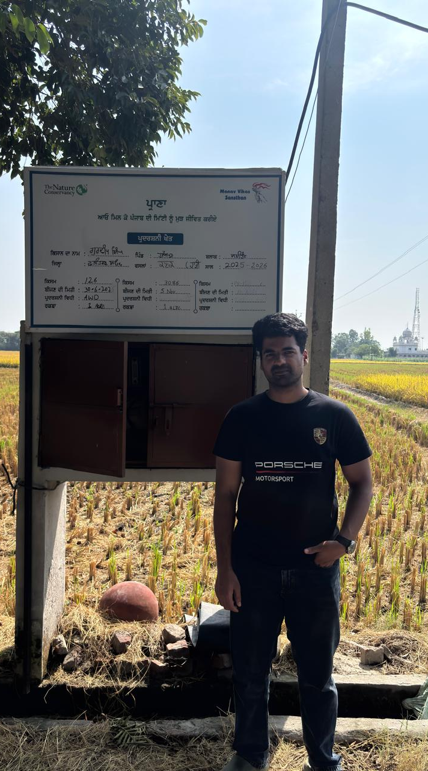
ACT V · REFLECTIONS
What the journey taught us.
1
Development cannot be understood entirely from a desk.
Learned in village homes, nurseries and fields — not in meetings alone.
2
Farmer adoption depends on economic viability and practical realities.
Learned from farmers weighing costs, prices, arthiyas and risk.
3
Local capabilities need market access to become livelihoods.
Learned in Chandpur and in our interactions with SHG members.
4
Institutions, communities and markets must work together.
Learned at PAU and through MVS’s programme and field teams.
5
A credible consumer proposition needs evidence, consistency and trust.
Learned from shoppers, retailers and the work of building Sangat.
Team reflections
21 / 22
Notes:
Finally, what did this journey teach us? First, development cannot be understood entirely from a desk. Second, farmer adoption depends on economic viability and practical realities. Third, local capabilities need market access to become livelihoods. Fourth, institutions, communities and markets have to work together. And fifth, a credible consumer proposition needs evidence, consistency and trust. Each of these lessons came from a specific place in the journey, whether a village home, a farmer's field, PAU or a grocery shelf.

Slide 22
Sanjhi Soch, Sunehra Kal.
“Building a credible brand is not just about what reaches the consumer.
It is about the people, practices and partnerships behind every grain.”
Ashish Satpathy | Janardhan Reddy Bogireddy
With thanks to the MVS field and programme teams, and to the farmers and community members who gave us their time;
and to the DoCC team and SPJIMR for their guidance.
Notes:
We will close with the line that runs through all of this: Sanjhi Soch, Sunehra Kal, shared thinking for a brighter tomorrow. Building a credible brand is not just about what reaches the consumer. It is about the people, practices and partnerships behind every grain. We are grateful to the MVS field and programme teams, to the farmers and community members who gave us their time, and to the DoCC team and SPJIMR for their guidance. Thank you, and we welcome your questions.

