Slide 1
Electricity Management System
Our team
An Van Quoc – BI11-004
Hieu Nguyen Huy – BI11-086
Hieu Pham Minh – BI11-090
Hung Le Quoc – BI11-104
Huy Hoang Quang – BI11-111
Minh Nguyen Dang – BI11-179
Thong Le Dinh – BI11-257
Lecturer: Dr. Son Tran Giang
Department of ICT, USTH
Advanced Programming w/ Python
Hanoi, May 04 2022
A project by group 8
MidterM

Slide 2
Agenda
Introduction
Introduction
Introduction
Introduction
Breakdown and analysis
Methodologies
Application
Outro
Our team
An Van Quoc – BI11-004
Hieu Nguyen Huy – BI11-086
Hieu Pham Minh – BI11-090
Hung Le Quoc – BI11-104
Hoàng Quang Huy – BI11-111
Minh Nguyen Dang – BI11-179
Thong Le Dinh – BI11-257
Electricity Management System
Lecturer: Dr. Son Tran Giang
Department of ICT, USTH
Advanced Programming w/ Python
A project by group 8
Midterm - A.Python

Slide 3




Agenda
Introduction
90%
?
Breakdown and analysis
Introduction
Methodologies
Application
Outro

Slide 4

Introduction
Breakdown and analysis
90%
?
Electricity Management System

Slide 5





Introduction
Breakdown and analysis
90%
Initial design

Slide 6





Methodologies
Breakdown and analysis
Users
User
username
password
Stats
Main
Client
Energy_usage_per_client
Bill_per_client
Amount_of_days
id
name
address
info
electricity_management
amount_of_days

Slide 7

Breakdown and analysis
Methodologies
Users
Sign up
Username
Pickle
Password
Encryption
Statistic
Masked prompt
Login
Username
Password
Main
Unpickle
Log in
Sign up
user_database.obj
Clients
Username
Log in
Check
Encryption
Password
Masked prompt
Outro

Slide 8
Breakdown and analysis
Methodologies
Users
Statistic
Main
GUI
made by Pyside6, based on PyQt
Clients
Final design

Slide 9
Statistic
Methodologies
watt
id
name
address
infomations
Clients
+
energy_mode
start_date
Pickle
*double click*
Add
Upin
…
…
HDD-OM3g4lul / Upin .
date
setter
__str__
plotting
Input edit
Print to file
Energy usage
(per day)
Close contract

Slide 10
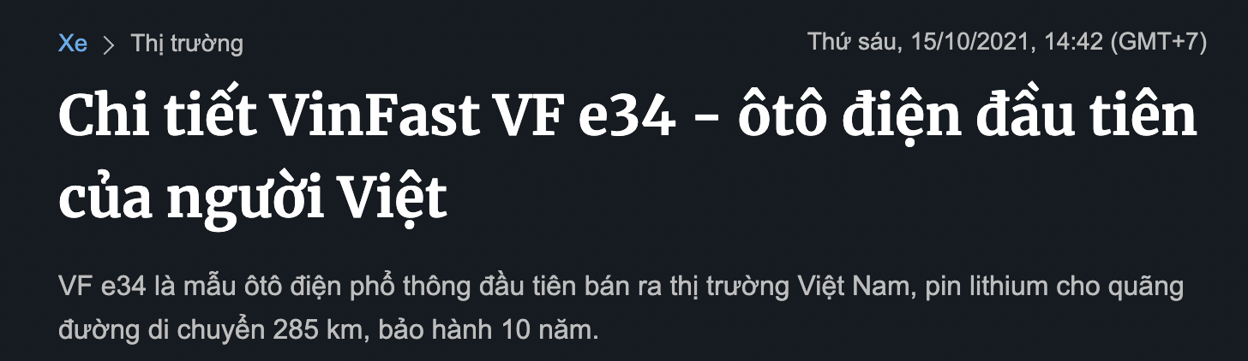
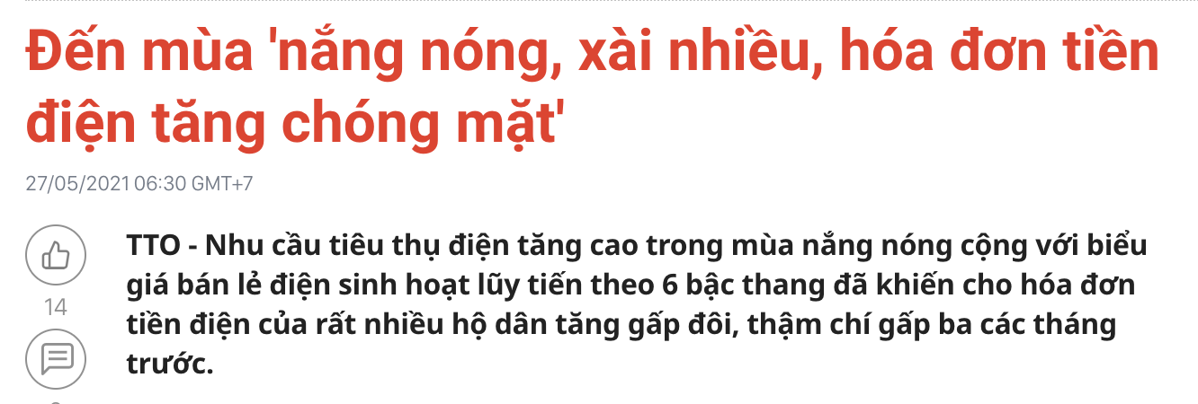
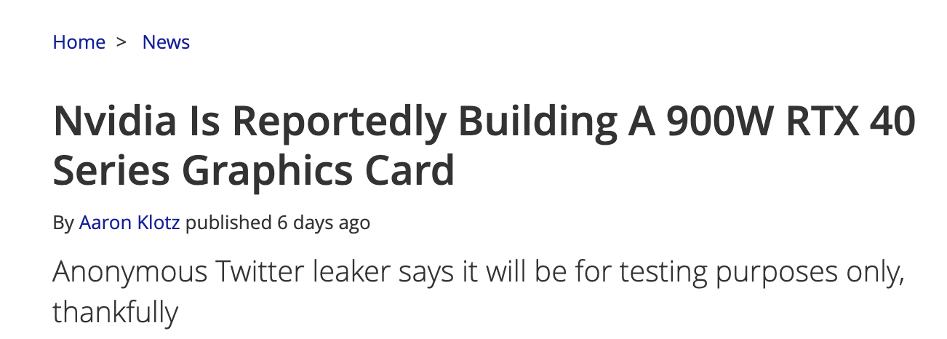


Application
vnexpress.net
tuoitre.vn
Breakdown and analysis
tomhardware.com
Methodologies
watt
Statistic
Wattage (one | total)
Bill (one | total)
Per day
Per month
(or specific days)
…
…
date
Energy usage
(per day)
(one client)
Energy usage
(in a range of days)
“Ladder electricity price”
Load file (unpickle)
Bill
(in a range of days)
A range of days
Write file
Excel
save file (pickle)
Clients

Slide 11
Application
vnexpress.net
tuoitre.vn
tomhardware.com
Methodologies
watt
Statistic
Wattage (one | total)
Bill (one | total)
Per day
Per month
(or specific days)
Clients
…
…
date
Energy usage
(per day)
(one client)
Energy usage
(in a range of days)
“Ladder electricity price”
Load file (unpickle)
Bill
(in a range of days)
A range of days
Write file
Excel
save file (pickle)

Slide 12



Conclusion and outro
Thank you for listening to us!
Notes:
Eficient, Stability and Realiability

