Slide 1
Circular Anchor SSD
Fred Lu

Slide 2
Outline
Original Mobilenet SSD Structure
Designing the Circular Anchor Box Variation
Changes to Training
Changes to Inferencing
Results
Potential Room for Improvement

Slide 3
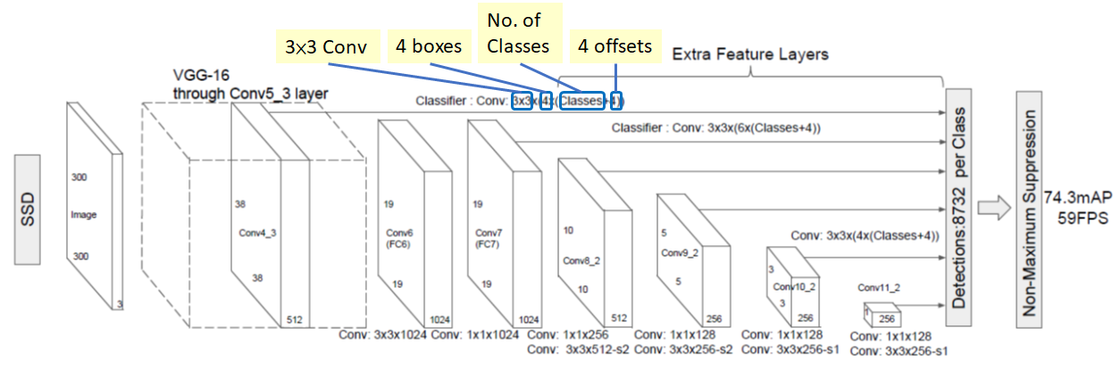
Original Mobilenet SSD
Sample Diagram of SSD with VGG-300

Slide 4
Original Mobilenet SSD
The output has two parts:
Class logits representing confidence of object in an anchor being of a specific class
#out channels classes = anchor boxes per location * #classes
Anchor box offsets representing the location and size of the object in relation to the anchor box
#out channels box offsets = anchor boxes per location * 4: (dx, dy, d width, d height)
In order to have circular anchor boxes, we need to modify this setup a little bit.
Notes:
The output data is made of contatentations of 3x3 convolutions of the output of the backbone (MobileNet) at 3 different levels.

Slide 5
Circular Anchor Mobilenet SSD
Goal
Make anchor boxes and output bounding boxes to be representative of circles.

Slide 6
Circular Anchor Mobilenet SSD
SSD Output
Since we’re only changing the shape of the anchor boxes, the class logits remains the same dimensions:
#out channels classes = anchor boxes per location * #classes
Since the anchors are now circular and we want output bounding boxes to be also circular,
#out channels box offsets = anchor boxes per location * 3: (dx, dy, d radius)
Which allows us to represent output boxes as circles while reducing computations and parameters.
Notes:
In practice, the d radius here is treated as the side length of the square anchor in train-time. We don’t want to get into the non-linearing IOU calculations involved with intersecting circles.

Slide 7
Circular Anchor Mobilenet SSD
SSD Output
Old: For each location of backbone’s output, output box d(x, y, w, h) relative to the anchors in the location
New: For each location of backbone’s output, output box d(x, y, r) relative to the anchors in the location

Slide 8
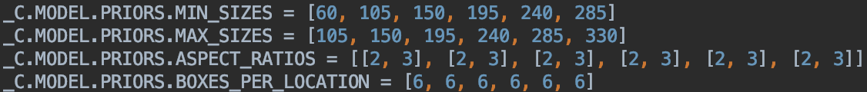
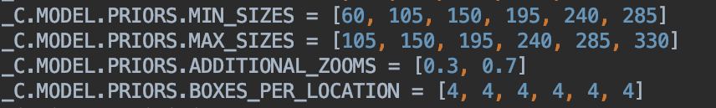
Circular Anchor Mobilenet SSD
Anchor Box Generation: Same Dims, but w = h
Since anchors boxes are just numbers (x, y, w, h), circular just means making w and h equal.
The aspect ratio configuration is replaced with zoom levels. Default max/min anchors unchanged.
Notes:
Effectively, anchor boxes are now all squares.

Slide 9
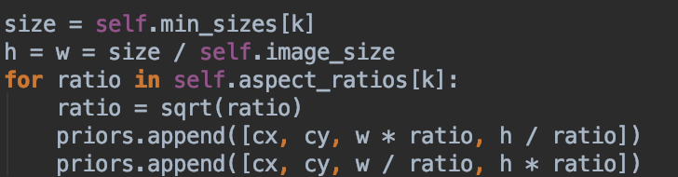
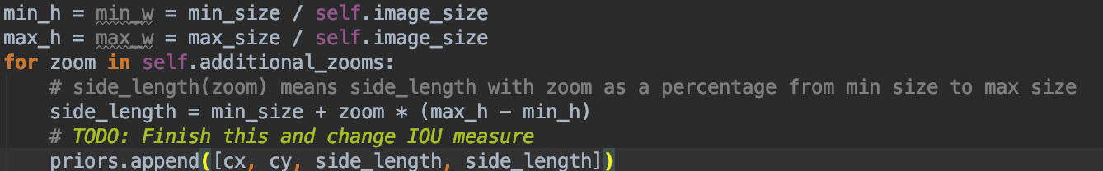
Circular Anchor Mobilenet SSD
Anchor Box Generation: Same Dims, but w = h
Notes:
Effectively, anchor boxes are now all squares.

Slide 10
Circular Anchor Mobilenet SSD
Training: Different Loss function
The square ground truth boxes still have 4 offsets but the predictions only have 3. The Smooth L1 Loss function have to operate on the same dimensions. -> Remove the height offset from ground truth.
Trim dimension 2 of square ground truth boxes to preserve only the first three values (dx, dy, d width).
Notes:
Note that this make the loss to be more weighted toward position error than size error.

Slide 11
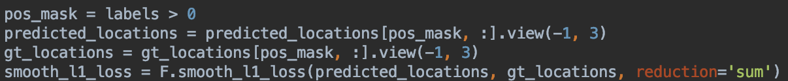
Circular Anchor Mobilenet SSD
Training: Different Loss function
Now that GT and prediction bounding boxes have the same dimensions (# batches, # boxes per location, 3), flatten and run smooth L1 loss.

Slide 12
Circular Anchor Mobilenet SSD
Inferencing: Expanding BBox Dimensions to 4
To be able to evaluate performance indices such as IOU against GT Boxes, we need to convert the 3-offset circular bounding boxes produced by SSD to the conventional 4-offset square representations.

Slide 13
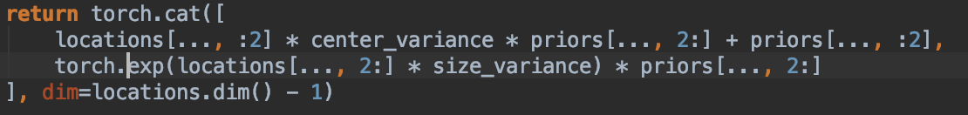
Circular Anchor Mobilenet SSD
Inferencing: Code
Locations: Raw SSD Bounding Box Offsets d(x, y, radius). Priors: anchor boxes (x, y, w, h=w)
The logic for adding offsets (dx, dy) to anchors in the first line after cat() remains the same.
In the second line which gives the final box width and height, instead of doing element-wise multiplication of locations(w,h) * priors(w,h) like before, we just scale pirors(w,h) by a scalar, locations(d radius).
Notes:
Locations (d radius) is just the last element of locations = locations[..., 2:]

Slide 14
Circular Anchor Mobilenet SSD
Inferencing: Scaling and Drawing Bounding Boxes
Now that we have converted the SSD’s output into conventional bounding boxes that can drawn on an image, it’s time to show these boxes.
But there is one slight problem...

Slide 15
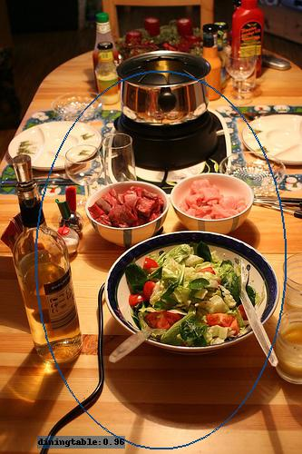
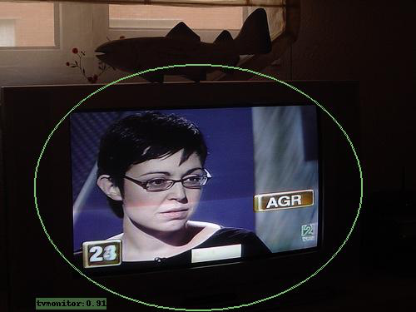
Circular Anchor Mobilenet SSD
SSD has a fixed input image size of 300x300, on which the bounding boxes are generated.
When scaling the SSD’s bounding boxes back to the original image size, the height and width are no longer equal. As a result, the bounding boxes will be ellipses (or rectangles).

Slide 16
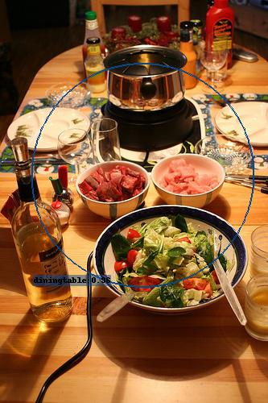

Circular Anchor Mobilenet SSD
To fix the scaling distortion, set both the w and h of the scaled bounding ellipses to min(w,h):
Notes:
This is just a choice of how to draw / represent the SSD’s output. We could easily also draw the circles with radius equal to the average

Slide 17
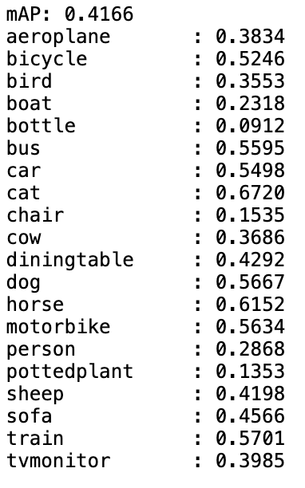
Results
mAP on VOC 2007 Testing Images

Slide 18
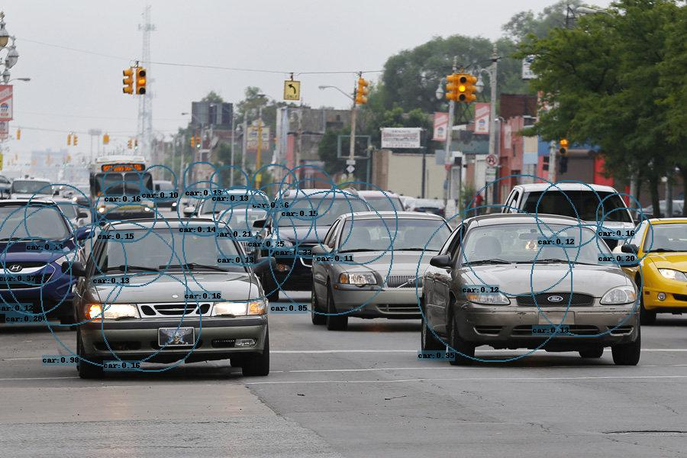
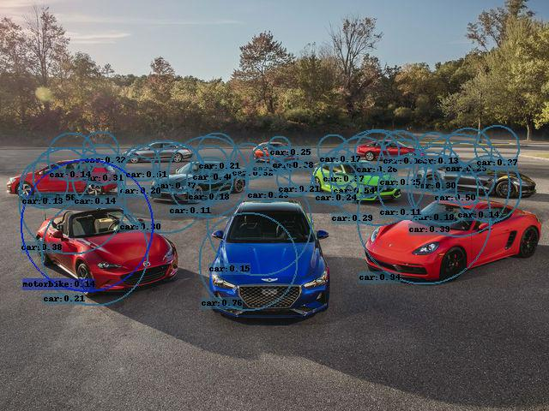
Results
Sample Output Images showing circles with class confidence > 0.1

Slide 19
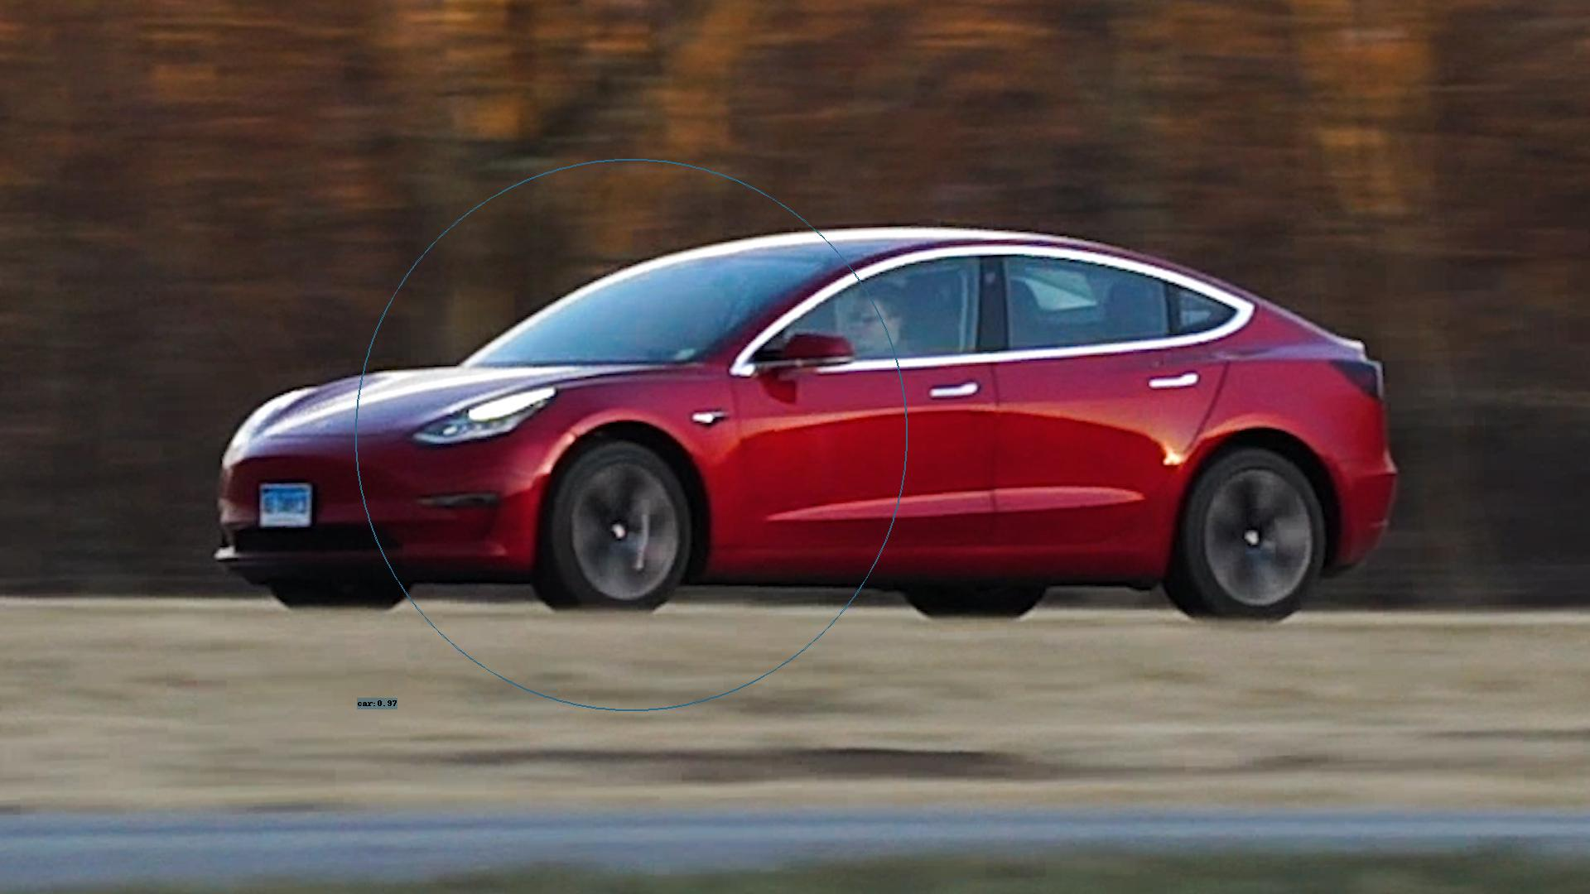
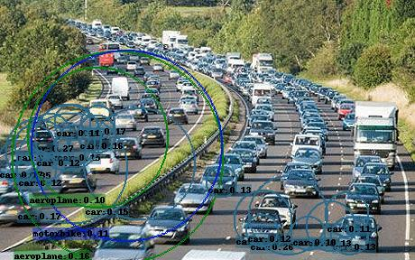
Results
Sample Output Images showing circles with class confidence > 0.1

Slide 20
Room for Improvement
Could draw bounding circles with avg (or max) of scaled (w,h)
Calculate IOU for circles instead of squares when generating class confidences for anchors.
Give equal weight to box position and size offsets in Smooth L1 Loss.
Test Different zoom configs for generating anchors for each location.

Slide 21
Questions

Slide 22
Thank You

