Slide 1
Lab 3: CNNs & Image Classification
EEC 174AY
Fall 2026

Slide 2
Peer Review
Add your peer to your GitHub
Fork project and clone the forked repo
Setup environment
Run project
Evaluate
Write report
Availability
  Organized - easy to find what you need
Functionality
  Quick to setup – collaborator on GitHub, fork, pull, and run
Validity
  Confirming results – able to reproduce results, or similar when non-deterministic
Understandability
  Document – Code comments, figures labeled and clear, and report well explained

Slide 3
Lab 3
Due Dates:
Lab 3 Prelab: Did you do it?
Lab 3: October 30, 2026 12:59 PM
Lab 3 Peer Review?

Slide 4
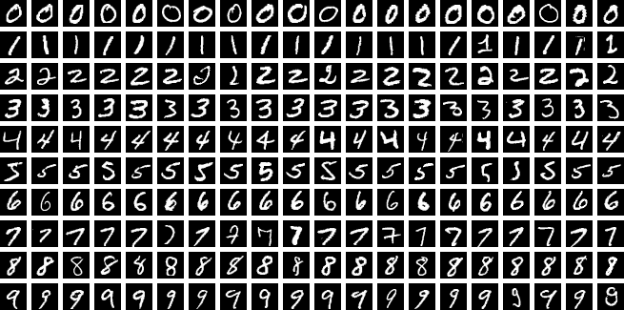
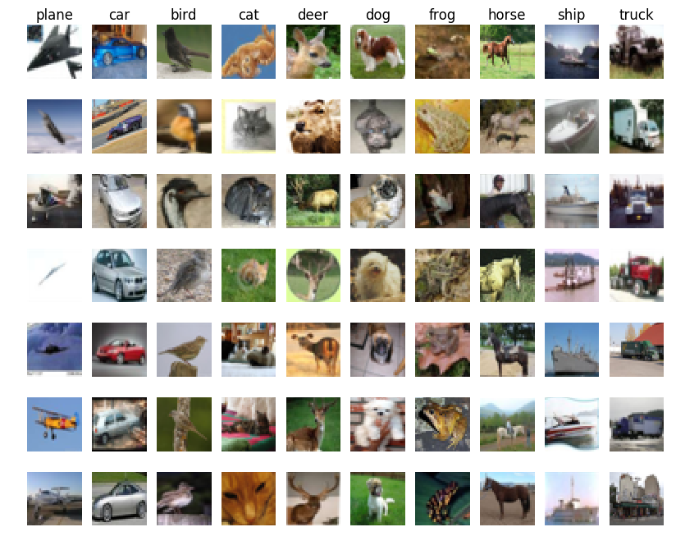
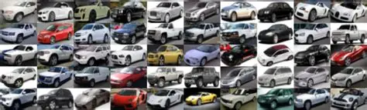
Lab 3 Tasks/Phases
Phase 1 – CNN on MNIST (40%)
Phase 2 – CNN on CIFAR10 (20%)
Phase 3 – Stanford Cars! (30%)
MNIST
CIFAR10
Stanford Cars

Slide 5
Phase 1
Lots of hallow functions
  Data loading
  Training loop
  Plotting loss
Explore hyperparameters
  Learning rate
  Optimizer
  Initial Weights
  Activation Function
  Batch Size
  Model Architecture
  Batch Normalization

Slide 6
Phase 2
Similar setup to Phase 1
Handle Images
Transfer Learning – Train a Trained Model
Confusion Matrix
Freezing and Training

Slide 7
Phase 3
Similar setup to other Phases
Create CarDataSet object
Select a model architecture to use
Setup for testing

Slide 8
Report
Questions are in the notebook this time!
No separate file.
Answer wherever you see “ANSWER HERE”

Slide 9
Lab 3 Questions

Slide 10
Office Hours
https://www.when2meet.com/?39297589-68Xpr

Slide 11
Week 4 Survey
https://forms.gle/hcAM3ycUQJTZBnci8

Slide 12
Survey Results

