Slide 1
CVDex: Bringing Pokémon to Life Through Real-World Image Recognition
By Jocelyn Dzuong, Cesar Santiago, Bryan Bravo, Roberto Hernandez

Slide 2
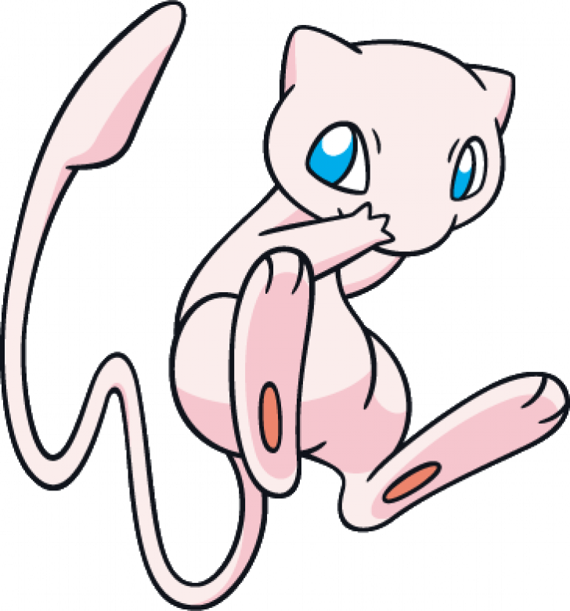
Problem Statement
The Problem
Frequent misclassification of Pokemon from people when referring to ads, shows, anywhere there's media
Lack of real-time, camera-based solution for identifying Pokemon from posters, cards, billboards, menus etc.
The Gap
Existing Pokedex apps focus on static 3D entities or manual input
No seamless integration of Pokemon image detection exists on mobile
What We Aim to Solve
Create a user-friendly app that detects Pokemon in real-time using a camera and provides accurate Pokedex entries

Slide 3
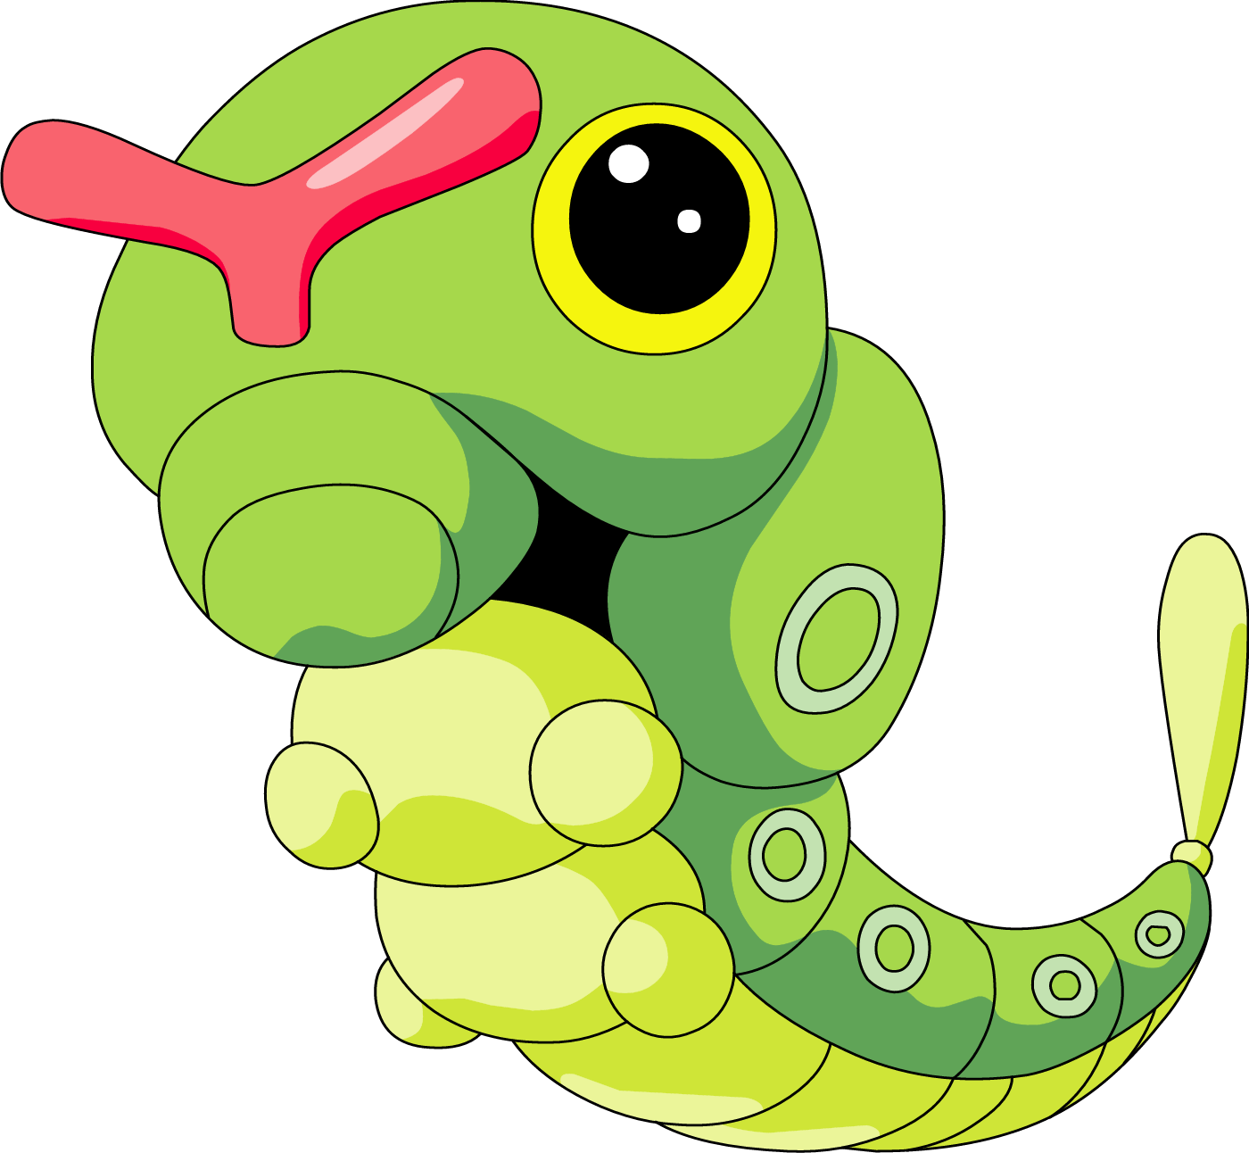
Project Landscape
Technological Landscape
Flutter: Cross-platform framework for seamless UI
YOLO + TensorFlow: Cutting-edge object detection for real-time performance
PokeAPI: Trusted source for data retrieval
Firebase: Backend for user data storage and leaderboard functionality
Competitive Analysis
Strengths:
Real-time object detection
Fully automated integration with a visual Pokedex
Weaknesses in Competitors:
Manual data input in competing apps
No integration of live ML object detection with databases

Slide 4
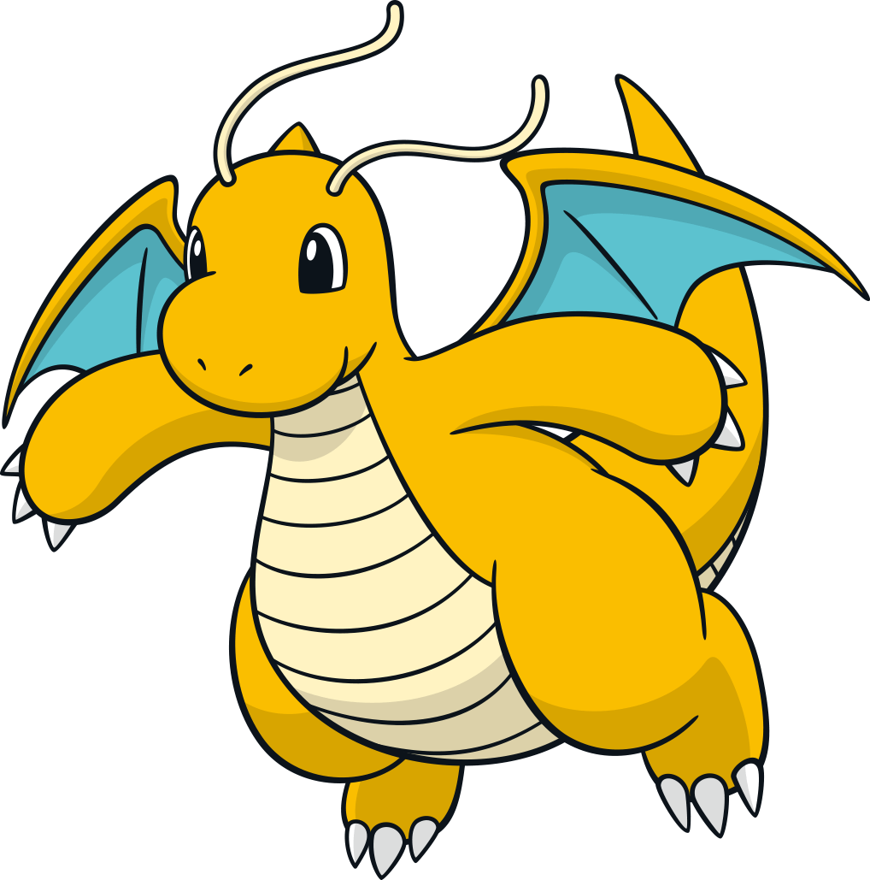
High-Level System Overview
User registers account and logs in
Pokedex entry display and storage
Camera input with YOLO model object detection
Prediction from YOLO model to parse as a request to PokeAPI

Slide 5
Team Contributions
Jocelyn
Front-End, Project Management, DevOps, Machine Learning
Roberto
Database Management, Camera Integration, Project Management, Backend
Bryan
Backend, Administrator, Database Mangement, API Integration
Cesar
Machine Learning, API Integration, User Account Management

Slide 6

Features Demo

Slide 7
Real-Time Pokemon Detection
[Video here]

Slide 8
Automated Pokedex Entry After Prediction
[Video here]

Slide 9
User Leaderboard
[Video here]

Slide 10
Liking and Viewing Pokemon Scans
[Video here]

Slide 11

Software Verification

Slide 12
Unit Testing

Slide 13
Integration Testing

Slide 14
Model Results

Slide 15
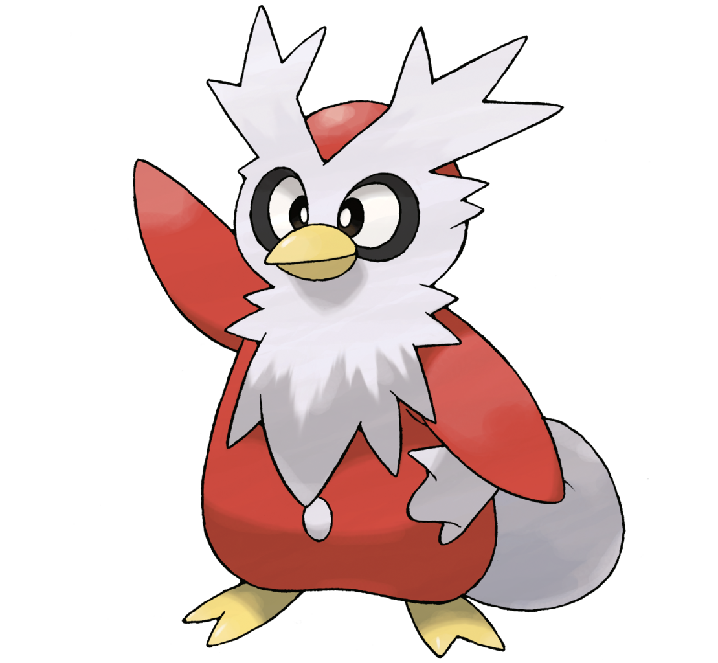
Problem Resolution
How We Solved the Problem
Bridging the gap with seamless integration of YOLO detection and PokeAPI for real-time, accurate Pokemon indentification
Impact
Seamless, accessible user experience (UX) for Pokemon enthusiasts
Gamification through leaderboards to encourage app use
Future Improvements
[Something here]

Slide 16
References
External Sources:
Flutter documentation: https://flutter.dev/
YOLO framework: https://github.com/ultralytics/yolov5
PokéAPI: https://pokeapi.co/
Firebase documentation: https://firebase.google.com/
Relevant Papers
[APA format reference here]

Slide 17
Thank You!

Slide 18
Additional Template Slides

Slide 19
Smartphone Infographics
01
02
03
04
Mars
Mercury
Neptune
Saturn
Despite being red, Mars is a cold place
Mercury is the closest planet to the Sun
Neptune is the farthest planet from the Sun
Saturn is the ringed one and a gas giant

Slide 20
Smartphone Infographics
Mars
Despite being red, Mars is a cold place. The planet is full of iron oxide dust
Mercury
Mercury is the closest planet to the Sun and the smallest one in the Solar System
Venus
Venus has a beautiful name and is the second planet from the Sun. It’s terribly hot
Neptune
Neptune is the farthest planet in the Solar System. It’s the fourth-largest by diameter

Slide 21
Smartphone Infographics
Venus
Mars
Venus has a beautiful name and it’s terribly hot
Mars is a cold place and is full of iron oxide dust
Neptune
Saturn
Neptune is the farthest planet in the Solar System
Saturn is the ringed one. It’s a gas giant, composed of helium

Slide 22
Smartphone Infographics
Mercury
Mars
Mercury is the closest planet to the Sun and the smallest one in the Solar System
Despite being red, Mars is a cold place. The planet is full of iron oxide dust
Neptune
Saturn
Neptune is the farthest planet in the Solar System. It’s the fourth-largest one
Saturn is the ringed one. It’s a gas giant, composed mostly of hydrogen and helium

Slide 23
Smartphone Infographics
Venus
Mars
Venus has a beautiful name and it’s terribly hot
Mars is a cold place and is full of iron oxide dust
32%
21%
18%
Neptune
14%
Saturn
Neptune is the farthest planet in the Solar System
It’s the ringed one. It’s a gas giant, composed of helium

Slide 24
Smartphone Infographics
Despite being red, Mars is a cold place and is full of iron oxide
Mars
Mercury is the closest planet to the Sun and the smallest one
Mercury
Venus has a beautiful name and is the second planet from the Sun
Venus
Neptune is the farthest planet in the Solar System
Neptune

Slide 25
Smartphone Infographics
Venus
Mars
Venus has a beautiful name and it’s terribly hot
Mars is a cold place and is full of iron oxide dust
Neptune
Saturn
Neptune is the farthest planet in the Solar System
Saturn is the ringed one. It’s a gas giant, composed of helium

Slide 26
Smartphone Infographics
Venus
Mars
Venus has a beautiful name and it’s terribly hot
Mars is a cold place and is full of iron oxide dust
Neptune
Saturn
Neptune is the farthest planet in the Solar System
it’s the ringed one. It’s a gas giant, composed of helium
Mercury
Jupiter
Mercury is the smallest planet in the Solar System
Jupiter is the biggest planet in the entire Solar System

Slide 27
Smartphone Infographics
Mercury
Mars
Mercury is the closest planet to the Sun and the smallest one in the Solar System
Despite being red, Mars is a cold place. The planet is full of iron oxide dust
Jupiter
Venus
Jupiter is the fourth-brightest object in the sky, and the biggest planet in Solar System
Venus has a beautiful name and is the second planet from the Sun, but it’s terribly hot
Neptune
Saturn
Neptune is the farthest planet in the Solar System. It’s the fourth-largest by diameter
Saturn is the ringed one. It’s a gas giant, composed mostly of hydrogen and helium

Slide 28
Smartphone Infographics
Mercury
Jupiter
Mercury is the closest planet to the Sun
It’s the biggest planet in the Solar System
01
04
Neptune
Saturn
Is the farthest planet in the Solar System
Saturn is the ringed one and a gas giant
02
05
Mars
Venus
Mars is a cold place and is full of iron oxide dust
Venus Is the second planet from the Sun
03
06

Slide 29
Smartphone Infographics
Mercury
Neptune
Mars
Saturn
Is the closest planet and the smallest in the Solar System
Neptune is the farthest planet in the Solar System
Mars is a cold place and is full of iron oxide dust
It’s a gas giant, composed mostly of hydrogen and helium
01
02
03
04

Slide 30
Smartphone Infographics
Venus
Mars
Venus has a beautiful name and it’s terribly hot
Mars is a cold place. The planet is full of iron oxide dust
Neptune
Saturn
Neptune is the farthest planet in the Solar System
Saturn is the ringed one. It’s a gas giant, composed of helium

Slide 31
Smartphone Infographics
01
03
Mercury
Neptune
Mercury is the closest planet to the Sun and the smallest one in the Solar System
Neptune is the farthest planet in the Solar System. It’s the fourth-largest by diameter
02
04
Jupiter
Venus
Jupiter is the fourth-brightest object in the sky and the biggest planet in our Solar System
Venus has a beautiful name and is the second planet from the Sun. It’s terribly hot

Slide 32
Smartphone Infographics
50%
Mars
Despite being red, Mars is a cold place
90%
Mercury
Mercury is the closest planet to the Sun
75%
Neptune
Neptune is the farthest planet from the Sun
20%
Saturn
Saturn is the ringed one and a gas giant

Slide 33
Smartphone Infographics
Mercury
Mars
Is the closest planet and the smallest in the Solar System
Mars is a cold place and is full of iron oxide dust
Neptune
Saturn
Neptune is the farthest planet in the Solar System
It’s a gas giant, composed mostly of hydrogen

Slide 34
Smartphone Infographics
Mercury
70%
35%
Mars
Is the closest planet and the smallest in the Solar System
Mars is a cold place and is full of iron oxide dust
Neptune
35%
50%
Jupiter
Neptune is the farthest planet in the Solar System
Jupiter is the fourth-brightest object in the sky
Venus
50%
25%
Saturn
It’s the second planet from the Sun, but it’s terribly hot
It’s a gas giant, composed mostly of hydrogen and helium

Slide 35
Smartphone Infographics
Mars
Mars is a cold place and is full of iron oxide dust
90%
Jupiter
It’s the biggest planet in the Solar System
60%
Venus
Venus is the second planet from the Sun
75%
Neptune
Neptune is the farthest planet in the Solar System
85%

Slide 36
Smartphone Infographics
15%
30%
22%
43%
Mars
Neptune
Mercury
Saturn
Despite being red, Mars is a cold place
Neptune is the farthest planet from the Sun
Mercury is the closest planet to the Sun
Saturn is the ringed one and a gas giant

Slide 37
Smartphone Infographics
Mercury
Neptune
Saturn
Mercury is the closest planet to the Sun
Neptune is the farthest planet from the Sun
Saturn is the ringed one and a gas giant
01
02
03

Slide 38
Smartphone Infographics
Mars
Neptune
Despite being red, Mars is a cold place
01
03
Neptune is the farthest planet from the Sun
Mercury
Saturn
Mercury is the closest planet to the Sun
02
04
Saturn is the ringed one and a gas giant

Slide 39
Smartphone Infographics
Mars is a cold place and is full of iron oxide dust
Neptune is the farthest planet in the Solar System
Mars
Neptune
Mercury
Saturn
Is the closest planet in the Solar System
Saturn is the ringed one and a gas giant

Slide 40
Smartphone Infographics
Mercury
Mars
Is the closest planet and the smallest in the Solar System
Mars is a cold place and is full of iron oxide dust
Neptune
Saturn
Neptune is the farthest planet in the Solar System
It’s a gas giant, composed mostly of hydrogen and helium

Slide 41
Smartphone Infographics
Mercury
01
Mars
03
Mercury is the closest planet to the Sun
Despite being red, Mars is a cold place
Saturn
02
Neptune
04
Saturn is the ringed one and a gas giant
Is the farthest planet in the Solar System

Slide 42
Smartphone Infographics
Mercury
Mars
Saturn
Neptune
Is the closest planet and the smallest in the Solar System
Mars is a cold place and is full of iron oxide dust
It’s a gas giant, composed mostly of hydrogen and helium
Neptune is the farthest planet in the Solar System

Slide 43
Smartphone Infographics
50%
35%
Mercury
Neptune
Mercury is the closest planet to the Sun and the smallest one in the Solar System
Neptune is the farthest planet in the Solar System. It’s the fourth-largest one

Slide 44
Smartphone Infographics
Mercury
Saturn
Is the closest planet and the smallest in the Solar System
2001
It’s a gas giant, composed mostly of hydrogen and helium
2010
Mars
Neptune
1999
Mars is a cold place and is full of iron oxide dust
2005
Neptune is the farthest planet in the Solar System

Slide 45
Smartphone Infographics
Mercury
Mars
Is the closest planet and the smallest in the Solar System
Mars is a cold place and full of iron oxide dust. Despite being
Neptune
Saturn
Is the farthest planet in the Solar System and the fourth-largest
It’s a gas giant, composed mostly of hydrogen and helium

Slide 46
Smartphone Infographics
01
Mars
Despite being red, Mars is a cold place. The planet is full of iron oxide dust
02
Venus
Mercury is the closest planet to the Sun and the smallest one in the Solar System
03
Jupiter
Venus has a beautiful name and is the second planet from the Sun

Slide 47
Smartphone Infographics
01
02
03
04
Mercury
Mars
Saturn
Neptune
Is the closest planet in the Solar System
Mars is a cold place and is full of iron
Saturn is the ringed one and a gas
Is the farthest planet in the Solar System

