Slide 1
SwiftFreight -- A logistics Company
Shipment Cost Prediction
Presented by -
Nooka Paramesh Ganireddy

Slide 2
Problem Statement
Data Understanding
Descriptive Statistics
Visualizations
Outliers
Model Building
CONTENTS

Slide 3
Problem Statement
Challenge :
given a request from a customer for shipment they (swiftFrieght service) would like to decide the estimated cost for the carriers.
Solution :
To enable swiftFreight service company to quote the best price for the customer and reduce the revenue leakages and increase their bottom line.

Slide 4
Features
1 EQUIPMENT_TYPE -------- Carrier used for the shipment
2 CUSTOMER_MILES ------ Distance in Miles
3 WEIGHT ------ Weight of the shipment
4 ORDER_COST ------ Cost of Shipment
5 FIRST_PICK_ZIP ------ Source City Zip Code / Pin Code
6 FIRST_PICK_EARLY_APPT ------- First Appointment Date to collect the shipment from Customer
7 FIRST_PICK_LATE_APPT ------- Late Appointment Date to collect the shipment from Customer
8 LAST_DELIVERY_ZIP ------ Destination City Zip Code / Pin Code
9 LAST_DELIVERY_EARLY_APPT ----Shipment Delivery Date - Early
10 LAST_DELIVERY_LATE_APPT ------Shipment Delivery Date - Late
11 IS_HAZARDOUS ------ Is the shipment hazardous or not
12 CREATED_DATE ------ Order Created Date
13 ORDER_NBR ------ Order Number

Slide 5
Data Understanding
Enter title
Given data consists of 18739 customers who ordered from different locations.
This shiftFreight company have to pick up from one location and deliver to the other location.
They used different type of equipment used for shipping services.
They will charge the customer and pay to the freight services and during the transaction they will make their profit/revenue.
They set up order cost depends on the distance that order to be delivered.
This Template Is Designed By Zuo An,It Will Help You Make You Report Easy And Fast.
Enter title
This Template Is Designed By Zuo An,It Will Help You Make You Report Easy And Fast.

Slide 6
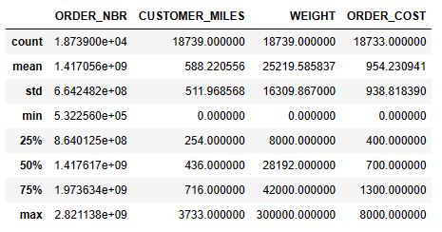
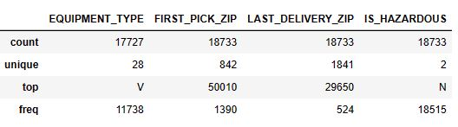
Descriptive Statistics

Slide 7
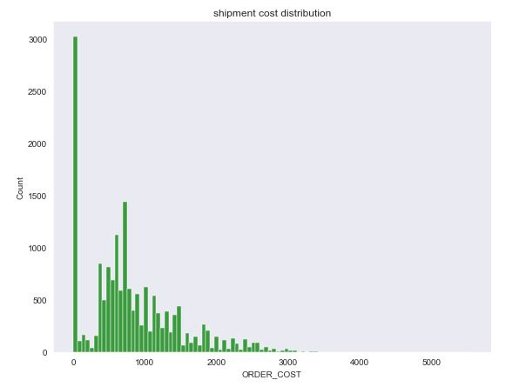
Shipment Cost Distribution
From the plot,nearly 3500 shipping orders have no order cost and 1000 orders have minimum value of 600 rupees

Slide 8
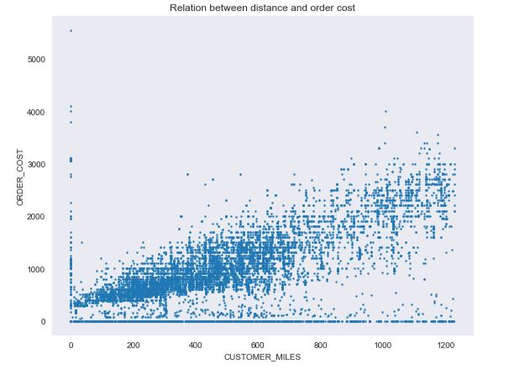
Does the shipment cost depends on the distance?
There is increasing in shipment cost as increasing in distance to be travelled.

Slide 9
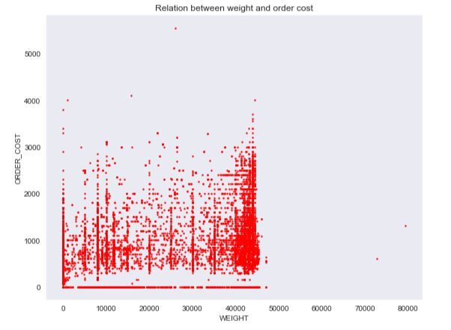
Is the weight of the shipment an important predictor to decide
the shipment cost?
Yes.It is an important predictor.
For unit change in weight ,121 rupees are changing in order-cost.
The above one is derived by using library statsmodel.api

Slide 10
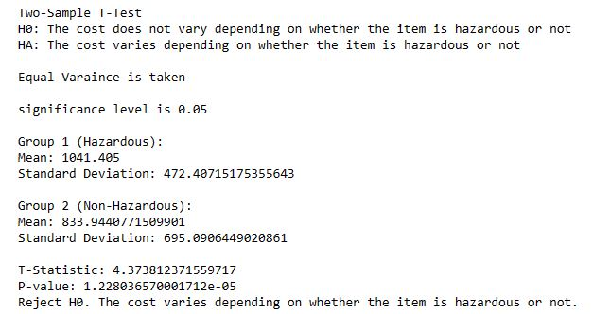
Does cost varies depending on the whether the item is hazardous or not ?

Slide 11
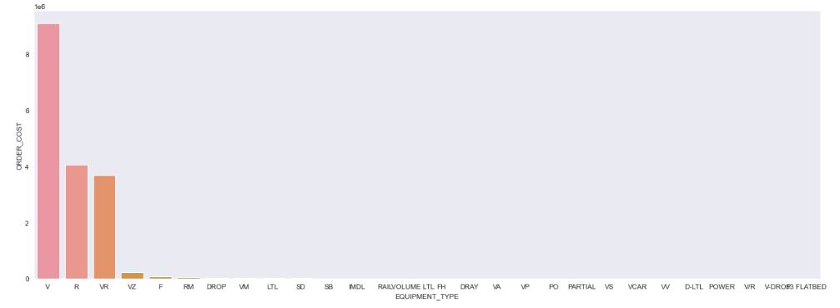
which equipment is used to ship more orders?
V: Vacuum
R: Refrigerated
VR: Virtual Reality
VZ:VacuumZone
F: Flatbed
RM: Rail Mounted
DROP: Drop Deck
VM: Van/Moving

Slide 12
Some actvities have done while dealing with the data
In target column (ORDER_COST),there are null values and zero values present.I removed the both null values and zero values in target column
There are date columns present where I extracted some extra features.
In date columns also, there null values present and to impute that it is difficult to impute using timeseries (there is no trend,seasonality,etc.)
I preferred KNN imputer to impute the extracted features from the date columns.

Slide 13
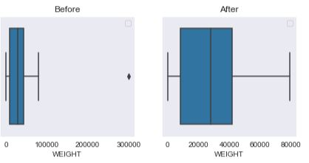
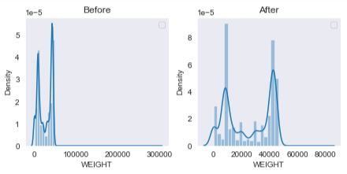
Outliers
Some weights which are almost away from the regulalr ones

Slide 14
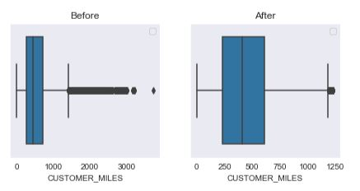
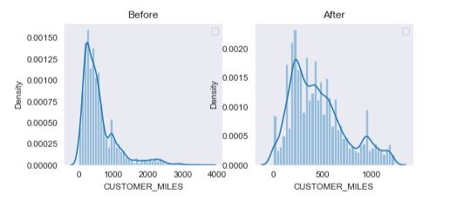
Some order’s delivey distances which are almost away from the regulalr ones
Enter title
Enter title
Enter title

Slide 15
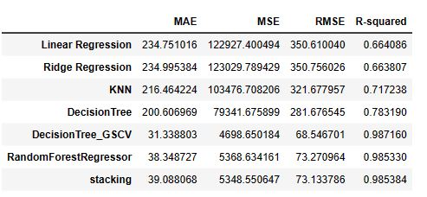
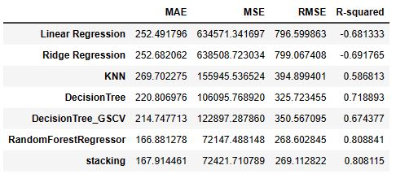
Model Building
(without outliers)
Train data
Test data

Slide 16
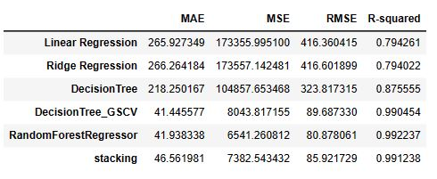
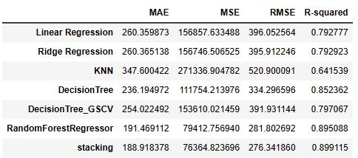
Model Building
(with outliers)
Train data
Test data

Slide 17
The performance metric I prefer is......
From all the above metrics ,I preferred R2 because that represents the proportion of the variance for a dependent variable is explained by the independent variables.
It ranges from 0 to 1, where a higher value indicates a better fit of the model to the data.
R-squared is particularly useful when comparing different models or assessing the goodness-of-fit.

Slide 18
THANK YOU

