Slide 1
SPEAKING + WRITING TOEIC
LESSION 2

Slide 2


the power of communication

Slide 3


Slide 4
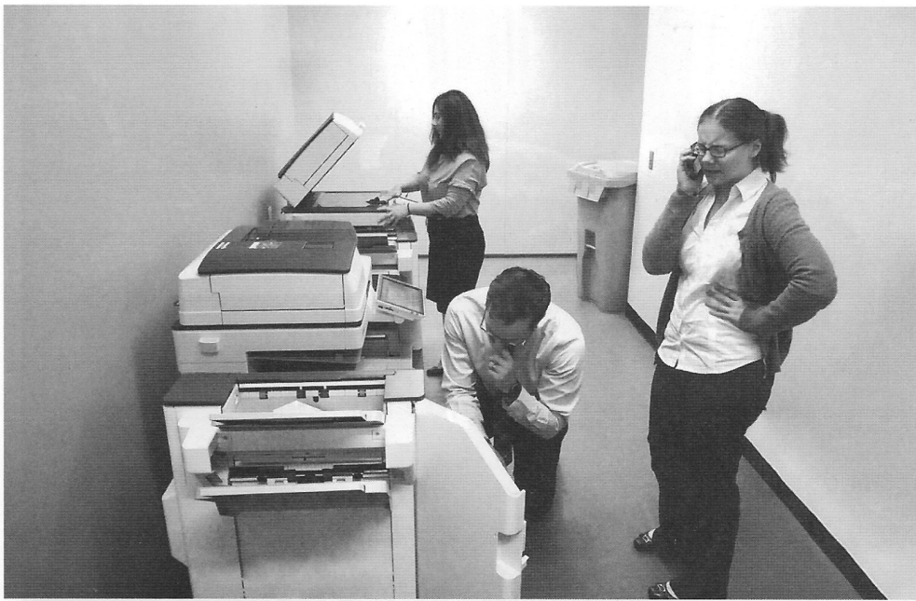

Slide 5


Slide 6
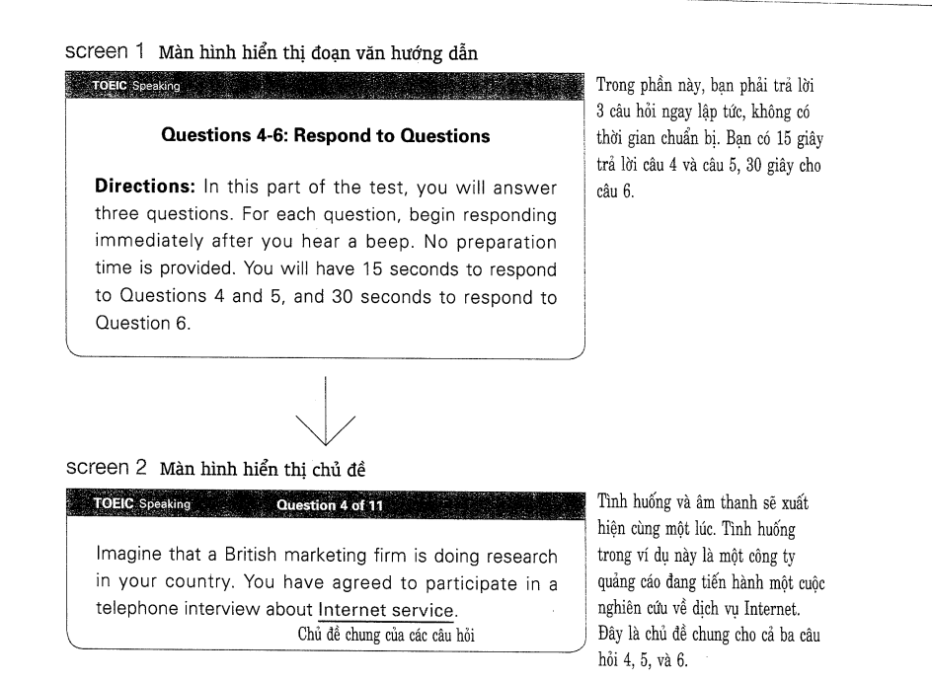

Slide 7


Slide 8


Slide 9


Slide 10


Slide 11


Slide 12
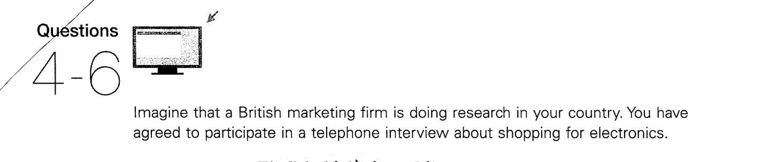


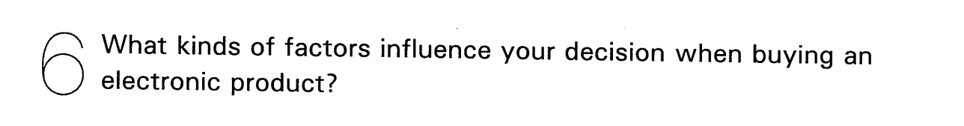

Slide 13
4 I shop for electronic products maybe three or four times a year. I usually go to a store in the mall to buy them.
5 bought a new cell phone a couple of days ago. I think that is the last thing I bought.
6 [Quan điểm] The most important thing for me is whether I recognize the brand of the product or not.
[Lý do] Lots of electronic products break down and, uh, this can be really annoying. But if I buy a reputable brand, I can guarantee that the product will be reliable. So I don't need to worry about the possibility of the product malfunctioning

Slide 14
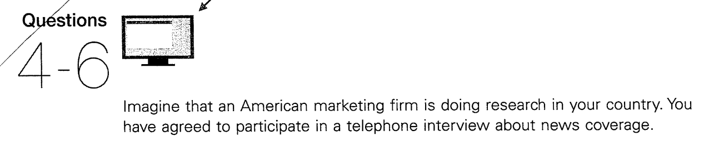




Slide 15
4 I usually get the news from online websites. I like to look at these websites at least two or three times a day.
5 I prefer to read about international news because I think this is the most important kind of news. It affects everyone.
6 [Câu chủ đề] I was very impressed recently when I read a news article about robot technology.
[Lý do] I thought it was amazing that companies are building robots right now that can do so many complex things. The article said that most people could own a robot within 20 years.
[Tóm tắt ] This news was very informative as well as fascinating to me.

Slide 16
What are benefits of attending a large university?
One major benefit of attending a large university is the wide variety of academic programs.
Large universities often offer diverse majors, elective courses, and specialized tracks that allow students to explore different fields of study.
For instance, a student might begin in general business administration and later switch to finance or marketing without having to transfer to another institution.
Therefore, the diversity of programs at a large university provides students with greater opportunities for personal and professional development.

Slide 17
Paragraph 2
Another important benefit of attending a large university is the wide range of social opportunities.
With thousands of students on campus, learners have more chances to meet people from different cultural and academic backgrounds.
For example, students can join clubs, sports teams, or international exchange programs where they can build lifelong friendships and professional networks.
Therefore, the vibrant social environment of a large university helps students grow both personally and professionally.

Slide 18
Homework
Do you think what is the most important invention over the last 20 years?

