Slide 1

AMCAT Data Analysis
by
Shaik Noor Basha

Slide 2
About me
Background
Master of Computer Applications (MCA) – 2022 to 2024
Madanapalle Institute of Technology and Science
Why you want to learn Data Science
For starters, it's an incredibly powerful tool that can help us make sense of the world around us. By analyzing and interpreting complex data, we can uncover hidden patterns, identify opportunities, and make informed decisions that drive real change. It's a field that's in super high demand, with tons of job opportunities and competitive salaries and Data Science is an incredibly versatile field that can be applied to almost any industry, from healthcare to finance to education. It's a field that's constantly evolving, with new technologies and techniques emerging all the time, which makes it super exciting.
Any work experience
As a fresher, I gained hands-on experience in data science through academic projects, utilizing tools like Python for analysis, statistics, and data visualization, preparing me for real-world applications.
Share your linkedin and github profile urls
www.linkedin.com/in/shaiknoor786

Slide 3
Agenda
Business Problem and Use case domain understanding(If Required)
Objective of the Project
Web Scraping – Details (Websites, Processor you followed)
Summary of the Data
Exploratory Data Analysis:
Data Cleaning Steps
Data Manipulation Steps
Univariate Analysis Steps
Bivariate Analysis Steps
Key Business Question
Conclusion (Key finding overall)
Q&A Slide
Your Experience/Challenges working on Web Scraping – Data Analysis Project.

Slide 4
Business Problem Statement
Problem Statement: Forecasting Salary Ranges for Job Seekers Based on Various Attributes
Key Questions to Investigate:
What key factors affect salary levels among job seekers?
Is there a correlation between educational background, area of specialization, and salary?
How do demographic factors such as gender, age, and geographic location influence salary expectations?
Can we uncover trends or patterns in salary distribution across various job titles and cities?

Slide 5
Objective of the Project
Objective: Analyze Factors Influencing Salary Levels for Job Seekers and Develop a Predictive Model
Key Goals:
Identify Key Influencers: Analyze factors like education, skills, experience, location, and demographics to determine salary drivers.
Build a Predictive Model: Develop a model to estimate salary based on these factors using machine learning algorithms.
Evaluate Model Performance: Test the model using metrics like MAE, RMSE, and R-squared to ensure accuracy.
Generate Insights: Extract actionable insights to identify salary trends and correlations.
Provide Recommendations: Offer tips for salary negotiation, hiring practices, and market trends.
Expected Outcome:
A predictive model that estimates salaries accurately and provides insights for job seekers and employers.

Slide 6
Summary of the Data
Dataset Overview
The dataset consists of 3,998 candidates who applied for various roles within an IT company, featuring 39 attributes.
Variables: It includes both numerical variables, such as salary, GPA, test scores, and personality trait scores, and categorical variables like gender, degree, specialization, and job city.
Data Analysis Components:
Range and Distribution: Key analysis involves examining the range and distribution of numerical variables through descriptive statistics (mean, median, standard deviation, etc.).
Outliers: Identifying outliers is crucial, as they can significantly affect results; each outlier will be assessed for validity.
Frequency Distribution: For categorical variables, frequency distributions will help understand the candidate pool's composition regarding gender, education, and specialization.
Relationships: Exploring relationships between variables, such as salary and educational qualifications or gender and specialization, can uncover valuable trends.
Summary:
This comprehensive understanding of the dataset's characteristics and relationships will serve as a foundation for further analysis and insights generation.

Slide 7
Objective of the Project
Approach:
Data Preprocessing: Clean and prepare the dataset by handling missing values and encoding categorical data.
Exploratory Data Analysis (EDA): Explore salary distributions and relationships between attributes.
Feature Engineering: Create or transform features to improve model accuracy.
Model Building: Use algorithms like linear regression or decision trees to predict salaries.
Model Evaluation: Assess performance using metrics like MAE and RMSE.
Interpretation and Insights: Analyze feature importance in salary prediction.
Recommendations: Provide actionable tips for job seekers and employers.
Expected Outcome:
A reliable predictive model and insights into salary factors for better decision-making in negotiations.

Slide 8
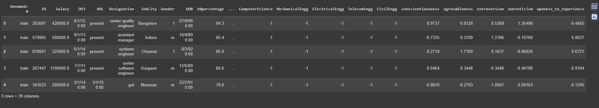
Cleaned Data Set

Slide 9
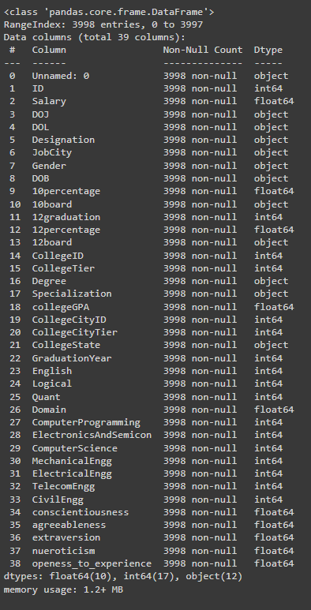
Data Info and Statistics

Slide 10

Data visualization is the process of turning data into visual formats like charts, graphs, and maps. This makes it easier to understand patterns, trends, and insights in the data. Instead of looking at rows of numbers, you can see the information in a way that’s quick to grasp, helping you make better decisions or communicate findings effectively.

Slide 11
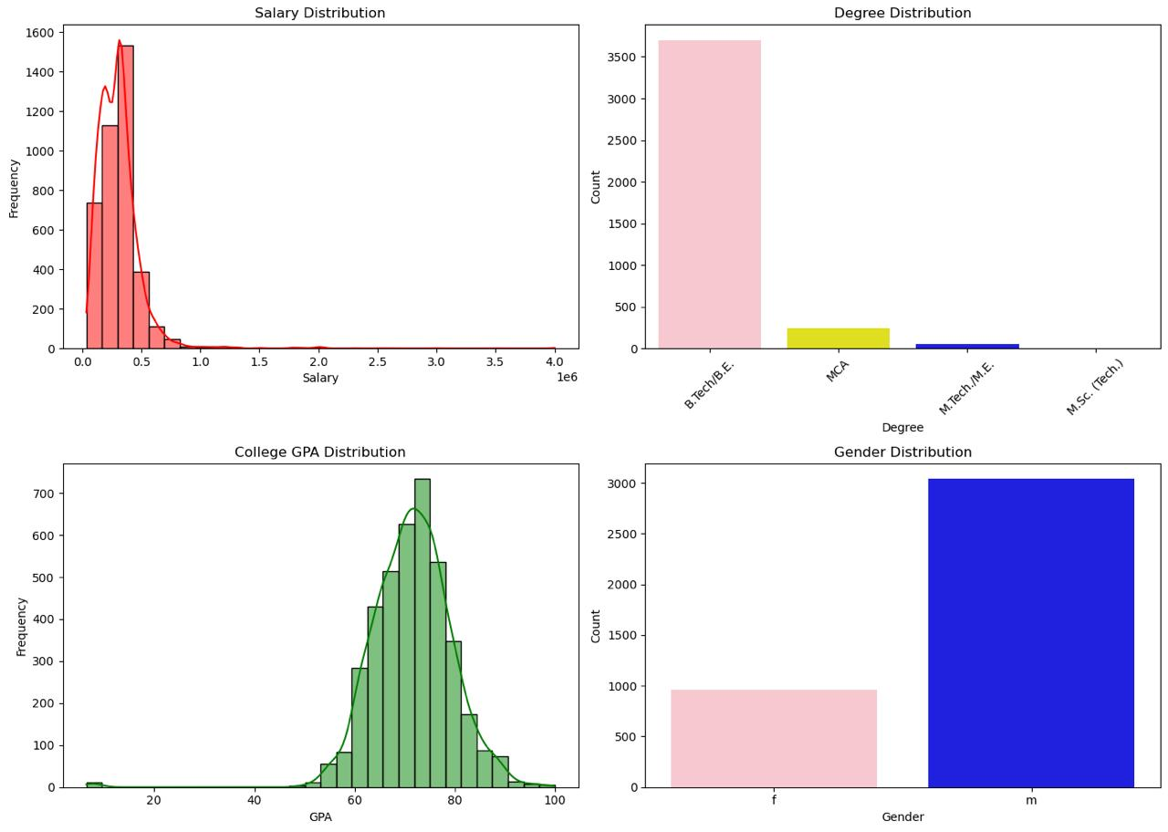
Distribution
In first graph, We can see that there is left skew in the frequency.

Slide 12
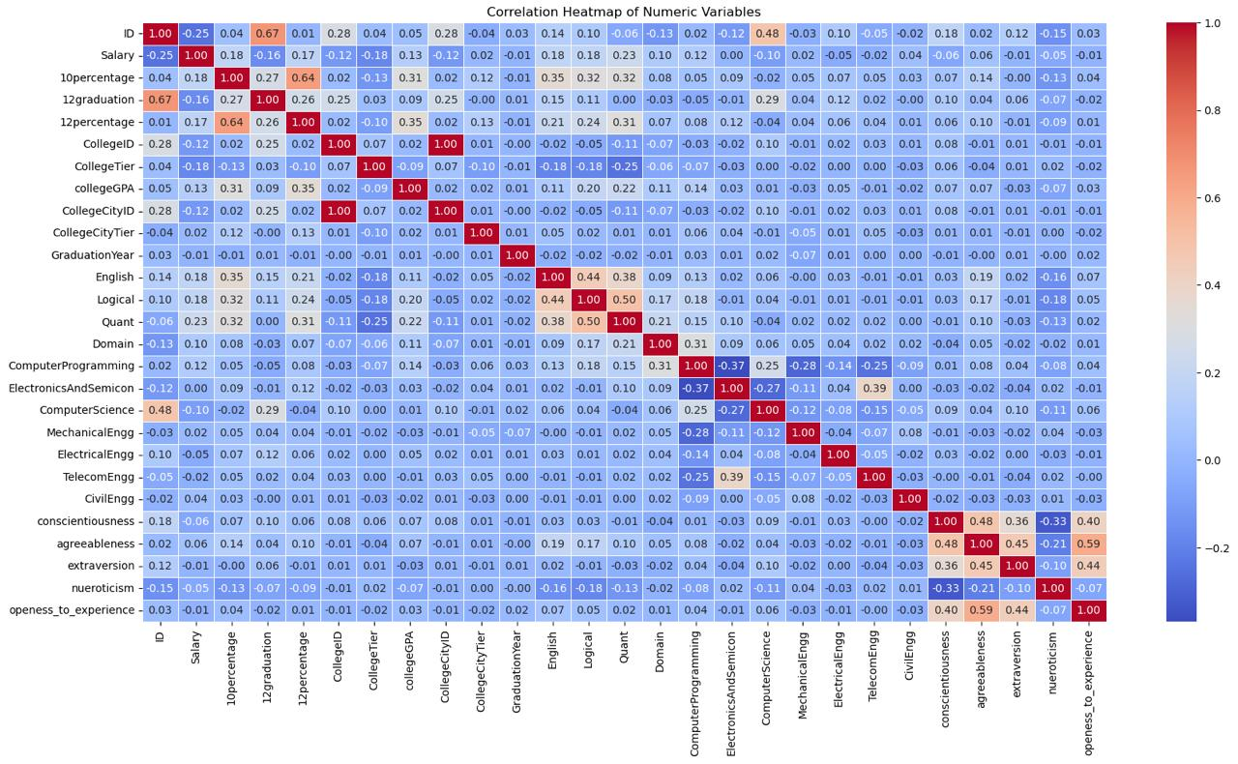
What key factors affect salary levels among job seekers?
Multiple Correlation Between Each Other Columns.

Slide 13
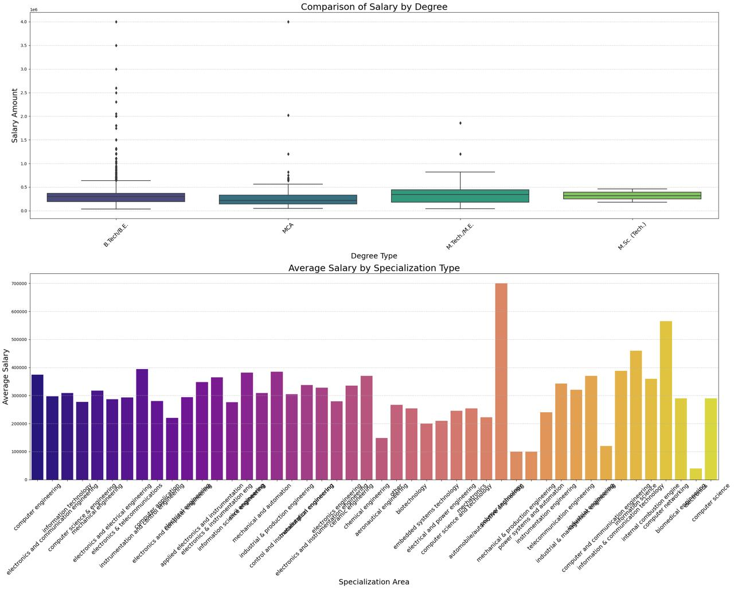
Is there a correlation between educational background, area of specialization, and salary?
Here we can see that B.Tech and M.Tech Students has the most of the salary distribution and Computer Science and technology stream students achieve highest avg of Salary

Slide 14
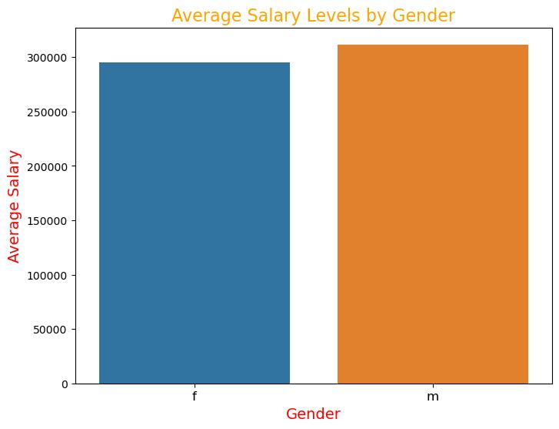
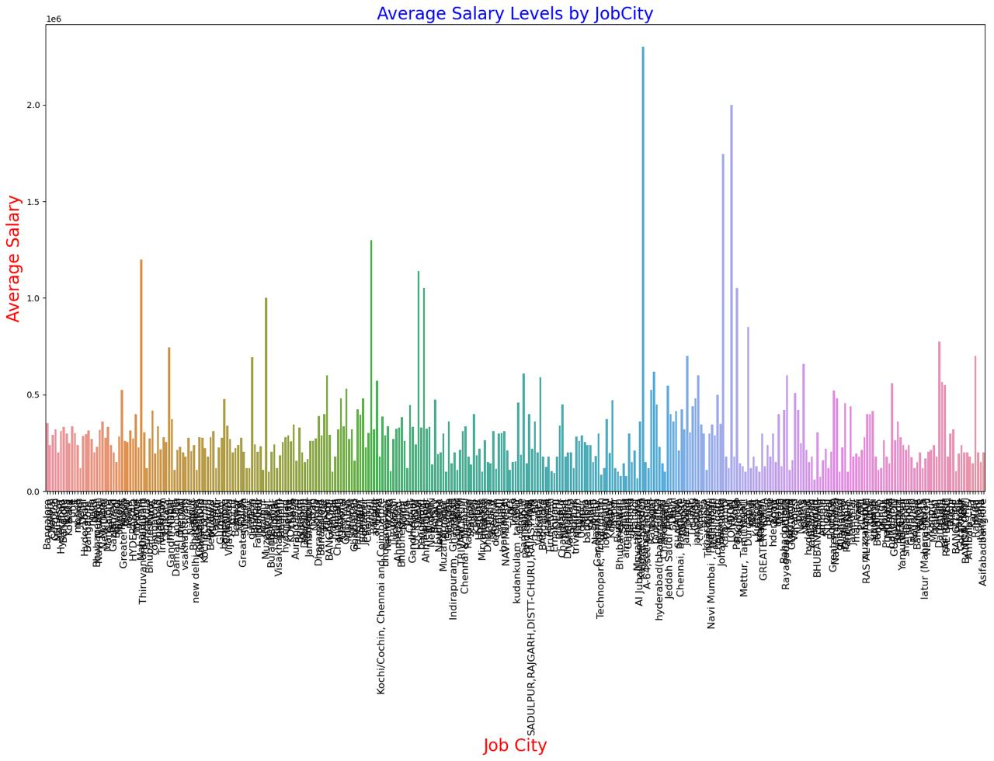
How do demographic factors such as gender, age, and geographic location influence salary expectations?

Slide 15
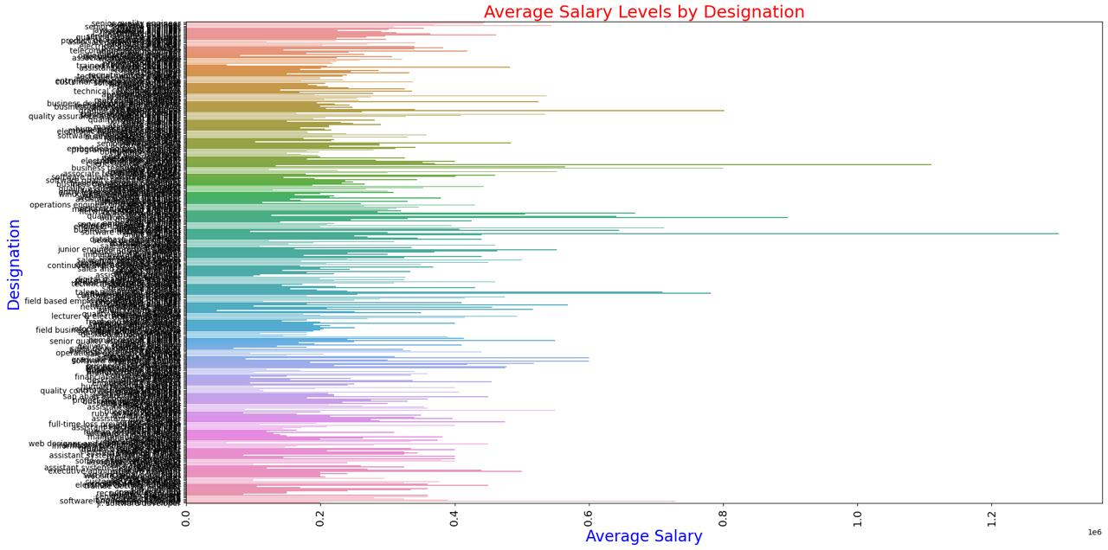
Can we uncover trends or patterns in salary distribution across various job titles and cities?

Slide 16
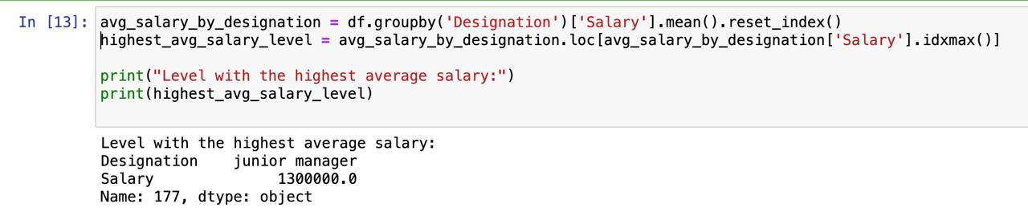
As we can see in above info, Junior manager Designation have the highest average Salary when compared to others.

Slide 17
Conclusion:
Importance of Education: Our analysis underscores the critical role of educational qualifications in influencing salary levels. Those with specialized degrees generally earn higher salaries, highlighting the value of investing in education for career growth.
Ongoing Gender Pay Gaps: Gender-based salary disparities remain evident in the job market. Our findings show noticeable differences in earnings between male and female employees, emphasizing the need for continued efforts to achieve workplace equality.
Impact of Location: The geographical location significantly affects salary levels, with certain cities providing higher average salaries. Understanding these regional trends can aid job seekers in making informed decisions about relocation and career opportunities.
Career Path Opportunities: By identifying job roles with the highest average salaries, our analysis offers valuable insights into promising career paths. Job seekers can use this information to guide their professional decisions effectively.
Emphasis on Data-Driven Choices: Our findings highlight the importance of data-driven decision-making in the job market. Both job seekers and employers can utilize these insights to enhance career outcomes and refine recruitment strategies.

Slide 18
Q&A Summary
Q: What was the main objective of your project? A: The primary goal of our project was to analyze the factors that influence salary levels among job seekers and to provide insights that assist both job seekers and employers in their decision-making processes.
Q: How did you approach the data analysis process? A: We started by preprocessing the dataset to clean and prepare the data for analysis. Next, we conducted exploratory data analysis (EDA) to examine the distribution of variables and identify trends and patterns. Finally, we developed predictive models to estimate salary levels based on various attributes.
Q: What were some of the key findings from your analysis? A: Key findings included the significant influence of educational qualifications and specialization on salary levels, persistent gender pay gaps, the effect of job location on salaries, and insights into promising career paths based on salary data.
Q: How can the insights from your analysis be applied in real-world scenarios? A: Job seekers can use these insights to make informed career choices, negotiate salary packages, and identify potential growth paths. Employers can leverage the findings to enhance recruitment strategies, benchmark salaries, and tackle diversity and inclusion issues within their organizations.
Q: What are the potential future directions or areas for further research? A: Future research could investigate additional factors that affect salary levels, such as years of experience, industry sector, or company size. Ongoing monitoring of salary trends and market dynamics will also provide valuable insights for stakeholders in the job market.

Slide 19

THANK YOU

