Slide 1


Slide 2

Health Care App

Slide 3
Group Members Introduction
VU Id: BC200401623
Name: Noor ul Ain
Group Id: <F230273EE9>

Slide 4

INTRODUCTION OF PROJECT
This project is being proposed to give online health care solutions to the patients dealing with various diseases and detail of the medical store or medicines that should be suggested to them and that are near to them. The project is about Health Care App which is a comprehensive solution designed to streamline and revolutionize the healthcare industry. The app is developed with an advanced technology stack to ensure security, privacy, and data integrity using android studio whose main language of programming will be Kotlin and firebase for backend. It provides users with an enhanced user experience through intuitive interfaces and a user-friendly platform. The functionality of the app includes Patients online consultation with doctors.
The app allows for remote monitoring and diagnosis of patients, which can help address healthcare challenges in remote areas and reduce the burden on healthcare providers.
Patients can easily book appointments and consult with specialists at various hospitals and diagnostic centers using the app. The app also provides an option for home-based healthcare services, which includes home nursing, home medical equipment supply, and even foreign doctor assist.
Patients can get prescription and pharmacy services. App also provides an integrated platform for patients to access various healthcare services like laboratory tests, dental services, physiotherapy, etc. Patients could get 24/7 support and emergency assistance. User’s data security and privacy will also be insured.

Slide 5
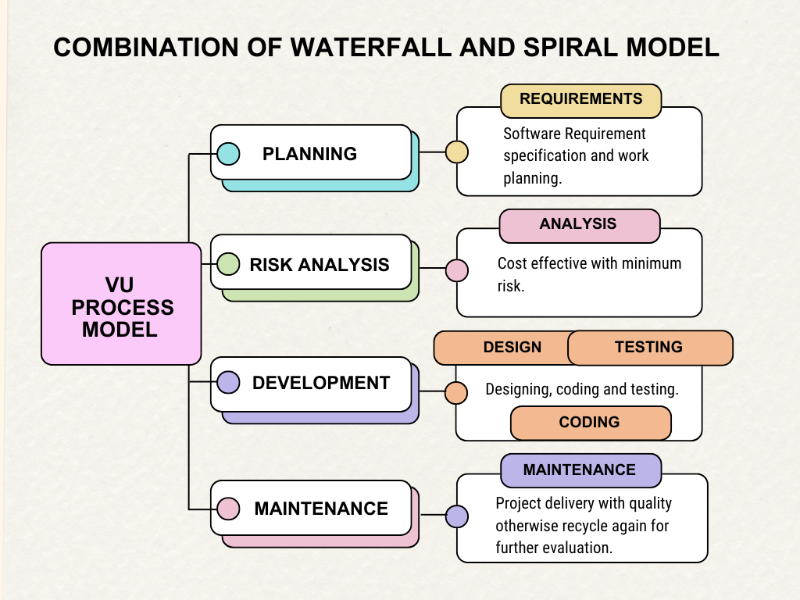
VU Process Model

Slide 6
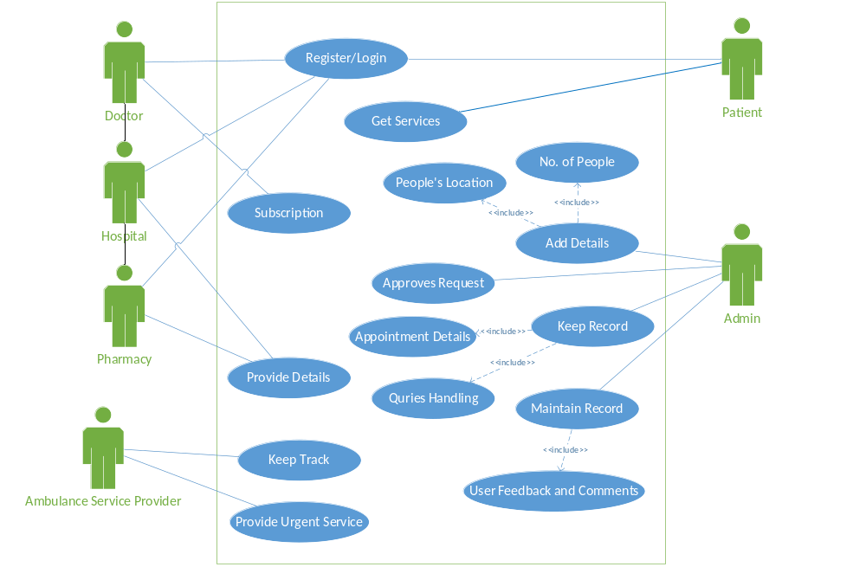
Use Case Diagram

Slide 7
Business Rules Catalog
User Registration and Authentication:
  Users must register with valid personal information to access the Wecare app.
  Authentication mechanisms such as email verification or SMS verification should be implemented to ensure the security of user accounts.
  Users must create strong passwords to protect their accounts.
Patient Records Management:
  App providers should only access patient records relevant to their role and responsibilities.
  Patient records should be securely stored and only accessible to authorized personnel.
  Any updates or modifications to patient records must be logged with timestamps and user information.
Appointment Scheduling:
  Patients should be able to schedule appointments with doctors through the app.
  Doctors and nurses should have visibility into their schedules and be able to manage appointments effectively.
  Notifications will be sent to both patients and vendors to remind them of upcoming appointments.

Slide 8

Billing and Payments:
  Patients should be able to view their bills and make payments securely through the app.
  Billing information should be accurate and reflect the services provided.
  Payment processing should comply with relevant security standards to protect sensitive financial data.
Prescription Management:
  Healthcare providers should be able to electronically prescribe medications to patients through the app.
  Patients should be able to view and manage their prescriptions, including refills and dosage instructions.
  Prescription information should be transmitted securely and comply with legal requirements.
Telemedicine and Consultations:
  Consultations should be conducted securely, maintaining patient confidentiality.
  Patients should have access to their consultation history for reference.

Slide 9
Compliance and Regulations:
  Data privacy and security measures should be in place to protect patient information.
  Regular audits and reviews should be conducted to ensure compliance with regulations.
Feedback and Reviews:
  Patients should have the ability to provide feedback and reviews for healthcare providers and services received through the app.
  Feedback should be monitored and addressed appropriately to improve the quality of care.
Emergency Response and Alerts:
  The app should have features to handle emergency situations, such as contacting emergency services or notifying designated contacts.
  Emergency response procedures should be clearly outlined and easily accessible within the app.
Accessibility and Usability:
  User interfaces should be intuitive and easy to navigate, promoting usability for all users.

Slide 10
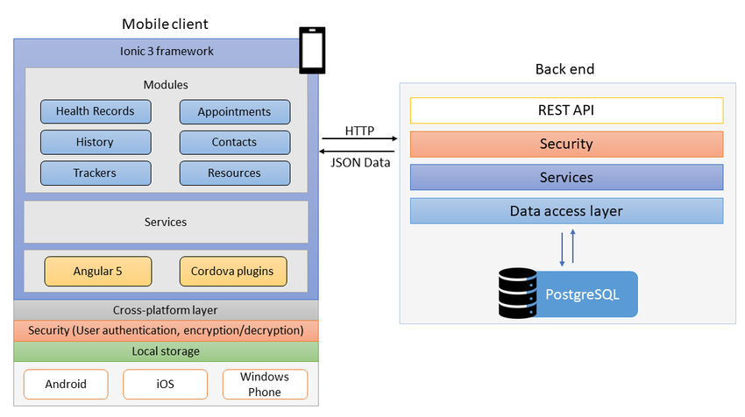
Architectural Design

Slide 11
Team Structure
Our team is consisted of one student only.
Student has all responsibilities.
Gathering
Testing
Planning
BC200401623
Development
Design

Slide 12
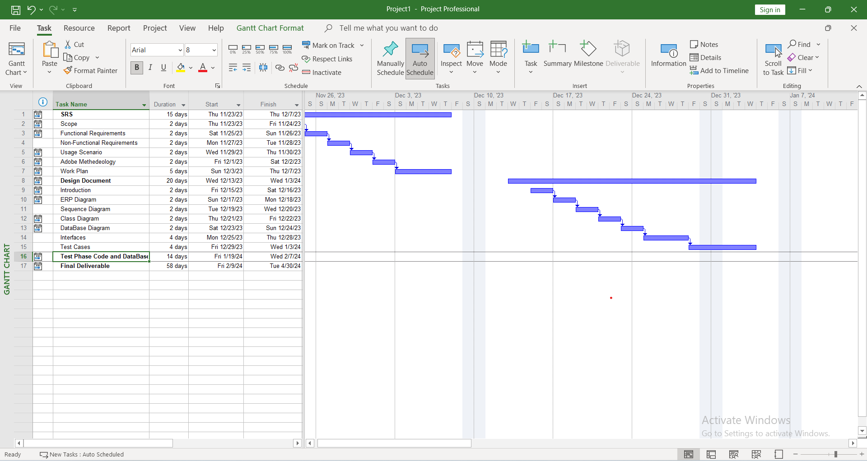
Project Schedule

Slide 13
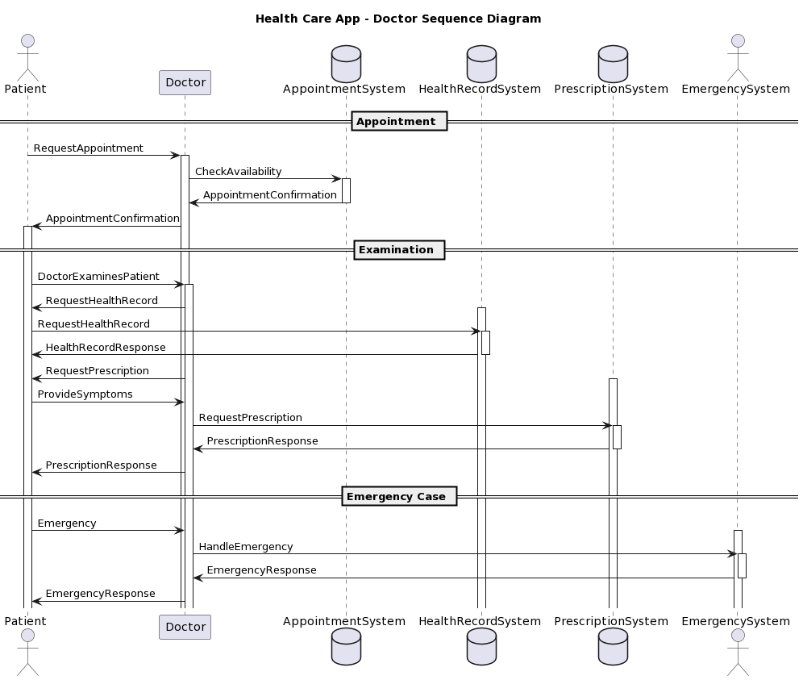
Sequence Diagrams
Doctor Sequence Diagram

Slide 14
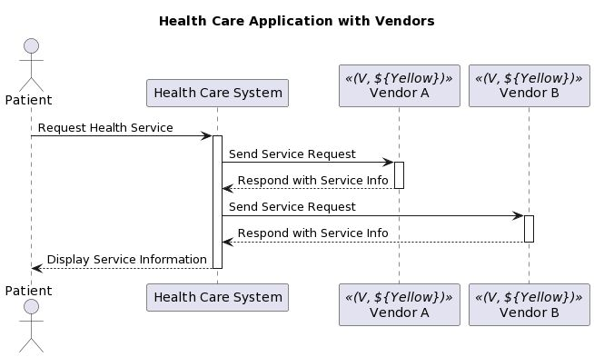
Vendors Sequence Diagram

Slide 15
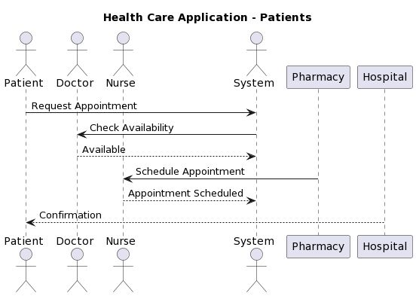
Patients Sequence Diagram

Slide 16
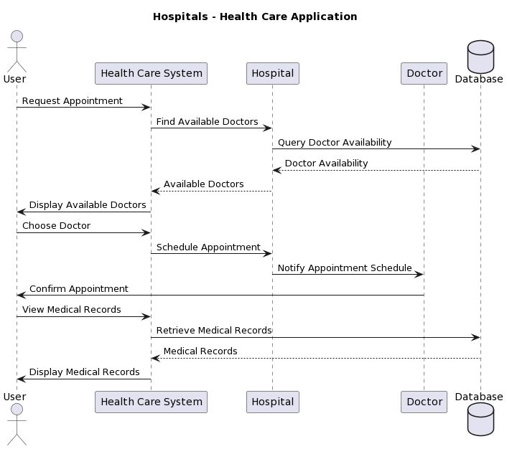
Hospitals Sequence Diagram

Slide 17
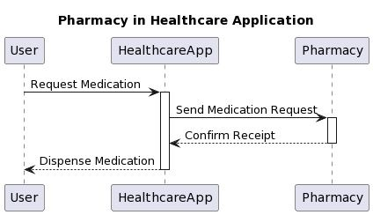
Pharmacy Sequence Diagram

Slide 18
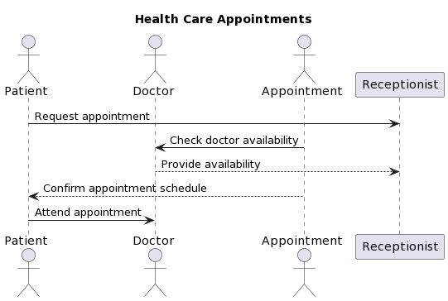
Appointment Sequence Diagram

Slide 19
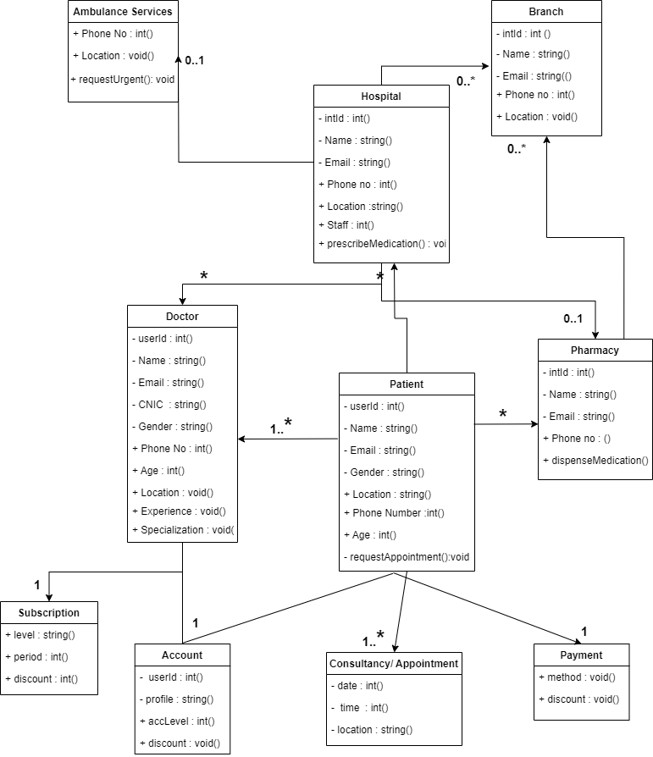
Logical Model/Class Diagram

Slide 20
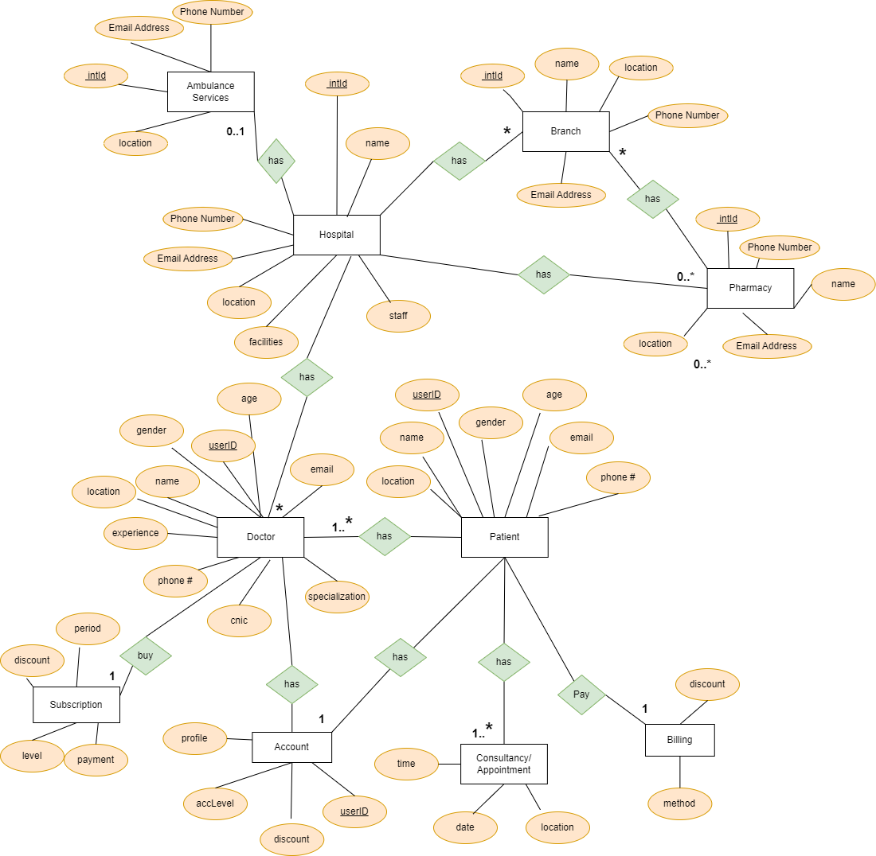
Entity-Relationship Diagram

Slide 21
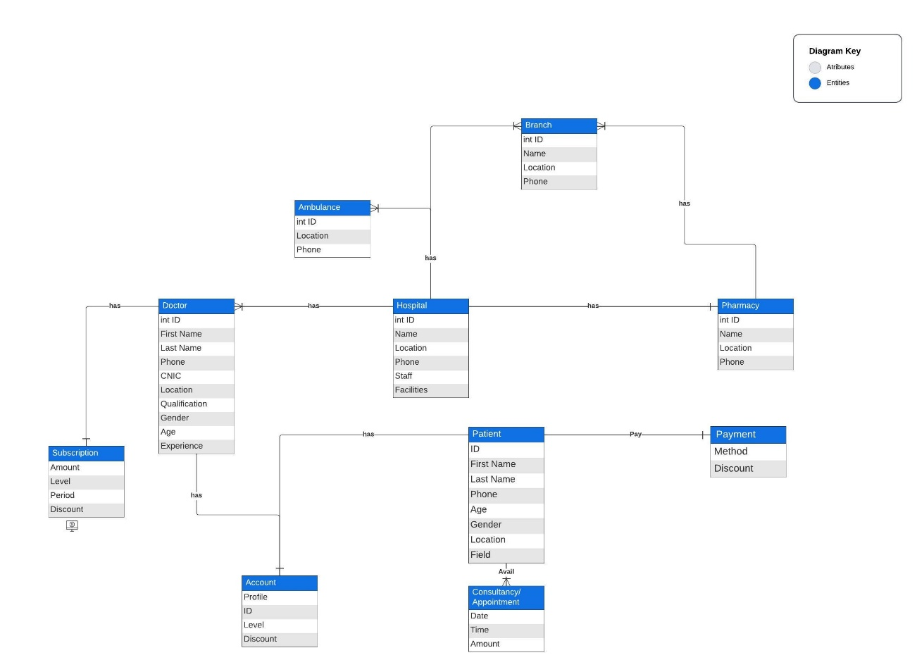
Entity-Relationship Diagram
Entity-Relationship Diagram

Slide 22
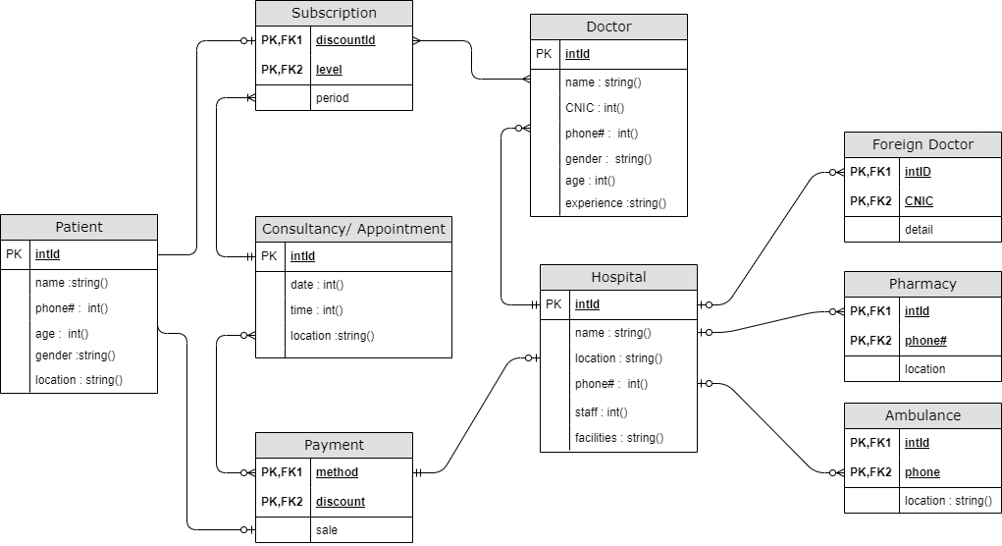
Database Diagram

Slide 23
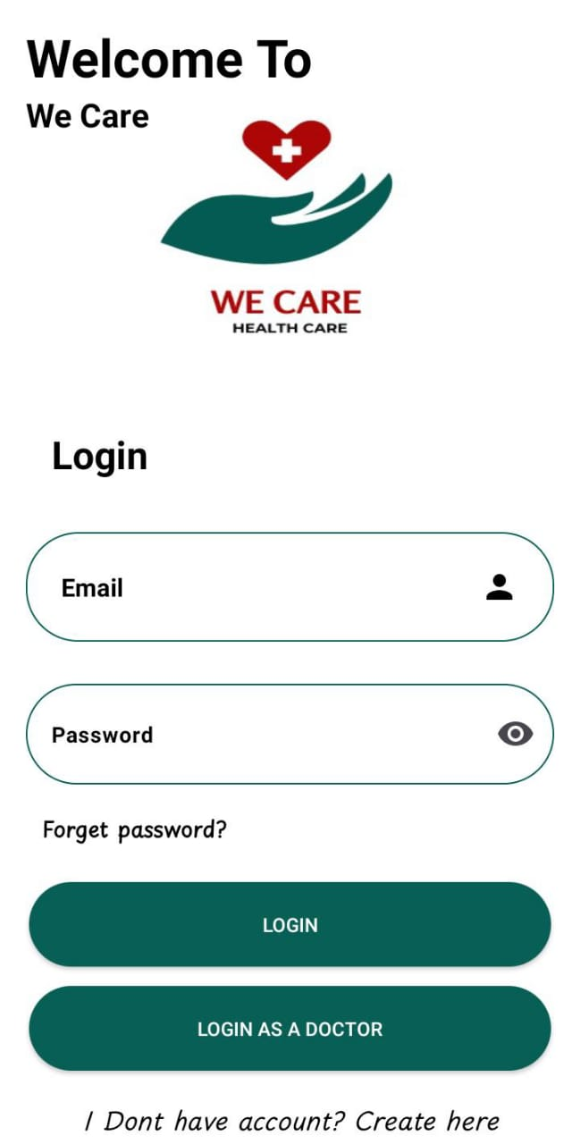
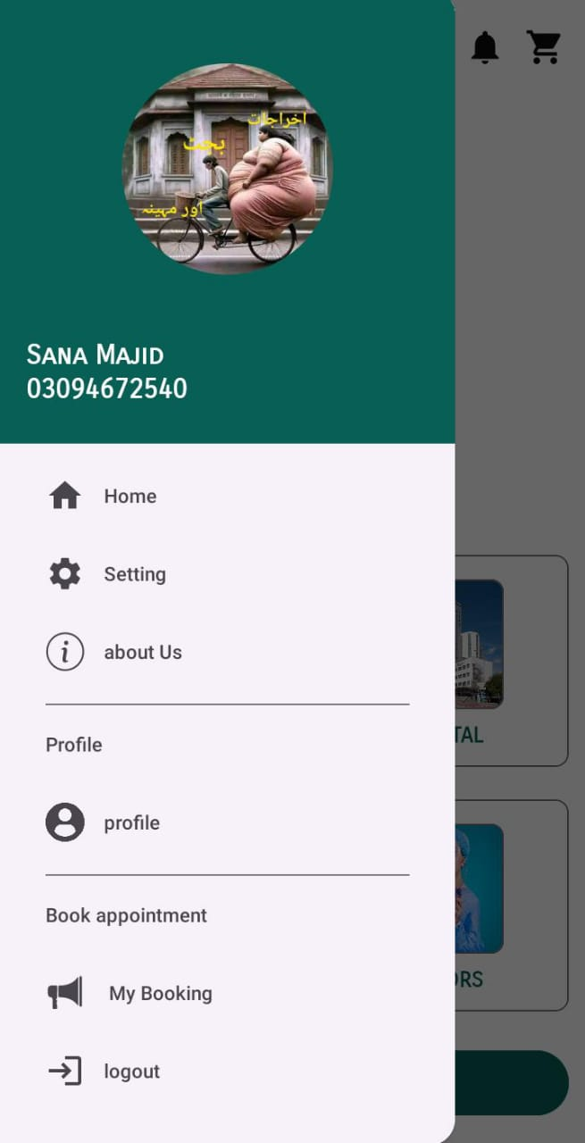
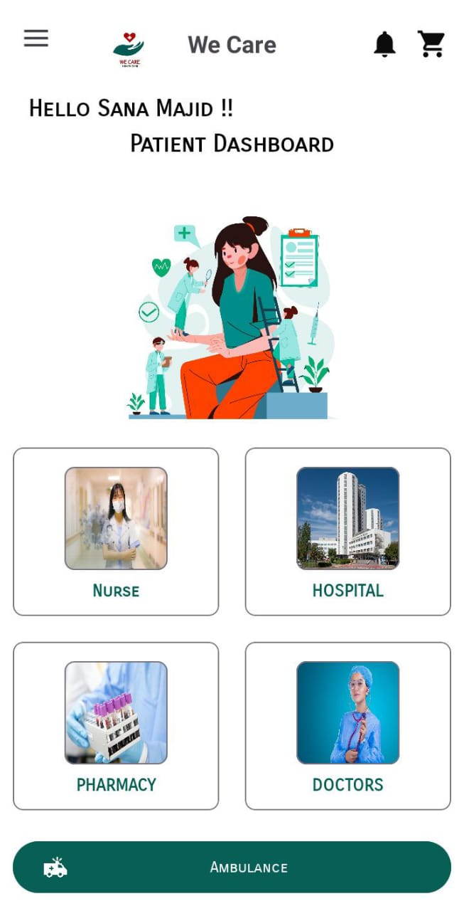
User Interfaces

Slide 24

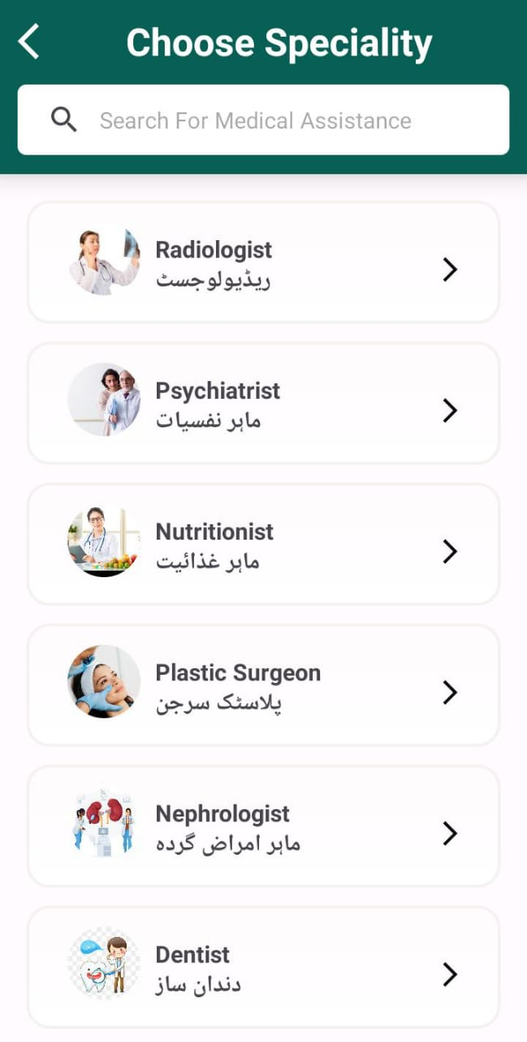

Slide 25
Tools
Kotlin
XML
Firebase

