Slide 1

Loan Predicting Approval
Predict whether a bank will approve a loan application based on applicant details.

Slide 2
About Project:
Goal: Build a model to classify loan applications as approved (1) or rejected (0).
Dataset: Created dataset with 200 applicants and 15 features (numerical, categorical, missing values).
Models: Random Forest, Gradient Boost Classifier
Impact: Automates loan approvals, reduces risks, improves customer satisfaction, and enhances decision-making.

Slide 3

WHY NOT USE OTHER MODELS?
Gradient Boost Classifier and Random Forest are interpretable and effective for small datasets.
Advanced models may overfit or require more data.

Slide 4
Creating a dataset
Created a loan approval dataset that simulates real-world scenarios
The dataset consists of 200 rows (loan applicants) and 15 columns
* Applicant Income,
* Coapplicant Income,
* Credit History,
* Property Area,
* Loan Amount, and Loan Purpose

Slide 5
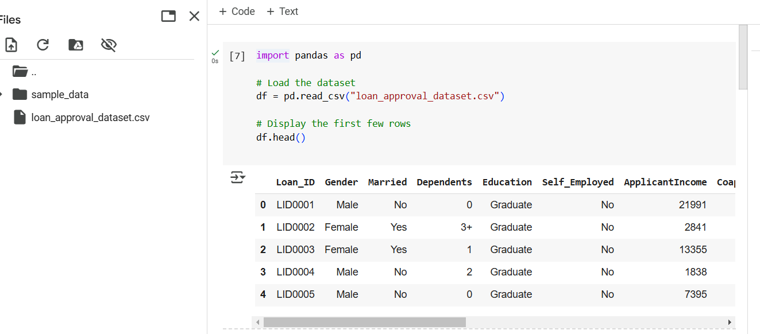
Dataset cont...

Slide 6
PRE-processing
Dropping Non-Relevant Column: The Loan_ID column, which served as an identifier, was dropped as it does not contribute to the prediction process.
Encoding Target Variable: The target variable Loan_Status was encoded to numerical values: 1 for Approved and 0 for Rejected. This prepares the data for binary classification.
Handling Categorical Variables: Categorical variables, including Gender, Married, Dependents, Education, Self_Employed were transformed into numerical values using One-Hot Encoding.

Slide 7
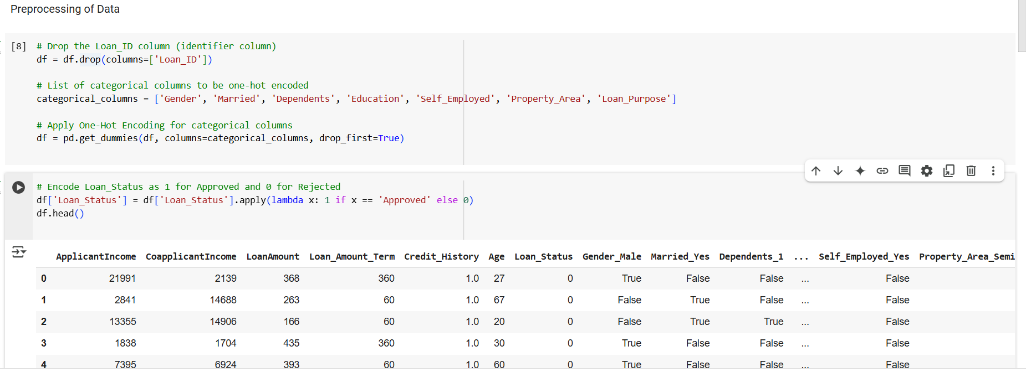
PREPROCESS DATA CONT...

Slide 8

Total Income: ApplicantIncome and CoapplicantIncome into a new feature
Log Transformation: log transformation to TotalIncome to reduce skewness
Loan-to-Income Ratio: The ratio of LoanAmount to TotalIncome
Credit History Encoding:1 for applicants with good credit history ,0 for applicants bad credit history.
Feature engineering

Slide 9
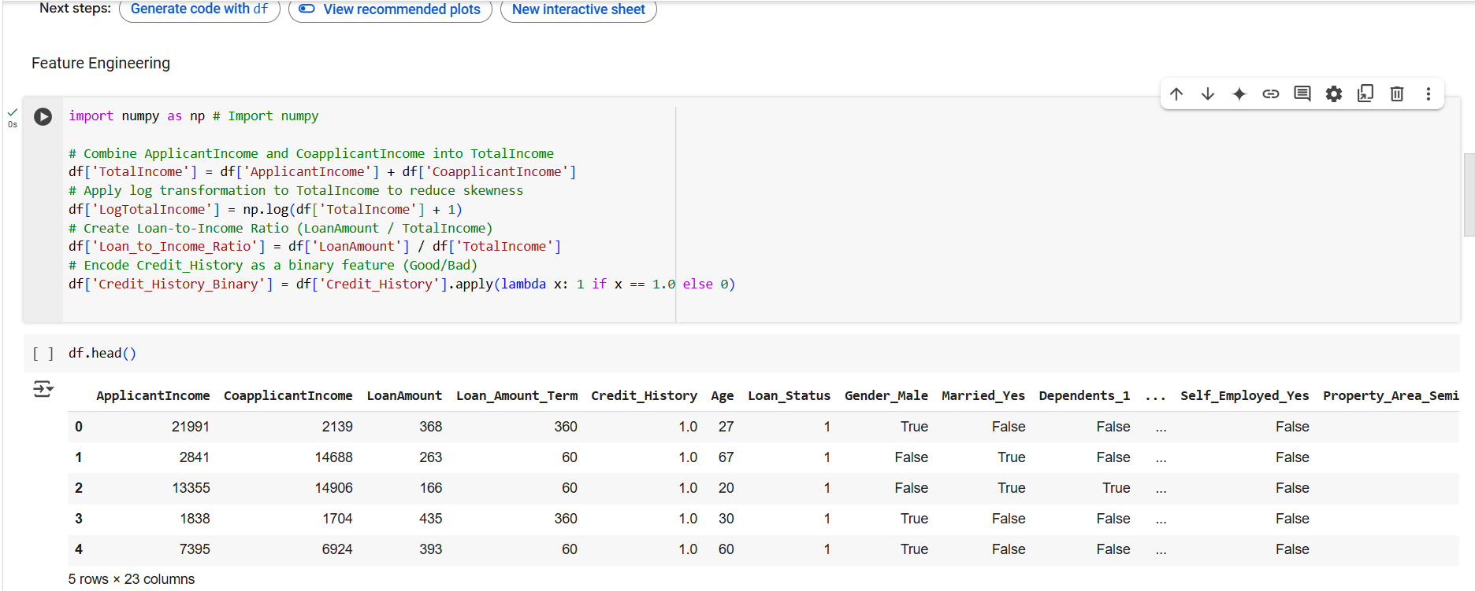

Slide 10
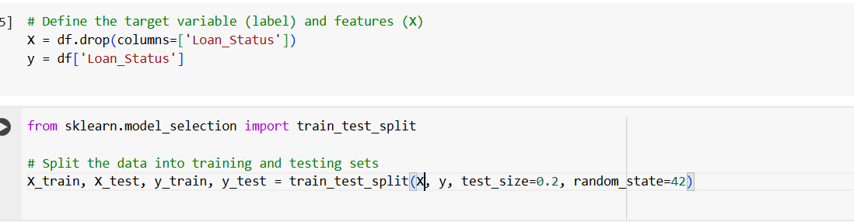
Data Splitting for Training and Testing
Split Ratio:
Training Set: 80% of the data, used for model training.
Testing Set: 20% of the data, used for model evaluation.

Slide 11
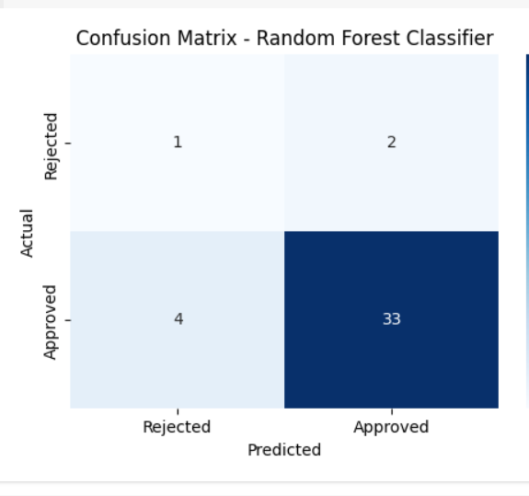
Random Forest Classifier
Accuracy: 0.8500≈85%
Confusion Matrix:

Slide 12
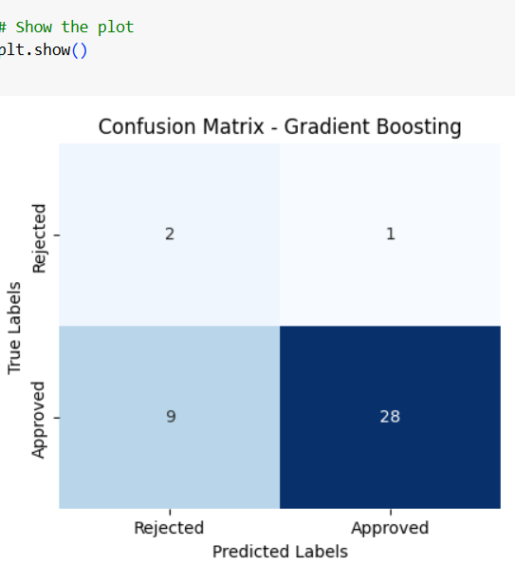
Gradient BOOST CLASSIFIER
Accuracy:0.7500≈75%
Confusion Matrix:

Slide 13
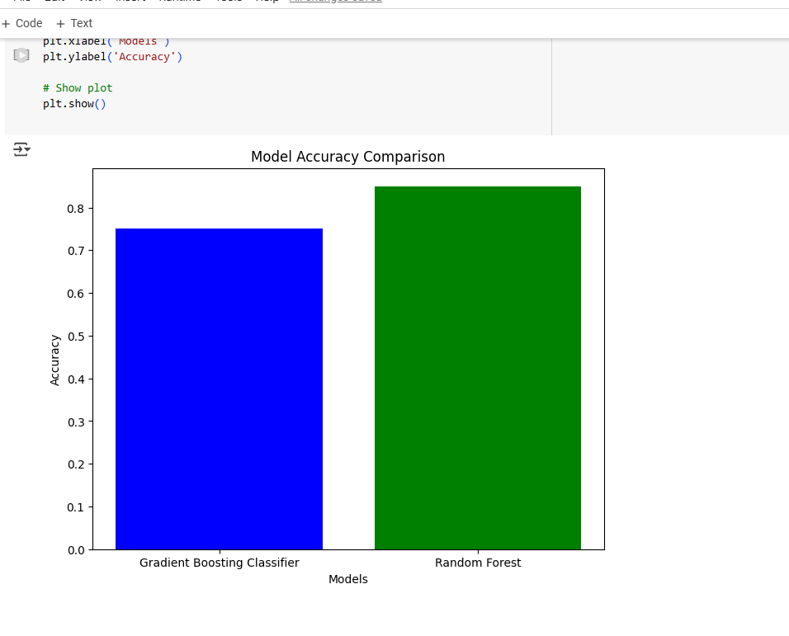

Slide 14

PRESENTATION BY: NOOR-UN-NISA
DATSET CREATION: NOOR-UN-NISA PREPROCESSING & FEATURE ENGINEERING BY: NOOR-UN-NISA
MODEL IMPLEMENTATION BY: NOOR-UN-NISA

