Slide 1

Web Programming
Instructor:
Ms. Hina Javed

Slide 2
HTML Unordered Lists
An unordered list starts with the <ul> tag. Each list item starts with the <li> tag.
The list items are marked with bullets (typically small black circles).
<ul>
<li>Coffee</li>
<li>Milk</li>
</ul>
How the HTML code above looks in a browser:
Coffee
Milk

Slide 3
HTML Ordered Lists
An ordered list starts with the <ol> tag. Each list item starts with the <li> tag.
The list items are marked with numbers.
<ol>
<li>Coffee</li>
<li>Milk</li>
</ol>
How the HTML code above looks in a browser:
Coffee
Milk

Slide 4
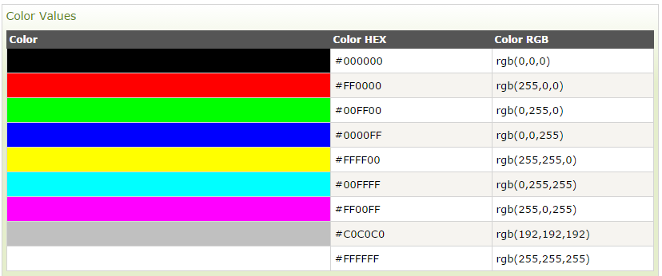
HTML Colors
HTML colors are defined using a hexadecimal notation (HEX) for the combination of Red, Green, and Blue color values (RGB).

Slide 5
Font Colors :<FONT>
By using <FONT> Tag one can specify the colors, size of the text. Example:
<FONT> Your text goes here </FONT>
Attributes of <FONT> are:
- COLOR: Sets the color of the text that will appear on the
screen. It can be set by giving the value as #rr0000 for red (in RGB hexadecimal format), or by name. Example: <FONT COLOR="RED"> Your text goes here </FONT>

Slide 6
Font Size :<FONT>
SIZE: Sets the size of the text, takes value between 1 and
7, default is 3. Size can also be set relative to default size
for example; SIZE=+X, where X is any integer value and it will add with the default size.
Example:
<FONT SIZE=5> Font Size changes to 5 </FONT>
FACE: Sets the normal font type, provided it is installed on the user’s machine.
Example:
<FONT FACE="ARIAL"> the text will be displayed in Arial</FONT>

Slide 7
Outline
Div
What is html5?
Semantic Elements
Forms

Slide 8
Div Tag
The <div> tag defines a division or a section in an HTML document.
The <div> tag is used as a container for HTML elements - which is then styled with CSS or manipulated with JavaScript.
The <div> tag is easily styled by using the class or id attribute.
Any sort of content can be put inside the <div> tag!

Slide 9
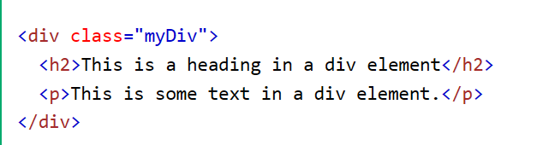
Example

Slide 10
<HTML5>
Hypertext Markup Language

Slide 11
What is HTML5?
HTML5 is the newest version of HTML.
HTML5 has new elements and attributes.
Making code easier to read for users and screen readers
Enable you to build more complex and powerful websites and apps.

Slide 12
Semantic Elements
HTML5 introduced several new semantically meaningful tags. These include:
  <section>
  <header>
  <footer>
  <nav>
  <figure>
  <figcaption>
  <progress>
  <main>

Slide 13
Section Tag
The <section> tag defines a section in a document.
The <section> tag means that the content inside relates to a single theme.
we can organize the content structure logically and meaningfully.
Allowing users and search engines to understand the page structure.

Slide 14
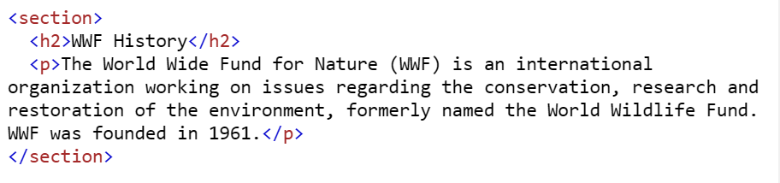
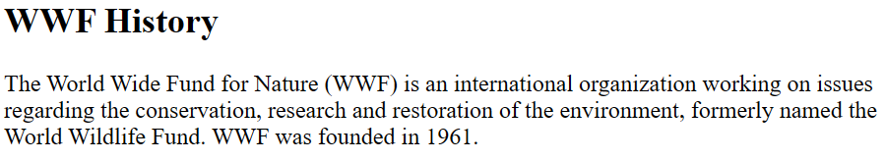
Example

Slide 15
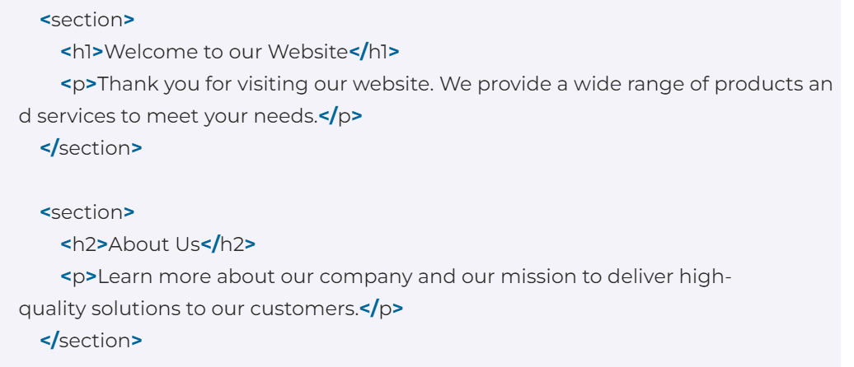
Example

Slide 16
Header Tag
The <header> element represents a container for introductory content or a set of navigational links.
A <header> element typically contains:
  one or more heading elements (<h1> - <h6>)
  logo or icon
  authorship information

Slide 17
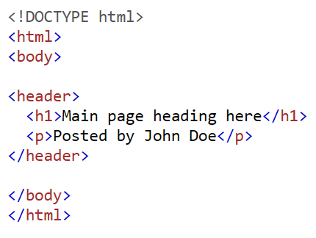
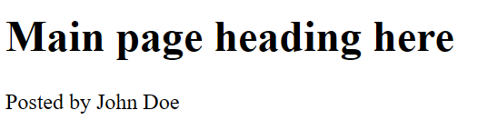
Example

Slide 18
Footer Tag
The <footer> tag defines a footer for a document or section.
A <footer> element typically contains:
  authorship information
  copyright information
  contact information
  sitemap
  back to top links
  related documents
You can have several <footer> elements in one document.

Slide 19
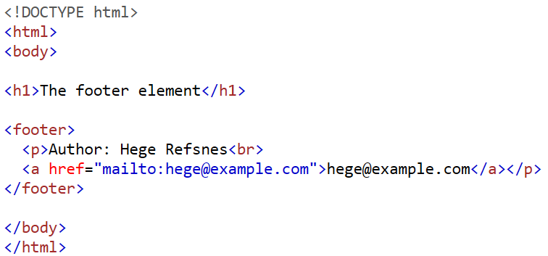
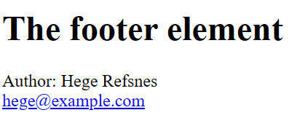
Example

Slide 20
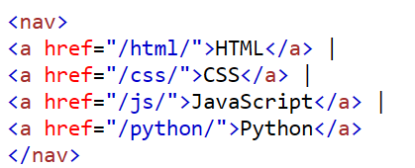

Nav Tag
The <nav> tag defines a set of navigation links.
Notice that NOT all links of a document should be inside a <nav> element. The <nav> element is intended only for major blocks of navigation links.

Slide 21
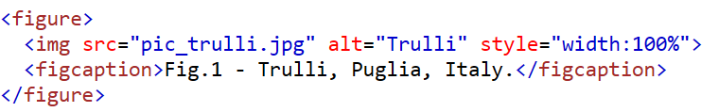
Figure & Figcaption Tag
The <figure> tag specifies self-contained content, like illustrations, diagrams, photos, code listings, etc.
While the content of the <figure> element is related to the main flow, its position is independent of the main flow, and if removed it should not affect the flow of the document.

Slide 22
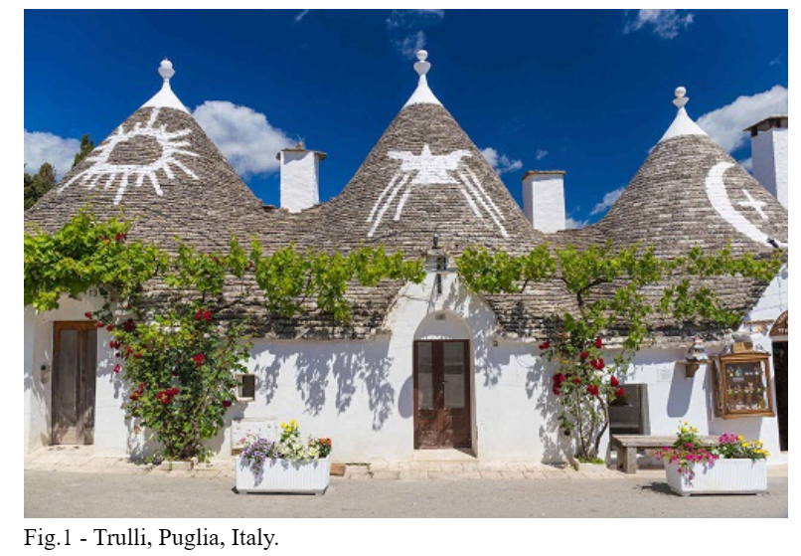

Slide 23

Progress Tag
The <progress> tag represents the completion progress of a task.
Always add the <label> tag for best accessibility practices!

Slide 24
Main Tag
The <main> tag specifies the main content of a document.
The content inside the <main> element should be unique to the document. It should not contain any content that is repeated across documents such as sidebars, navigation links, copyright information, site logos, and search forms.

Slide 25
Scalable Vector Graphics (SVG) Tag
With HTML5, you can add vector graphics directly in HTML documents using the <svg> tag.
You can also draw rectangles, circles, and other vector-based paths and shapes using this new element.
SVG has several methods for drawing paths, boxes, circles, text, and graphic images.

Slide 26
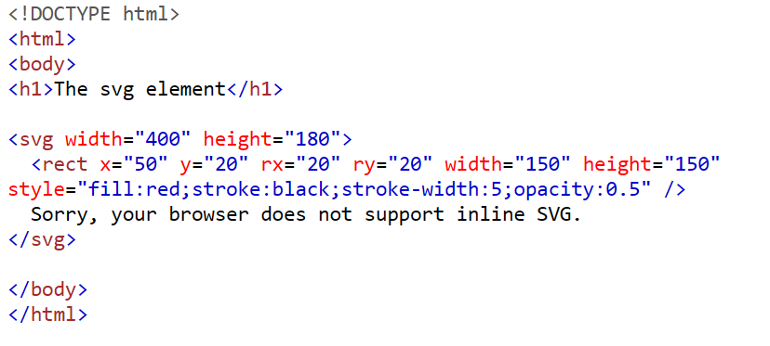
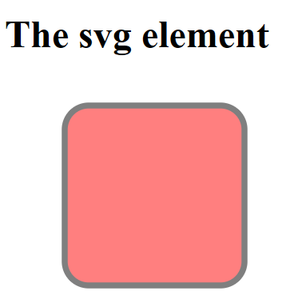
Example

Slide 27
Explain example
<svg width="400" height="180"> defines an SVG canvas with a width of 400 pixels and a height of 180 pixels.
Inside the SVG, there's a rectangle created with <rect>:
  x="50" and y="20" set the position of the rectangle.
  rx="20" and ry="20" give the rectangle rounded corners.
  width="150" and height="150" set the size of the rectangle.
  The style attribute specifies:
  fill:red; sets the fill color to red.
  stroke:black; sets the border color to black.
  stroke-width:5; sets the border thickness.
  opacity:0.5 makes the rectangle semi-transparent.

