Slide 1

Detection of Cyber Attacks on Cloud Environment using Machine Learning
Submitted to: Sir Bilal Hasan
Presentation by: Noor Ahmed (2112282)

Slide 2


Introduction
Cloud computing has revolutionized the way businesses and individuals store, access, and process data.
Unlike traditional on-premises systems, cloud environments are often more complex and distributed, involving multiple layers of infrastructure, platforms, and services.
Automated detection systems, powered by machine learning, have emerged as a critical tool in identifying and responding to potential attacks quickly and efficiently.
This research contributes to detecting cyberattacks on cloud virtual machines using machine learning techniques.

Slide 3
Methodology
1
Data Collection
2
Visualization
The dataset includes performance metrics from a cloud virtual machine, capturing various parameters such as CPU usage, memory statistics and network activity.
It contains 9610 rows and 44 columns
Visualizations were done to explore the data and understand patterns in the cloud environment metrics.
Plotting the significance of different features in the models, highlighting which metrics had the greatest impact on detecting cyberattacks.
3
Model Training
4
Model Evaluation
The dataset was split into training and testing sets, 70% for training and 30% for testing on unseen data.
The models were trained on the processed dataset to predict instances as either normal or under attack.
The models were evaluated using the classification metrics that are:
Accuracy:
Accuracy is a metric that measures the proportion of correct predictions made by a model out of all predictions.
It ranges from 0 to 1, where 1 indicates perfect accuracy.
Precision:
It focuses on the accuracy of positive predictions or in this research case (attack predictions).
It ranges from 0 to 1, where 1 indicates perfect precision.
Recall:
Recall is about how many of the actual positive (attack) cases were correctly identified by the model. It focuses on capturing all the relevant positive cases.
It ranges from 0 to 1, where 1 indicates perfect recall.

Slide 4
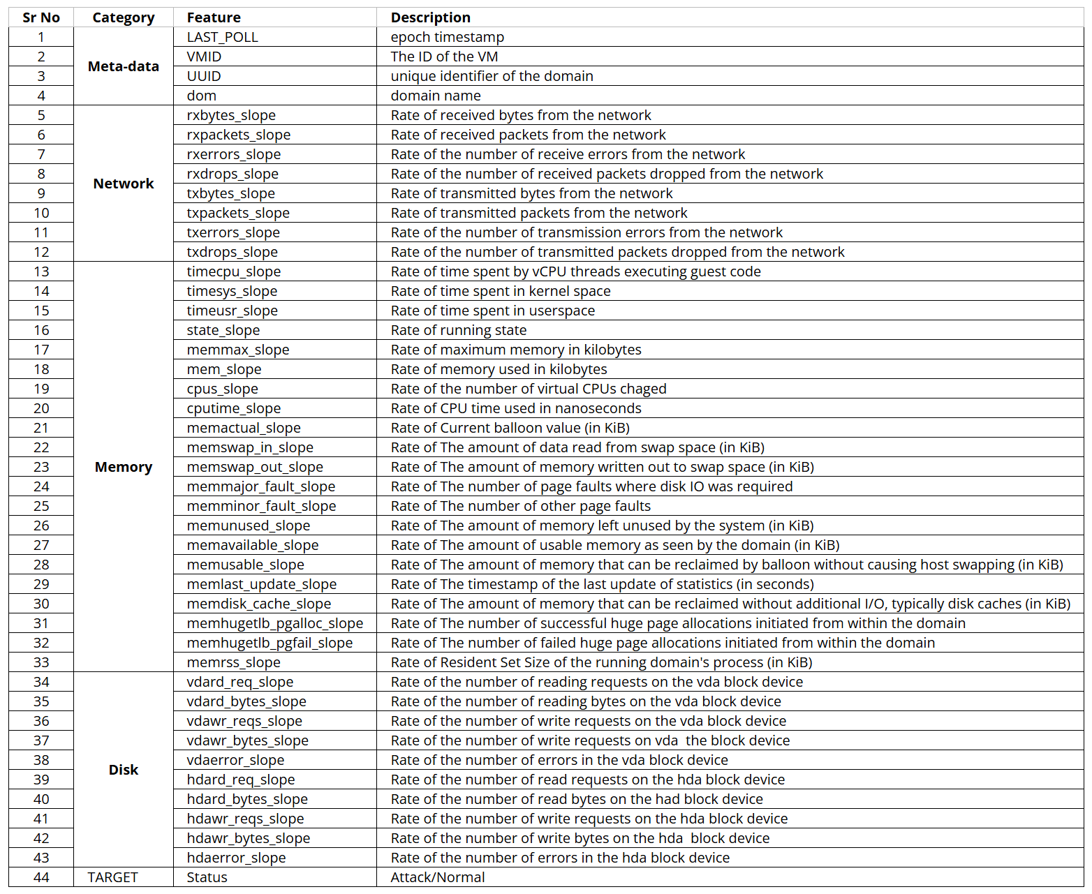
Dataset Details
Figure 1: Dataset Columns Description

Slide 5
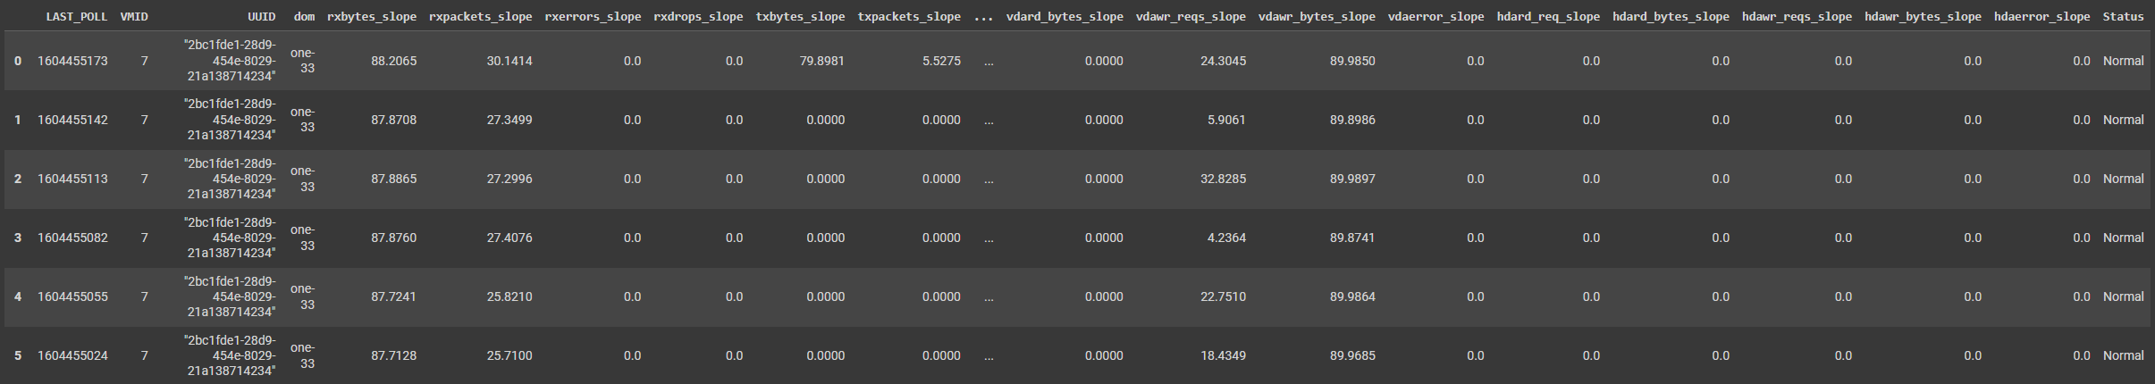
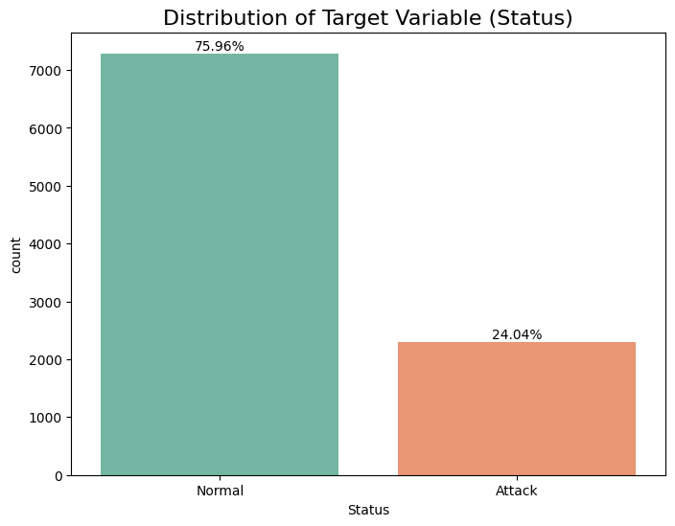
Dataset Details
Figure 2: Dataset Sample
Figure 3: Distribution of Status Column

Slide 6
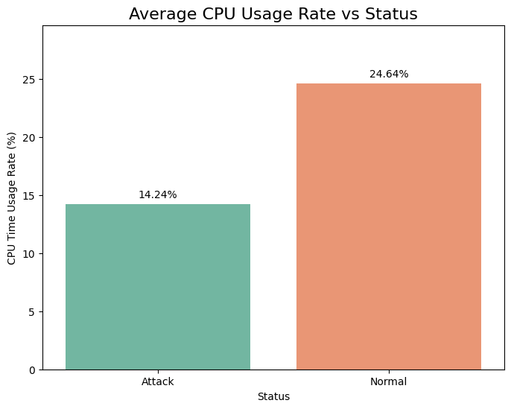
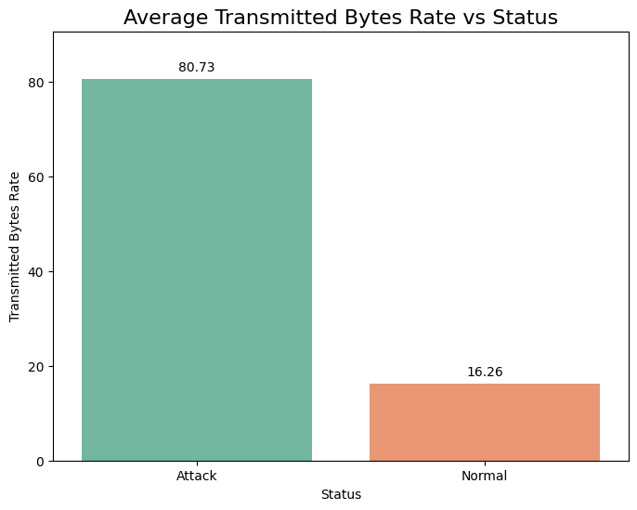
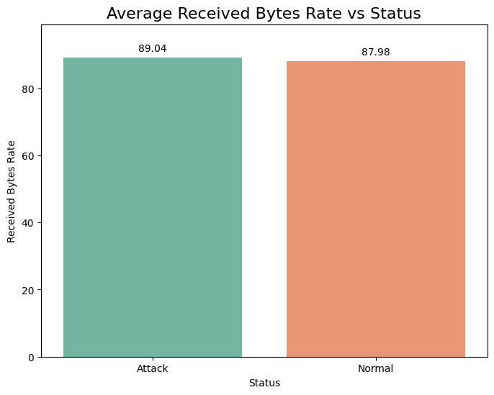
Results and Discussion
Figure 4: Average CPU Usage by Machine Status
Figure 5: Average Transmitted Bytes by Machine Status
Figure 6: Average Received Bytes by Machine Status
Findings:
A significant increase in transmitted bytes suggests the machine might be scripted to act as part of a botnet, participating in a Distributed Denial of Service (DDoS) attack.
This behavior is typical of infected machines sending large volumes of traffic to overwhelm a target.

Slide 7
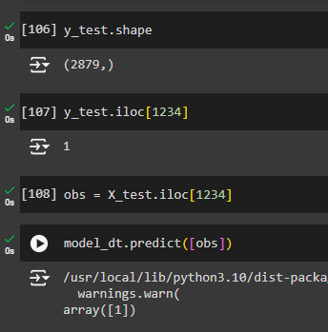
Results and Discussion
Model | Accuracy | Precision | Recall
Decision Tree | 0.9996 | 1.0 | 0.9985
KNN | 0.9972 | 0.9928 | 0.9956
Support Vector Machines (SVM) | 0.9217 | 0.9079 | 0.9418
Figure 7: Predicting on a random unseen row using Decision Tree Classifier

Slide 8




Conclusion
This research developed a machine learning-based framework for detecting cyberattacks in cloud environment.
The models demonstrated strong potential in identifying security threats based on system metrics and performance logs.
Future research could be done to classify the type of attack occurring on the cloud machine.
Future work could also explore advanced techniques like deep learning or hybrid models that combine multiple data sources.

