Slide 1
IEEE CSDE 2026 · Paper #3958 · Cox's Bazar, Bangladesh
Multi-Backbone Ensemble Learning for Robust Breast Cancer Classification on Mini-DDSM
Sheikh Noor Abdullah · Nafis Shahriar · Mehejabin Tabassum Lamia · Mysha Ibnat Mourin · Farah Ulfat Urmi · A.B.M. Kabir Hossain
Department of Information and Communication Engineering · Bangladesh Army University of Engineering & Technology (BAUET)
0.891
2,417
0
ROC-AUC
Patient groups
Leaked groups
IEEE CSDE 2026 · Mini-DDSM patient-grouped ensemble

Slide 2
WHY IT MATTERS
2.43 million women were diagnosed with breast cancer in 2024.
Benign and malignant findings look alike and readers are overloaded. AI can help — if its accuracy is real.
IEEE CSDE 2026 · Mini-DDSM patient-grouped ensemble

Slide 3
THE PROBLEM
Same patient on both sides of the split → inflated scores.
Image-level split ⚠
Patient-grouped split ✓
Train
Test
Train
Test
P1, P2, P3 leak into the test set.
No patient appears in both sets.
IEEE CSDE 2026 · Mini-DDSM patient-grouped ensemble

Slide 4
CONTRIBUTION 1 · DATA AUDIT
Every identifier audited before a single fold is built.
9,684
2,417
3
Mammograms
Patient groups
Cross-class ID collisions
2,728 Normal · 3,360 Benign · 3,596 Cancer
682 Normal · 836 Benign · 899 Cancer
A_1500, A_1511, A_1632 — 24 records
4
14
0
Eight-image blocks
Exact duplicate pairs
Leaked groups
Kept intact as one conservative group
SHA-256; none crosses a group boundary
Verified programmatically on all 9 splits
IEEE CSDE 2026 · Mini-DDSM patient-grouped ensemble

Slide 5
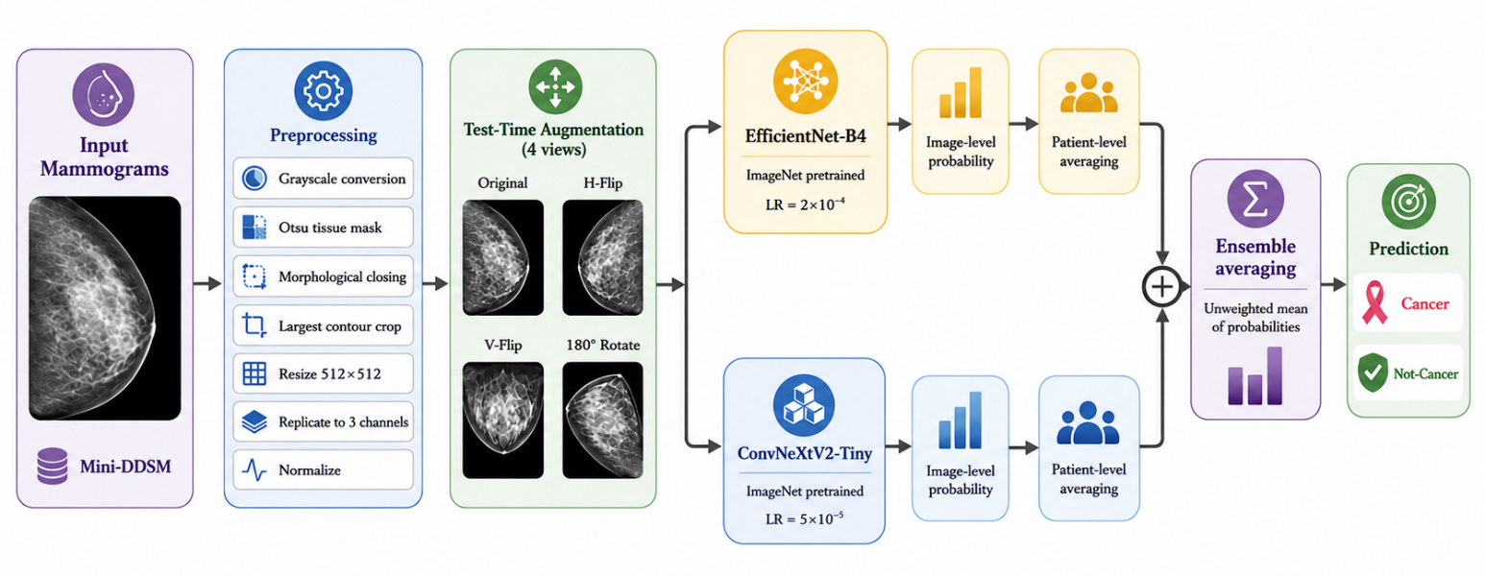
CONTRIBUTION 2 · METHOD
Simple pipeline. Fixed 50/50 ensemble. No test-set tuning.
IEEE CSDE 2026 · Mini-DDSM patient-grouped ensemble

Slide 6
CONTRIBUTION 3 · PROTOCOL
Nested, patient-grouped, repeated three times.
OUTER TRAINING
OUTER TEST
Inner train 88%
model weights
Val 12%
ckpt · threshold · Platt
→
Untouched until the end
same TTA · patient-level metrics
StratifiedGroupKFold × 3
Seeds 42 · 123 · 2026
2,000 patient bootstraps
IEEE CSDE 2026 · Mini-DDSM patient-grouped ensemble

Slide 7
RESULTS
Ensemble ROC-AUC 0.891 ± 0.008
Equal-average ensemble
0.891
EfficientNet-B4
0.882
Fold-selected single best
0.878
ConvNeXtV2-Tiny
0.857
PR-AUC 0.830 ± 0.012 · 95% t-interval 0.872–0.910
IEEE CSDE 2026 · Mini-DDSM patient-grouped ensemble

Slide 8
ABLATION
Best on 5 of 6 metrics — without learning any weights.
Metric | EfficientNet-B4 | ConvNeXtV2-Tiny | Single-best | Equal-average
ROC-AUC | 0.8820 | 0.8572 | 0.8775 | 0.8912
PR-AUC | 0.8198 | 0.7821 | 0.8078 | 0.8304
Accuracy | 0.8071 | 0.7777 | 0.7931 | 0.8120
Sensitivity | 0.6515 | 0.5517 | 0.5832 | 0.6188
Specificity | 0.8992 | 0.9115 | 0.9174 | 0.9264
PPV | 0.7938 | 0.7900 | 0.8071 | 0.8335
IEEE CSDE 2026 · Mini-DDSM patient-grouped ensemble

Slide 9
OPERATING POINT
Youden threshold: sensitivity 0.62 → 0.79
Threshold 0.5
Train-side Youden
0.619
0.926
0.812
0.788
0.839
0.820
Sensitivity
Specificity
Accuracy
Sensitivity
Specificity
Accuracy
Missed cancers per seed: 327 · 343 · 358
Missed cancers per seed: 181 · 187 · 205
IEEE CSDE 2026 · Mini-DDSM patient-grouped ensemble

Slide 10
BEYOND AUC
Calibrated probabilities and positive net benefit.
0.136 → 0.124
0.075 → 0.023
0.05–0.80
Brier score (Platt)
Expected calibration error
Threshold range with net benefit
Platt scaling fitted only on inner-validation predictions — outer labels stay reserved for evaluation.
IEEE CSDE 2026 · Mini-DDSM patient-grouped ensemble

Slide 11
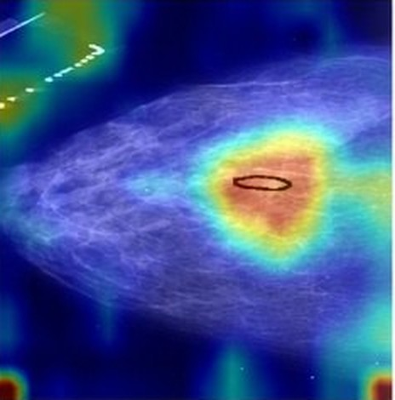
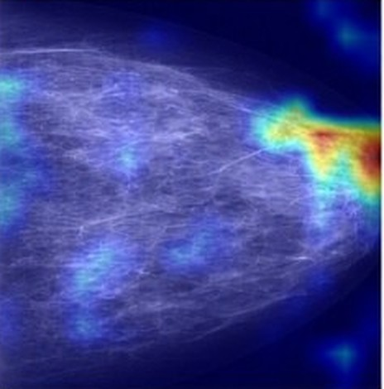
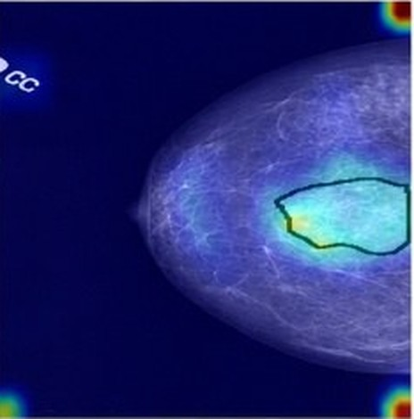
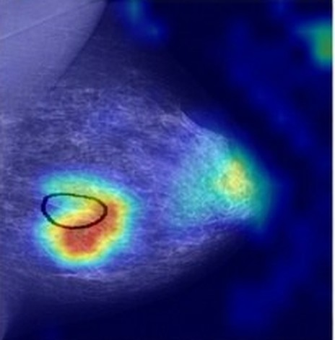
EXPLAINABILITY
Where the network looks — qualitatively.
True positive
True negative
False positive
False negative
IEEE CSDE 2026 · Mini-DDSM patient-grouped ensemble

Slide 12
HONEST LIMITS · FUTURE WORK
What this study does not claim.
Single dataset
Three folds
Results are internal to Mini-DDSM.
More folds would describe split variability more finely.
Conservative groups
Qualitative Grad-CAM
Eight-image IDs kept intact; may merge distinct subjects.
No overlap metric against radiologist annotations.
Next → CBIS-DDSM and INbreast · richer metadata · radiologist review.
IEEE CSDE 2026 · Mini-DDSM patient-grouped ensemble

Slide 13
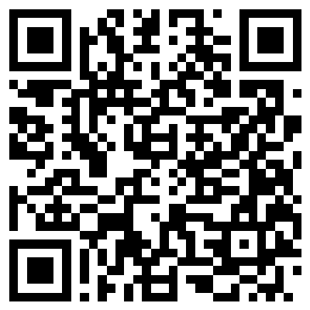
TAKEAWAYS
1
Protocol first
2
Simple ensemble
TRY IT LIVE
0 leaked patient groups
ROC-AUC 0.891
3
Thresholds matter
4
Calibrated
Sensitivity 0.79
ECE 0.023
Scan to run the model on your phone
Thank you.
mini-ddsm-csde2026.vercel.app
Questions welcome · code & audit files: github.com/NoorAbdullah02/MINI_DDSM
IEEE CSDE 2026 · Mini-DDSM patient-grouped ensemble

Slide 14
?
Q & A
Any questions?
Happy to dig into the patient-grouping protocol, the ensemble, the thresholds, or what we would do differently on a second dataset.
Sheikh Noor Abdullah
Code & audit files
Try it live
sheikhnoorabdullah02@gmail.com
github.com/NoorAbdullah02/MINI_DDSM
mini-ddsm-csde2026.vercel.app
IEEE CSDE 2026 · Mini-DDSM patient-grouped ensemble

