Slide 1
HIGH LEVEL DOCUMENT
PROJECT – PREDICT BANK CREDIT RISK

Slide 2
CONTENTS OF HLD
Problem statement
Architecture
Data description
Data sharing agreement (DSA)
Code module
Data validation
Data insertion in database
Pre-processing
Model training
Prediction
Deployment
Logging
File operations
Model performance

Slide 3
TABLE OF CONTENTS
01
02
03
PROBLEM STATEMENT
ARCHITECTURE
DATA DESCRIPTION
04
05
06
DSA
CODE MODULES
MODEL PERFORMANCE

Slide 4
01
Problem Statement

Slide 5
CREDIT RISK PREDICTION
WHAT ARE WE WORKING ON ?
“ The goal of this project, you have to build a model to predict whether the person, described by the attributes of the dataset, is a good (1) or a bad (0) credit risk. ”

Slide 6
02
Architecture

Slide 7
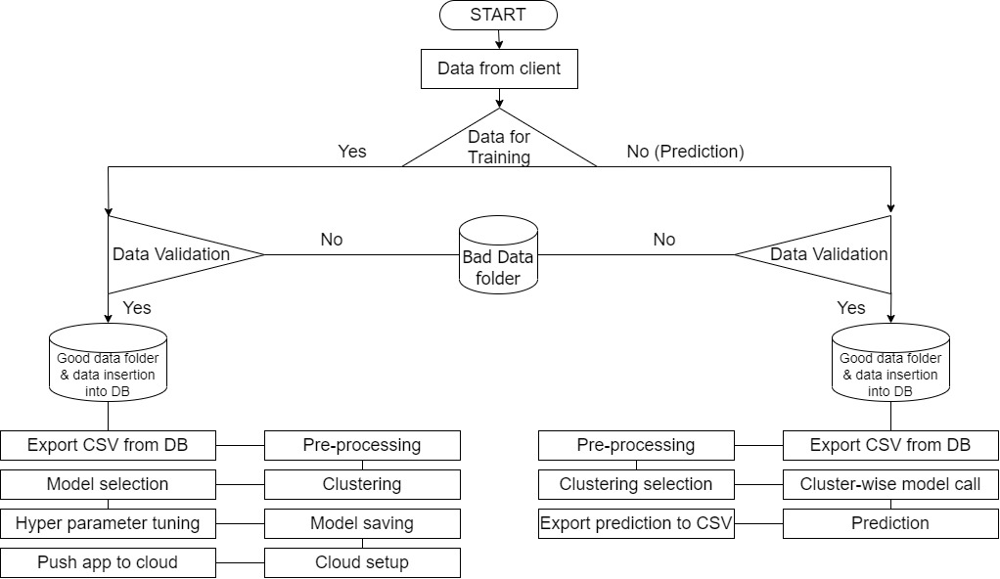
ARCHITECTURE

Slide 8
03
Data Description

Slide 9
DATA OVERVIEW
The client will send data in multiple batch files stored at a given location.
Data will contain 20 independent features and one column will have
“0” or “1” for credit score
FEATURE NAMES
Status
Duration
Credit history
Purpose
Amount
Savings
Employment duration
Installment rate
Personal status and sex
Other debtors
Present residence
Property
Age
Other installment plans
Housing
Number credits
Job
People liable
Telephone
Foreign worker
Credit risk
DATASET SOURCE LINK

Slide 10
FEATURE DESCRIPTION
FEATURE NAME: STATUS | TYPE: CATEGORICAL
status of the debtor's checking account with the bank
1 : no checking account 2 : ... < 0 DM
3 : 0<= ... < 200 DM 4 : ... >= 200 DM / salary for at least 1 year
FEATURE NAME: DURATION | TYPE: QUANTITATIVE
credit duration in months
FEATURE NAME: CREDIT HISTORY | TYPE: CATEGORICAL
history of compliance with previous or concurrent credit contracts
0 : delay in paying off in the past
1 : critical account/other credits elsewhere
2 : no credits taken/all credits paid back duly
3 : existing credits paid back duly till now
4 : all credits at this bank paid back duly
DATASET SOURCE LINK

Slide 11
FEATURE DESCRIPTION
FEATURE NAME: PURPOSE | TYPE: CATEGORICAL
purpose for which the credit is needed
0 : others
1 : car (new)
2 : car (used)
3 : furniture/equipment
4 : radio/television
5 : domestic appliances
6 : repairs
7 : education
8 : vacation
9 : retraining
10 : business
DATASET SOURCE LINK

Slide 12
FEATURE DESCRIPTION
FEATURE NAME: AMOUNT | TYPE: QUANTITATIVE
credit amount in DM
FEATURE NAME: SAVINGS | TYPE: CATEGORICAL
debtor's savings
1 : unknown/no savings account 2 : ... < 100 DM
3 : 100 <= ... < 500 DM 4 : 500 <= ... < 1000 DM
5 : ... >= 1000 DM
FEATURE NAME: EMPLOYMENT DURATION | TYPE: CATEGORICAL (ORDINAL)
duration of debtor's employment with current employer
1 : unemployed
2 : < 1 yr
3 : 1 <= ... < 4 yrs
4 : 4 <= ... < 7 yrs
5 : >= 7 yrs
DATASET SOURCE LINK

Slide 13
FEATURE DESCRIPTION
FEATURE NAME: INSTALLMENT RATE | TYPE: CATEGORICAL (ORDINAL)
credit installments as a percentage of debtor's disposable income
1 : >= 35
2 : 25 <= ... < 35
3 : 20 <= ... < 25
4 : < 20
FEATURE NAME: PERSONAL STATUS SEX | TYPE: CATEGORICAL
combined information on sex and marital status
1 : male : divorced/separated
2 : female : non-single or male : single
3 : male : married/widowed
4 : female : single
DATASET SOURCE LINK

Slide 14
FEATURE DESCRIPTION
FEATURE NAME: OTHER DEBTORS | TYPE: CATEGORICAL
Is there another debtor or a guarantor for the credit ?
1 : none
2 : co-applicant
3 : guarantor
FEATURE NAME: PRESENT RESIDENCE | TYPE: CATEGORICAL (ORDINAL)
length of time (in years) the debtor lives in the present residence
1 : < 1 yr
2 : 1 <= ... < 4 yrs
3 : 4 <= ... < 7 yrs
4 : >= 7 yrs
DATASET SOURCE LINK

Slide 15
FEATURE DESCRIPTION
FEATURE NAME: PROPERTY | TYPE: CATEGORICAL
the debtor's most valuable property,
1 : unknown / no property
2 : car or other
3 : building soc. savings agr./life insurance
4 : real estate
FEATURE NAME: AGE | TYPE: QUANTITATIVE
age in years
FEATURE NAME: OTHER INSTALLMENT PLANS | TYPE: CATEGORICAL
installment plans from providers other than the credit-giving bank
1 : bank
2 : stores
3 : none
DATASET SOURCE LINK

Slide 16
FEATURE DESCRIPTION
FEATURE NAME: HOUSING | TYPE: CATEGORICAL
type of housing the debtor lives in
1 : for free
2 : rent
3 : own
FEATURE NAME: NUMBER CREDITS | TYPE: CATEGORICAL (ORDINAL)
number of credits including the current one the debtor has (or had) at this bank
1 : 1
2 : 2-3
3 : 4-5
4 : >= 6
DATASET SOURCE LINK

Slide 17
FEATURE DESCRIPTION
FEATURE NAME: JOB | TYPE: CATEGORICAL (ORDINAL)
quality of debtor's job
1 : unemployed/unskilled - non-resident
2 : unskilled - resident
3 : skilled employee/official
4 : manager/self-empl. /highly qualif. employee
FEATURE NAME: PEOPLE LIABLE | TYPE: CATEGORICAL (ORDINAL)
number of persons who financially depend on the debtor (i.e., are entitled to maintenance)
1 : 3 or more
2 : 0 to 2
DATASET SOURCE LINK

Slide 18
FEATURE DESCRIPTION
FEATURE NAME: TELEPHONE | TYPE: CATEGORICAL
Is there a telephone landline registered on the debtor's name?
1 : no
2 : yes (under customer name)
FEATURE NAME: FOREIGN WORKER | TYPE: CATEGORICAL
Is the debtor a foreign worker?
1 : yes
2 : no
FEATURE NAME: CREDIT RISK | TYPE: CATEGORICAL
Has the credit contract been complied with (good) or not (bad) ?
0 : bad
1 : good
DATASET SOURCE LINK

Slide 19
04
DSA

Slide 20
WHAT WE ARE WORKING ON

Slide 22
05
Modules

Slide 23
WHAT WE ARE WORKING ON

Slide 25
06
Model Performance

Slide 26
WHAT WE ARE WORKING ON

