Slide 1
File Management System

Slide 2
Introduction:
When start a project, choose where you want to store the files. using a MySQL database as a file repositoryوcan set up a MySQL database and create a table to store files.
Choose a programming language using java. You can use Java to establish a MySQL database connection, create a single design pattern for the database connection, and implement user authentication and file repository features.
Create a single design pattern for the database connection. The singleton design pattern ensures that only one instance of the connection is created, which can improve the performance of this application.
Implement user authentication. the system should have three types of users: administrator, employee, and reader. You can create a registration and login feature for these users, and store the user information in a MySQL database.

Slide 3
Implement file repository features. the ability to import, export, delete, read, write and undo previous files. You can use the factory design pattern to create methods for each of these operations.
Perform file encryption. using the Adapter design pattern to encode filenames before importing them into the file repository. create a converter class that implements encryption and use it to encrypt filenames before storing them in the file repository.
Create a user enumeration of different types of users. You can create an enumeration of constants for each type of user (e.g. ADMIN, STAFF, READER) and use them to represent the different types of users in this code. and show the operation can do it

Slide 4
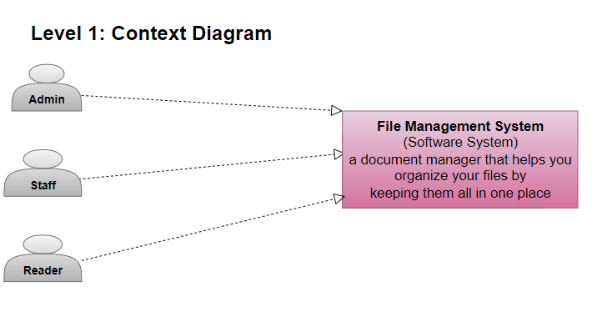

Slide 5
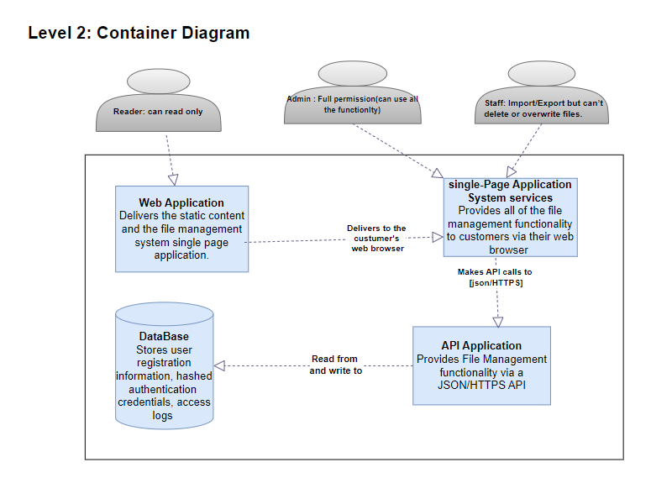

Slide 6
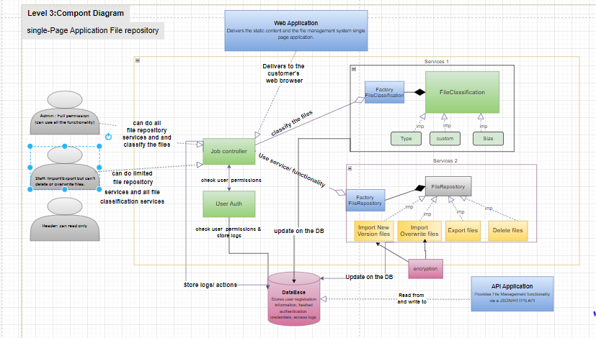

Slide 7
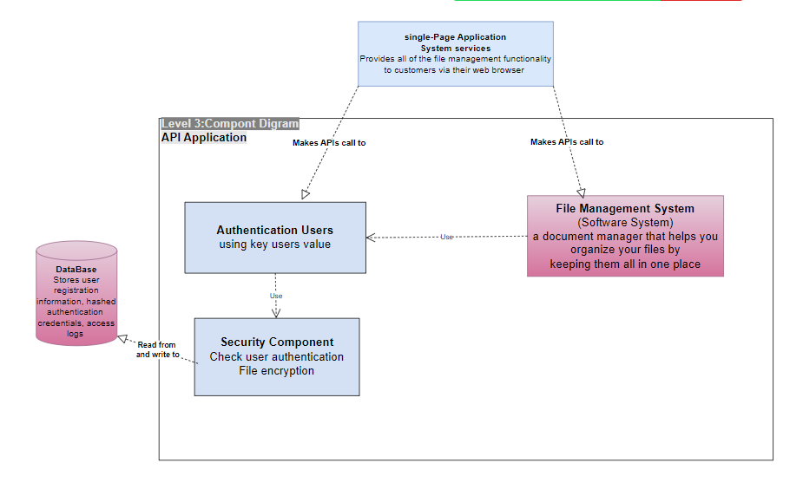

Slide 8
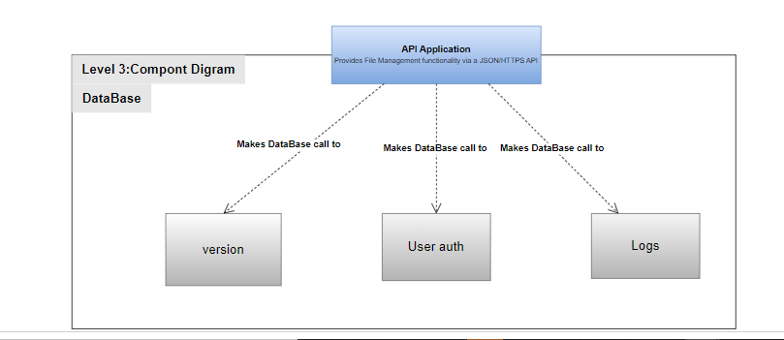

Slide 9
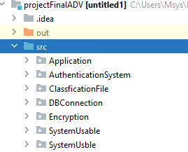

Slide 10
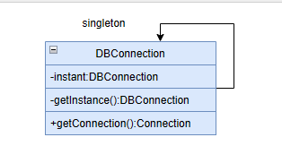

Slide 11
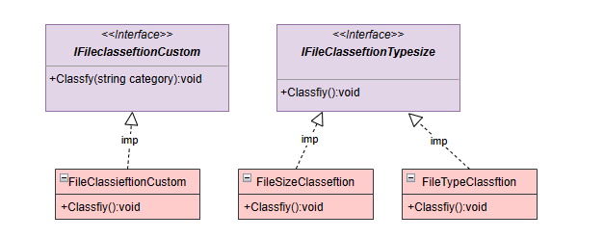

Slide 12
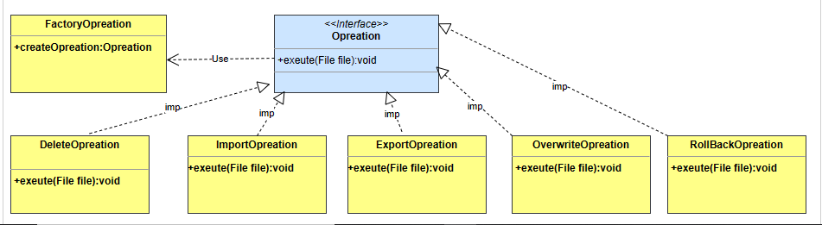
Factory Design pattern

Slide 13
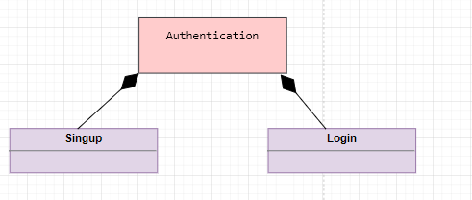

Slide 14
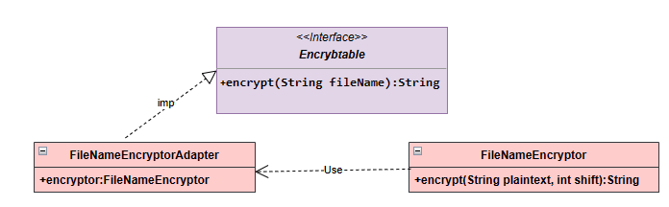
Encrypted Adapter

